Slide 1

MedSavant
search engine for
genetic variants
Marc Fiume
University of Toronto
Hospital for Sick Children

Slide 2




Causal Variant Discovery

Slide 3




Variant Search and Inspection

Slide 4
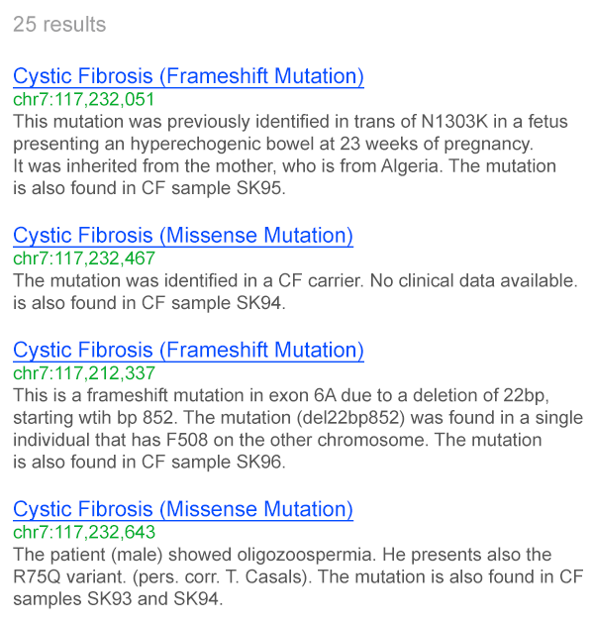

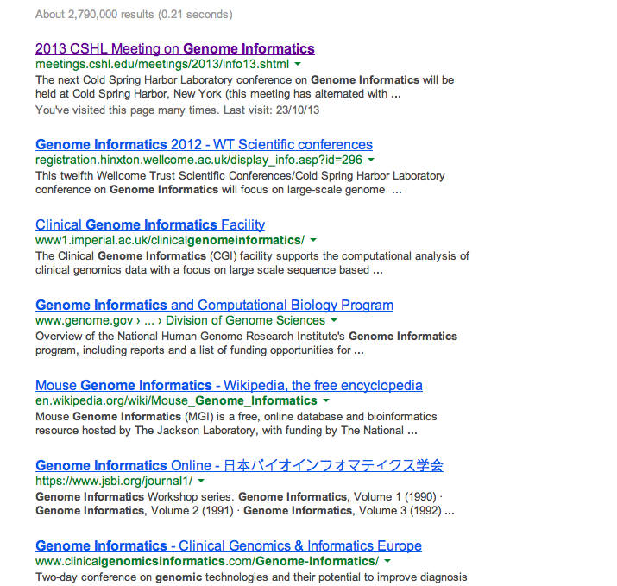
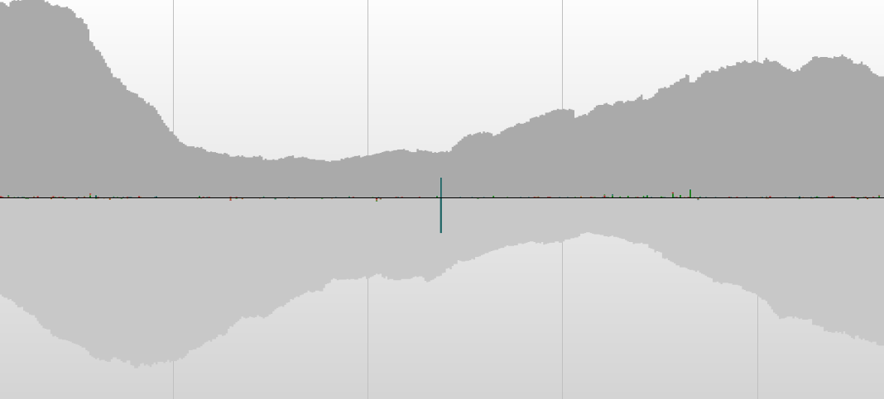
internet browsers, circa 1990s
internet browsers, today
genome browsers
genome browsers, in the future
Causal Mutations
Genome Informatics
chrX: 2,456,983 - 2,504,232
http://meetings. cshl.edu/meetings/2013/info13.shtml

Slide 5
internet browsers, circa 1990s
internet browsers, today
Genome Informatics
http://meetings. cshl.edu/meetings/2013/info13.shtml

Slide 6
Search Engines
use natural language
search huge volumes of data
results return quickly
provide links to relevant results

Slide 7
genome browsers
genome browsers, in the future
Causal mutations in my data
chrX: 2,456,983 - 2,504,232

Slide 8
MedSavant
search engine for genetic variants
use natural language
search huge volumes of genetic data
results return quickly
provide links to relevant results
spreadsheet format
genome browser
external datasets, internet

Slide 9
MedSavant Performance

Slide 10
Notes:
demo goes here

Slide 11
There’s an app for that
Built-in App Store
App types
search: add search functionality to search bar
inspect: add details to variant or gene drilldown
visualize: create custom visualizations
clinic: push button analyses

Slide 12
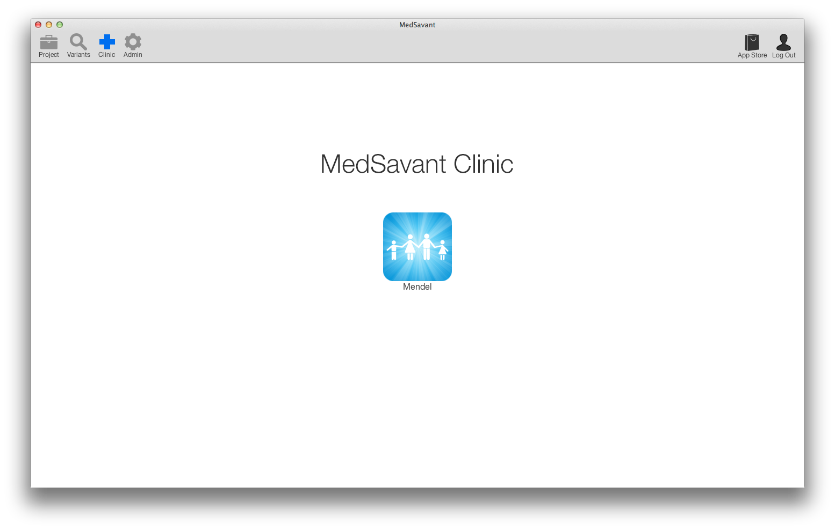
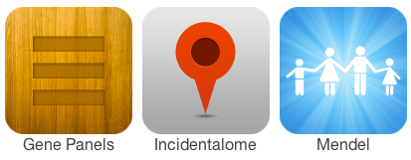
MedSavant Clinic
simplified interface for clinical analyses

Slide 13
Mendel
a proof of concept Clinical App that allows clinicians to find causal mutations from groups of patients with the same disease

Slide 14
FORGE
FORGE is a Canadian consortium whose goal is to discover the etiology of a large number of rare genetic conditions
chose 20 FORGE projects – all projects that were sequenced and analyzed at McGill
imported raw VCFs into MedSavant equipped with Mendel App with the goal of rediscovering the causal genes and variants
Notes:
underdevelopment of the cerebellar vermis , an area of the brain that controls balance and coordination

Slide 15
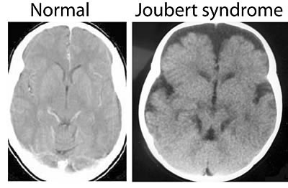
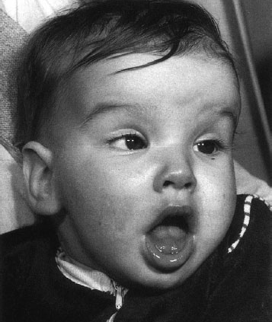
Joubert Syndrome
Notes:
underdevelopment of the cerebellar vermis , an area of the brain that controls balance and coordination

Slide 16
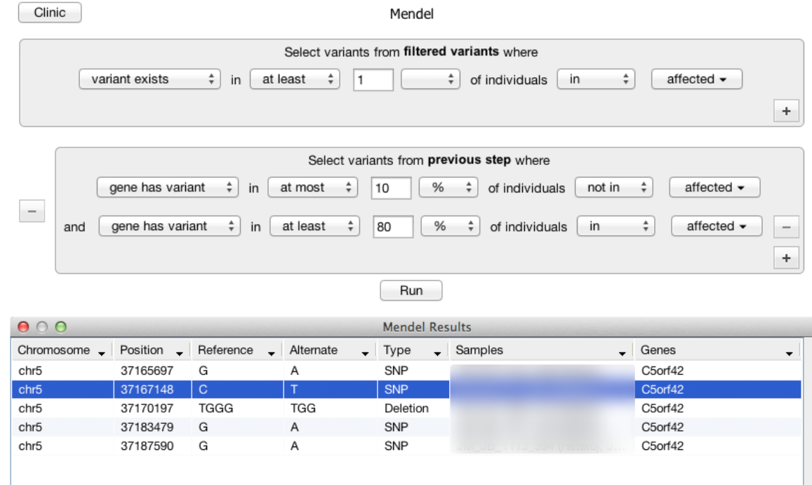

Slide 17
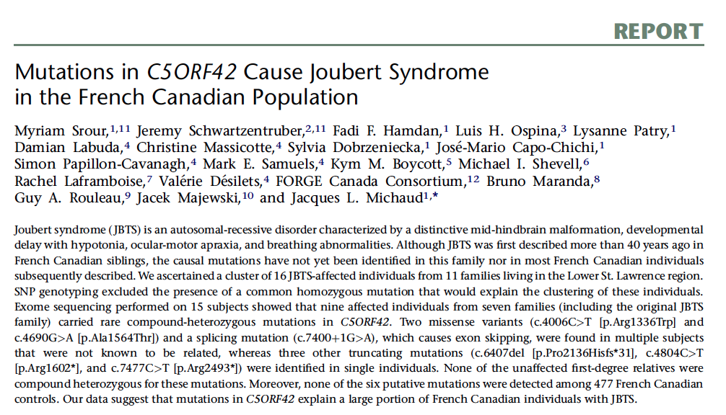

Slide 18

Mendel Results
Causal gene identified in 16 of 20 projects
AD retinitis pigmentosa
AR pontocerebellar hypoplasia with cortical atrophy
Floating Harbour Syndrome
French Canadian Joubert
Hadju-Cheney
Hawk-Junction Microcephaly
Hereditary leg dominant quadri- paresis
Hutterite CASS
Hutterite Syndromic ID
Mandibulofacial Dysostosis with Microcephaly
MIC-CAP
MPPH-CM
Multiple Intestinal Atresia
Sensory neuropathy

Slide 19
Summary
search engine for genetic variants
integrated solution for the storage, annotation, filtration, prioritization, and visual inspection
helps in the discovery of disease causing mutations
designed for both research and clinical applications

Slide 20




Acknowledgements
Developers: James Vlasblom, Orion Buske, Eric Smith, Andrew Brook, Misko Dzamba, Khushi Chachcha, Sergiu Dumitriu
Scientific Advisors: Christian Marshall, Kym Boycott, Marta Girdea, Peter Ray, Gary Bader, Michael Brudno
try at medsavant.com

