Slide 1
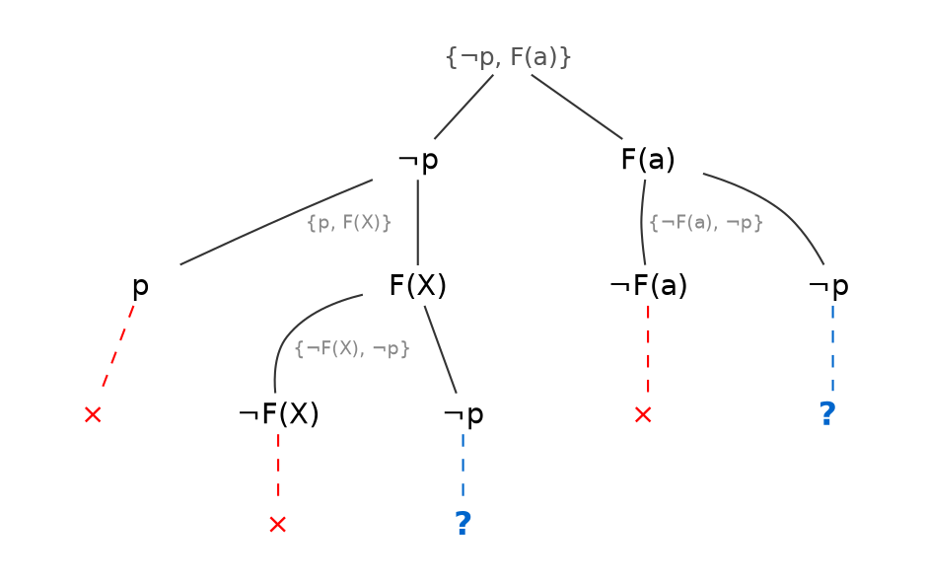
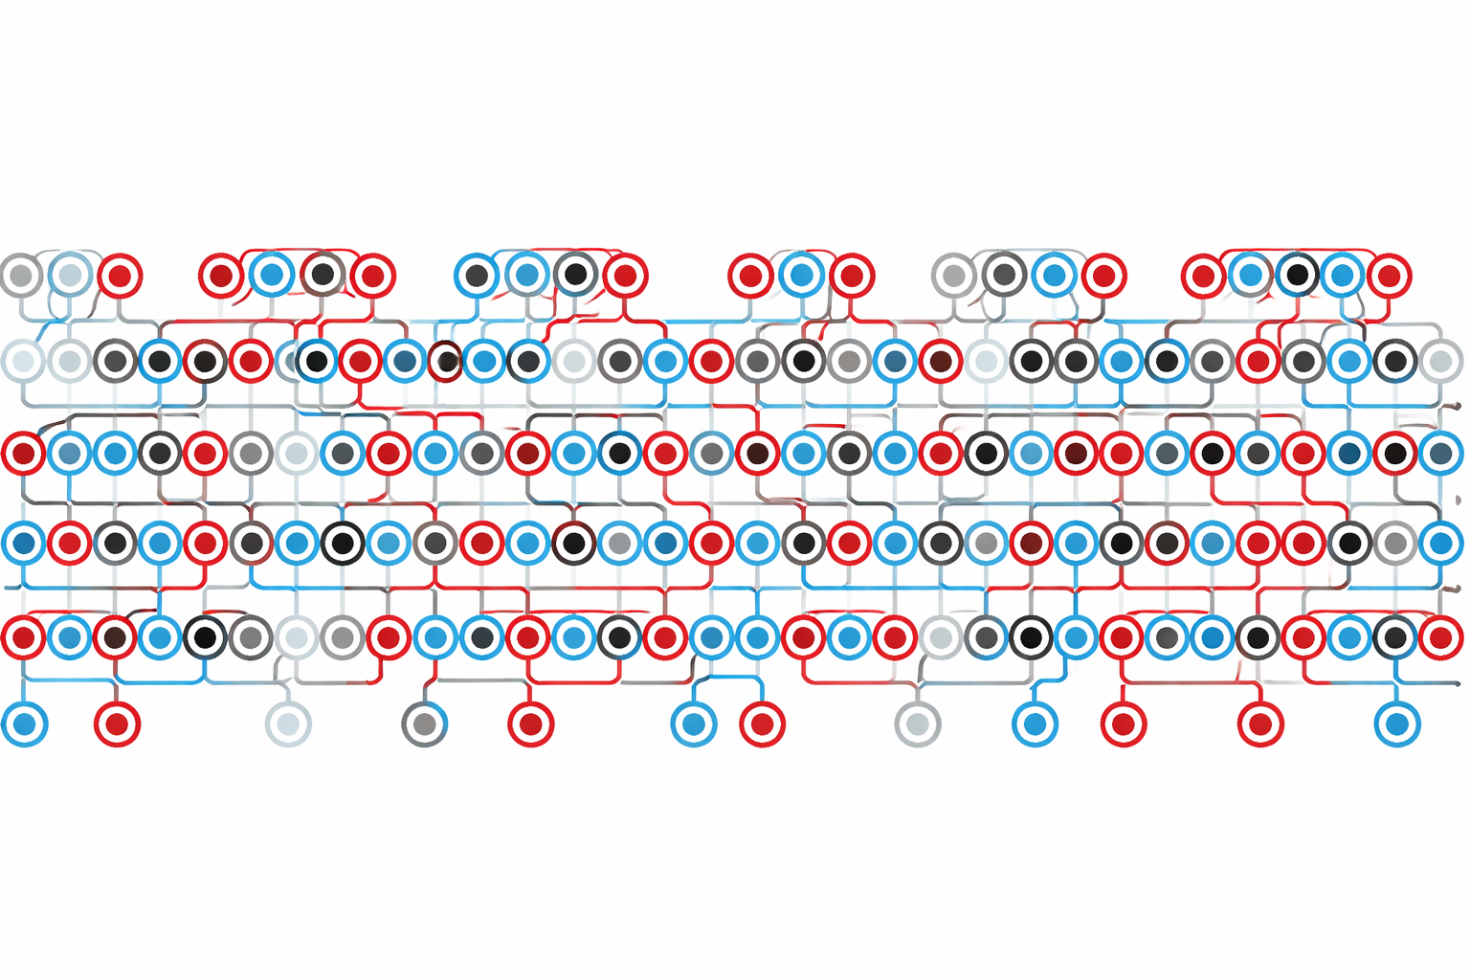
Solving Maths and Logic Problems Fast
Can we teach computers to prove mathematical theorems — and do it quickly?
The Problem
My Approach
Theorem provers explore a search tree of possible proof steps. For hard problems, this tree can be infinite — so choosing where to search matters enormously.
SAT solvers (simpler logic) got dramatically faster by learning when to backtrack and restart. I'm bringing these ideas to first-order theorem proving with ML and heuristics to decide when to cut losses and try a different path.
Search trace through a theorem proving problem
A connection tableau: red ✕ = dead end, blue ? = still searching
Goal: make theorem provers solve more problems better by learning smarter search strategies, and faster by not using deep neural networks
Martin Fixman

