Slide 1


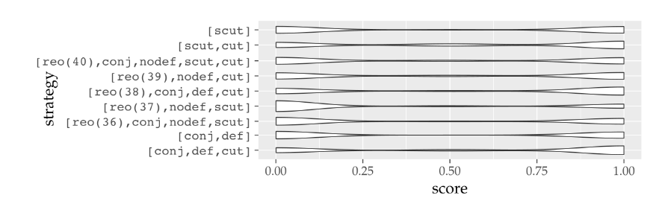
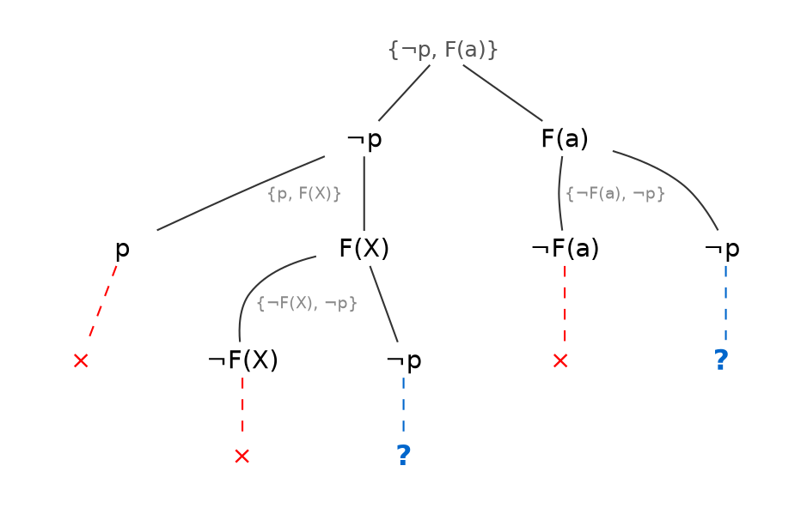
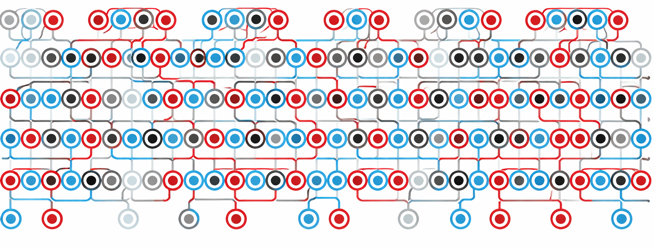

Solving Maths and Logic Problems Fast
It’s hard to tell whether a first-order formula is valid (a theorem) or not.
It’s hard to tell whether a first-order formula is valid (a theorem) or not.
Slow Solution: Machine Learning at each step
SYN051-1
(¬p ∨ big_f(a)) ∧ (¬big_f(b) ∨ p) ∧ (p ∨ big_f(X)) ∧ (¬big_f(X) ∨ ¬p)
SET045-5
(¬element(X,f(Y)) ∨ element(X,Y)) ∧ (¬element(X,f(Y)) ∨ ¬element(X,X))
∧ (¬element(X,Y) ∨ element(X,X) ∨ element(X,f(Y))) ∧ element(X,a)
PUZ001-1
l(agatha) ∧ l(butler) ∧ l(charles) ∧ (¬k(X,Y) ∨ ¬r(X,Y)) ∧ (¬h(agatha,X) ∨ ¬h(charles,X))
∧ (¬h(X,agatha) ∨ ¬h(X,butler) ∨ ¬h(X,charles)) ∧ h(agatha,agatha) ∧ h(agatha,charles)
∧ (¬k(X,Y) ∨ h(X,Y)) ∧ (¬h(agatha,X) ∨ h(butler,X)) ∧ (¬l(X) ∨ r(X,agatha) ∨ h(butler,X))
∧ (k(butler,agatha) ∨ k(charles,agatha))
[1] Kaliszyk et al., “Reinforcement Learning of Theorem Proving,” NeurIPS 2018.
(Sometimes) Wrong Solution: build trees with heuristics
[2] Otten, “Restricting Backtracking in Connection Calculi,” AI Communications, 2010.
[3] Färber, “A Curiously Effective Backtracking Strategy for Connection Tableaux,” AReCCa 2023.
[4] Mangla, “Machine Learning for Theorem Prover Strategies,” PhD thesis, University of Cambridge, 2025.
A connection tableau tells us whether this formula is invalid
Note: p is a theorem ↔ ¬p is invalid
Better Solution:
Why don’t we plagiarise get inspiration from SAT solvers
This works well for SAT.
For first-order formulas, this tree can be infinite!
[5] Fichte et al., “The Silent (R)evolution of SAT,” CACM, 2023.
[6] Liang et al., “Machine Learning-Based Restart Policy for CDCL SAT Solvers,” SAT 2018.
[7] Liu et al., “NeuroSelect: Learning to Select Clauses in SAT Solvers,” DAC 2024.
Martin Fixman

