Slide 1

2nd Place Solution
UCSD-Winter-2025-DSC148 Competition
Airbnb Price Prediction Model
Matthew Jacobsen | March 06, 2025

Slide 2
CONTENTS
1
XGBoost
2
Approach and Model Evaluation
3
Feature Engineering and Selection
4
Latent Dirichlet Allocation
5
Hyperparameter Tuning

Slide 3
XGBoost
Extreme Gradient Boosting
Sequential tree building
Each tree is trained to minimize the errors of previous trees
Handles missing values internally
Incorporates L1 and L2 regularization

Slide 4
Design Process
Use a lot of features
  638 features after encoding
  Hyperparameter tuning to avoid overfitting
Evaluation
  10-fold cross validation on the ENTIRE training set
  Train model on ENTIRE training set before predicting test set

Slide 5
Categorical Features Used:
One Hot Encoding
Property Location
  Neighborhood group cleansed – 5
  Neighborhood cleansed – 220
  Zip code – 190
Property Info
  Property type – 29
  Room type – 3
  Bed type – 5
  Amenities – 123
Booking Info
  Cancellation policy – 7
  Host response time – 4
  Host is super host – 2
  Host identity verified – 2
  Instant bookable – 2
Notes:
Most of the features were ready to use .
Zip Code required some cleaning
Amenitites required manually one hot encoding

Slide 6
Numerical Features Used:
Robust Scaler
Property Info
  Accommodates
  Bathrooms
  Bedrooms
  Beds
  Square feet
Host Info
  Response rate
  Listings Count
  Host since - year
Booking Info
  Guests included
  Extra people
  Minimum nights
  Maximum nights
  Reviews per month
  Number of reviews
Review Scores
  Rating
  Accuracy
  Cleanliness
  Check-in
  Communication
  Location
  Value
Notes:
Bedrooms, beds, bathrooms had a few missing values which I imputed with the median from accommodates. This was a holdover from a linear model that I initially used, after switching to xgboost, I decided to keep it when removing it decreased my cross validation score.
Extra people and host response rate were strings and had to be cleaned
Host since –had to extract the year from the date

Slide 7
Results
Using only Categorical and Numerical Features:
Public Leaderboard Score – 80.162 – 5th
Private Leaderboard Score – 83.879 – 3rd
XGBoost is extremely powerful with very little effort!

Slide 8
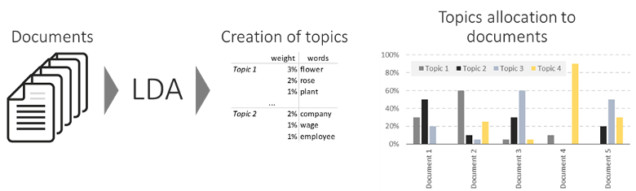
Latent Dirichlet Allocation
Identifies the topics that best define the corpus and assigns a stochastic weight of each topic to each document

Slide 9
LDA on Text Features
Concatenate all text features into a single feature
  name, summary, space, description, neighborhood, notes, transit, access, interaction, house rules
Use LDA to extract 20 topics
  Topic 0: tv, bed, kitchen, apartment, coffee, …
  Topic 5: private, floor, garden, outdoor, deck, …
Each document (combination of all text features) are topics in various proportions
  Example: Listing 1: 70% topic 1, 20% topic 17, 10% topic 19
  Example: Listing 2: 50% topic 1, 30% topic 10, 20% topic 15

Slide 10
Hyperparameter Tuning
 | Default | Tuned | Comments
Learning Rate | 0.3 | 0.025 | Very slow learning rate balanced by large number of trees.
Number of Estimators | 100 | 1100
Max Depth | 6 | 9 | Allow the tree to grow deep but requires a large reduction in loss to split a node.
Minimum Split Loss | 0 | 6.5
L1 Regularization | 0 | 0 | High L2 regularization of leaf weights, prevents single leaves from having outsize impact on prediction
L2 Regularization | 1 | 18
Subsample | 1 | 0.5 | Use 50% of the data in each tree but use all features.
Col Subsample by Tree | 1 | 1
Tree Method | histogram | exact | Use histogram for evaluation, exact for prediction
Notes:
High L2 regularization reduces variance

Slide 11
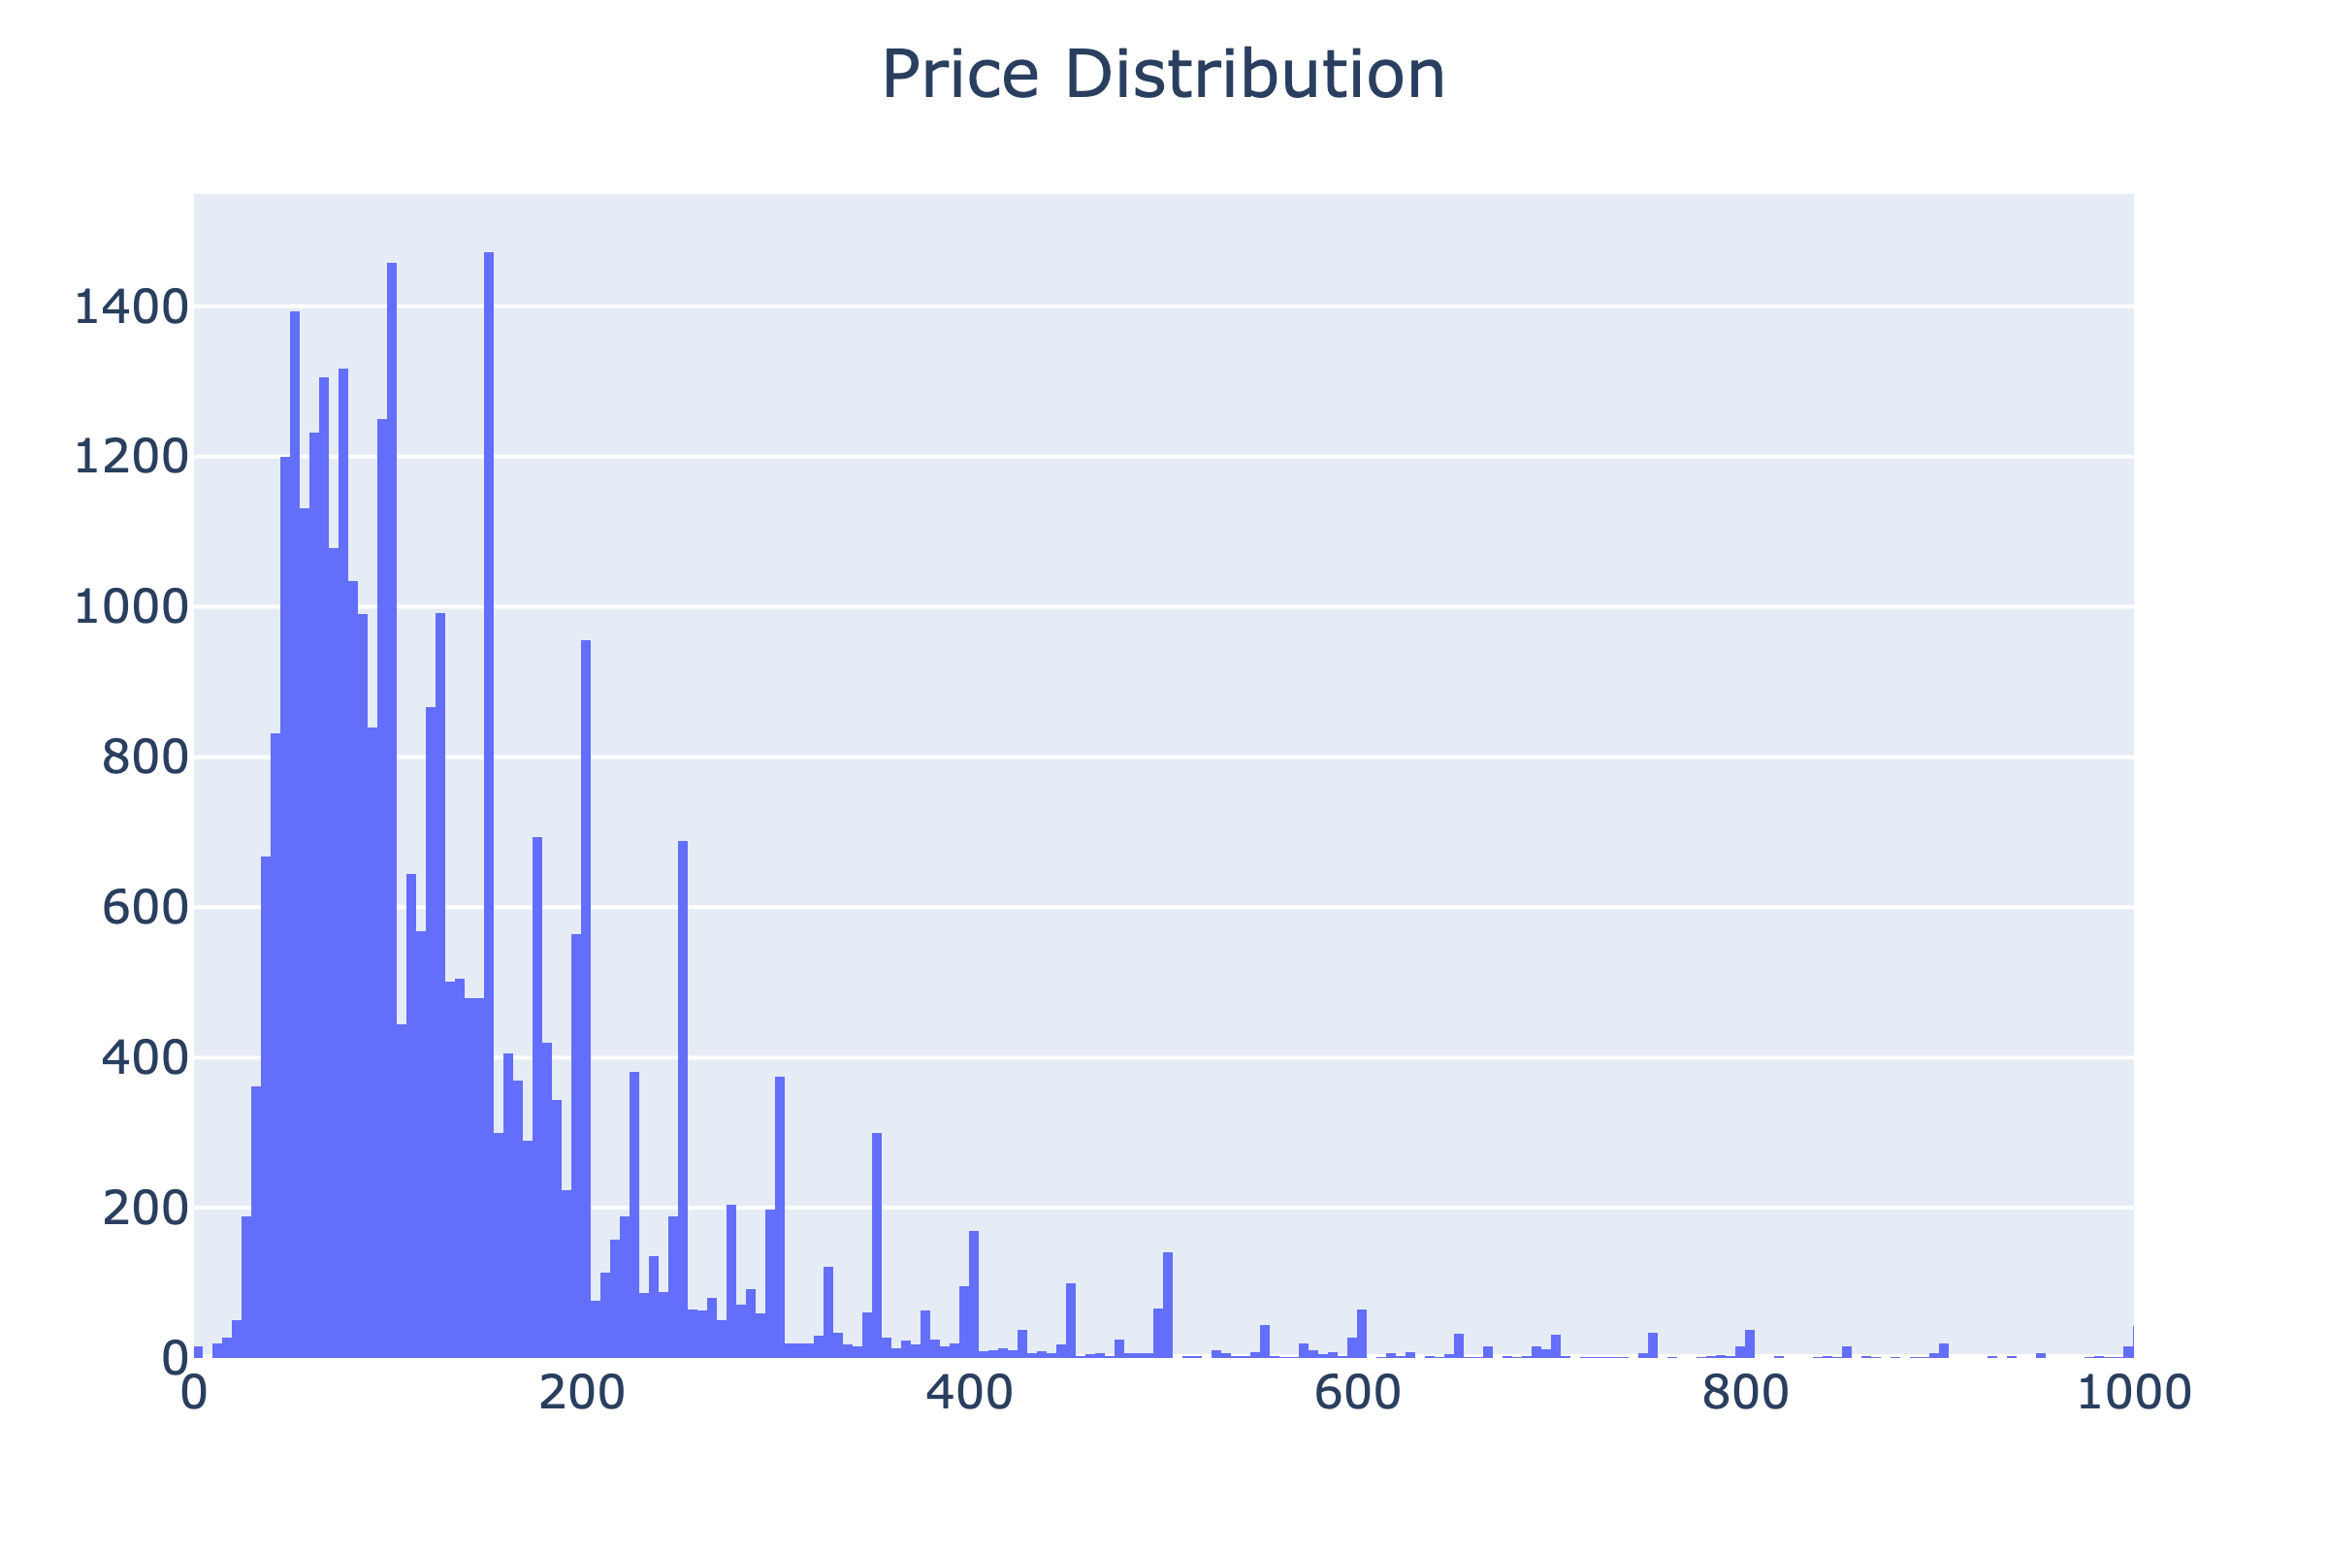
Final Adjustments
72% of all prices in the training set are divisible by 5
Round model predictions to the nearest 5

Slide 12
Questions

