Slide 1

Current Expected Credit Loss (CECL) Loss Rates & PD Modeling
Rohit Khurana
Financial mathematics, NC State University

Slide 2
Objective & Methodology
Understand the need for CECL
Data Exploration & Preparation
Model Loss Rates & Probability of Default
Data Exploration
Mortgage Transition Model
Transition Matrix
Validating Results
LGD & EAD
Vintage Model

Slide 3
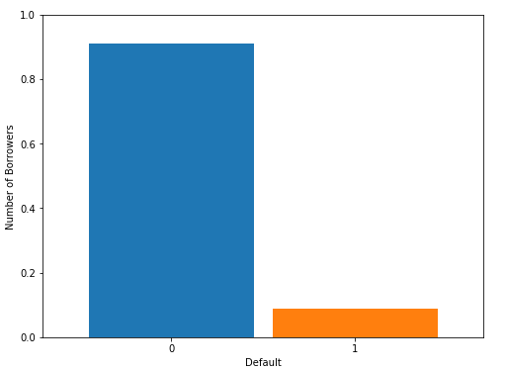
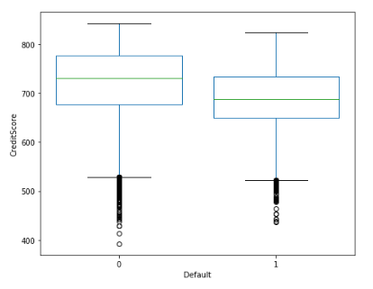
Data Exploration
Dealing with NULL values
Selecting relevant variables from Acquisition and Performance data
Foreclosure Date populated = Default
Correlation heat map on features to check for multicollinearity
Findings:
1. Defaults were very low, data was balanced later
2. Interest rates on defaults were slightly higher
3. Lesser defaults on loans with 2 borrowers
4. Relatively high DTI for default loans
5. Significant difference between median credit scores

Slide 4
Vintage Model (Loss Rate)
Loss rate model with closed pools
Sorted by origination
Works well with homogenous portfolio
Qualitative factor (Q), enhances the estimates
Projected loss rate is given by,
LR_{Proj} = [ LR_{Avg} / Q_{Avg} ]* Q_{Proj}

Slide 5




Loss Rate Matrix

Slide 6

Improvements
Qualitative factors can be lagging indicators of loss rates
Multiple factors like Interest Rates, HPI, etc., can be incorporated into the Q factor

Slide 7
Mortgage Transition Model
Estimate losses at loan level
Expected Credit Loss = PD * LGD * EAD
Various delinquency states including prepaid and default are considered discrete Markov states
Estimate Transition Probabilities using Multinomial Logistic Regression
State space, S = {-1,0,1,2,3,4}
State | Description
-1 | Prepaid
0 | Current
1 | Not performing for 30 days
2 | Not performing for 60 days
3 | Not performing for 90 days
4 | Default

Slide 8
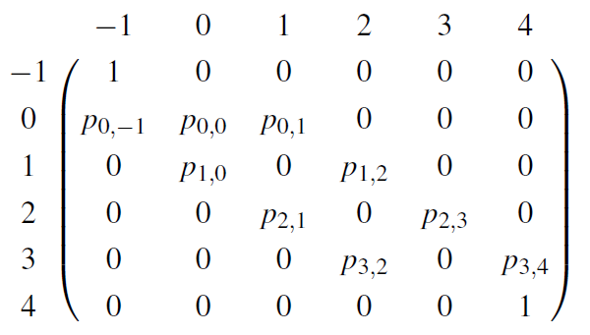

One Step Transition Matrix
Monthly delinquency transitions are considered
Transition matrix is represented as follows:
The corresponding probabilities are calculated using Logistic Regression:
Covariates:
X1 = Credit Score
X2 = % change in HPI
X3 = % change in Unemployment Rate
X4 = % change in CPI
X5 = 3-month Treasury Rate

Slide 9
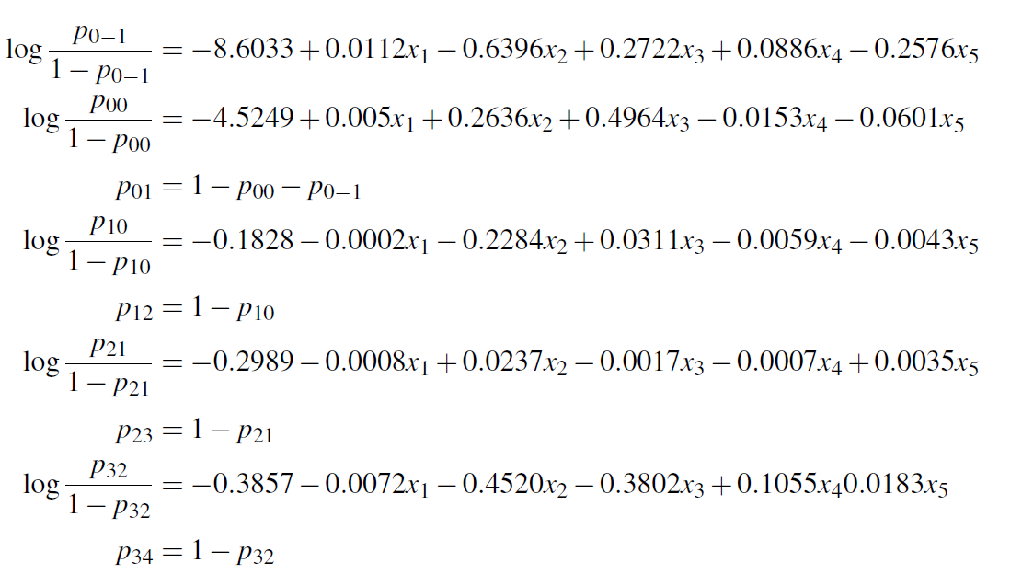
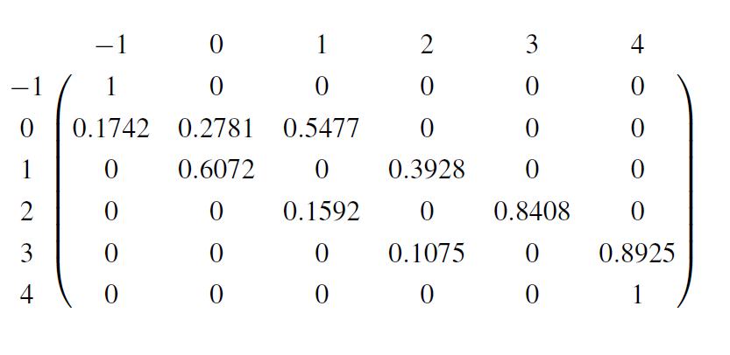
Transition Probabilities and Matrix
At baseline credit score 650

Slide 10
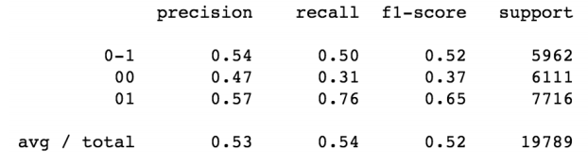
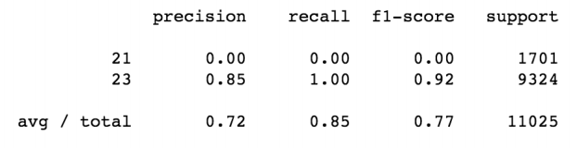
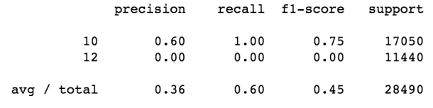
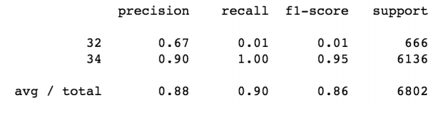
State 0
State 2
State 1
State 4
Efficiency

Slide 11
Remarks & Limitations
Credit Score is the only borrower characteristic, updated quarterly
Need predicted macroeconomic variables for future forecasts
Unbalanced data set, can adjust feature variable distributions by applying transformations
Verify cross validation scores and AUC to pick the champion & challenger models

Slide 12

LGD & EAD
Loss given Default = Unpaid Balance + Expenses – Proceeds
LGD can be modelled using a linear regression with features like Credit Score, CLTV, HPI, Unemployment Rate, Loan type, etc.
Exposure at Default = Unpaid balance at Default
EAD can be modelled using a linear regression with features like Current Unpaid Balance, CLTV, and Balance Clearing Rate from history

Slide 13
Thank You

