Slide 1

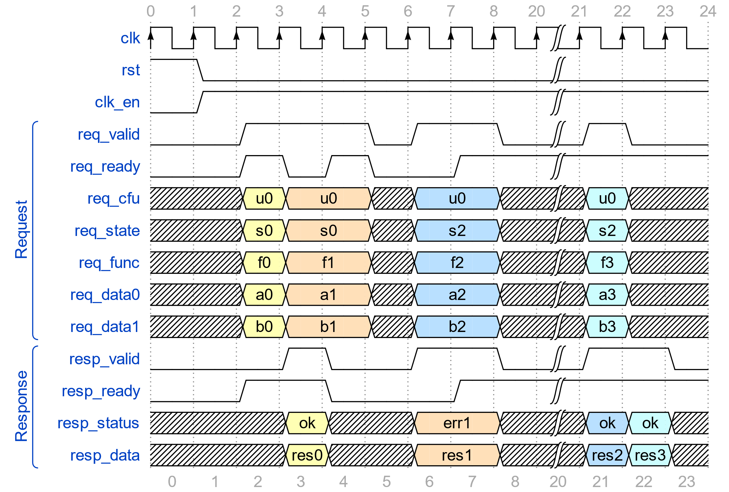


Composable Custom Extensions and Custom Function Units for RISC-V
Jan Gray (Gray Research) , Tim Vogt (Lattice Semiconductor), Tim Callahan (Google), Charles Papon (SpinalHDL),
Guy Lemieux (University of British Columbia), Maciej Kurc (Antmicro), Karol Gugala (Antmicro), Olof Kindgren (Qamcom)

RISC-V custom extensions’ interop problem
Standard extensions layer and compose well. Each takes years to ratify
Custom extensions allow rapid in-house accelerator & library solutions
Solutions may not work together – conflicting encodings, different signaling, discovery, computation, state, error handling, versioning
Incompatible solution silos limit reuse and fragment the ecosystem
Let us build a mix-and-match custom extensions future
Agility of custom extensions with composability of standard extensions
Proposed HW-SW and HW-HW interop interfaces enable reusable accelerators that just work together – a marketplace of accelerators
Key ideas
Custom interface (CI): abstracts a composable custom extension
Custom function unit (CFU): core that implements a custom interface
Accelerated library: issues custom instructions of a custom interface
New interop interfaces
HW-SW: interface multiplexing: libs select hart’s current CI & CI-state → each custom interface enjoys full custom instruction encoding space
HW-HW: CFU Logic Interface (CFU-LI): CFU signaling standard → automatic composition of CPU+CFU complexes
Example
HW-SW stack changes
Custom Interface Runtime: accelerated library services (discovery …)
“-Zicfu”: interface multiplexing CSRs: mcfu_select, cfu_status
CFU Logic Interface & metadata: automatic CPUs+CFUs composition
Some composition challenges we address
Dynamic discovery of custom extensions
Namespace / ID management with no central authority
Collision free custom instruction encodings
Correct composition of stateful custom extensions
Uniform error handling
Uniform context save/restore
Versioning of custom extensions
Privileged systems: access control to extensions and state
Please see spec for all the details
Correct composition via isolation
Behavior of an extension must not change when composed with others
Custom instructions only access registers & selected CFU’s state context
Each interface/CFU may have 0, 1, #harts, or n isolated state contexts
HW-SW interface: custom interface multiplexing
Inexhaustible, collision-free instruction encodings
mcfu_selector CSR selects hart’s current CFU and some state context
custom-0/-1/-2 functions routed to the selected CFU
CFU performs function, may update its state context
CFU response updates destination register and cfu_status CSR
Example accelerated library programming model
Try to select a custom interface, issue custom instructions if CFU present
if (CI bm(CI_ID_IBitmanip); bm) // … csrrw mcfu_selector …
count = cf(pcnt, data, 0); // cfu_reg pcnt,rd,data,x0 else count = popcount(data); // no CFU: use software version
HW-HW interface: CFU Logic Interface (CFU-LI)
Flexible feature levels: combinational, fixed, variable latency, reordering
Prebuilt switches & adapters for glueless composition
Example: CFU-L2 variable latency signaling:
Learn more
Draft Proposed RISC-V Composable Custom Extensions Specification, https://github.com/grayresearch/CFU
Status: refining spec, building CPUs+CFUs composition demos
Join us! Discuss, meet on RISC-V [sig-soft-cpu] list
mcfu_selector CSR cfu_status CSR
cfu reg cf_id,rd,rs1,rs2 cfu_imm cf_id,rd,rs1,imm cfu_flex cf_id,rs1,rs2
instruction
CPU
cfu_reg cf_id rd rs1 rs2
register file
mcfu_selector
Composable CPU and CFU Packages
cfu_id state_id en=1
ALU
cfu_status
CPU MD
Mux MD
Crypt. MD
Comp. MD
bobs_bnn_cfu MD
cu op fi of si ci
request
CPU RTL
Mux RTL
Crypt. CFU RTL
Comp. CFU RTL
bobs_bnn_ cfu RTL
System manifest
id cfu state insn func data0 data1
Composer
state contexts
datapath
CFUs
Accelerated System (Composed Hardware)
Accelerated Application (Composed Software)
response
CPU₀ <2>
Switch
Cryptography CFU <4>
Crypt. library
System CFU map
id status data
CPU₁ <2>
Compression CFU <4>
Comp. library
bobs_bnn_cfu <4>
ML library
Runtime
Applications
-uses
CI₀ lib
CI₁ lib
CI₀
CI₁
CI-ABI
CI-RT
Language-VM / OS / VM
CFU Metadata
RV-I -Zicsr
-Zicfu
SYS-MD
CPU-MD
CPU
CFU₀-MD
CFU₁-MD
CFU Logic Interface
CFU₀
CFU₁
Video narration of this poster: https://youtu.be/MPZ5wx8-03U
Let’s define a common custom extensions architecture so our custom extensions “just work” together

