Slide 1
Placement of Instruction Decode
Fetch buffers
Limited Decode
Instruction Queueing
Issue
Functional Unit
Instruction Decode
Functional Unit
Instruction Decode
Fetch buffers
Functional Unit
Instruction Decode
Except for a handful of signal (like sync) that control the overall operation of the core, most instruction decode is actually done in the functional unit. The instruction register is passed right through to the functional units in the core.

Slide 2
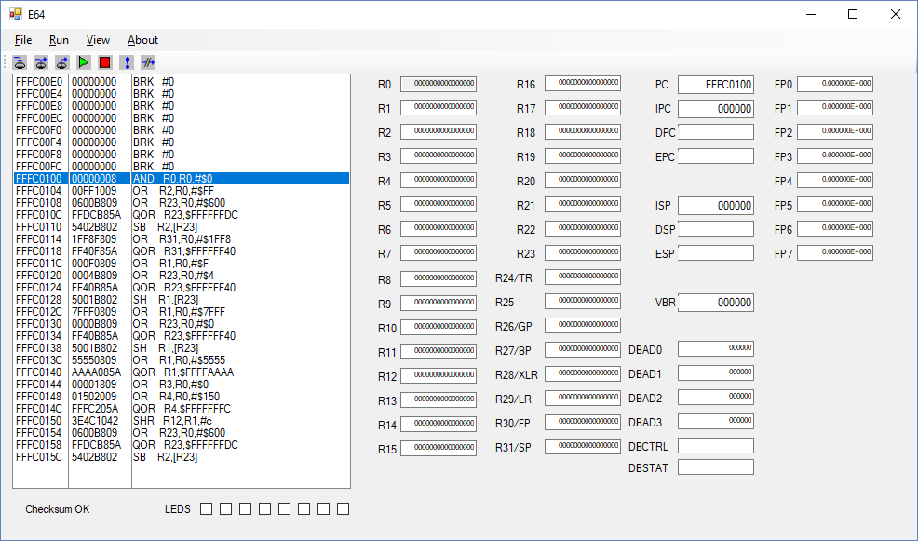

Slide 3
SMT
Thread 0
Thread 1
Fetchbuf A
Fetchbuf B
Fetchbuf C
Fetchbuf D
SMT uses the fetchbuf pairs independently to fetch two different instruction streams.
Each thread has it’s own program counters.

Slide 4
Sequence num.
.. 0: 0 0 0 0 0 0 0 0 0 a0000001c 0 0 00 0000000000000000 0000000000000000 0000000000000000 1 00 0000000000000000 1 00 fffc0154.v 16 0#
.. 1: 0 0 0 0 0 0 0 0 0 a0044081c 0 1 00 0000000141000000 0000000000000044 0000000000000000 1 00 0000000000000000 1 00 fffc0158.^ 01 0#
.. 2: 0 0 0 0 0 0 0 0 0 a0044081c 0 1 00 0000000140000000 0000000000000044 0000000000000000 1 00 0000000000010000 1 07 fffc0158.v 17 0#
.. 3: 0 0 0 0 0 0 0 0 0 a6618085c 0 1 00 0000000000000001 0000000000006618 0000000141000000 1 01 0000000000000000 1 00 fffc015c.^ 02 0#
CQ 4: 0 0 0 0 0 0 0 0 0 a0000001c 0 0 00 0000000000000000 0000000000000000 0000000000000000 1 00 0000000000000000 1 00 fffc0144.v 13 0#
.. 5: 0 0 0 0 0 0 0 0 0 a0000001c 0 0 00 0000000000000000 0000000000000000 0000000000000000 1 00 0000000000000000 1 00 fffc0148.v 14 0#
.. 6: 0 0 0 0 0 0 0 0 0 a0000001c 0 0 00 0000000000000000 0000000000000000 0000000000000000 1 00 0000000000000000 1 00 fffc014c.v 15 0#
.. 7: 0 0 0 0 0 0 0 0 0 a0000001c 0 0 00 0000000000000000 0000000000000000 0000000000000000 1 00 0000000000000000 1 00 fffc0150.^ 00 0#
Last single thread insn.
1st insn of thread 2.

Slide 5
Integer
Regs
Thread 0
Floating Point
Regs
Thread 0
Integer
Regs
Thread 1
Floating Point
Regs
Thread 1
60
61
62
63
14 more sets
Integer
Regs
Thread 0
Floating Point
Regs
Thread 0
Integer
Regs
Thread 1
Floating Point
Regs
Thread 1
0
1
2
3

Slide 6
Vector ALU
Vector ALU
Vector ALU
Vector ALU
Vector ALU
Vector ALU
Vector ALU
Vector ALU

Slide 8
Integer
Regs
Floating Point
Regs
Vector
Register
Vector
Register
62
63
31
30
30 more sets
30 more registers
Vector
Register
Integer
Regs
Floating Point
Regs
Vector
Register
63 elements
1
0
1
0

Slide 9
256 Bit wide bus from L2 Cache
Cache Ram
256 bits wide
256 to 32 mux (8 to 1)
I-Cache miss instruction
Interrupt Instruction
3 to 1

Slide 10
64 bit input data bus
64 bits
Wide memory
64 bits
Wide memory
64 bits
Wide memory
64 bits
Wide memory
256 bit output to L1

Slide 12
Placement of Instruction Decode
Fetch buffers
Limited Decode
Reg. Spec
Ins. Class
Instruction Queueing
Issue
Functional Unit
Instruction Decode
Functional Unit
Instruction Decode
Fetch buffers
Functional Unit
Instruction Decode
Limited decode takes place between fetch and queue. Between fetch and queue register specifications are decoded along with general instruction classes for the benefit of issue. A handful of additional signals (like sync) that control the overall operation of the core are also decoded. Much of the instruction decode is actually done in the functional unit. The instruction register is passed right through to the functional units in the core.

Slide 13
Instruction Queue – Re-order Buffer
slot
slot
slot
Mux
slot
slot
Func.
Unit
slot
slot
slot
The instruction queue is circular with eight slots. Each slot feeds a multiplexor which in turn feeds a functional unit. Providing arguments to the functional unit is done under the vise of issue logic. Output from the functional unit is fed back to the same queue slot that issued to the functional unit.
The queue slots are fed from the fetch buffers.

