Slide 1
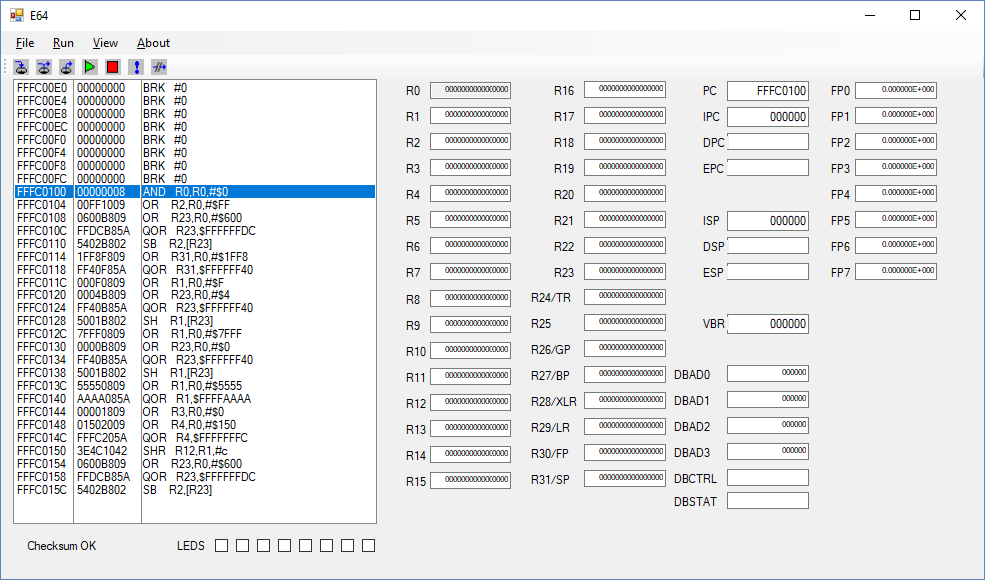

Slide 2
SMT
Thread 0
Thread 1
Fetchbuf A
Fetchbuf B
Fetchbuf C
Fetchbuf D
SMT uses the fetchbuf pairs independently to fetch two different instruction streams.
Each thread has it’s own program counters.

Slide 3
Sequence num.
.. 0: 0 0 0 0 0 0 0 0 0 a0000001c 0 0 00 0000000000000000 0000000000000000 0000000000000000 1 00 0000000000000000 1 00 fffc0154.v 16 0#
.. 1: 0 0 0 0 0 0 0 0 0 a0044081c 0 1 00 0000000141000000 0000000000000044 0000000000000000 1 00 0000000000000000 1 00 fffc0158.^ 01 0#
.. 2: 0 0 0 0 0 0 0 0 0 a0044081c 0 1 00 0000000140000000 0000000000000044 0000000000000000 1 00 0000000000010000 1 07 fffc0158.v 17 0#
.. 3: 0 0 0 0 0 0 0 0 0 a6618085c 0 1 00 0000000000000001 0000000000006618 0000000141000000 1 01 0000000000000000 1 00 fffc015c.^ 02 0#
CQ 4: 0 0 0 0 0 0 0 0 0 a0000001c 0 0 00 0000000000000000 0000000000000000 0000000000000000 1 00 0000000000000000 1 00 fffc0144.v 13 0#
.. 5: 0 0 0 0 0 0 0 0 0 a0000001c 0 0 00 0000000000000000 0000000000000000 0000000000000000 1 00 0000000000000000 1 00 fffc0148.v 14 0#
.. 6: 0 0 0 0 0 0 0 0 0 a0000001c 0 0 00 0000000000000000 0000000000000000 0000000000000000 1 00 0000000000000000 1 00 fffc014c.v 15 0#
.. 7: 0 0 0 0 0 0 0 0 0 a0000001c 0 0 00 0000000000000000 0000000000000000 0000000000000000 1 00 0000000000000000 1 00 fffc0150.^ 00 0#
Last single thread insn.
1st insn of thread 2.

Slide 4
Integer
Regs
Thread 0
Floating Point
Regs
Thread 0
Integer
Regs
Thread 1
Floating Point
Regs
Thread 1
60
61
62
63
14 more sets
Integer
Regs
Thread 0
Floating Point
Regs
Thread 0
Integer
Regs
Thread 1
Floating Point
Regs
Thread 1
0
1
2
3

Slide 5
Vector ALU
Vector ALU
Vector ALU
Vector ALU
Vector ALU
Vector ALU
Vector ALU
Vector ALU

Slide 7
Integer
Regs
Floating Point
Regs
Vector
Register
Vector
Register
62
63
31
30
30 more sets
30 more registers
Vector
Register
Integer
Regs
Floating Point
Regs
Vector
Register
63 elements
1
0
1
0

Slide 8
L2 Cache Organization
64 bit input data bus
Bus Error
Non-Execute Mem Error
Privilege Violation
Bus Error Code
64 bits
Wide memory
64 bits
Wide memory
64 bits
Wide memory
64 bits
Wide memory
32 bits
Wide memory
Mux
Input register 288 bits
Mux
288 bit output to L1
A cache load reads five words, four words for the cache line and a fifth word which is the first word of the next cache line, and stores four and a half words in the cache. The extra half-word is to accommodate 32 and 48 bit instructions that don’t fit evenly into 256 bits and would overflow a 256 bit cache line. Cache line size is 36 bytes.
An input register is used to feed the L1 cache directly on a load so that it doesn’t have to wait for a read of the L2 cache before proceeding, otherwise there would be an additional three cycle delay during a cache miss.
If there is an error during the fetch, the L1 cache line is loaded with a break instruction corresponding to the error. A subsequent instruction fetch will cause the processor to execute the error routine.
The L2 cache is 18kB (512 rows * 36 bytes) composed of block ram which has a three cycle read latency. The L2 cache is four-way set associative.

Slide 9
288 Bit wide bus from L2 Cache
There are multiple copies of the L1 cache corresponding to the number of ways parallel of the core. Each copy may operate independently if SMT is enabled or in unison with other copies for a wider instruction fetch.
Cache Ram
288 bits wide
288 to 48 instr. aligner
I-Cache miss instruction
Interrupt Instruction
3 to 1

Slide 11
PC2
When SMT enabled selects multiplexor outputs that make the copies of the L1 cache operate independently. Caches are indexed by pc0, pc1 and pc2.
With SMT turned off the L1 caches operate in unison and are indexed by only pc0. Outputs are concatenated together.
PC1
+12
+6
PC0
L1 Cache
L1 Cache
L1 Cache
Insn0
Insn1
Insn2
Shift Reg (Insn alignment)

Slide 12
Pipeline
ICache
Fetch buffers
Decode
Reg. Access
Instruction Queueing
Issue
Functional Unit
Instruction Decode
Functional Unit
Fetch buffers
Instruction Decode
Functional Unit
Instruction Decode
Branch Predict
Prog. Counter
.

Slide 13
Instruction Queue – Re-order Buffer
slot
slot
slot
Mux
slot
slot
Func.
Unit
slot
slot
slot
The instruction queue is circular with eight slots. Each slot feeds a multiplexor which in turn feeds a functional unit. Providing arguments to the functional unit is done under the vise of issue logic. Output from the functional unit is fed back to the same queue slot that issued to the functional unit.
The queue slots are fed from the fetch buffers.

Slide 14
TLB Entries
ASID_{7..0}
G
PL_{7..0}
D
U
S
A
C
R
W
X
Virtual Page_{63..0}
Physical Page_{63..0}
Reference Count_{31..0}

Slide 15
Input Data Path
The output from external memory is replicated three times and multiplexed with three data cache channels going to the three channel data aligner.
The data aligner shifts the data into position and sign or zero extends the data as required.
Output from the data aligner is presented on the common data bus to be captured in instruction result registers.
Instruction x3
Input Data Latch
Data Aligner
(3 chan.)
Data Address x3
External Data
MUX
Common Data Bus
Cache Data

Slide 16
Instruction Conveyor Belt
Fetch
tail2
tail1
tail0
Execute
Execute
head2
head1
head0
Commit
Basic idea is to use fifo’s rather than a circular buffer. This is basically a classic split dispatch / re-order buffer.
Instructions are queued at tail0, tail1, and tail2 as space allows and shifted towards head0, head1, and head2 as instructions commit to the machine state.
Some management of source / destination tags is required. The tags for a given instruction increment as it passes through to commit.

