Slide 2
…

Slide 3
Bayesian Inference
GNSS Observations
Kinematic Positioning
Displacement
Extraction
Measurement Update
Displacement
Identification
Prediction
Update
Extended Kalman Filter
Posterior
Samples
Displacement Detection Bayesian Model
Metropolis-Hasting
No-U-Turn
Markov Chain Monte Carlo

Slide 4
Bayesian Inference
GNSS Observations
Kinematic Positioning
Displacement
Extraction
Measurement Update
Displacement
Identification
Prediction
Update
Extended Kalman Filter
Posterior
Samples
Displacement Detection Probability Model
Metropolis-Hasting
No-U-Turn
Markov Chain Monte Carlo

Slide 5
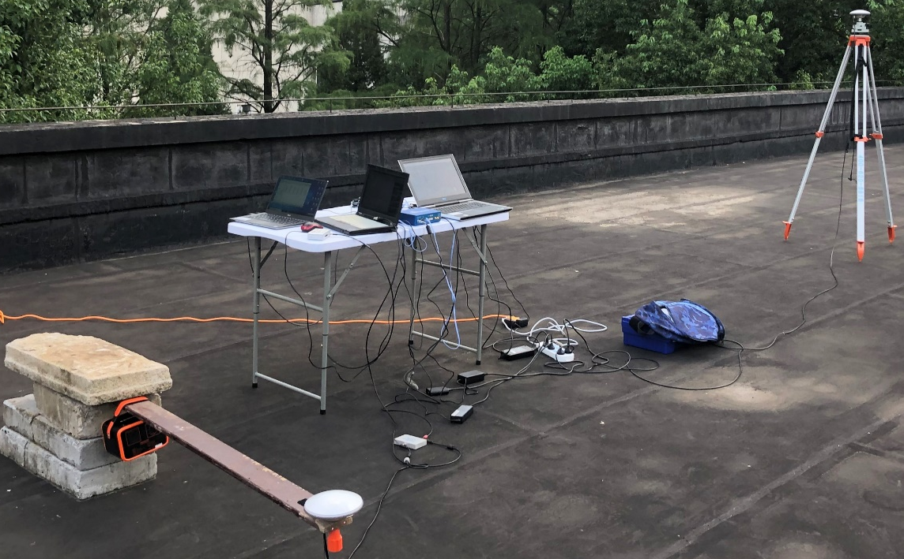
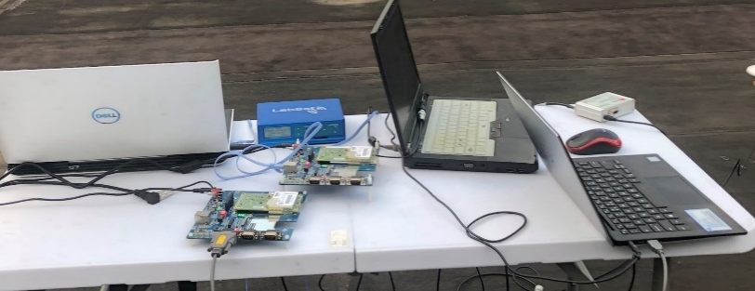
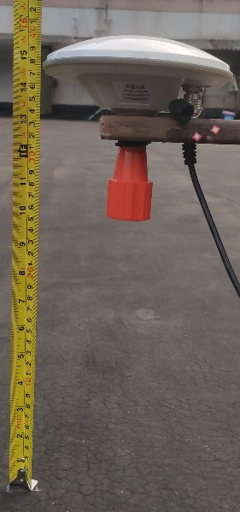
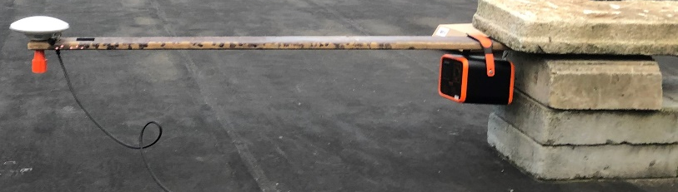
base
rover
(a)
BD992
(b)
h
(c)
(d)

Slide 6
base
rover
(a)
BD992
(b)
h
(c)
(d)

Slide 7
贝叶斯推理
GNSS 观测数据
动态定位
位移提取
测量更新
位移识别
预测更新
扩展卡尔曼滤波
后验样本
位移探测概率模型
Metropolis-Hasting
No-U-Turn
马尔可夫链蒙特卡罗采样

Slide 8
位移探测概率模型

Slide 9
位移探测概率模型
Metropolis-Hasting
No-U-Turn
马尔可夫链蒙特卡罗采样

