Slide 1
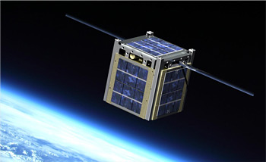
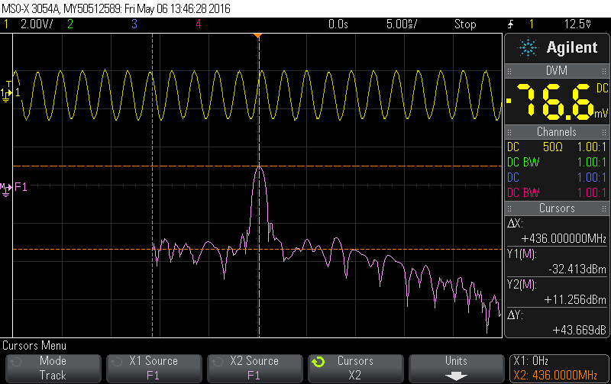
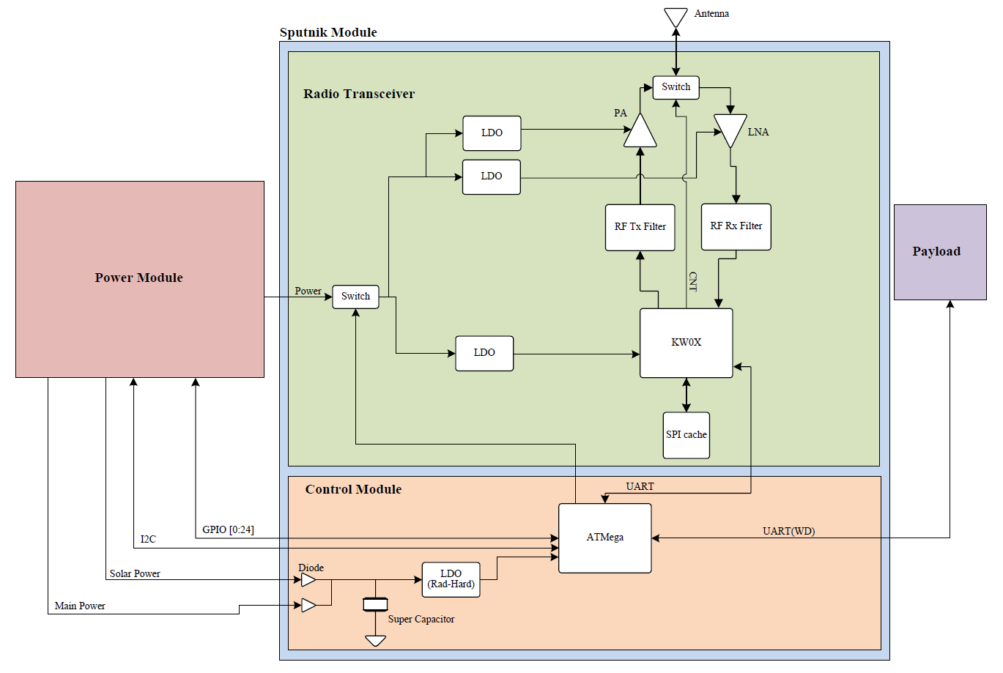

Sputnik: Command, Control and Communications Board for Cubesat
Concept
The Sputnik module is split up in two separate submodules: the radio transceiver module and control module. It is connected to two other important modules within the CubeSat: the payload module and power module.
At the heart of Sputnik is the Radio transceiver which contains the KW0x and a radio infrastructure. This is the communications pipeline. It is connected to the Control Module via UART.
The radio infrastructure in this submodule will consist of a bandpass filter, AC blocking network, aLow-Noise Amplifier, and a Power Amplifier. It will be expecting a 50ohm impedance for its load (the antenna) which is not within the scope of this project. It will need to be capable of producing 1 Watt of power for long distance communication.
The Payload is its own separate module that is not within the scope of this project. What it contains is undetermined but it can be assumed that it will consist of other electronic modules capable of UART communication.
The Control Module is composed entirely of rad-hard parts. It is the lifeline of Sputnik. It will be responsible for detecting the first sign of trouble and rebooting the module. It is also connected to the Power module via I2C and to the Payload via UART. Provisions will need to be made to ensure that the microcontroller is given a little bit of charge during a reboot cycle so that it can maintain control.
The entire architecture will have to run off of a single cell Li-Po battery pack that is connected to the Power module. The Power Management System will take input power from 6 photovoltaic cells. It will use this input power to charge the battery and power the module when possible. When there is no input power, the module will run off the battery.
Description
The Portland State Aerospace Society (PSAS) needs a command, control, and communications system for their CubeSat project. The focus of this project will be rapidly prototyping this module. The code name for the module is Sputnik because of it's requirements to be a simple, reliable space system.
Sputnik will have the following responsibilities:
Long distance RF communications to and from a 400km Low Earth Orbit
Controlling and communicating with a payload that is housed within the CubeSat
On top of fulfilling these duties, it will need to be able to deal with a temperature range of -40C to 50C and radiation events that could cause components to latch up. It will have to have a way for dealing with these events such as rebooting the entire module and/or fault-tolerance.
Aspects of this project include
Building a C3 system from scratch to meet
The harsh environment of space
Compliance with governmental regulations
Programming the system to perform the aforementioned duties
Testing and verifying the device
Documentation
Adhering to the PSAS open-source standard
Department of Electrical and Computer Engineering

