Slide 1
Vector Extension for Wireless Signal Processing base on RVV 1.0
05/2024
ligaoshan@cmiot.chinamobile.com

Slide 2
RISC-V RVV 1.0 Advantages
1
Scalability and Flexibility
Open Standard
2
eliminates licensing,reduced costs,broader adoption,leading to faster innovation
scale vector lengths without changing the core arch.
from low-power embedded systems to high-performance
RVV
3
4
Efficiency
Orthogonality
single instruction process much more data, leading memory access and power efficiency
simplifies programming, compiler design and micro-arch design
Notes:
字体要求：微软雅黑 12-18号字体
具体内容、文字及图表要求不限（可展开多页）

Slide 3
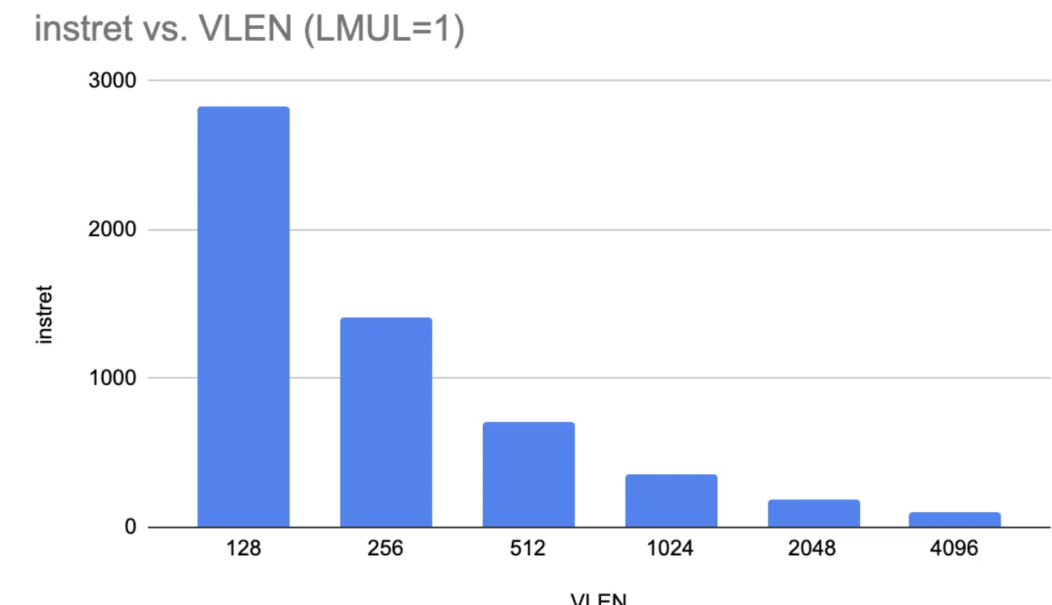
RISC-V V is efficient
Compared to traditional SIMD (etc. ARM Neon , x86 SSE/AVX)，difference is VLEN is a variable
Reduce codesize
A
data longer than VLEN can be processed naturaly
Micro-Arch Opt is easy
C
B
Reduce Loop
pipeline between multi-VR operation is possible
single instruction can process multiple VR
Notes:
字体要求：微软雅黑 12-18号字体
具体内容、文字及图表要求不限（可展开多页）

Slide 4


Wireless Signal Processing has additional ISA requirements
RVV not mature for DSP
Over 50% application for AI & Grap
block wise stride load/store,
float point vector instruction,
common nonlinear function, rsqrt, recip
etc.
Wireless DSP still need:
Dynamic scaling to fully utilize the dynamic range&accuracy with limited bitwidth
Complex number related instructions
highly efficient non-linear functions
highly efficient inter-element instructions
Notes:
字体要求：微软雅黑 12-18号字体
具体内容、文字及图表要求不限（可展开多页）

Slide 5
“Zvw” Extention overview, W for Wireless
aaa
Complex number inst.
01
>20 complex related vector instruction
aaa
Efficient Inter-element Inst.
04
>3 Perm. + funnel shift instrutions
aaa
Dynamic Scaling for multiply & accu.
02
>20 dynamic scaling functions
aaa
Sequence generation Inst.
05
several sequence Gen instructions
aaa
fast Non-linear inst.
03
3 unified fast non-linear functions

Slide 6
Typical Key instructions
vconj(vector complex conjugate)
vcpack(vector complex packing instruction)
vcunpack(vector complex packing instruction)
vdscmul (vector dynamic scaling complex multiply)
vdscmulj (vector dynamic scaling complex conjugate multiply)
vdsmacini(vector dynamic scaling MAC initialization)
vdscmac(vector dynamic scaling complex MAC)
vdscmacj(vector dynamic scaling complex conjugate MAC)
vdscmaco(vector dynamic scaling complex MAC final result output)
vdsredsumn(vector dynamic scaling reduced sum for each n element)
vdscredsum(vector dynamic scaling complex reduced sum)
vredmaxi(vector reduced max with index)
vredmini(vector reduced max with index)
vlnlp(vector load nonlinear parameter)
vnle(vector non-linear exponent calculation instruction)
vnlm(vector non-linear mantissa calculation instruction)

Slide 7
Zvw VS. RVV1.0 -- Conjugate Complex multiply
vsetvl (SEW = 32bit LMUL=1)
vle32.v %[A], (%[Aaddr])
vle32.v %[B], (%[Baddr])
vdscmulj.vv %[C], %[A], %[B]
Zvw 4 Inst.
vsetvl (SEW = 16bit LMUL=1)
vlm.v v0, (%[imageMaskAddr])
vmv.i %[zero], 0
vle16.v %[A], (%[Aaddr])
vle16.v %[B], (%[Baddr])
vmul.vi %[B], %[B], -1, v0
vmerge. vvm %[Aimage], %[zeor], %[A], v0
vmerge. vim %[Areal], %[A], %[zero], v0
slidedown. vi %[Aimage], %[Aimage], 1
vmerge. vvm %[Bimage], %[zeor], %[B], v0
vmerge. vim %[Breal], %[B], %[zero], v0
slidedown. vi %[Bimage], %[Bimage], 1
vmul.vv %[real1], %[Areal], %[Breal]
vmul.vv %[real2], %[Aimage], %[Bimage]
vmul.vv %[image1], %[Areal], %[Bimage]
vmul.vv %[image2], %[Aimage], %[Breal]
vadd.vv %[real], %[real1], %[real2]
vadd.vv %[image], %[image1], %[image2]
slideup.vi %[image], %[image], 1
vmerge. vvm %[result], %[image], %[real], v0
RVV 1.0 20 Inst.
A31
B31*
A30
SC16
B30*
SC16
A29
SC16
B29*
SC16
SC16
SC16
A2
SC16
B2*
A1
SC16
B1*
SC16
A0
SC16
B0*
SC16
SC16
A1, A2 ... A31
B1*, B2* ... B31*
Zvw is 5X more efficient in codesize, efficency and power in this case.

Slide 8
Zvw VS. RVV1.0 -- Complex dynamic scaling MAC
vsetvl (SEW = 32bit LMUL=2)
vdsmacini. s %[AntShift]
vle32.v %[cir0], (%[cir0Addr])
vle32.v %[cir1], (%[cir1Addr])
vdscmacj.vv %[cir0], %[cir1]
vdscmaco.v %[cirSum]
vdscredsum.v %[result], %[cirSum]
Zvw 7 Inst.
vsetvl (SEW = 16bit LMUL=2)
vlm.v v0, (%[imageMaskAddr])
vmv.i %[zero], 0
vmv.v %[accReal], %[zero]
vmv.v %[accImage], %[zero]
vle16.v %[A], (%[Aaddr])
vle16.v %[B], (%[Baddr])
vmerge. vvm %[Aimage], %[zeor], %[A], v0
vmerge. vim %[Areal], %[A], %[zero], v0
slidedown. vi %[Aimage], %[Aimage], 1
vmerge. vvm %[Bimage], %[zeor], %[B], v0
vmerge. vim %[Breal], %[B], %[zero], v0
slidedown. vi %[Bimage], %[Bimage], 1
vwmac.vv %[accReal], %[Areal], %[Breal]
vwmac.vv %[accReal], %[Aimage], %[Bimage]
vwmac.vv %[accImage], %[Areal], %[Bimage]
vwmac.vv %[accImage], %[Aimage], %[Breal]
vsetvl (SEW = 32bit LMUL=1)
vsra.vv %[accReal], %[accReal], %[AntShift]
vsra.vv %[accImage], %[accImage], %[AntShift]
vsetvl (SEW = 16bit LMUL=1)
slideup. vi %[accImage], %[accImage], 1
vmerge. vvm %[result], %[accImage], %[accReal], v0
RVV 1.0 23 Inst.
A63
B63*
A62
SC16
B62*
SC16
A61
SC16
B61*
SC16
SC16
SC16
A2
SC16
B2*
A1
SC16
B1*
SC16
A0
SC16
B0*
SC16
SC16
A1, A2 ... A31
B1*, B2* ... B31*
Zvw is 3.5X more efficient in codesize, efficency and power in this case. Accuracy is another advantage.

Slide 9
Zvw VS. RVV1.0 -- wideband average power
vsetvl (SEW = 16bit LMUL=2)
vmv.v.i %[acc], 0
vmv.v.v %[gainShift2], %[gainShift]
vsetvl (SEW = 16bit LMUL=1)
vle16.v %[a0], (%[a0Addr])
vwmul.vv %[a0], %[a0], %[a0]
vle16.v %[a1], (%[a1Addr])
vwmacc.vv %[acc], %[a1], %[a1]
vsetvl (SEW = 16bit LMUL=2)
vsra.vv %[a0], %[a0], %[gainShift] // lost accuracy here
vsra.vv %[a1], %[a1], %[gainShift] // lost accuracy here
vadd %[a0], %[a0], %[a1]
vsra.vi %[a0], %[a0], n // output fixpoint format
vredsum.vs %[sum32], %[a0], %[acc]
sum32[0] is the final result of SC16
RVV 1.0 14 Inst.
A = [a0, a1]
vsetvl (SEW = 32bit LMUL=1)
vdsmacini.v %[gainShift]
vle32.v %[a0], (%[a0Addr])
vdsmacj.vv %[a0], %[a0]
vle32.v %[a1], (%[a1Addr])
vdscmacj.vv %[a1], %[a1]
vdscmacor.v %[acc]
vdscredsum.v %[sum32]
sum32[0] is the final result of SC16
Zvw 8 Inst.
A31
SC16
A30
SC16
A31
A29
SC16
A30
SC16
SC16
SC16
A29
SC16
SC16
SC16
SC16
SC16
A2
SC16
A1
SC16
SC16
A2
A0
SC16
A1
SC16
SC16
SC16
A0
SC16
SC16
SC16
SC16
SC16
SC16
A1^{H}
A2^{H}
...
A31^{H}
A1, A2 ... A31
Zvw is 2X more efficient in codesize, efficency and power in this case. Accuracy is another advantage.
Each A vector has different gain shift

Slide 10
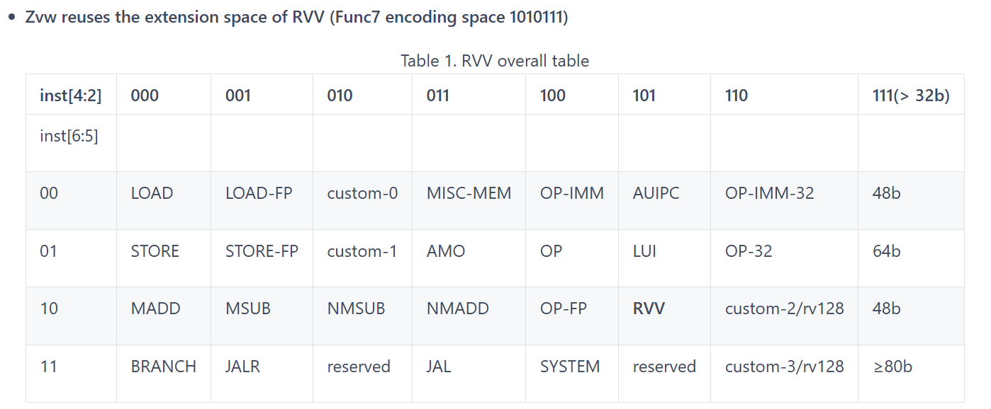
Zvw encoding space

Slide 11
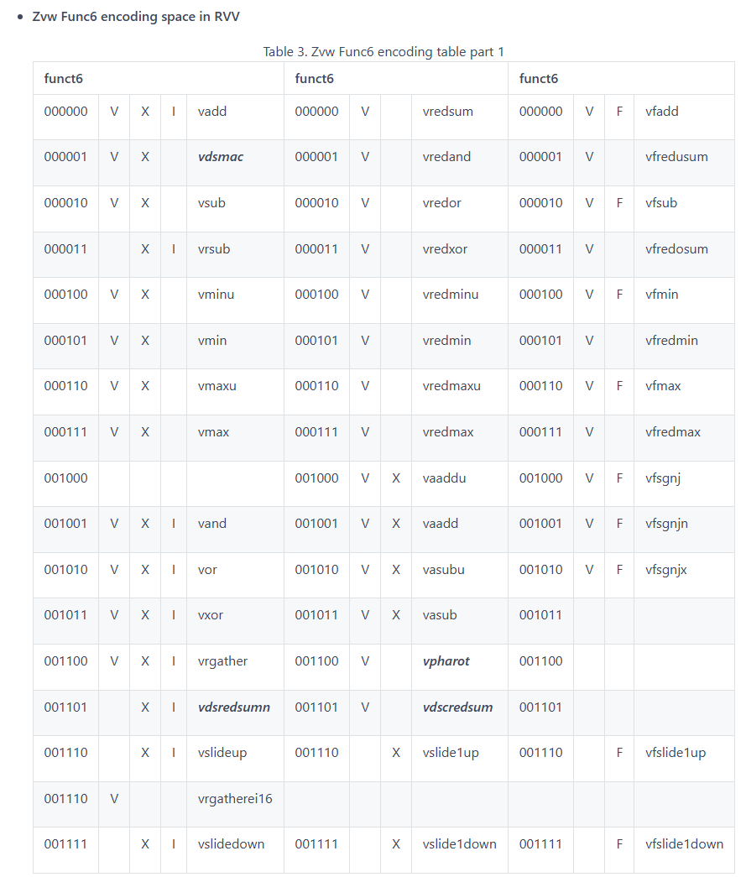
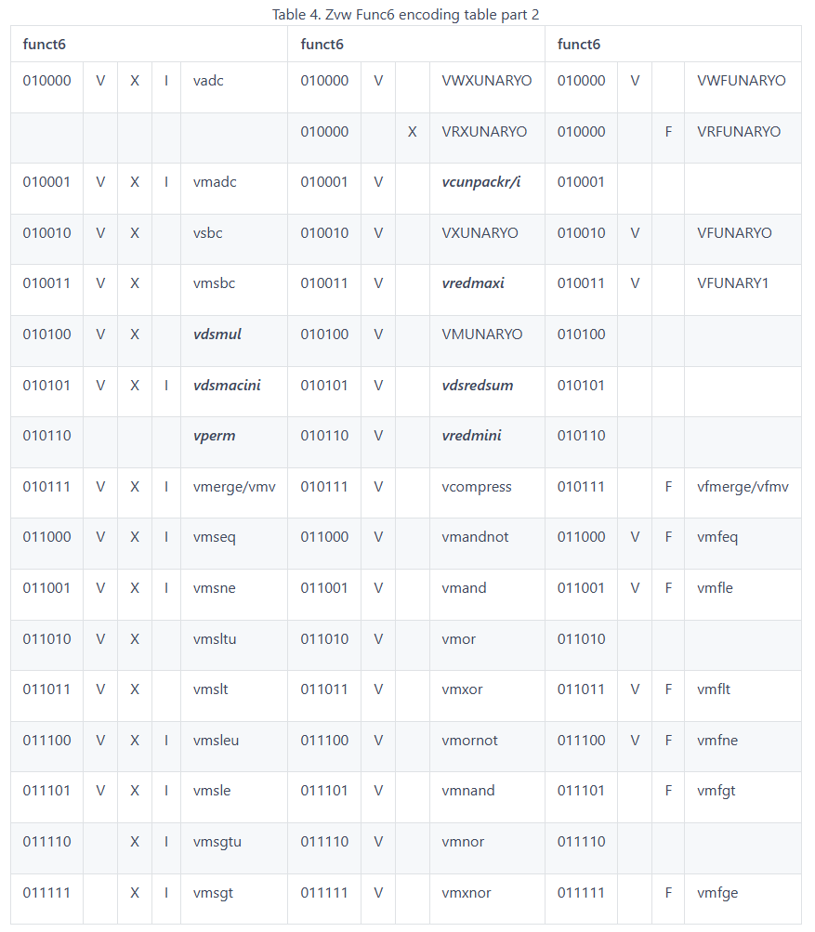
Zvw encoding space

Slide 12
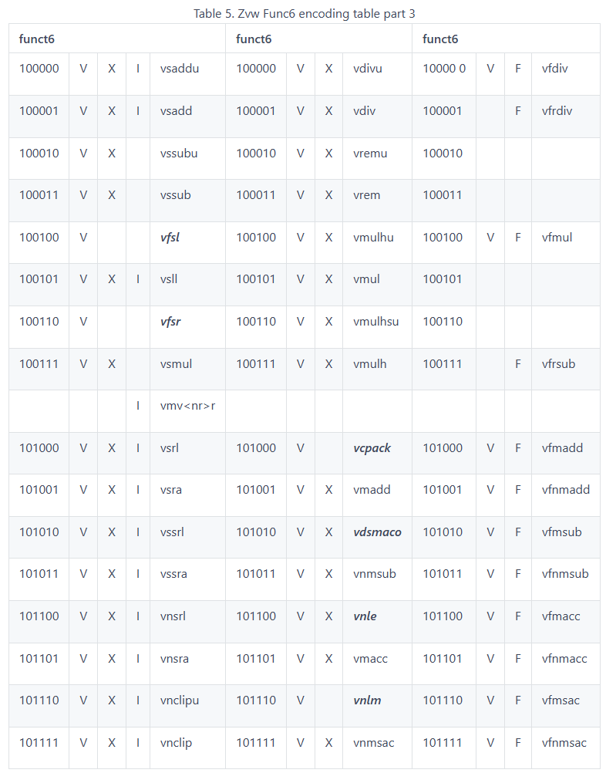
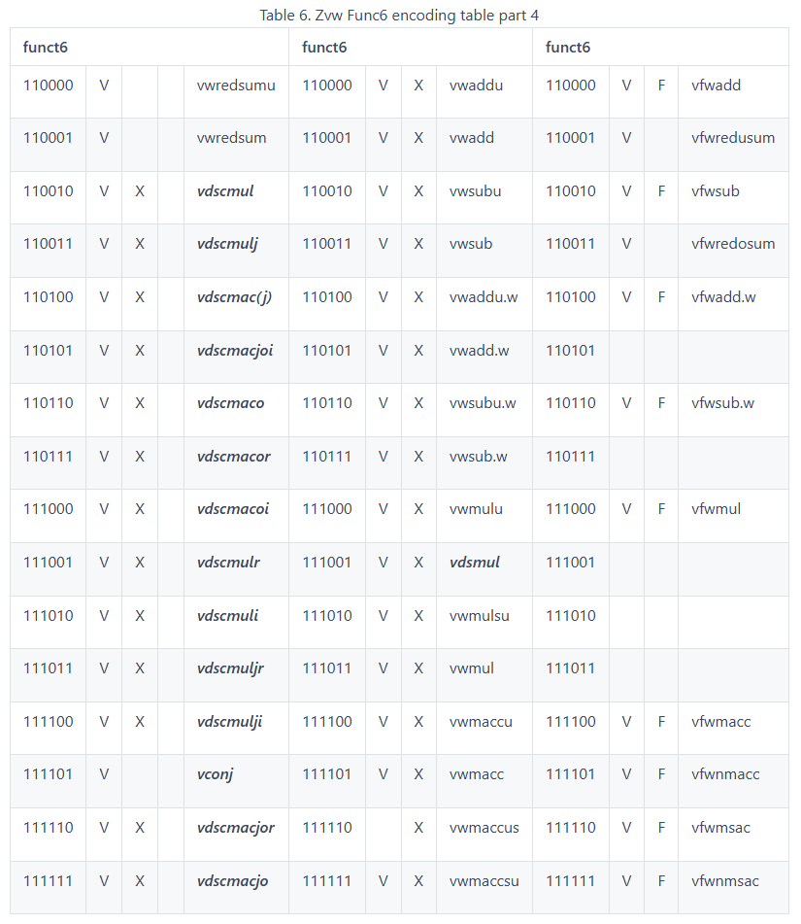
Zvw encoding space

