Slide 1

Tomasulo 2009
Issue Unit and CDB Controller
Prasanjeet Das
Department of Electrical Engineering
University of Southern California

Slide 2
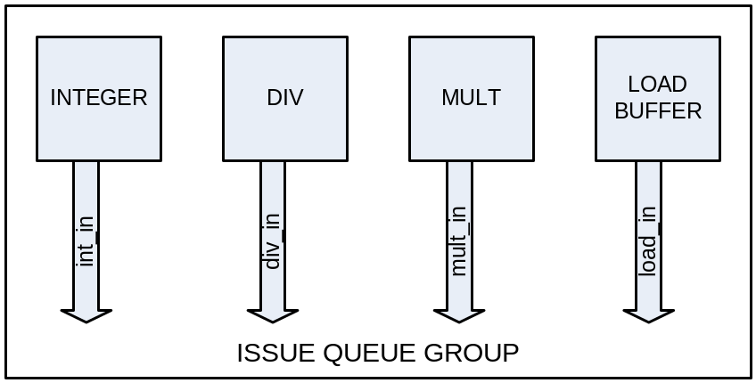

Four Issue Queues send instructions to the Fuctional Units (FUs)
Integer Issue Queue, Div Issue Queue and Mult Issue Queue are exactly same.
Lw/Sw Queue is little different because of the memory disambiguation rules resulting in need of Address Buffer and counters.

Slide 3
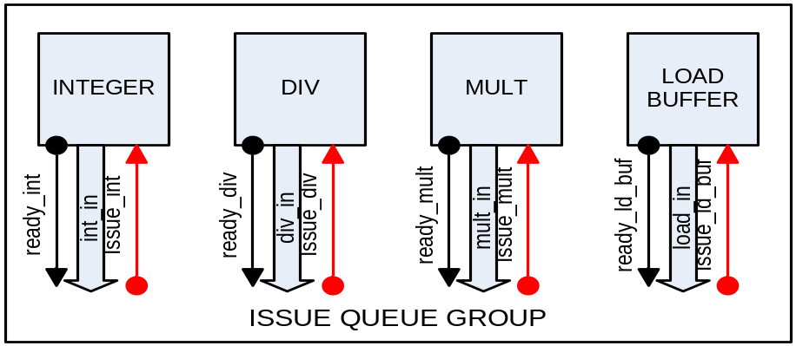
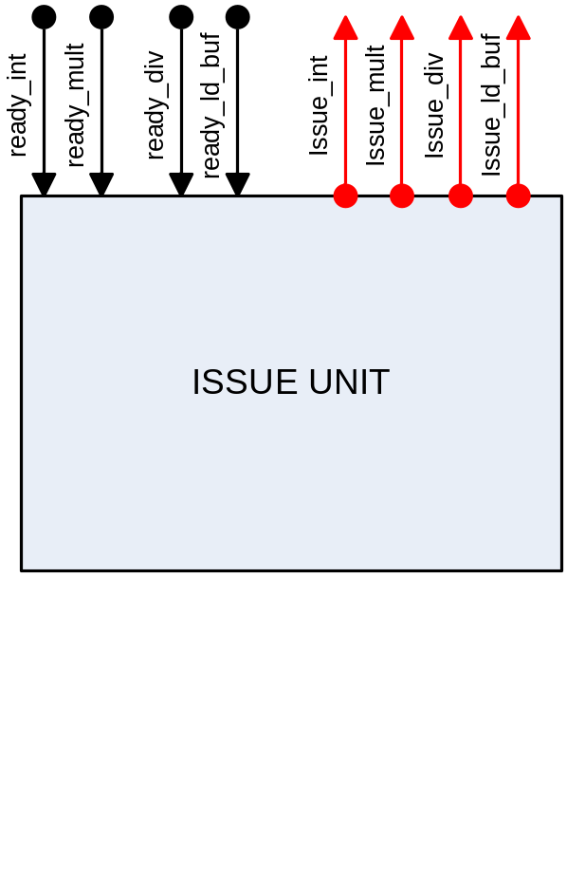
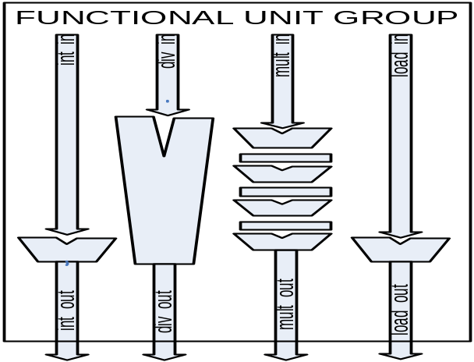
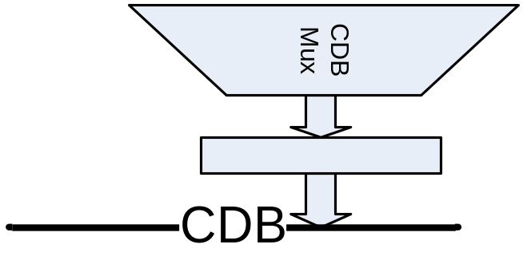
Issue Unit generates the mux-control signals
Receive requests from one of the Issue Queues and make Issue Decision
requests
decision

Slide 4
Issue decision goes to the Issue Queue and CDB Mux
requests
decision
To Issue Queue
acknowledgement to the Issue request
To CDB Mux
Mux control signal
Send Mux control signals right away?

Slide 5
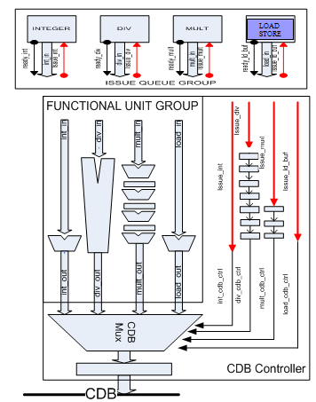
Mux control signals travel through stage registers along with the FU data
requests
decision
Causes BUS contention ?
(or collision of CDB Mux controls ?)

Slide 6
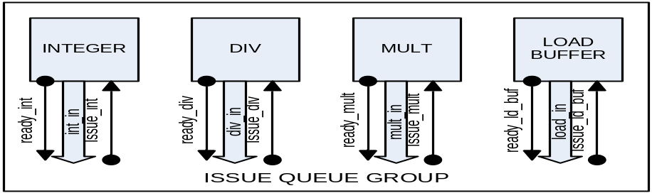
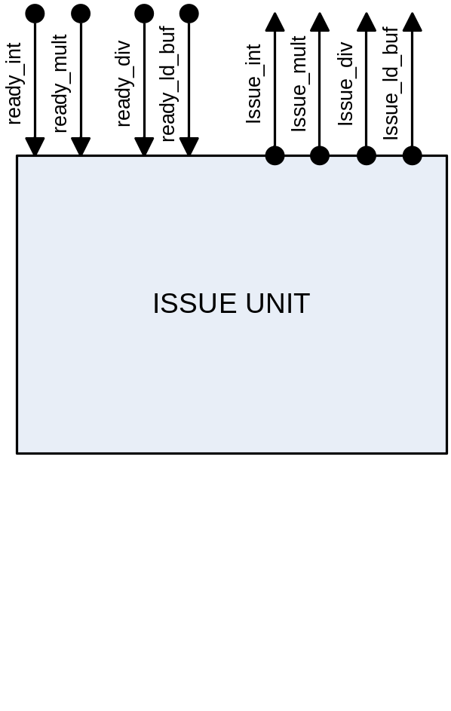
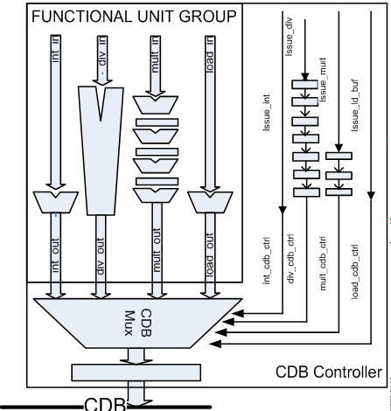
To avoid collision, employ a bus reservation table
requests
decision
div_exec_ready
6
5
4
3
2
1
0
cdb_valid
CDB Reservation Registers
divider is a multi cycle unit
- non-pipelined
div_exec_ready signal
to prevent consecutive execution of div.
1: div has finished its execution, so issue next
0: busy

Slide 7
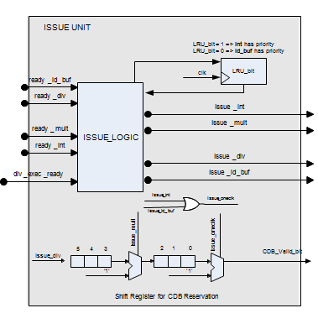
Inside the Issue Unit
Issue Policy
long-latency instruction first
LRU for instructions of same latency (decided on by using the rd tag info)
Latencies
div: 6 clocks + 1 clock
mult: 3 clocks (pipelined) + 1clock
int: 1 clock
ld_buf: 1 clock
LRU_bit
1: int has priority
0: ld_buf has priority
if both requested,
- issue according to the LRU_bit
if one of them requested,
- issue it
Up to 3 instructions enter the CDB Reservation Register

