Slide 1
Guidelines for Neural Network Models Performance Assessment and Improvement from the perspective of image analysis
Nov. 17, 2020 Research Computing Center

Slide 2
Use your UC email address to login your Google account, and then click “Slides”
Click https://github.com/rcc-uchicago/Guidelines_Neura_Network_Model_Performance and download the entire folder
unzip the folder and then upload “Performance guidelines of neural network models_workshop.jpynb” onto your Google Drive.
Use Google Colaboratory to open it.

Slide 3
We are going to use Google’s Colab for this workshop
Google’s Colab is basically Google Docs for interactive, runnable Jupyter Notebooks, and it is a fantastic resource for playing around with machine learning models. It comes with great sharing and collaboration features and even a free GPU runtime!
If you have never used Colab, please follow the instruction below; otherwise, you can skip it:

Slide 4
Sign up for Colab
Anyone with a Google Drive account can sign up for Colab by heading to colab.research.google.com and following the listed instructions.
Create a new notebook
File -> New Notebook. Either Python 2 or 3 will work, but I would recommend Python 3 (that’s what the rest of this tutorial will be using)
Set up the GPU runtime (we DO use GPU for this workshop actually)
Runtime -> Change runtime type -> Hardware Accelerator -> GPU. Free GPU cycles!

Slide 5
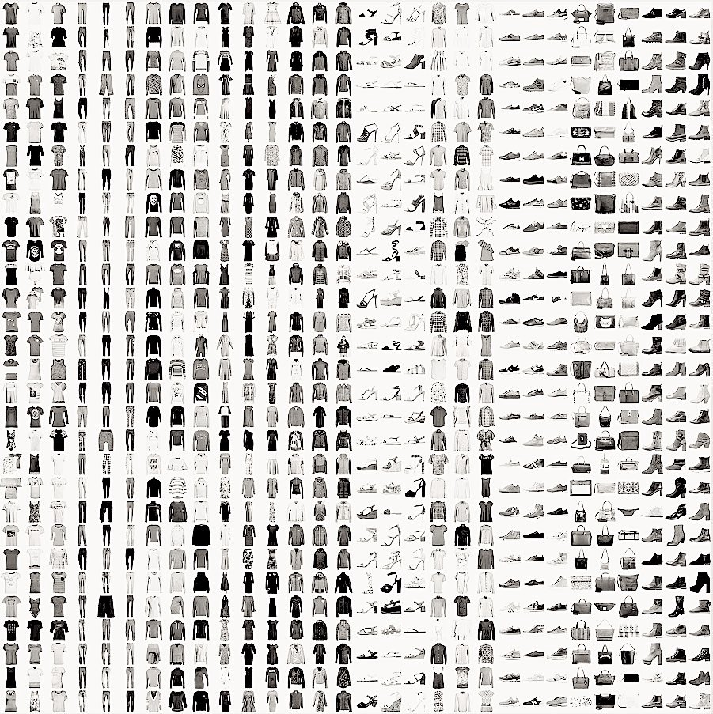
Fashion MNIST Dataset

