Slide 1
Guidelines for Neural Network Models Performance Assessment and Improvement
Nov. 17, 2020

Slide 2
Use your UC email address to login your Google account, and then click “Slides”
Click https://github.com/rcc-uchicago/Guidelines_Neura_Network_Model_Performance and download the entire folder
unzip the folder and then upload “work_temp of image_classification_workshop.jpynb” onto your Google Drive (You do not need to upload another .jpynb notebook file now).
Use Google Colaboratory to open it.

Slide 3
We are going to use Google’s Colab for this workshop
Google’s Colab is basically Google Docs for interactive, runnable Jupyter Notebooks, and it is a fantastic resource for playing around with machine learning models. It comes with great sharing and collaboration features and even a free GPU runtime!
If you have never used Colab, please follow the instruction below; otherwise, you can skip it:

Slide 4
Sign up for Colab
Anyone with a Google Drive account can sign up for Colab by heading to colab.research.google.com and following the listed instructions.
Create a new notebook
File -> New Notebook. Either Python 2 or 3 will work, but I would recommend Python 3 (that’s what the rest of this tutorial will be using)
Set up the GPU runtime (we DO use GPU for this workshop actually)
Runtime -> Change runtime type -> Hardware Accelerator -> GPU. Free GPU cycles!

Slide 5
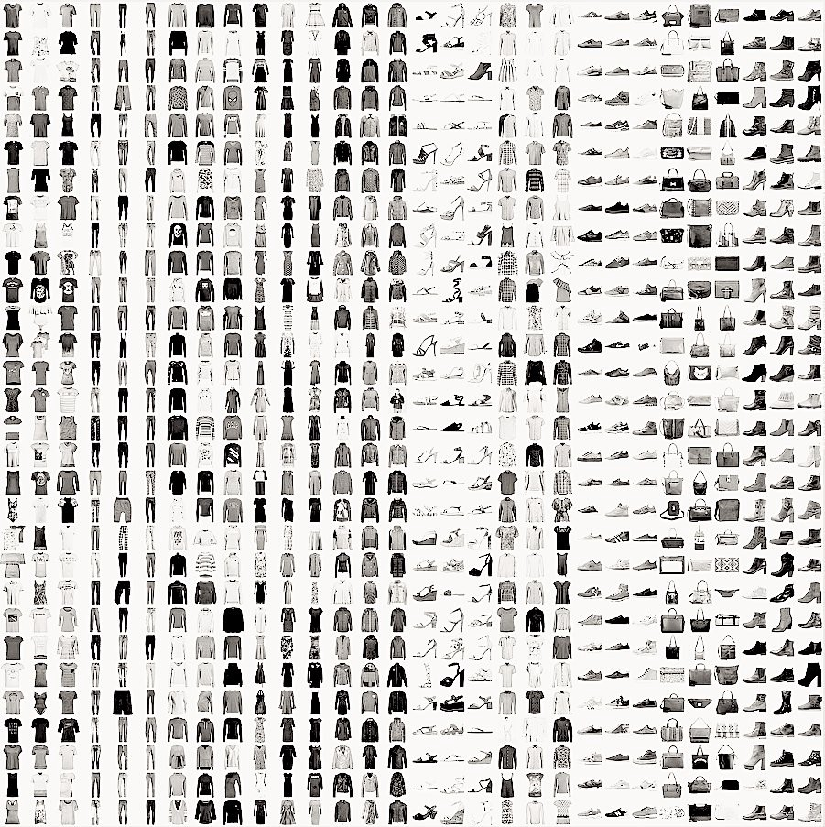
Fashion MNIST Dataset

Slide 6
Training CNN Models on Fashion MNIST
For all the models (except for the pre-trained one), here is the approach:
Split the original training data (60,000 images) into 80% training (48,000 images) and 20% validation (12000 images) optimize the classifier, while keeping the test data (10,000 images) to finally evaluate the accuracy of the model on the data it has never seen.
This helps to see whether we are over-fitting on the training data and whether we should lower the learning rate and train for more epochs if validation accuracy is higher than training accuracy or stop over-training if training accuracy shift higher than the validation.
Train the model for 10 epochs with batch size of 256, compiled with categorical crossentropy loss function and Adam optimizer.
Then, add data augmentation, which generates new training samples by rotating, shifting and zooming on the training samples, and train the model on updated data for another 50 epochs.

Slide 7
Convolutional Neural Networks
Convolutional Neural Networks (CNNs) is the most popular neural network model being used for image classification problem.
The big idea behind CNNs is that a local understanding of an image is good enough. The practical benefit is that having fewer parameters greatly improves the time it takes to learn as well as reduces the amount of data required to train the model.
Instead of a fully connected network of weights from each pixel, a CNN has just enough weights to look at a small patch of the image. It’s like reading a book by using a magnifying glass; eventually, you read the whole page, but you look at only a small patch of the page at any given time.

Slide 8
While training a deep neural network, we are required to make a lot of decisions regarding the following hyperparameters:
Number of hidden layers in the network
Number of hidden units for each hidden layer
Learning rate
Activation function for different layers, etc.

Slide 9
There is no specified or pre-defined way of choosing these hyperparameters. The below is what we generally follow:
Start with an idea, i.e. start with a certain number of hidden layers, certain learning rate, etc.
Try the idea by coding it
Experiment how well the idea has worked
Refine the idea and iterate this process

Slide 10
Hyperparameter Tuning
Tuning process
Hyperparameters. We see this term popularly being bandied about in data science competitions and hackathons. But how important is it in the overall scheme of things?
Tuning these hyperparameters effectively can lead to a massive improvement in your position on the leaderboard. Following are a few common hyperparameters we frequently work with in a deep neural network:
Learning rate – α
Momentum – β
Adam’s hyperparameter – β₁, β₂, ε
Number of hidden layers
Number of hidden units for different layers
Learning rate decay
Mini-batch size

Slide 11
Data Augmentation
Data augmentation is often used in order to improve generalization properties. Typically, random cropping of rescaled images together with random horizontal ﬂipping and random RGB color and brightness shifts are used.
Different schemes exist for rescaling and cropping the images (i.e. single scale vs. multi scale training). Multi-crop evaluation during test time is also often used, although computationally more expensive and with limited performance improvement.
Note that the goal of the random rescaling and cropping is to learn the important features of each object at different scales and positions.

Slide 12
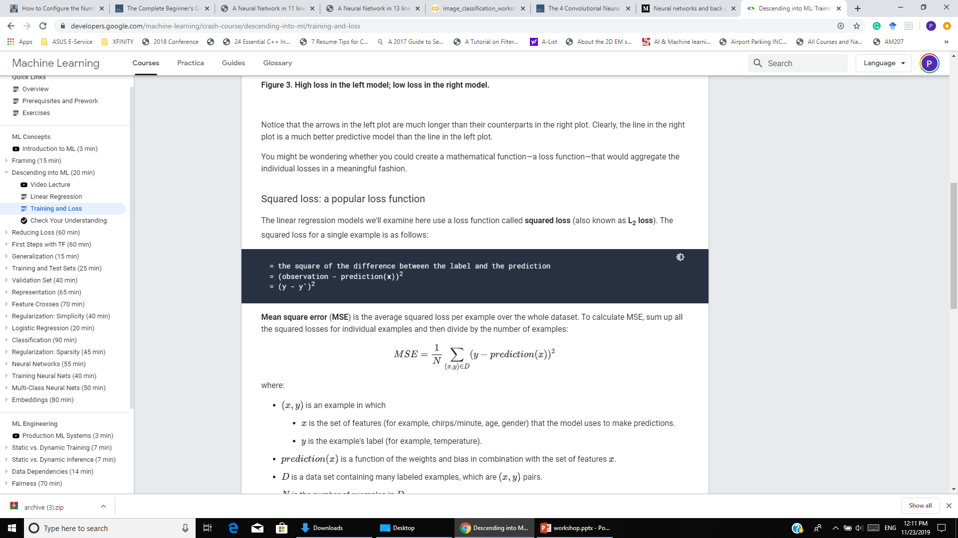
Squared loss: a popular loss function
The linear regression models we examine here use a loss function called squared loss (also known as L₂ loss).
The squared loss for a single example is as follows:
Mean square error (MSE) is the average squared loss per example over the whole dataset.
To calculate MSE, sum up all the squared losses for individual examples and then divide by the number of examples:
How to minimize the loss (in the case here, to minimize the MSE)?

Slide 13
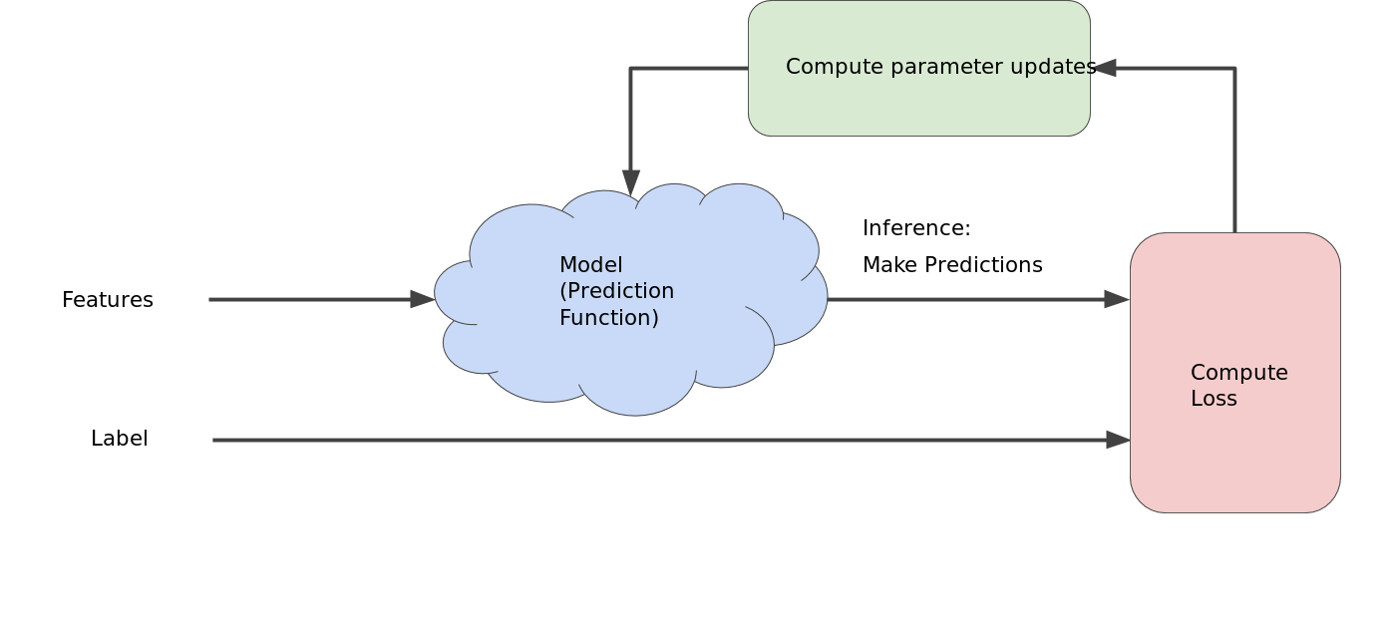
Reducing loss: an iterative approach
This figure suggests the iterative trial-and-error process that machine learning algorithms use to train a model:
backpropagation
The "model" takes one or more features as input and returns one prediction () as output.

Slide 14
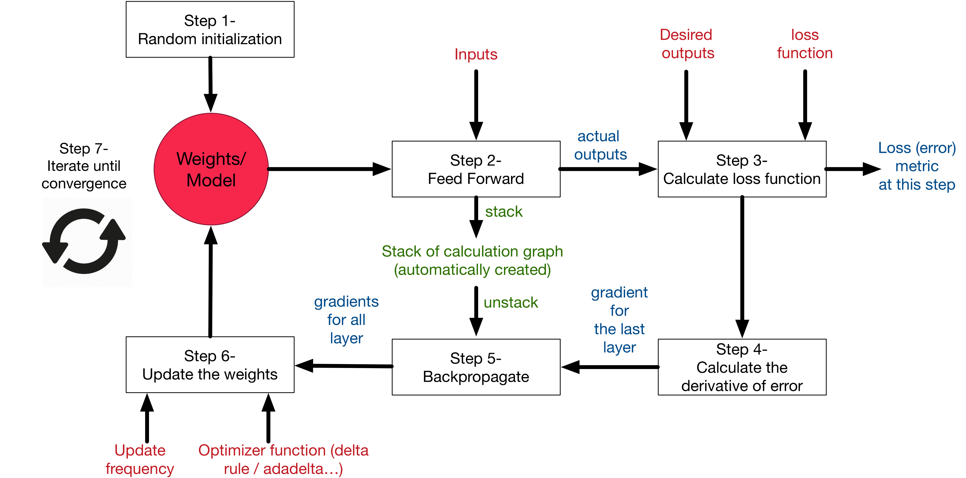
Step 7- Iterate until convergence
How many iterations are needed to converge?
Overall picture

