Slide 1
External Citizenship and Political Response in Argentina:
Evidence from Spain’s Ancestry-Based Citizenship Reform
05/29/2026

Slide 2
Research Question
Does exogenous access to EU citizenship through an ancestry-based reforms alter political behavior?
We study Spain’s Ley de Nietos, which expanded access to Spanish/EU citizenship for descendants of Spanish emigrants, creating variation in potential eligibility across Argentine municipalities.
Eligibility depend on ancestry and migration timing: grandchildren of Spanish exiles who left Spain during 1936–1955, or during 1956–1978 if exile status could be documented.
Argentina offers a precise exposure measurement. Historical censuses record the exact year of arrival to the country, allowing for a cleaner classification of exile cohorts.
Argentina received a substantially higher number of Spanish immigrants, generating greater cross-municipality variation in historical exposure.
2 / 37

Slide 3
Motivation
A growing literature shows that international migration affects political behavior in origin countries through both financial and social remittances (cross-border social ties).
Transnational networks and communication with migrants abroad increase political interest, civic engagement, and support for redistribution in Latin America (Córdova & Hiskey 2015; Duquette-Rury, 2018; Meseguer et al. 2016).
However, financial remittances may reduce voter turnout by lowering dependence on the state and weakening incentives for electoral participation (López García 2018).
Migration has also been shown to alter local electoral outcomes, weakening traditional political machines and increasing opposition victories in Mexico (Pfutze 2012).
Selection channel: Areas losing migrants may also lose voters with specific characteristics (for example, stronger democratic preferences or political activism).
Most existing evidence comes from Mexico and other Latin American countries; there is very limited causal evidence for Argentina, and virtually none linking migration shocks to political outcomes.
Comparative context: Argentina differs from prior case studies. Both origin and destination are democracies (Gaikwad et al. 2026).
3 / 37
Notes:
VM: López Garcia (2018) makes a a big point about the channel for return migration being important. In places with higher return migrants, the negative effect weakens. So, there are channels through communication, but also channels through increased presence of people exposed to democratic institutions which can contribute to diverse impacts on political behavior.
Pfutze (2012) provides unique perspective about being able to defeat an opposition party. They “found that migration significantly increases the probability of a party in opposition to the former state party PRI to win in a municipal election for the first time.” Can we do something similar?
Other channels to think about:
Leadership effects: Migrants from more democratic places become leaders that perpetuate could different policies or types of engagement with constituents (Mercier, 2016 in Journal of Development Economics)
(2) Selection effects: Migrants who leave in result of the policy have more favorable democratic views or tend to be more political activists. This may far outweigh the impact of changes in remittances which opens the line of communication and effectively lower voting participation and worsen democratic outcomes. Can we compare the political participation and views of individuals historically from areas with high Spanish ties versus low Spanish ties to understand this selection effect? Even better if we can link previous voting behavior to those who eventually move to Spain during the years of interest and compare their historical political behavior and tendencies relative to the general population.
(3) Collective action undermined getting fewer people to mobilize and participate politically (Sellers, 2019 in Journal of Politics)
We need to think about what makes Argentina interesting relative to other case studies in the literature.
Origin regime matters: “Remittances are more likely to finance activities that deter political competition in autocracies than in democracies.” (Easton and Montinola, 2017 in Studies in Comparative International Development)
Destination regime matters: Migration to autocracies generates stronger engagement in politics at among migrants that return to democratic country. Experimental evidence from Gaikwad, Hanson, and Tóth among migrants from India who move to the Persion Gulf. Published in World Politics in 2026.
Clientelistic patronage structures matter: Remittances are more effective at reducing turnout or support for opposing parties in places that traditionally rely on clientelistic patronage structures. Ana Isabel Lopez Garcia in International Migration (2025) has a nice layout of the different types of theories political scientists use to explain the role of remittances on political participation in Latin America and the Carribean. Argentina was one of the countries included there, but the focus was on protests. Positive effect in appendix table between remittances and protest in Argentina-specific regression.
Compulsory voting for specific age groups

Slide 4
Argentine Political System
Federal presidential republic with national, provincial, and municipal governments. Provinces have autonomy over their own electoral calendars and rules.
Bicameral National Congress: Chamber of Deputies, 257 members; Senate, 72 members.
President: directly elected for a four-year term, with one immediate re-election allowed.
Deputies serve four-year terms and half of the Chamber is renewed every two years. Senators serve six-year terms and one-third of the Senate is renewed every two years.
Voting is compulsory for citizens ages 18–70, and optional for ages 16–17 and over 70.
Since 2009, the PASO (Primarias Abiertas, Simultáneas y Obligatorias) are open simultaneous and mandatory primary elections held before each general election to select candidates. PASO were suspended for the 2025 national elections.
4 / 37

Slide 5
The Chamber of Deputies
The Chamber of Deputies is the lower house of the National Congress, with 257 members representing the 23 provinces and the Autonomous City of Buenos Aires (CABA) under proportional representation.
Seats are allocated by province in proportion to population, with a minimum of five deputies for less populated provinces.
Half of the Chamber is renewed every two years, and each deputy serves a four-year term.
Provincial and local legislative races are not analyzed because electoral calendars vary across jurisdictions, many provinces hold these elections separately from the national calendar, and subnational electoral data are less consistent over time, especially when elections are decoupled from national races.
Year | Election type
2011 | Chamber of Deputies + presidential
2013 | Chamber of Deputies
2015 | Chamber of Deputies + presidential
2017 | Chamber of Deputies
2019 | Chamber of Deputies + presidential
2021 | Chamber of Deputies
2023 | Chamber of Deputies + presidential
2025 | Chamber of Deputies
5 / 37

Slide 6
Data
Argentine Population Census (IPUMS 1970, 1980, 2010). The census provides information on place of birth, earlier place of residence, years residing in the current locality and, importantly, the year of arrival to the country.
Electoral public data from the National Electoral Commission (Comisión Nacional Electoral). These data provide detailed electoral results for all national elections since 2011, including votes received by each political party, voter turnout, and blank votes, among other indicators. We focus on national legislative elections for the Chamber of Deputies, as they offer the largest number of electoral observations over the period 2011–2025. We rely on national elections because the database does not consistently include provincial or local elections, particularly in years when those contests are held separately from the national electoral calendar.
Spanish immigration microdata (INE, Spain). Annual records of immigrants entering Spain in 2023 and 2024, covering age, sex, place of destination in Spain, place of origin, and nationality. We use these data to characterize the profile of Argentine migrants moving to Spain after the implementation of the Ley de Nietos reform.
LAPOP rounds 2012, 2014, 2017 and 2019. Repeated cross-section data reporting political attitudes and intentions to migrate at the individual level.
6 / 37

Slide 7
Empirical Strategy
Window Exposure Measure
We exploit a question in the historical Argentine censuses that records the exact year immigrants arrived in the country.
This allows us to identify Spanish-born individuals who settled during specific periods (1936–1955 vs. 1956–1978) and to construct the share of the population that arrived in each time window ( R1936–1955 and R1956–1978, respectively).
The 1970 census is used to measure Spanish immigrants who arrived between 1936–1955, while the 1980 census is used to capture those who arrived between 1956–1978.
We compare outcomes across municipalities with greater exposure to refugees arriving in 1936–1955 relative to those with greater exposure to arrivals in 1956–1978.
7 / 37

Slide 8
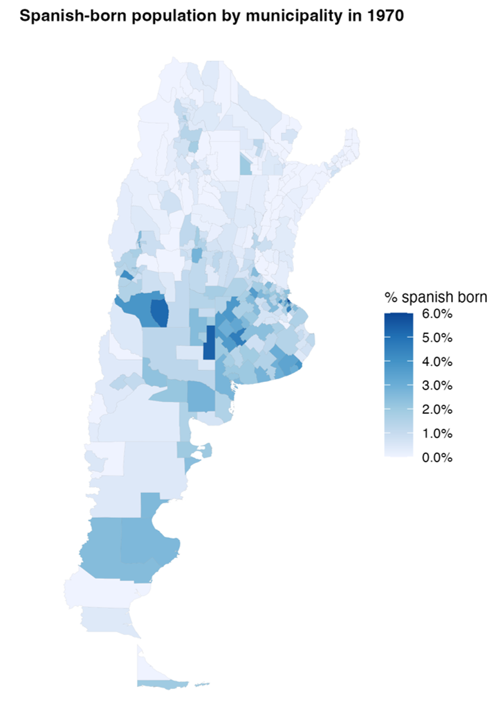
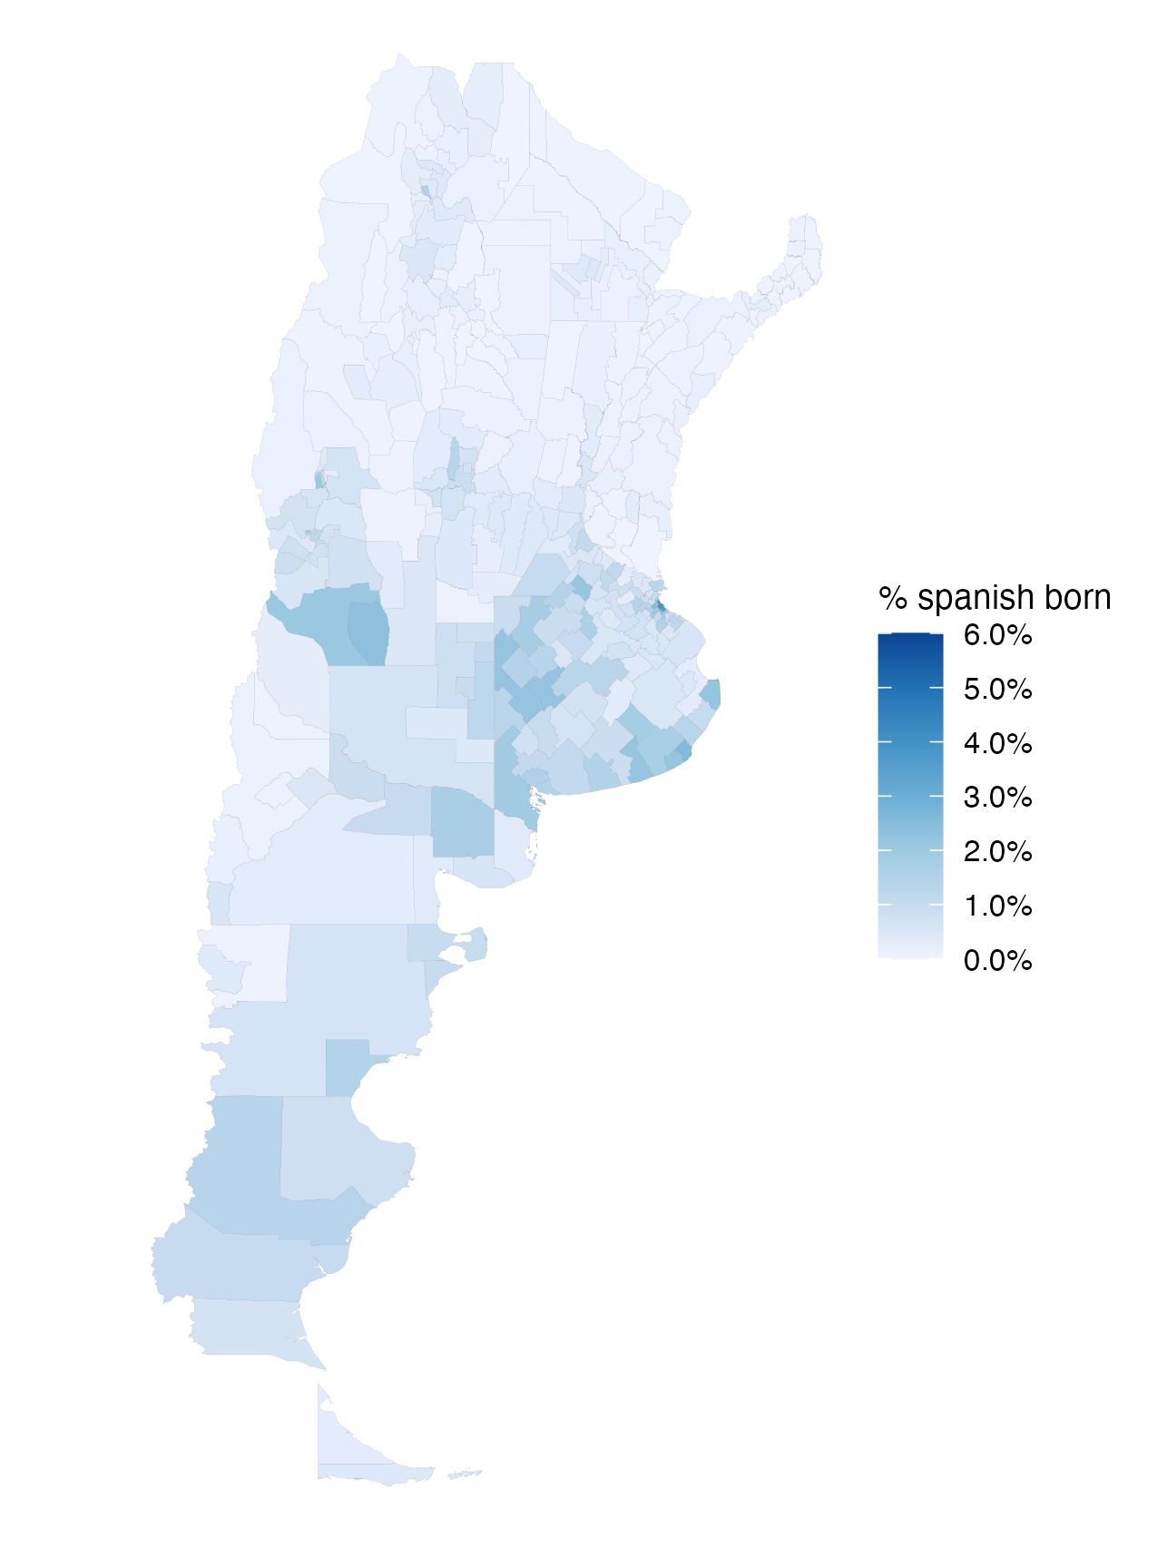
Distribution of Spanish-Born Population
Share of Spanish-born population 1970
Share of Spanish-born population 1980
8 / 37

Slide 9
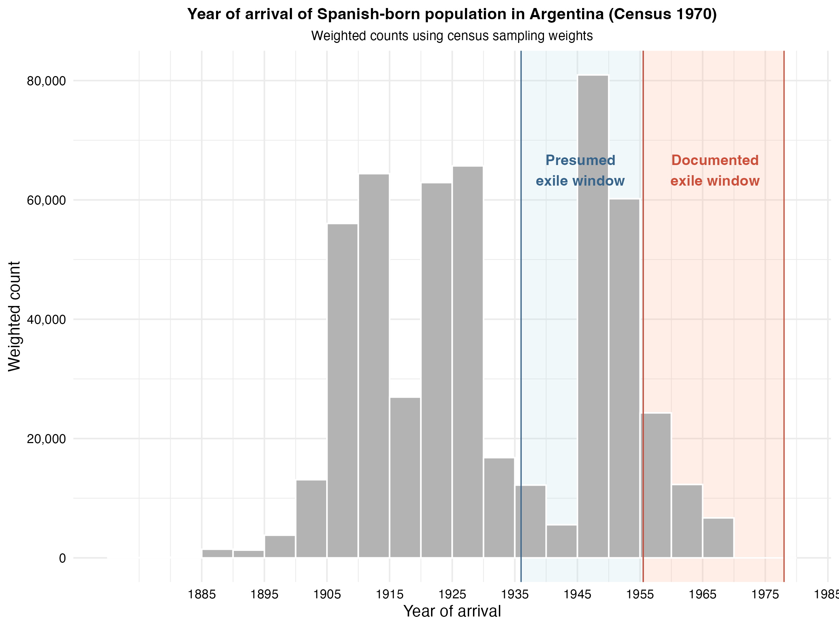
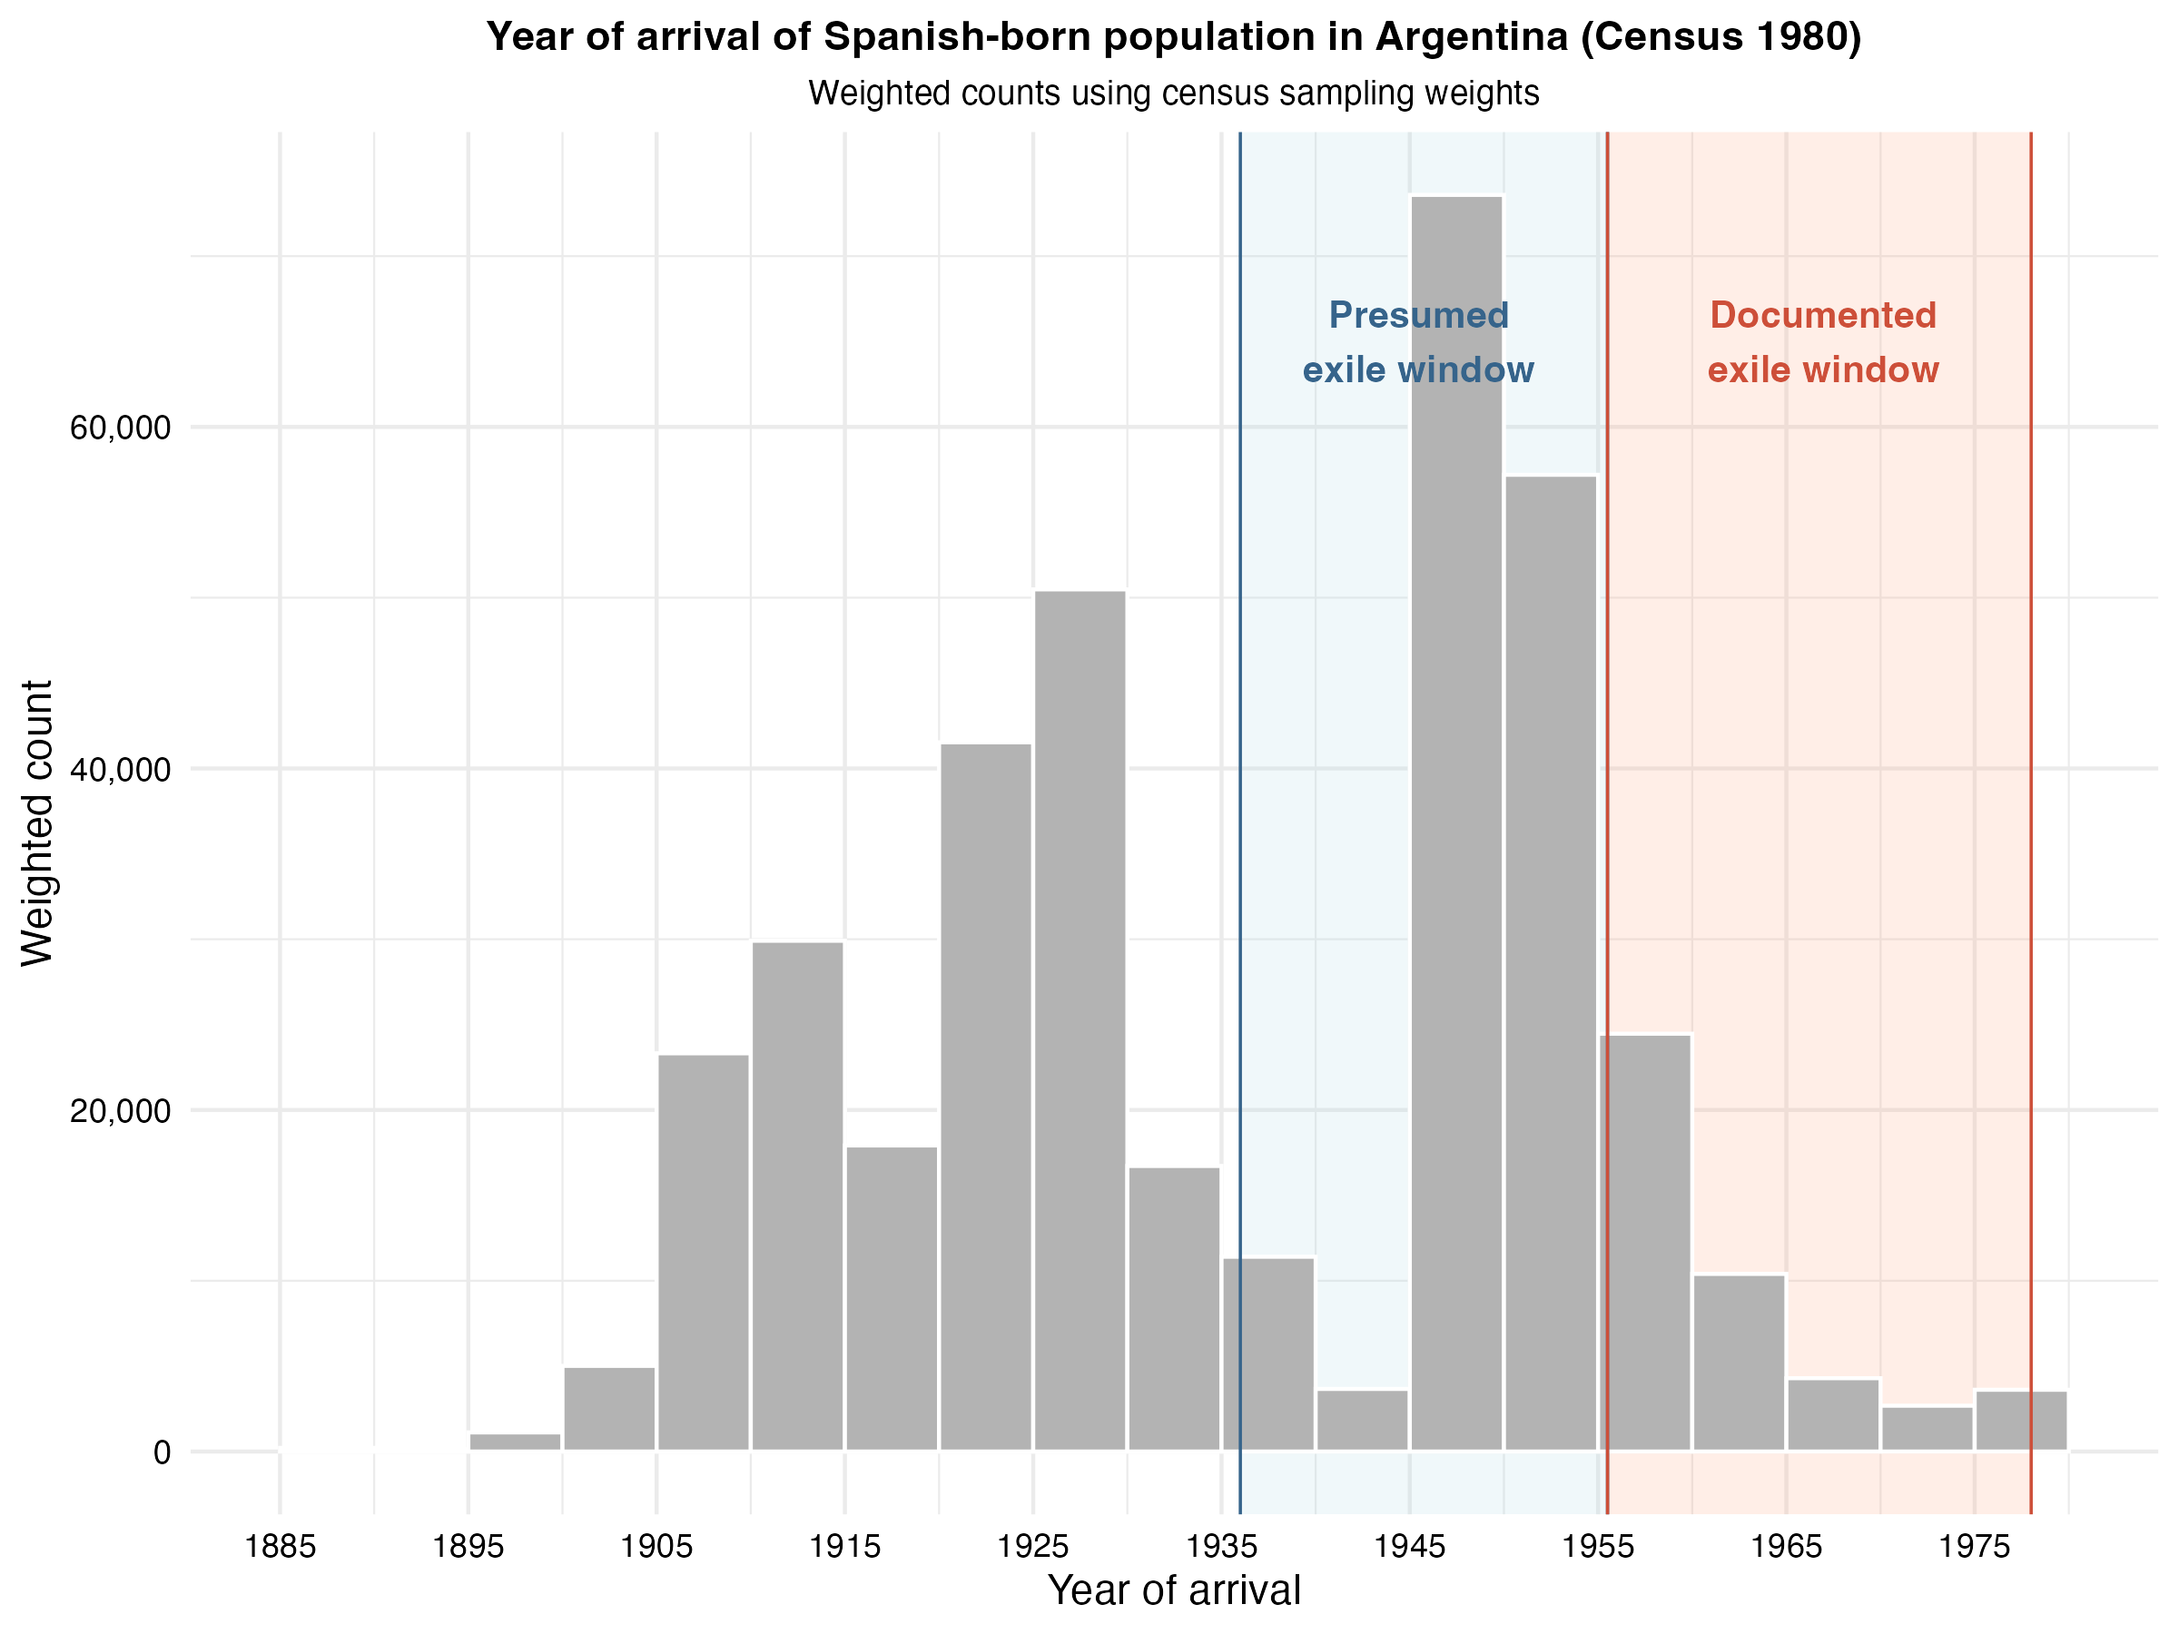
Year of Arrival of Spanish-Born Population
9 / 37
Notes:
VM: Nice bar chart! Can we differentiate the colors of the bars 1936–1955 vs. 1956–1975 or by adding more vertical lines to highlight the different periods of policy stringency? From this graph, it seems that the power to detect difference between two treatment arms may be limited since much fewer arrivals occurred between 1956-1975. But, it is probably still worth distinguishing between the two since we would expect the effects might be greater in places that have arrivals from the first period.

Slide 10
Empirical Strategy
Window Exposure Measure
Formally, we estimate the following equation (1):
yₘₜ = β₁ · postₜ × S₁₉₃₆₋₁₉₅₅,ₘ + β₂ · postₜ × S₁₉₅₆₋₁₉₇₈,ₘ + γₜ + δₘ + ElectionTypeₘₜ + uₘₜ (1)
The main outcome is the share of blank votes, defined as the percentage of votes cast in blank over the total number of voters. As an additional outcome, we also explore voter turnout.
Blank voting as protest behavior: blank votes often reflect dissatisfaction with available political options rather than abstention.
ElectionType is an indicator for whether the election corresponds to a General election or a PASO (primary) election.
We also estimate model (2) restricting the sample to general elections only.
yₘₜ = β₁ · postₜ × S₁₉₃₆₋₁₉₅₅,ₘ + β₂ · postₜ × S₁₉₅₆₋₁₉₇₈,ₘ + γₜ + δₘ + uₘₜ (2)
10 / 37
Notes:
Question: Can we look at share that voted for incumbent or non-incumbent also as an indicator of protest behavior?

Slide 11
Preliminary Results: Blank Votes
 | Share of blank votes
 | (1) | (2)
Post × Spanish share (1936-1955) | -2.112** | -1.881***
 | (0.843) | (0.549)
Post × Spanish share (1956-1978) | -4.285* | -2.498
 | (2.238) | (2.285)
Observations | 4,680 | 2,496
Municipality FE | Yes | Yes
Time FE | Yes | Yes
Election type FE | Yes | No
General elections only | No | Yes
p < 0.1, ** p < 0.05, *** p < 0.01
Standard errors clustered at the municipality level in parentheses.
11 / 37
Notes:
Result 1: In places where Ley de Nietos would have influenced the most, we see a decline in share of blank votes.
Question: Does this suggest less protest behavior? Or does this suggest that people that would otherwise protest withdraw themselves from the process which is consistent with arguments around private resources (remittances) crowd out incentives to support institutions that mobilize public resources. It sounds like you might have done this already, but we need to show whether there is an effect on political participation or electoral turnout (e.g., percent of people that come out to vote?) If not, then this suggests that we do not see fewer people voting, instead we see that among those who vote, they are less likely to protest.
Is this a selection effect, i.e. activist people are leaving? Do we need to be concerned about endogeneity of the composition of voters in places with a higher percentage of Spanish immigrants? We should correlate Spanish share (1936-1995) and Spanish share (1956-1978) with historical political outcomes to see the extent we might need to use a propensity score matching approach to adjust for the selection effect.
It would also be important to show the share of votes to each political party and whether that changed. Is it a matter of people protesting less or sticking up more for the opposition candidate or non-traditional party candidates?
Result 2: It appears that in places that would face the more strict version of immigration policy, we potentially see a stronger effect. Can we test if -4.285<-2.122? Again, it depends how we might want to interpret this. It could be that selection is different in these places in the way I mentioned above and we should see how so, if that’s true. OR, you could imagine that because the costs of proving you are eligible rise then those who are eligible must have higher expected returns (and therefore send more communication/influence or more remittances).
Result 3: We lose power focusing on general elections and the magnitudes of the effects go down. When comparing models (1) and (2), it seems that what may be driving the effects are the primaries. I wonder if voter turnout changes over the primaries relative to the general elections because this is where you have the potential to actually influence the candidates of your party.
Question: My understanding in Argentina is that voting is compulsory for ages 18-70. Are we only looking at votes provided within the compulsory voting age group?

Slide 12
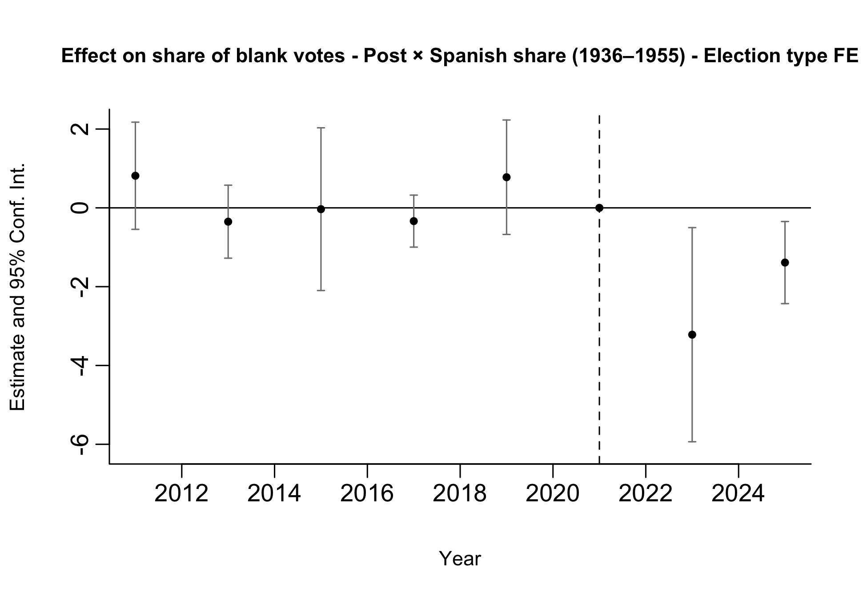
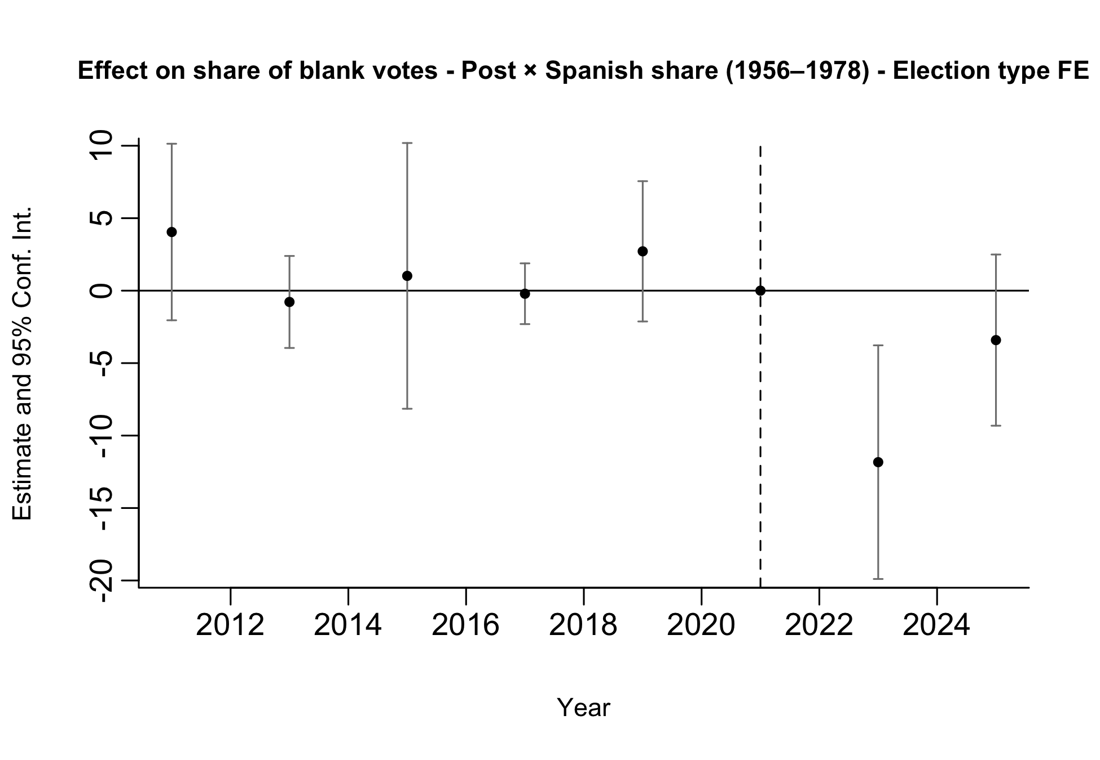
Preliminary Results: Blank Votes
Pre-trends look parallel, although estimates are noisy.
12 / 37
Notes:
We run two separate event-study specifications. In one regression (left), treatment is given by the interaction between post and the municipal Spanish share for arrivals in 1936–1955; in the other (right), treatment is given by the interaction between post and the municipal Spanish share for arrivals in 1956–1978.
This allows us to assess pre-trends in terms of total exposure rather than conditional effects. When both exposure measures are included jointly, coefficients reflect the effect of one exposure holding the other constant, which is less informative for pre-trend analysis.
Therefore, the event-study plots should be used primarily as a diagnostic tool for pre-trends rather than as our main treatment-effect estimates.
Both specifications are estimated on the full sample of elections (PASO and general), including election-type fixed effects.
VM: Pre-processing the data may help with this.

Slide 13
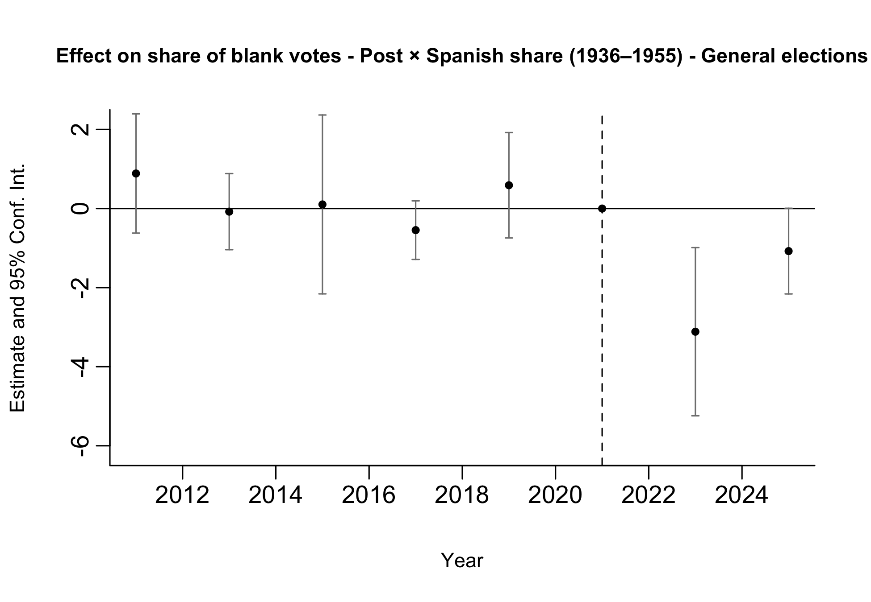
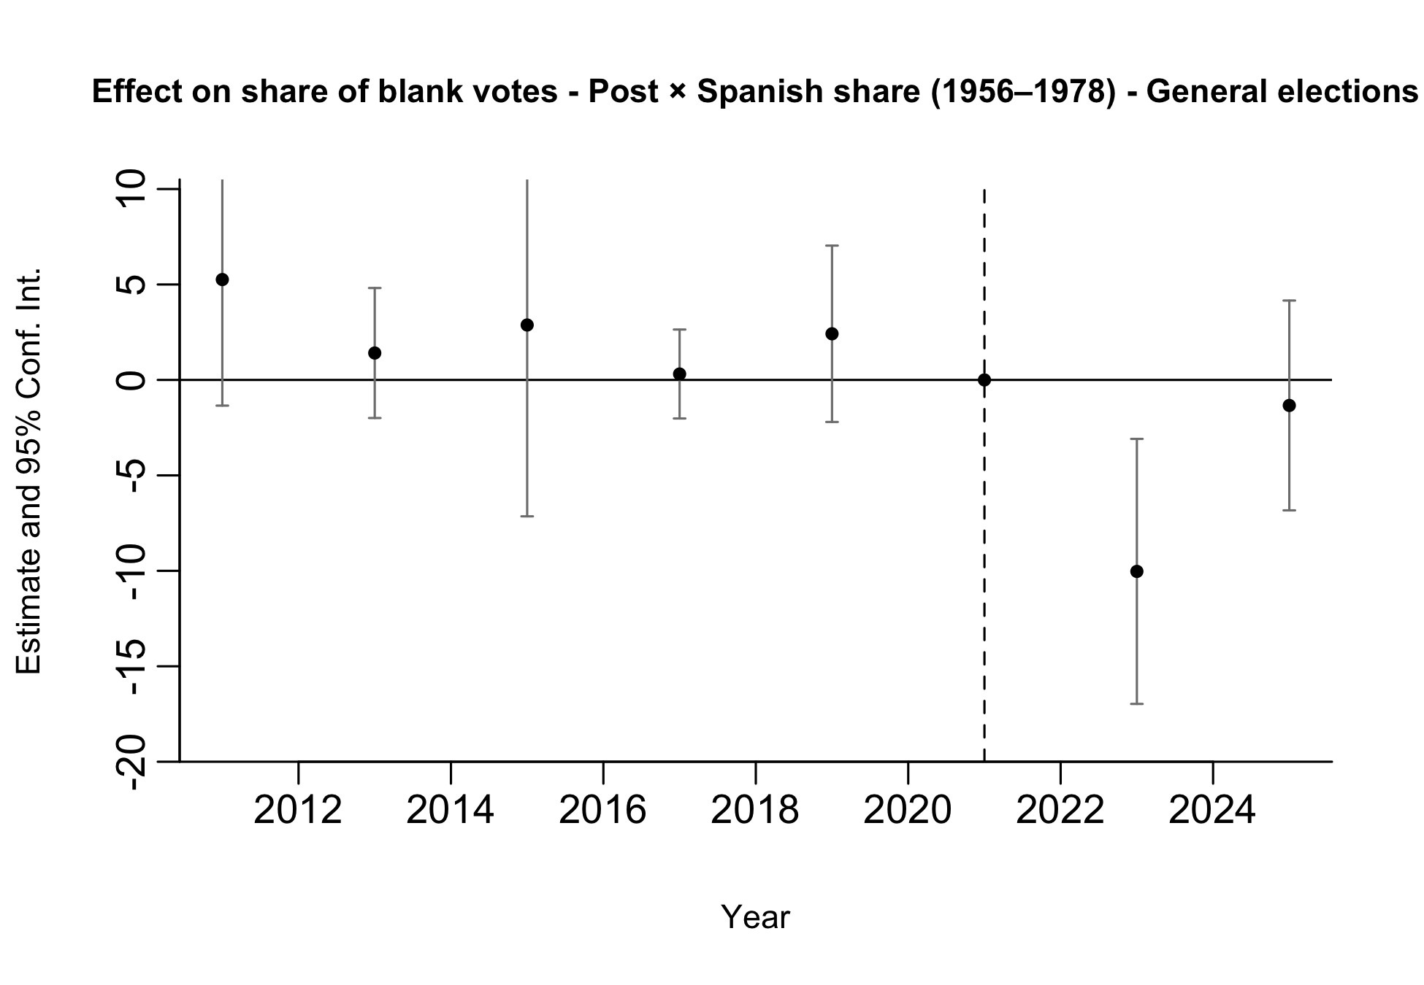
Preliminary Results: Blank Votes
Pre-trends look parallel, although estimates are noisy.
13 / 37
Notes:
We run two separate event-study specifications. In one regression (left), treatment is given by the interaction between post and the municipal Spanish share for arrivals in 1936–1955; in the other (right), treatment is given by the interaction between post and the municipal Spanish share for arrivals in 1956–1978.
This allows us to assess pre-trends in terms of total exposure rather than conditional effects. When both exposure measures are included jointly, coefficients reflect the effect of one exposure holding the other constant, which is less informative for pre-trend analysis.
Therefore, the event-study plots should be used primarily as a diagnostic tool for pre-trends rather than as our main treatment-effect estimates.
Both specifications are estimated on the restricted sample of General elections.

Slide 14
Preliminary Results: Participation
 | Participation
 | (1) | (2)
Post × Spanish share (1936-1955) | -0.468 | -0.481
 | (0.361) | (0.365)
Post × Spanish share (1956-1978) | 2.977** | 2.525*
 | (1.365) | (1.320)
Observations | 4,680 | 2,496
Municipality FE | Yes | Yes
Time FE | Yes | Yes
Election type FE | Yes | No
General elections only | No | Yes
p < 0.1, ** p < 0.05, *** p < 0.01
Standard errors clustered at the municipality level in parentheses.
Less clear effects are found on electoral participation (as expected, since voting is mandatory and participation is high in Argentina).
No significant effects are found for the 1936–1955 cohort, while some effects appear for the 1956–1978 cohort in the expected direction.
However, pre-trends are not flat, which cautions against a causal interpretation.
14 / 37
Notes:
VM: This is super interesting! I think we need something like this and try to improve the identification strategy perhaps focusing on the compulsory age group.

Slide 15
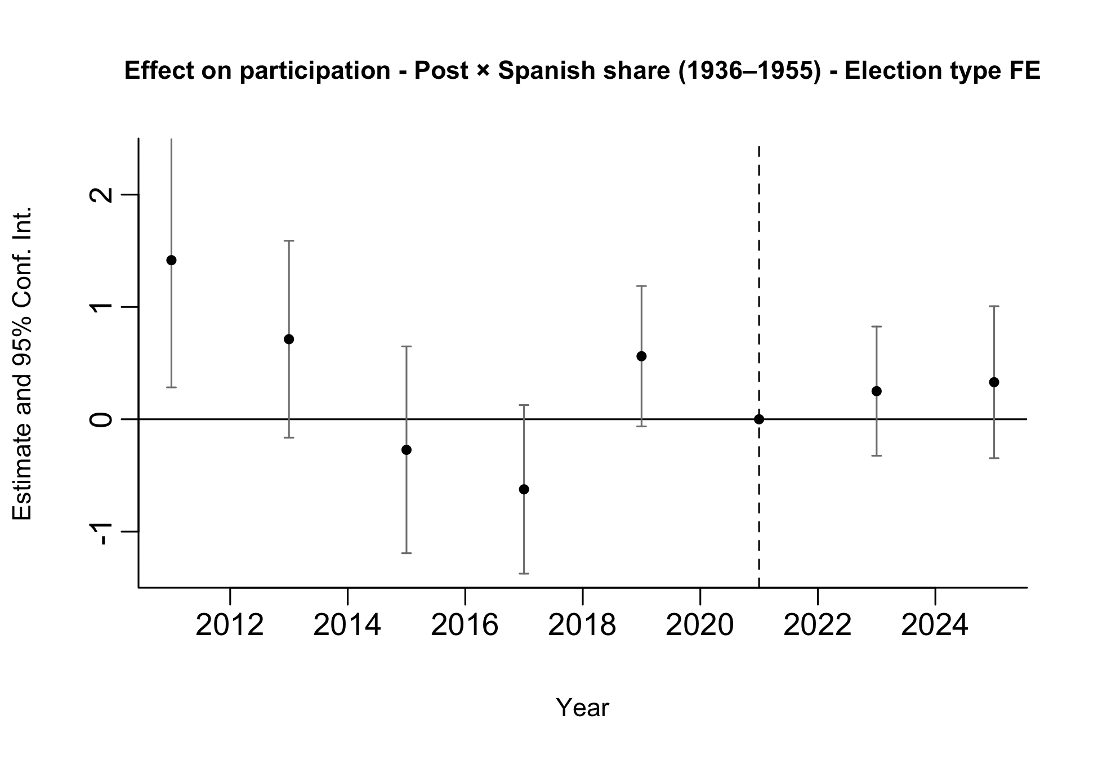
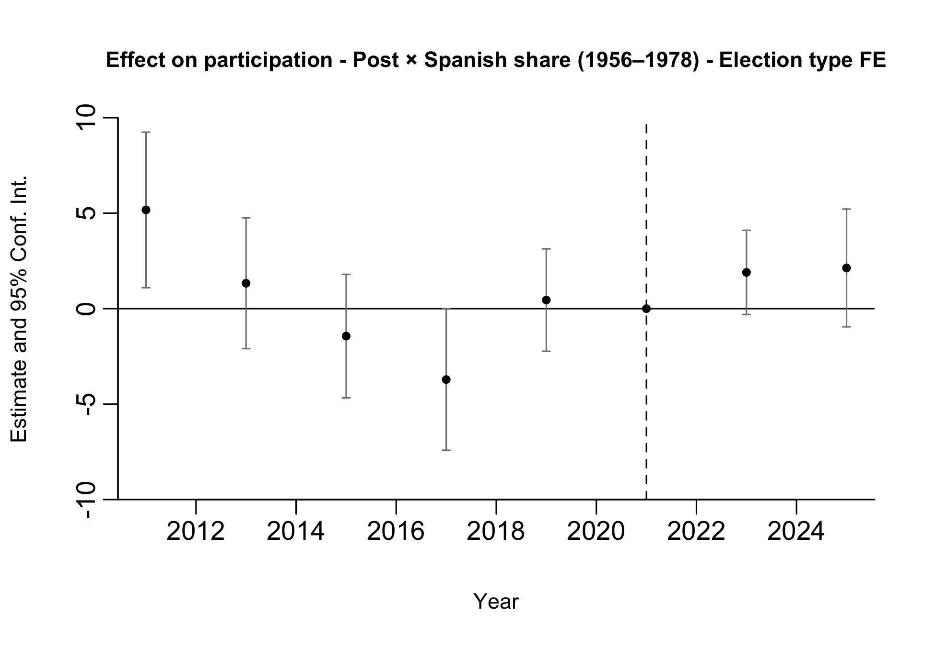
Preliminary Results: Participation
15 / 37
Notes:
We run two separate event-study specifications. In one regression (left), treatment is given by the interaction between post and the municipal Spanish share for arrivals in 1936–1955; in the other (right), treatment is given by the interaction between post and the municipal Spanish share for arrivals in 1956–1978. Full sample (PASO and general).

Slide 16
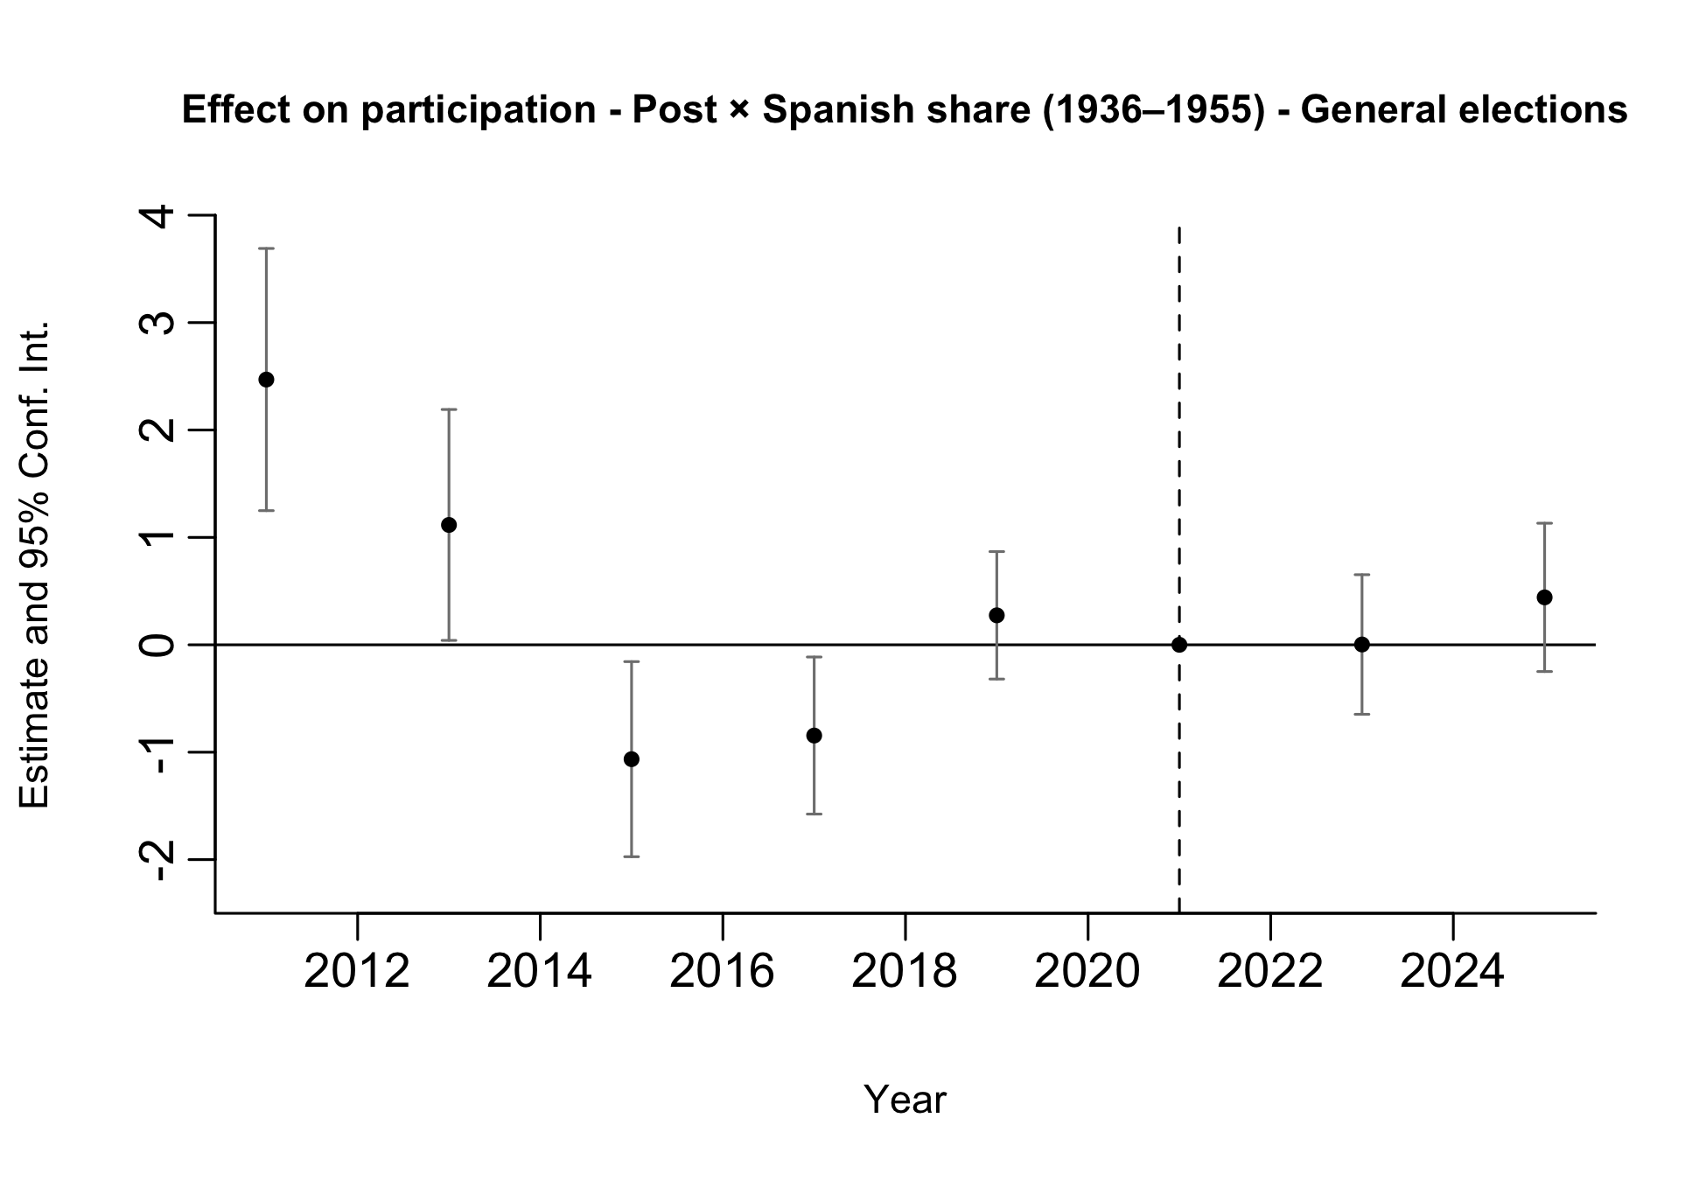
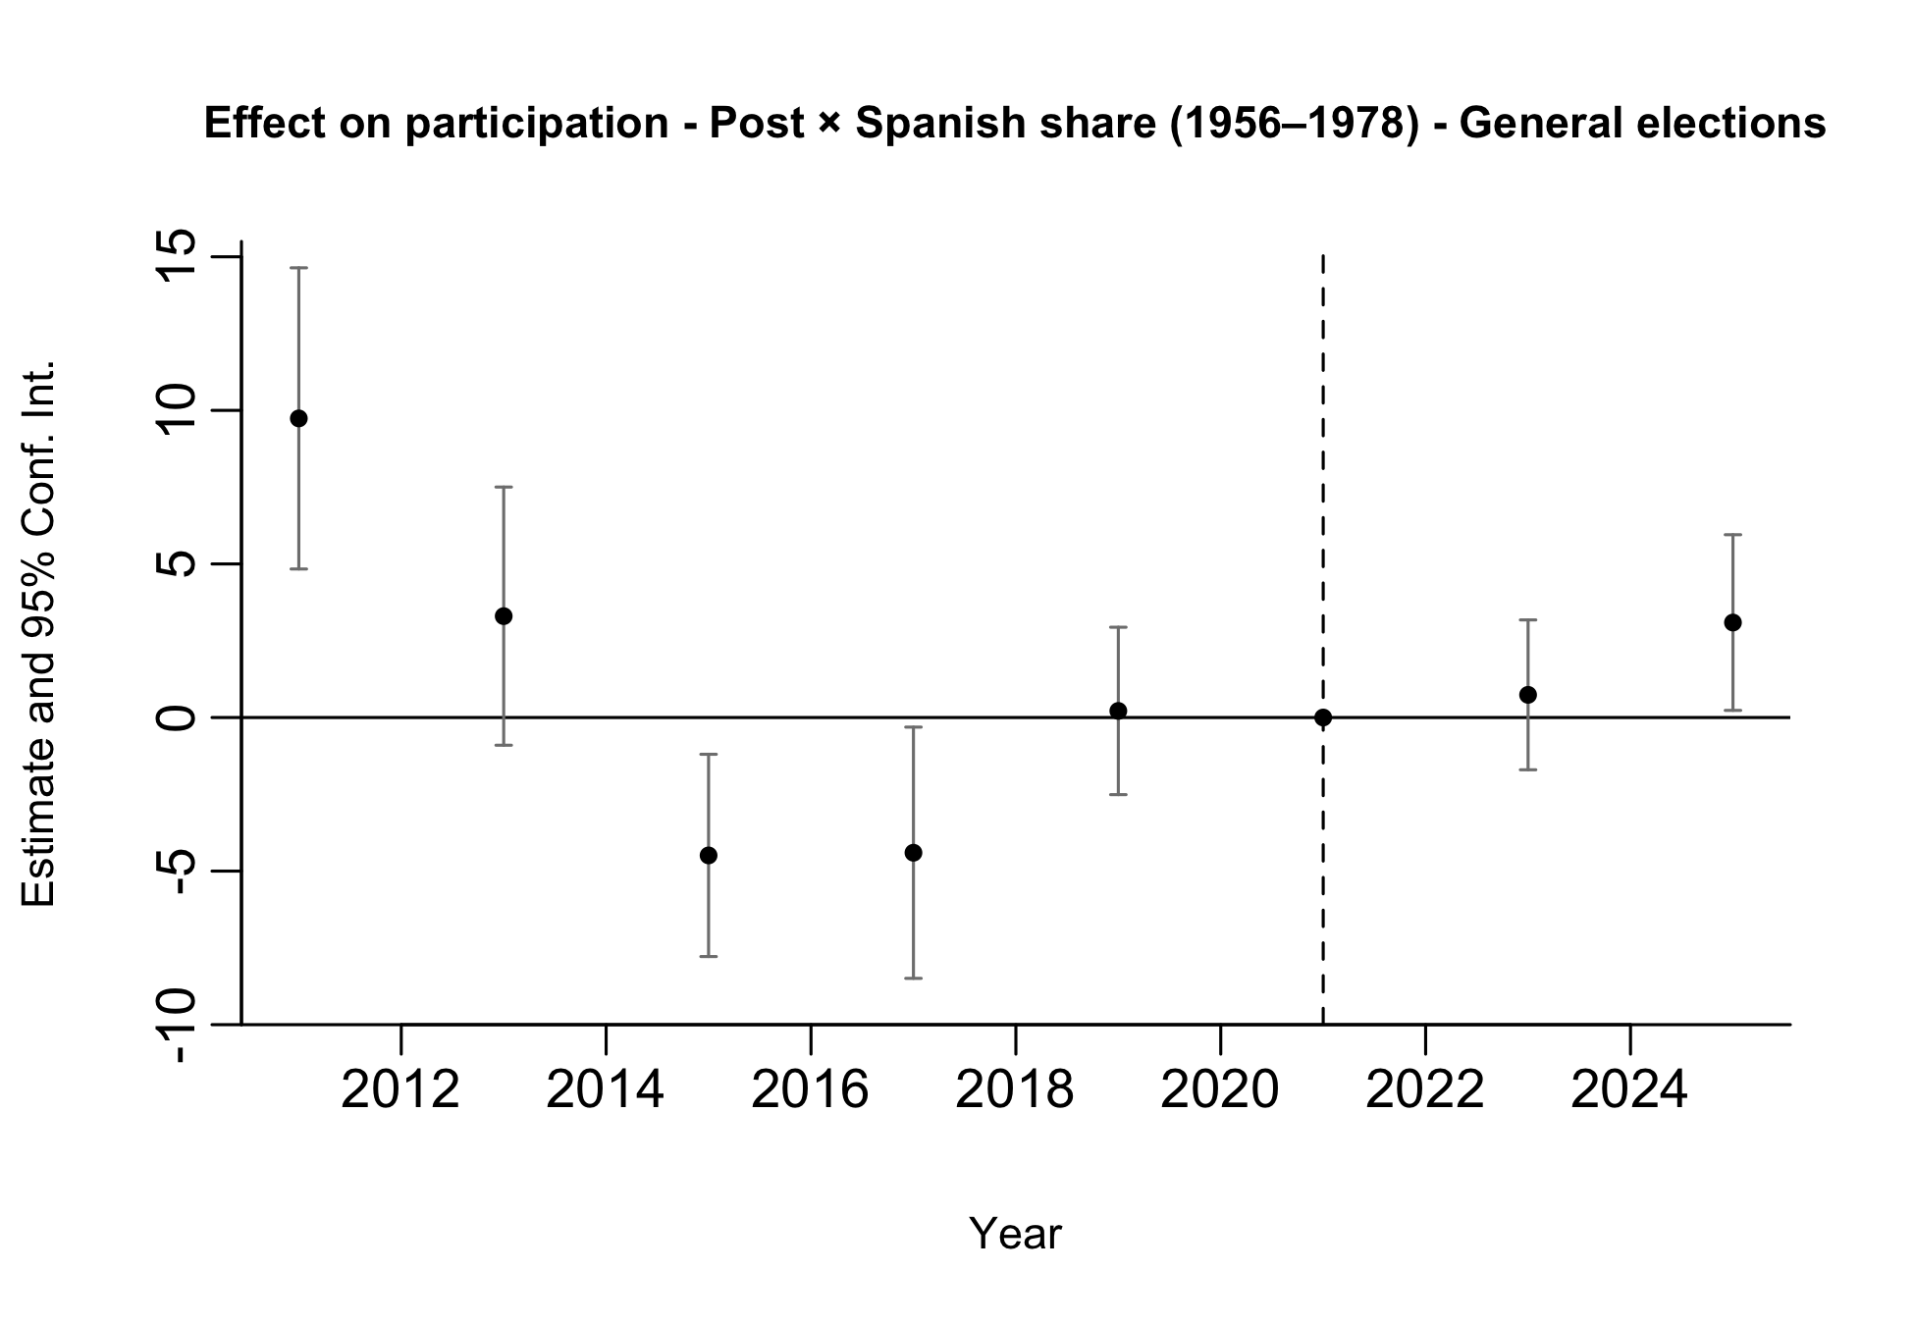
Preliminary Results: Participation
16 / 37
Notes:
We run two separate event-study specifications. Restricted to general elections only.

Slide 17
Feedback
Look into selection issues particularly around political behavior by percent of Spanish immigrants to understand bias.
Correlate Spanish share (1936-1995) and Spanish share (1956-1978) with historical political outcomes.
Link previous voting behavior to those who eventually move to Spain during the years of interest and compare their historical political behavior and tendencies relative to the general population.
Use Spanish data online to describe the characteristics of Argentians who gain Spanish citizenship post 2022 to get a sense if they are positively selected.
Run a version of these models with pre-processed data.
Test if -4.285<-2.122.
Are we only looking at votes provided within the compulsory voting age group?
17 / 37
Notes:
There is no historical electoral data available for Argentina before 2011. We only have electoral outcomes starting in 2011, so we address this using pre-treatment data from 2011–2021.
We do not have individual-level data linking voting behavior to subsequent migration to Spain. We can use LAPOP to describe the political attitudes of individuals who report an intention to migrate.
6. No. We use all votes, since the data are aggregated at the electoral-section level and are not disaggregated by compulsory voting status. We do not have individual-level voting data. Potencially, we can web scrap the infraction registry in order to have individual level data indicatin whether a person voted in a given election. This data includes basic geographic and demographic indivual level variables.

Slide 18
Feedback
Additional Outcomes
Vote share by political party: Since parties and coalition labels change frequently across elections, we instead compute vote shares for the main political forces, focusing on Peronism and Radicalism. This measure is built from a classification of approximately 540 unique parties competing between 2011 and 2025.
Vote share for the incumbent party: For the same reason, We measure both the municipal vote share for the ruling national party and a dummy for whether it wins locally.
Turnout by compulsory and non-compulsory voting age groups: We do not have vote or turnout data disaggregated by compulsory and non-compulsory voting age groups.
Electoral alternation: We construct three measures:
Across elections, whether the winning ideological bloc changes between consecutive elections;
Within elections, whether the PASO-winning party differs from the general-election winner;
Within elections, whether the PASO-winning ideological bloc differs from the general-election winner.
18 / 37
Notes:
National incumbent party:
2011–2015. Cristina Fernández de Kirchner. Frente para la Victoria (FPV).
2015–2019. Mauricio Macri. Cambiemos.
2019–2023. Alberto Fernández. Frente de Todos.
In election years, the variable classifies the national incumbent party as the party that held the executive office up to that point. For example, in 2019, the national incumbent party is Cambiemos.

Slide 19

Feedback
Additional Outcomes
Vote share by ideological bloc: We construct the following measures based on a classification of approximately 540 unique parties competing between 2011 and 2025:
Vote shares for left, center-left, center, center-right and right blocs,
Vote shares fot broad-left and broad-right blocs;
Left–right index, where lower values indicate stronger broad-right support and higher values indicate stronger broad-left support;
Left-rights Index = (Share broad left) - (Share broad right)
An ideological index that summarizes the municipality’s position along the left–right spectrum, with lower values indicating a more left-leaning electorate and higher values indicating a more right-leaning electorate.
Ideological Index = -2(Share left) - 1(Share center-left) + 1(Share center-right) + 2(Share right)
Electoral competition:
Margin between the first- and second-place parties.
Effective Number of Parties (ENP), where higher values indicate a more fragmented party system;
19 / 37

Slide 20
1. Pre-treatment Political Behavior
We conduct three exercises to assess whether municipalities with higher historical Spanish exposure and individuals more likely to migrate already differed politically before the reform.
A. Pre-treatment political differences across municipalities We estimate the following specification for each political outcome using the pre-treatment electoral data (2011–2021).
yₘₜ = β₁ S₁₉₃₆₋₁₉₅₅,ₘ + β₂ S₁₉₅₆₋₁₉₇₈,ₘ + γₜ + δₘ + uₘₜ (3)
B. Differential pre-trends We estimate a pre-treatment event-study specification for each political outcome.
yₘₜ = ∑ₜ β₁ (S₁₉₃₆₋₁₉₅₅,ₘ × Yearₜ) + ∑ₜ β₂ (S₁₉₅₆₋₁₉₇₈,ₘ × Yearₜ) + γₜ + δₘ + uₘₜ (4)
For each outcome, we test whether the year-by-exposure coefficients are jointly equal to zero, separately for each exposure window and jointly for both.
The detailed coefficient estimates from the pre-trends specification are reported in the Appendix.
20 / 37
Notes:
Model 3 tests whether municipalities with higher Spanish exposure already had different political outcomes before the reform; model 4 test whether there are differencial pre trends between municipalities with different share of Spanish populations in the years previos to the law.

Slide 21
1. Pre-treatment Political Behavior
We conduct three complementary exercises to assess whether municipalities with higher historical Spanish exposure and individuals more likely to migrate already differed politically before the reform.
C. Individual-level political selection using LAPOP We estimate the following specification for each political outcome using LAPOP pre-treatment survey rounds (2012, 2014, 2017, 2019).
yᵢₜ = β₁ (S₁₉₃₆₋₁₉₅₅,ₘ × Migrateᵢ) + β₂ (S₁₉₅₆₋₁₉₇₈,ₘ × Migrateᵢ) + Xᵢ + γₜ + δₘ + uᵢₜ (5)
21 / 37
Notes:
Model 3 tests whether municipalities with higher Spanish exposure already had different political outcomes before the reform; model 4 test whether there are differencial pre trends between municipalities with different share of Spanish populations in the years previos to the law.

Slide 22
1. Pre-treatment Political Behavior
A. Pre-treatment political differences across municipalities
 | Blank votes | Turnout | Left | Center-left | Center-right | Right | Broad left | Broad right | Left-right index
Share 1936-1955 | 0.487 | 1.521*** | 0.444 | 1.917 | -0.975 | 0.398* | 2.362 | -0.577 | 2.938
 | (0.488) | (0.557) | (0.308) | (1.973) | (1.240) | (0.221) | (1.926) | (1.218) | (2.940)
Share 1956-1978 | 0.565 | 1.827 | 7.233*** | -9.362 | 0.051 | 1.111 | -2.129 | 1.161 | -3.291
 | (2.420) | (2.161) | (1.271) | (7.194) | (4.717) | (1.064) | (6.792) | (5.071) | (10.706)
Year FE | Yes | Yes | Yes | Yes | Yes | Yes | Yes | Yes | Yes
Num.Obs. | 3744 | 3744 | 3744 | 3744 | 3744 | 3744 | 3744 | 3744 | 3744
R2 | 0.231 | 0.153 | 0.144 | 0.122 | 0.413 | 0.165 | 0.106 | 0.416 | 0.275
 | Ideological index | Peronist vote | Radical vote | Incumbent party (share) | Ideological alternation | Different party: PASO-general | Different bloc: PASO-general | Margin | ENP
Share 1936-1955 | -0.030 | 1.328 | -0.187 | 1.392 | -0.056 | -0.055*** | -0.043** | 0.651 | 0.037
 | (0.029) | (1.397) | (0.490) | (0.878) | (0.040) | (0.021) | (0.019) | (1.128) | (0.053)
Share 1956-1978 | -0.028 | -21.809*** | -1.242 | -2.482 | 0.402*** | 0.243** | 0.102 | -17.392*** | 1.008***
 | (0.107) | (5.750) | (1.837) | (4.147) | (0.130) | (0.095) | (0.082) | (5.346) | (0.257)
Year FE | Yes | Yes | Yes | Yes | Yes | Yes | Yes | Yes | Yes
Num.Obs. | 3744 | 3744 | 3744 | 3744 | 3120 | 3744 | 3744 | 3744 | 3744
R2 | 0.265 | 0.207 | 0.183 | 0.147 | 0.027 | 0.078 | 0.045 | 0.115 | 0.107
* p < 0.1, ** p < 0.05, *** p < 0.01. Standard errors clustered at the municipality level in parentheses.
22 / 37

Slide 23
1. Pre-treatment Political Behavior
B. Differential pre-trends
Outcome | p-value (1936-1955) | p-value (1956-1978) | p-value (joint)
Blank votes | 0,396 | 0,960 | 0,501
Turnout | 0,039 | 0,133 | 0,004
Left | 0,055 | 0,023 | 0,002
Center-left | 0,569 | 0,042 | 0,005
Center-right | 0,000 | 0,470 | 0,000
Right | 0,000 | 0,059 | 0,000
Broad left | 0,638 | 0,012 | 0,000
Broad right | 0,000 | 0,444 | 0,000
Left-right index | 0,003 | 0,271 | 0,000
Ideological index | 0,010 | 0,123 | 0,000
Peronist vote | 0,001 | 0,831 | 0,000
Radical vote | 0,244 | 0,082 | 0,002
Incumbent party (share) | 0,001 | 0,093 | 0,000
Ideological alternation | 0,120 | 0,066 | 0,012
Same party: PASO-general | 0,529 | 0,009 | 0,018
Same bloc: PASO-general | 0,025 | 0,083 | 0,007
Margin | 0,012 | 0,197 | 0,004
ENP | 0,000 | 0,027 | 0,000
Wald test of the joint null hypothesis that all pre-treatment interaction coefficients are equal to zero.
23 / 37

Slide 24
1. Pre-treatment Political Behavior
C. Individual-level political selection using LAPOP
 | Left-right ideology | Previous vote | Party identification | Vote intention | Blank/null vote intention | Community meetings
Intends to migrate | 0.009 | -0.097*** | 0.005 | -0.015 | 0.037 | 0.032*
 | (0.124) | (0.024) | (0.018) | (0.014) | (0.024) | (0.017)
Intends to migrate × Spanish share 1936–1955 | 0.455*** | 0.055 | 0.010 | 0.018 | -0.017 | 0.003
 | (0.167) | (0.036) | (0.027) | (0.028) | (0.026) | (0.034)
Intends to migrate × Spanish share 1956–1978 | -2.138*** | -0.276 | -0.005 | -0.179 | 0.082 | 0.057
 | (0.595) | (0.172) | (0.115) | (0.114) | (0.128) | (0.137)
Age | 0.014*** | 0.004*** | 0.004*** | -0.002*** | -0.002*** | 0.001***
 | (0.002) | (0.000) | (0.000) | (0.000) | (0.000) | (0.000)
Male | -0.074 | -0.006 | 0.033*** | -0.003 | -0.017 | -0.010
 | (0.066) | (0.010) | (0.011) | (0.007) | (0.011) | (0.010)
Years of education | -0.013 | 0.014*** | 0.007*** | 0.007*** | -0.015*** | 0.005***
 | (0.011) | (0.002) | (0.002) | (0.002) | (0.002) | (0.002)
Year FE | Yes | Yes | Yes | Yes | Yes | Yes
Municipality FE | Yes | Yes | Yes | Yes | Yes | Yes
Num.Obs. | 4802 | 5748 | 5687 | 4953 | 4426 | 5752
R2 | 0.060 | 0.075 | 0.048 | 0.044 | 0.081 | 0.022
* p < 0.1, ** p < 0.05, *** p < 0.01. Standard errors clustered at the municipality level in parentheses.
24 / 37

Slide 25
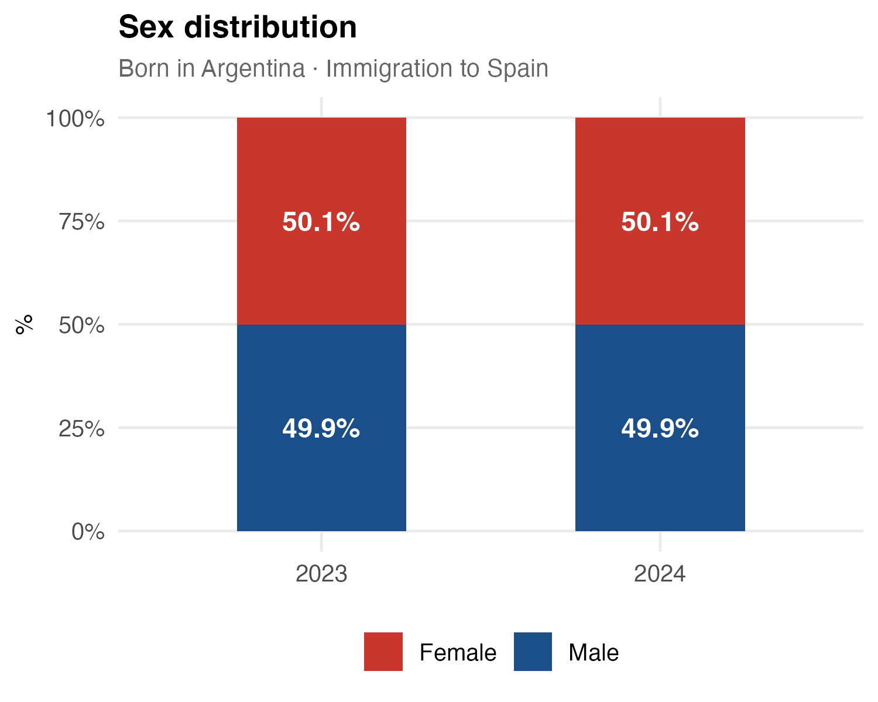
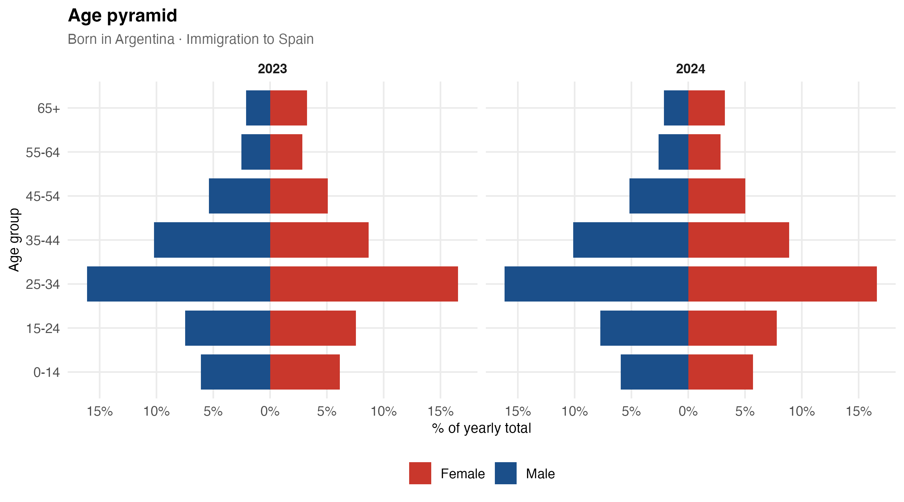
2. Argentine Migrants in Spain: Age and Sex
INE microdata: comparison of immigration inflows to Spain, 2023 vs 2024
25 / 37

Slide 26
3. Pre-processed Data
Entropy balancing of treatment intensity
We re-weight municipalities using entropy balancing for a continuous treatment.
It finds weights that break the association between the Spanish-share exposure measure and a set of pre-treatment covariates, while keeping the weights as close as possible to uniform.
We try 8 covariate sets, each run twice — with and without the other window's Spanish share as a covariate.
Set | Pre-treatment covariates
1 | Blank vote share, voter turnout, log population, log population density.
2 | Set 1 + share of women, mean age.
3 | Set 2 + share employed, share in the labor force, share literate.
4 | Set 3 + left and Peronist vote shares, effective number of parties, margin of victory.
5 | Set 1 + left and Peronist vote shares, effective number of parties, margin of victory.
6 | Voter turnout, left and Peronist vote shares, effective number of parties, margin of victory.
7 | Log population density, mean age, share employed, mean years of schooling.
8 | Log population density, share aged 25–44, share employed, share with university education.
26 / 37
Notes:
Entropy balancing for a continuous treatment generalises entropy balancing (Hainmueller) to a continuous exposure variable. Instead of matching treated and control groups, it chooses municipality weights so that, in the weighted sample, the chosen pre-treatment covariates become orthogonal to the Spanish-share exposure measure, while staying as close as possible to the uniform (unweighted) distribution. We implement it with the Stata command ebct.
We explore 8 covariate sets that move from a minimal specification (Set 1: population size, density, blank vote and turnout) to progressively richer ones adding demographics (Set 2), socioeconomic and education variables (Set 3), and the pre-treatment electoral outcomes that looked unbalanced (Sets 4-6). Sets 7 and 8 are deliberately parsimonious specifications built only from census covariates.
Each set is estimated twice: with and without the Spanish share of the OTHER exposure window as an additional covariate. Why include it? Our final specification regresses the outcome on BOTH shares (1936-1955 and 1956-1978) jointly. The two shares are correlated (rho = 0.65), so municipalities with a larger 1936-1955 Spanish presence also tend to have a larger 1956-1978 presence. If the other share is not balanced, the coefficient on one window would partly capture differences associated with the other. Including the other share in the balancing means we compare municipalities that differ in one window but are similar in the other, which makes the 'net' effect of each window more credible.
Why also run it WITHOUT the other share? Precisely because the two shares are highly correlated, asking the algorithm to balance one share while holding the other fixed is empirically demanding: it must place very large weight on a small number of unusual municipalities to break that correlation. That is visible in the weight distributions and effective sample sizes, so we report both versions.

Slide 27
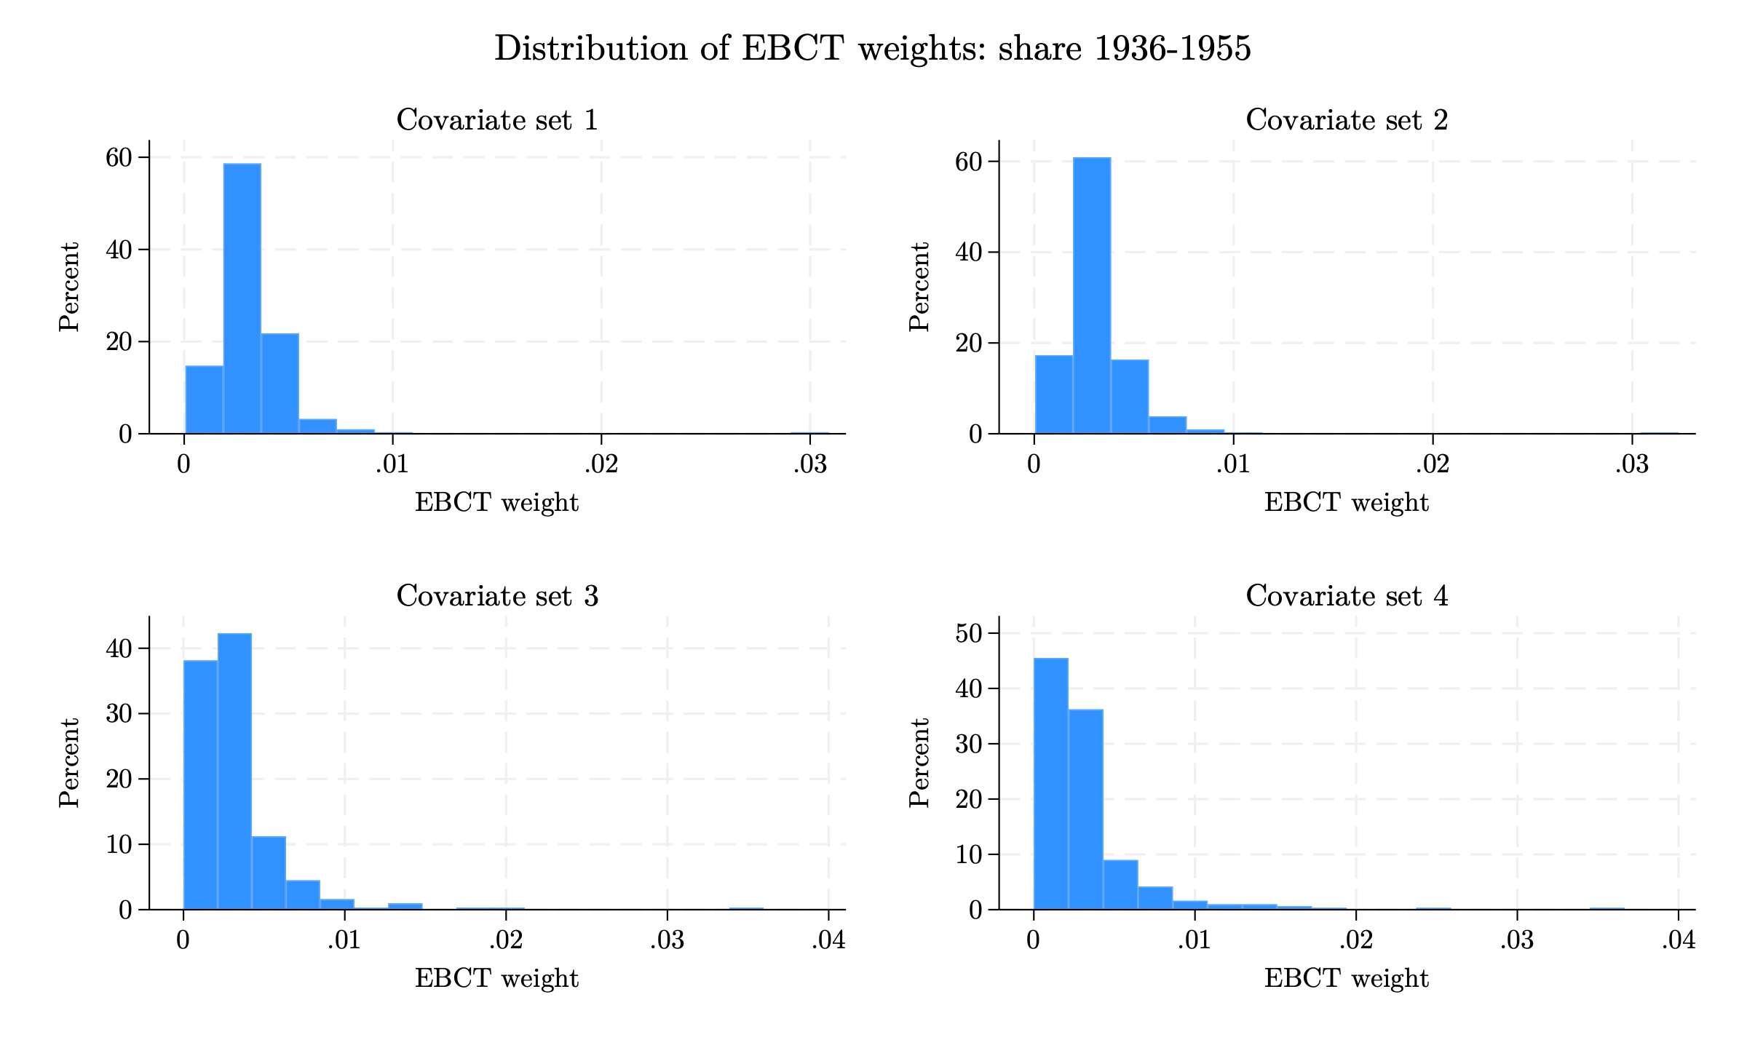
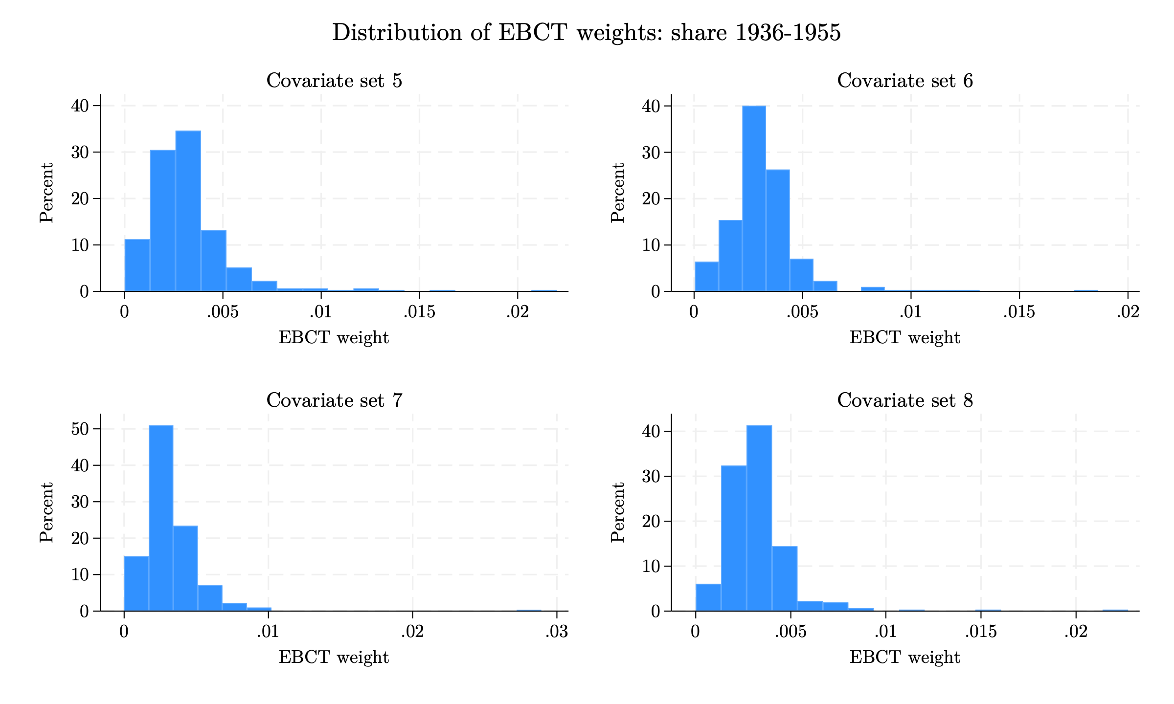
3. Pre-processed Data
Distribution of entropy-balancing weights: Spanish share 1936–1955
Histograms of EBCT weights across the 8 covariate sets (left: sets 1–4; right: sets 5–8). Weights exclude the other exposure window's Spanish share.
27 / 37
Notes:
Each histogram shows the distribution of entropy-balancing weights for one covariate set, for the 1936-1955 exposure window, in the version that excludes the other Spanish share. By construction the weights average 1/312 (about 0.0032) and are non-negative. A well-behaved distribution is concentrated near the mean with a short right tail; a long right tail means a few municipalities receive a large share of the weight, which lowers the effective sample size and makes the weighted estimates noisier. Richer covariate sets (3 and 4) and the parsimonious sets generally produce more dispersed weights than the minimal Set 1.

Slide 28
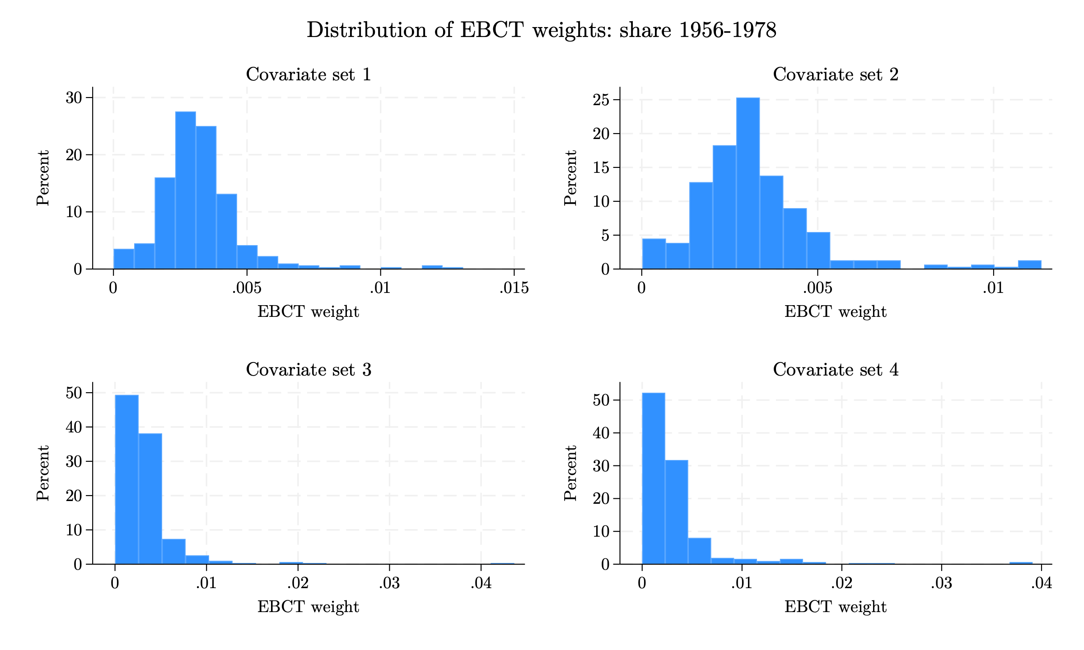
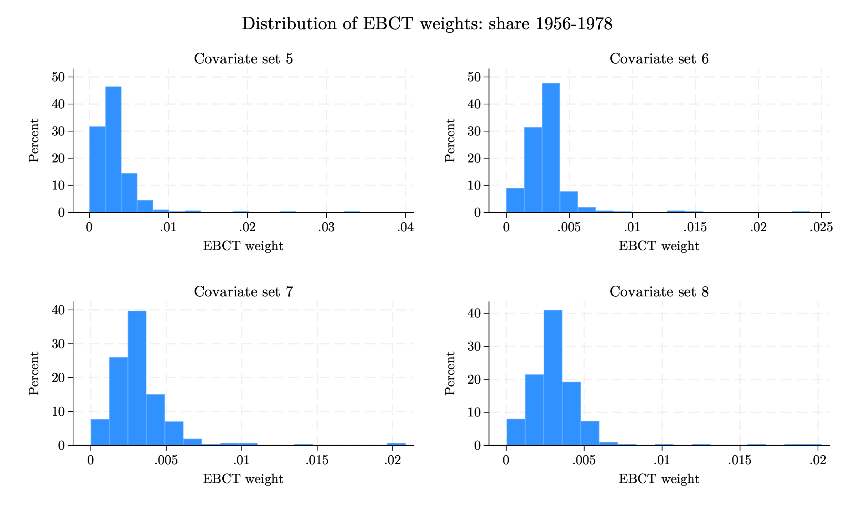
3. Pre-processed Data
Distribution of entropy-balancing weights: Spanish share 1956–1978
Histograms of EBCT weights across the 8 covariate sets (left: sets 1–4; right: sets 5–8). Weights exclude the other exposure window's Spanish share.
28 / 37
Notes:
Each histogram shows the distribution of entropy-balancing weights for one covariate set, for the 1956-1978 exposure window, in the version that excludes the other Spanish share. By construction the weights average 1/312 (about 0.0032) and are non-negative. A well-behaved distribution is concentrated near the mean with a short right tail; a long right tail means a few municipalities receive a large share of the weight, which lowers the effective sample size and makes the weighted estimates noisier. Richer covariate sets (3 and 4) and the parsimonious sets generally produce more dispersed weights than the minimal Set 1.

Slide 29
3. Pre-processed Data
EB balance check: treatment–covariate correlations
Linear correlations
Set | Bef. 36–55 | Aft. 36–55 | Bef. 56–78 | Aft. 56–78
1 | 0.463 | 0.000 | 0.423 | 0.000
2 | 0.463 | 0.000 | 0.423 | 0.000
3 | 0.463 | 0.000 | 0.423 | 0.000
4 | 0.463 | 0.000 | 0.423 | 0.000
5 | 0.463 | 0.000 | 0.423 | 0.000
6 | 0.286 | 0.000 | 0.369 | 0.000
7 | 0.463 | 0.000 | 0.423 | 0.000
8 | 0.463 | 0.000 | 0.423 | 0.000
Treatment–covariate correlation across the covariates in each set, before and after weighting. Entropy balancing drives every weighted correlation to zero (exact mean balance). Weights exclude the other exposure window's Spanish share.
29 / 37
Notes:
This check verifies that entropy balancing achieved its objective. For each covariate set we compute the correlation between every covariate and the Spanish-share exposure measure, before and after weighting, and report the largest absolute value. Before weighting, correlations reach 0.46 (log density). After weighting, every correlation is 0.000: entropy balancing imposes exact balance of the covariate means against the treatment by construction, so the linear association is removed exactly for all 8 covariate sets and for both the with- and without-other-share versions. The remaining question (next slide) is whether non-linear associations also disappear.

Slide 30
3. Pre-processed Data
Event study of blank vote share with entropy-balancing weights
 | No EB | EB 1 | EB 2 | EB 3 | EB 4 | EB 5 | EB 6 | EB 7 | EB 8
Year × Spanish share, 1936–1955 exposure window
2011 | 0.815 (0.691) | -1.068 (1.336) | -1.101 (1.372) | -2.601** (1.012) | -1.782 (1.081) | -0.479 (1.287) | 0.942 (0.900) | -1.655 (1.127) | -1.789 (1.147)
2013 | -0.351 (0.471) | -1.584** (0.651) | -1.630** (0.674) | -1.877** (0.916) | -1.088 (0.809) | -0.917 (0.681) | -0.328 (0.643) | -1.851*** (0.670) | -2.058** (0.818)
2015 | -0.034 (1.049) | -0.798 (2.448) | -1.242 (2.047) | -2.720 (1.964) | -1.646 (2.190) | 1.287 (3.471) | 3.678 (3.210) | -1.536 (2.152) | -1.512 (2.424)
2017 | -0.337 (0.335) | -1.088*** (0.373) | -0.945** (0.373) | -1.343*** (0.375) | -0.958** (0.468) | -0.975** (0.462) | -0.755 (0.483) | -1.310*** (0.443) | -1.487*** (0.456)
2019 | 0.777 (0.738) | 0.393 (1.308) | 0.570 (1.386) | -1.185 (0.789) | -0.688 (0.828) | 0.376 (0.937) | 0.768 (0.943) | -0.140 (0.841) | -0.251 (0.770)
2023 | -3.218** (1.381) | -4.302 (2.726) | -3.826 (2.847) | -6.439*** (1.093) | -4.873*** (1.264) | -4.699** (1.814) | -3.056** (1.318) | -5.779*** (1.473) | -6.225*** (1.330)
2025 | -1.388*** (0.530) | 0.215 (1.379) | 0.137 (1.444) | -0.466 (1.306) | -0.125 (1.153) | 0.657 (1.303) | -0.031 (1.287) | -0.208 (1.482) | -0.583 (1.375)
Year × Spanish share, 1956–1978 exposure window
2011 | 4.047 (3.096) | -2.642 (4.259) | -3.392 (3.921) | -9.007 (6.212) | -6.088 (6.150) | -3.268 (4.852) | 8.280*** (2.560) | 0.209 (3.861) | -1.337 (4.940)
2013 | -0.780 (1.613) | -4.012** (1.855) | -4.725** (2.248) | -9.071* (4.708) | -7.679* (4.234) | -6.333* (3.730) | -0.032 (1.979) | -5.114* (2.879) | -6.376 (3.974)
2015 | 1.019 (4.660) | 3.461 (11.415) | 1.323 (10.611) | -12.275 (9.035) | -7.059 (9.348) | 3.220 (13.521) | 25.920* (14.010) | 5.732 (11.470) | 5.428 (13.818)
2017 | -0.212 (1.065) | -2.940*** (1.076) | -3.152** (1.229) | -3.274 (2.850) | -3.594 (2.295) | -4.051* (2.129) | -1.202 (1.043) | -3.548** (1.599) | -4.676** (2.117)
2019 | 2.714 (2.460) | 1.144 (3.876) | -0.160 (3.135) | -5.515 (4.034) | -4.224 (3.797) | 0.021 (3.223) | 5.315* (2.943) | 1.815 (2.730) | 0.995 (3.242)
2023 | -11.835*** (4.097) | -13.356*** (4.055) | -15.776*** (4.088) | -26.009*** (5.835) | -16.683** (6.949) | -17.625*** (6.360) | -7.840** (3.862) | -15.792*** (5.341) | -18.684*** (6.488)
2025 | -3.412 (3.002) | 4.562 (3.546) | 3.004 (4.319) | -5.606 (4.337) | -6.249* (3.785) | -2.937 (5.006) | 0.684 (6.756) | -2.872 (4.602) | -3.468 (5.492)
R² (1936–55) | 0.449 | 0.436 | 0.439 | 0.454 | 0.462 | 0.450 | 0.456 | 0.452 | 0.449
R² (1956–78) | 0.447 | 0.438 | 0.442 | 0.454 | 0.469 | 0.459 | 0.484 | 0.454 | 0.450
Coefficients on year × Spanish share; 2021 omitted as the reference year. Each EB column is a separate regression weighted to balance the corresponding window. Clustered std. errors at the municipality level in parentheses. * p<0.1, ** p<0.05, *** p<0.01. N = 4,680. Weights exclude the other Spanish share.
30 / 37
Notes:
Event-study estimates for the blank vote share, re-weighted with entropy-balancing weights from each of the 8 covariate sets (version that excludes the other Spanish share). The 'No EB' column is the unweighted benchmark. 2021 is the omitted reference year (the Spanish 'Ley de Nietos' / grandchildren law took effect in late 2022).
Pre-2021 coefficients should be small and insignificant if pre-trends are parallel; the 2023 and 2025 coefficients capture the post-reform response. Across covariate sets the post-reform (2023) effect on blank voting is consistently negative and often significant. Weighting generally preserves the sign and strengthens the precision of the 2023 effect relative to the unweighted estimates, which is reassuring. Some pre-period coefficients (e.g. 2013, 2017) remain marginally significant in a several specifications, so the pre-trends are not perfectly flat.

Slide 31
3. Pre-processed Data
Event study of electoral participation with entropy-balancing weights
 | No EB | EB 1 | EB 2 | EB 3 | EB 4 | EB 5 | EB 6 | EB 7 | EB 8
Year × Spanish share, 1936–1955 exposure window
2011 | 1.416** (0.576) | 1.190 (1.163) | 1.277 (1.214) | 0.035 (1.402) | 1.080 (1.148) | 1.542* (0.910) | 2.282*** (0.539) | 0.958 (1.039) | 0.655 (0.896)
2013 | 0.713 (0.445) | 0.859 (0.754) | 0.923 (0.773) | 0.445 (0.789) | 1.103 (0.816) | 1.478* (0.775) | 1.465** (0.594) | 0.968 (0.750) | 0.729 (0.634)
2015 | -0.272 (0.468) | 0.402 (0.528) | 0.354 (0.578) | -0.135 (0.558) | 0.255 (0.547) | 0.966*** (0.372) | 1.018*** (0.356) | 0.440 (0.477) | 0.403 (0.469)
2017 | -0.624 (0.382) | 1.116 (1.009) | 1.257 (1.060) | 0.883 (0.845) | 0.850 (0.730) | 1.357* (0.793) | 0.568 (0.396) | 1.463 (0.977) | 1.309* (0.777)
2019 | 0.561* (0.318) | 0.569 (0.420) | 0.473 (0.401) | 0.346 (0.603) | 0.965 (0.602) | 1.353*** (0.443) | 1.770*** (0.300) | 0.553 (0.367) | 0.495 (0.359)
2023 | 0.250 (0.292) | -0.088 (0.487) | -0.114 (0.477) | -0.348 (0.417) | -0.317 (0.539) | -0.349 (0.644) | 0.654* (0.333) | -0.633 (0.485) | -0.800 (0.513)
2025 | 0.330 (0.344) | 1.172 (0.944) | 1.200 (1.016) | 0.647 (0.921) | 0.319 (0.815) | 1.029 (0.847) | 0.801* (0.473) | 1.382 (0.961) | 1.082 (0.838)
Year × Spanish share, 1956–1978 exposure window
2011 | 5.170** (2.070) | 4.683*** (1.804) | 5.384*** (1.957) | -3.978 (5.194) | -1.064 (5.626) | 3.503 (4.311) | 8.435*** (2.842) | 2.343 (3.664) | 0.878 (3.590)
2013 | 1.330 (1.741) | 2.432* (1.370) | 1.849 (1.580) | -0.630 (3.625) | 4.130 (4.691) | 6.625* (3.766) | 2.688 (2.788) | 2.806 (3.281) | 2.719 (3.023)
2015 | -1.438 (1.643) | 0.721 (1.506) | 0.883 (1.582) | -0.145 (2.421) | 1.797 (2.757) | 5.606*** (1.514) | 4.405*** (1.248) | 3.264** (1.554) | 3.337** (1.588)
2017 | -3.714** (1.882) | 1.748 (1.356) | 1.667 (1.436) | -1.112 (1.650) | -0.000 (2.800) | 3.361 (2.384) | -0.726 (1.854) | 1.573 (2.350) | 1.832 (2.325)
2019 | 0.449 (1.362) | -0.471 (2.547) | -0.075 (2.583) | -0.795 (2.387) | 4.729 (3.260) | 7.710*** (1.559) | 7.471*** (1.039) | 4.556** (1.846) | 4.015** (1.864)
2023 | 1.898* (1.121) | 0.986 (1.410) | 0.860 (1.442) | 1.402 (2.664) | 1.010 (2.479) | 1.617 (2.173) | 4.056*** (0.987) | 1.390 (1.748) | 0.327 (2.181)
2025 | 2.131 (1.567) | 5.111*** (1.542) | 4.179** (1.845) | 1.835 (3.225) | 0.401 (3.145) | 3.532 (2.468) | 2.343 (1.688) | 4.117* (2.189) | 3.848* (2.220)
R² (1936–55) | 0.743 | 0.752 | 0.757 | 0.773 | 0.774 | 0.753 | 0.751 | 0.758 | 0.758
R² (1956–78) | 0.743 | 0.754 | 0.758 | 0.768 | 0.765 | 0.762 | 0.757 | 0.761 | 0.760
Coefficients on year × Spanish share; 2021 omitted as the reference year. Each EB column is a separate regression weighted to balance the corresponding window. Clustered std. errors at the municipality level in parentheses. * p<0.1, ** p<0.05, *** p<0.01. N = 4,680. Weights exclude the other Spanish share.
31 / 37
Notes:
Event-study estimates for electoral participation (turnout), re-weighted with entropy-balancing weights from each of the 8 covariate sets (version that excludes the other Spanish share). 'No EB' is the unweighted benchmark and 2021 is the omitted reference year.
As expected, the effects on participation are weaker and less systematic than on blank voting: turnout is compulsory in Argentina, so there is less room for movement. Most post-reform (2023, 2025) coefficients are small and statistically insignificant when the weights are applied. Several pre-period coefficients (2011-2019) are positive and a few are significant, especially in the richer covariate sets. Balancing worked better at flattening these pre-trends. However, it did not work as well for blank votes, which already showed no significant pre-treatment coefficients.

Slide 32
3. Pre-processed Data
An alternative: Covariate Balancing Generalized Propensity Score
We re-weight municipalities with the Covariate Balancing Generalized Propensity Score (CBGPS) based on Fong Hazlett and Imai (2018).
CBGPS chooses weights so that, in the weighted sample, the continuous treatment (the Spanish share) becomes uncorrelated with the covariates.
Unlike EB, CBGPS uses covariate-balancing generalized propensity score conditions to construct weights.
We use the same 8 covariate sets. Here the other exposure window's Spanish share is never included as a covariate.
Similar results to EB, see Appendix.
32 / 37
Notes:
The CBGPS (Fong, Hazlett and Imai, 2018) extends covariate-balancing propensity scores to a continuous treatment. Standard generalized propensity score methods first fit a model for the treatment given the covariates and then build weights from it; CBGPS instead estimates the weights directly from the moment condition that the weighted treatment be uncorrelated with the covariates. This makes the method more robust to misspecification of the treatment model, which is why it is a useful second opinion alongside entropy balancing. We use the 'exact' method in the CBPS package.
Unlike the entropy-balancing exercise, here we never add the other exposure window's Spanish share as a covariate. The two shares are highly correlated, and when the other share is included the CBGPS optimisation either fails to converge or returns extremely large weights for a handful of municipalities, which makes the weighted sample uninformative. We therefore keep CBGPS to the covariate sets without the other share and rely on it as a complementary check rather than the main specification.
Fong, C., Hazlett, C., & Imai, K. (2018). Covariate balancing propensity score for a continuous treatment: Application to the efficacy of political advertisements. The Annals of Applied Statistics, 12(1), 156-177.

Slide 33
3. Pre-processed Data
Re-weighted average effect on the blank vote share
BlankVotesₘₜ = β₁ · postₜ × S₁₉₃₆₋₁₉₅₅,ₘ + β₂ · postₜ × S₁₉₅₆₋₁₉₇₈,ₘ + γₜ + δₘ + ElectionTypeₘₜ + uₘₜ (1)
 | Unweighted | EB, set 3 |  | EB, set 4 |  | CBGPS, set 3 |  | CBGPS, set 4
 |  | 1936–55 | 1956–78 | 1936–55 | 1956–78 | 1936–55 | 1956–78 | 1936–55 | 1956–78
Spanish share 1936–1955 × Post | -2.112** | -2.049** | -3.026*** | -1.573* | -3.862*** | -1.601 | -3.067*** | -1.711 | -3.012
 | (0.843) | (0.887) | (1.094) | (0.833) | (1.188) | (1.520) | (0.729) | (1.275) | (1.845)
Spanish share 1956–1978 × Post | -4.285* | -6.277** | -4.001 | -6.339* | 3.013 | -9.556** | -2.709 | -9.645** | 1.063
 | (2.238) | (2.919) | (4.399) | (3.249) | (5.614) | (4.354) | (2.525) | (4.642) | (9.335)
Observations | 4680 | 4680 | 4680 | 4680 | 4680 | 4680 | 4680 | 4680 | 4680
Municipality FE | Yes | Yes | Yes | Yes | Yes | Yes | Yes | Yes | Yes
Time FE | Yes | Yes | Yes | Yes | Yes | Yes | Yes | Yes | Yes
Election type FE | Yes | Yes | Yes | Yes | Yes | Yes | Yes | Yes | Yes
* p < 0.1, ** p < 0.05, *** p < 0.01. Standard errors clustered at the municipality level in parentheses.​ Post × Spanish share, re-weighted with the best pre-trend covariate sets (3 and 4).
33 / 37
Notes:
Headline difference-in-differences estimates (Post x Spanish share) for the blank vote share, re-weighted with the covariate sets that produced the best pre-trends: entropy balancing sets 3 and 4 (without the other Spanish share) and CBGPS sets 3 and 4. Each column is a separate weighted regression; the weights balance one exposure window, so the coefficient on that same window (shown in bold) is the estimate to read — the off-diagonal coefficient is not balanced in that column.
The blank-vote effect is negative across weighting schemes. Under entropy balancing the 1936-1955 effect is about -1.6 to -2.0 and statistically significant, and the 1956-1978 point estimates are also negative though less precise. The CBGPS estimates point in the same direction but are noisier, consistent with the smaller effective sample sizes of those specifications. Overall the re-weighting confirms the negative blank-vote response seen in the event study.

Slide 34
3. Pre-processed Data
Re-weighted average effect on electoral participation
Turnoutₘₜ = β₁ · postₜ × S₁₉₃₆₋₁₉₅₅,ₘ + β₂ · postₜ × S₁₉₅₆₋₁₉₇₈,ₘ + γₜ + δₘ + ElectionTypeₘₜ + uₘₜ (1)
 | Unweighted | EB, set 3 |  | EB, set 4 |  | CBGPS, set 3 |  | CBGPS, set 4
 |  | 1936–55 | 1956–78 | 1936–55 | 1956–78 | 1936–55 | 1956–78 | 1936–55 | 1956–78
Spanish share 1936–1955 × Post | -0.468 | -0.514 | -0.836 | -0.965** | -0.143 | -0.766* | -0.885** | -0.876** | -1.217
 | (0.361) | (0.417) | (0.851) | (0.445) | (0.552) | (0.425) | (0.388) | (0.423) | (0.938)
Spanish share 1956–1978 × Post | 2.977** | 1.892* | 5.055 | 1.392 | -0.367 | 2.010 | 1.966 | 1.490 | 5.130
 | (1.365) | (1.110) | (4.508) | (1.151) | (2.653) | (1.313) | (1.524) | (1.297) | (6.545)
Observations | 4680 | 4680 | 4680 | 4680 | 4680 | 4680 | 4680 | 4680 | 4680
Municipality FE | Yes | Yes | Yes | Yes | Yes | Yes | Yes | Yes | Yes
Time FE | Yes | Yes | Yes | Yes | Yes | Yes | Yes | Yes | Yes
Election type FE | Yes | Yes | Yes | Yes | Yes | Yes | Yes | Yes | Yes
* p < 0.1, ** p < 0.05, *** p < 0.01. Standard errors clustered at the municipality level in parentheses.​ Post × Spanish share, re-weighted with the best pre-trend covariate sets (3 and 4).
34 / 37
Notes:
Headline difference-in-differences estimates (Post x Spanish share) for electoral participation, re-weighted with entropy balancing sets 3 and 4 (without the other Spanish share) and CBGPS sets 3 and 4. As before, each column is a separate weighted regression and the bold coefficient — on the window used to build the weights — is the balanced estimate.
The re-weighted effects on participation are small. For the 1936-1955 window the effect is mildly negative and statistically significant under CBGPS and under entropy balancing set 4; for the 1956-1978 window the estimates are imprecise. This is consistent with the event study and with the fact that voting is compulsory in Argentina, leaving little room for a turnout response.

Slide 35
4. Equality of Coefficients Test
Testing whether the effects on the 1936–1955 and 1956–1978 cohorts differ
BlankVotesₘₜ = β₁ · postₜ × S₁₉₃₆₋₁₉₅₅,ₘ + β₂ · postₜ × S₁₉₅₆₋₁₉₇₈,ₘ + γₜ + δₘ + ElectionTypeₘₜ + uₘₜ (1)
BlankVotesₘₜ = β₁ · postₜ × S₁₉₃₆₋₁₉₅₅,ₘ + β₂ · postₜ × S₁₉₅₆₋₁₉₇₈,ₘ + γₜ + δₘ + uₘₜ (2)
 | Share of blank votes
 | (1) | (2)
Post × Spanish share (1936-1955) | -2.112** | -1.881***
 | (0.843) | (0.549)
Post × Spanish share (1956-1978) | -4.285* | -2.498
 | (2.238) | (2.285)
Observations | 4,680 | 2,496
Municipality FE | Yes | Yes
Time FE | Yes | Yes
Election type FE | Yes | No
General elections only | No | Yes
p < 0.1, ** p < 0.05, *** p < 0.01 Standard errors clustered at the municipality level in parentheses.
Specification | Null hypothesis | Two-sided p-value (β₂ ≠ β₁) | One-sided p-value (|β₂| > |β₁|)
Model (1): all elections | β₁ = β₂ | 0.425 | 0.213
Model (2): general elections only | β₁ = β₂ | 0.816 | 0.408
Notes: β₁ and β₂ denote the coefficients on Post × Spanish share (1936–1955) and Post × Spanish share (1956–1978), respectively. p-values computed from a standard normal approximation using clustered standard errors. We fail to reject equality in both specifications.
35/ 37

Slide 36
Additional Outcomes: Ideological Vote Shares
Effects on left–right vote shares and ideological summary measures
 | Left | Center-left | Center-right | Right | Broad left | Broad right | Left-right ideology | Ideological polarization
Post × Spanish share (1936–1955) | 0.345 | -0.723 | 0.820 | 2.903 | -0.378 | 3.723* | -4.101* | 0.067*
 | (0.369) | (1.369) | (1.259) | (1.795) | (1.385) | (2.035) | (2.395) | (0.036)
Post × Spanish share (1956–1978) | -0.538 | -2.661 | 4.850 | -0.555 | -3.199 | 4.295 | -7.494 | 0.075
 | (1.841) | (6.235) | (5.056) | (7.214) | (6.675) | (9.610) | (11.353) | (0.164)
Municipality FE | Yes | Yes | Yes | Yes | Yes | Yes | Yes | Yes
Time FE | Yes | Yes | Yes | Yes | Yes | Yes | Yes | Yes
Election type FE | Yes | Yes | Yes | Yes | Yes | Yes | Yes | Yes
General elections only | No | No | No | No | No | No | No | No
Observations | 4680 | 4680 | 4680 | 4680 | 4680 | 4680 | 4680 | 4680
R² | 0.404 | 0.657 | 0.639 | 0.818 | 0.658 | 0.700 | 0.714 | 0.767
* p < 0.1, ** p < 0.05, *** p < 0.01. Standard errors clustered at the municipality level in parentheses.
36 / 37
Notes:
After the law, municipalities more exposed in the first window increase their vote share for the broad right — right plus center-right — although the vote share for the right or the center-right separately does not change.
The negative coefficient is consistent with the previous result. After the law, in municipalities more exposed in the first window, the left-right index decreases, indicating greater support for the broad right.
The positive coefficient on the ideological polarization index points in the same direction: after the law, municipalities more exposed in the first window shift further to the right.
Although before the law there was no evidence of significant differences in the average left-right index, the average ideological index, or the average vote share for the broad right, we did find that municipalities more exposed in the first window had a higher average vote share for the right in the pre-law years.
Left–right index: lower values indicate stronger broad-right support, and higher values indicate stronger broad-left support. Left-right Index = (Share broad-left) – (Share broad-right)
Ideological index: lower values indicating a more left-leaning electorate and higher values indicating a more right-leaning electorate. Ideological Index = –2(Share left) – 1(Share center-left) + 1(Share center-right) + 2(Share right)

Slide 37
Additional Outcomes: Incumbency and Electoral Dynamics
Effects on party support, incumbency outcomes, alternation and competition
 | Peronism | Radicalism | Incumbent party (share) | Incumbent party (dummy) | Ideological alternation | Same party: PASO-general | Same bloc: PASO-general | Victory margin | ENP
Post × Spanish share (1936–1955) | -1.281 | 0.119 | 2.065** | 0.026 | -0.104** | 0.059 | 0.044 | -1.168 | -0.003
 | (1.460) | (0.491) | (1.035) | (0.039) | (0.044) | (0.069) | (0.065) | (1.252) | (0.063)
Post × Spanish share (1956–1978) | 8.511 | 0.841 | 7.549* | 0.026 | 0.223 | -0.270 | -0.191 | 11.428** | -0.581*
 | (6.750) | (1.884) | (4.276) | (0.172) | (0.201) | (0.288) | (0.270) | (5.758) | (0.321)
Municipality FE | Yes | Yes | Yes | Yes | Yes | Yes | Yes | Yes | Yes
Time FE | Yes | Yes | Yes | Yes | Yes | Yes | Yes | Yes | Yes
Election type FE | Yes | Yes | Yes | Yes | Yes | No | No | Yes | Yes
General elections only | No | No | No | No | No | No | No | No | No
Observations | 4680 | 4680 | 4680 | 4680 | 4056 | 2184 | 2184 | 4680 | 4680
R² | 0.590 | 0.389 | 0.446 | 0.254 | 0.288 | 0.214 | 0.197 | 0.553 | 0.549
* p < 0.1, ** p < 0.05, *** p < 0.01. Standard errors clustered at the municipality level in parentheses.
37 / 37
Notes:
After the law, the vote share for the incumbent party increases. We do not find evidence that municipalities differed in this dimension before treatment.
After the law, the probability that the ideological bloc of the winning party changes from one election to the next decreases for more exposed municipalities in the first window. We do not find evidence that municipalities differed in this dimension before treatment. However, for the second window, we do find that before the law, municipalities were on average more likely to switch ideological blocs between elections.
The margin of victory and the ENP index move in opposite directions relative to their average pre-treatment characteristics.

Slide 38
APPENDIX II

Slide 39
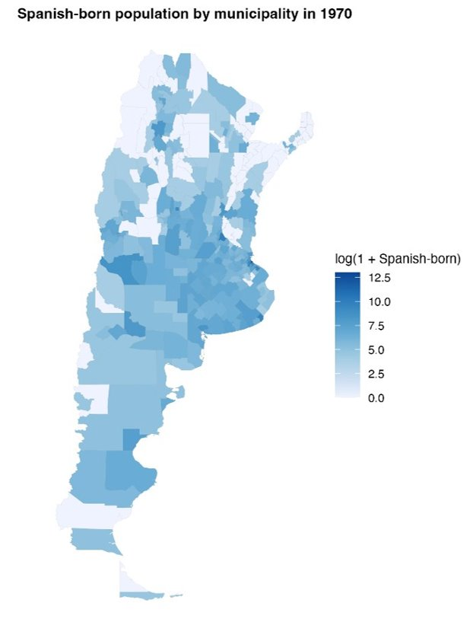
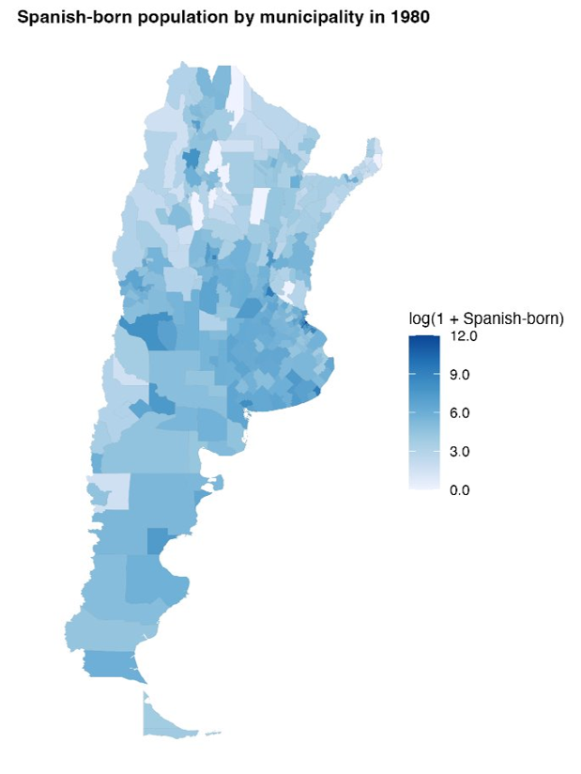
Appendix: Distribution of Spanish-Born Population
Log of Spanish-born population 1970
Log of Spanish-born population 1980

Slide 40
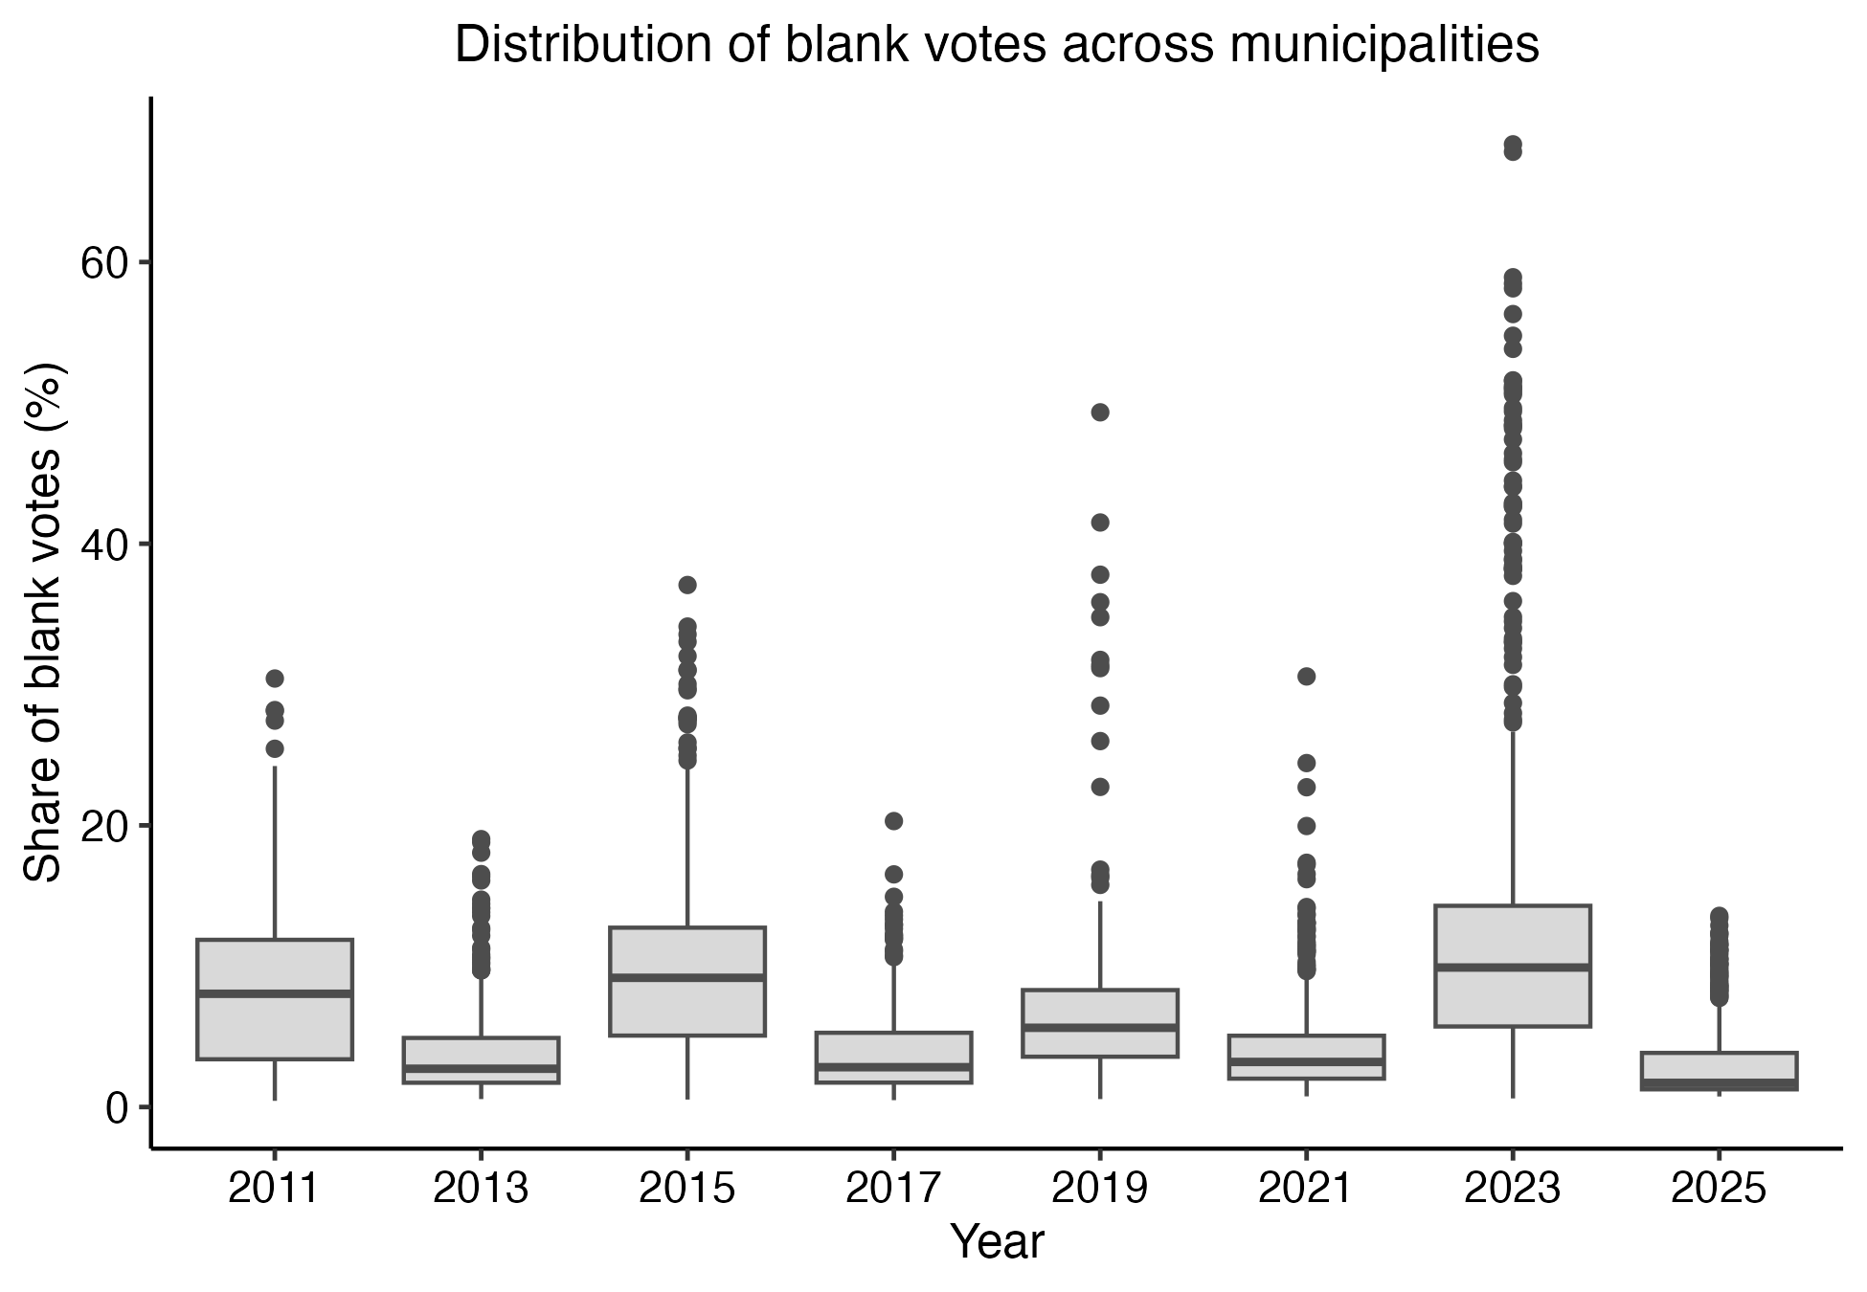
Appendix: Distribution of Blank Votes
High dispersion in blank vote shares may contribute to noisier estimates in some years.

Slide 41
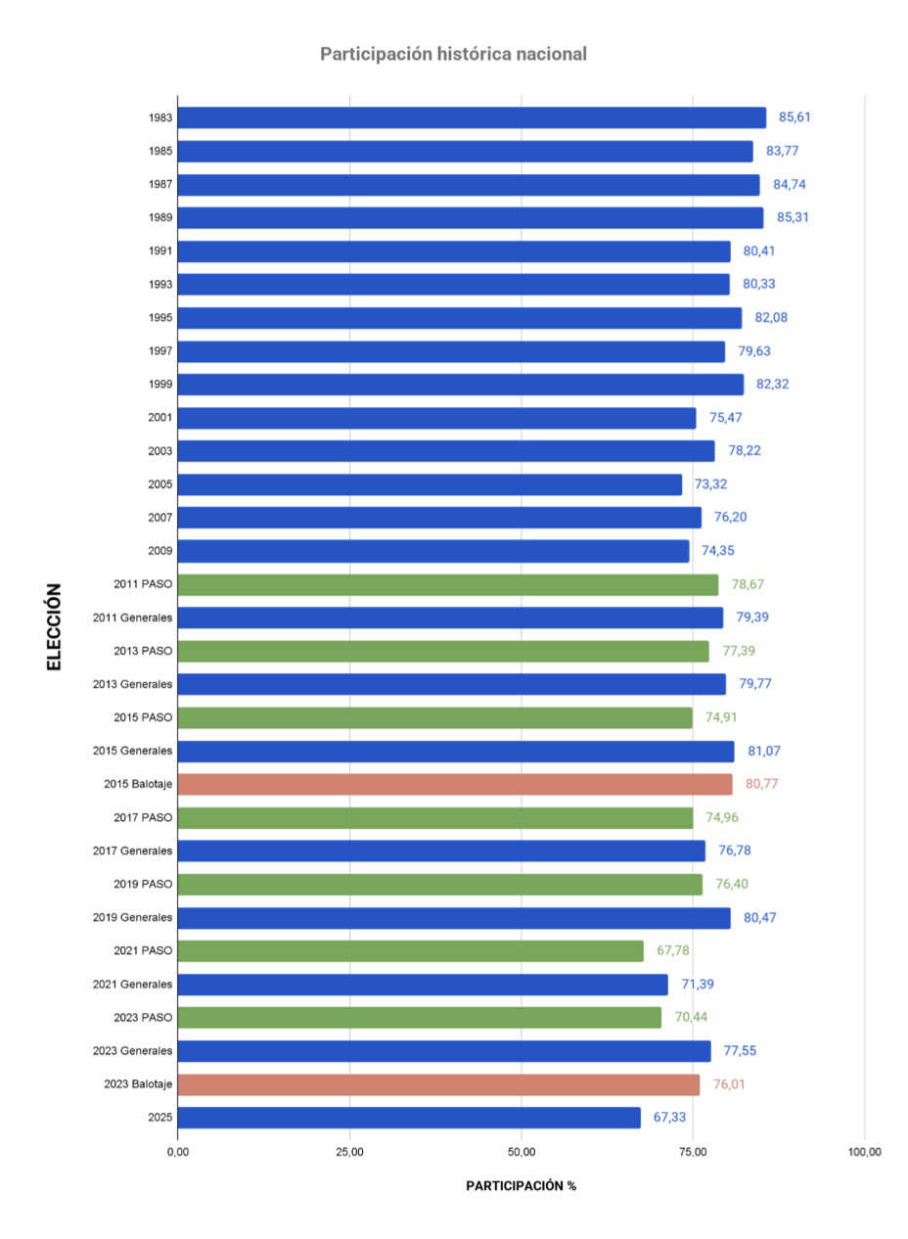
Appendix: Turnout
Voter turnout for national office elections between 1983 and 2025.
For years in which the election was legislative, the data were aggregated at the national level.
Source: Comisión Nacional Electoral Argentina

Slide 42
Appendix: Pre-treatment Political Behavior
B. Differential pre-trends
 | Blank votes | Turnout | Left | Center-left | Center-right | Right | Broad left | Broad right | Left-right index | Ideological index | Peronist vote | Radical vote | Margin | ENP
2013 × share_1936_1955 | -0.759 | -0.221 | -0.014 | 0.322 | -0.879 | 1.583** | 0.308 | 0.704 | -0.396 | 0.020 | 3.235 | 2.199 | -1.256 | -0.112
2013 × share_1936_1955 | (0.737) | (0.561) | (0.495) | (2.871) | (1.571) | (0.763) | (2.601) | (1.416) | (2.966) | (0.024) | (3.292) | (2.304) | (2.789) | (0.202)
2015 × share_1936_1955 | -0.677 | -1.198** | 0.598 | -0.834 | -0.658 | 0.190*** | -0.235 | -0.468 | 0.232 | -0.006 | -5.578*** | 1.420 | -5.407** | 0.200*
2015 × share_1936_1955 | (0.673) | (0.598) | (0.433) | (1.945) | (2.462) | (0.047) | (1.700) | (2.463) | (3.577) | (0.034) | (1.694) | (0.934) | (2.375) | (0.107)
2017 × share_1936_1955 | -0.880 | -1.218 | -1.371* | 0.764 | -3.666** | 0.002 | -0.606 | -3.664** | 3.058 | -0.017 | -2.137 | 2.084* | -4.713* | 0.072
2017 × share_1936_1955 | (0.782) | (0.768) | (0.698) | (2.428) | (1.827) | (0.110) | (2.181) | (1.825) | (3.314) | (0.032) | (4.490) | (1.095) | (2.804) | (0.155)
2019 × share_1936_1955 | 0.277 | -0.255 | 0.241 | -1.867 | -3.145* | 0.012 | -1.626 | -3.134* | 1.508 | -0.017 | -2.433 | 1.703* | 0.687 | -0.098
2019 × share_1936_1955 | (0.669) | (0.550) | (0.391) | (1.579) | (1.630) | (0.063) | (1.536) | (1.631) | (2.789) | (0.028) | (1.970) | (0.950) | (2.093) | (0.119)
2021 × share_1936_1955 | -0.358 | -1.101 | 0.151 | 3.780 | -11.959*** | 1.539*** | 3.931 | -10.420*** | 14.350** | -0.130** | -5.681*** | 1.692* | -4.833 | 0.234
2021 × share_1936_1955 | (0.994) | (0.697) | (0.543) | (3.621) | (3.129) | (0.588) | (3.683) | (2.608) | (6.101) | (0.057) | (1.913) | (0.944) | (3.110) | (0.166)
2013 × share_1956_1978 | -2.716 | -3.225 | 4.493* | 16.621 | -5.527 | 5.186 | 21.113* | -0.341 | 21.454* | -0.208** | 3.522 | 11.036 | -12.660 | 0.719
2013 × share_1956_1978 | (3.453) | (2.554) | (2.373) | (13.209) | (4.837) | (3.843) | (11.758) | (4.164) | (12.185) | (0.096) | (15.412) | (6.942) | (10.944) | (1.088)
2015 × share_1956_1978 | -1.145 | -3.275 | -0.679 | 6.551 | 24.148** | 0.407 | 5.871 | 24.556** | -18.684 | 0.198 | -6.817 | 7.806** | -14.287 | -0.387
2015 × share_1956_1978 | (3.406) | (2.191) | (2.135) | (9.618) | (11.797) | (0.359) | (8.066) | (11.854) | (17.773) | (0.163) | (7.196) | (3.901) | (10.763) | (0.617)
2017 × share_1956_1978 | -1.812 | -5.498* | -2.517 | -7.484 | 11.466 | -1.053** | -10.000 | 10.413 | -20.413 | 0.219 | 2.954 | 8.529* | -1.933 | -0.373
2017 × share_1956_1978 | (3.412) | (3.146) | (1.885) | (9.165) | (10.005) | (0.517) | (8.425) | (10.112) | (15.446) | (0.153) | (18.795) | (4.750) | (11.909) | (0.834)
2019 × share_1956_1978 | -2.104 | -4.013* | -1.379 | -8.205 | 12.315 | -0.482* | -9.584* | 11.833 | -21.417* | 0.223** | -4.384 | 8.590** | -11.864 | -0.548
2019 × share_1956_1978 | (2.897) | (2.299) | (2.242) | (6.032) | (7.522) | (0.264) | (5.273) | (7.509) | (11.411) | (0.109) | (7.287) | (3.985) | (9.349) | (0.692)
2021 × share_1956_1978 | -3.051 | -2.108 | 1.188 | 17.199 | -18.194 | 4.996* | 18.387 | -13.198 | 31.586 | -0.278 | -8.127 | 8.130** | -7.750 | -0.076
2021 × share_1956_1978 | (4.297) | (2.414) | (2.545) | (17.467) | (13.891) | (2.984) | (18.364) | (11.546) | (29.249) | (0.279) | (7.613) | (3.955) | (13.413) | (0.898)
Num.Obs. | 3744 | 3744 | 3744 | 3744 | 3744 | 3744 | 3744 | 3744 | 3744 | 3744 | 3744 | 3744 | 3744 | 3744
R2 | 0.518 | 0.738 | 0.418 | 0.614 | 0.660 | 0.439 | 0.606 | 0.677 | 0.665 | 0.663 | 0.578 | 0.422 | 0.574 | 0.591

Slide 43
Appendix: Pre-treatment Political Behavior
C. Individual-level political selection using LAPOP
Averages by exposure quintile and intention to migrate
Exposure | Share quintile | Observations | Left-right ideology | Previous vote | Party identification | Vote intention | Blank/null vote intention | Community meetings
Spanish share 1936-1955 | Q1 | 1216 | 5,719 | 0,857 | 0,254 | 0,916 | 0,158 | 0,096
Spanish share 1936-1955 | Q2 | 1216 | 5,546 | 0,824 | 0,222 | 0,880 | 0,187 | 0,102
Spanish share 1936-1955 | Q3 | 1216 | 5,571 | 0,829 | 0,263 | 0,897 | 0,163 | 0,095
Spanish share 1936-1955 | Q4 | 1216 | 5,114 | 0,832 | 0,226 | 0,890 | 0,131 | 0,096
Spanish share 1936-1955 | Q5 | 1216 | 5,233 | 0,803 | 0,233 | 0,885 | 0,125 | 0,098
Spanish share 1956-1978 | Q1 | 1216 | 5,714 | 0,846 | 0,261 | 0,896 | 0,175 | 0,092
Spanish share 1956-1978 | Q2 | 1216 | 5,490 | 0,825 | 0,236 | 0,888 | 0,169 | 0,094
Spanish share 1956-1978 | Q3 | 1216 | 5,608 | 0,835 | 0,224 | 0,896 | 0,161 | 0,108
Spanish share 1956-1978 | Q4 | 1216 | 5,331 | 0,821 | 0,232 | 0,896 | 0,149 | 0,089
Spanish share 1956-1978 | Q5 | 1216 | 5,049 | 0,819 | 0,244 | 0,892 | 0,109 | 0,104
Migration intent | Observations | Left-right ideology | Previous vote | Party identification | Vote intention | Blank/null vote intention | Community meetings
Does not intend to migrate | 5135 | 5,450 | 0,848 | 0,246 | 0,893 | 0,143 | 0,092
Intends to migrate | 845 | 5,282 | 0,721 | 0,207 | 0,898 | 0,207 | 0,132
No response | 100 | 5,797 | 0,763 | 0,196 | 0,882 | 0,147 | 0,071

Slide 44
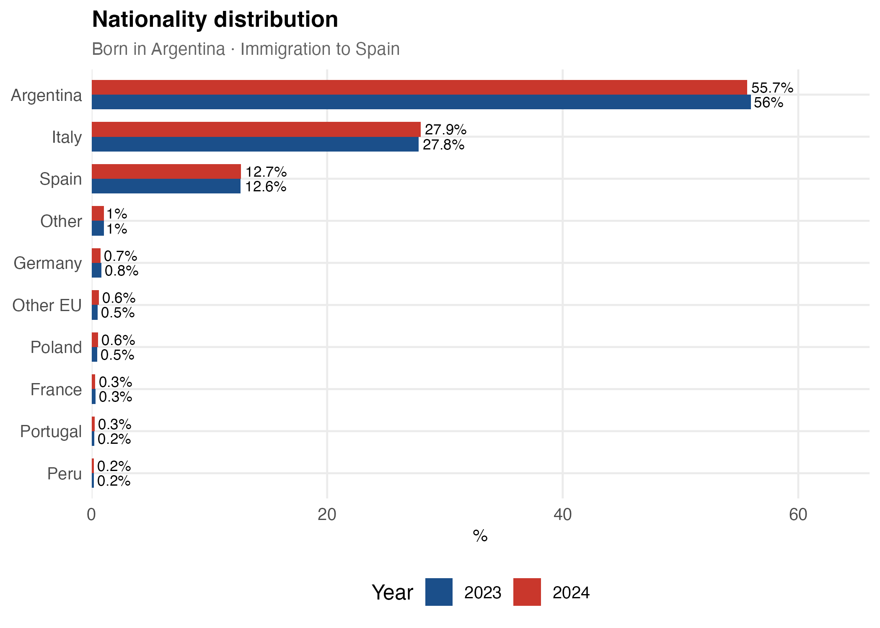
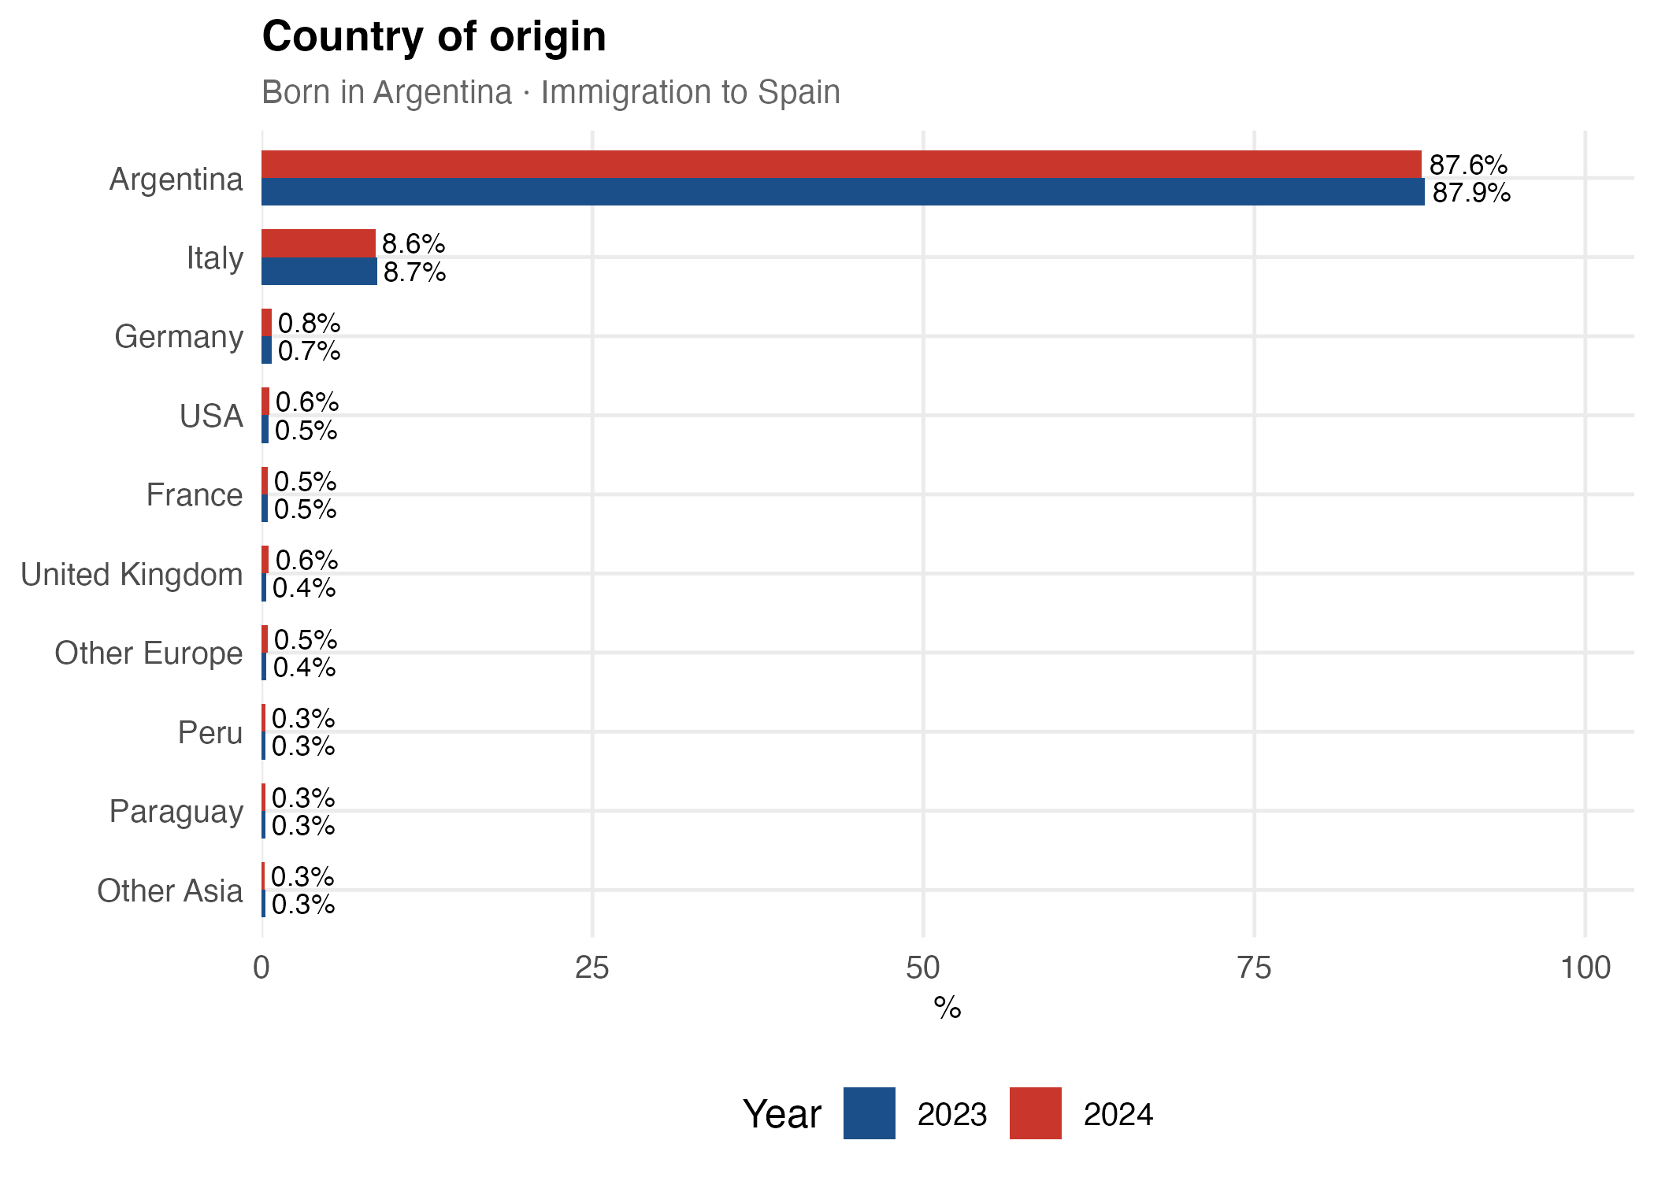
Appendix: Argentine Migrants in Spain, Nationality and Origin
INE microdata: comparison of immigration inflows to Spain, 2023 vs 2024

Slide 45
Appendix: Pre-processed Data - EB
Summary statistics of entropy-balancing weights
1936–1955 exposure window
1956–1978 exposure window
Set | Mean | SD | Min | p99 | Max
1 | 0.0032 | 0.0021 | 0.0001 | 0.0077 | 0.0309
2 | 0.0032 | 0.0022 | 0.0001 | 0.0081 | 0.0323
3 | 0.0032 | 0.0032 | 0.0000 | 0.0144 | 0.0360
4 | 0.0032 | 0.0036 | 0.0000 | 0.0170 | 0.0367
5 | 0.0032 | 0.0023 | 0.0000 | 0.0120 | 0.0220
6 | 0.0032 | 0.0018 | 0.0000 | 0.0105 | 0.0186
7 | 0.0032 | 0.0021 | 0.0000 | 0.0090 | 0.0289
8 | 0.0032 | 0.0020 | 0.0000 | 0.0089 | 0.0227
Set | Mean | SD | Min | p99 | Max
1 | 0.0032 | 0.0016 | 0.0000 | 0.0104 | 0.0131
2 | 0.0032 | 0.0018 | 0.0000 | 0.0113 | 0.0114
3 | 0.0032 | 0.0036 | 0.0000 | 0.0184 | 0.0436
4 | 0.0032 | 0.0043 | 0.0000 | 0.0216 | 0.0391
5 | 0.0032 | 0.0030 | 0.0000 | 0.0128 | 0.0342
6 | 0.0032 | 0.0021 | 0.0000 | 0.0138 | 0.0241
7 | 0.0032 | 0.0022 | 0.0000 | 0.0103 | 0.0209
8 | 0.0032 | 0.0021 | 0.0000 | 0.0123 | 0.0202
Summary statistics of municipality weights for each covariate set. The mean weight equals 1/312 by construction.
16 / 27
Notes:
These tables summarise the entropy-balancing weights for each covariate set in the version that EXCLUDES the other Spanish share. The mean is fixed at 1/312 (the number of municipalities). The key diagnostics are the standard deviation and the maximum: a larger SD and a heavier upper tail (p99, Max) mean the weighting concentrates influence on fewer municipalities and reduces the effective sample size. Set 1 (minimal) gives the most uniform weights; sets that add socioeconomic variables or electoral outcomes (3-6) and the parsimonious sets show somewhat more dispersion. None of the maxima are extreme (all below 0.05, i.e. below ~15 times the mean weight), so the entropy-balancing solutions remain usable across all 8 specifications.

Slide 46
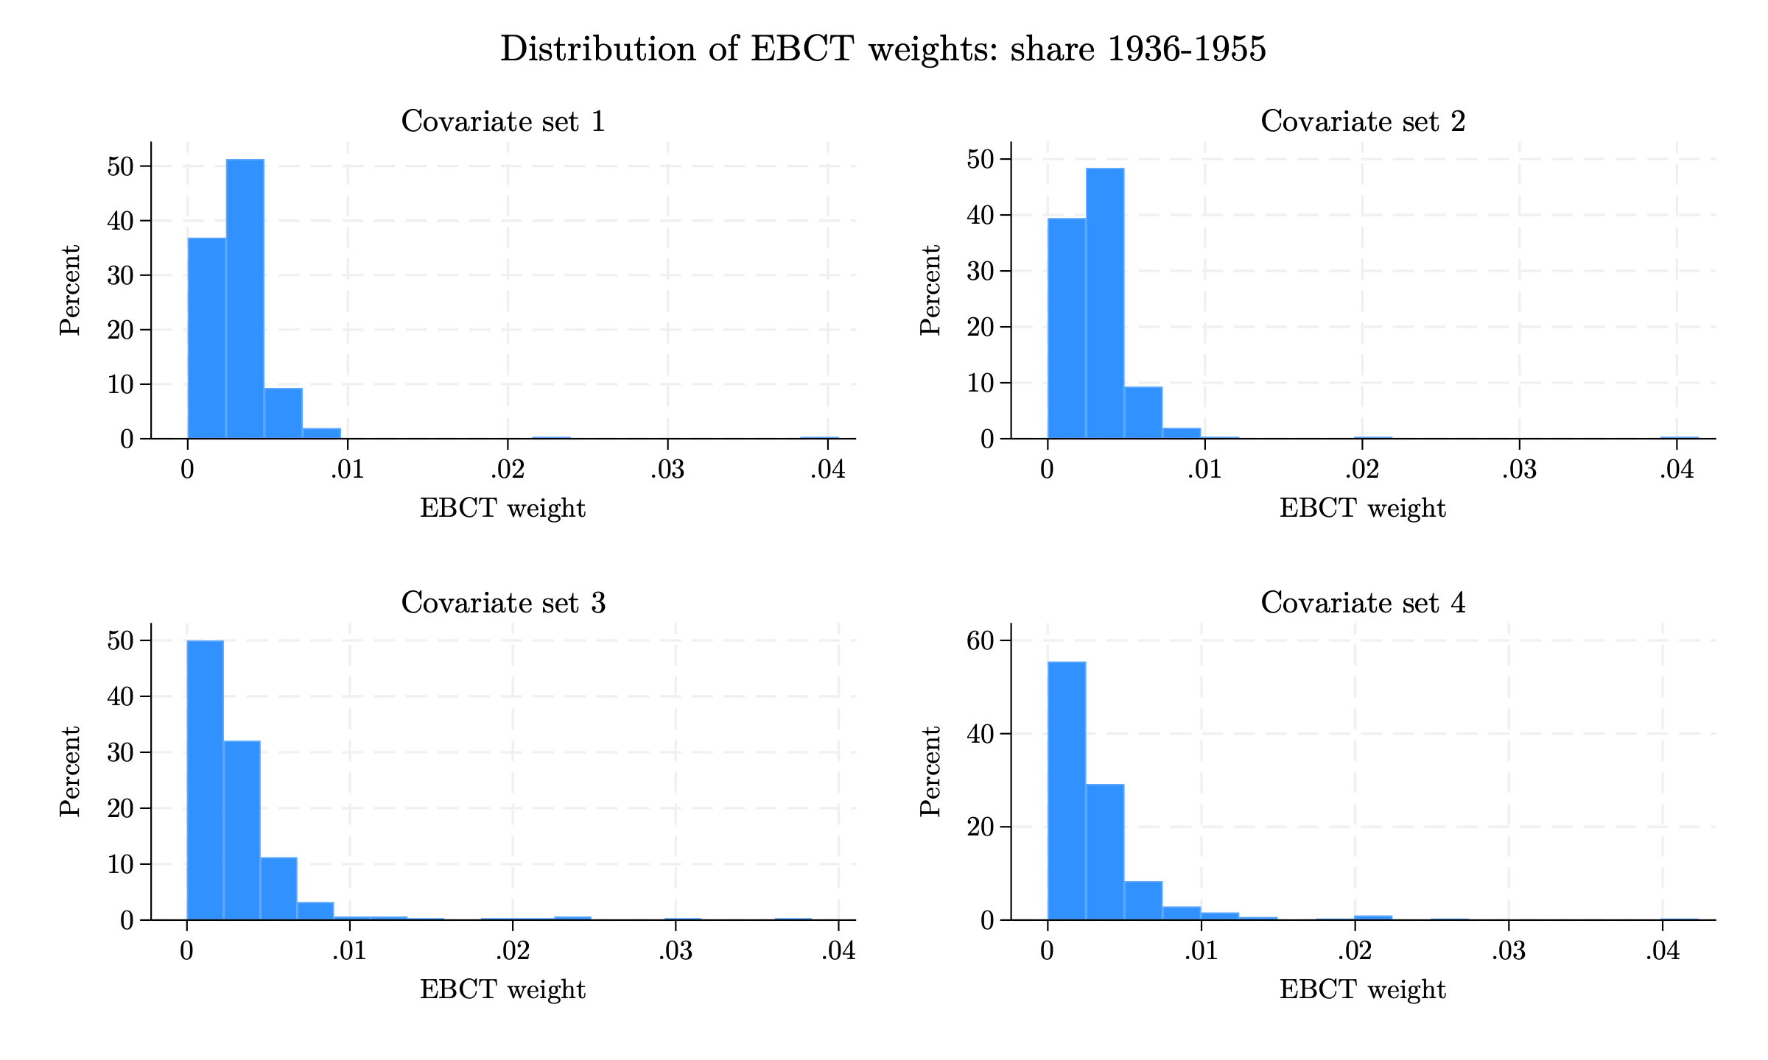
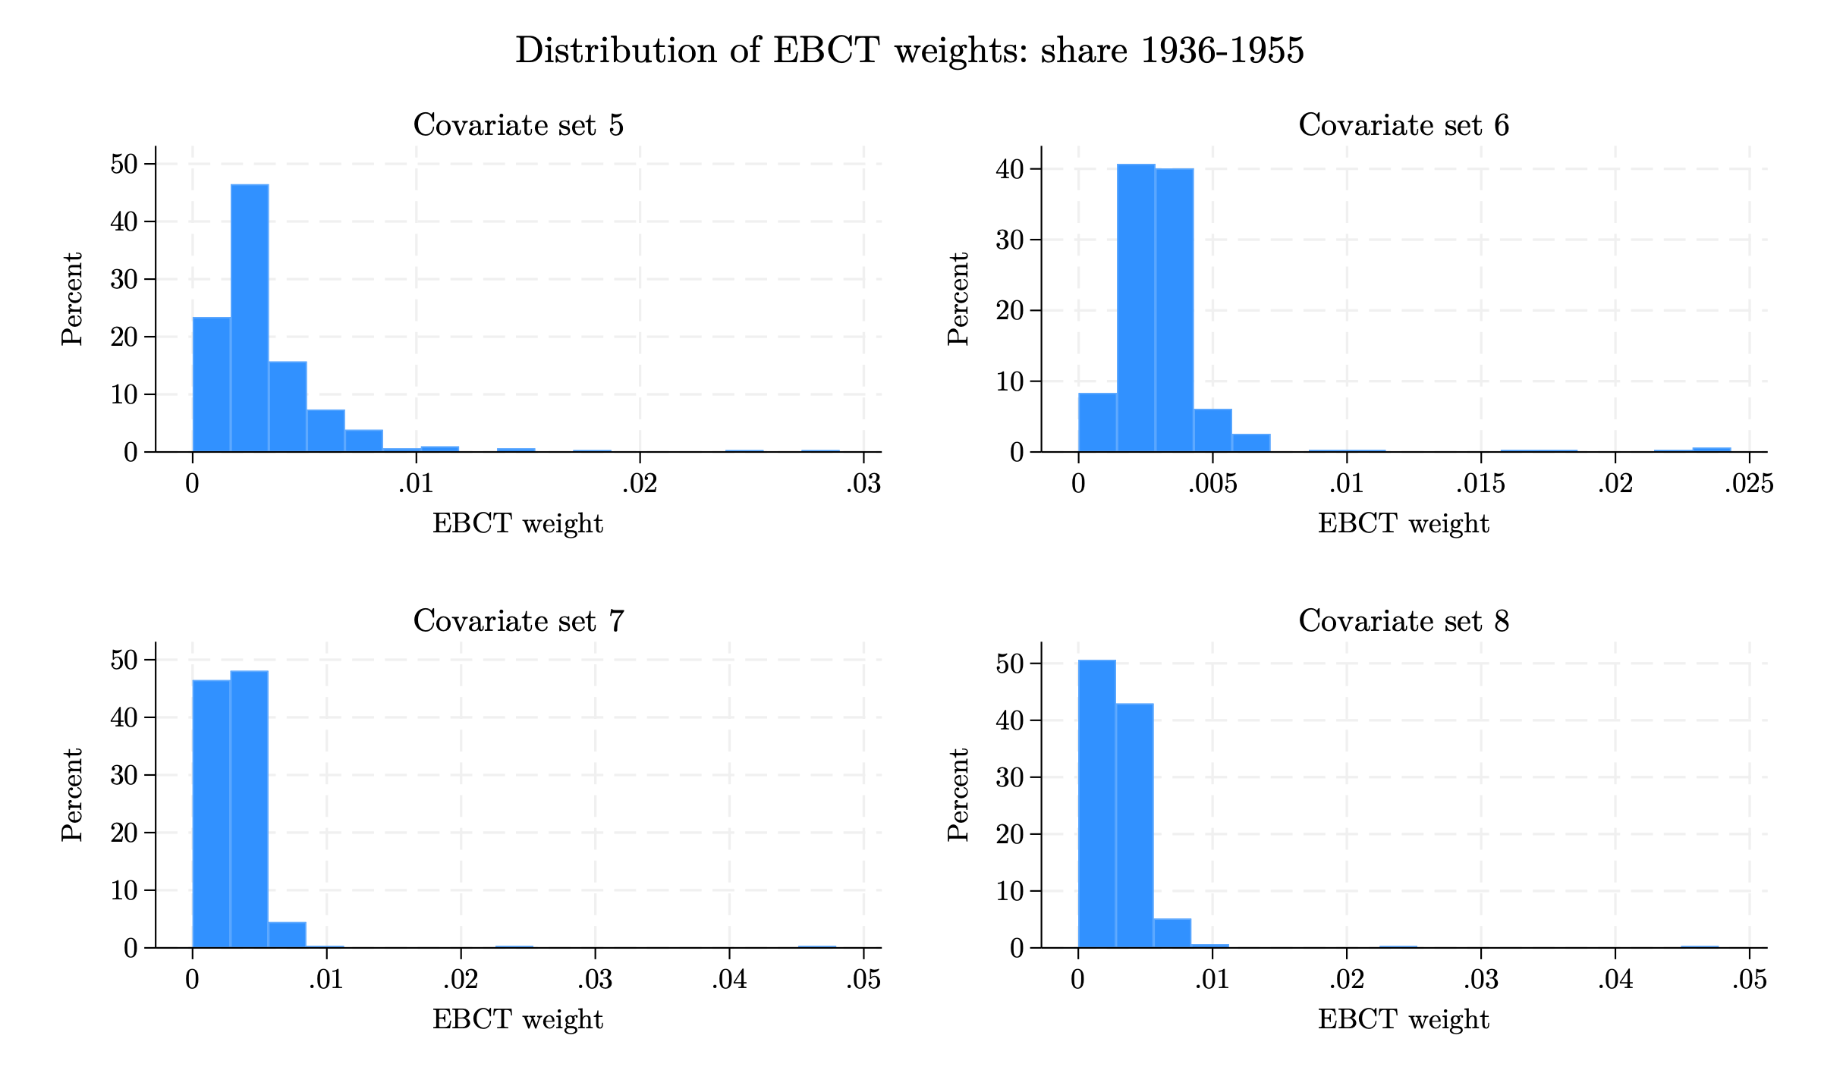
Appendix: Pre-processed Data - EB
EB weight distributions (including the other Spanish share): 1936–1955
Histograms of EBCT weights across the 8 covariate sets (left: sets 1–4; right: sets 5–8). Specifications include the other exposure window's Spanish share.
16 / 27
Notes:
Weight distributions for the 1936–1955 window in the version that INCLUDES the other exposure window's Spanish share as a covariate. Because the two shares are highly correlated, balancing one while holding the other fixed forces the algorithm to place more weight on a small set of unusual municipalities; the weight distributions here are visibly more dispersed and right-skewed than in the version without the other share (shown in the main body).

Slide 47
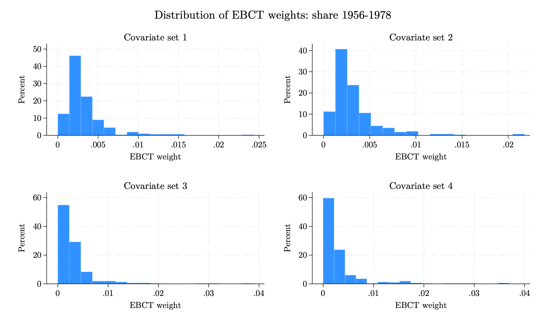
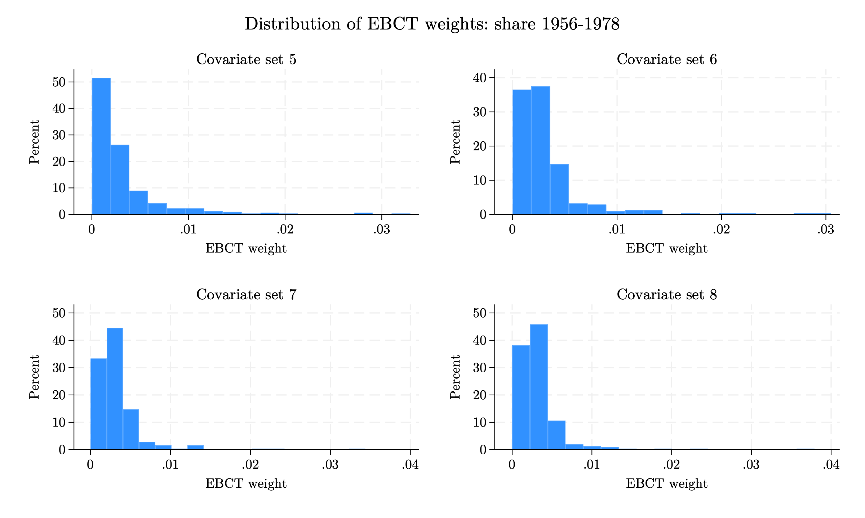
Appendix: Pre-processed Data - EB
EB weight distributions (including the other Spanish share): 1956–1978
Histograms of EBCT weights across the 8 covariate sets (left: sets 1–4; right: sets 5–8). Specifications include the other exposure window's Spanish share.
16 / 27
Notes:
Weight distributions for the 1956–1978 window in the version that INCLUDES the other exposure window's Spanish share as a covariate. Because the two shares are highly correlated, balancing one while holding the other fixed forces the algorithm to place more weight on a small set of unusual municipalities; the weight distributions here are visibly more dispersed and right-skewed than in the version without the other share (shown in the main body).

Slide 48
Appendix: Pre-processed Data - EB
EB weight summary statistics (including the other Spanish share)
1936–1955 exposure window
1956–1978 exposure window
Set | Mean | SD | Min | p99 | Max
1 | 0.0032 | 0.0028 | 0.0000 | 0.0094 | 0.0407
2 | 0.0032 | 0.0029 | 0.0000 | 0.0094 | 0.0414
3 | 0.0032 | 0.0040 | 0.0000 | 0.0230 | 0.0383
4 | 0.0032 | 0.0041 | 0.0000 | 0.0210 | 0.0423
5 | 0.0032 | 0.0030 | 0.0000 | 0.0146 | 0.0289
6 | 0.0032 | 0.0026 | 0.0000 | 0.0183 | 0.0243
7 | 0.0032 | 0.0032 | 0.0000 | 0.0073 | 0.0479
8 | 0.0032 | 0.0031 | 0.0000 | 0.0085 | 0.0477
Set | Mean | SD | Min | p99 | Max
1 | 0.0032 | 0.0026 | 0.0000 | 0.0139 | 0.0243
2 | 0.0032 | 0.0027 | 0.0000 | 0.0131 | 0.0218
3 | 0.0032 | 0.0042 | 0.0000 | 0.0199 | 0.0389
4 | 0.0032 | 0.0050 | 0.0000 | 0.0277 | 0.0369
5 | 0.0032 | 0.0042 | 0.0000 | 0.0200 | 0.0330
6 | 0.0032 | 0.0036 | 0.0000 | 0.0202 | 0.0305
7 | 0.0032 | 0.0032 | 0.0000 | 0.0140 | 0.0344
8 | 0.0032 | 0.0033 | 0.0000 | 0.0151 | 0.0379
Summary statistics of municipality weights for each covariate set. The mean weight equals 1/312 by construction Specifications include the other exposure window's Spanish share..
Notes:
Summary statistics of the entropy-balancing weights for the version that INCLUDES the other Spanish share as a covariate. Compared with the main-body tables (which exclude the other share), the standard deviations and maxima are somewhat larger, reflecting that balancing two correlated shares simultaneously requires more uneven weights.

Slide 49
Appendix: Pre-processed Data - EB
EB (including the other Spanish share) balance check: treatment–covariate correlations
Linear correlations
Set | Bef. 36–55 | Aft. 36–55 | Bef. 56–78 | Aft. 56–78
1 | 0.463 | 0.000 | 0.423 | 0.000
2 | 0.463 | 0.000 | 0.423 | 0.000
3 | 0.463 | 0.000 | 0.423 | 0.000
4 | 0.463 | 0.000 | 0.423 | 0.000
5 | 0.463 | 0.000 | 0.423 | 0.000
6 | 0.286 | 0.000 | 0.369 | 0.000
7 | 0.463 | 0.000 | 0.423 | 0.000
8 | 0.463 | 0.000 | 0.423 | 0.000
Treatment–covariate correlation across the covariates in each set, before and after weighting. Entropy balancing drives every weighted correlation to zero (exact mean balance). Weights inlude the other exposure window's Spanish share.
Notes:
This check verifies that entropy balancing achieved its objective. For each covariate set we compute the correlation between every covariate and the Spanish-share exposure measure, before and after weighting, and report the largest absolute value. Before weighting, correlations reach 0.46 (log density). After weighting, every correlation is 0.000: entropy balancing imposes exact balance of the covariate means against the treatment by construction, so the linear association is removed exactly for all 8 covariate sets and for both the with- and without-other-share versions. The remaining question (next slide) is whether non-linear associations also disappear.

Slide 50
Appendix: Pre-processed Data - EB
Event study of blank vote share (EB including the other Spanish share)
 | No EB | EB 1 | EB 2 | EB 3 | EB 4 | EB 5 | EB 6 | EB 7 | EB 8
Year × Spanish share, 1936–1955 exposure window
2011 | 0.815 (0.691) | -0.317 (1.783) | -0.121 (1.861) | -1.827 (1.275) | -1.454 (1.326) | -0.474 (1.508) | 0.866 (1.314) | -1.288 (1.560) | -1.369 (1.469)
2013 | -0.351 (0.471) | -0.994** (0.498) | -0.844* (0.483) | -0.892 (0.677) | -0.659 (0.685) | -0.834 (0.638) | -0.400 (0.532) | -1.102** (0.541) | -1.280** (0.546)
2015 | -0.034 (1.049) | -0.801 (2.166) | -0.578 (2.241) | -2.326 (2.123) | -2.462 (1.805) | -0.267 (2.555) | 0.940 (2.216) | -1.225 (2.283) | -1.731 (1.941)
2017 | -0.337 (0.335) | -0.843* (0.469) | -0.554 (0.422) | -1.252* (0.699) | -0.919 (0.697) | -0.958* (0.537) | -0.670 (0.468) | -0.881* (0.468) | -0.988* (0.509)
2019 | 0.777 (0.738) | 0.826 (1.621) | 1.179 (1.676) | -0.863 (0.934) | -0.519 (0.998) | 0.528 (1.293) | 0.531 (1.120) | 0.127 (1.037) | -0.336 (0.877)
2023 | -3.218** (1.381) | -3.783 (3.572) | -2.746 (3.645) | -5.513*** (1.494) | -4.287** (1.943) | -4.277* (2.584) | -3.433* (2.036) | -5.475*** (1.754) | -6.041*** (1.643)
2025 | -1.388*** (0.530) | 0.701 (2.036) | 0.893 (2.076) | 0.430 (1.820) | 0.230 (1.732) | 0.418 (1.713) | -0.189 (1.412) | 1.108 (2.209) | 0.567 (2.328)
Year × Spanish share, 1956–1978 exposure window
2011 | 4.047 (3.096) | -2.975 (4.440) | -3.588 (3.850) | -2.896 (4.868) | 1.963 (6.087) | 1.372 (5.913) | 10.595** (5.265) | -3.380 (4.003) | -3.631 (4.067)
2013 | -0.780 (1.613) | -4.299*** (1.451) | -4.972*** (1.801) | -3.517 (2.356) | -4.440* (2.556) | -7.414** (2.931) | -3.810* (2.039) | -5.092*** (1.780) | -5.712** (2.247)
2015 | 1.019 (4.660) | -4.804 (3.646) | -6.713*** (2.415) | -8.119** (3.746) | -2.167 (6.278) | -6.399 (5.098) | 1.420 (4.347) | -8.060*** (2.030) | -8.492*** (2.333)
2017 | -0.212 (1.065) | -2.282** (0.915) | -2.395* (1.237) | 0.154 (3.494) | -1.858 (2.621) | -4.137* (2.371) | -0.531 (2.003) | -2.789** (1.085) | -3.455** (1.469)
2019 | 2.714 (2.460) | -0.800 (3.235) | -2.753 (1.839) | -4.293 (3.154) | -2.367 (3.168) | -3.725 (3.155) | 0.164 (2.686) | -4.310*** (1.320) | -4.641*** (1.389)
2023 | -11.835*** (4.097) | -10.411** (4.131) | -14.112*** (3.763) | -16.423*** (5.543) | -3.705 (9.380) | -7.133 (8.734) | -1.756 (5.164) | -16.215*** (4.037) | -16.725*** (4.555)
2025 | -3.412 (3.002) | 2.723 (5.467) | 0.765 (6.520) | -1.019 (6.245) | -5.270 (5.107) | -9.993** (4.514) | -16.799*** (6.141) | -1.365 (7.784) | -1.674 (8.132)
R² (1936–55) | 0.449 | 0.443 | 0.449 | 0.469 | 0.472 | 0.449 | 0.451 | 0.460 | 0.457
R² (1956–78) | 0.447 | 0.451 | 0.459 | 0.462 | 0.478 | 0.468 | 0.495 | 0.473 | 0.478
Coefficients on year × Spanish share; 2021 omitted as the reference year. Each EB column is a separate regression weighted to balance the corresponding window. Clustered std. errors clustered at the municipality level in parentheses. * p<0.1, ** p<0.05, *** p<0.01. N = 4,680. Weights include the other Spanish share.
Notes:
Event study for the blank vote share using entropy-balancing weights that INCLUDE the other exposure window's Spanish share as a covariate. This is the appendix counterpart to the main-body slide. The post-reform (2023) effect remains negative and is sizeable for the 1956-1978 window; results are broadly consistent with the version that excludes the other share, though the weights here are more dispersed (see appendix weight distributions).

Slide 51
Appendix: Pre-processed Data - EB
Event study of electoral participation – EB including the other Spanish share
 | No EB | EB 1 | EB 2 | EB 3 | EB 4 | EB 5 | EB 6 | EB 7 | EB 8
Year × Spanish share, 1936–1955 exposure window
2011 | 1.416** (0.576) | 2.260* (1.203) | 2.486** (1.122) | 1.987* (1.134) | 2.617** (1.111) | 1.724 (1.208) | 2.032* (1.129) | 2.273* (1.270) | 2.383** (1.184)
2013 | 0.713 (0.445) | 1.462 (1.066) | 1.576 (1.044) | 1.611 (1.143) | 2.050* (1.106) | 1.833** (0.920) | 2.289*** (0.698) | 1.675 (1.085) | 1.742* (1.032)
2015 | -0.272 (0.468) | 0.615 (0.624) | 0.720 (0.602) | 0.608 (0.692) | 1.004 (0.675) | 0.924* (0.532) | 1.243*** (0.471) | 0.749 (0.563) | 0.687 (0.535)
2017 | -0.624 (0.382) | 1.876 (1.580) | 2.087 (1.590) | 1.683 (1.190) | 1.642 (1.120) | 1.682 (1.176) | 1.207 (0.917) | 2.385 (1.622) | 2.286 (1.609)
2019 | 0.561* (0.318) | 0.597 (0.394) | 0.640 (0.390) | 1.227 (0.755) | 1.452* (0.768) | 1.045** (0.519) | 1.578*** (0.421) | 0.646* (0.348) | 0.663* (0.344)
2023 | 0.250 (0.292) | -0.451 (0.594) | -0.460 (0.588) | -0.412 (0.715) | -0.274 (0.802) | -0.638 (0.669) | 0.495 (0.426) | -0.635 (0.397) | -0.614 (0.378)
2025 | 0.330 (0.344) | 1.472 (1.448) | 1.524 (1.522) | 0.933 (1.304) | 0.547 (1.343) | 0.878 (1.360) | 1.489* (0.870) | 2.100 (1.456) | 1.876 (1.514)
Year × Spanish share, 1956–1978 exposure window
2011 | 5.170** (2.070) | 5.356** (2.241) | 5.690** (2.581) | 1.335 (3.662) | 0.999 (6.364) | 2.281 (6.558) | 6.256 (6.164) | 4.312** (2.074) | 3.262 (2.001)
2013 | 1.330 (1.741) | 1.990 (1.975) | 2.114 (2.165) | 1.723 (3.663) | 6.624 (4.964) | 5.027 (5.147) | -3.035 (6.116) | 0.376 (3.803) | 0.570 (4.082)
2015 | -1.438 (1.643) | 0.259 (1.392) | 0.624 (1.602) | 2.920 (2.921) | 6.453** (2.894) | 5.439** (2.511) | 2.801 (3.120) | -0.271 (1.496) | -0.299 (1.612)
2017 | -3.714** (1.882) | 0.601 (2.756) | 0.367 (2.738) | 0.509 (2.341) | 0.591 (4.176) | -0.835 (4.093) | -8.027 (5.638) | -0.916 (3.911) | -1.121 (4.188)
2019 | 0.449 (1.362) | -2.819** (1.356) | -2.107 (1.892) | -2.390 (2.207) | 4.821 (3.536) | 7.196*** (2.597) | 6.296** (2.711) | -1.495 (2.111) | -1.851 (1.906)
2023 | 1.898* (1.121) | 1.103 (1.516) | 1.349 (1.680) | 1.610 (3.501) | 2.935 (3.801) | 1.238 (3.351) | 4.044* (2.290) | 1.202 (1.495) | 0.883 (1.439)
2025 | 2.131 (1.567) | 4.004 (2.468) | 2.809 (3.111) | 3.758 (3.705) | 1.273 (4.445) | -1.154 (4.461) | -3.485 (5.363) | 2.435 (3.688) | 2.389 (3.934)
R² (1936–55) | 0.743 | 0.760 | 0.767 | 0.778 | 0.777 | 0.753 | 0.753 | 0.767 | 0.766
R² (1956–78) | 0.743 | 0.770 | 0.773 | 0.767 | 0.771 | 0.781 | 0.771 | 0.770 | 0.772
Coefficients on year × Spanish share; 2021 omitted as the reference year. Each EB column is a separate regression weighted to balance the corresponding window. Clustered std. errors clustered at the municipality level in parentheses. * p<0.1, ** p<0.05, *** p<0.01. N = 4,680. Weights include the other Spanish share.
Notes:
Event study for electoral participation using entropy-balancing weights that INCLUDE the other exposure window's Spanish share. As in the main body, effects on participation are weaker and less systematic than on blank voting, with some significant pre-period coefficients in the richer covariate sets.

Slide 52
Appendix: Pre-processed Data - EB
Re-weighted ATT (EB including the other Spanish share)
 | Share of blank votes |  |  |  | Electoral turnout
 | EB, set 3 |  | EB, set 4 |  | EB, set 3 |  | EB, set 4
 | 1936–55 | 1956–78 | 1936–55 | 1956–78 | 1936–55 | 1956–78 | 1936–55 | 1956–78
Spanish share 1936–1955 × Post | -2.339*** | -4.449*** | -1.779* | -4.710*** | -1.150*** | -0.864 | -1.461*** | -0.482
 | (0.901) | (1.005) | (1.043) | (1.373) | (0.426) | (0.765) | (0.479) | (0.687)
Spanish share 1956–1978 × Post | -3.553* | -8.177* | -3.381 | -2.748 | 0.576 | 1.643 | 0.147 | -0.867
 | (2.150) | (4.507) | (2.253) | (5.409) | (0.485) | (3.699) | (0.560) | (3.262)
R² | 0.464 | 0.469 | 0.468 | 0.488 | 0.777 | 0.767 | 0.776 | 0.771
Observations | 4680 | 4680 | 4680 | 4680 | 4680 | 4680 | 4680 | 4680
* p < 0.1, ** p < 0.05, *** p < 0.01. Standard errors clustered at the municipality level in parentheses.​ Post × Spanish share, re-weighted with the best pre-trend covariate sets (3 and 4) that include the other window's Spanish share.
Notes:
Appendix counterpart of the main-body ATT results: difference-in-differences estimates for the blank vote share from entropy-balancing sets 3 and 4 weights that INCLUDE the other exposure window's Spanish share as a covariate. Compared with the main-body version that excludes the other share, the estimates are somewhat larger in absolute value and more often significant; the trade-off is that including the highly correlated other share makes the weights more dispersed.

Slide 53
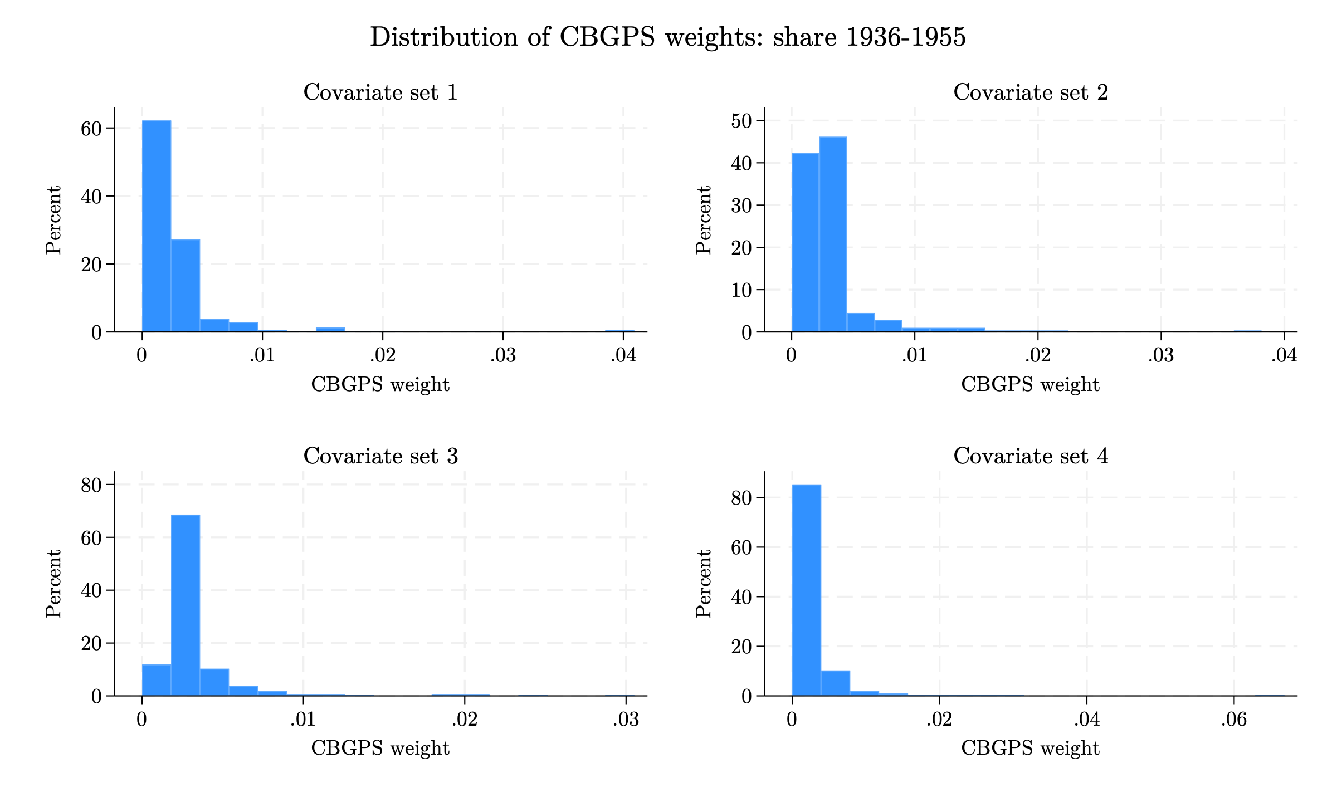
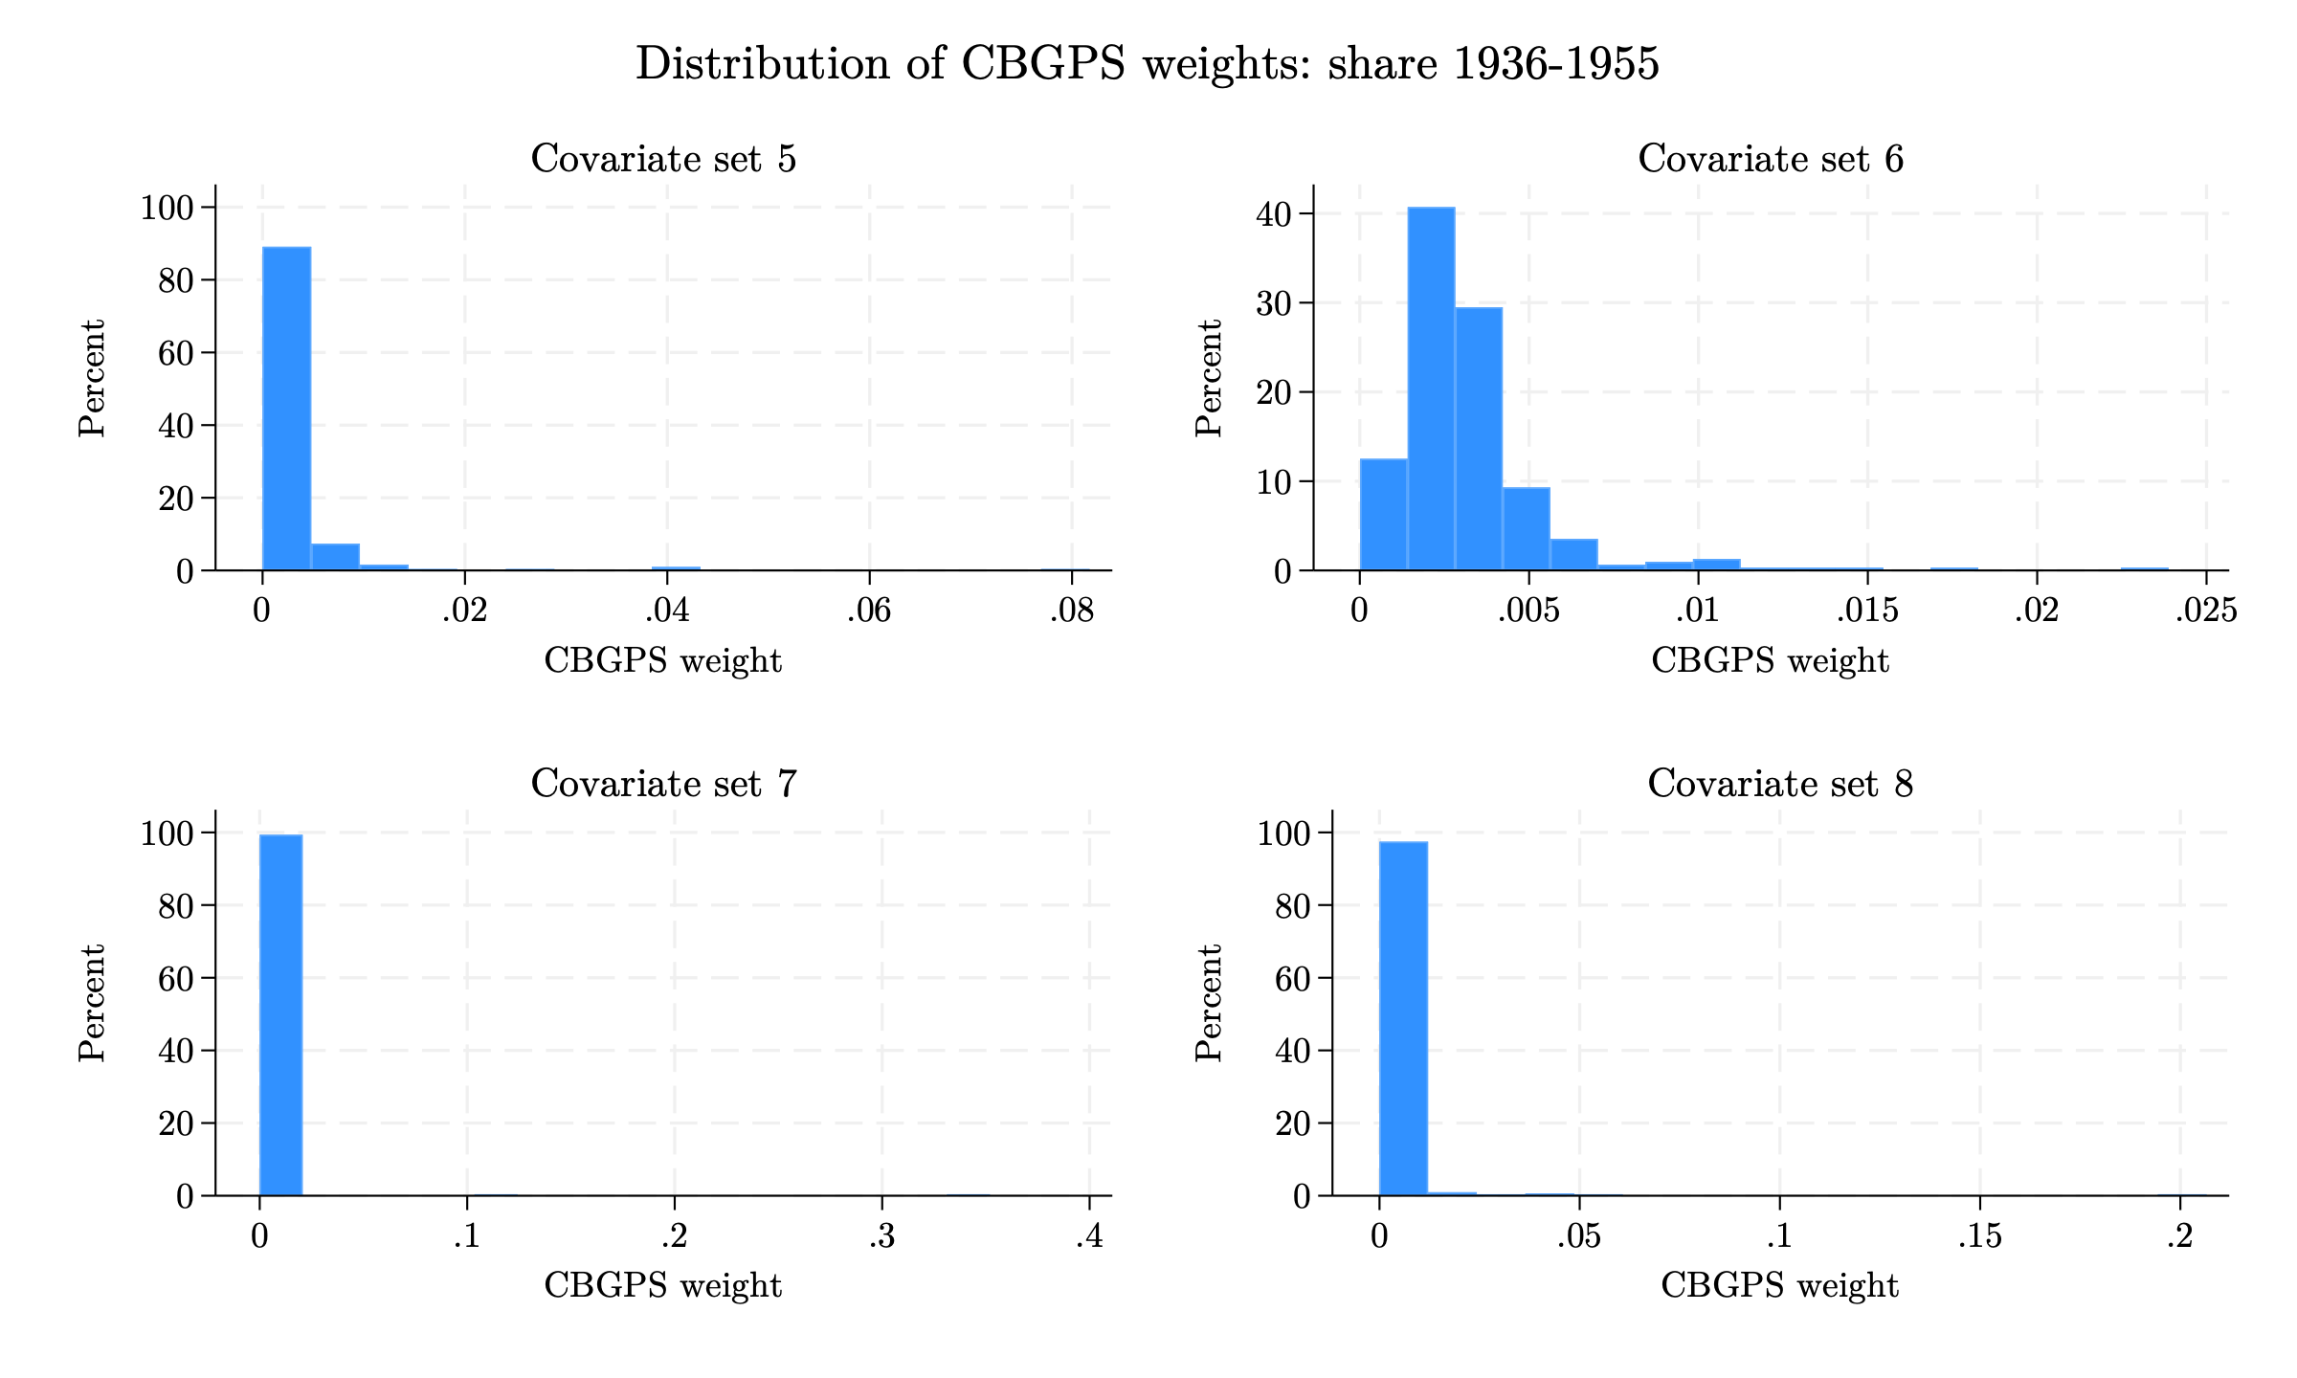
3. Pre-processed Data - CBGPS
Distribution of CBGPS weights: Spanish share 1936–1955
Histograms of CBGPS weights across the 8 covariate specifications (left: specs 1–4; right: specs 5–8).
Notes:
Histograms of the CBGPS weights for the 1936-1955 exposure window, one panel per covariate specification. As with entropy balancing, the weights average 1/312 by construction and are non-negative; a tight distribution near the mean is desirable, while a long right tail signals that a few municipalities absorb most of the weight. For this window specifications 7 and 8 show very heavy right tails — a handful of municipalities receive weights an order of magnitude above the mean — which is why their effective sample sizes collapse to roughly 7 and 19 municipalities. The remaining specifications are far better behaved.

Slide 54
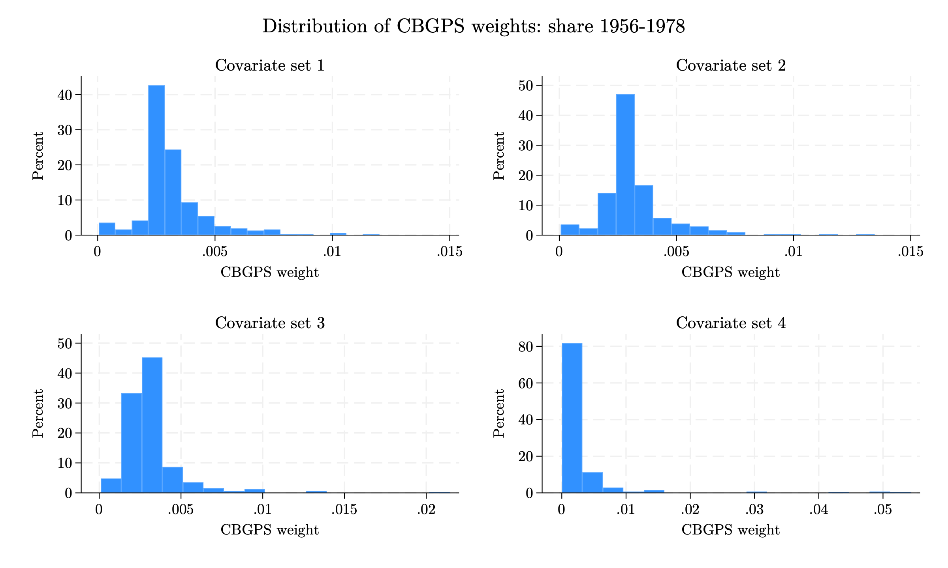
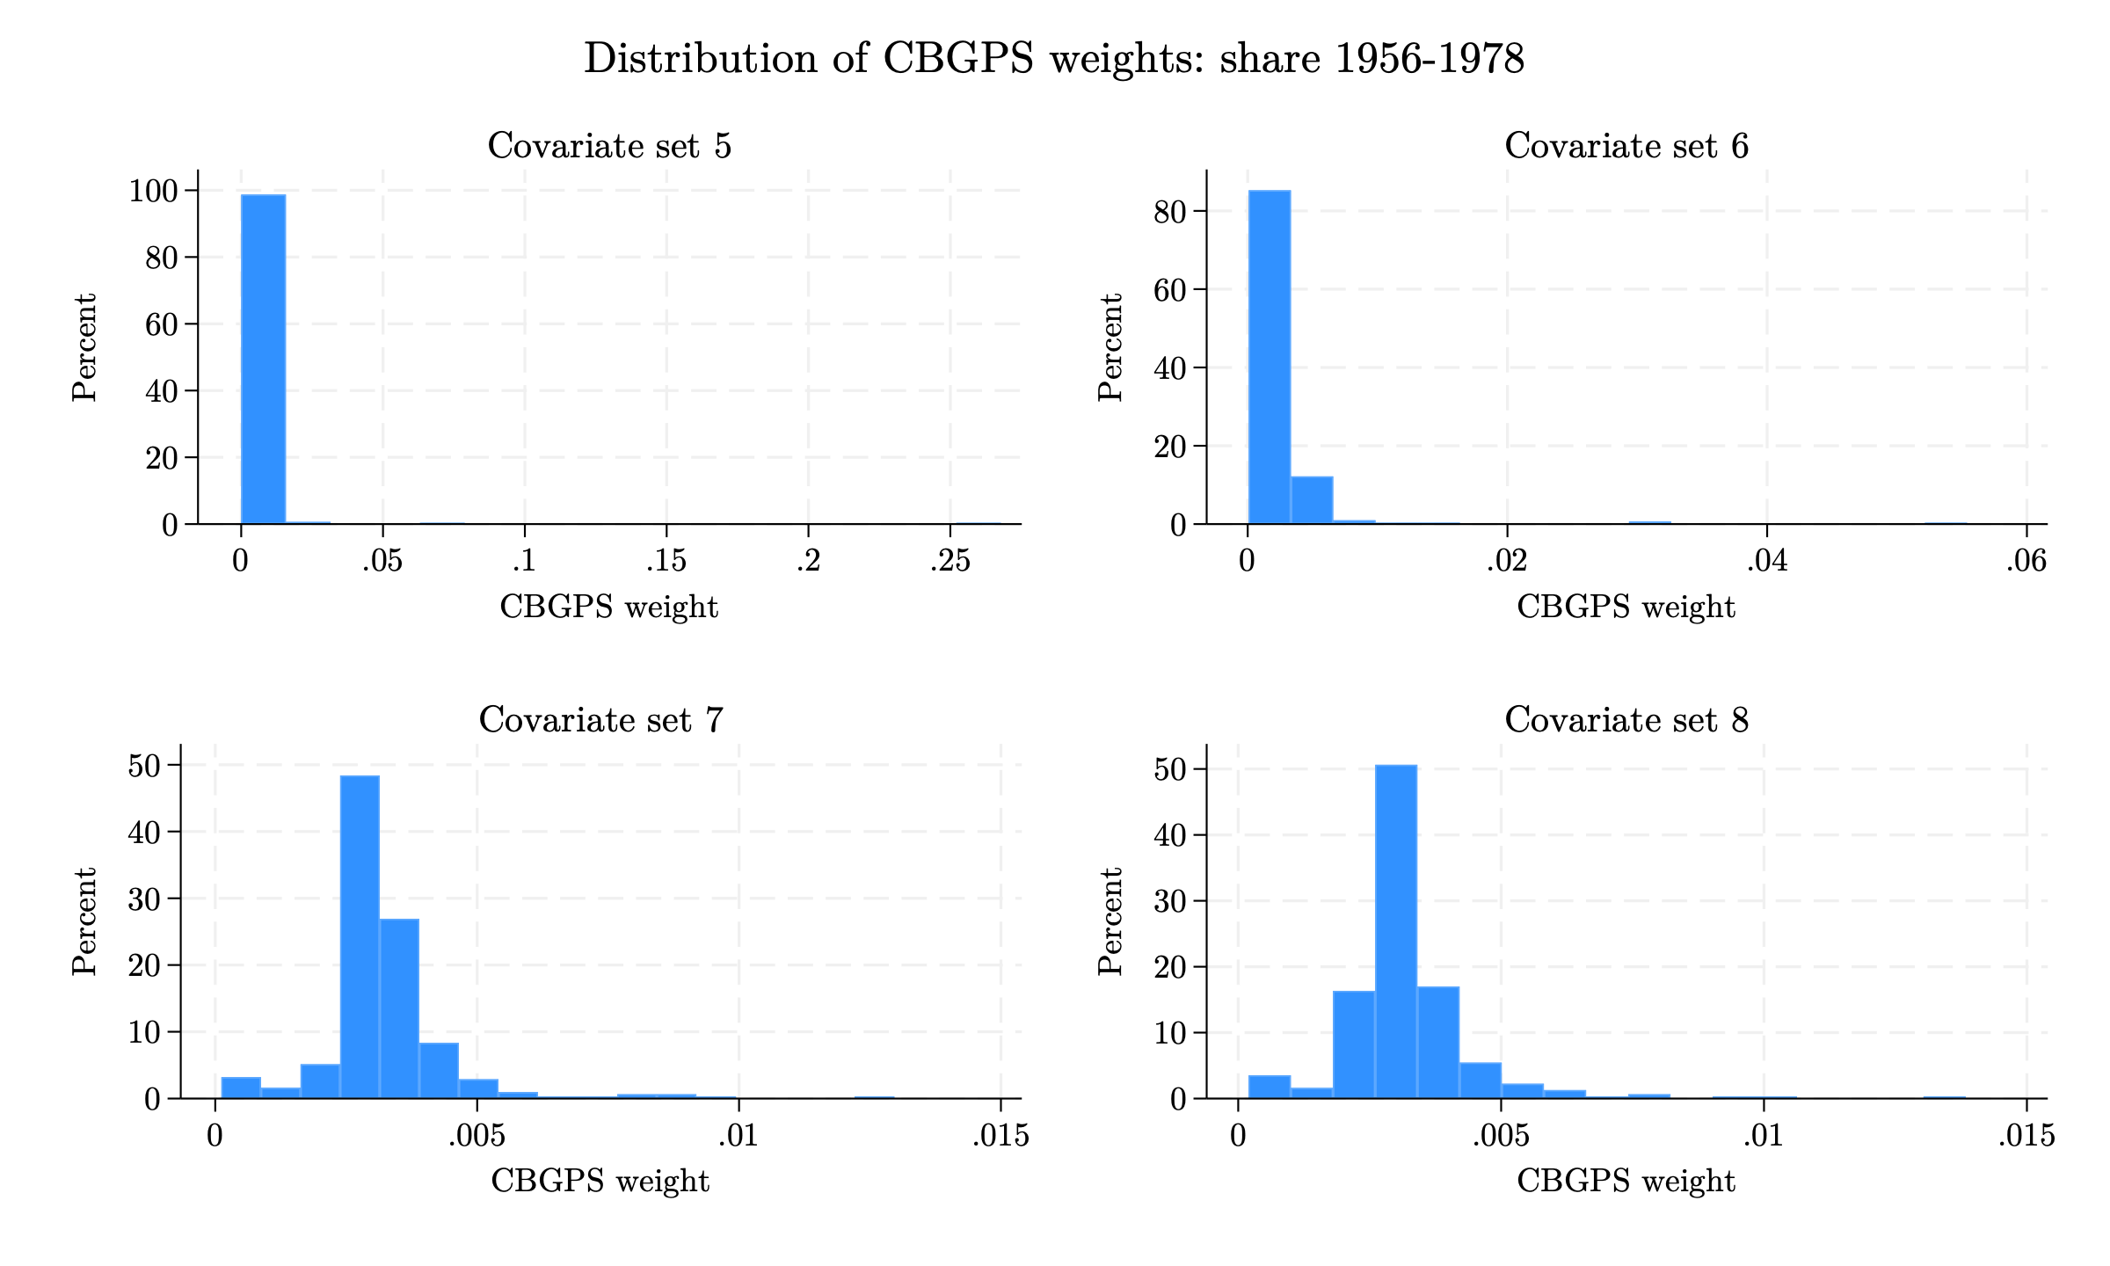
3. Pre-processed Data - CBGPS
Distribution of CBGPS weights: Spanish share 1956–1978
Histograms of CBGPS weights across the 8 covariate specifications (left: specs 1–4; right: specs 5–8).
Notes:
Histograms of the CBGPS weights for the 1956-1978 exposure window, one panel per covariate specification. The weights average 1/312 by construction. Specification 5 produces an extreme right tail — a few municipalities absorb most of the weight — consistent with its effective sample size collapsing to roughly 12 municipalities; specifications 1-3, 7 and 8 are much better behaved.

Slide 55
Appendix: Pre-processed Data - CBGPS
Summary statistics of CBGPS weights
1936–1955 exposure window
1956–1978 exposure window
Set | Mean | SD | Min | p99 | Max
1 | 0.0032 | 0.0042 | 0.0000 | 0.0198 | 0.0409
2 | 0.0032 | 0.0033 | 0.0000 | 0.0167 | 0.0381
3 | 0.0032 | 0.0032 | 0.0000 | 0.0200 | 0.0305
4 | 0.0032 | 0.0047 | 0.0000 | 0.0202 | 0.0668
5 | 0.0032 | 0.0062 | 0.0000 | 0.0389 | 0.0817
6 | 0.0032 | 0.0024 | 0.0000 | 0.0133 | 0.0239
7 | 0.0032 | 0.0208 | 0.0000 | 0.0124 | 0.3519
8 | 0.0032 | 0.0125 | 0.0000 | 0.0385 | 0.2065
Set | Mean | SD | Min | p99 | Max
1 | 0.0032 | 0.0015 | 0.0000 | 0.0090 | 0.0120
2 | 0.0032 | 0.0015 | 0.0001 | 0.0094 | 0.0135
3 | 0.0032 | 0.0019 | 0.0001 | 0.0099 | 0.0214
4 | 0.0032 | 0.0061 | 0.0000 | 0.0416 | 0.0543
5 | 0.0032 | 0.0158 | 0.0000 | 0.0182 | 0.2678
6 | 0.0032 | 0.0039 | 0.0001 | 0.0148 | 0.0554
7 | 0.0032 | 0.0013 | 0.0001 | 0.0091 | 0.0130
8 | 0.0032 | 0.0013 | 0.0002 | 0.0081 | 0.0138
Summary statistics of municipality weights for each covariate set. The mean weight equals 1/312 by construction.
Notes:
Summary statistics of the CBGPS weights for each covariate specification. The mean is fixed at 1/312. The key diagnostics are the standard deviation and the maximum. Unlike the entropy-balancing weights, whose maxima all stayed below 0.05, several CBGPS specifications produce very large weights: for the 1936-1955 window specification 7 reaches a maximum weight of about 0.35 and specification 8 about 0.21 (over 100 and 60 times the mean weight), and for the 1956-1978 window specification 5 reaches about 0.27. These extreme weights are the flip side of the low effective sample sizes: in those specifications the CBGPS estimate is driven by a handful of municipalities and should be interpreted with caution. Specifications 1-3 and 6 keep the most even weights and are the more reliable choices.

Slide 56
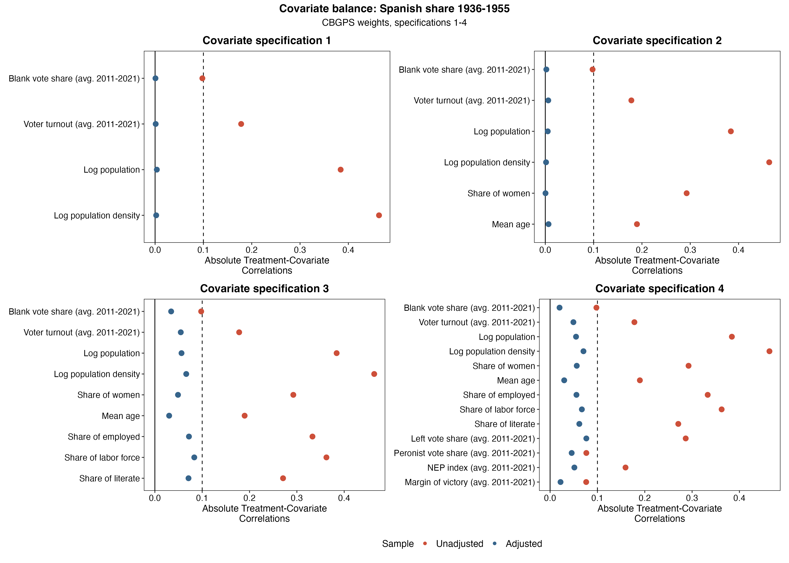
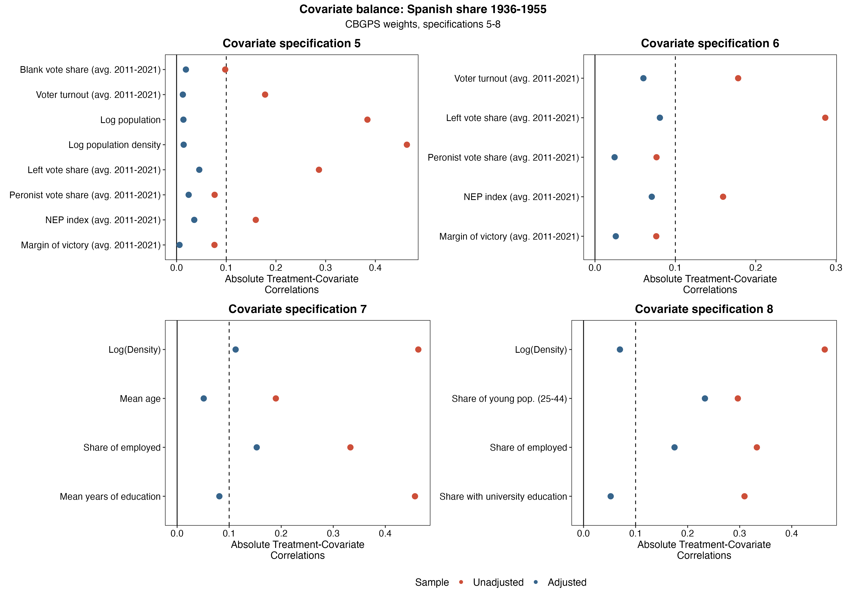
3. Pre-processed Data - CBGPS
Covariate balance under CBGPS weights: Spanish share 1936–1955
Absolute treatment–covariate correlations, unadjusted vs. CBGPS-weighted (left: covariate specifications 1–4; right: 5–8).
Notes:
Love plots compare the absolute correlation between each covariate and the Spanish-share exposure measure before weighting (unadjusted, red) and after applying the CBGPS weights (blue); points below the dashed 0.1 line indicate good balance. For the 1936–1955 window the CBGPS weights pull essentially every covariate below the 0.1 threshold across the 8 covariate specifications, confirming that the method achieves good covariate balance. The numeric values behind these plots are reported in the appendix.

Slide 57
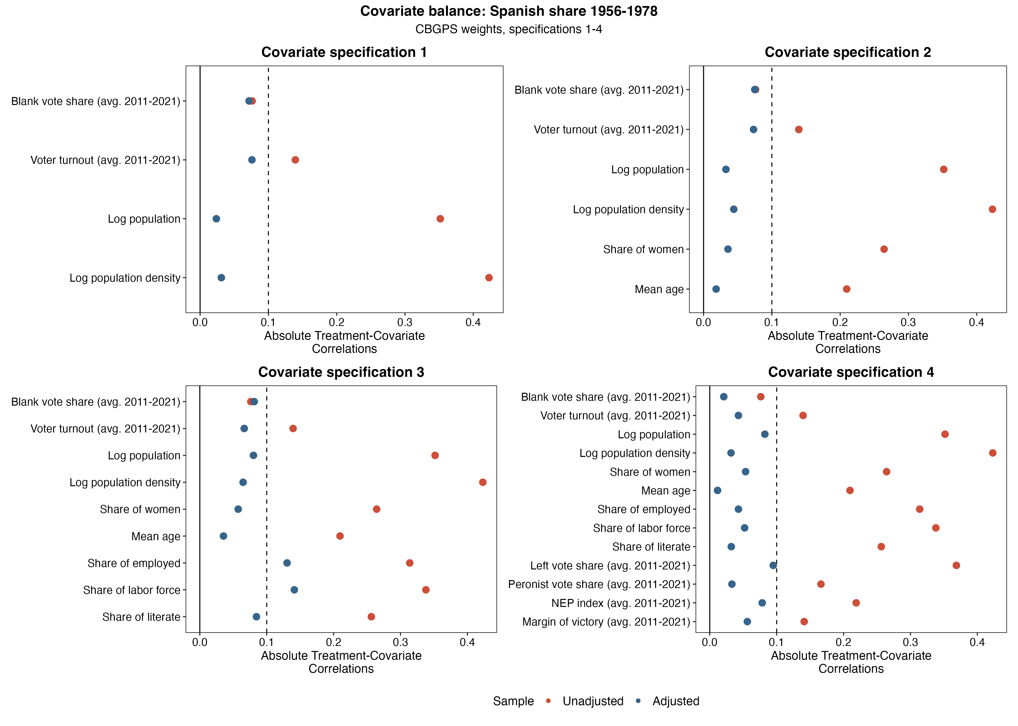
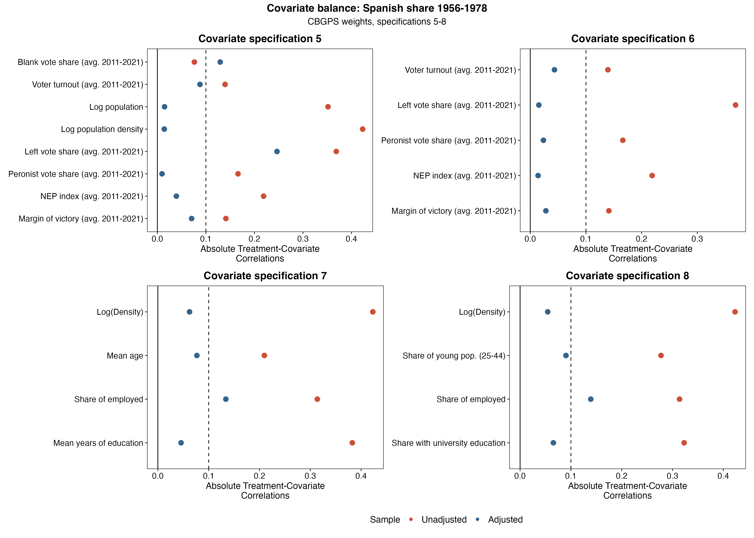
3. Pre-processed Data - CBGPS
Covariate balance under CBGPS weights: Spanish share 1956–1978
Absolute treatment–covariate correlations, unadjusted vs. CBGPS-weighted (left: covariate specifications 1–4; right: 5–8).
Notes:
Love plots compare the absolute correlation between each covariate and the Spanish-share exposure measure before weighting (unadjusted, red) and after applying the CBGPS weights (blue); points below the dashed 0.1 line indicate good balance. For the 1956–1978 window the CBGPS weights pull essentially every covariate below the 0.1 threshold across the 8 covariate specifications, confirming that the method achieves good covariate balance. The numeric values behind these plots are reported in the appendix.

Slide 58
3. Pre-processed Data - CBGPS
Effective sample size under CBGPS weights
Covariate specification | Unadjusted N (1936–1955) | Effective N (1936–1955) | Unadjusted N (1956–1978) | Effective N (1956–1978)
Specification 1 | 312 | 115.6 | 312 | 256.4
Specification 2 | 312 | 151.2 | 312 | 255.0
Specification 3 | 312 | 155.1 | 312 | 228.4
Specification 4 | 312 | 98.0 | 312 | 68.4
Specification 5 | 312 | 65.6 | 312 | 12.4
Specification 6 | 312 | 199.0 | 312 | 127.2
Specification 7 | 312 | 7.2 | 312 | 268.8
Specification 8 | 312 | 19.4 | 312 | 269.3
Effective (weighted) sample size from CBGPS, out of 312 municipalities.
Notes:
The effective sample size measures how many municipalities effectively contribute to the weighted estimate; it falls below the nominal 312 whenever the weights are uneven. It varies sharply across the 8 covariate specifications. For the 1936-1955 window, specifications 7 and 8 collapse to a very small effective sample (about 7 and 19 of 312 municipalities) and specification 5 to roughly 66; the largest effective samples come from specification 6 (~199) and specifications 2-3 (~150). For the 1956-1978 window the pattern differs: specification 5 collapses to only ~12 effective municipalities and specification 4 to ~68, while specifications 1, 7 and 8 retain large effective samples (~255-269).
The practical message is that several covariate specifications are too demanding for CBGPS in at least one window: the weighting concentrates almost all influence on a handful of municipalities, so the corresponding weighted estimates are very imprecise and should be read with caution. Specifications that keep a reasonable effective sample in both windows (1, 2, 3 and 6) are the more reliable choices.

Slide 59
3. Pre-processed Data - CBGPS
Event study of blank vote share with CBGPS weights
 | No CBGPS | CBGPS 1 | CBGPS 2 | CBGPS 3 | CBGPS 4 | CBGPS 5 | CBGPS 6 | CBGPS 7 | CBGPS 8
Year × Spanish share, 1936–1955 exposure window
2011 | 0.815 (0.691) | 0.081 (2.132) | 0.278 (2.318) | 0.342 (1.247) | -0.528 (1.272) | -0.654 (1.736) | 1.647 (1.374) | 4.541 (2.823) | 5.637*** (2.111)
2013 | -0.351 (0.471) | -1.030** (0.458) | -1.081** (0.462) | -0.888 (0.703) | -1.210 (0.766) | -1.646* (0.898) | -0.145 (0.866) | 0.128 (0.194) | 0.165 (0.368)
2015 | -0.034 (1.049) | -0.630 (2.316) | -0.919 (2.061) | 0.765 (3.050) | -0.407 (3.187) | -1.080 (2.492) | -0.163 (1.697) | 2.254 (1.870) | 4.034*** (1.372)
2017 | -0.337 (0.335) | -0.614 (0.395) | -0.510 (0.388) | -0.669* (0.396) | -0.846* (0.442) | -0.847 (0.641) | -0.940 (0.678) | 0.060 (0.552) | 0.330 (0.515)
2019 | 0.777 (0.738) | 1.433 (2.322) | 2.140 (2.793) | 0.665 (1.231) | -0.081 (1.129) | 0.111 (1.895) | 0.422 (1.211) | 6.289 (5.613) | 8.411** (4.211)
2023 | -3.218** (1.381) | -1.893 (5.528) | -0.150 (6.665) | -4.197* (2.409) | -5.003*** (1.874) | -2.355 (3.660) | -7.698*** (2.243) | 11.866 (12.982) | 10.159 (9.376)
2025 | -1.388*** (0.530) | 1.081 (1.873) | 0.962 (1.830) | -0.224 (1.172) | -0.578 (1.202) | 0.396 (1.872) | -1.712 (1.362) | 0.052 (0.552) | 0.264 (0.789)
Year × Spanish share, 1956–1978 exposure window
2011 | 4.047 (3.096) | 11.558** (5.801) | 10.784* (6.453) | 3.978 (5.055) | -0.142 (5.155) | -1.186 (6.830) | -2.448 (4.516) | 9.991 (20.793) | 17.524 (14.143)
2013 | -0.780 (1.613) | -1.809 (2.413) | -3.187 (2.447) | -2.873 (2.537) | -5.499 (3.729) | -10.313* (5.607) | -3.933** (1.524) | -2.127 (2.269) | 0.400 (2.059)
2015 | 1.019 (4.660) | 12.058 (9.113) | 7.948 (7.388) | 6.176 (10.275) | 0.589 (10.558) | -4.471 (12.249) | -6.864** (2.750) | 1.235 (13.600) | 11.153 (9.863)
2017 | -0.212 (1.065) | -0.433 (1.911) | -0.599 (1.938) | -1.454 (1.749) | -3.490 (2.723) | -6.440 (4.550) | -2.016 (1.335) | -2.678 (3.713) | 0.963 (2.714)
2019 | 2.714 (2.460) | 8.092 (6.072) | 8.231 (7.336) | 1.132 (3.498) | -1.849 (3.902) | -3.802 (6.473) | -3.590** (1.811) | 5.981 (38.409) | 18.576 (24.612)
2023 | -11.835*** (4.097) | -1.248 (12.971) | 1.828 (15.610) | -15.511*** (5.313) | -19.409*** (6.627) | -14.614 (10.212) | -16.499*** (3.966) | 2.841 (85.381) | 8.881 (46.126)
2025 | -3.412 (3.002) | -8.971 (5.997) | -10.246* (5.579) | -2.025 (5.061) | -3.193 (5.673) | -12.409* (6.875) | 0.707 (6.059) | -4.751 (4.372) | -1.465 (4.978)
R² (1936–55) | 0.449 | 0.437 | 0.437 | 0.455 | 0.454 | 0.444 | 0.453 | 0.570 | 0.537
R² (1956–78) | 0.447 | 0.439 | 0.439 | 0.457 | 0.457 | 0.446 | 0.450 | 0.551 | 0.519
Coefficients on year × Spanish share; 2021 omitted as the reference year. Each CBGPS column is a separate regression weighted to balance the corresponding window. Clustered std. errors clustered at the municipality level in parentheses. * p<0.1, ** p<0.05, *** p<0.01. N = 4,680. Weights include the other Spanish share.
Notes:
The effective sample size measures how many municipalities effectively contribute to the weighted estimate; it falls below the nominal 312 whenever the weights are uneven. It varies sharply across the 8 covariate specifications. For the 1936-1955 window, specifications 7 and 8 collapse to a very small effective sample (about 7 and 19 of 312 municipalities) and specification 5 to roughly 66; the largest effective samples come from specification 6 (~199) and specifications 2-3 (~150). For the 1956-1978 window the pattern differs: specification 5 collapses to only ~12 effective municipalities and specification 4 to ~68, while specifications 1, 7 and 8 retain large effective samples (~255-269).
The practical message is that several covariate specifications are too demanding for CBGPS in at least one window: the weighting concentrates almost all influence on a handful of municipalities, so the corresponding weighted estimates are very imprecise and should be read with caution. Specifications that keep a reasonable effective sample in both windows (1, 2, 3 and 6) are the more reliable choices.

Slide 60
3. Pre-processed Data - CBGPS
Event study of electoral participation share with CBGPS weights
 | No CBGPS | CBGPS 1 | CBGPS 2 | CBGPS 3 | CBGPS 4 | CBGPS 5 | CBGPS 6 | CBGPS 7 | CBGPS 8
Year × Spanish share, 1936–1955 exposure window
2011 | 1.416** (0.576) | 3.898*** (0.926) | 3.604*** (1.143) | 1.861* (1.003) | 1.762* (1.059) | 3.928*** (1.186) | 1.775* (1.026) | 8.148*** (1.750) | 4.979*** (1.839)
2013 | 0.713 (0.445) | 2.102** (0.931) | 2.071** (0.986) | 1.156 (0.777) | 1.376* (0.765) | 3.101** (1.427) | 1.145 (0.877) | 4.174** (1.937) | 2.910* (1.628)
2015 | -0.272 (0.468) | 1.569** (0.630) | 1.549** (0.756) | 0.761 (0.552) | 0.674 (0.558) | 1.514* (0.786) | -0.176 (0.789) | 4.310*** (0.668) | 2.391** (1.158)
2017 | -0.624 (0.382) | 2.217 (1.592) | 2.124 (1.607) | 0.579 (0.630) | 0.591 (0.603) | 2.556* (1.382) | -0.270 (0.624) | 1.763 (1.077) | 0.901 (0.956)
2019 | 0.561* (0.318) | 1.107** (0.475) | 0.861* (0.480) | 1.153** (0.506) | 1.102** (0.544) | 2.040** (0.805) | 1.151* (0.691) | 3.050*** (0.665) | 1.765** (0.720)
2023 | 0.250 (0.292) | 0.424 (0.794) | 0.632 (0.908) | 0.371 (0.478) | 0.165 (0.479) | 0.229 (0.730) | 0.433 (0.658) | 3.553*** (0.847) | 2.572*** (0.929)
2025 | 0.330 (0.344) | 1.459 (1.399) | 1.609 (1.308) | 0.541 (0.739) | 0.399 (0.640) | 1.984* (1.198) | 1.019 (0.785) | 1.501*** (0.180) | 2.129*** (0.401)
Year × Spanish share, 1956–1978 exposure window
2011 | 5.170** (2.070) | 10.340** (4.541) | 8.474* (4.676) | 5.357* (2.947) | 3.211 (3.658) | 2.777 (5.398) | 5.493*** (1.903) | 41.849** (16.194) | 23.012** (10.597)
2013 | 1.330 (1.741) | 2.749 (3.483) | 1.956 (3.287) | 1.401 (2.256) | 0.474 (2.751) | 1.138 (5.997) | 3.642*** (1.294) | 24.749** (11.844) | 14.365* (8.422)
2015 | -1.438 (1.643) | 3.746 (2.717) | 3.589 (2.972) | 1.424 (1.834) | 0.544 (1.972) | 0.876 (3.066) | 1.254 (1.695) | 18.883** (8.993) | 9.181 (6.325)
2017 | -3.714** (1.882) | -6.092 (3.973) | -5.778 (4.020) | -2.892 (2.819) | -2.772 (2.870) | -3.697 (3.391) | 1.556 (2.105) | 10.218 (6.773) | 4.636 (4.847)
2019 | 0.449 (1.362) | 3.857 (2.562) | 1.897 (2.399) | 1.545 (2.376) | 0.813 (2.466) | 2.858 (3.527) | -1.039 (1.950) | 14.580** (6.513) | 6.828 (4.687)
2023 | 1.898* (1.121) | 4.212* (2.496) | 4.150 (2.743) | 1.933 (1.587) | 0.483 (1.705) | 0.346 (3.018) | 0.909 (1.350) | 13.437 (8.931) | 9.303** (4.695)
2025 | 2.131 (1.567) | -2.149 (3.235) | -2.598 (3.329) | 1.821 (2.308) | 0.605 (2.842) | -0.729 (3.904) | 4.197* (2.401) | 6.887*** (2.238) | 8.820*** (2.283)
R² (1936–55) | 0.743 | 0.761 | 0.757 | 0.757 | 0.756 | 0.757 | 0.747 | 0.783 | 0.768
R² (1956–78) | 0.743 | 0.760 | 0.756 | 0.757 | 0.756 | 0.753 | 0.747 | 0.777 | 0.767
Coefficients on year × Spanish share; 2021 omitted as the reference year. Each EB column is a separate regression weighted to balance the corresponding window. Clustered std. errors clustered at the municipality level in parentheses. * p<0.1, ** p<0.05, *** p<0.01. N = 4,680. Weights include the other Spanish share.​
Notes:
The effective sample size measures how many municipalities effectively contribute to the weighted estimate; it falls below the nominal 312 whenever the weights are uneven. It varies sharply across the 8 covariate specifications. For the 1936-1955 window, specifications 7 and 8 collapse to a very small effective sample (about 7 and 19 of 312 municipalities) and specification 5 to roughly 66; the largest effective samples come from specification 6 (~199) and specifications 2-3 (~150). For the 1956-1978 window the pattern differs: specification 5 collapses to only ~12 effective municipalities and specification 4 to ~68, while specifications 1, 7 and 8 retain large effective samples (~255-269).
The practical message is that several covariate specifications are too demanding for CBGPS in at least one window: the weighting concentrates almost all influence on a handful of municipalities, so the corresponding weighted estimates are very imprecise and should be read with caution. Specifications that keep a reasonable effective sample in both windows (1, 2, 3 and 6) are the more reliable choices.

Slide 61
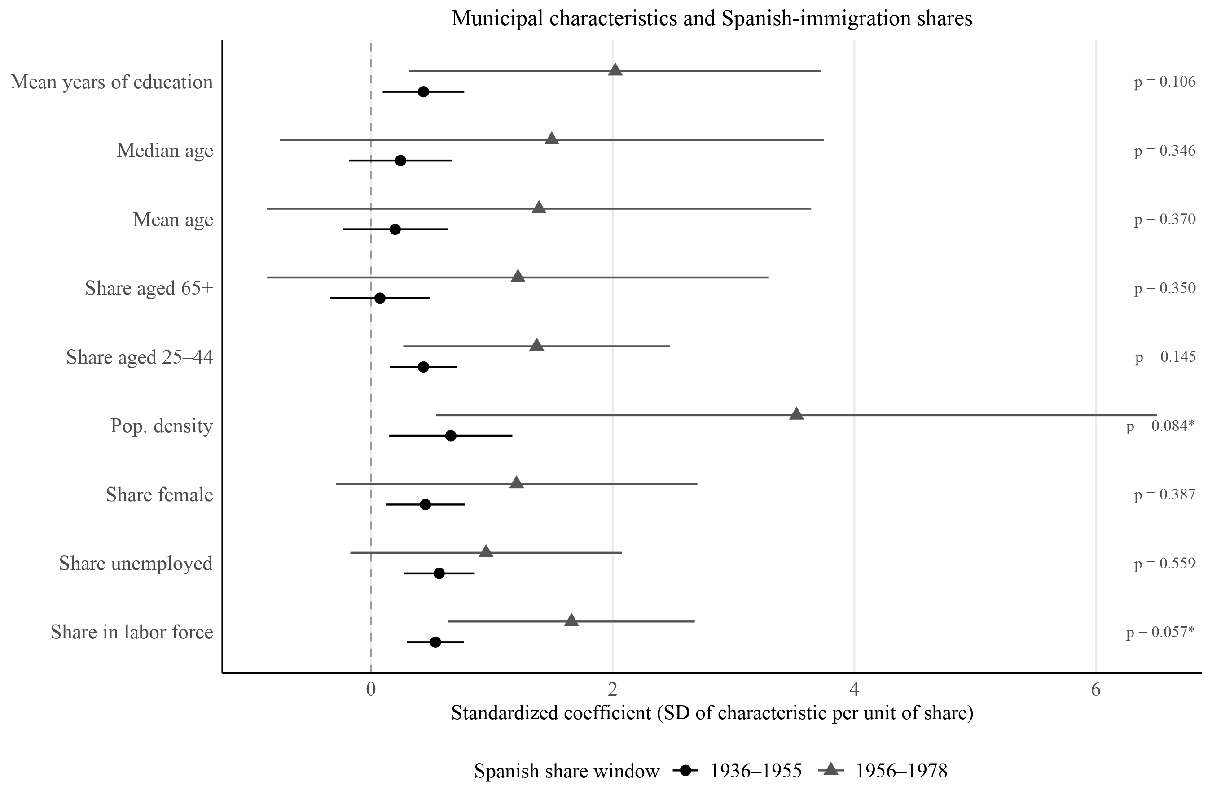
Differential characteristics of exposed municipalities
Note: Estimated coefficients come from separate regressions of each municipal characteristic listed on the y-axis on the share of Spanish immigrants or descendants in each window. The p-values reported on the right correspond to Wald tests of equality between the coefficients for the two Spanish-share windows.
Notes:
The turnout results suggest opposite patterns for municipalities more exposed in the first and second Spanish-share windows, although the negative coefficient for the first window is not always statistically significant. For this reason, we test whether municipalities with higher exposure in the first window differ systematically from those with higher exposure in the second window. We find that they differ in population density and labor force participation, both of which are higher among municipalities more exposed in the second window. These differences could help explain why turnout increases in municipalities more exposed in the second window: in larger and more economically active cities, the law may have generated greater political discussion. However, this interpretation may also be intertwined with the institutional design of the process. In the second window, applicants must prove exile, making the process more explicitly political, whereas in the first window the process is more utilitarian and bureaucratic.

