Slide 1
External Citizenship and Political Response in Argentina:
Evidence from Spain’s Ancestry-Based Citizenship Reform
20/03/2026

Slide 2
Research Question
Does exogenous access to EU citizenship through an ancestry-based reforms alter political behavior?
Argentina offers a more precise exposure measurement. Historical censuses record the exact year of arrival to the country, allowing for a cleaner classification of exile cohorts.
Argentina received a substantially higher number of Spanish immigrants, generating greater cross-municipality variation in historical exposure.
However, unlike Mexico, Argentina lacks municipal-level data on remittances or other migration-related flows.
While economic migration outcomes are harder to measure, electoral and political behavior data are typically available at fine geographic levels and offer a feasible alternative outcome dimension.

Slide 3
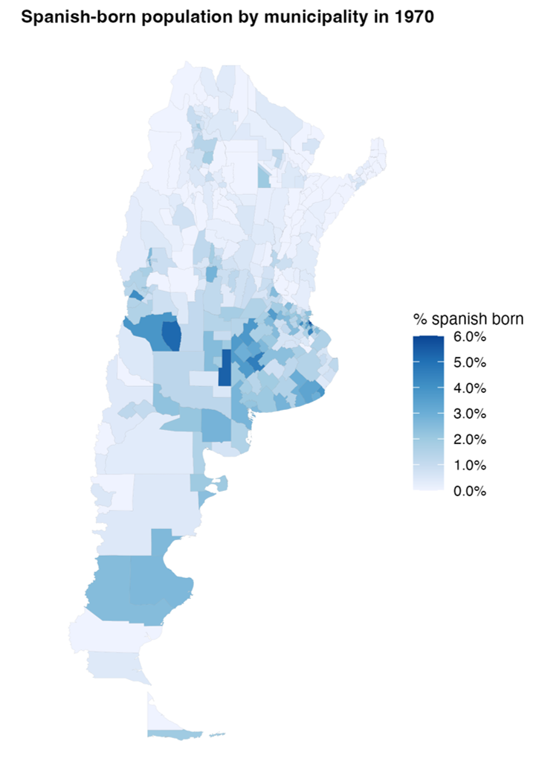
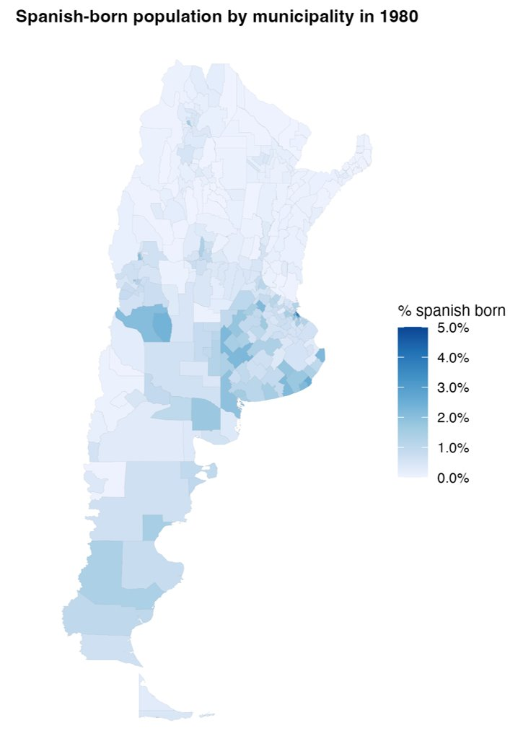
Distribution of Spanish-Born Population
Share of Spanish-born population 1970
Share of Spanish-born population 1980

Slide 4
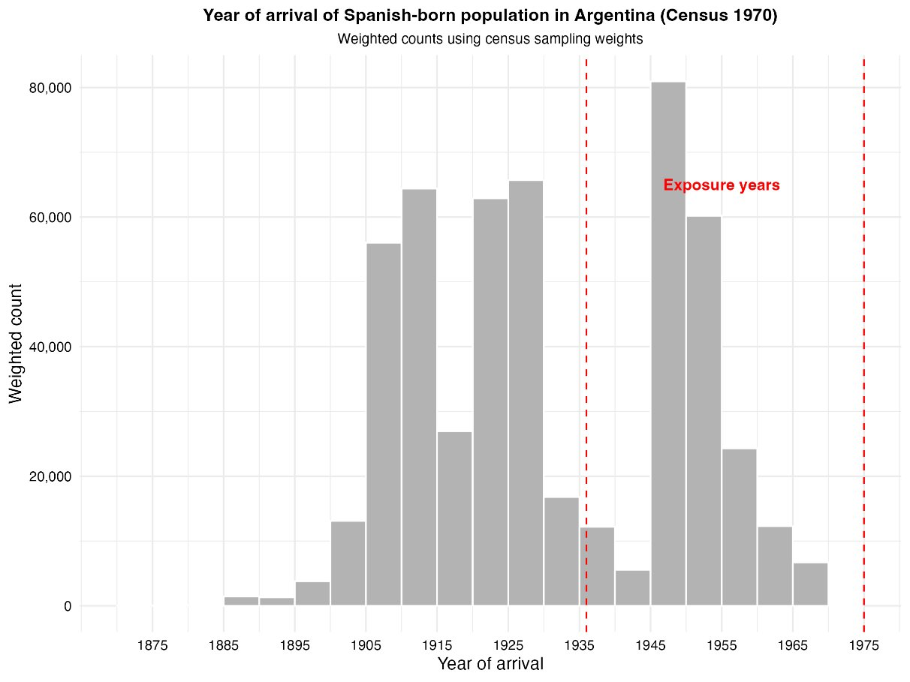
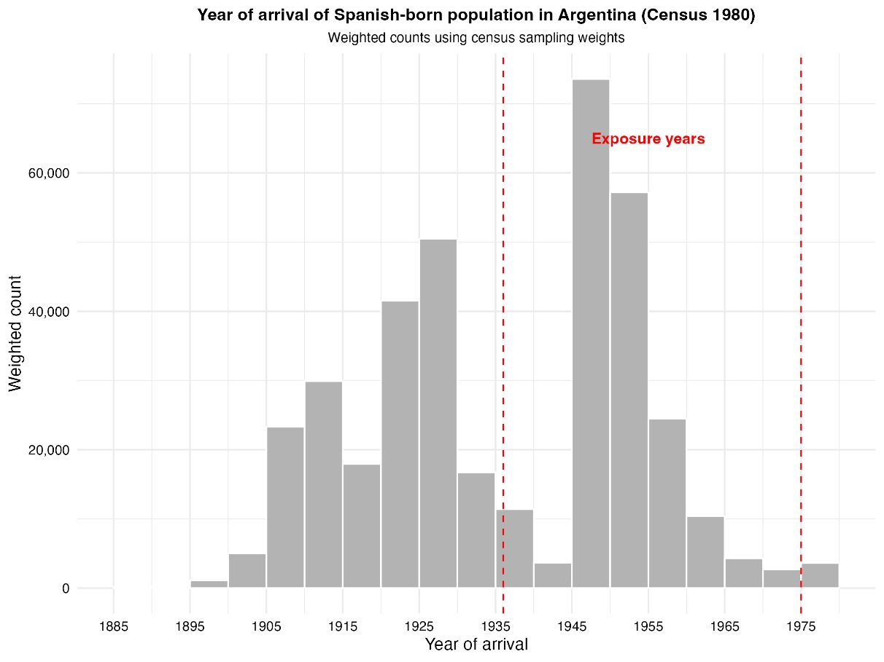
Year of Arrival of Spanish-Born Population

Slide 5
Motivation
A growing literature shows that international migration affects political behavior in origin countries through both financial and social remittances (cross-border social ties).
Transnational networks and communication with migrants abroad increase political interest, civic engagement, and support for redistribution in Latin America (Córdova & Hiskey 2015; Duquette-Rury, 2018; Meseguer et al. 2016).
However, financial remittances may reduce voter turnout by lowering dependence on the state and weakening incentives for electoral participation (López García 2018).
Migration has also been shown to alter local electoral outcomes, weakening traditional political machines and increasing opposition victories in Mexico (Pfutze 2012).
Most existing evidence comes from Mexico and other Latin American countries; there is very limited causal evidence for Argentina, and virtually none linking migration shocks to political outcomes.

Slide 6
Data
Argentine Population Census (IPUMS 1970, 1980). The census provides information on place of birth, previous place of residence, years residing in the current locality and, importantly, the year of arrival to the country.
Electoral public data from the National Electoral Commission (Comisión Nacional Electoral). These data provide detailed electoral results for all national elections since 2011, including votes received by each political party, voter turnout, and blank votes, among other indicators. We focus on national legislative elections for the Chamber of Deputies, as they offer the largest number of electoral observations over the period 2011–2025. We rely on national elections because the database does not consistently include provincial or local elections, particularly in years when those contests are held separately from the national electoral calendar.

Slide 7
Empirical Strategy
Timing-Based Exposure Measure
We exploit a question in the historical Argentine censuses that records the exact year immigrants arrived in the country.
This allows us to identify Spanish-born individuals who settled during specific periods (1936–1955 vs. 1956–1978) and to construct the share of the population that arrived in each time window ( R1936–1955 and R1956–1978, respectively).
The 1970 census is used to measure Spanish immigrants who arrived between 1936–1955, while the 1980 census is used to capture those who arrived between 1956–1978.
We compare outcomes across municipalities with greater exposure to refugees arriving in 1936–1955 relative to those with greater exposure to arrivals in 1956–1978.

Slide 8
Empirical Strategy
Timing-Based Exposure Measure
Formally, we estimate the following equation (1):
The main outcome is the share of blank votes, defined as the percentage of votes cast in blank over the total number of voters. As an additional outcome, we also explore voter turnout.
Blank voting as protest behavior: blank votes often reflect dissatisfaction with available political options rather than abstention.
ElectionType is an indicator for whether the election corresponds to a General election or a PASO (primary) election.
Since PASO (primary) elections were not held in 2025, we also estimate model (2) restricting the sample to general elections only.

Slide 9
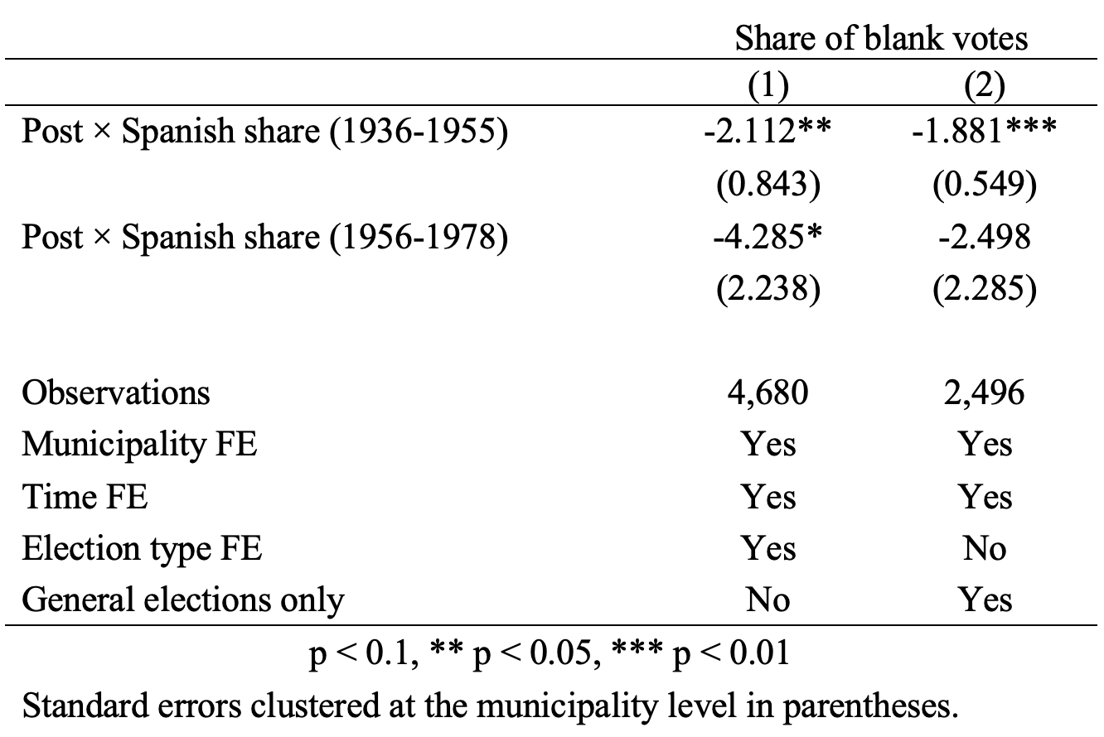
Preliminary Results

Slide 10
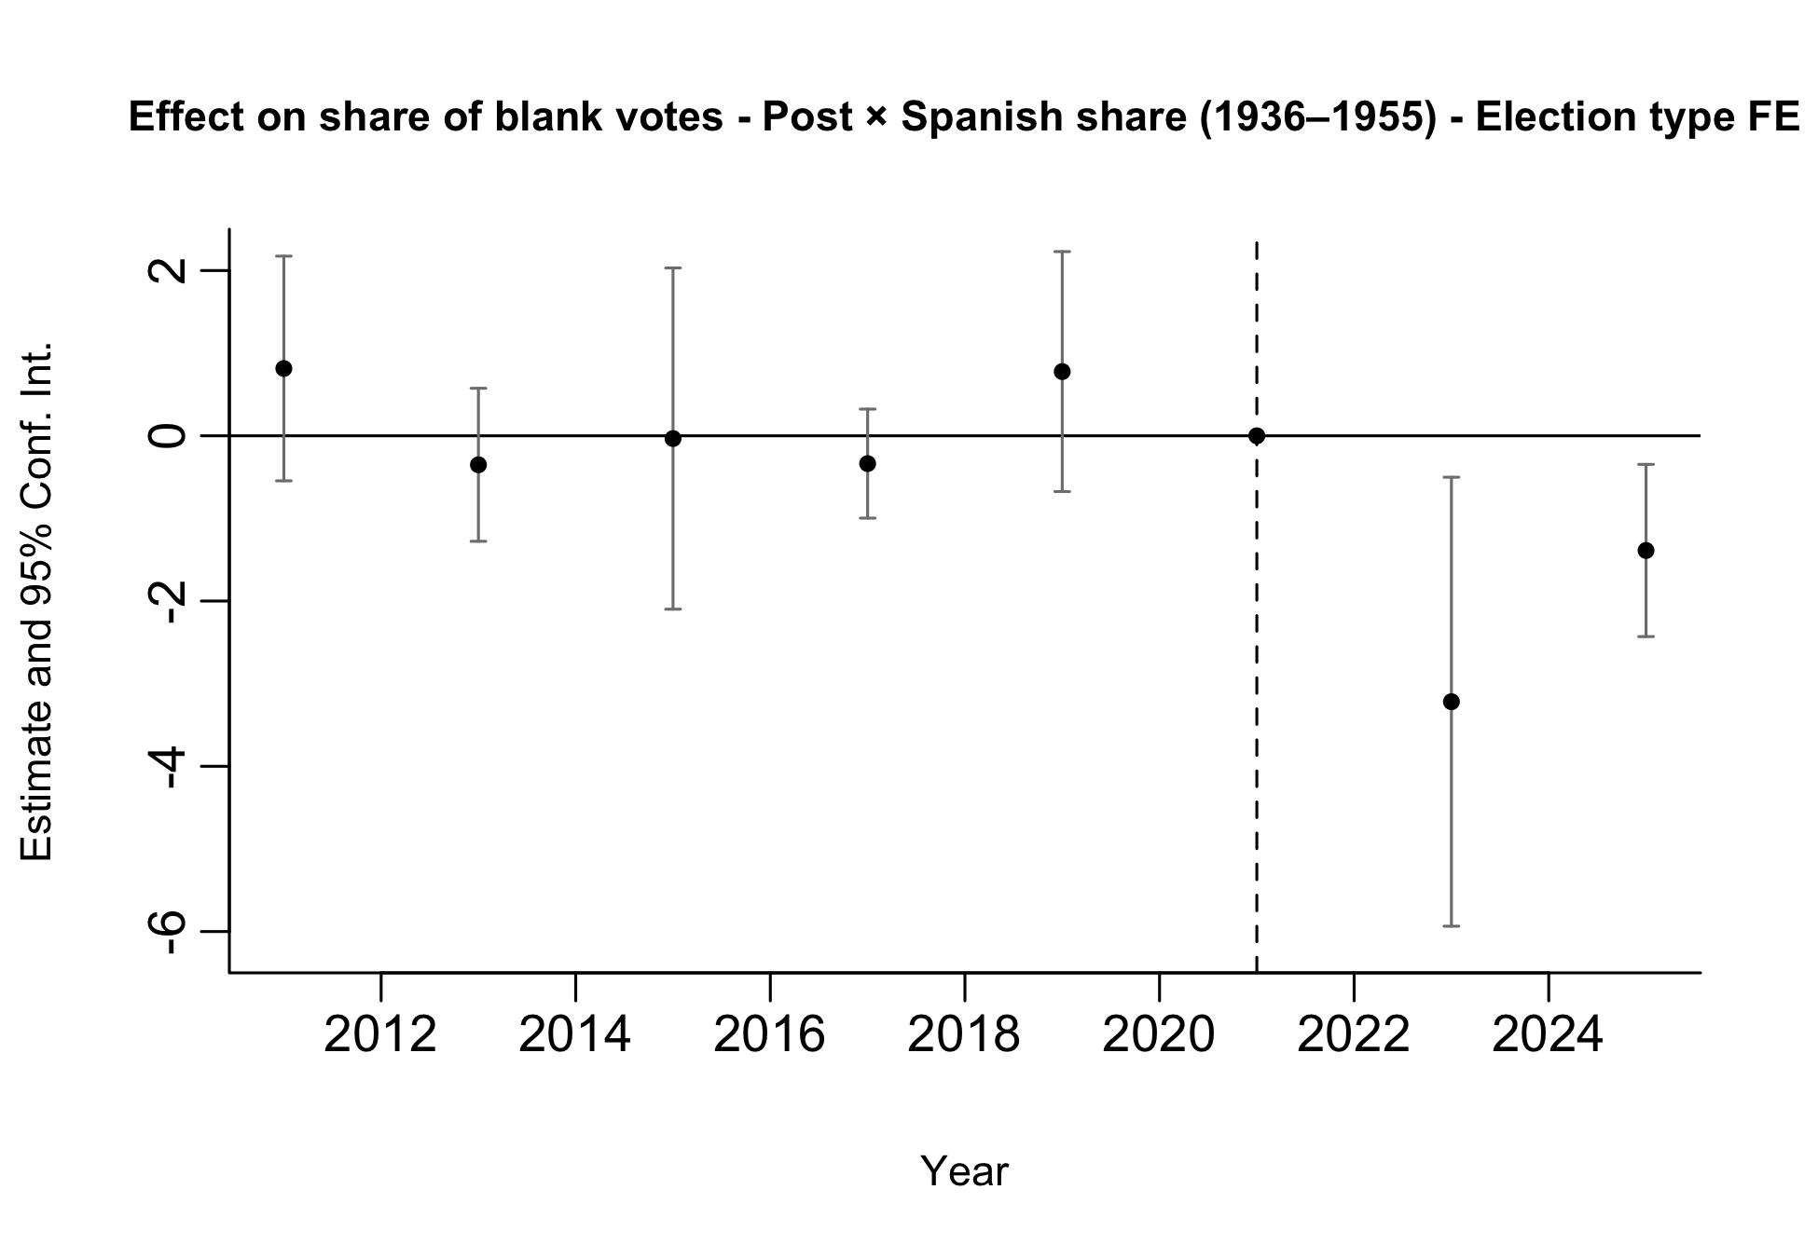
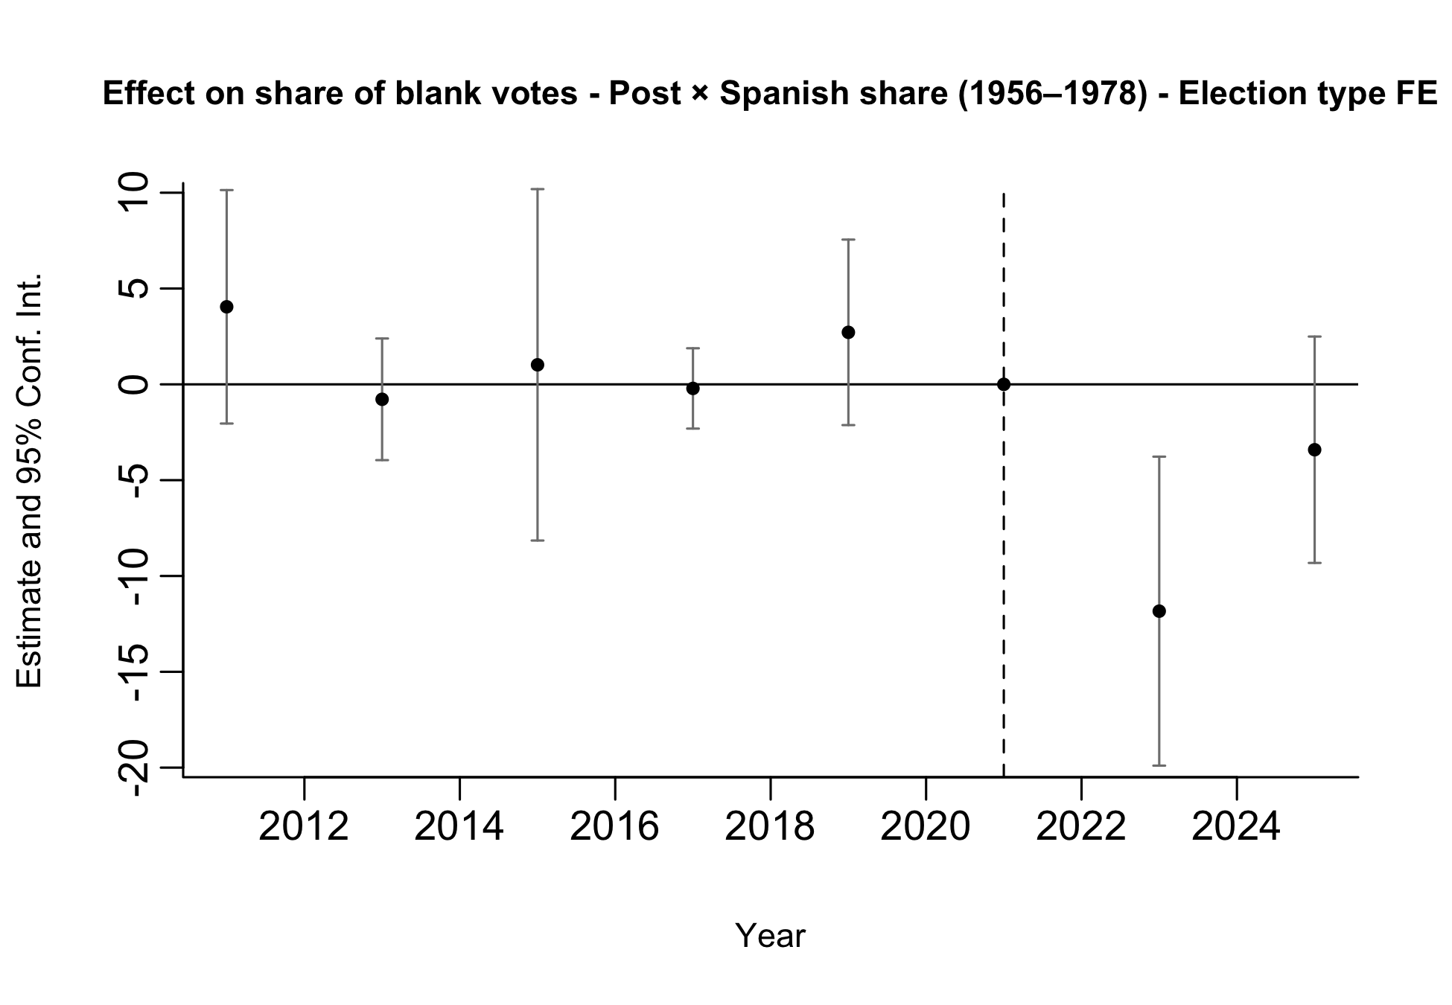
Preliminary Results: Pre-trends
Pre-trends look parallel, although estimates are noisy.
Notes:
We run two separate event-study specifications. In one regression (left), treatment is given by the interaction between post and the municipal Spanish share for arrivals in 1936–1955; in the other (right), treatment is given by the interaction between post and the municipal Spanish share for arrivals in 1956–1978.
This allows us to assess pre-trends in terms of total exposure rather than conditional effects. When both exposure measures are included jointly, coefficients reflect the effect of one exposure holding the other constant, which is less informative for pre-trend analysis.
Therefore, the event-study plots should be used primarily as a diagnostic tool for pre-trends rather than as our main treatment-effect estimates.
Both specifications are estimated on the full sample of elections (PASO and general), including election-type fixed effects.

Slide 11
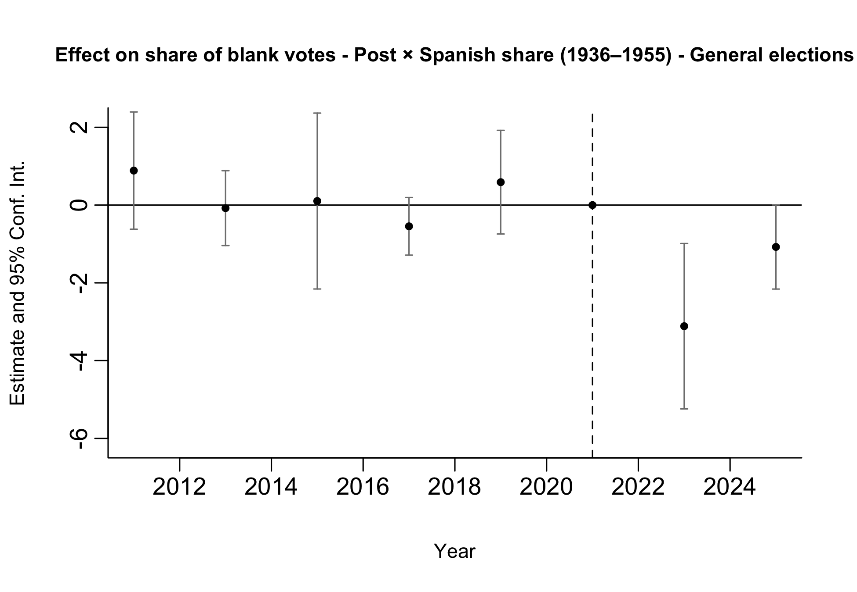
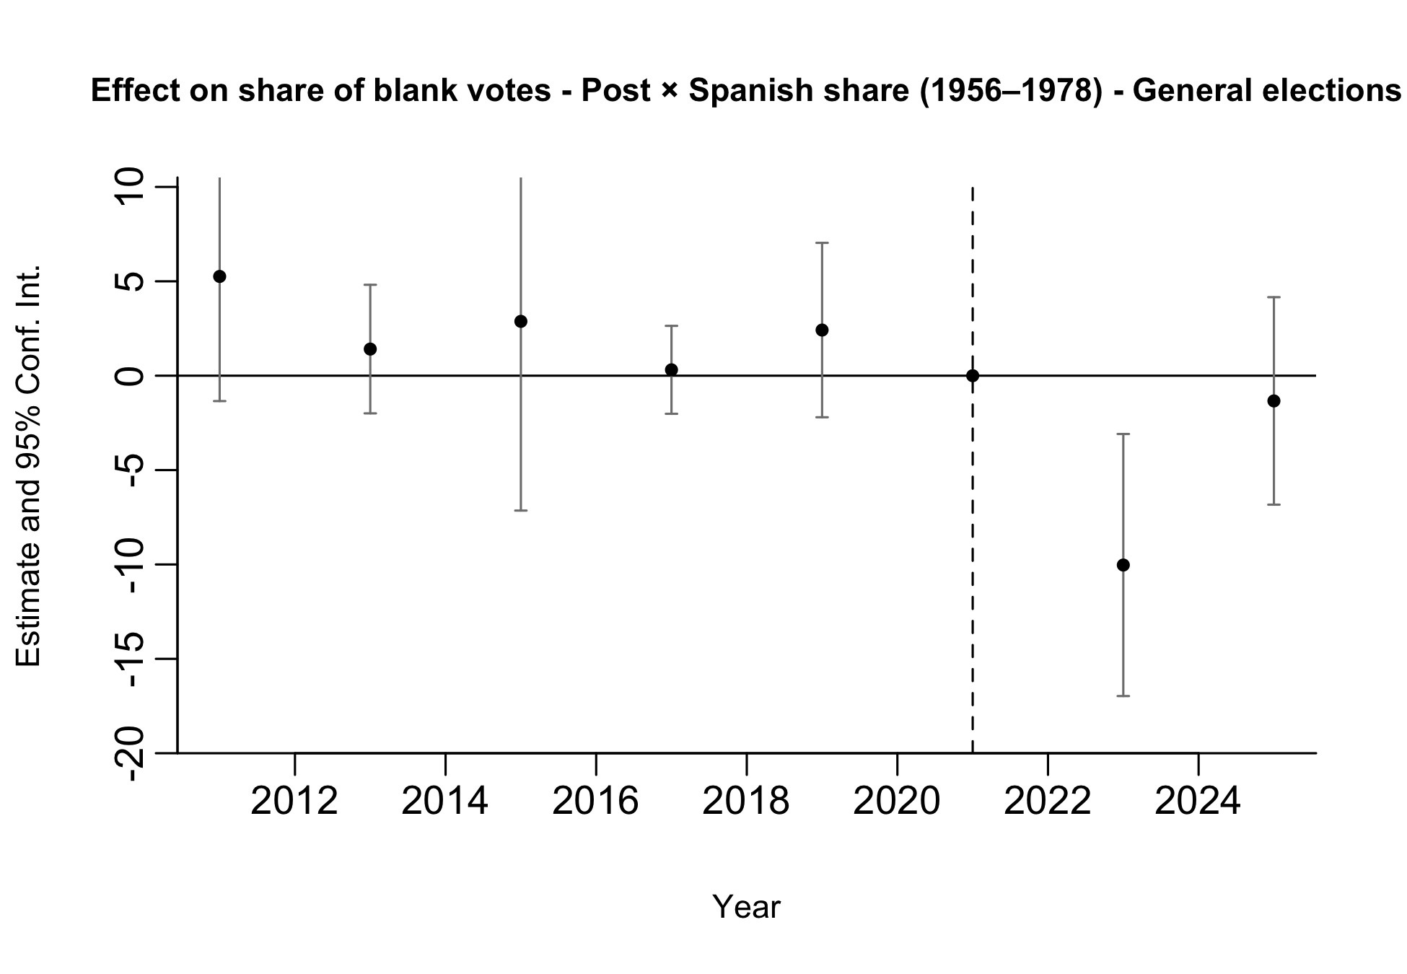
Preliminary Results: Pre-trends
Pre-trends look parallel, although estimates are noisy.
Notes:
We run two separate event-study specifications. In one regression (left), treatment is given by the interaction between post and the municipal Spanish share for arrivals in 1936–1955; in the other (right), treatment is given by the interaction between post and the municipal Spanish share for arrivals in 1956–1978.
This allows us to assess pre-trends in terms of total exposure rather than conditional effects. When both exposure measures are included jointly, coefficients reflect the effect of one exposure holding the other constant, which is less informative for pre-trend analysis.
Therefore, the event-study plots should be used primarily as a diagnostic tool for pre-trends rather than as our main treatment-effect estimates.
Both specifications are estimated on the restricted sample of General elections.

Slide 12
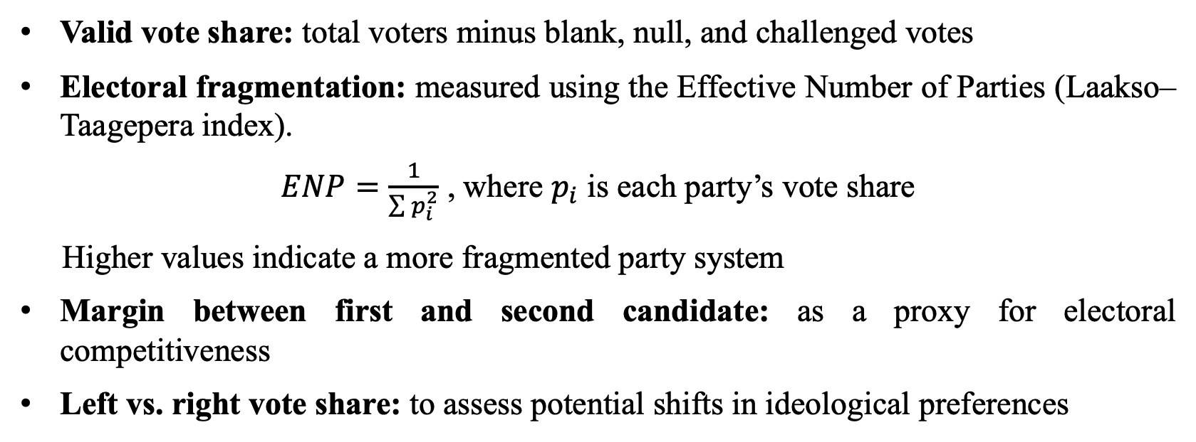
Additional Outcomes to Explore
Valid vote share: total voters minus blank, null, and challenged votes
Electoral fragmentation: measured using the Effective Number of Parties (Laakso–Taagepera index).
$ENP=\frac{1}{\sum{p_{i}^{2}}}$ , where $p_{i}$ is each party’s vote share
Higher values indicate a more fragmented party system
Margin between first and second candidate: as a proxy for electoral competitiveness
Left vs. right vote share: to assess potential shifts in ideological preferences

Slide 13
APPENDIX II

Slide 14
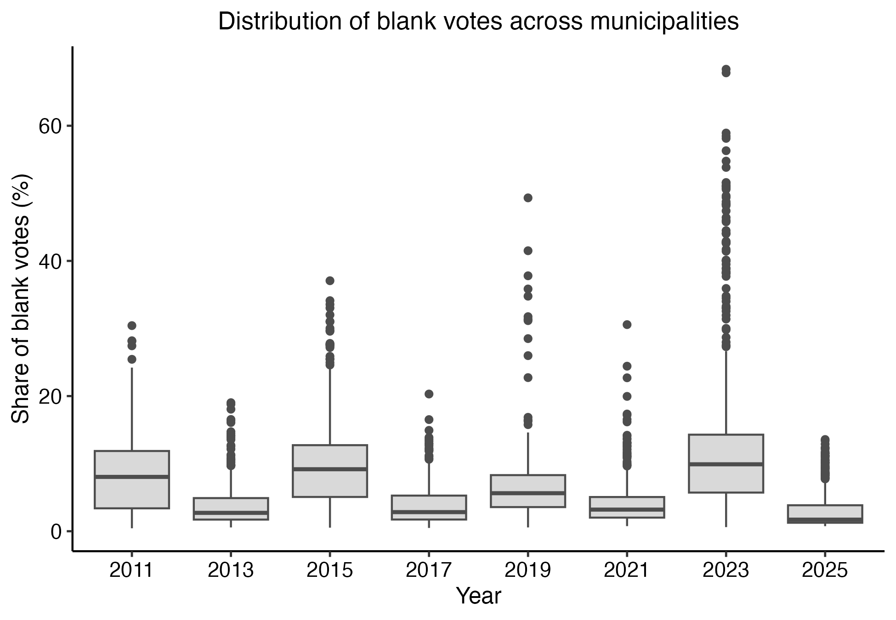
Distribution of Blank Votes
High dispersion in blank vote shares may contribute to noisier estimates in some years.

Slide 15
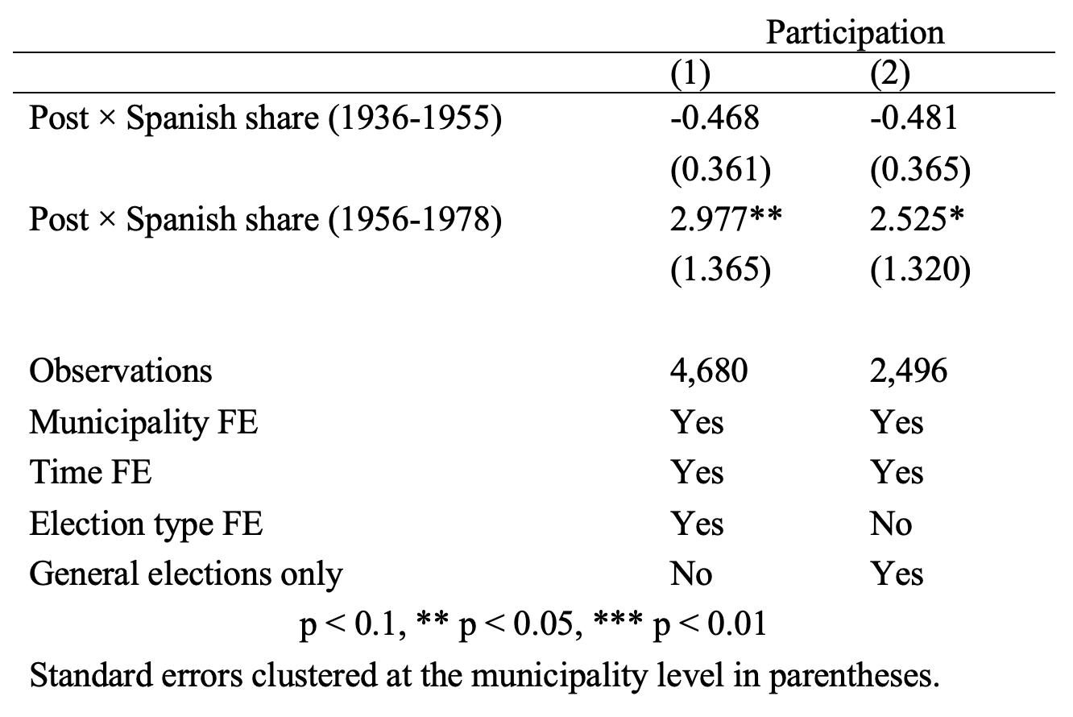
Preliminary Results: Participation
Less clear effects are found on electoral participation (as expected, since voting is mandatory and participation is relatively high in Argentina).
No significant effects are found for the 1936–1955 cohort, while some effects appear for the 1956–1978 cohort in the expected direction.
However, pre-trends are not flat, which cautions against a causal interpretation.

Slide 16
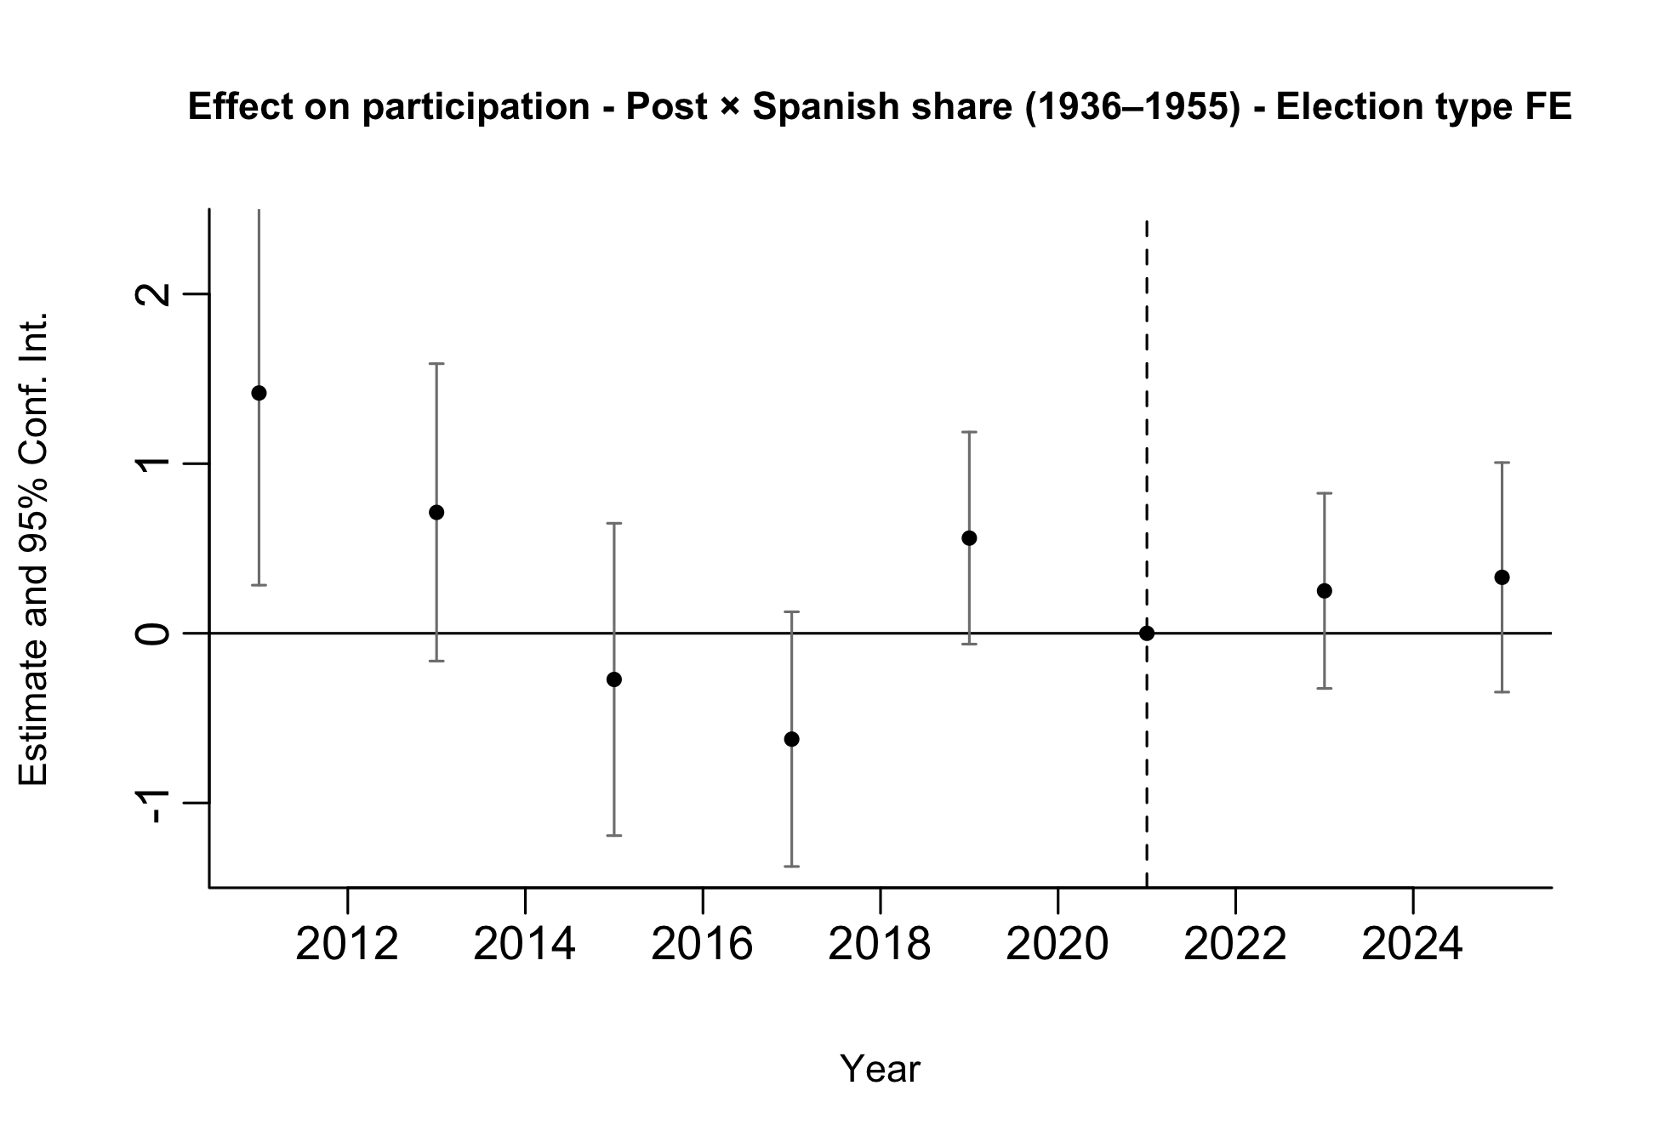
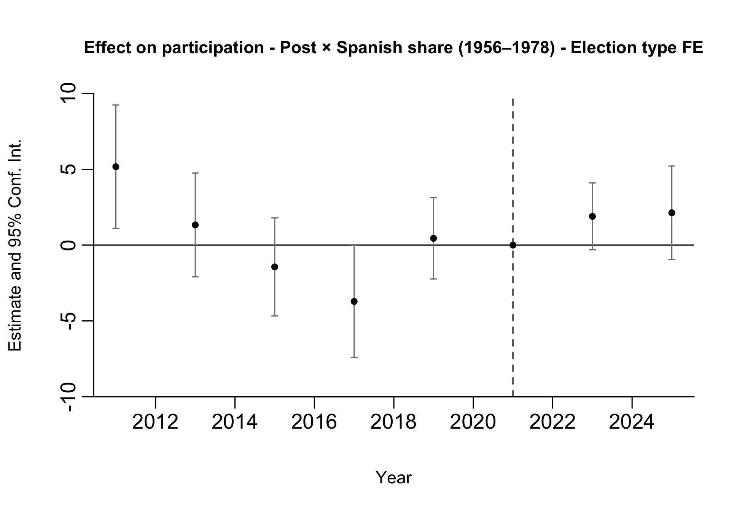
Preliminary Results: Participation
Notes:
We run two separate event-study specifications. In one regression (left), treatment is given by the interaction between post and the municipal Spanish share for arrivals in 1936–1955; in the other (right), treatment is given by the interaction between post and the municipal Spanish share for arrivals in 1956–1978.
This allows us to assess pre-trends in terms of total exposure rather than conditional effects. When both exposure measures are included jointly, coefficients reflect the effect of one exposure holding the other constant, which is less informative for pre-trend analysis.
Therefore, the event-study plots should be used primarily as a diagnostic tool for pre-trends rather than as our main treatment-effect estimates.
Both specifications are estimated on the full sample of elections (PASO and general), including election-type fixed effects.

Slide 17
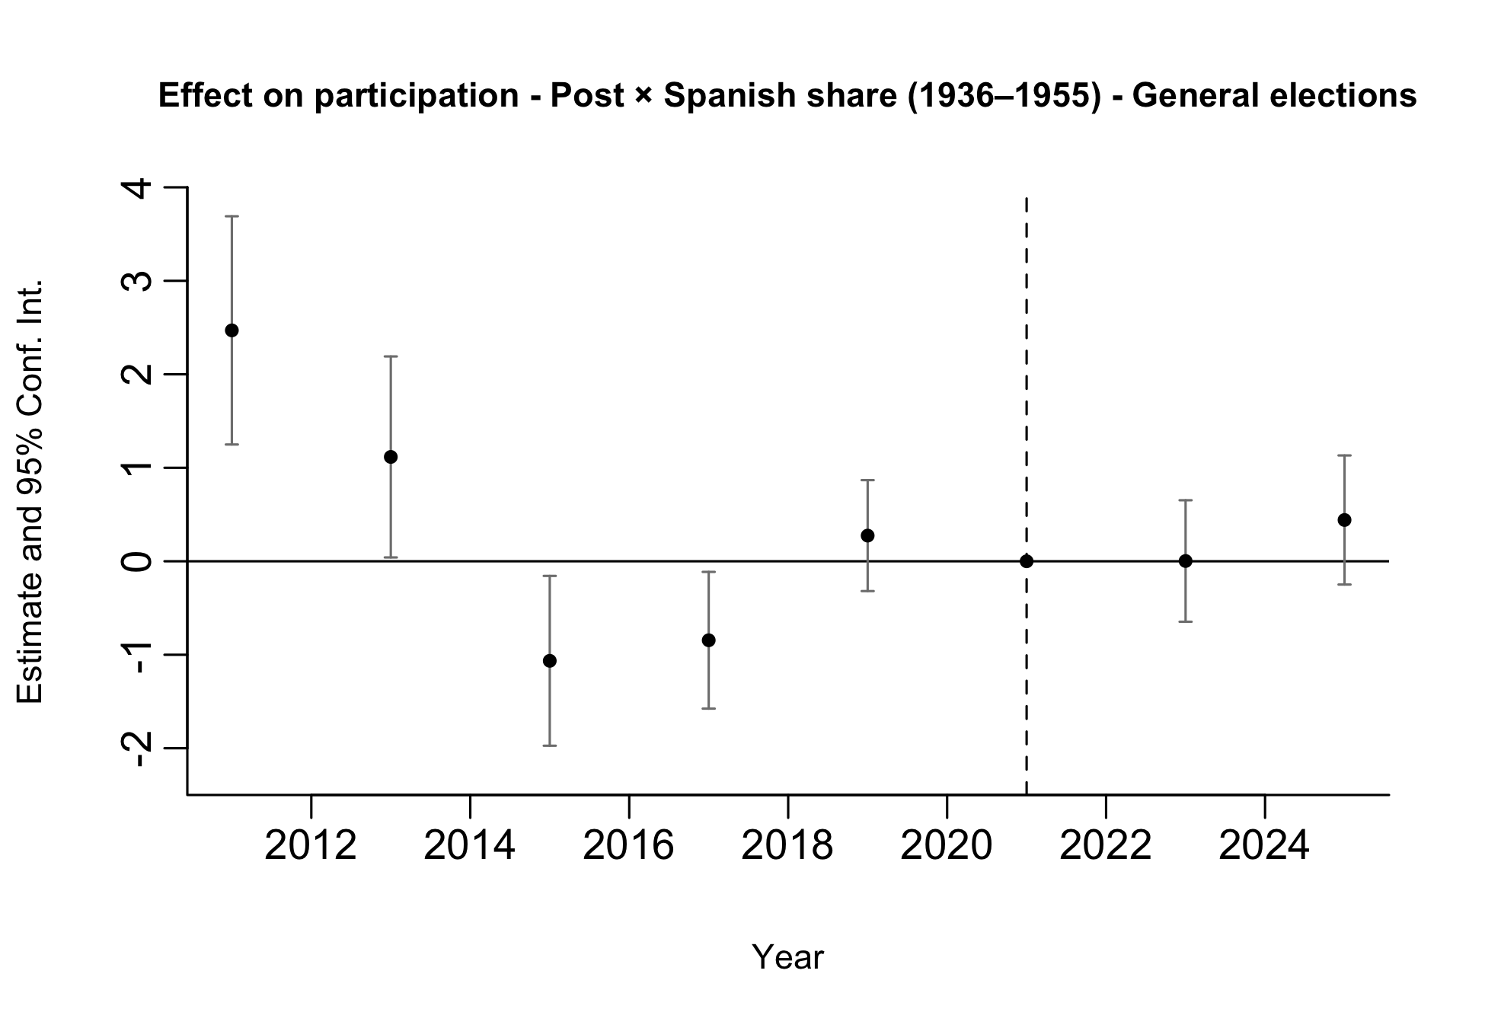
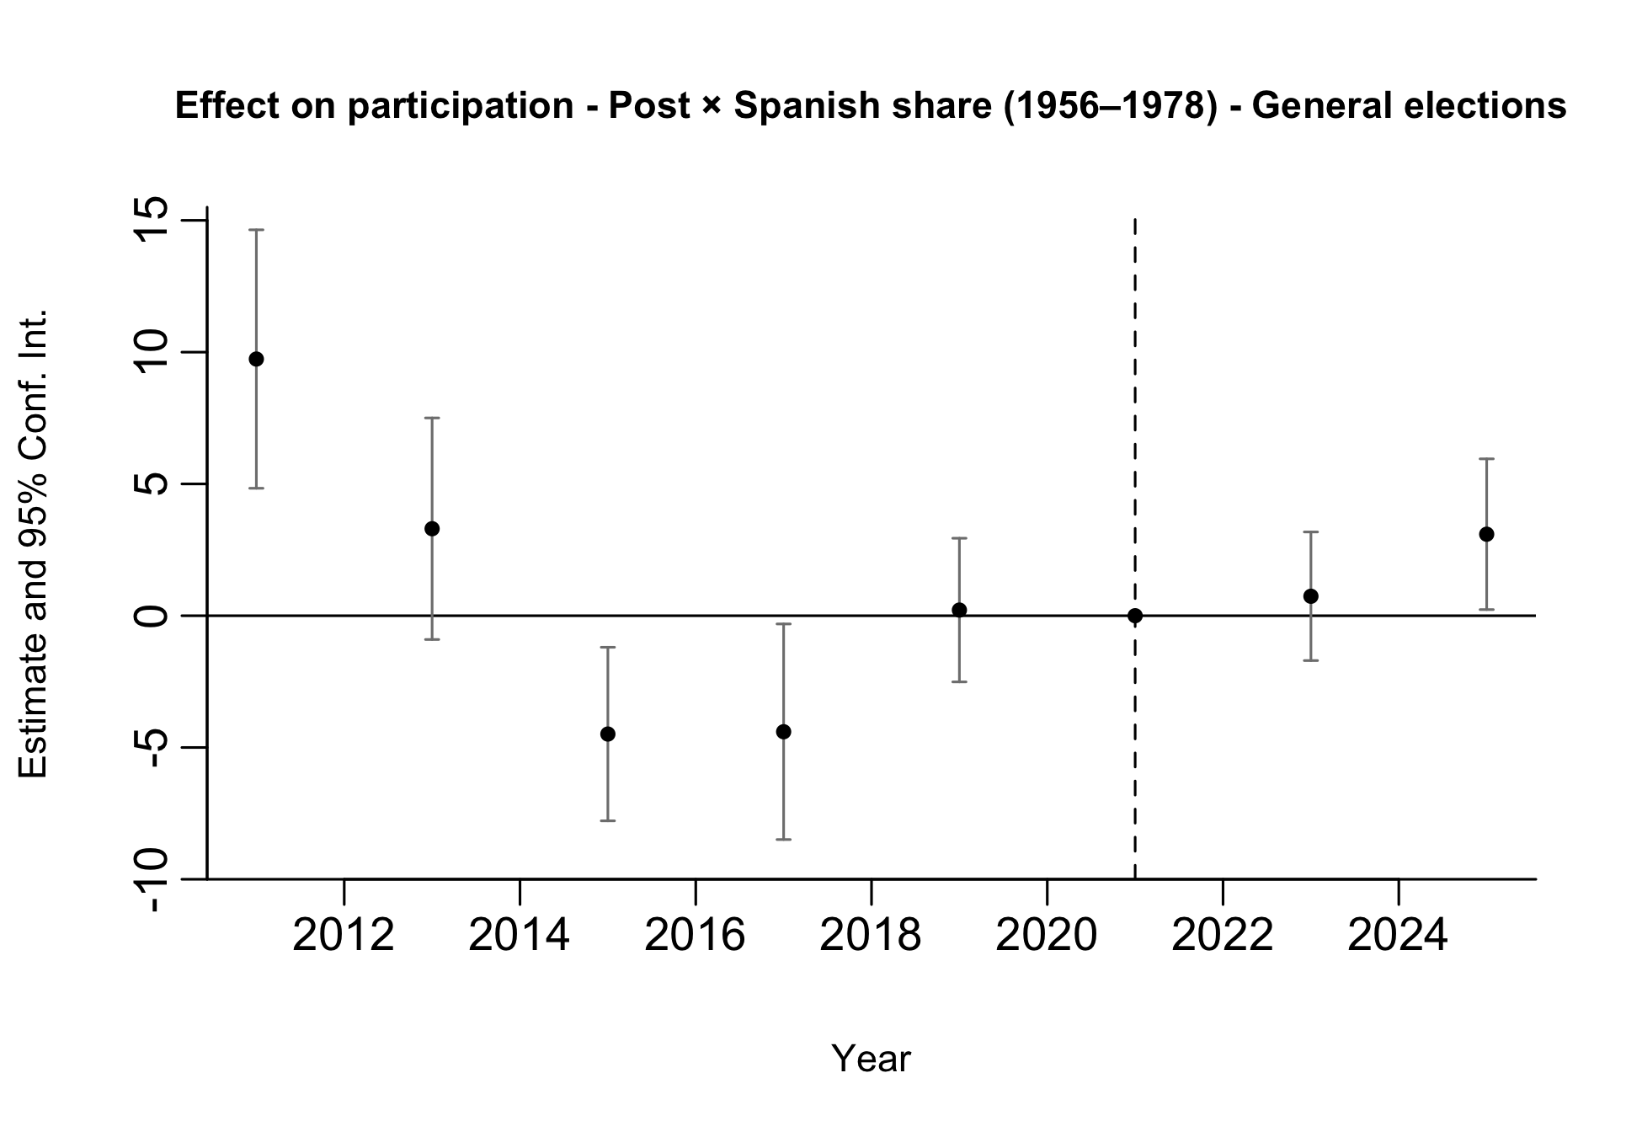
Preliminary Results: Participation
Notes:
We run two separate event-study specifications. In one regression (left), treatment is given by the interaction between post and the municipal Spanish share for arrivals in 1936–1955; in the other (right), treatment is given by the interaction between post and the municipal Spanish share for arrivals in 1956–1978.
This allows us to assess pre-trends in terms of total exposure rather than conditional effects. When both exposure measures are included jointly, coefficients reflect the effect of one exposure holding the other constant, which is less informative for pre-trend analysis.
Therefore, the event-study plots should be used primarily as a diagnostic tool for pre-trends rather than as our main treatment-effect estimates.
Both specifications are estimated on the restricted sample of General elections.

Slide 18
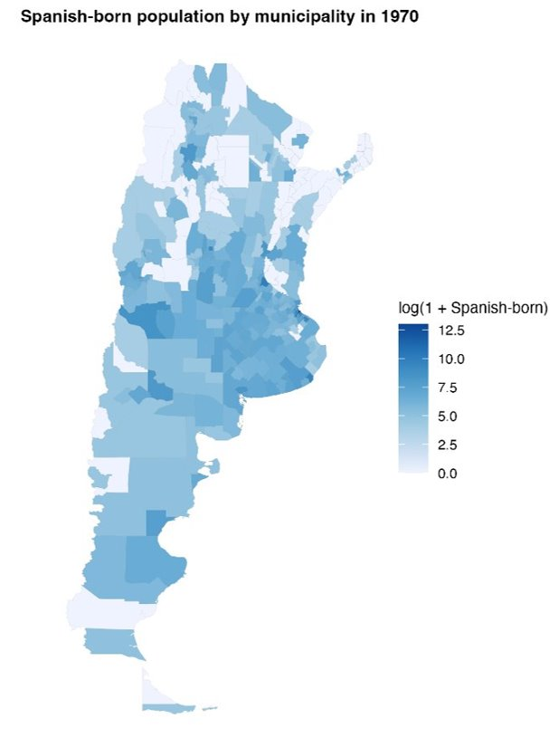
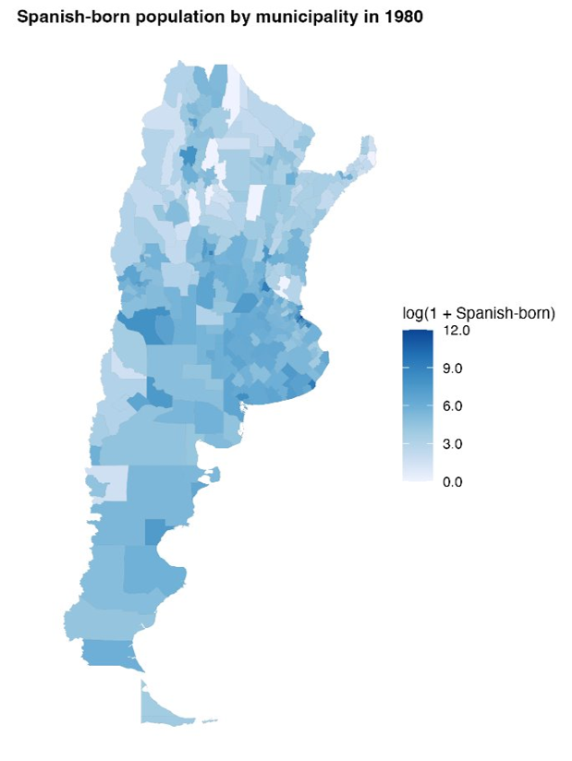
Distribution of Spanish-Born Population
Log of Spanish-born population 1970
Log of Spanish-born population 1980

