Slide 1
External Citizenship and Political Response in Argentina:
Evidence from Spain’s Ancestry-Based Citizenship Reform
20/03/2026

Slide 2
Research Question
Does exogenous access to EU citizenship through an ancestry-based reforms alter political behavior?
Argentina offers a more precise exposure measurement. Historical censuses record the exact year of arrival to the country, allowing for a cleaner classification of exile cohorts.
Argentina received a substantially higher number of Spanish immigrants, generating greater cross-municipality variation in historical exposure.
However, unlike Mexico, Argentina lacks municipal-level data on remittances or other migration-related flows.
While economic migration outcomes are harder to measure, electoral and political behavior data are typically available at fine geographic levels and offer a feasible alternative outcome dimension.

Slide 3
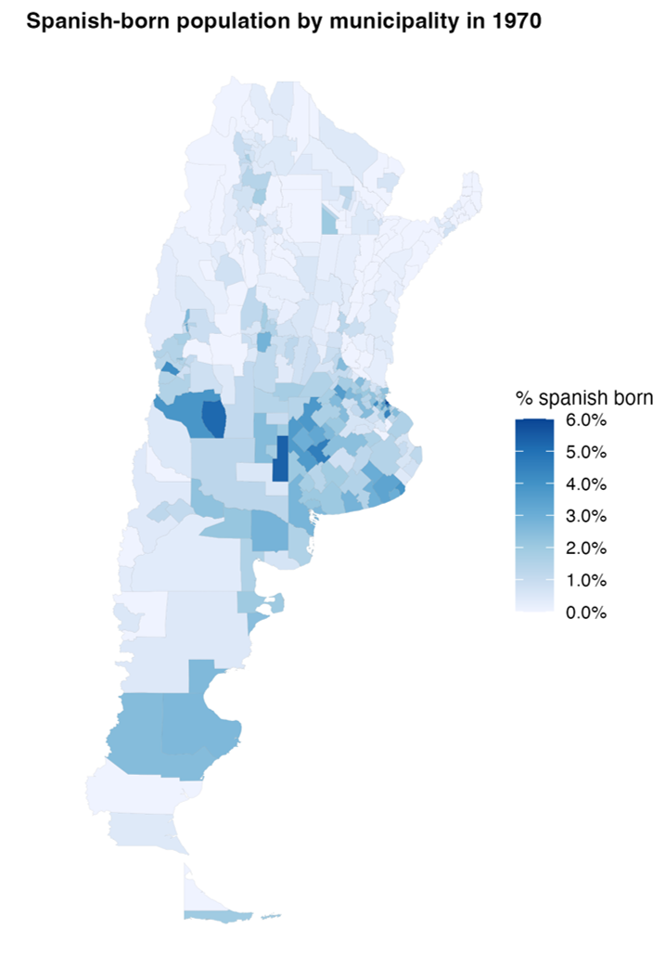
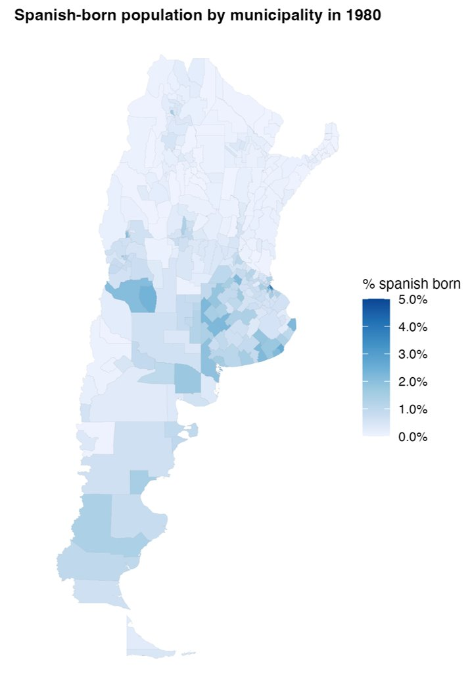
Distribution of Spanish-Born Population
Share of Spanish-born population 1970
Share of Spanish-born population 1980
Notes:
VM: Stylistic comment. I would harmonize the legends so that the colors mean the same thing across the two panels.

Slide 4
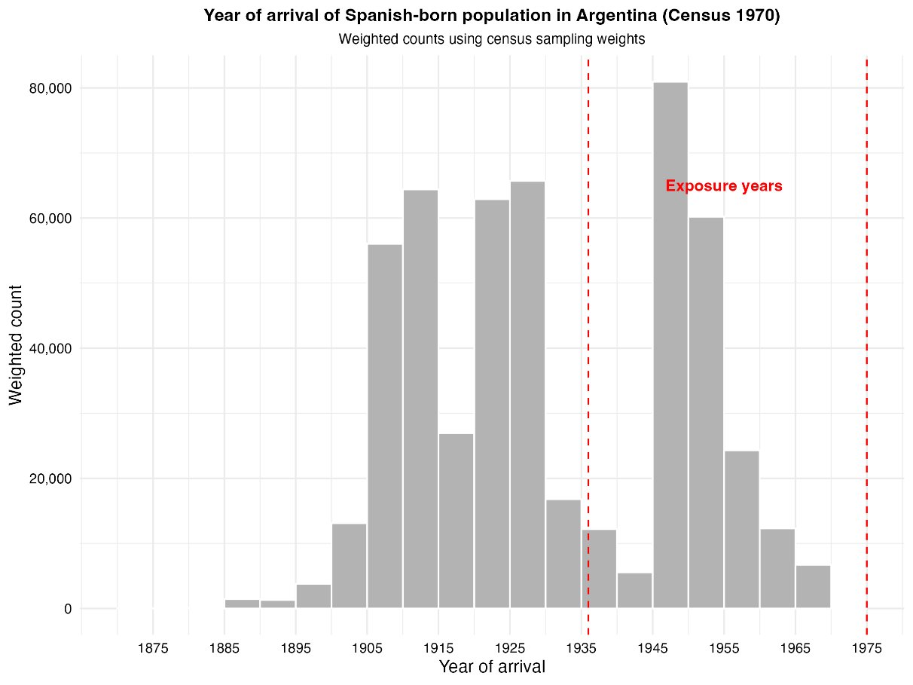
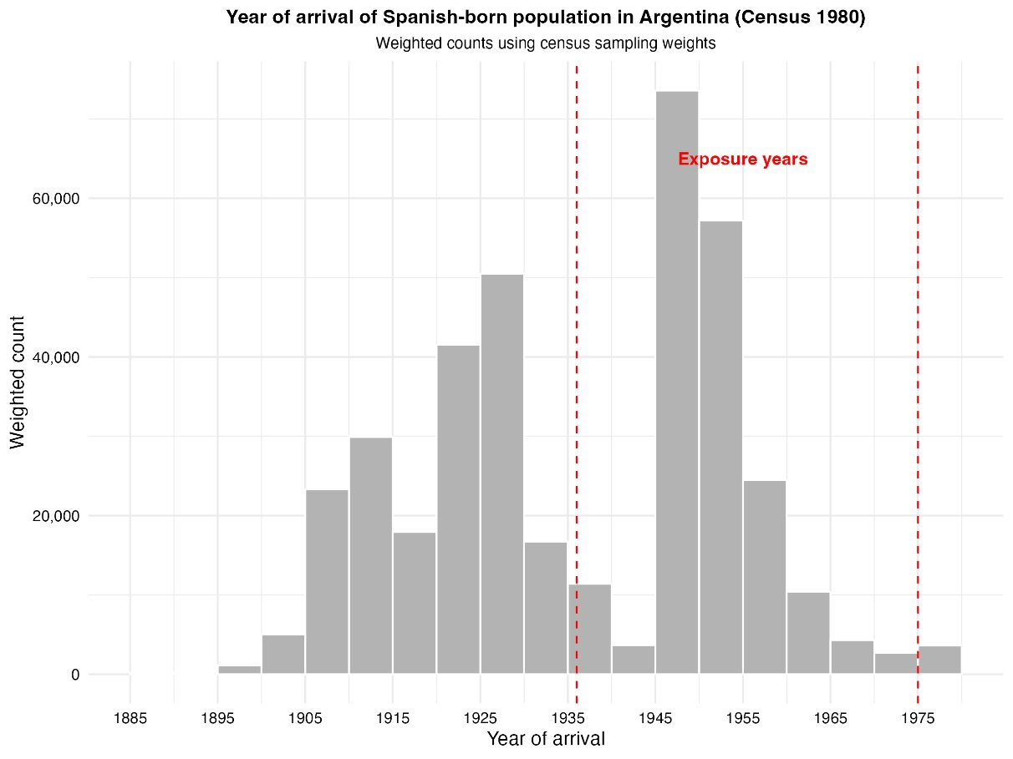
Year of Arrival of Spanish-Born Population
Notes:
VM: Nice bar chart! Can we differentiate the colors of the bars 1936–1955 vs. 1956–1975 or by adding more vertical lines to highlight the different periods of policy stringency? From this graph, it seems that the power to detect difference between two treatment arms may be limited since much fewer arrivals occurred between 1956-1975. But, it is probably still worth distinguishing between the two since we would expect the effects might be greater in places that have arrivals from the first period.

Slide 5
Motivation
A growing literature shows that international migration affects political behavior in origin countries through both financial and social remittances (cross-border social ties).
Transnational networks and communication with migrants abroad increase political interest, civic engagement, and support for redistribution in Latin America (Córdova & Hiskey 2015; Duquette-Rury, 2018; Meseguer et al. 2016).
However, financial remittances may reduce voter turnout by lowering dependence on the state and weakening incentives for electoral participation (López García 2018).
Migration has also been shown to alter local electoral outcomes, weakening traditional political machines and increasing opposition victories in Mexico (Pfutze 2012).
Most existing evidence comes from Mexico and other Latin American countries; there is very limited causal evidence for Argentina, and virtually none linking migration shocks to political outcomes.
Notes:
VM: López Garcia (2018) makes a a big point about the channel for return migration being important. In places with higher return migrants, the negative effect weakens. So, there are channels through communication, but also channels through increased presence of people exposed to democratic institutions which can contribute to diverse impacts on political behavior.
Pfutze (2012) provides unique perspective about being able to defeat an opposition party. They “found that migration significantly increases the probability of a party in opposition to the former state party PRI to win in a municipal election for the first time.” Can we do something similar?
Other channels to think about:
Leadership effects: Migrants from more democratic places become leaders that perpetuate could different policies or types of engagement with constituents (Mercier, 2016 in Journal of Development Economics)
(2) Selection effects: Migrants who leave in result of the policy have more favorable democratic views or tend to be more political activists. This may far outweigh the impact of changes in remittances which opens the line of communication and effectively lower voting participation and worsen democratic outcomes. Can we compare the political participation and views of individuals historically from areas with high Spanish ties versus low Spanish ties to understand this selection effect? Even better if we can link previous voting behavior to those who eventually move to Spain during the years of interest and compare their historical political behavior and tendencies relative to the general population.
(3) Collective action undermined getting fewer people to mobilize and participate politically (Sellers, 2019 in Journal of Politics)
We need to think about what makes Argentina interesting relative to other case studies in the literature.
Origin regime matters: “Remittances are more likely to finance activities that deter political competition in autocracies than in democracies.” (Easton and Montinola, 2017 in Studies in Comparative International Development)
Destination regime matters: Migration to autocracies generates stronger engagement in politics at among migrants that return to democratic country. Experimental evidence from Gaikwad, Hanson, and Tóth among migrants from India who move to the Persion Gulf. Published in World Politics in 2026.
Clientelistic patronage structures matter: Remittances are more effective at reducing turnout or support for opposing parties in places that traditionally rely on clientelistic patronage structures. Ana Isabel Lopez Garcia in International Migration (2025) has a nice layout of the different types of theories political scientists use to explain the role of remittances on political participation in Latin America and the Carribean. Argentina was one of the countries included there, but the focus was on protests. Positive effect in appendix table between remittances and protest in Argentina-specific regression.
Compulsory voting for specific age groups

Slide 6
Data
Argentine Population Census (IPUMS 1970, 1980). The census provides information on place of birth, previous place of residence, years residing in the current locality and, importantly, the year of arrival to the country.
Electoral public data from the National Electoral Commission (Comisión Nacional Electoral). These data provide detailed electoral results for all national elections since 2011, including votes received by each political party, voter turnout, and blank votes, among other indicators. We focus on national legislative elections for the Chamber of Deputies, as they offer the largest number of electoral observations over the period 2011–2025. We rely on national elections because the database does not consistently include provincial or local elections, particularly in years when those contests are held separately from the national electoral calendar.
Notes:
VM Notes: What is the Chamber of Deputies? Wikipedia definition: It is made up of 257 national deputies who are elected in multi-member constituencies corresponding with the territories of the 23 provinces of Argentina (plus the Federal Capital) by party list proportional representation. Elections to the Chamber are held every two years, so that half of its members are up in each election, making it a rare example of staggered elections used in a lower house.

Slide 7
Empirical Strategy
Timing-Based Exposure Measure
We exploit a question in the historical Argentine censuses that records the exact year immigrants arrived in the country.
This allows us to identify Spanish-born individuals who settled during specific periods (1936–1955 vs. 1956–1978) and to construct the share of the population that arrived in each time window ( R1936–1955 and R1956–1978, respectively).
The 1970 census is used to measure Spanish immigrants who arrived between 1936–1955, while the 1980 census is used to capture those who arrived between 1956–1978.
We compare outcomes across municipalities with greater exposure to refugees arriving in 1936–1955 relative to those with greater exposure to arrivals in 1956–1978.

Slide 8
Empirical Strategy
Timing-Based Exposure Measure
Formally, we estimate the following equation (1):
The main outcome is the share of blank votes, defined as the percentage of votes cast in blank over the total number of voters. As an additional outcome, we also explore voter turnout.
Blank voting as protest behavior: blank votes often reflect dissatisfaction with available political options rather than abstention.
ElectionType is an indicator for whether the election corresponds to a General election or a PASO (primary) election.
Since PASO (primary) elections were not held in 2025, we also estimate model (2) restricting the sample to general elections only.
Notes:
Question: Can we look at share that voted for incumbent or non-incumbent also as an indicator of protest behavior?

Slide 9
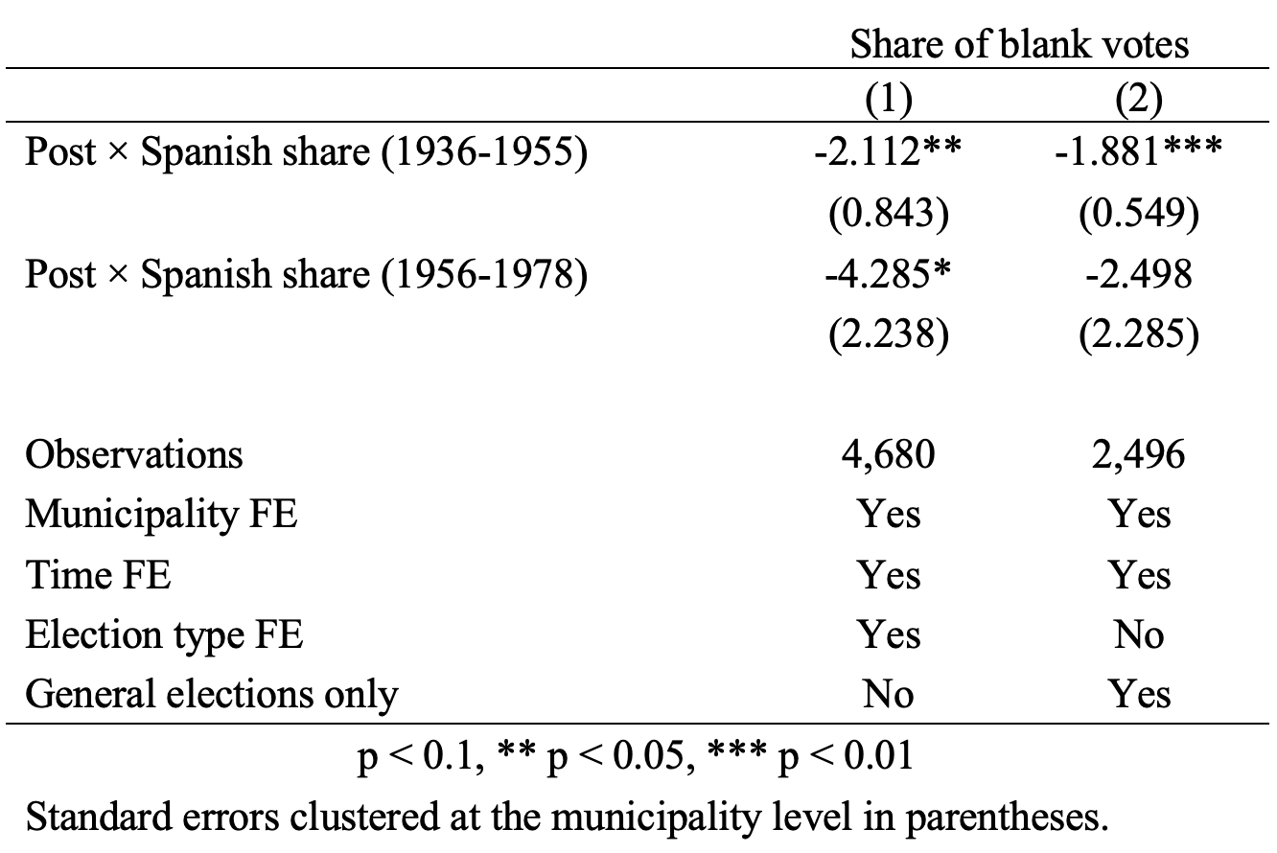
Preliminary Results
Notes:
Result 1: In places where Ley de Nietos would have influenced the most, we see a decline in share of blank votes.
Question: Does this suggest less protest behavior? Or does this suggest that people that would otherwise protest withdraw themselves from the process which is consistent with arguments around private resources (remittances) crowd out incentives to support institutions that mobilize public resources. It sounds like you might have done this already, but we need to show whether there is an effect on political participation or electoral turnout (e.g., percent of people that come out to vote?) If not, then this suggests that we do not see fewer people voting, instead we see that among those who vote, they are less likely to protest.
Is this a selection effect, i.e. activist people are leaving? Do we need to be concerned about endogeneity of the composition of voters in places with a higher percentage of Spanish immigrants? We should correlate Spanish share (1936-1995) and Spanish share (1956-1978) with historical political outcomes to see the extent we might need to use a propensity score matching approach to adjust for the selection effect.
It would also be important to show the share of votes to each political party and whether that changed. Is it a matter of people protesting less or sticking up more for the opposition candidate or non-traditional party candidates?
Result 2: It appears that in places that would face the more strict version of immigration policy, we potentially see a stronger effect. Can we test if -4.285<-2.122? Again, it depends how we might want to interpret this. It could be that selection is different in these places in the way I mentioned above and we should see how so, if that’s true. OR, you could imagine that because the costs of proving you are eligible rise then those who are eligible must have higher expected returns (and therefore send more communication/influence or more remittances).
Result 3: We lose power focusing on general elections and the magnitudes of the effects go down. When comparing models (1) and (2), it seems that what may be driving the effects are the primaries. I wonder if voter turnout changes over the primaries relative to the general elections because this is where you have the potential to actually influence the candidates of your party.
Question: My understanding in Argentina is that voting is compulsory for ages 18-70. Are we only looking at votes provided within the compulsory voting age group?

Slide 10
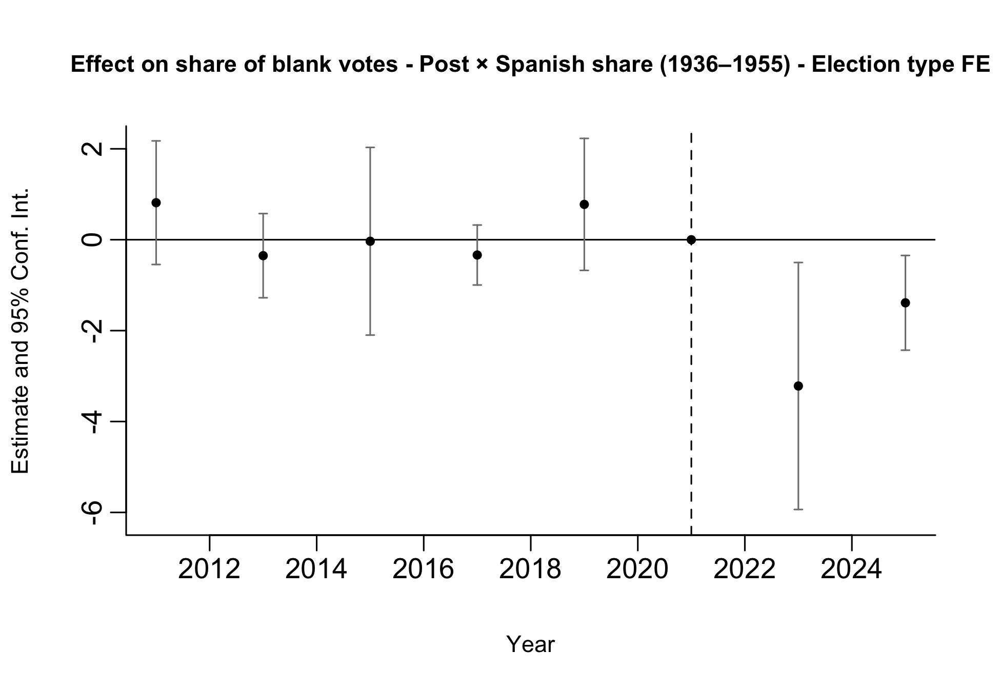
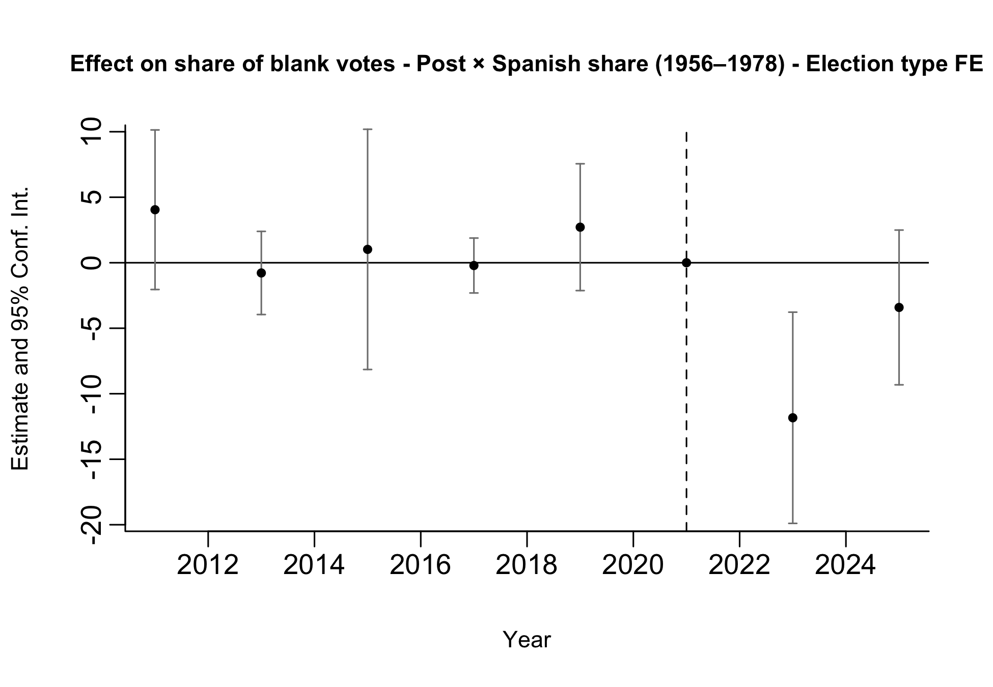
Preliminary Results: Pre-trends
Pre-trends look parallel, although estimates are noisy.
Notes:
We run two separate event-study specifications. In one regression (left), treatment is given by the interaction between post and the municipal Spanish share for arrivals in 1936–1955; in the other (right), treatment is given by the interaction between post and the municipal Spanish share for arrivals in 1956–1978.
This allows us to assess pre-trends in terms of total exposure rather than conditional effects. When both exposure measures are included jointly, coefficients reflect the effect of one exposure holding the other constant, which is less informative for pre-trend analysis.
Therefore, the event-study plots should be used primarily as a diagnostic tool for pre-trends rather than as our main treatment-effect estimates.
Both specifications are estimated on the full sample of elections (PASO and general), including election-type fixed effects.
VM: Pre-processing the data may help with this.

Slide 11
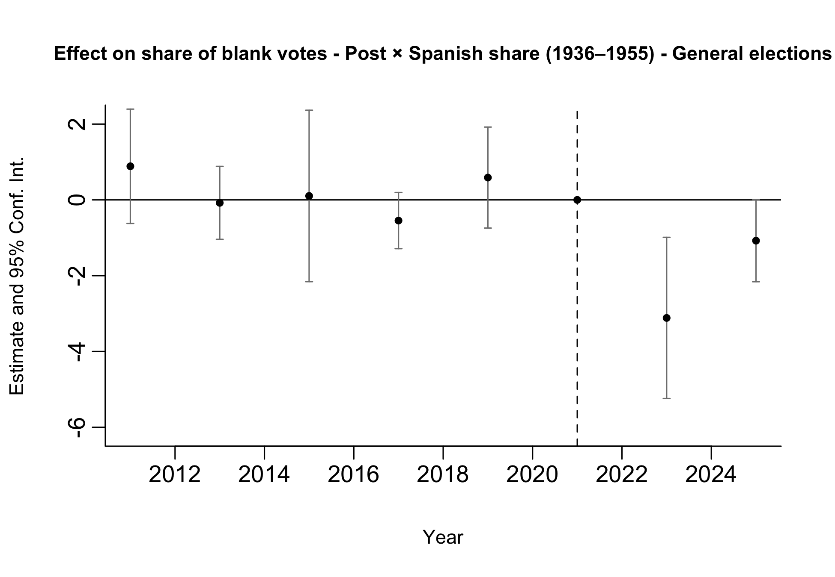
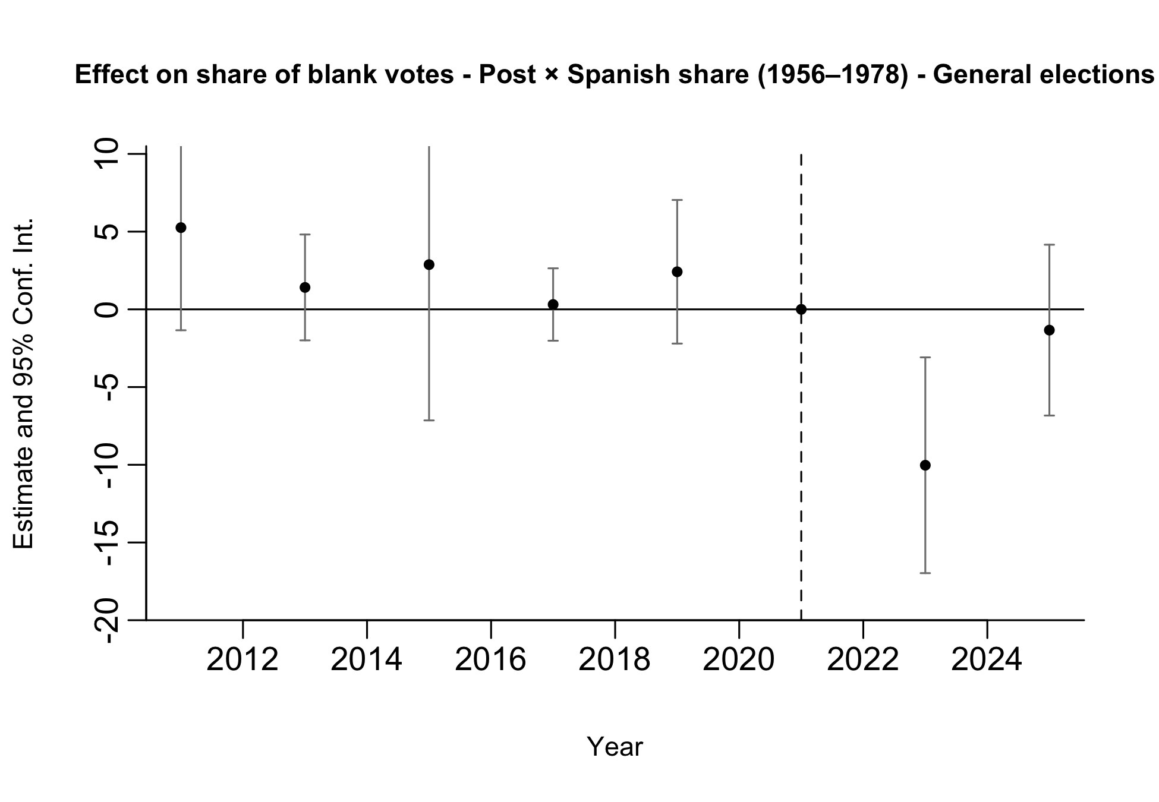
Preliminary Results: Pre-trends
Pre-trends look parallel, although estimates are noisy.
Notes:
We run two separate event-study specifications. In one regression (left), treatment is given by the interaction between post and the municipal Spanish share for arrivals in 1936–1955; in the other (right), treatment is given by the interaction between post and the municipal Spanish share for arrivals in 1956–1978.
This allows us to assess pre-trends in terms of total exposure rather than conditional effects. When both exposure measures are included jointly, coefficients reflect the effect of one exposure holding the other constant, which is less informative for pre-trend analysis.
Therefore, the event-study plots should be used primarily as a diagnostic tool for pre-trends rather than as our main treatment-effect estimates.
Both specifications are estimated on the restricted sample of General elections.

Slide 12
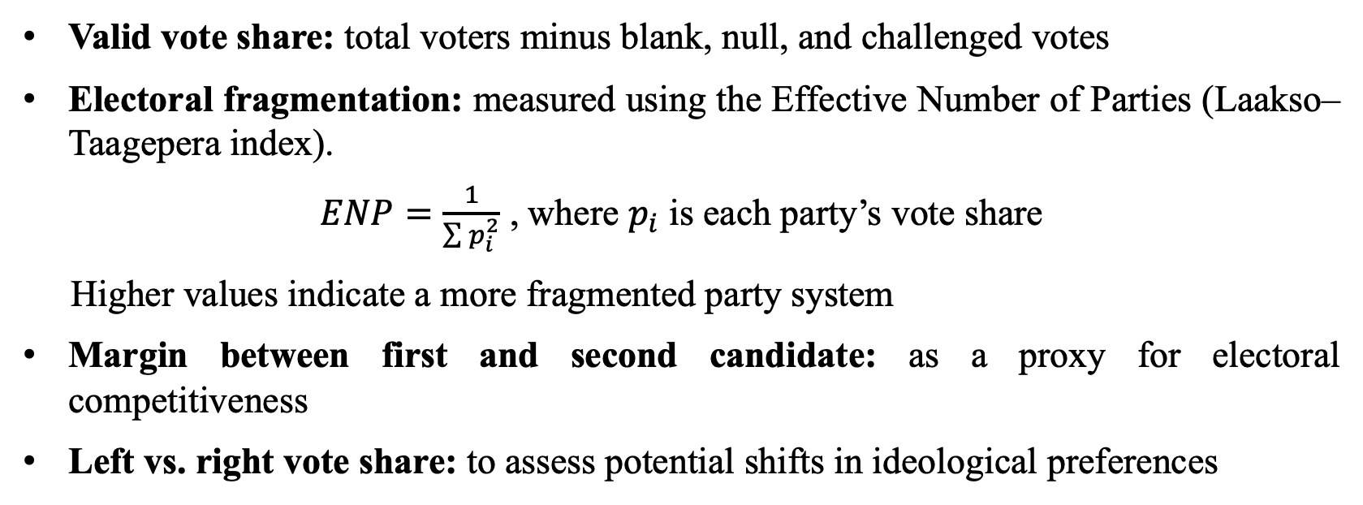
Additional Outcomes to Explore
Valid vote share: total voters minus blank, null, and challenged votes
Electoral fragmentation: measured using the Effective Number of Parties (Laakso–Taagepera index).
$ENP=\frac{1}{\sum{p_{i}^{2}}}$ , where $p_{i}$ is each party’s vote share
Higher values indicate a more fragmented party system
Margin between first and second candidate: as a proxy for electoral competitiveness
Left vs. right vote share: to assess potential shifts in ideological preferences

Slide 13
APPENDIX II

Slide 14
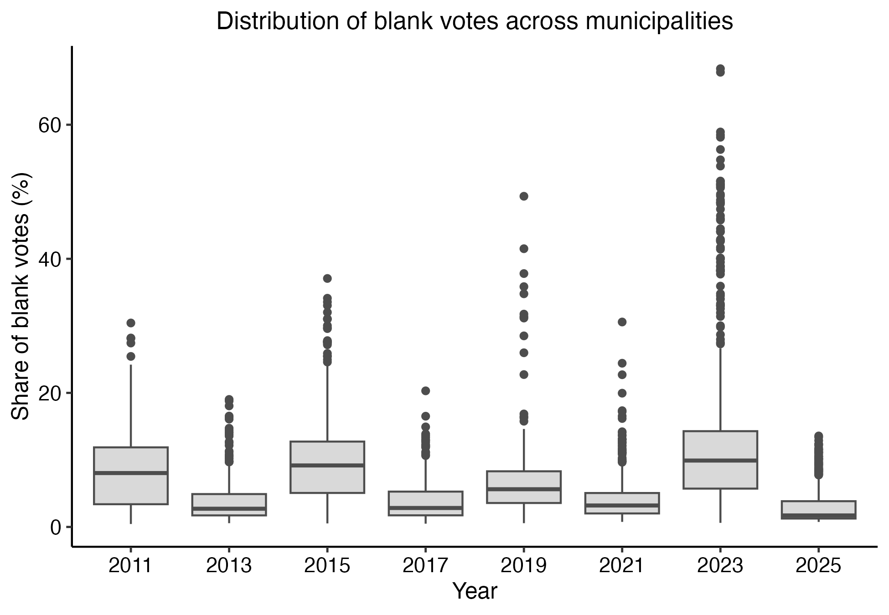
Distribution of Blank Votes
High dispersion in blank vote shares may contribute to noisier estimates in some years.

Slide 15
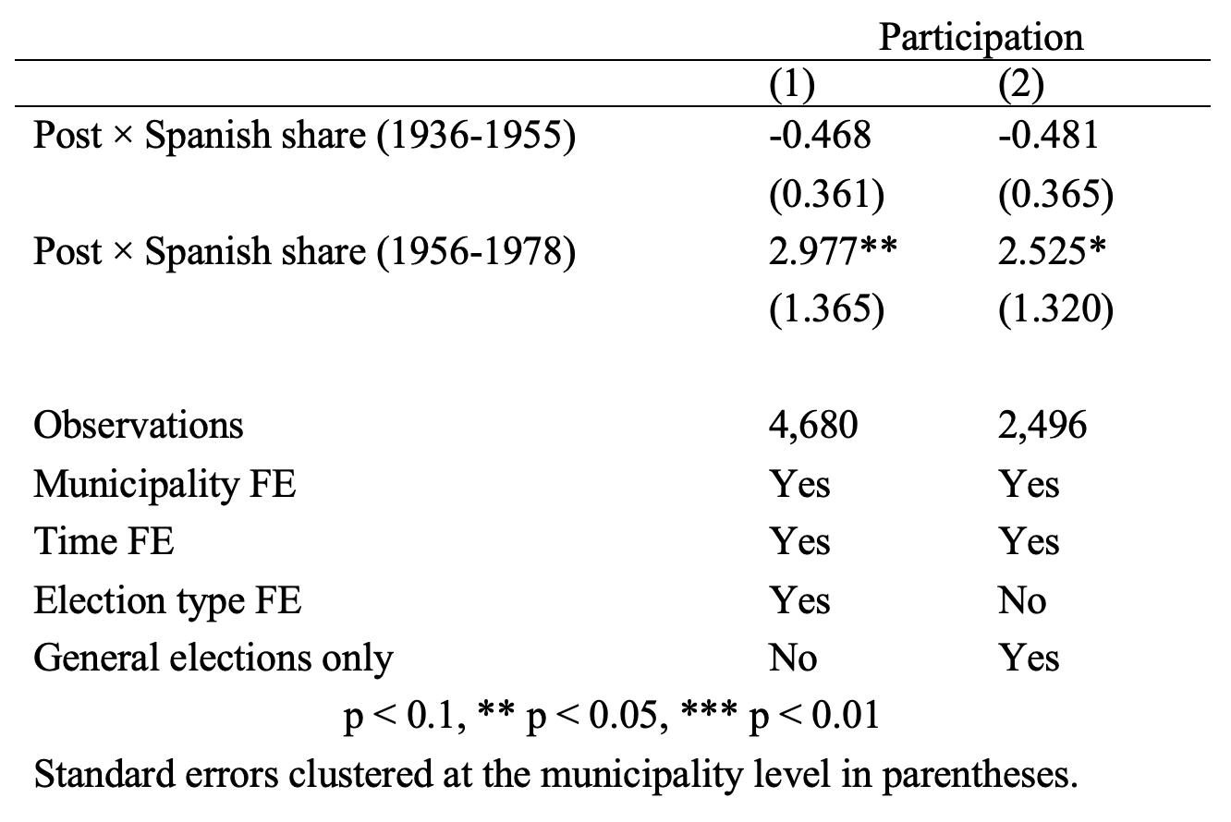
Preliminary Results: Participation
Less clear effects are found on electoral participation (as expected, since voting is mandatory and participation is relatively high in Argentina).
No significant effects are found for the 1936–1955 cohort, while some effects appear for the 1956–1978 cohort in the expected direction.
However, pre-trends are not flat, which cautions against a causal interpretation.
Notes:
VM: This is super interesting! I think we need something like this and try to improve the identification strategy perhaps focusing on the compulsory age group.

Slide 16
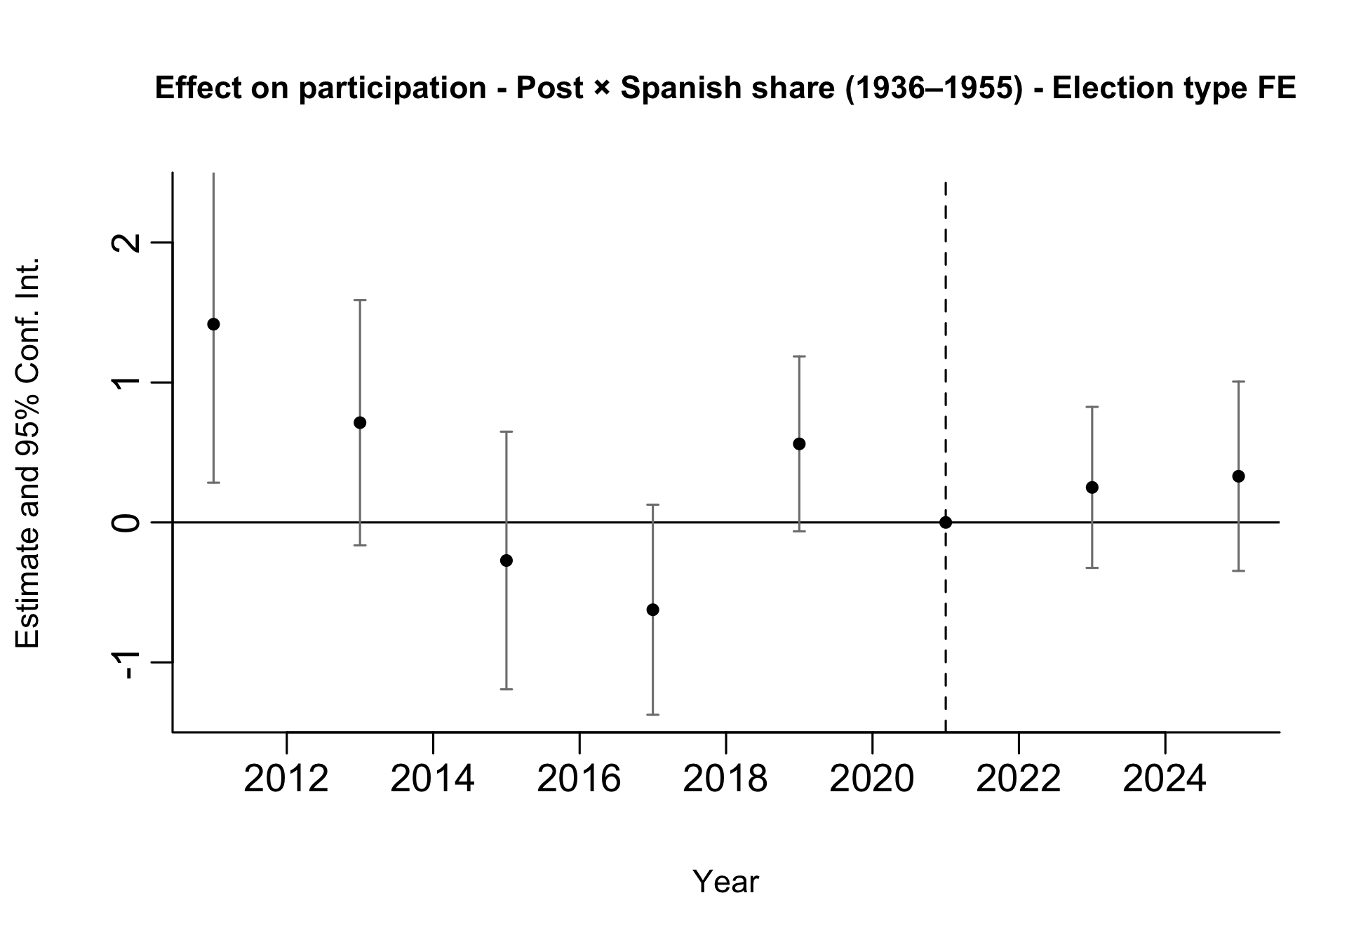
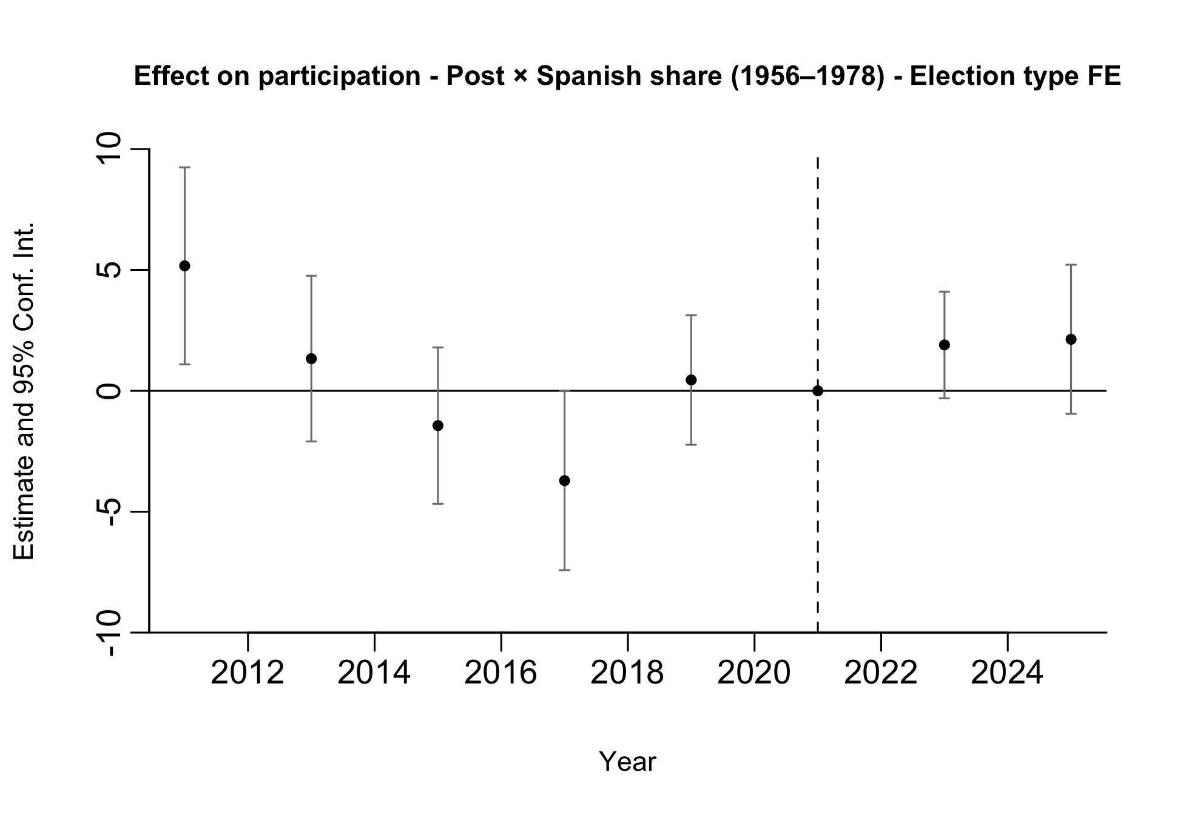
Preliminary Results: Participation
Notes:
We run two separate event-study specifications. In one regression (left), treatment is given by the interaction between post and the municipal Spanish share for arrivals in 1936–1955; in the other (right), treatment is given by the interaction between post and the municipal Spanish share for arrivals in 1956–1978.
This allows us to assess pre-trends in terms of total exposure rather than conditional effects. When both exposure measures are included jointly, coefficients reflect the effect of one exposure holding the other constant, which is less informative for pre-trend analysis.
Therefore, the event-study plots should be used primarily as a diagnostic tool for pre-trends rather than as our main treatment-effect estimates.
Both specifications are estimated on the full sample of elections (PASO and general), including election-type fixed effects.

Slide 17
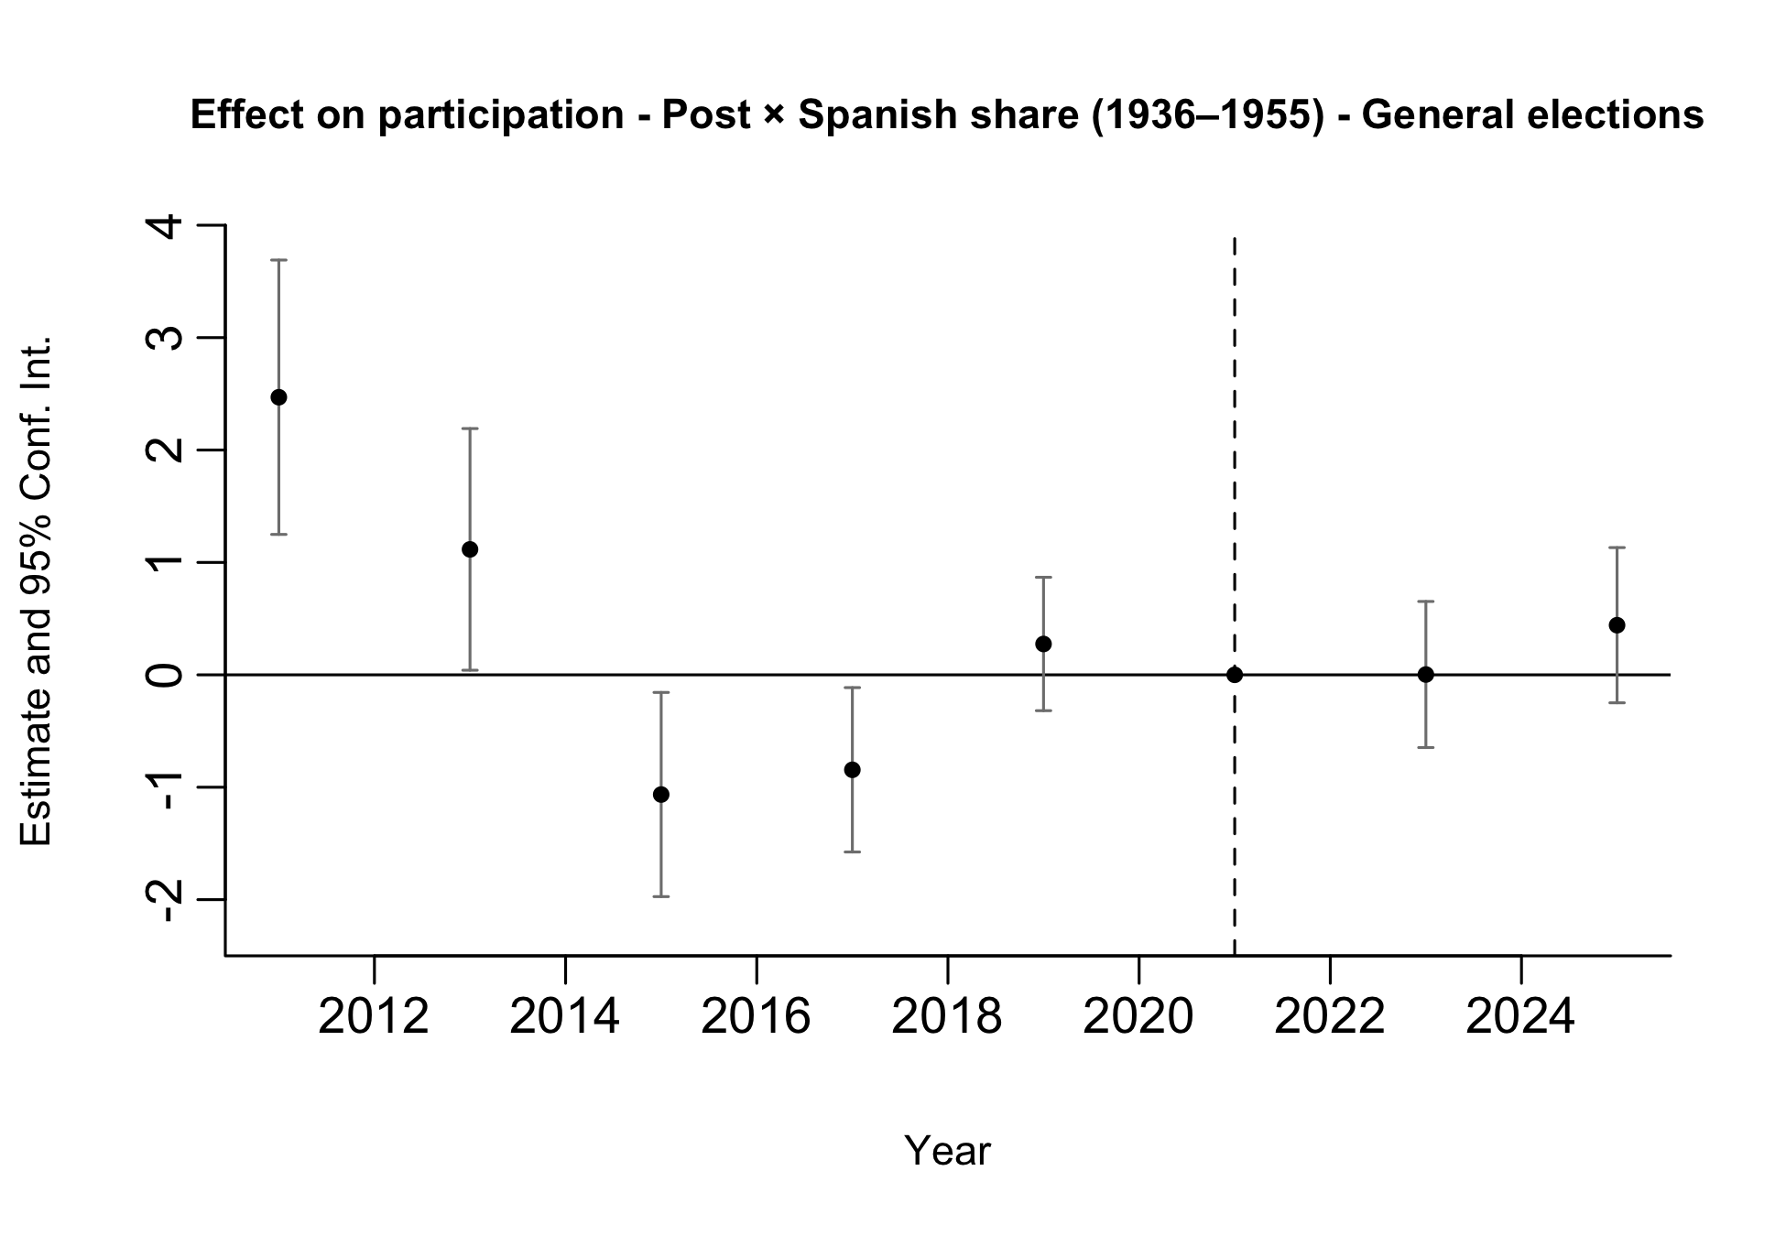
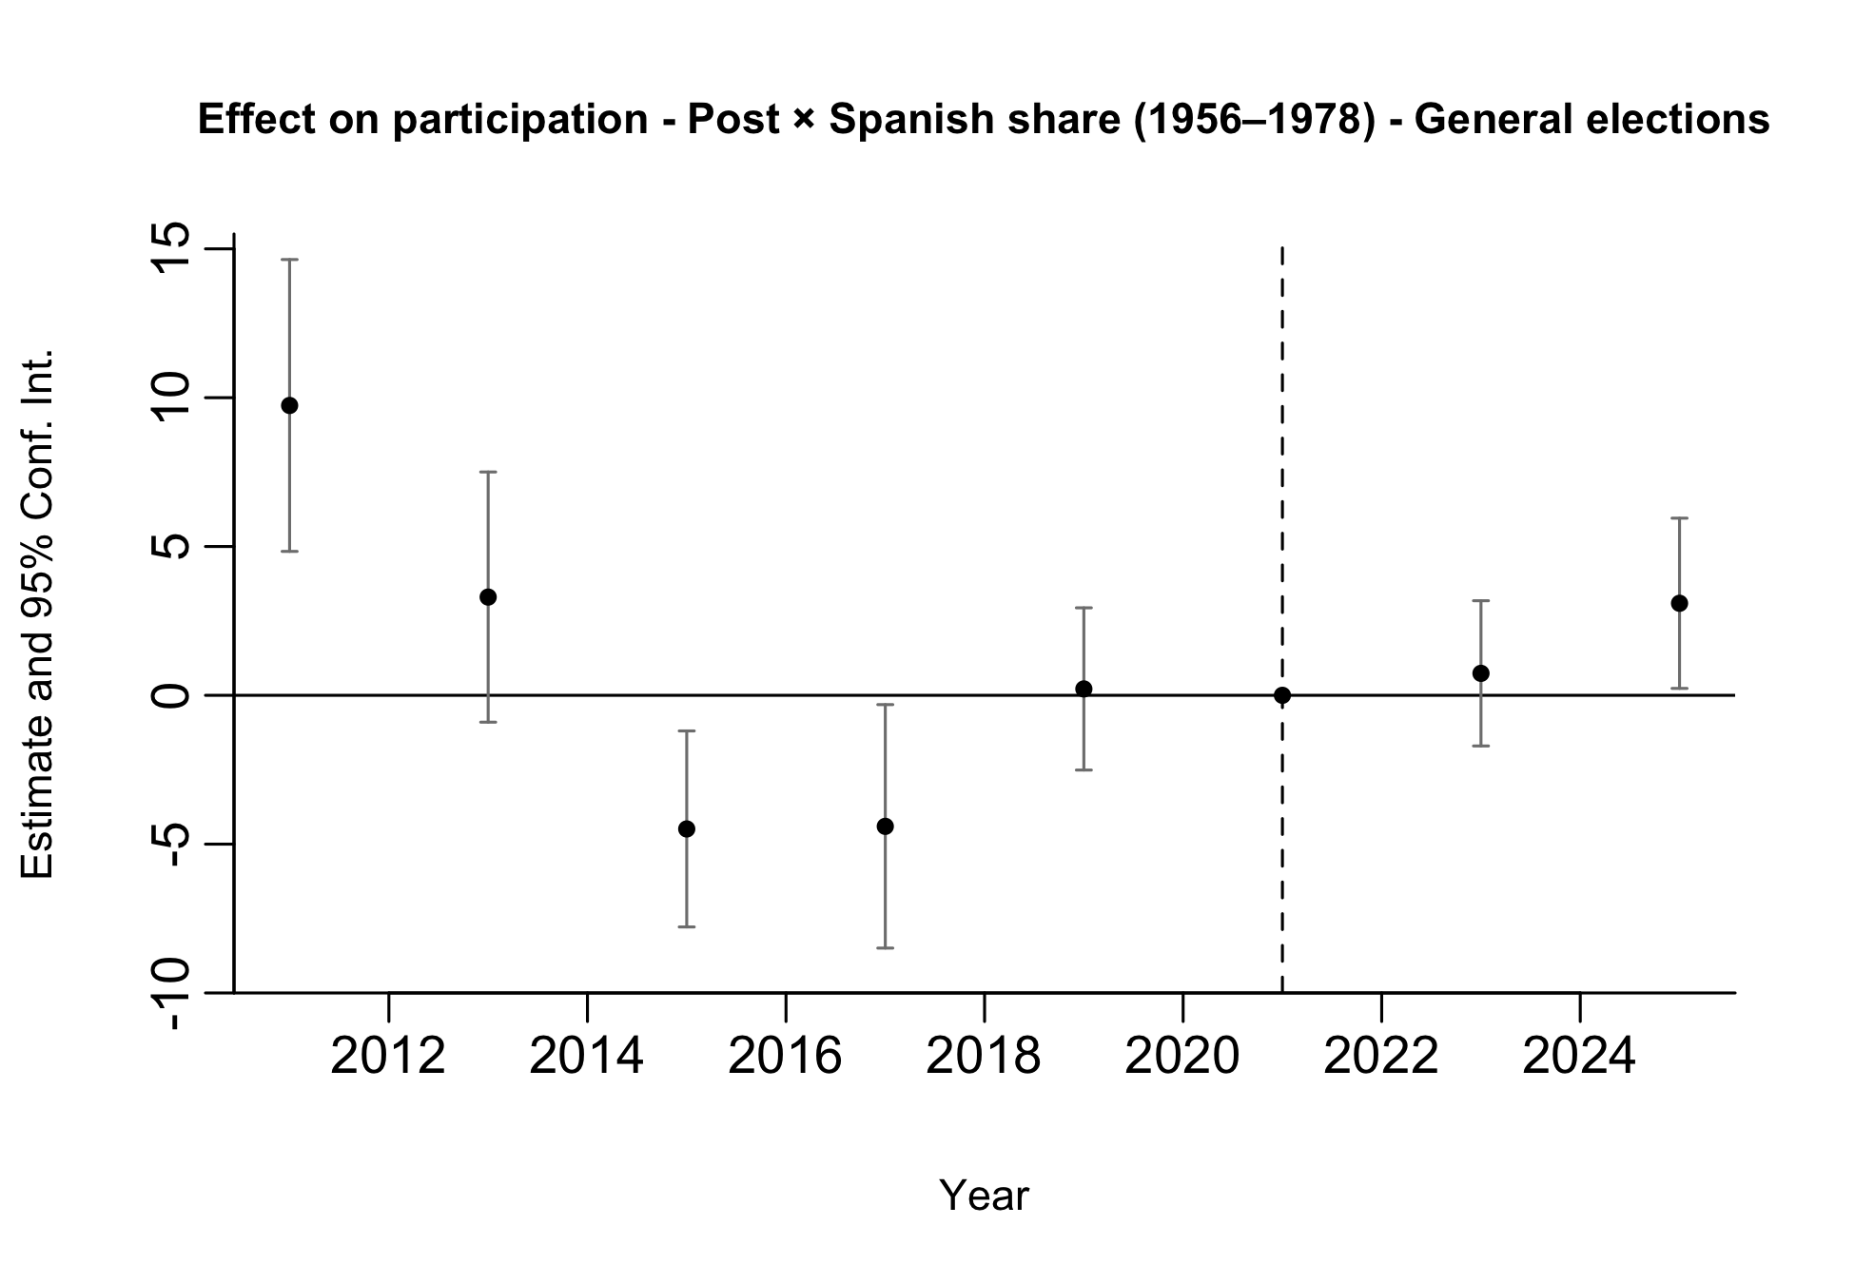
Preliminary Results: Participation
Notes:
We run two separate event-study specifications. In one regression (left), treatment is given by the interaction between post and the municipal Spanish share for arrivals in 1936–1955; in the other (right), treatment is given by the interaction between post and the municipal Spanish share for arrivals in 1956–1978.
This allows us to assess pre-trends in terms of total exposure rather than conditional effects. When both exposure measures are included jointly, coefficients reflect the effect of one exposure holding the other constant, which is less informative for pre-trend analysis.
Therefore, the event-study plots should be used primarily as a diagnostic tool for pre-trends rather than as our main treatment-effect estimates.
Both specifications are estimated on the restricted sample of General elections.

Slide 18
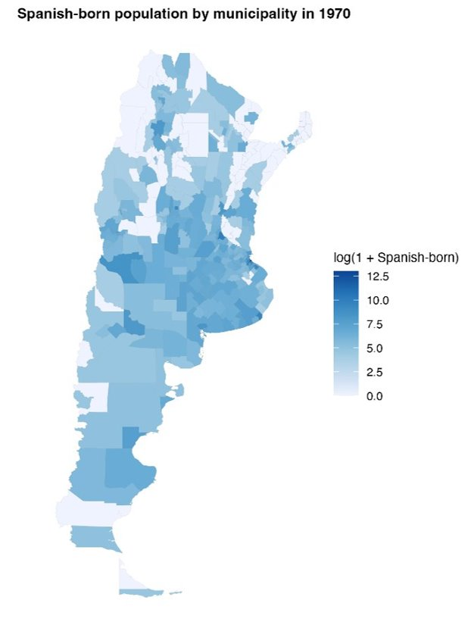
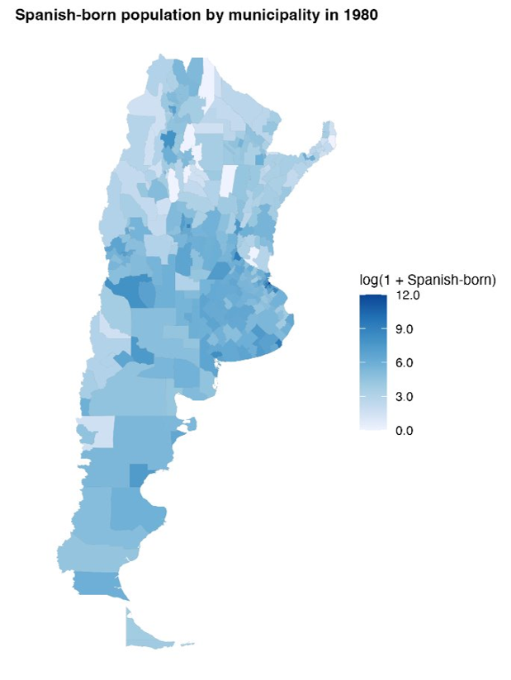
Distribution of Spanish-Born Population
Log of Spanish-born population 1970
Log of Spanish-born population 1980

