Slide 1
External Citizenship and Political Response in Argentina:
Evidence from Spain’s Ancestry-Based Citizenship Reform
05/29/2026

Slide 2
Research Question
Does exogenous access to EU citizenship through an ancestry-based reforms alter political behavior?
We study Spain’s Ley de Nietos, which expanded access to Spanish/EU citizenship for descendants of Spanish emigrants, creating variation in potential eligibility across Argentine municipalities.
Eligibility depend on ancestry and migration timing: grandchildren of Spanish exiles who left Spain during 1936–1955, or during 1956–1978 if exile status could be documented.
Argentina offers a precise exposure measurement. Historical censuses record the exact year of arrival to the country, allowing for a cleaner classification of exile cohorts.
Argentina received a substantially higher number of Spanish immigrants, generating greater cross-municipality variation in historical exposure.
2 / 37

Slide 3
Motivation
A growing literature shows that international migration affects political behavior in origin countries through both financial and social remittances (cross-border social ties).
Transnational networks and communication with migrants abroad increase political interest, civic engagement, and support for redistribution in Latin America (Córdova & Hiskey 2015; Duquette-Rury, 2018; Meseguer et al. 2016).
However, financial remittances may reduce voter turnout by lowering dependence on the state and weakening incentives for electoral participation (López García 2018).
Migration has also been shown to alter local electoral outcomes, weakening traditional political machines and increasing opposition victories in Mexico (Pfutze 2012).
Selection channel: Areas losing migrants may also lose voters with specific characteristics (for example, stronger democratic preferences or political activism).
Most existing evidence comes from Mexico and other Latin American countries; there is very limited causal evidence for Argentina, and virtually none linking migration shocks to political outcomes.
Comparative context: Argentina differs from prior case studies. Both origin and destination are democracies (Gaikwad et al. 2026).
3 / 37

Slide 4
Argentine Political System
Federal presidential republic with national, provincial, and municipal governments. Provinces have autonomy over their own electoral calendars and rules.
Bicameral National Congress: Chamber of Deputies, 257 members; Senate, 72 members.
President: directly elected for a four-year term, with one immediate re-election allowed.
Deputies serve four-year terms and half of the Chamber is renewed every two years. Senators serve six-year terms and one-third of the Senate is renewed every two years.
Voting is compulsory for citizens ages 18–70, and optional for ages 16–17 and over 70.
Since 2009, the PASO (Primarias Abiertas, Simultáneas y Obligatorias) are open simultaneous and mandatory primary elections held before each general election to select candidates. PASO were suspended for the 2025 national elections.
4 / 37

Slide 5
The Chamber of Deputies
The Chamber of Deputies is the lower house of the National Congress, with 257 members representing the 23 provinces and the Autonomous City of Buenos Aires (CABA) under proportional representation.
Seats are allocated by province in proportion to population, with a minimum of five deputies for less populated provinces.
Half of the Chamber is renewed every two years, and each deputy serves a four-year term.
Provincial and local legislative races are not analyzed because electoral calendars vary across jurisdictions, many provinces hold these elections separately from the national calendar, and subnational electoral data are less consistent over time, especially when elections are decoupled from national races.
Year | Election type
2011 | Chamber of Deputies + presidential
2013 | Chamber of Deputies
2015 | Chamber of Deputies + presidential
2017 | Chamber of Deputies
2019 | Chamber of Deputies + presidential
2021 | Chamber of Deputies
2023 | Chamber of Deputies + presidential
2025 | Chamber of Deputies
5 / 37

Slide 6
Data
Argentine Population Census (IPUMS 1970, 1980, 2010). The census provides information on place of birth, earlier place of residence, years residing in the current locality and, importantly, the year of arrival to the country.
Electoral public data from the National Electoral Commission (Comisión Nacional Electoral). These data provide detailed electoral results for all national elections since 2011, including votes received by each political party, voter turnout, and blank votes, among other indicators. We focus on national legislative elections for the Chamber of Deputies, as they offer the largest number of electoral observations over the period 2011–2025. We rely on national elections because the database does not consistently include provincial or local elections, particularly in years when those contests are held separately from the national electoral calendar.
Spanish immigration microdata (INE, Spain). Annual records of immigrants entering Spain in 2023 and 2024, covering age, sex, place of destination in Spain, place of origin, and nationality. We use these data to characterize the profile of Argentine migrants moving to Spain after the implementation of the Ley de Nietos reform.
LAPOP rounds 2012, 2014, 2017 and 2019. Repeated cross-section data reporting political attitudes and intentions to migrate at the individual level.
6 / 37

Slide 7
Empirical Strategy
Window Exposure Measure
We exploit a question in the historical Argentine censuses that records the exact year immigrants arrived in the country.
This allows us to identify Spanish-born individuals who settled during specific periods (1936–1955 vs. 1956–1978) and to construct the share of the population that arrived in each time window ( R1936–1955 and R1956–1978, respectively).
The 1970 census is used to measure Spanish immigrants who arrived between 1936–1955, while the 1980 census is used to capture those who arrived between 1956–1978.
We compare outcomes across municipalities with greater exposure to refugees arriving in 1936–1955 relative to those with greater exposure to arrivals in 1956–1978.
7 / 37

Slide 8
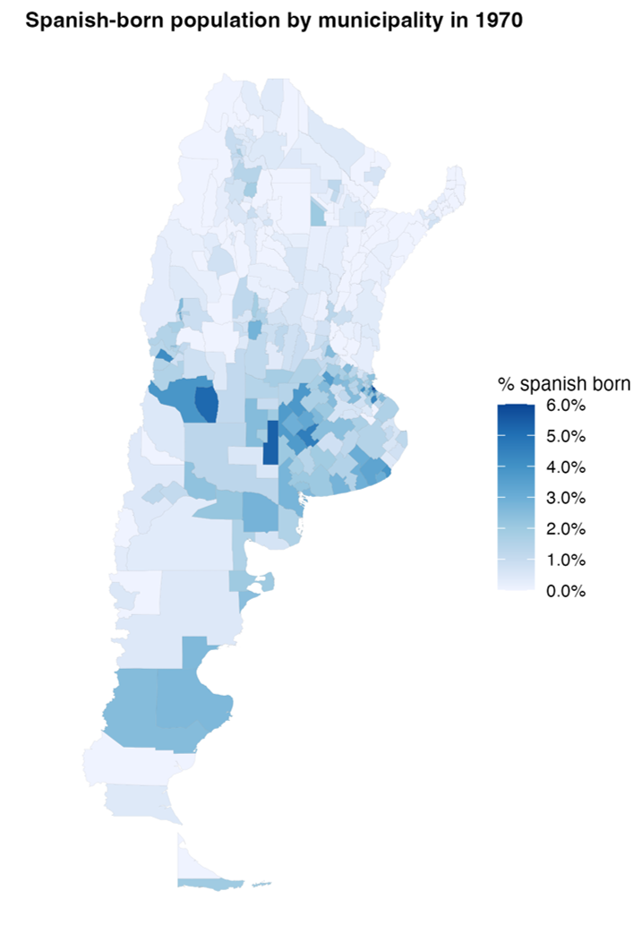
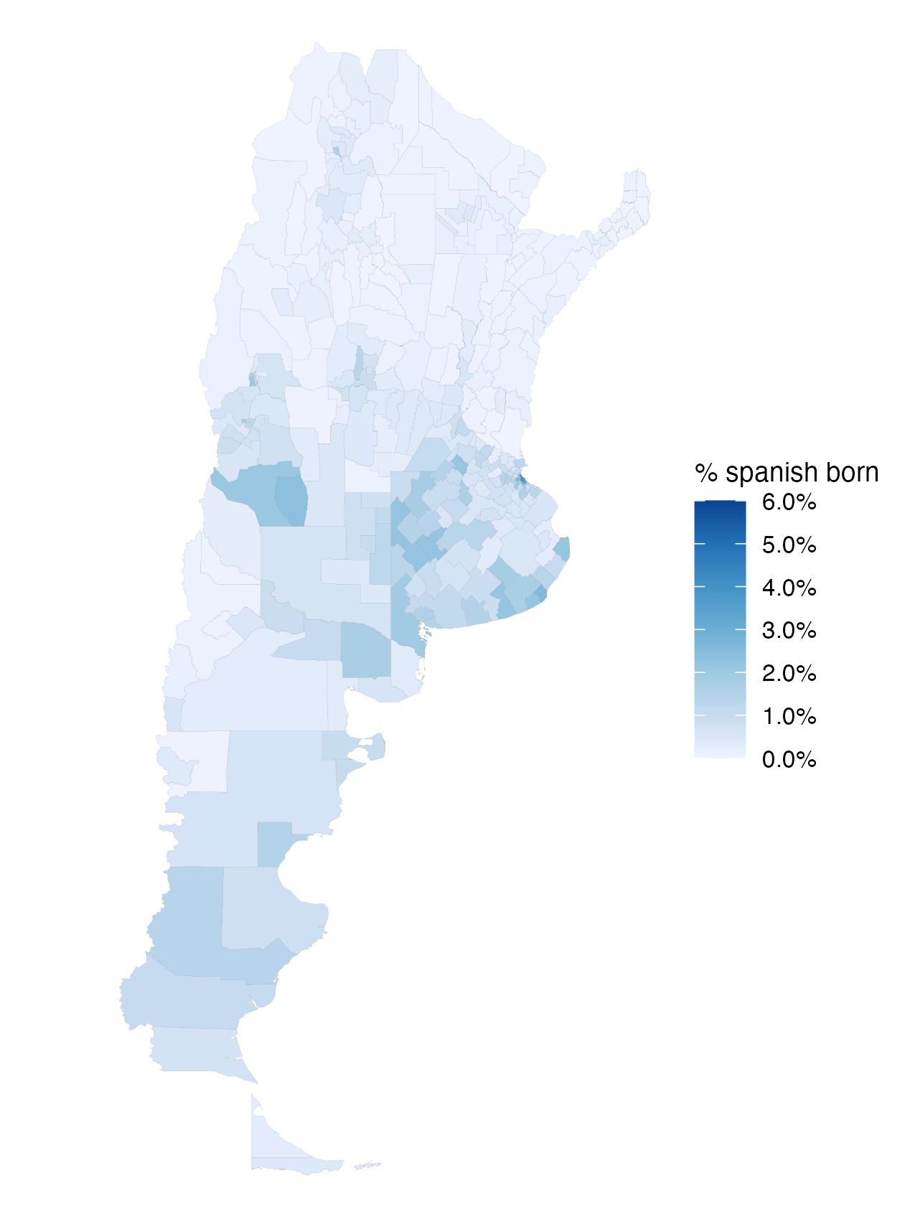
Distribution of Spanish-Born Population
Share of Spanish-born population 1970
Share of Spanish-born population 1980
8 / 37

Slide 9
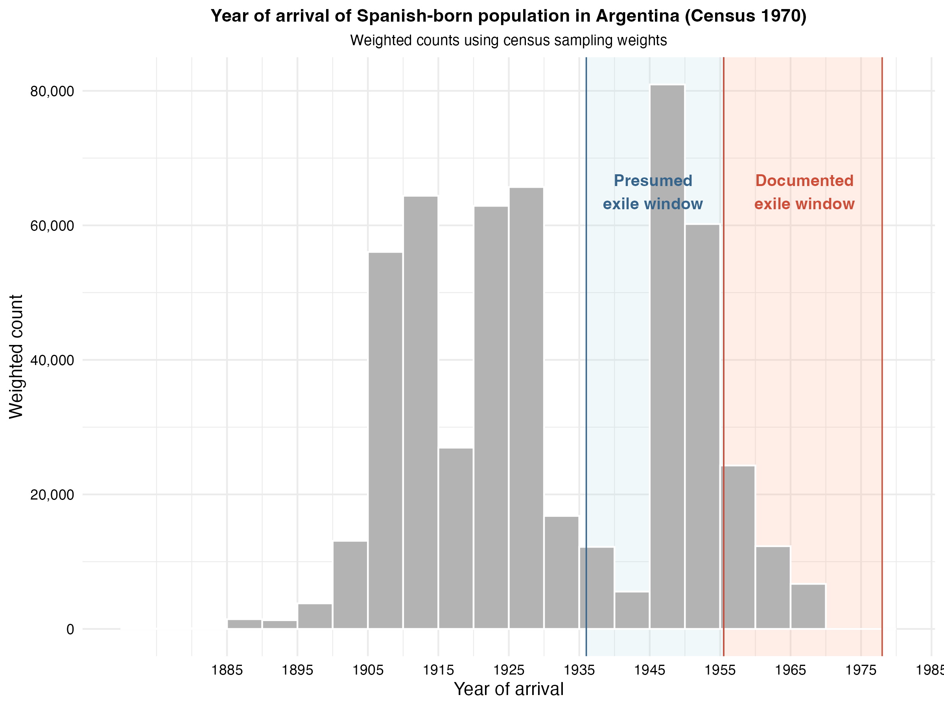
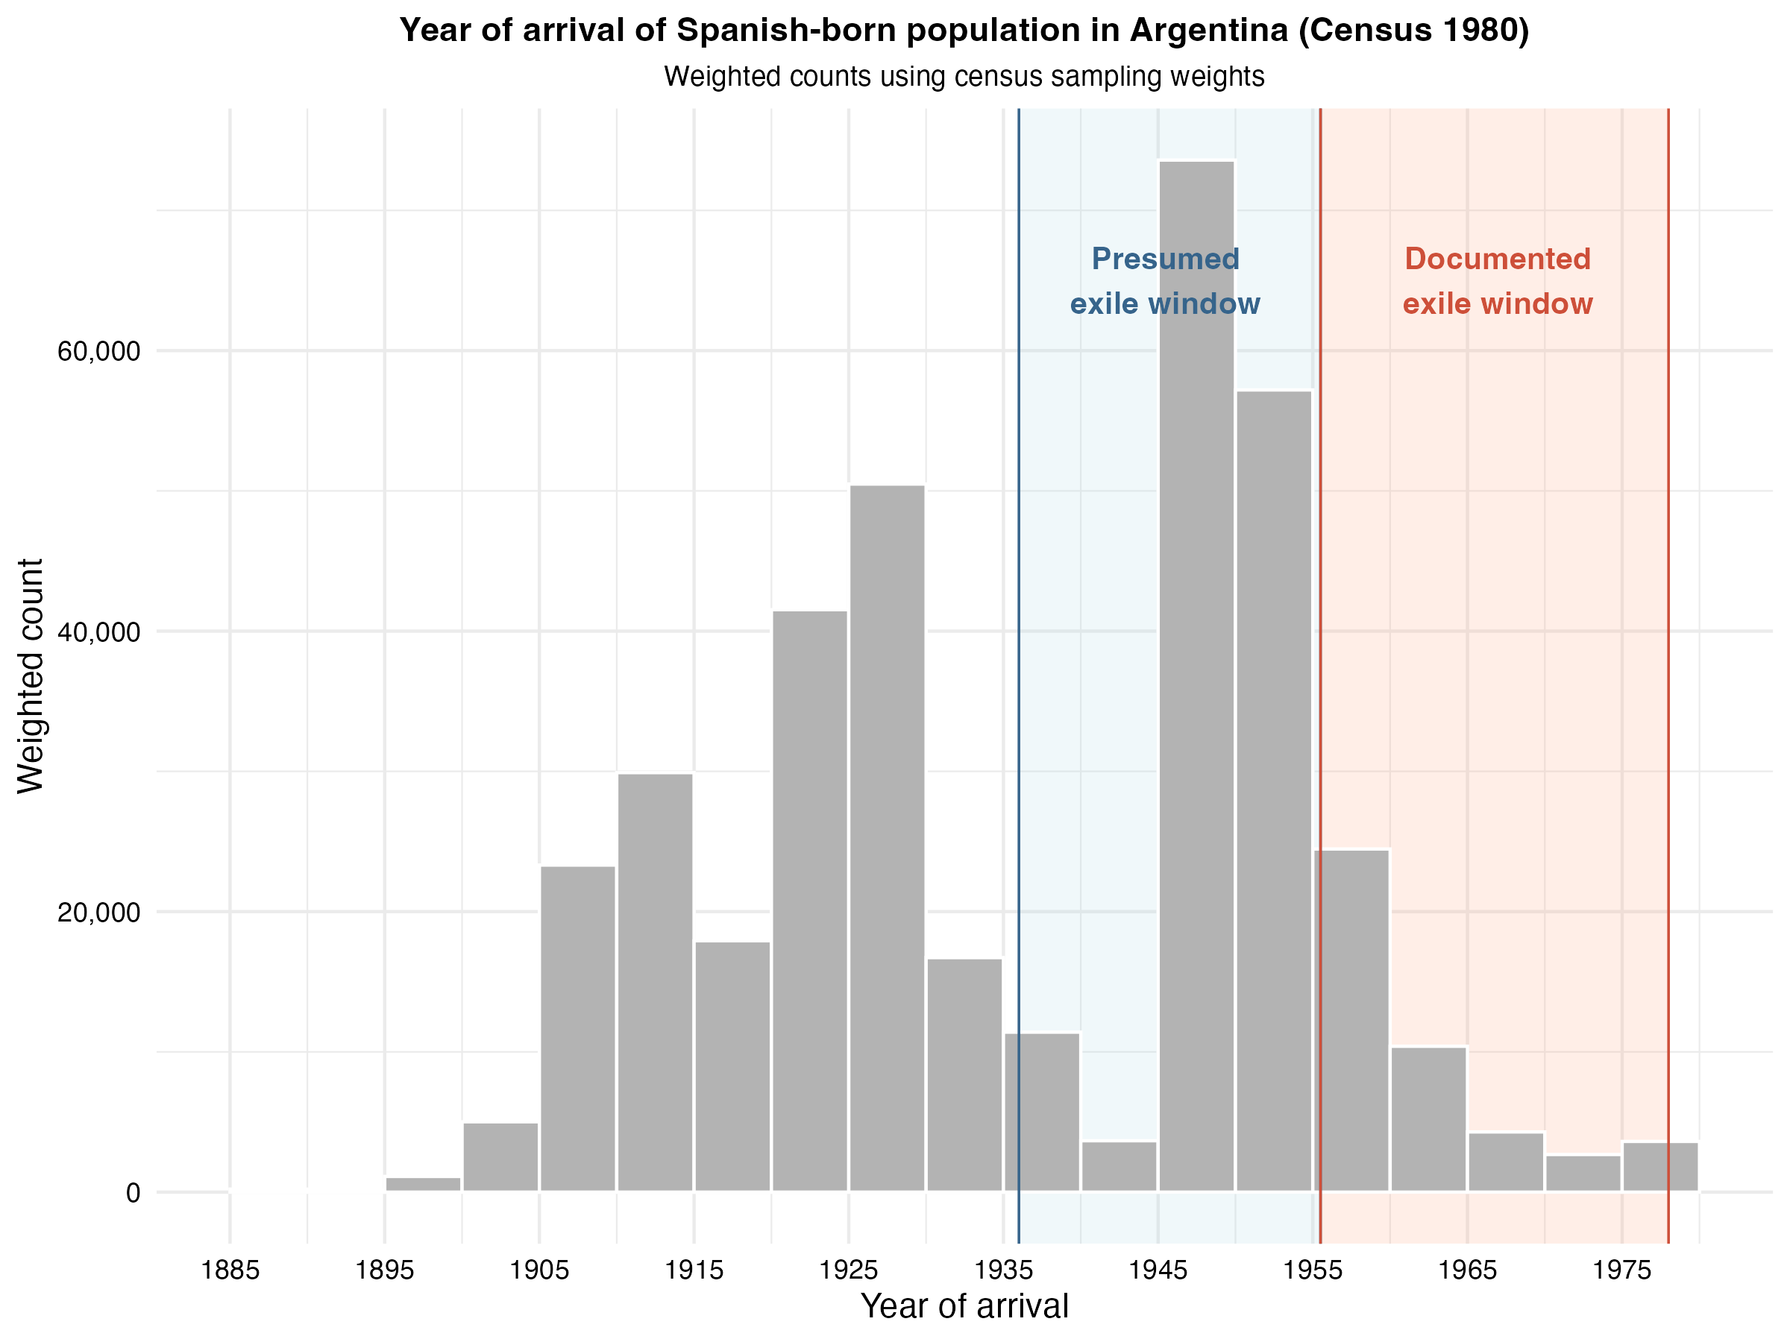
Year of Arrival of Spanish-Born Population
9 / 37

Slide 10
Empirical Strategy
Window Exposure Measure
Formally, we estimate the following equation (1):
yₘₜ = β₁ · postₜ × S₁₉₃₆₋₁₉₅₅,ₘ + β₂ · postₜ × S₁₉₅₆₋₁₉₇₈,ₘ + γₜ + δₘ + ElectionTypeₘₜ + uₘₜ (1)
The main outcome is the share of blank votes, defined as the percentage of votes cast in blank over the total number of voters. As an additional outcome, we also explore voter turnout.
Blank voting as protest behavior: blank votes often reflect dissatisfaction with available political options rather than abstention.
ElectionType is an indicator for whether the election corresponds to a General election or a PASO (primary) election.
We also estimate model (2) restricting the sample to general elections only.
yₘₜ = β₁ · postₜ × S₁₉₃₆₋₁₉₅₅,ₘ + β₂ · postₜ × S₁₉₅₆₋₁₉₇₈,ₘ + γₜ + δₘ + uₘₜ (2)
10 / 37

Slide 11
Preliminary Results: Blank Votes
 | Share of blank votes
 | (1) | (2)
Post × Spanish share (1936-1955) | -2.112** | -1.881***
 | (0.843) | (0.549)
Post × Spanish share (1956-1978) | -4.285* | -2.498
 | (2.238) | (2.285)
Observations | 4,680 | 2,496
Municipality FE | Yes | Yes
Time FE | Yes | Yes
Election type FE | Yes | No
General elections only | No | Yes
p < 0.1, ** p < 0.05, *** p < 0.01
Standard errors clustered at the municipality level in parentheses.
11 / 37

Slide 12
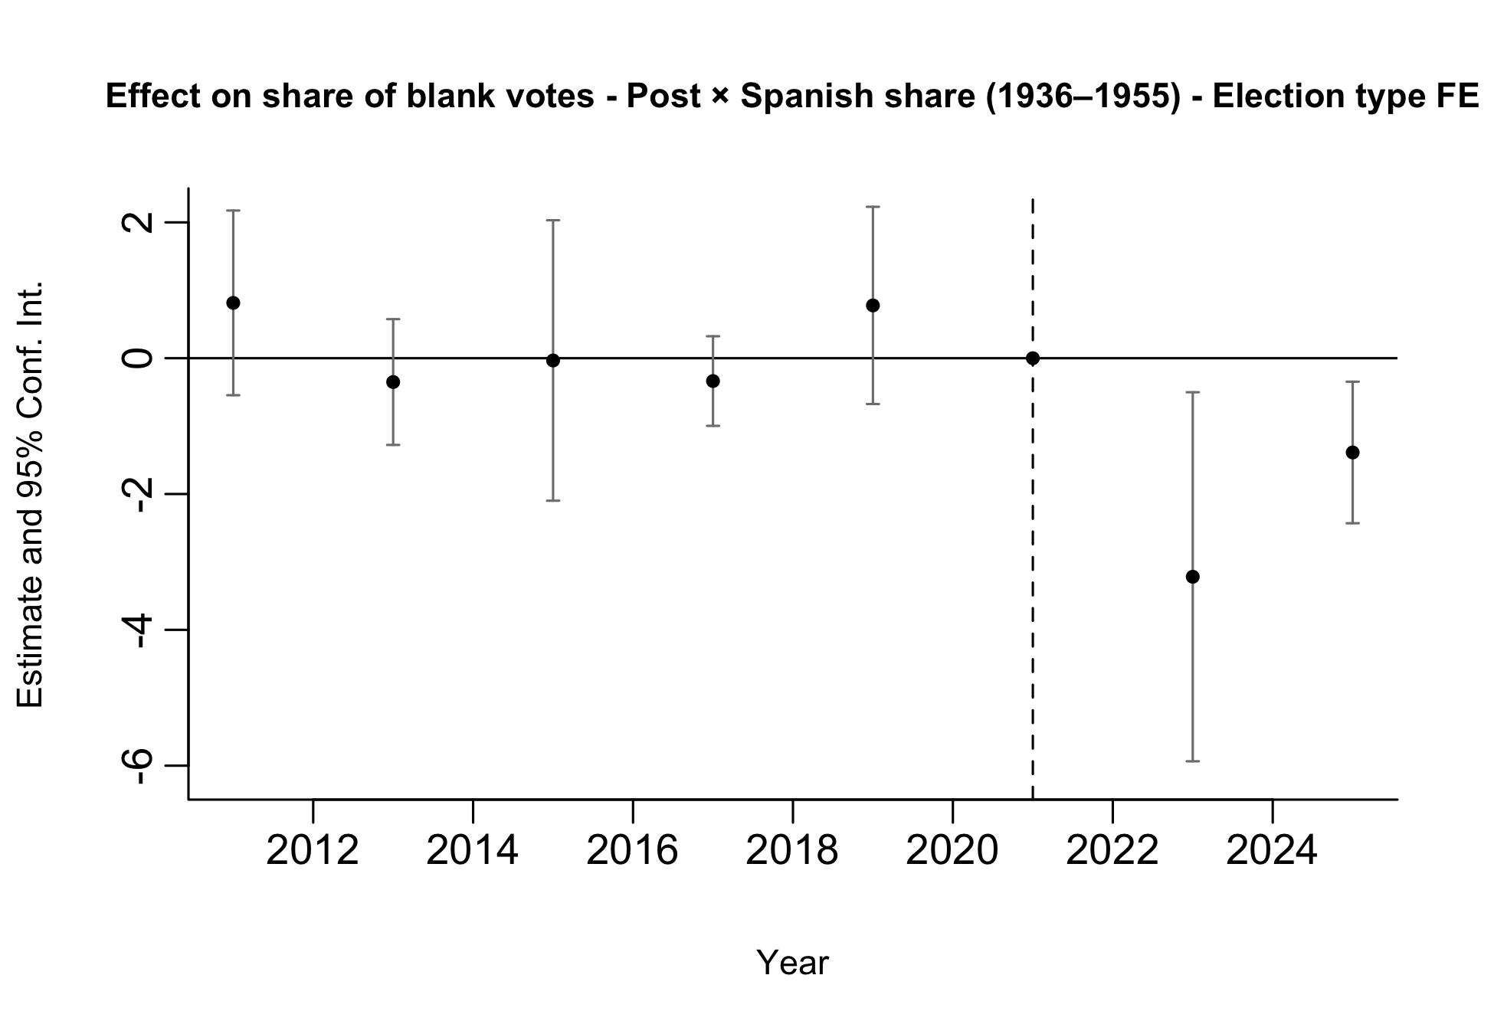
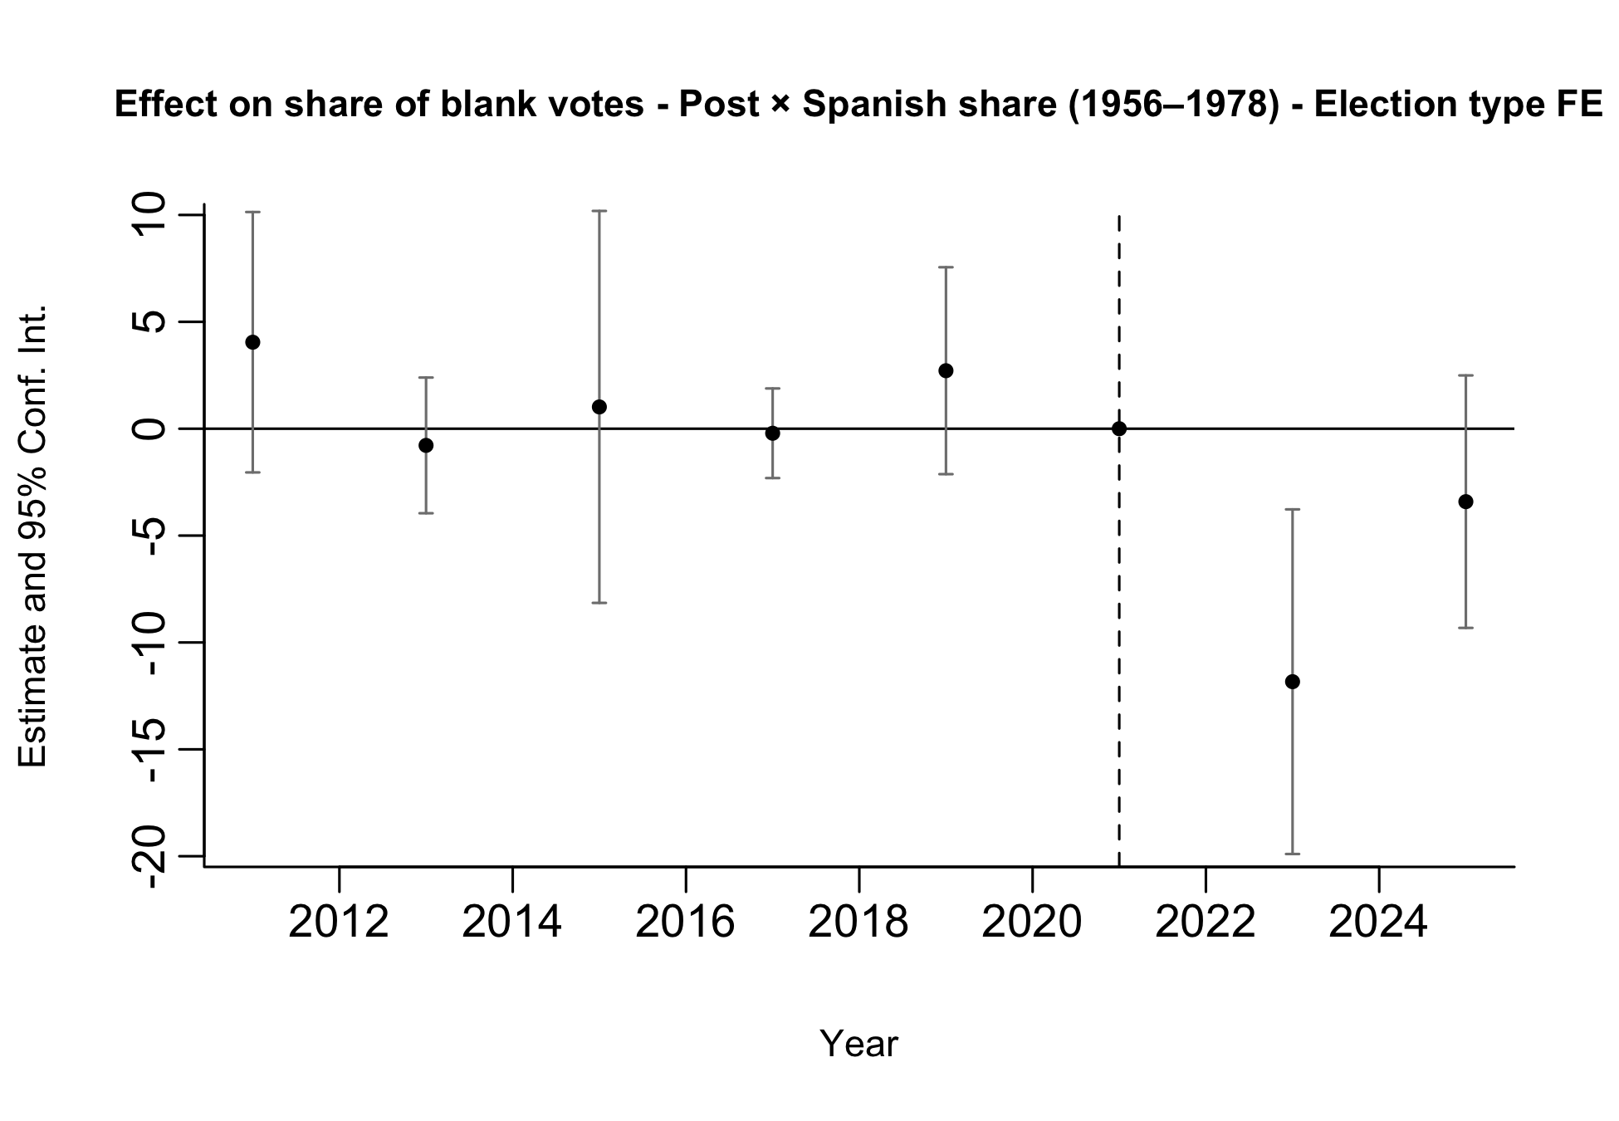
Preliminary Results: Blank Votes
Pre-trends look parallel, although estimates are noisy.
12 / 37
Notes:
We run two separate event-study specifications. In one regression (left), treatment is given by the interaction between post and the municipal Spanish share for arrivals in 1936–1955; in the other (right), treatment is given by the interaction between post and the municipal Spanish share for arrivals in 1956–1978.
This allows us to assess pre-trends in terms of total exposure rather than conditional effects.
Both specifications are estimated on the full sample of elections (PASO and general), including election-type fixed effects.

Slide 13
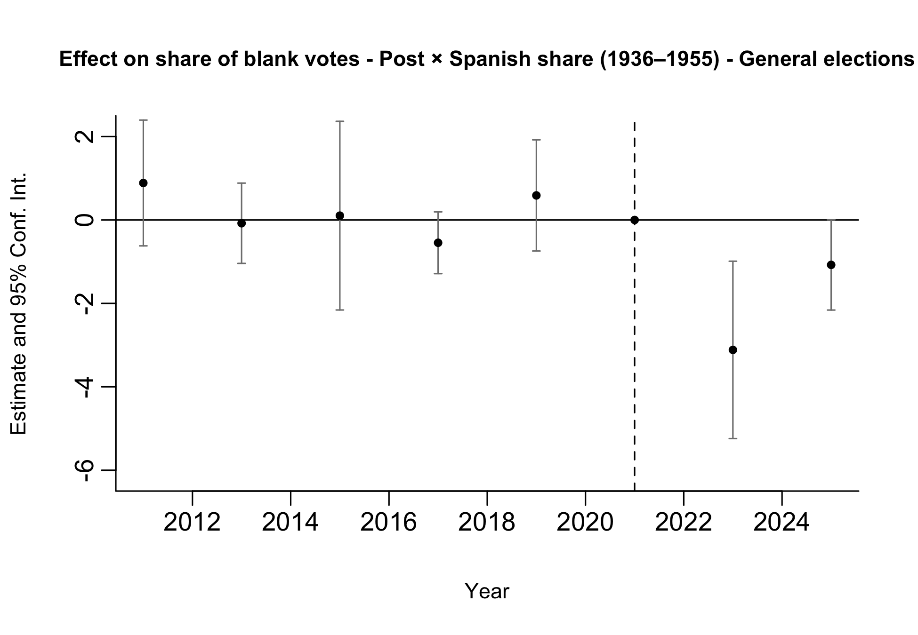
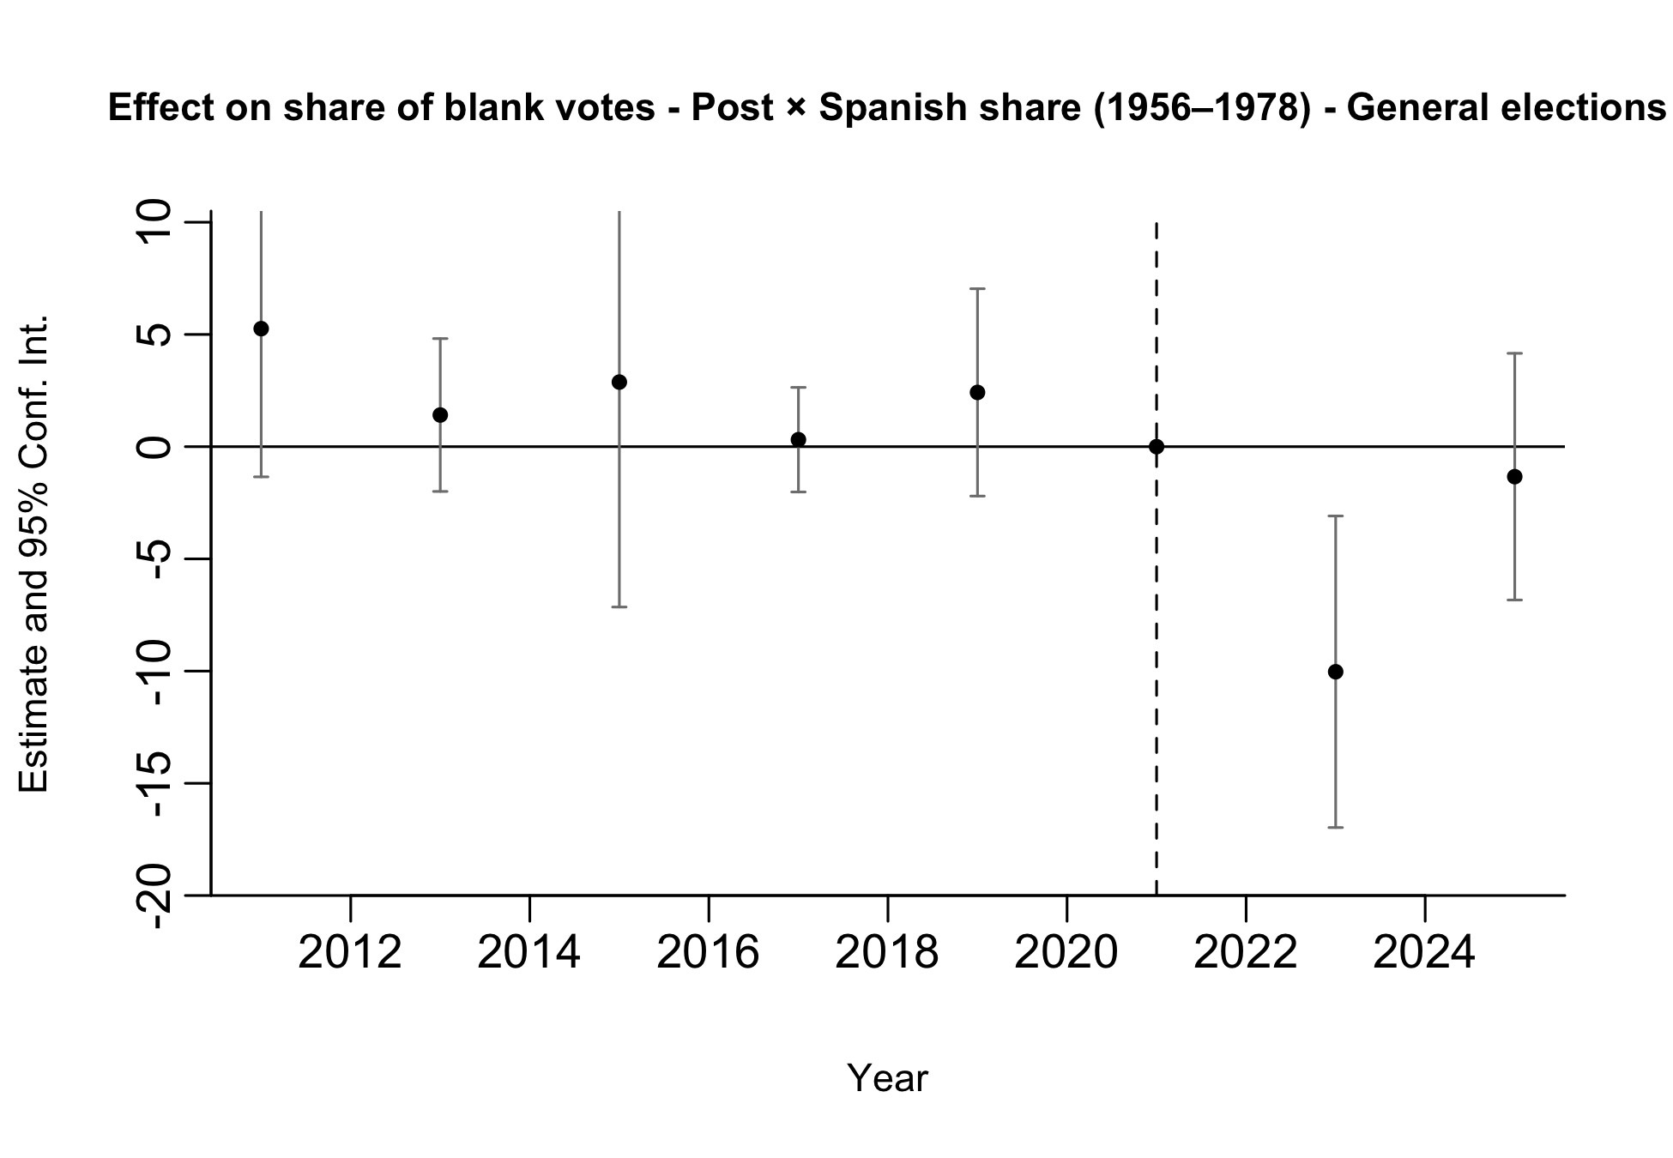
Preliminary Results: Blank Votes
Pre-trends look parallel, although estimates are noisy.
13 / 37
Notes:
We run two separate event-study specifications. In one regression (left), treatment is given by the interaction between post and the municipal Spanish share for arrivals in 1936–1955; in the other (right), treatment is given by the interaction between post and the municipal Spanish share for arrivals in 1956–1978.
This allows us to assess pre-trends in terms of total exposure rather than conditional effects.
Both specifications are estimated on the restricted sample of General elections.

Slide 14
Preliminary Results: Participation
 | Participation
 | (1) | (2)
Post × Spanish share (1936-1955) | -0.468 | -0.481
 | (0.361) | (0.365)
Post × Spanish share (1956-1978) | 2.977** | 2.525*
 | (1.365) | (1.320)
Observations | 4,680 | 2,496
Municipality FE | Yes | Yes
Time FE | Yes | Yes
Election type FE | Yes | No
General elections only | No | Yes
p < 0.1, ** p < 0.05, *** p < 0.01
Standard errors clustered at the municipality level in parentheses.
Less clear effects are found on electoral participation (as expected, since voting is mandatory and participation is high in Argentina).
No significant effects are found for the 1936–1955 cohort, while some effects appear for the 1956–1978 cohort in the expected direction.
However, pre-trends are not flat, which cautions against a causal interpretation.
14 / 37

Slide 15
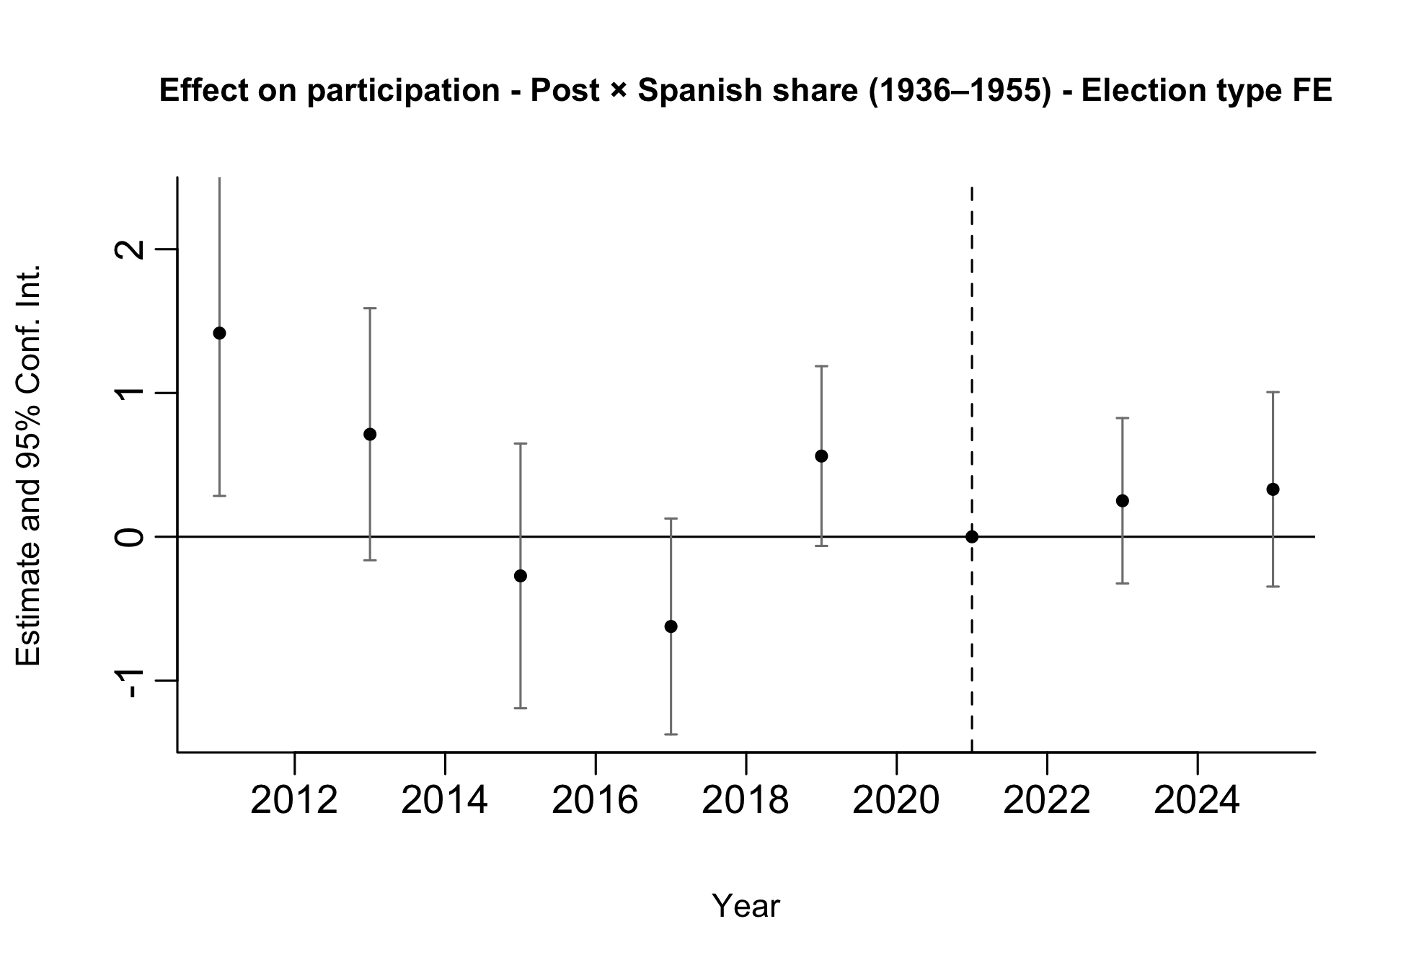
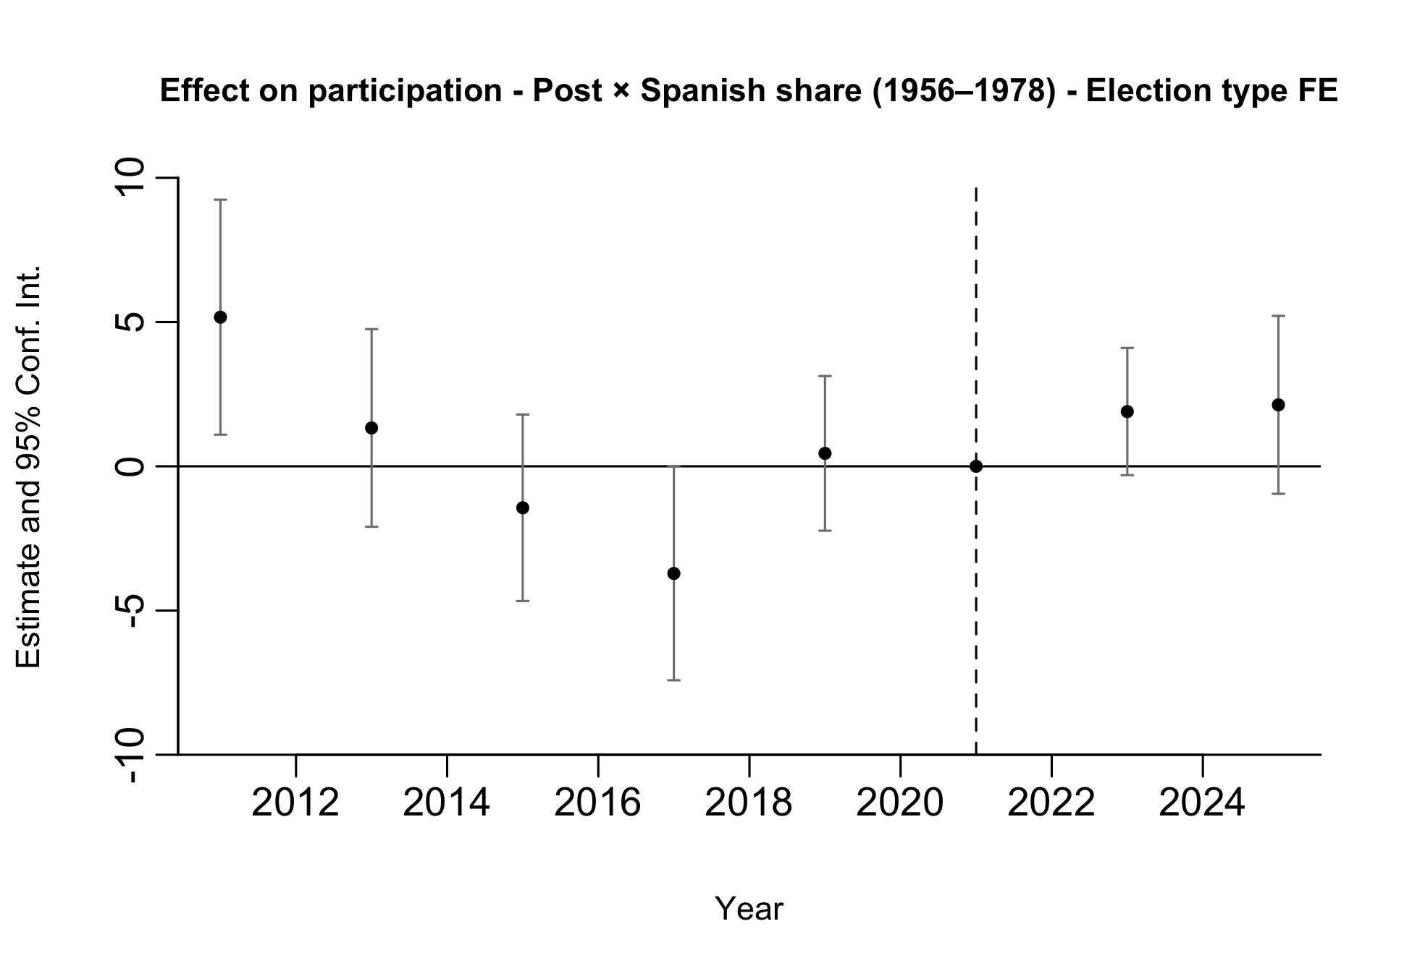
Preliminary Results: Participation
15 / 37
Notes:
We run two separate event-study specifications. In one regression (left), treatment is given by the interaction between post and the municipal Spanish share for arrivals in 1936–1955; in the other (right), treatment is given by the interaction between post and the municipal Spanish share for arrivals in 1956–1978. Full sample (PASO and general).

Slide 16
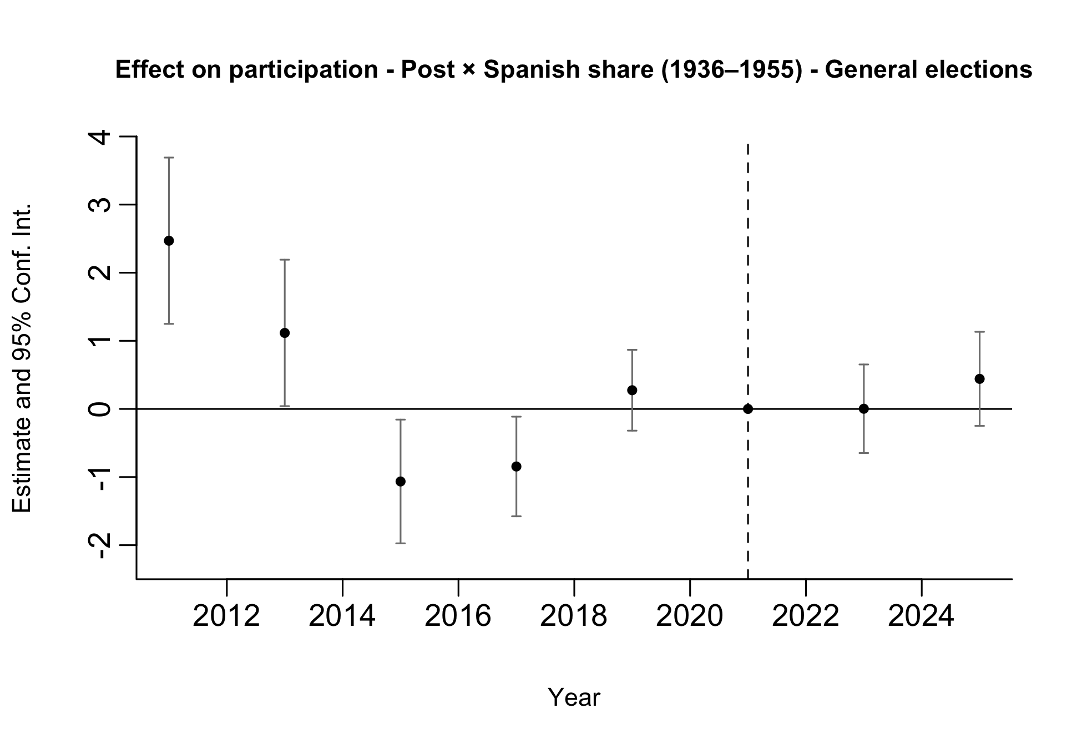
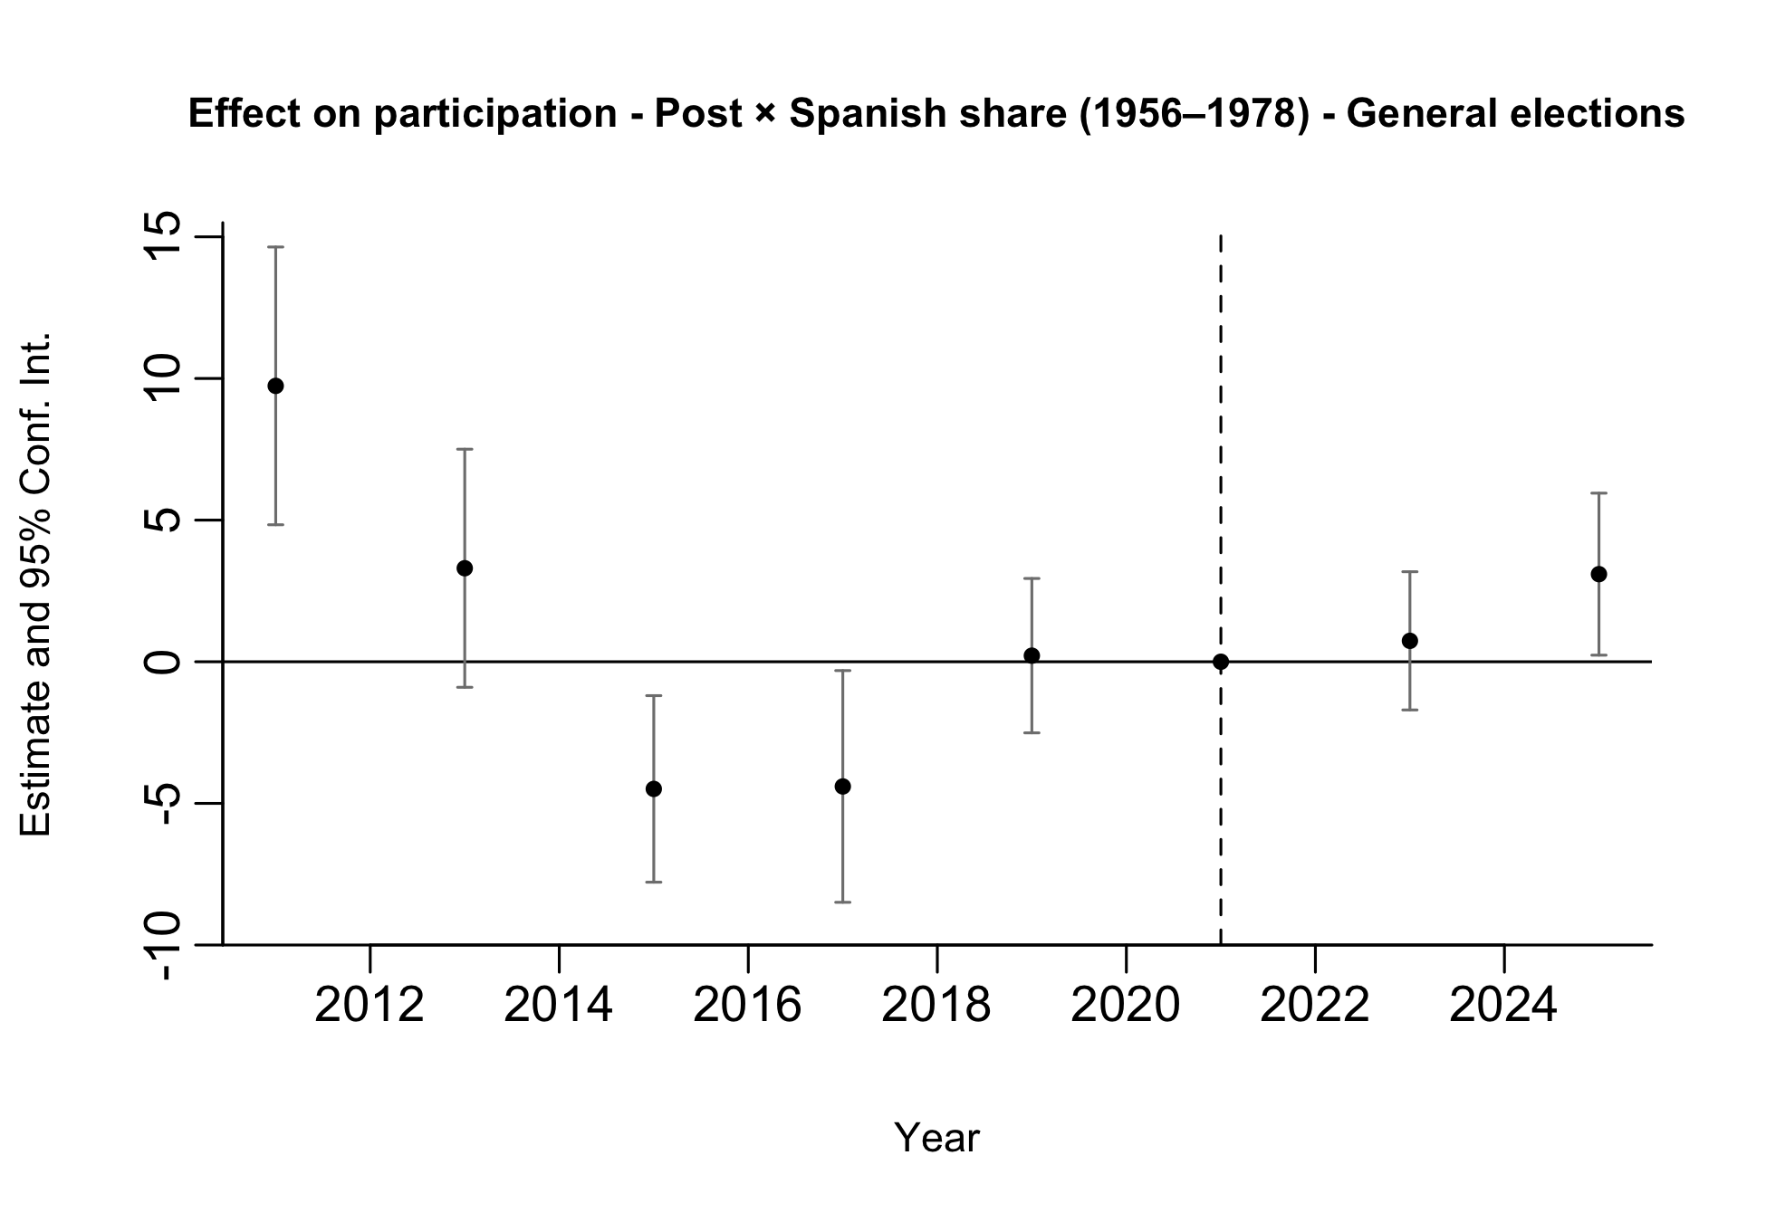
Preliminary Results: Participation
16 / 37
Notes:
We run two separate event-study specifications. Restricted to general elections only.

Slide 17
Feedback
Look into selection issues particularly around political behavior by percent of Spanish immigrants to understand bias.
Correlate Spanish share (1936-1995) and Spanish share (1956-1978) with historical political outcomes.
Link previous voting behavior to those who eventually move to Spain during the years of interest and compare their historical political behavior and tendencies relative to the general population.
Use Spanish data online to describe the characteristics of Argentians who gain Spanish citizenship post 2022 to get a sense if they are positively selected.
Run a version of these models with pre-processed data.
Test if -4.285<-2.122.
Are we only looking at votes provided within the compulsory voting age group?
17 / 37
Notes:
There is no historical electoral data available for Argentina before 2011. We only have electoral outcomes starting in 2011, so we address this using pre-treatment data from 2011–2021.
We do not have individual-level data linking voting behavior to subsequent migration to Spain. We can use LAPOP to describe the political attitudes of individuals who report an intention to migrate.
5. No. We use all votes, since the data are aggregated at the electoral-section level and are not disaggregated by compulsory voting status. We do not have individual-level voting data.

Slide 18
Feedback
Additional Outcomes
Vote share by political party: Since parties and coalition labels change frequently across elections, we instead compute vote shares for the main political forces, focusing on Peronism and Radicalism. This measure is built from a classification of approximately 540 unique parties competing between 2011 and 2025.
Vote share for the incumbent party: For the same reason, We measure both the municipal vote share for the ruling national party and a dummy for whether it wins locally.
Turnout by compulsory and non-compulsory voting age groups: We do not have vote or turnout data disaggregated by compulsory and non-compulsory voting age groups.
Electoral alternation: We construct three measures:
Across elections, whether the winning ideological bloc changes between consecutive elections;
Within elections, whether the PASO-winning party differs from the general-election winner;
Within elections, whether the PASO-winning ideological bloc differs from the general-election winner.
18 / 37
Notes:
National incumbent party:
2011–2015. Cristina Fernández de Kirchner. Frente para la Victoria (FPV).
2015–2019. Mauricio Macri. Cambiemos.
2019–2023. Alberto Fernández. Frente de Todos.
In election years, the variable classifies the national incumbent party as the party that held the executive office up to that point. For example, in 2019, the national incumbent party is Cambiemos.

Slide 19

Feedback
Additional Outcomes
Vote share by ideological bloc: We construct the following measures based on a classification of approximately 540 unique parties competing between 2011 and 2025:
Vote shares for left, center-left, center, center-right and right blocs,
Vote shares fot broad-left and broad-right blocs;
Left–right index, where lower values indicate stronger broad-right support and higher values indicate stronger broad-left support;
Left-rights Index = (Share broad left) - (Share broad right)
An ideological index that summarizes the municipality’s position along the left–right spectrum, with lower values indicating a more left-leaning electorate and higher values indicating a more right-leaning electorate.
Ideological Index = -2(Share left) - 1(Share center-left) + 1(Share center-right) + 2(Share right)
Electoral competition:
Margin between the first- and second-place parties.
Effective Number of Parties (ENP), where higher values indicate a more fragmented party system;
19 / 37

Slide 20
1. Pre-treatment Political Behavior
We conduct three exercises to assess whether municipalities with higher historical Spanish exposure and individuals more likely to migrate already differed politically before the reform.
A. Pre-treatment political differences across municipalities We estimate the following specification for each political outcome using the pre-treatment electoral data (2011–2021).
yₘₜ = β₁ S₁₉₃₆₋₁₉₅₅,ₘ + β₂ S₁₉₅₆₋₁₉₇₈,ₘ + γₜ + δₘ + uₘₜ (3)
B. Differential pre-trends We estimate a pre-treatment event-study specification for each political outcome.
yₘₜ = ∑ₜ β₁ (S₁₉₃₆₋₁₉₅₅,ₘ × Yearₜ) + ∑ₜ β₂ (S₁₉₅₆₋₁₉₇₈,ₘ × Yearₜ) + γₜ + δₘ + uₘₜ (4)
For each outcome, we test whether the year-by-exposure coefficients are jointly equal to zero, separately for each exposure window and jointly for both.
The detailed coefficient estimates from the pre-trends specification are reported in the Appendix.
20 / 37
Notes:
Model 3 tests whether municipalities with higher Spanish exposure already had different political outcomes before the reform; model 4 test whether there are differencial pre trends between municipalities with different share of Spanish populations in the years previos to the law.

Slide 21
1. Pre-treatment Political Behavior
We conduct three complementary exercises to assess whether municipalities with higher historical Spanish exposure and individuals more likely to migrate already differed politically before the reform.
C. Individual-level political selection using LAPOP We estimate the following specification for each political outcome using LAPOP pre-treatment survey rounds (2012, 2014, 2017, 2019).
yᵢₜ = β₁ (S₁₉₃₆₋₁₉₅₅,ₘ × Migrateᵢ) + β₂ (S₁₉₅₆₋₁₉₇₈,ₘ × Migrateᵢ) + Xᵢ + γₜ + δₘ + uᵢₜ (5)
21 / 37

Slide 22
1. Pre-treatment Political Behavior
A. Pre-treatment political differences across municipalities
 | Blank votes | Turnout | Left | Center-left | Center-right | Right | Broad left | Broad right | Left-right index
Share 1936-1955 | 0.487 | 1.521*** | 0.444 | 1.917 | -0.975 | 0.398* | 2.362 | -0.577 | 2.938
 | (0.488) | (0.557) | (0.308) | (1.973) | (1.240) | (0.221) | (1.926) | (1.218) | (2.940)
Share 1956-1978 | 0.565 | 1.827 | 7.233*** | -9.362 | 0.051 | 1.111 | -2.129 | 1.161 | -3.291
 | (2.420) | (2.161) | (1.271) | (7.194) | (4.717) | (1.064) | (6.792) | (5.071) | (10.706)
Year FE | Yes | Yes | Yes | Yes | Yes | Yes | Yes | Yes | Yes
Num.Obs. | 3744 | 3744 | 3744 | 3744 | 3744 | 3744 | 3744 | 3744 | 3744
R2 | 0.231 | 0.153 | 0.144 | 0.122 | 0.413 | 0.165 | 0.106 | 0.416 | 0.275
 | Ideological index | Peronist vote | Radical vote | Incumbent party (share) | Ideological alternation | Different party: PASO-general | Different bloc: PASO-general | Margin | ENP
Share 1936-1955 | -0.030 | 1.328 | -0.187 | 1.392 | -0.056 | -0.055*** | -0.043** | 0.651 | 0.037
 | (0.029) | (1.397) | (0.490) | (0.878) | (0.040) | (0.021) | (0.019) | (1.128) | (0.053)
Share 1956-1978 | -0.028 | -21.809*** | -1.242 | -2.482 | 0.402*** | 0.243** | 0.102 | -17.392*** | 1.008***
 | (0.107) | (5.750) | (1.837) | (4.147) | (0.130) | (0.095) | (0.082) | (5.346) | (0.257)
Year FE | Yes | Yes | Yes | Yes | Yes | Yes | Yes | Yes | Yes
Num.Obs. | 3744 | 3744 | 3744 | 3744 | 3120 | 3744 | 3744 | 3744 | 3744
R2 | 0.265 | 0.207 | 0.183 | 0.147 | 0.027 | 0.078 | 0.045 | 0.115 | 0.107
* p < 0.1, ** p < 0.05, *** p < 0.01. Standard errors clustered at the municipality level in parentheses.
22 / 37

Slide 23
1. Pre-treatment Political Behavior
B. Differential pre-trends
Outcome | p-value (1936-1955) | p-value (1956-1978) | p-value (joint)
Blank votes | 0,396 | 0,960 | 0,501
Turnout | 0,039 | 0,133 | 0,004
Left | 0,055 | 0,023 | 0,002
Center-left | 0,569 | 0,042 | 0,005
Center-right | 0,000 | 0,470 | 0,000
Right | 0,000 | 0,059 | 0,000
Broad left | 0,638 | 0,012 | 0,000
Broad right | 0,000 | 0,444 | 0,000
Left-right index | 0,003 | 0,271 | 0,000
Ideological index | 0,010 | 0,123 | 0,000
Peronist vote | 0,001 | 0,831 | 0,000
Radical vote | 0,244 | 0,082 | 0,002
Incumbent party (share) | 0,001 | 0,093 | 0,000
Ideological alternation | 0,120 | 0,066 | 0,012
Same party: PASO-general | 0,529 | 0,009 | 0,018
Same bloc: PASO-general | 0,025 | 0,083 | 0,007
Margin | 0,012 | 0,197 | 0,004
ENP | 0,000 | 0,027 | 0,000
Wald test of the joint null hypothesis that all pre-treatment interaction coefficients are equal to zero.
23 / 37

Slide 24
1. Pre-treatment Political Behavior
C. Individual-level political selection using LAPOP
 | Left-right ideology | Previous vote | Party identification | Vote intention | Blank/null vote intention | Community meetings
Intends to migrate | 0.009 | -0.097*** | 0.005 | -0.015 | 0.037 | 0.032*
 | (0.124) | (0.024) | (0.018) | (0.014) | (0.024) | (0.017)
Intends to migrate × Spanish share 1936–1955 | 0.455*** | 0.055 | 0.010 | 0.018 | -0.017 | 0.003
 | (0.167) | (0.036) | (0.027) | (0.028) | (0.026) | (0.034)
Intends to migrate × Spanish share 1956–1978 | -2.138*** | -0.276 | -0.005 | -0.179 | 0.082 | 0.057
 | (0.595) | (0.172) | (0.115) | (0.114) | (0.128) | (0.137)
Age | 0.014*** | 0.004*** | 0.004*** | -0.002*** | -0.002*** | 0.001***
 | (0.002) | (0.000) | (0.000) | (0.000) | (0.000) | (0.000)
Male | -0.074 | -0.006 | 0.033*** | -0.003 | -0.017 | -0.010
 | (0.066) | (0.010) | (0.011) | (0.007) | (0.011) | (0.010)
Years of education | -0.013 | 0.014*** | 0.007*** | 0.007*** | -0.015*** | 0.005***
 | (0.011) | (0.002) | (0.002) | (0.002) | (0.002) | (0.002)
Year FE | Yes | Yes | Yes | Yes | Yes | Yes
Municipality FE | Yes | Yes | Yes | Yes | Yes | Yes
Num.Obs. | 4802 | 5748 | 5687 | 4953 | 4426 | 5752
R2 | 0.060 | 0.075 | 0.048 | 0.044 | 0.081 | 0.022
* p < 0.1, ** p < 0.05, *** p < 0.01. Standard errors clustered at the municipality level in parentheses.
24 / 37

Slide 25
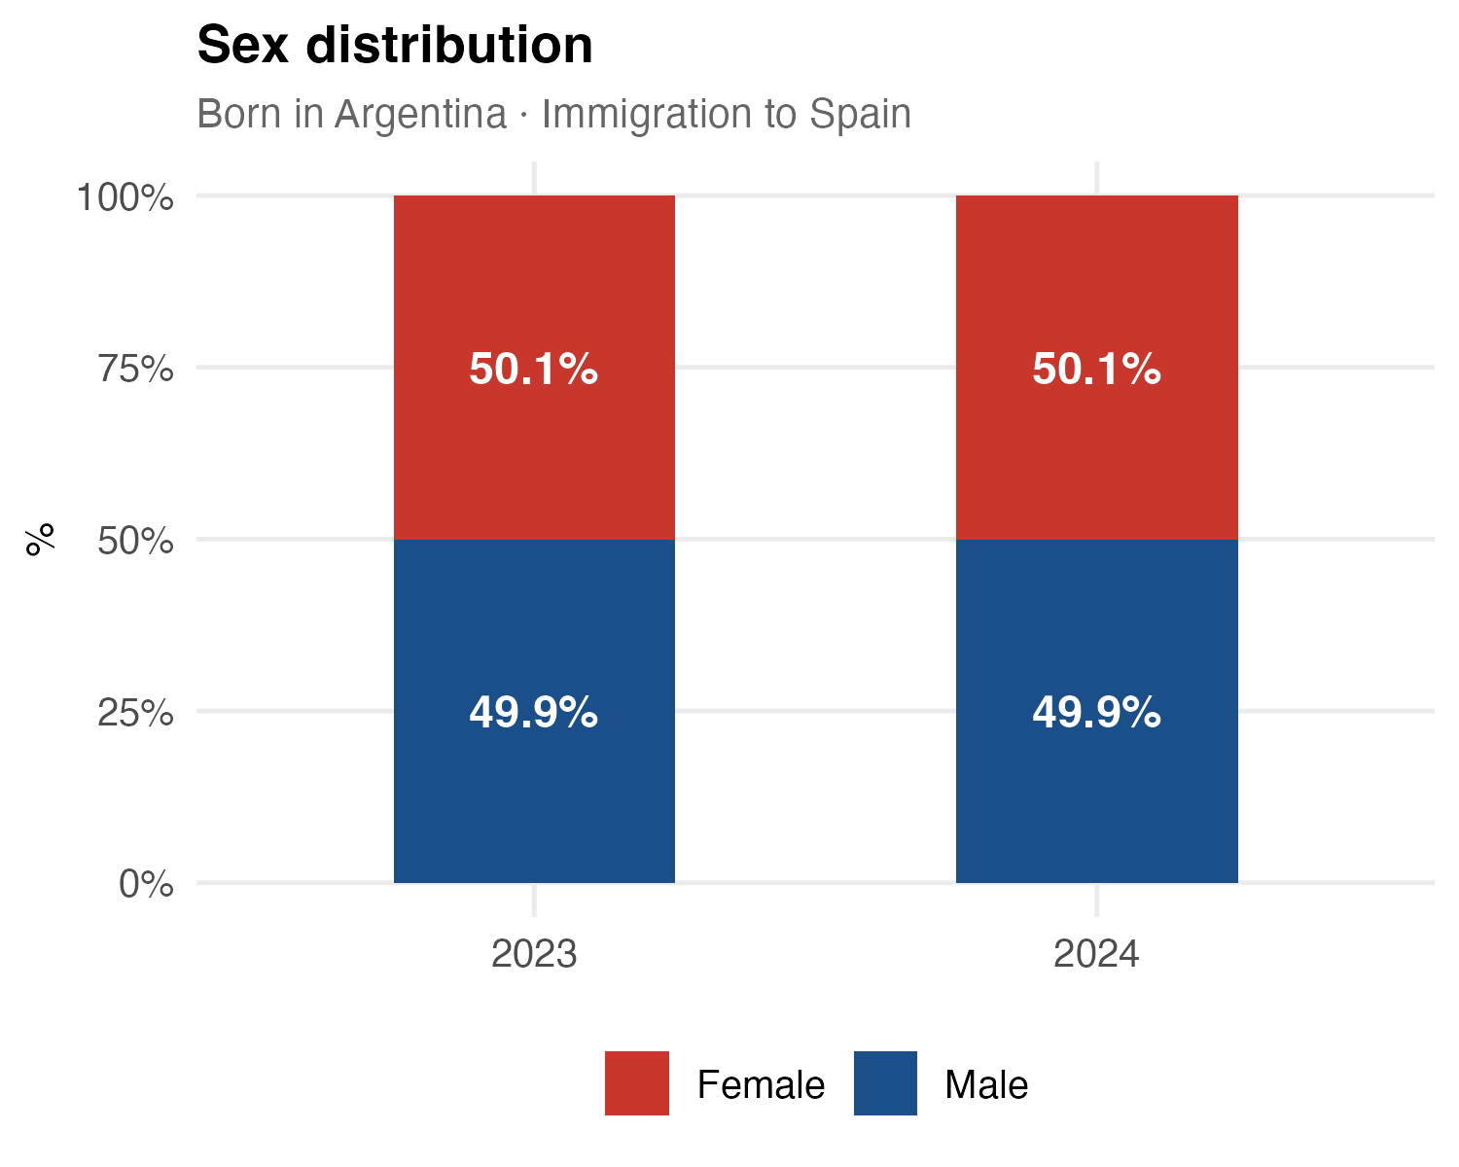
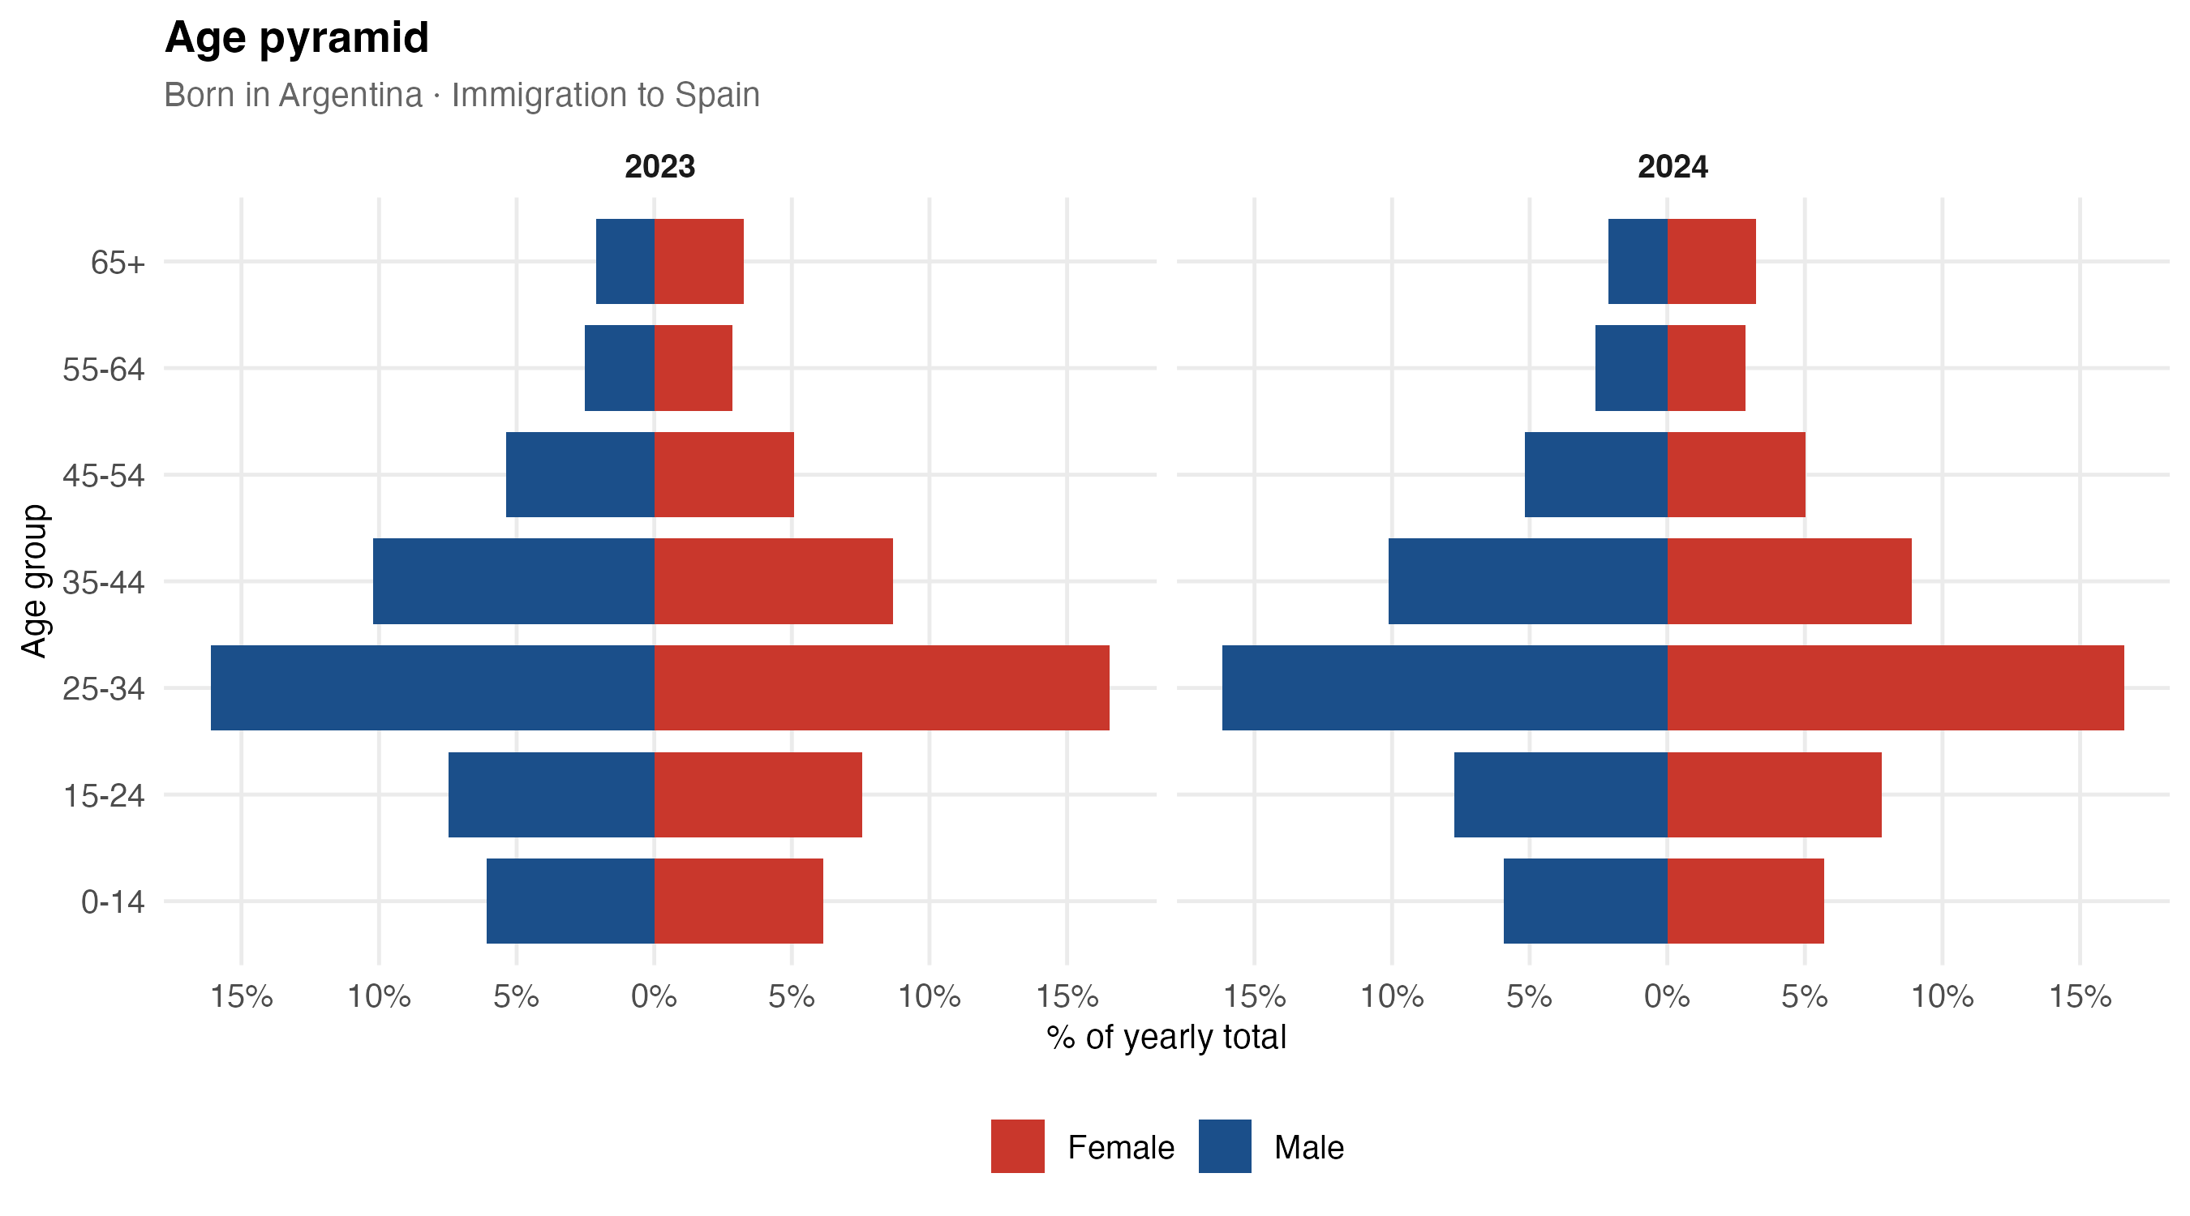
2. Argentine Migrants in Spain: Age and Sex
INE microdata: comparison of immigration inflows to Spain, 2023 vs 2024
25 / 37

Slide 26
3. Pre-processed Data
Entropy balancing of treatment intensity
We re-weight municipalities using entropy balancing for a continuous treatment.
It finds weights that break the association between the Spanish-share exposure measure and a set of pre-treatment covariates, while keeping the weights as close as possible to uniform.
We try 8 covariate sets, each run twice — with and without the other window's Spanish share as a covariate.
Set | Pre-treatment covariates
1 | Blank vote share, voter turnout, log population, log population density.
2 | Set 1 + share of women, mean age.
3 | Set 2 + share employed, share in the labor force, share literate.
4 | Set 3 + left and Peronist vote shares, effective number of parties, margin of victory.
5 | Set 1 + left and Peronist vote shares, effective number of parties, margin of victory.
6 | Voter turnout, left and Peronist vote shares, effective number of parties, margin of victory.
7 | Log population density, mean age, share employed, mean years of schooling.
8 | Log population density, share aged 25–44, share employed, share with university education.
26 / 37
Notes:
Entropy balancing for a continuous treatment generalises entropy balancing (Hainmueller) to a continuous exposure variable. Instead of matching treated and control groups, it chooses municipality weights so that, in the weighted sample, the chosen pre-treatment covariates become orthogonal to the Spanish-share exposure measure, while staying as close as possible to the uniform (unweighted) distribution. We implement it with the Stata command ebct.
We explore 8 covariate sets that move from a minimal specification (Set 1: population size, density, blank vote and turnout) to progressively richer ones adding demographics (Set 2), socioeconomic and education variables (Set 3), and the pre-treatment electoral outcomes that looked unbalanced (Sets 4-6). Sets 7 and 8 are deliberately parsimonious specifications built only from census covariates.
Each set is estimated twice: with and without the Spanish share of the OTHER exposure window as an additional covariate. Why include it? Our final specification regresses the outcome on BOTH shares (1936-1955 and 1956-1978) jointly. The two shares are correlated (rho = 0.65), so municipalities with a larger 1936-1955 Spanish presence also tend to have a larger 1956-1978 presence. If the other share is not balanced, the coefficient on one window would partly capture differences associated with the other. Including the other share in the balancing means we compare municipalities that differ in one window but are similar in the other, which makes the 'net' effect of each window more credible.
Why also run it WITHOUT the other share? Precisely because the two shares are highly correlated, asking the algorithm to balance one share while holding the other fixed is empirically demanding: it must place very large weight on a small number of unusual municipalities to break that correlation. That is visible in the weight distributions and effective sample sizes, so we report both versions.

Slide 27
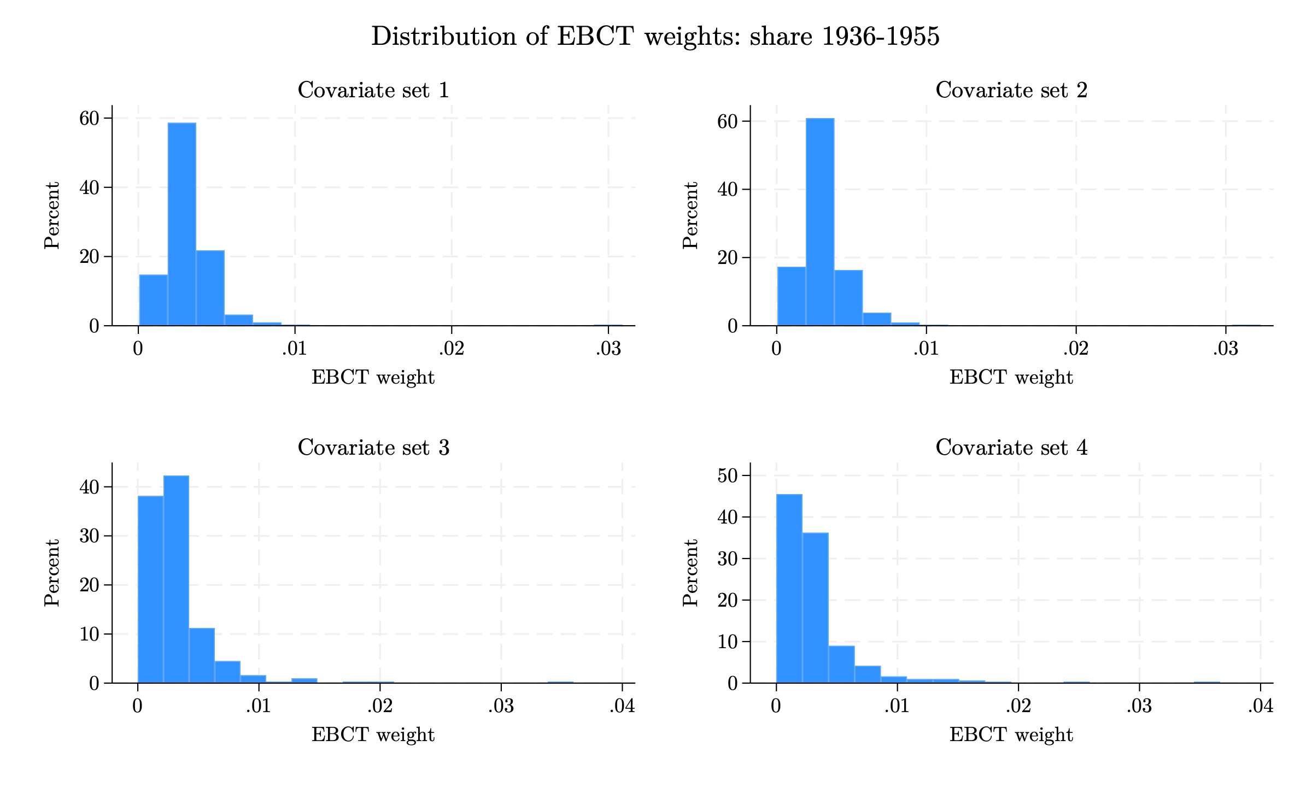
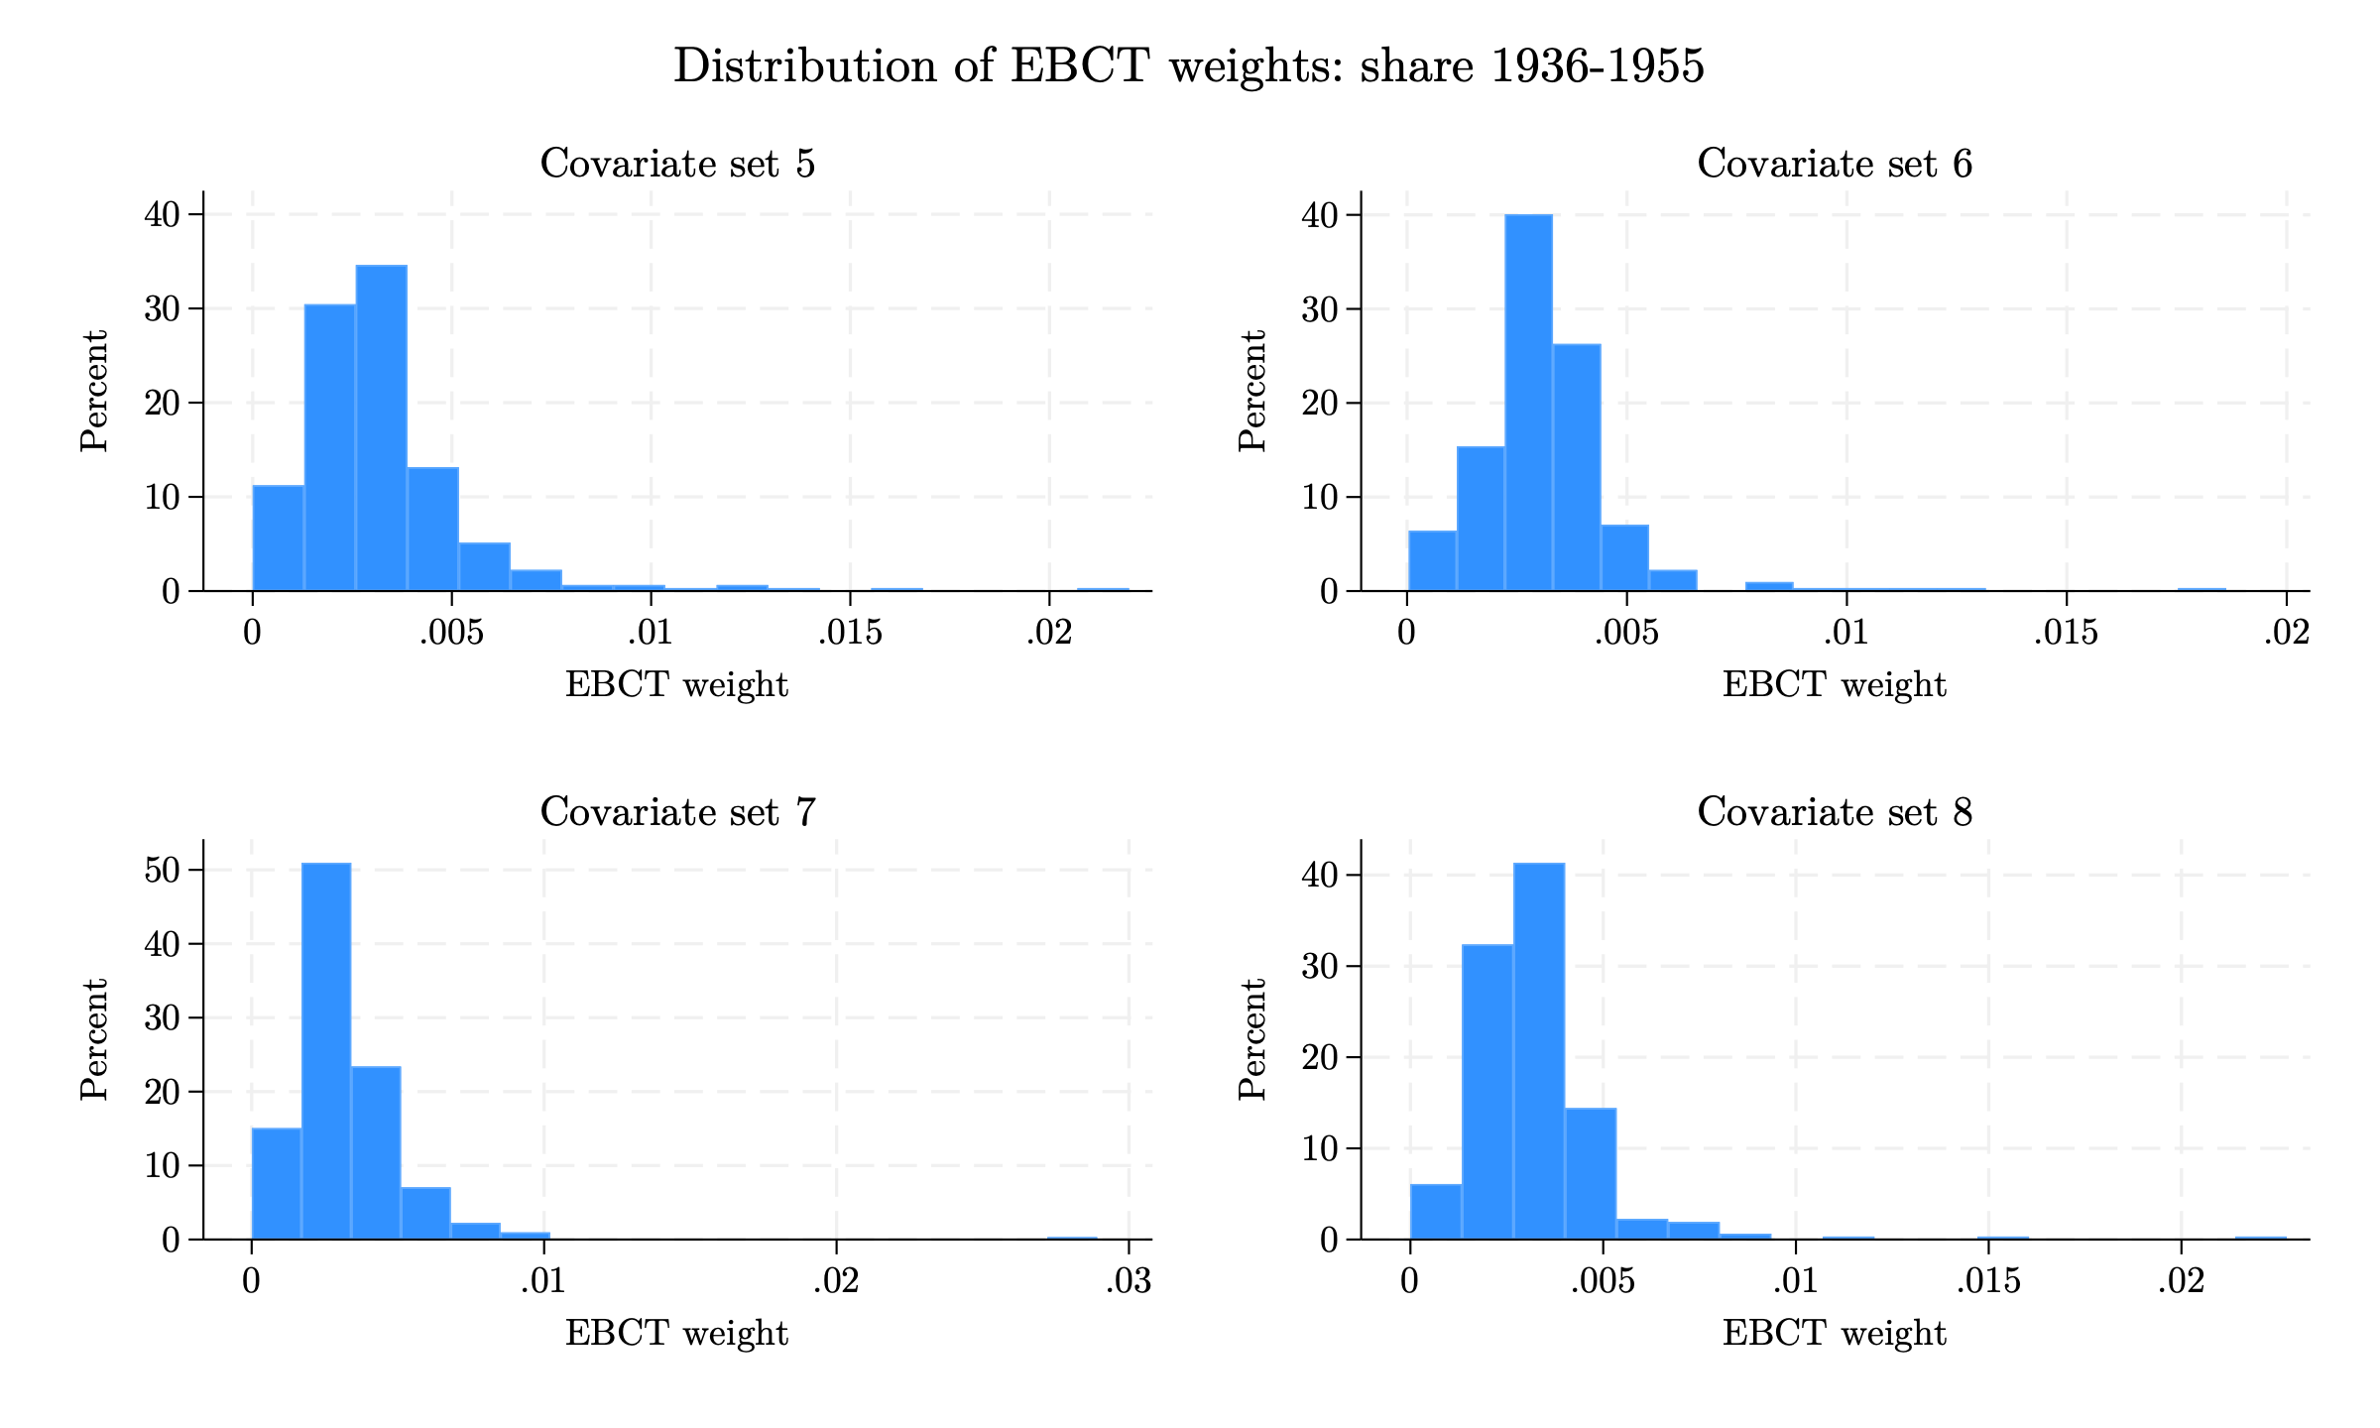
3. Pre-processed Data
Distribution of entropy-balancing weights: Spanish share 1936–1955
Histograms of EBCT weights across the 8 covariate sets (left: sets 1–4; right: sets 5–8). Weights exclude the other exposure window's Spanish share.
27 / 37
Notes:
Each histogram shows the distribution of entropy-balancing weights for one covariate set, for the 1936-1955 exposure window, in the version that excludes the other Spanish share. By construction the weights average 1/312 (about 0.0032) and are non-negative. A well-behaved distribution is concentrated near the mean with a short right tail; a long right tail means a few municipalities receive a large share of the weight, which lowers the effective sample size and makes the weighted estimates noisier. Richer covariate sets (3 and 4) and the parsimonious sets generally produce more dispersed weights than the minimal Set 1.

Slide 28
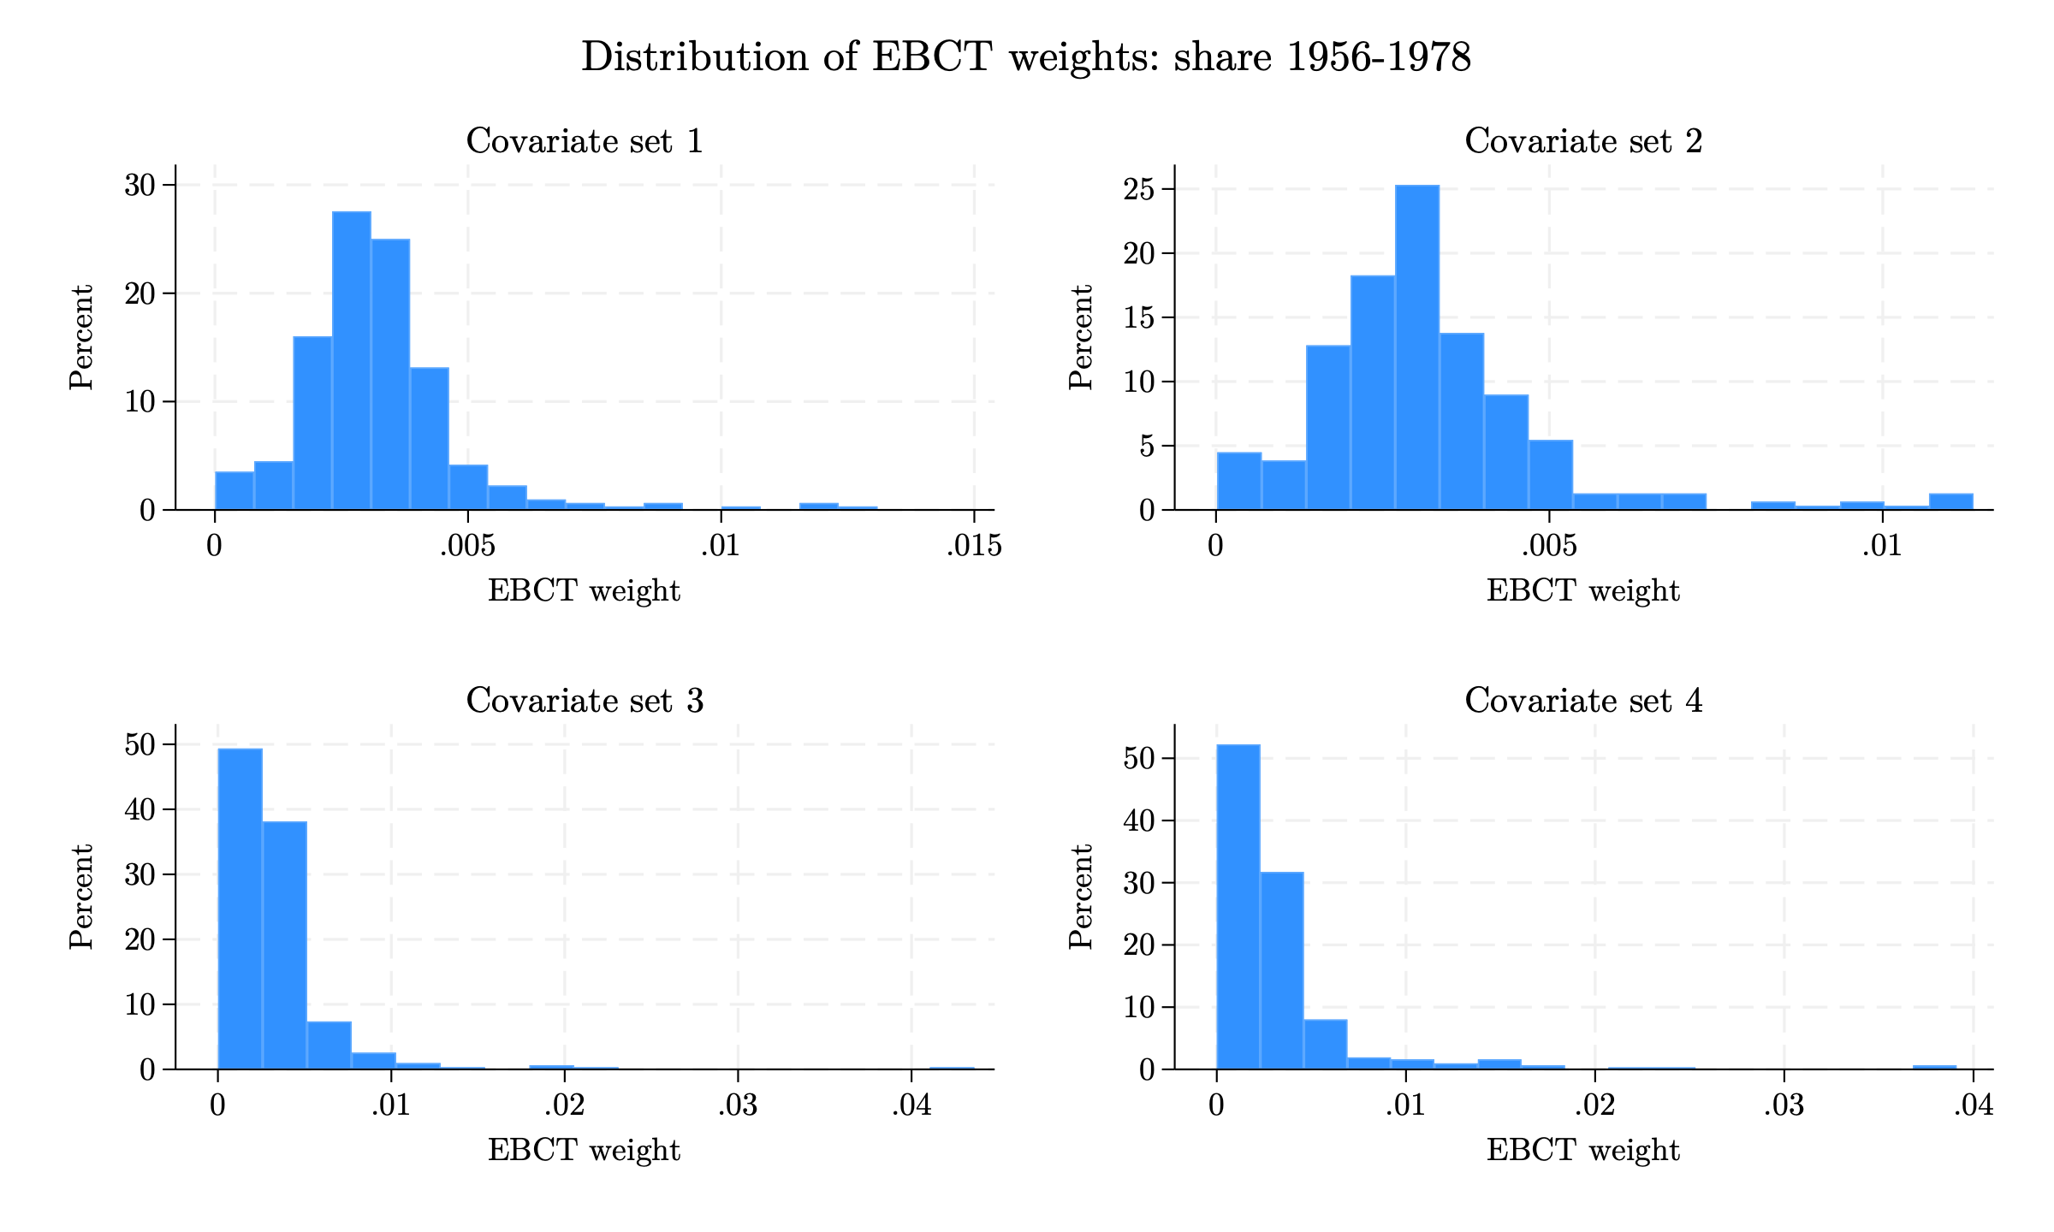
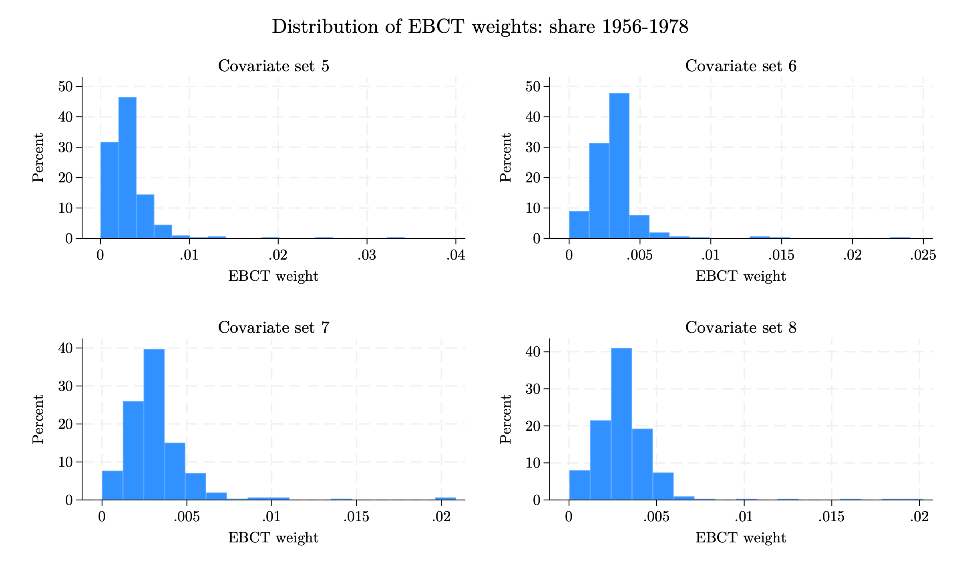
3. Pre-processed Data
Distribution of entropy-balancing weights: Spanish share 1956–1978
Histograms of EBCT weights across the 8 covariate sets (left: sets 1–4; right: sets 5–8). Weights exclude the other exposure window's Spanish share.
28 / 37
Notes:
Each histogram shows the distribution of entropy-balancing weights for one covariate set, for the 1956-1978 exposure window, in the version that excludes the other Spanish share. By construction the weights average 1/312 (about 0.0032) and are non-negative. A well-behaved distribution is concentrated near the mean with a short right tail; a long right tail means a few municipalities receive a large share of the weight, which lowers the effective sample size and makes the weighted estimates noisier. Richer covariate sets (3 and 4) and the parsimonious sets generally produce more dispersed weights than the minimal Set 1.

Slide 29
3. Pre-processed Data
EB balance check: treatment–covariate correlations
Linear correlations
Set | Bef. 36–55 | Aft. 36–55 | Bef. 56–78 | Aft. 56–78
1 | 0.463 | 0.000 | 0.423 | 0.000
2 | 0.463 | 0.000 | 0.423 | 0.000
3 | 0.463 | 0.000 | 0.423 | 0.000
4 | 0.463 | 0.000 | 0.423 | 0.000
5 | 0.463 | 0.000 | 0.423 | 0.000
6 | 0.286 | 0.000 | 0.369 | 0.000
7 | 0.463 | 0.000 | 0.423 | 0.000
8 | 0.463 | 0.000 | 0.423 | 0.000
Treatment–covariate correlation across the covariates in each set, before and after weighting. Entropy balancing drives every weighted correlation to zero (exact mean balance). Weights exclude the other exposure window's Spanish share.
29 / 37

Slide 30
3. Pre-processed Data
Event study of blank vote share with entropy-balancing weights
 | No EB | EB 1 | EB 2 | EB 3 | EB 4 | EB 5 | EB 6 | EB 7 | EB 8
Year × Spanish share, 1936–1955 exposure window
2011 | 0.815 (0.691) | -1.068 (1.336) | -1.101 (1.372) | -2.601** (1.012) | -1.782 (1.081) | -0.479 (1.287) | 0.942 (0.900) | -1.655 (1.127) | -1.789 (1.147)
2013 | -0.351 (0.471) | -1.584** (0.651) | -1.630** (0.674) | -1.877** (0.916) | -1.088 (0.809) | -0.917 (0.681) | -0.328 (0.643) | -1.851*** (0.670) | -2.058** (0.818)
2015 | -0.034 (1.049) | -0.798 (2.448) | -1.242 (2.047) | -2.720 (1.964) | -1.646 (2.190) | 1.287 (3.471) | 3.678 (3.210) | -1.536 (2.152) | -1.512 (2.424)
2017 | -0.337 (0.335) | -1.088*** (0.373) | -0.945** (0.373) | -1.343*** (0.375) | -0.958** (0.468) | -0.975** (0.462) | -0.755 (0.483) | -1.310*** (0.443) | -1.487*** (0.456)
2019 | 0.777 (0.738) | 0.393 (1.308) | 0.570 (1.386) | -1.185 (0.789) | -0.688 (0.828) | 0.376 (0.937) | 0.768 (0.943) | -0.140 (0.841) | -0.251 (0.770)
2023 | -3.218** (1.381) | -4.302 (2.726) | -3.826 (2.847) | -6.439*** (1.093) | -4.873*** (1.264) | -4.699** (1.814) | -3.056** (1.318) | -5.779*** (1.473) | -6.225*** (1.330)
2025 | -1.388*** (0.530) | 0.215 (1.379) | 0.137 (1.444) | -0.466 (1.306) | -0.125 (1.153) | 0.657 (1.303) | -0.031 (1.287) | -0.208 (1.482) | -0.583 (1.375)
Year × Spanish share, 1956–1978 exposure window
2011 | 4.047 (3.096) | -2.642 (4.259) | -3.392 (3.921) | -9.007 (6.212) | -6.088 (6.150) | -3.268 (4.852) | 8.280*** (2.560) | 0.209 (3.861) | -1.337 (4.940)
2013 | -0.780 (1.613) | -4.012** (1.855) | -4.725** (2.248) | -9.071* (4.708) | -7.679* (4.234) | -6.333* (3.730) | -0.032 (1.979) | -5.114* (2.879) | -6.376 (3.974)
2015 | 1.019 (4.660) | 3.461 (11.415) | 1.323 (10.611) | -12.275 (9.035) | -7.059 (9.348) | 3.220 (13.521) | 25.920* (14.010) | 5.732 (11.470) | 5.428 (13.818)
2017 | -0.212 (1.065) | -2.940*** (1.076) | -3.152** (1.229) | -3.274 (2.850) | -3.594 (2.295) | -4.051* (2.129) | -1.202 (1.043) | -3.548** (1.599) | -4.676** (2.117)
2019 | 2.714 (2.460) | 1.144 (3.876) | -0.160 (3.135) | -5.515 (4.034) | -4.224 (3.797) | 0.021 (3.223) | 5.315* (2.943) | 1.815 (2.730) | 0.995 (3.242)
2023 | -11.835*** (4.097) | -13.356*** (4.055) | -15.776*** (4.088) | -26.009*** (5.835) | -16.683** (6.949) | -17.625*** (6.360) | -7.840** (3.862) | -15.792*** (5.341) | -18.684*** (6.488)
2025 | -3.412 (3.002) | 4.562 (3.546) | 3.004 (4.319) | -5.606 (4.337) | -6.249* (3.785) | -2.937 (5.006) | 0.684 (6.756) | -2.872 (4.602) | -3.468 (5.492)
R² (1936–55) | 0.449 | 0.436 | 0.439 | 0.454 | 0.462 | 0.450 | 0.456 | 0.452 | 0.449
R² (1956–78) | 0.447 | 0.438 | 0.442 | 0.454 | 0.469 | 0.459 | 0.484 | 0.454 | 0.450
Coefficients on year × Spanish share; 2021 omitted as the reference year. Each EB column is a separate regression weighted to balance the corresponding window. Clustered std. errors at the municipality level in parentheses. * p<0.1, ** p<0.05, *** p<0.01. N = 4,680. Weights exclude the other Spanish share.
30 / 37
Notes:
Event-study estimates for the blank vote share, re-weighted with entropy-balancing weights from each of the 8 covariate sets (version that excludes the other Spanish share). The 'No EB' column is the unweighted benchmark. 2021 is the omitted reference year (the Spanish 'Ley de Nietos' / grandchildren law took effect in late 2022).

Slide 31
3. Pre-processed Data
Event study of electoral participation with entropy-balancing weights
 | No EB | EB 1 | EB 2 | EB 3 | EB 4 | EB 5 | EB 6 | EB 7 | EB 8
Year × Spanish share, 1936–1955 exposure window
2011 | 1.416** (0.576) | 1.190 (1.163) | 1.277 (1.214) | 0.035 (1.402) | 1.080 (1.148) | 1.542* (0.910) | 2.282*** (0.539) | 0.958 (1.039) | 0.655 (0.896)
2013 | 0.713 (0.445) | 0.859 (0.754) | 0.923 (0.773) | 0.445 (0.789) | 1.103 (0.816) | 1.478* (0.775) | 1.465** (0.594) | 0.968 (0.750) | 0.729 (0.634)
2015 | -0.272 (0.468) | 0.402 (0.528) | 0.354 (0.578) | -0.135 (0.558) | 0.255 (0.547) | 0.966*** (0.372) | 1.018*** (0.356) | 0.440 (0.477) | 0.403 (0.469)
2017 | -0.624 (0.382) | 1.116 (1.009) | 1.257 (1.060) | 0.883 (0.845) | 0.850 (0.730) | 1.357* (0.793) | 0.568 (0.396) | 1.463 (0.977) | 1.309* (0.777)
2019 | 0.561* (0.318) | 0.569 (0.420) | 0.473 (0.401) | 0.346 (0.603) | 0.965 (0.602) | 1.353*** (0.443) | 1.770*** (0.300) | 0.553 (0.367) | 0.495 (0.359)
2023 | 0.250 (0.292) | -0.088 (0.487) | -0.114 (0.477) | -0.348 (0.417) | -0.317 (0.539) | -0.349 (0.644) | 0.654* (0.333) | -0.633 (0.485) | -0.800 (0.513)
2025 | 0.330 (0.344) | 1.172 (0.944) | 1.200 (1.016) | 0.647 (0.921) | 0.319 (0.815) | 1.029 (0.847) | 0.801* (0.473) | 1.382 (0.961) | 1.082 (0.838)
Year × Spanish share, 1956–1978 exposure window
2011 | 5.170** (2.070) | 4.683*** (1.804) | 5.384*** (1.957) | -3.978 (5.194) | -1.064 (5.626) | 3.503 (4.311) | 8.435*** (2.842) | 2.343 (3.664) | 0.878 (3.590)
2013 | 1.330 (1.741) | 2.432* (1.370) | 1.849 (1.580) | -0.630 (3.625) | 4.130 (4.691) | 6.625* (3.766) | 2.688 (2.788) | 2.806 (3.281) | 2.719 (3.023)
2015 | -1.438 (1.643) | 0.721 (1.506) | 0.883 (1.582) | -0.145 (2.421) | 1.797 (2.757) | 5.606*** (1.514) | 4.405*** (1.248) | 3.264** (1.554) | 3.337** (1.588)
2017 | -3.714** (1.882) | 1.748 (1.356) | 1.667 (1.436) | -1.112 (1.650) | -0.000 (2.800) | 3.361 (2.384) | -0.726 (1.854) | 1.573 (2.350) | 1.832 (2.325)
2019 | 0.449 (1.362) | -0.471 (2.547) | -0.075 (2.583) | -0.795 (2.387) | 4.729 (3.260) | 7.710*** (1.559) | 7.471*** (1.039) | 4.556** (1.846) | 4.015** (1.864)
2023 | 1.898* (1.121) | 0.986 (1.410) | 0.860 (1.442) | 1.402 (2.664) | 1.010 (2.479) | 1.617 (2.173) | 4.056*** (0.987) | 1.390 (1.748) | 0.327 (2.181)
2025 | 2.131 (1.567) | 5.111*** (1.542) | 4.179** (1.845) | 1.835 (3.225) | 0.401 (3.145) | 3.532 (2.468) | 2.343 (1.688) | 4.117* (2.189) | 3.848* (2.220)
R² (1936–55) | 0.743 | 0.752 | 0.757 | 0.773 | 0.774 | 0.753 | 0.751 | 0.758 | 0.758
R² (1956–78) | 0.743 | 0.754 | 0.758 | 0.768 | 0.765 | 0.762 | 0.757 | 0.761 | 0.760
Coefficients on year × Spanish share; 2021 omitted as the reference year. Each EB column is a separate regression weighted to balance the corresponding window. Clustered std. errors at the municipality level in parentheses. * p<0.1, ** p<0.05, *** p<0.01. N = 4,680. Weights exclude the other Spanish share.
31 / 37
Notes:
Event-study estimates for electoral participation (turnout), re-weighted with entropy-balancing weights from each of the 8 covariate sets (version that excludes the other Spanish share). 'No EB' is the unweighted benchmark and 2021 is the omitted reference year.

Slide 32
3. Pre-processed Data
An alternative: Covariate Balancing Generalized Propensity Score
We re-weight municipalities with the Covariate Balancing Generalized Propensity Score (CBGPS) based on Fong Hazlett and Imai (2018).
CBGPS chooses weights so that, in the weighted sample, the continuous treatment (the Spanish share) becomes uncorrelated with the covariates.
Unlike EB, CBGPS uses covariate-balancing generalized propensity score conditions to construct weights.
We use the same 8 covariate sets. Here the other exposure window's Spanish share is never included as a covariate.
Similar results to EB, see Appendix.
32 / 37
Notes:
The CBGPS (Fong, Hazlett and Imai, 2018) extends covariate-balancing propensity scores to a continuous treatment. Standard generalized propensity score methods first fit a model for the treatment given the covariates and then build weights from it; CBGPS instead estimates the weights directly from the moment condition that the weighted treatment be uncorrelated with the covariates. This makes the method more robust to misspecification of the treatment model, which is why it is a useful second opinion alongside entropy balancing. We use the 'exact' method in the CBPS package.
Unlike the entropy-balancing exercise, here we never add the other exposure window's Spanish share as a covariate. The two shares are highly correlated, and when the other share is included the CBGPS optimisation either fails to converge or returns extremely large weights for a handful of municipalities, which makes the weighted sample uninformative. We therefore keep CBGPS to the covariate sets without the other share and rely on it as a complementary check rather than the main specification.
Fong, C., Hazlett, C., & Imai, K. (2018). Covariate balancing propensity score for a continuous treatment: Application to the efficacy of political advertisements. The Annals of Applied Statistics, 12(1), 156-177.

Slide 33
3. Pre-processed Data
Re-weighted average effect on the blank vote share
BlankVotesₘₜ = β₁ · postₜ × S₁₉₃₆₋₁₉₅₅,ₘ + β₂ · postₜ × S₁₉₅₆₋₁₉₇₈,ₘ + γₜ + δₘ + ElectionTypeₘₜ + uₘₜ (1)
 | Unweighted | EB, set 3 |  | EB, set 4 |  | CBGPS, set 3 |  | CBGPS, set 4
 |  | 1936–55 | 1956–78 | 1936–55 | 1956–78 | 1936–55 | 1956–78 | 1936–55 | 1956–78
Spanish share 1936–1955 × Post | -2.112** | -2.049** | -3.026*** | -1.573* | -3.862*** | -1.601 | -3.067*** | -1.711 | -3.012
 | (0.843) | (0.887) | (1.094) | (0.833) | (1.188) | (1.520) | (0.729) | (1.275) | (1.845)
Spanish share 1956–1978 × Post | -4.285* | -6.277** | -4.001 | -6.339* | 3.013 | -9.556** | -2.709 | -9.645** | 1.063
 | (2.238) | (2.919) | (4.399) | (3.249) | (5.614) | (4.354) | (2.525) | (4.642) | (9.335)
Observations | 4680 | 4680 | 4680 | 4680 | 4680 | 4680 | 4680 | 4680 | 4680
Municipality FE | Yes | Yes | Yes | Yes | Yes | Yes | Yes | Yes | Yes
Time FE | Yes | Yes | Yes | Yes | Yes | Yes | Yes | Yes | Yes
Election type FE | Yes | Yes | Yes | Yes | Yes | Yes | Yes | Yes | Yes
* p < 0.1, ** p < 0.05, *** p < 0.01. Standard errors clustered at the municipality level in parentheses.​ Post × Spanish share, re-weighted with the best pre-trend covariate sets (3 and 4).
33 / 37
Notes:
Headline difference-in-differences estimates (Post x Spanish share) for the blank vote share, re-weighted with the covariate sets that produced the best pre-trends: entropy balancing sets 3 and 4 (without the other Spanish share) and CBGPS sets 3 and 4.

Slide 34
3. Pre-processed Data
Re-weighted average effect on electoral participation
Turnoutₘₜ = β₁ · postₜ × S₁₉₃₆₋₁₉₅₅,ₘ + β₂ · postₜ × S₁₉₅₆₋₁₉₇₈,ₘ + γₜ + δₘ + ElectionTypeₘₜ + uₘₜ (1)
 | Unweighted | EB, set 3 |  | EB, set 4 |  | CBGPS, set 3 |  | CBGPS, set 4
 |  | 1936–55 | 1956–78 | 1936–55 | 1956–78 | 1936–55 | 1956–78 | 1936–55 | 1956–78
Spanish share 1936–1955 × Post | -0.468 | -0.514 | -0.836 | -0.965** | -0.143 | -0.766* | -0.885** | -0.876** | -1.217
 | (0.361) | (0.417) | (0.851) | (0.445) | (0.552) | (0.425) | (0.388) | (0.423) | (0.938)
Spanish share 1956–1978 × Post | 2.977** | 1.892* | 5.055 | 1.392 | -0.367 | 2.010 | 1.966 | 1.490 | 5.130
 | (1.365) | (1.110) | (4.508) | (1.151) | (2.653) | (1.313) | (1.524) | (1.297) | (6.545)
Observations | 4680 | 4680 | 4680 | 4680 | 4680 | 4680 | 4680 | 4680 | 4680
Municipality FE | Yes | Yes | Yes | Yes | Yes | Yes | Yes | Yes | Yes
Time FE | Yes | Yes | Yes | Yes | Yes | Yes | Yes | Yes | Yes
Election type FE | Yes | Yes | Yes | Yes | Yes | Yes | Yes | Yes | Yes
* p < 0.1, ** p < 0.05, *** p < 0.01. Standard errors clustered at the municipality level in parentheses.​ Post × Spanish share, re-weighted with the best pre-trend covariate sets (3 and 4).
34 / 37
Notes:
Headline difference-in-differences estimates (Post x Spanish share) for electoral participation, re-weighted with entropy balancing sets 3 and 4 (without the other Spanish share) and CBGPS sets 3 and 4.

Slide 35
4. Equality of Coefficients Test
Testing whether the effects on the 1936–1955 and 1956–1978 cohorts differ
BlankVotesₘₜ = β₁ · postₜ × S₁₉₃₆₋₁₉₅₅,ₘ + β₂ · postₜ × S₁₉₅₆₋₁₉₇₈,ₘ + γₜ + δₘ + ElectionTypeₘₜ + uₘₜ (1)
BlankVotesₘₜ = β₁ · postₜ × S₁₉₃₆₋₁₉₅₅,ₘ + β₂ · postₜ × S₁₉₅₆₋₁₉₇₈,ₘ + γₜ + δₘ + uₘₜ (2)
 | Share of blank votes
 | (1) | (2)
Post × Spanish share (1936-1955) | -2.112** | -1.881***
 | (0.843) | (0.549)
Post × Spanish share (1956-1978) | -4.285* | -2.498
 | (2.238) | (2.285)
Observations | 4,680 | 2,496
Municipality FE | Yes | Yes
Time FE | Yes | Yes
Election type FE | Yes | No
General elections only | No | Yes
p < 0.1, ** p < 0.05, *** p < 0.01 Standard errors clustered at the municipality level in parentheses.
Specification | Null hypothesis | Two-sided p-value (β₂ ≠ β₁) | One-sided p-value (|β₂| > |β₁|)
Model (1): all elections | β₁ = β₂ | 0.425 | 0.213
Model (2): general elections only | β₁ = β₂ | 0.816 | 0.408
Notes: β₁ and β₂ denote the coefficients on Post × Spanish share (1936–1955) and Post × Spanish share (1956–1978), respectively. p-values computed from a standard normal approximation using clustered standard errors. We fail to reject equality in both specifications.
35/ 37

Slide 36
Additional Outcomes: Ideological Vote Shares
Effects on left–right vote shares and ideological summary measures
 | Left | Center-left | Center-right | Right | Broad left | Broad right | Left-right ideology | Ideological polarization
Post × Spanish share (1936–1955) | 0.345 | -0.723 | 0.820 | 2.903 | -0.378 | 3.723* | -4.101* | 0.067*
 | (0.369) | (1.369) | (1.259) | (1.795) | (1.385) | (2.035) | (2.395) | (0.036)
Post × Spanish share (1956–1978) | -0.538 | -2.661 | 4.850 | -0.555 | -3.199 | 4.295 | -7.494 | 0.075
 | (1.841) | (6.235) | (5.056) | (7.214) | (6.675) | (9.610) | (11.353) | (0.164)
Municipality FE | Yes | Yes | Yes | Yes | Yes | Yes | Yes | Yes
Time FE | Yes | Yes | Yes | Yes | Yes | Yes | Yes | Yes
Election type FE | Yes | Yes | Yes | Yes | Yes | Yes | Yes | Yes
General elections only | No | No | No | No | No | No | No | No
Observations | 4680 | 4680 | 4680 | 4680 | 4680 | 4680 | 4680 | 4680
R² | 0.404 | 0.657 | 0.639 | 0.818 | 0.658 | 0.700 | 0.714 | 0.767
* p < 0.1, ** p < 0.05, *** p < 0.01. Standard errors clustered at the municipality level in parentheses.
36 / 37
Notes:
Left–right index: lower values indicate stronger broad-right support, and higher values indicate stronger broad-left support. Left-right Index = (Share broad-left) – (Share broad-right)
Ideological index: lower values indicating a more left-leaning electorate and higher values indicating a more right-leaning electorate. Ideological Index = –2(Share left) – 1(Share center-left) + 1(Share center-right) + 2(Share right)

Slide 37
Additional Outcomes: Incumbency and Electoral Dynamics
Effects on party support, incumbency outcomes, alternation and competition
 | Peronism | Radicalism | Incumbent party (share) | Incumbent party (dummy) | Ideological alternation | Same party: PASO-general | Same bloc: PASO-general | Victory margin | ENP
Post × Spanish share (1936–1955) | -1.281 | 0.119 | 2.065** | 0.026 | -0.104** | 0.059 | 0.044 | -1.168 | -0.003
 | (1.460) | (0.491) | (1.035) | (0.039) | (0.044) | (0.069) | (0.065) | (1.252) | (0.063)
Post × Spanish share (1956–1978) | 8.511 | 0.841 | 7.549* | 0.026 | 0.223 | -0.270 | -0.191 | 11.428** | -0.581*
 | (6.750) | (1.884) | (4.276) | (0.172) | (0.201) | (0.288) | (0.270) | (5.758) | (0.321)
Municipality FE | Yes | Yes | Yes | Yes | Yes | Yes | Yes | Yes | Yes
Time FE | Yes | Yes | Yes | Yes | Yes | Yes | Yes | Yes | Yes
Election type FE | Yes | Yes | Yes | Yes | Yes | No | No | Yes | Yes
General elections only | No | No | No | No | No | No | No | No | No
Observations | 4680 | 4680 | 4680 | 4680 | 4056 | 2184 | 2184 | 4680 | 4680
R² | 0.590 | 0.389 | 0.446 | 0.254 | 0.288 | 0.214 | 0.197 | 0.553 | 0.549
* p < 0.1, ** p < 0.05, *** p < 0.01. Standard errors clustered at the municipality level in parentheses.
37 / 37

Slide 38
APPENDIX II

Slide 39
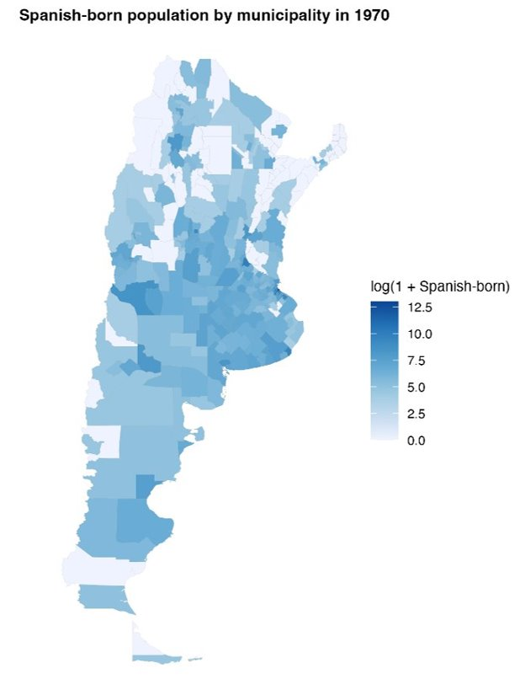
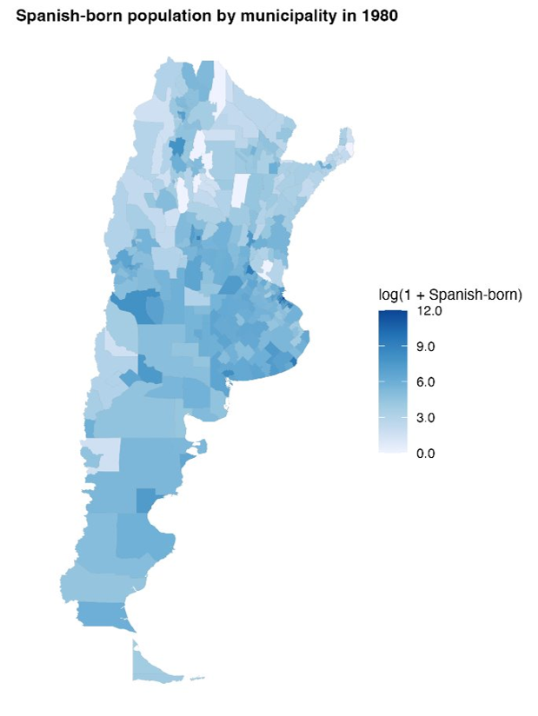
Appendix: Distribution of Spanish-Born Population
Log of Spanish-born population 1970
Log of Spanish-born population 1980

Slide 40
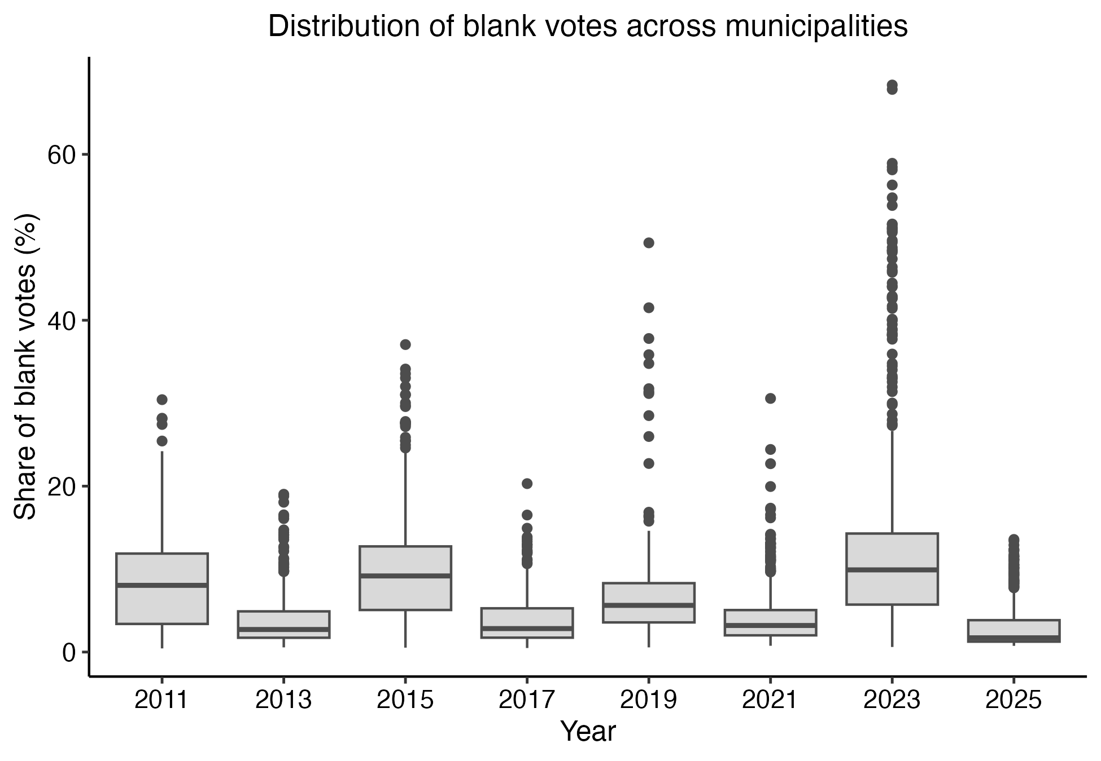
Appendix: Distribution of Blank Votes
High dispersion in blank vote shares may contribute to noisier estimates in some years.

Slide 41
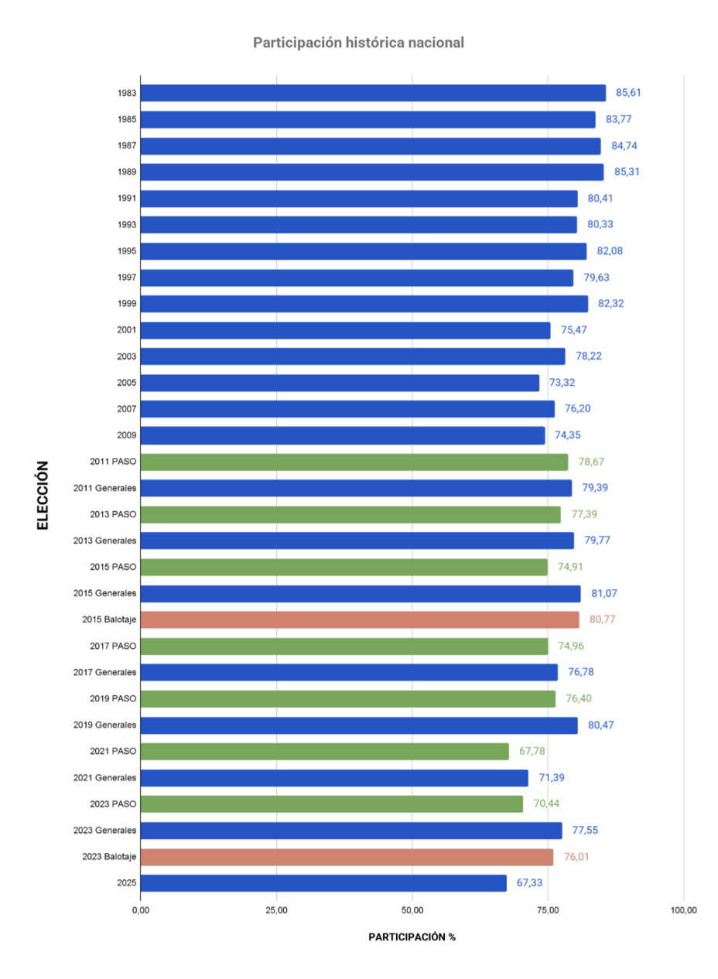
Appendix: Turnout
Voter turnout for national office elections between 1983 and 2025.
For years in which the election was legislative, the data were aggregated at the national level.
Source: Comisión Nacional Electoral Argentina

Slide 42
Appendix: Pre-treatment Political Behavior
B. Differential pre-trends
 | Blank votes | Turnout | Left | Center-left | Center-right | Right | Broad left | Broad right | Left-right index | Ideological index | Peronist vote | Radical vote | Margin | ENP
2013 × share_1936_1955 | -0.759 | -0.221 | -0.014 | 0.322 | -0.879 | 1.583** | 0.308 | 0.704 | -0.396 | 0.020 | 3.235 | 2.199 | -1.256 | -0.112
2013 × share_1936_1955 | (0.737) | (0.561) | (0.495) | (2.871) | (1.571) | (0.763) | (2.601) | (1.416) | (2.966) | (0.024) | (3.292) | (2.304) | (2.789) | (0.202)
2015 × share_1936_1955 | -0.677 | -1.198** | 0.598 | -0.834 | -0.658 | 0.190*** | -0.235 | -0.468 | 0.232 | -0.006 | -5.578*** | 1.420 | -5.407** | 0.200*
2015 × share_1936_1955 | (0.673) | (0.598) | (0.433) | (1.945) | (2.462) | (0.047) | (1.700) | (2.463) | (3.577) | (0.034) | (1.694) | (0.934) | (2.375) | (0.107)
2017 × share_1936_1955 | -0.880 | -1.218 | -1.371* | 0.764 | -3.666** | 0.002 | -0.606 | -3.664** | 3.058 | -0.017 | -2.137 | 2.084* | -4.713* | 0.072
2017 × share_1936_1955 | (0.782) | (0.768) | (0.698) | (2.428) | (1.827) | (0.110) | (2.181) | (1.825) | (3.314) | (0.032) | (4.490) | (1.095) | (2.804) | (0.155)
2019 × share_1936_1955 | 0.277 | -0.255 | 0.241 | -1.867 | -3.145* | 0.012 | -1.626 | -3.134* | 1.508 | -0.017 | -2.433 | 1.703* | 0.687 | -0.098
2019 × share_1936_1955 | (0.669) | (0.550) | (0.391) | (1.579) | (1.630) | (0.063) | (1.536) | (1.631) | (2.789) | (0.028) | (1.970) | (0.950) | (2.093) | (0.119)
2021 × share_1936_1955 | -0.358 | -1.101 | 0.151 | 3.780 | -11.959*** | 1.539*** | 3.931 | -10.420*** | 14.350** | -0.130** | -5.681*** | 1.692* | -4.833 | 0.234
2021 × share_1936_1955 | (0.994) | (0.697) | (0.543) | (3.621) | (3.129) | (0.588) | (3.683) | (2.608) | (6.101) | (0.057) | (1.913) | (0.944) | (3.110) | (0.166)
2013 × share_1956_1978 | -2.716 | -3.225 | 4.493* | 16.621 | -5.527 | 5.186 | 21.113* | -0.341 | 21.454* | -0.208** | 3.522 | 11.036 | -12.660 | 0.719
2013 × share_1956_1978 | (3.453) | (2.554) | (2.373) | (13.209) | (4.837) | (3.843) | (11.758) | (4.164) | (12.185) | (0.096) | (15.412) | (6.942) | (10.944) | (1.088)
2015 × share_1956_1978 | -1.145 | -3.275 | -0.679 | 6.551 | 24.148** | 0.407 | 5.871 | 24.556** | -18.684 | 0.198 | -6.817 | 7.806** | -14.287 | -0.387
2015 × share_1956_1978 | (3.406) | (2.191) | (2.135) | (9.618) | (11.797) | (0.359) | (8.066) | (11.854) | (17.773) | (0.163) | (7.196) | (3.901) | (10.763) | (0.617)
2017 × share_1956_1978 | -1.812 | -5.498* | -2.517 | -7.484 | 11.466 | -1.053** | -10.000 | 10.413 | -20.413 | 0.219 | 2.954 | 8.529* | -1.933 | -0.373
2017 × share_1956_1978 | (3.412) | (3.146) | (1.885) | (9.165) | (10.005) | (0.517) | (8.425) | (10.112) | (15.446) | (0.153) | (18.795) | (4.750) | (11.909) | (0.834)
2019 × share_1956_1978 | -2.104 | -4.013* | -1.379 | -8.205 | 12.315 | -0.482* | -9.584* | 11.833 | -21.417* | 0.223** | -4.384 | 8.590** | -11.864 | -0.548
2019 × share_1956_1978 | (2.897) | (2.299) | (2.242) | (6.032) | (7.522) | (0.264) | (5.273) | (7.509) | (11.411) | (0.109) | (7.287) | (3.985) | (9.349) | (0.692)
2021 × share_1956_1978 | -3.051 | -2.108 | 1.188 | 17.199 | -18.194 | 4.996* | 18.387 | -13.198 | 31.586 | -0.278 | -8.127 | 8.130** | -7.750 | -0.076
2021 × share_1956_1978 | (4.297) | (2.414) | (2.545) | (17.467) | (13.891) | (2.984) | (18.364) | (11.546) | (29.249) | (0.279) | (7.613) | (3.955) | (13.413) | (0.898)
Num.Obs. | 3744 | 3744 | 3744 | 3744 | 3744 | 3744 | 3744 | 3744 | 3744 | 3744 | 3744 | 3744 | 3744 | 3744
R2 | 0.518 | 0.738 | 0.418 | 0.614 | 0.660 | 0.439 | 0.606 | 0.677 | 0.665 | 0.663 | 0.578 | 0.422 | 0.574 | 0.591

Slide 43
Appendix: Pre-treatment Political Behavior
C. Individual-level political selection using LAPOP
Averages by exposure quintile and intention to migrate
Exposure | Share quintile | Observations | Left-right ideology | Previous vote | Party identification | Vote intention | Blank/null vote intention | Community meetings
Spanish share 1936-1955 | Q1 | 1216 | 5,719 | 0,857 | 0,254 | 0,916 | 0,158 | 0,096
Spanish share 1936-1955 | Q2 | 1216 | 5,546 | 0,824 | 0,222 | 0,880 | 0,187 | 0,102
Spanish share 1936-1955 | Q3 | 1216 | 5,571 | 0,829 | 0,263 | 0,897 | 0,163 | 0,095
Spanish share 1936-1955 | Q4 | 1216 | 5,114 | 0,832 | 0,226 | 0,890 | 0,131 | 0,096
Spanish share 1936-1955 | Q5 | 1216 | 5,233 | 0,803 | 0,233 | 0,885 | 0,125 | 0,098
Spanish share 1956-1978 | Q1 | 1216 | 5,714 | 0,846 | 0,261 | 0,896 | 0,175 | 0,092
Spanish share 1956-1978 | Q2 | 1216 | 5,490 | 0,825 | 0,236 | 0,888 | 0,169 | 0,094
Spanish share 1956-1978 | Q3 | 1216 | 5,608 | 0,835 | 0,224 | 0,896 | 0,161 | 0,108
Spanish share 1956-1978 | Q4 | 1216 | 5,331 | 0,821 | 0,232 | 0,896 | 0,149 | 0,089
Spanish share 1956-1978 | Q5 | 1216 | 5,049 | 0,819 | 0,244 | 0,892 | 0,109 | 0,104
Migration intent | Observations | Left-right ideology | Previous vote | Party identification | Vote intention | Blank/null vote intention | Community meetings
Does not intend to migrate | 5135 | 5,450 | 0,848 | 0,246 | 0,893 | 0,143 | 0,092
Intends to migrate | 845 | 5,282 | 0,721 | 0,207 | 0,898 | 0,207 | 0,132
No response | 100 | 5,797 | 0,763 | 0,196 | 0,882 | 0,147 | 0,071

Slide 44
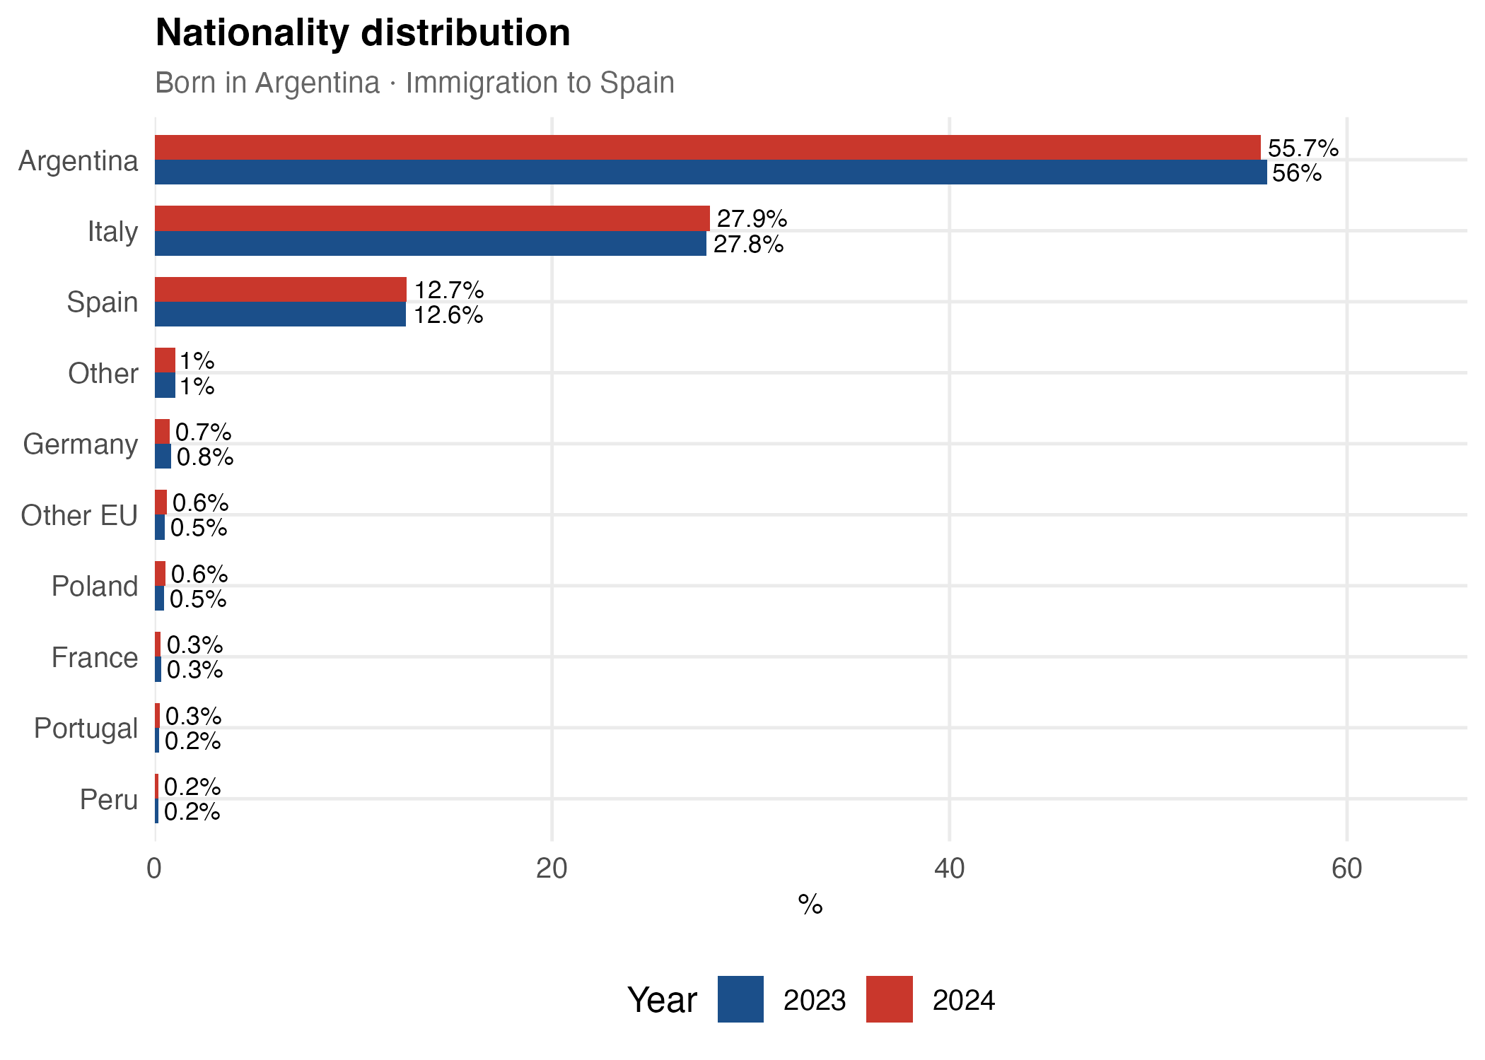
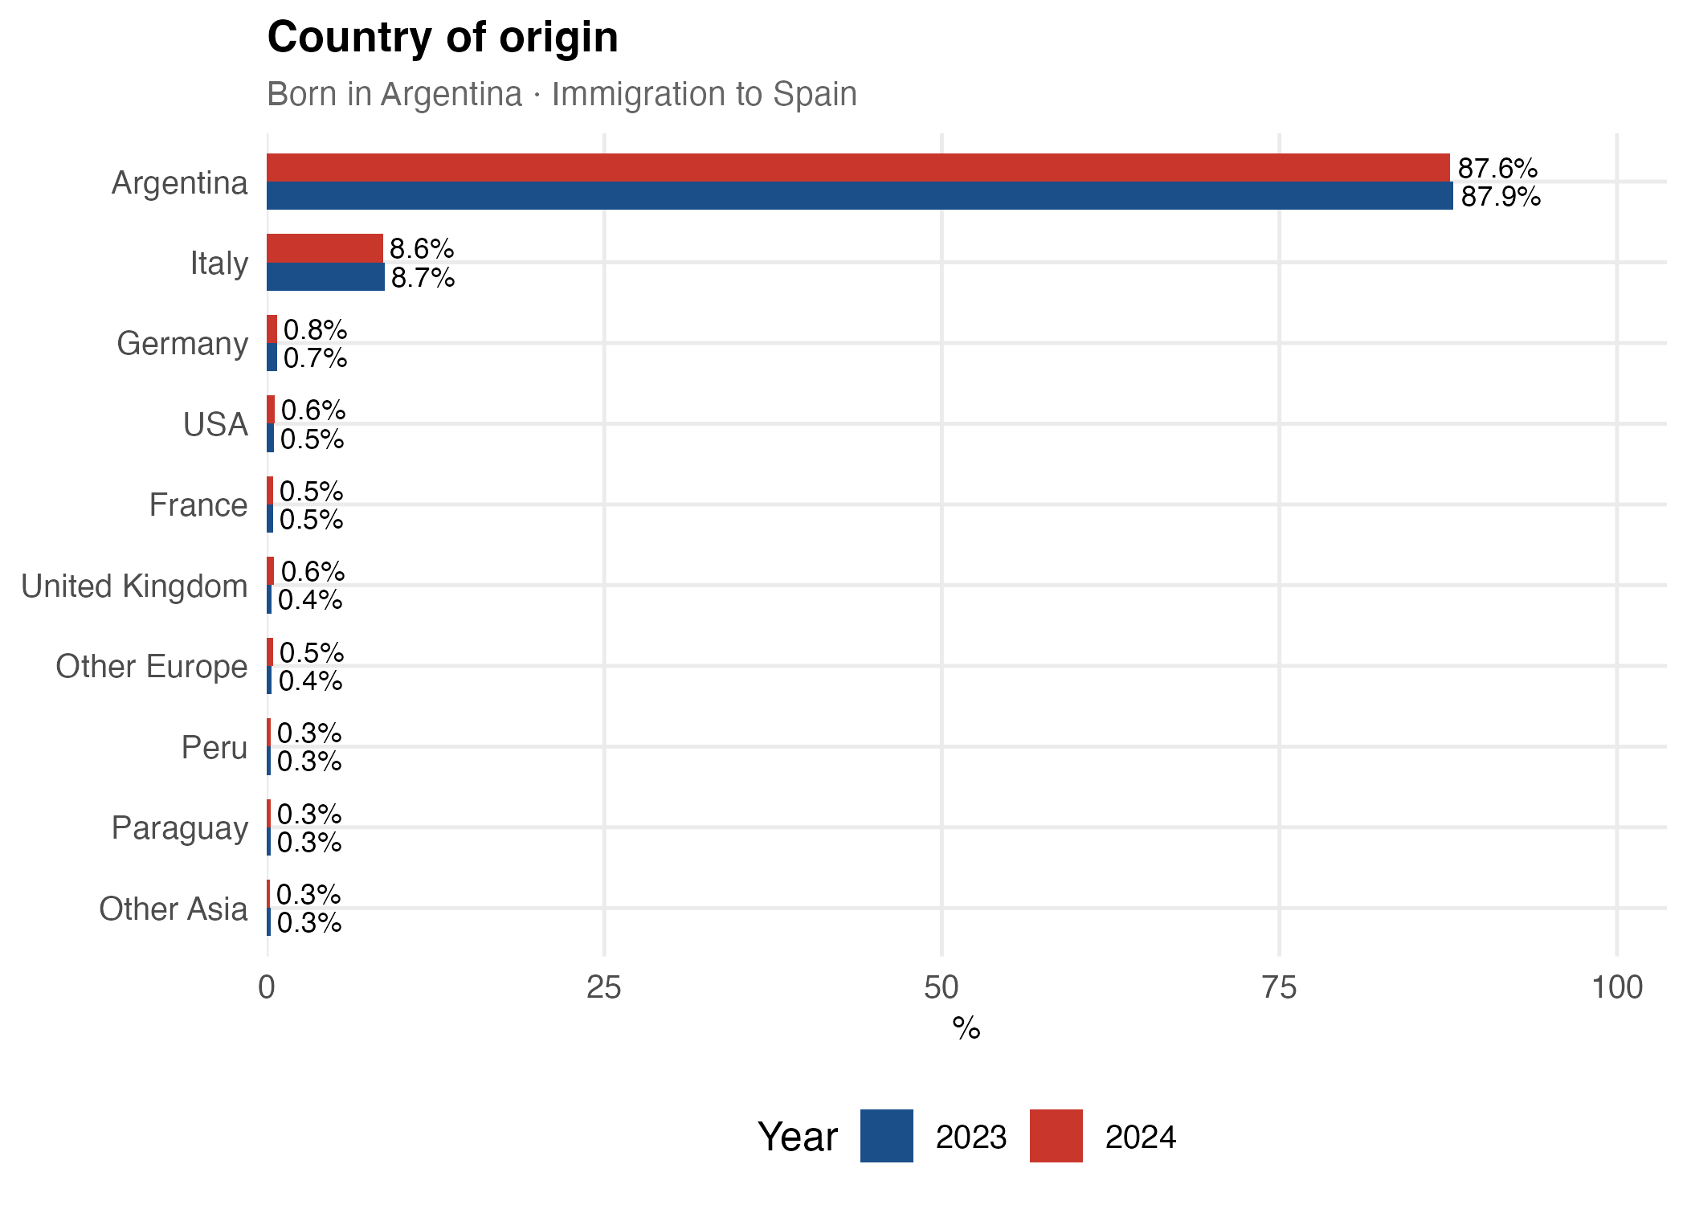
Appendix: Argentine Migrants in Spain, Nationality and Origin
INE microdata: comparison of immigration inflows to Spain, 2023 vs 2024

Slide 45
Appendix: Pre-processed Data - EB
Summary statistics of entropy-balancing weights
1936–1955 exposure window
1956–1978 exposure window
Set | Mean | SD | Min | p99 | Max
1 | 0.0032 | 0.0021 | 0.0001 | 0.0077 | 0.0309
2 | 0.0032 | 0.0022 | 0.0001 | 0.0081 | 0.0323
3 | 0.0032 | 0.0032 | 0.0000 | 0.0144 | 0.0360
4 | 0.0032 | 0.0036 | 0.0000 | 0.0170 | 0.0367
5 | 0.0032 | 0.0023 | 0.0000 | 0.0120 | 0.0220
6 | 0.0032 | 0.0018 | 0.0000 | 0.0105 | 0.0186
7 | 0.0032 | 0.0021 | 0.0000 | 0.0090 | 0.0289
8 | 0.0032 | 0.0020 | 0.0000 | 0.0089 | 0.0227
Set | Mean | SD | Min | p99 | Max
1 | 0.0032 | 0.0016 | 0.0000 | 0.0104 | 0.0131
2 | 0.0032 | 0.0018 | 0.0000 | 0.0113 | 0.0114
3 | 0.0032 | 0.0036 | 0.0000 | 0.0184 | 0.0436
4 | 0.0032 | 0.0043 | 0.0000 | 0.0216 | 0.0391
5 | 0.0032 | 0.0030 | 0.0000 | 0.0128 | 0.0342
6 | 0.0032 | 0.0021 | 0.0000 | 0.0138 | 0.0241
7 | 0.0032 | 0.0022 | 0.0000 | 0.0103 | 0.0209
8 | 0.0032 | 0.0021 | 0.0000 | 0.0123 | 0.0202
Summary statistics of municipality weights for each covariate set. The mean weight equals 1/312 by construction.
16 / 27
Notes:
These tables summarise the entropy-balancing weights for each covariate set in the version that EXCLUDES the other Spanish share. The mean is fixed at 1/312 (the number of municipalities). The key diagnostics are the standard deviation and the maximum: a larger SD and a heavier upper tail (p99, Max) mean the weighting concentrates influence on fewer municipalities and reduces the effective sample size.

Slide 46
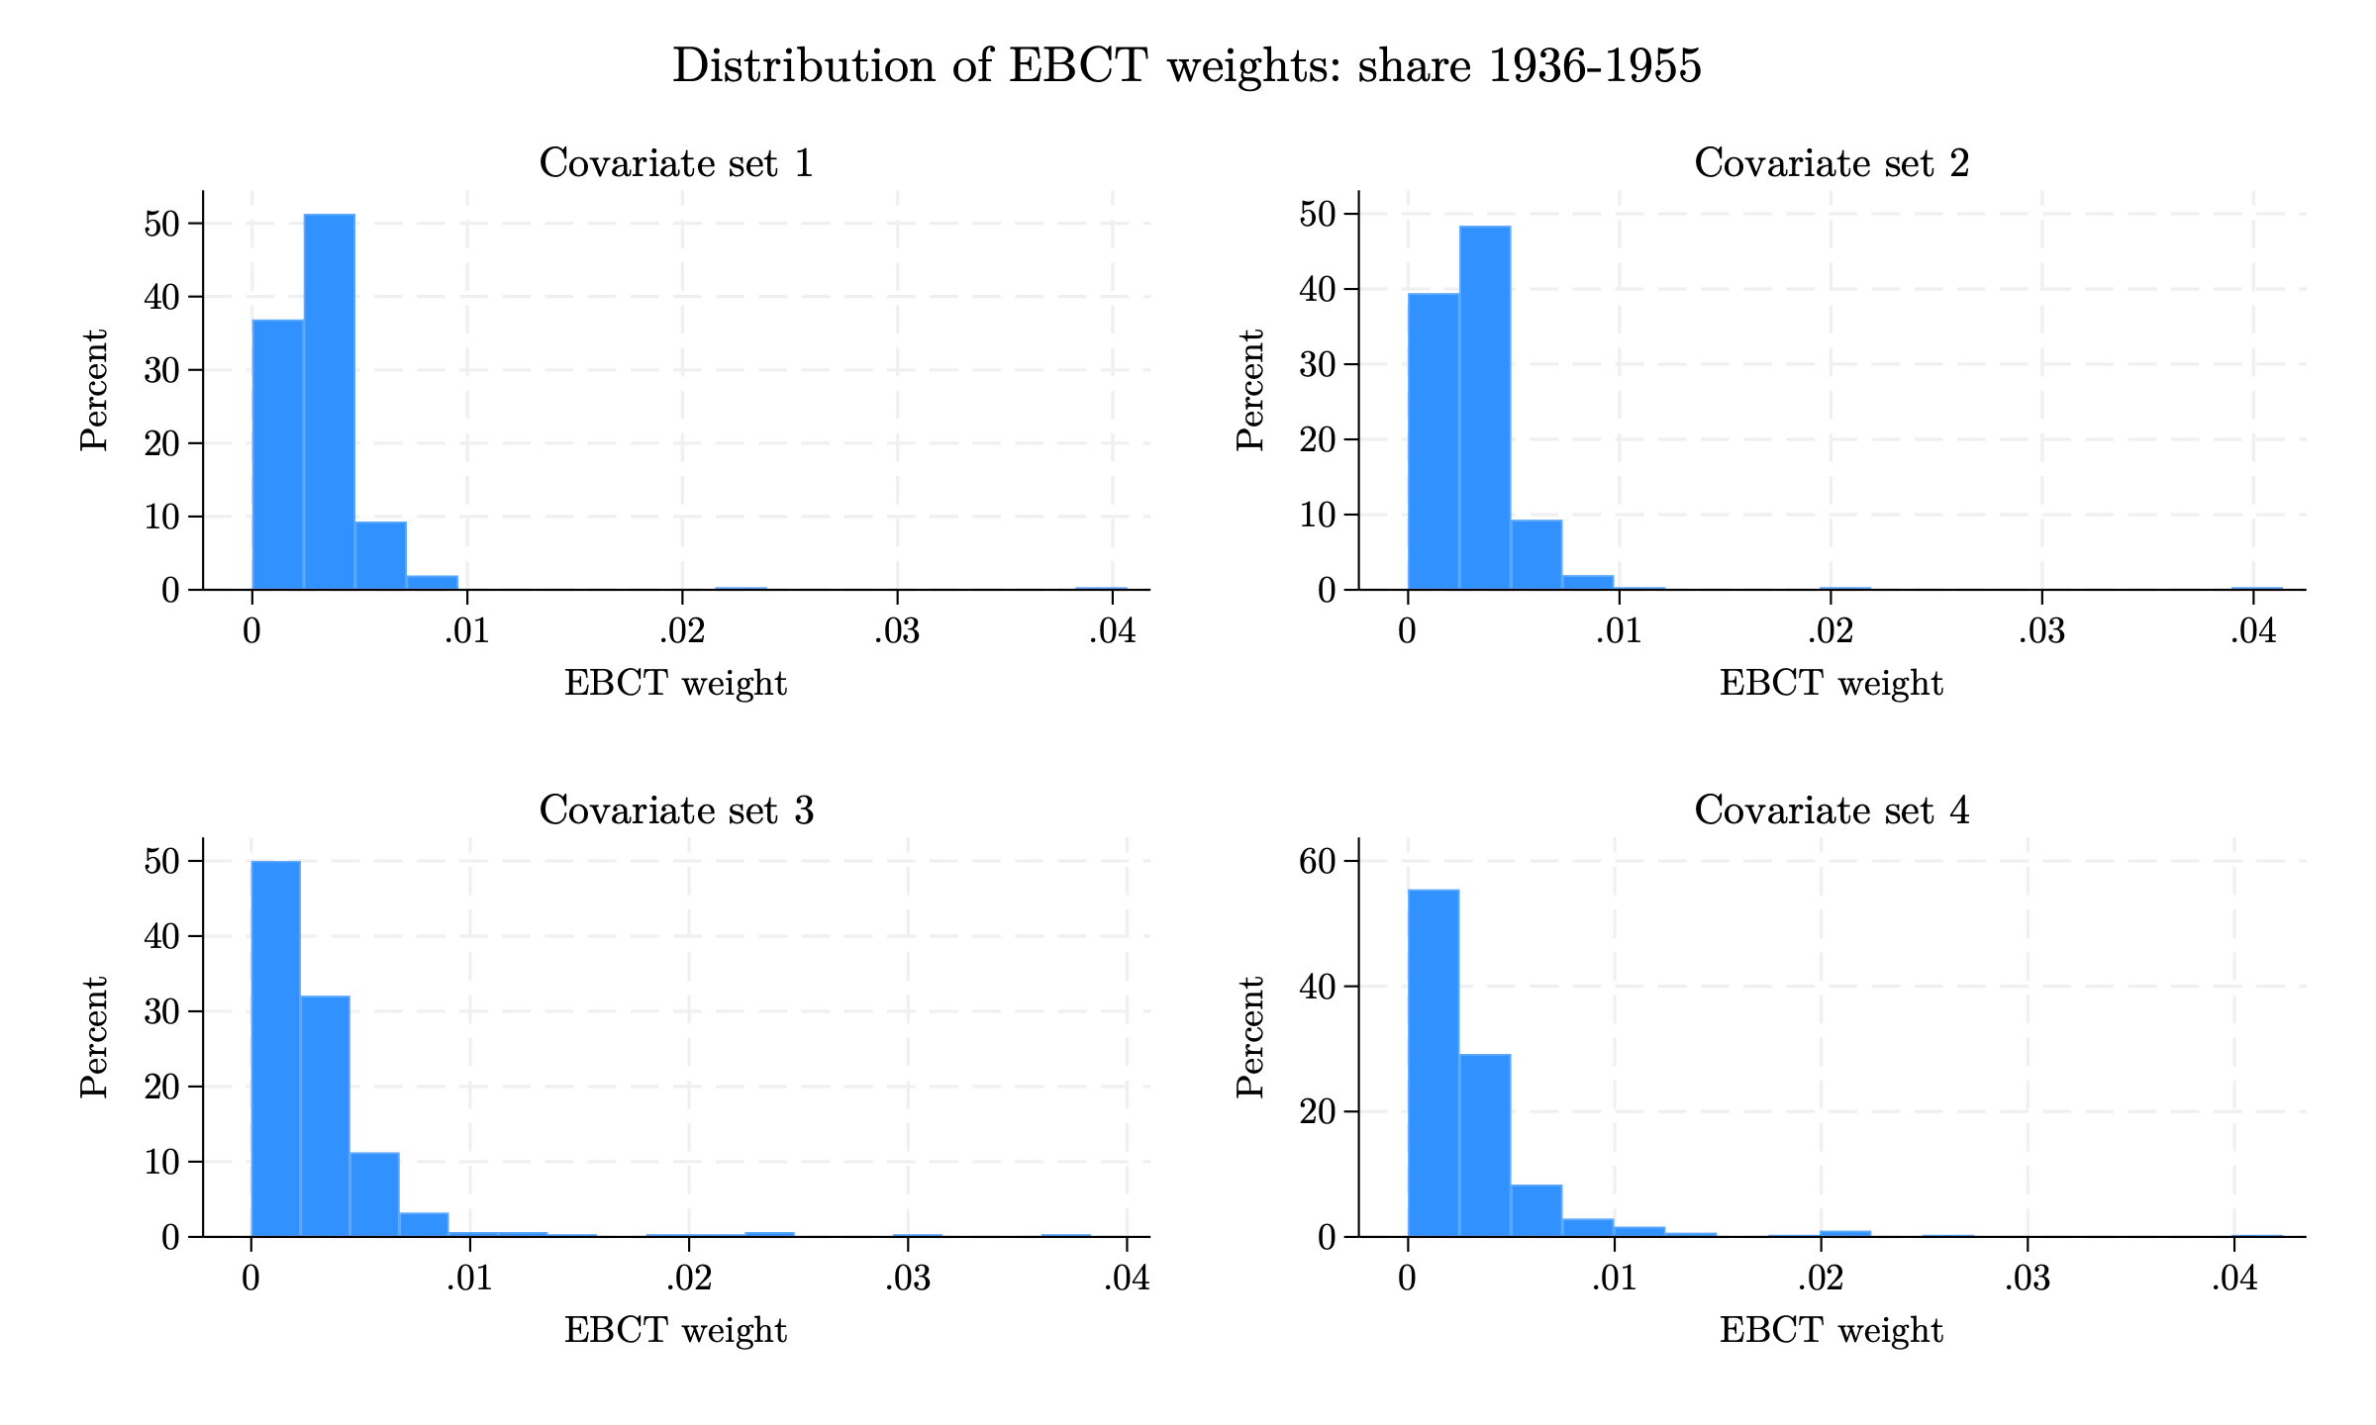
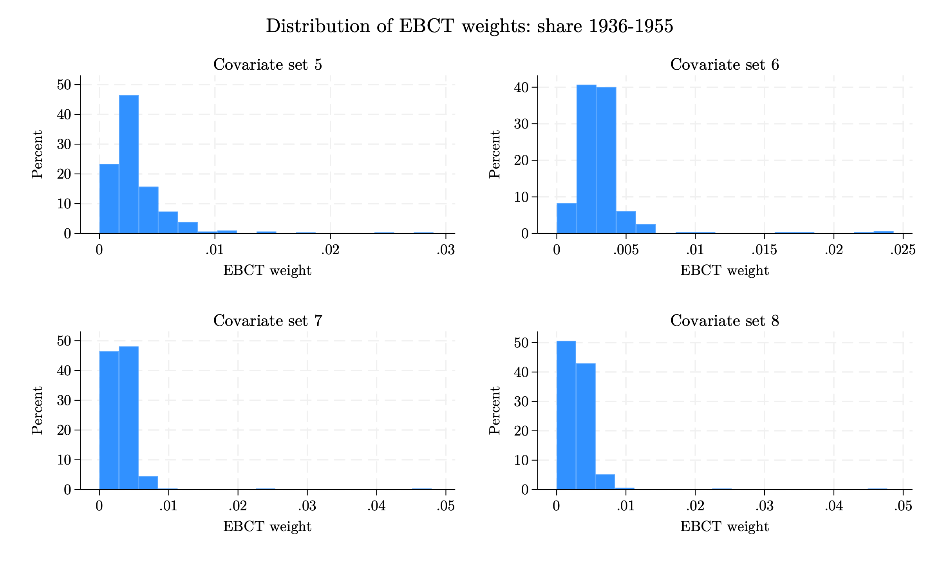
Appendix: Pre-processed Data - EB
EB weight distributions (including the other Spanish share): 1936–1955
Histograms of EBCT weights across the 8 covariate sets (left: sets 1–4; right: sets 5–8). Specifications include the other exposure window's Spanish share.
16 / 27
Notes:
Weight distributions for the 1936–1955 window in the version that INCLUDES the other exposure window's Spanish share as a covariate. Because the two shares are highly correlated, balancing one while holding the other fixed forces the algorithm to place more weight on a small set of unusual municipalities; the weight distributions here are more dispersed and right-skewed than in the version without the other share (shown in the main body).

Slide 47
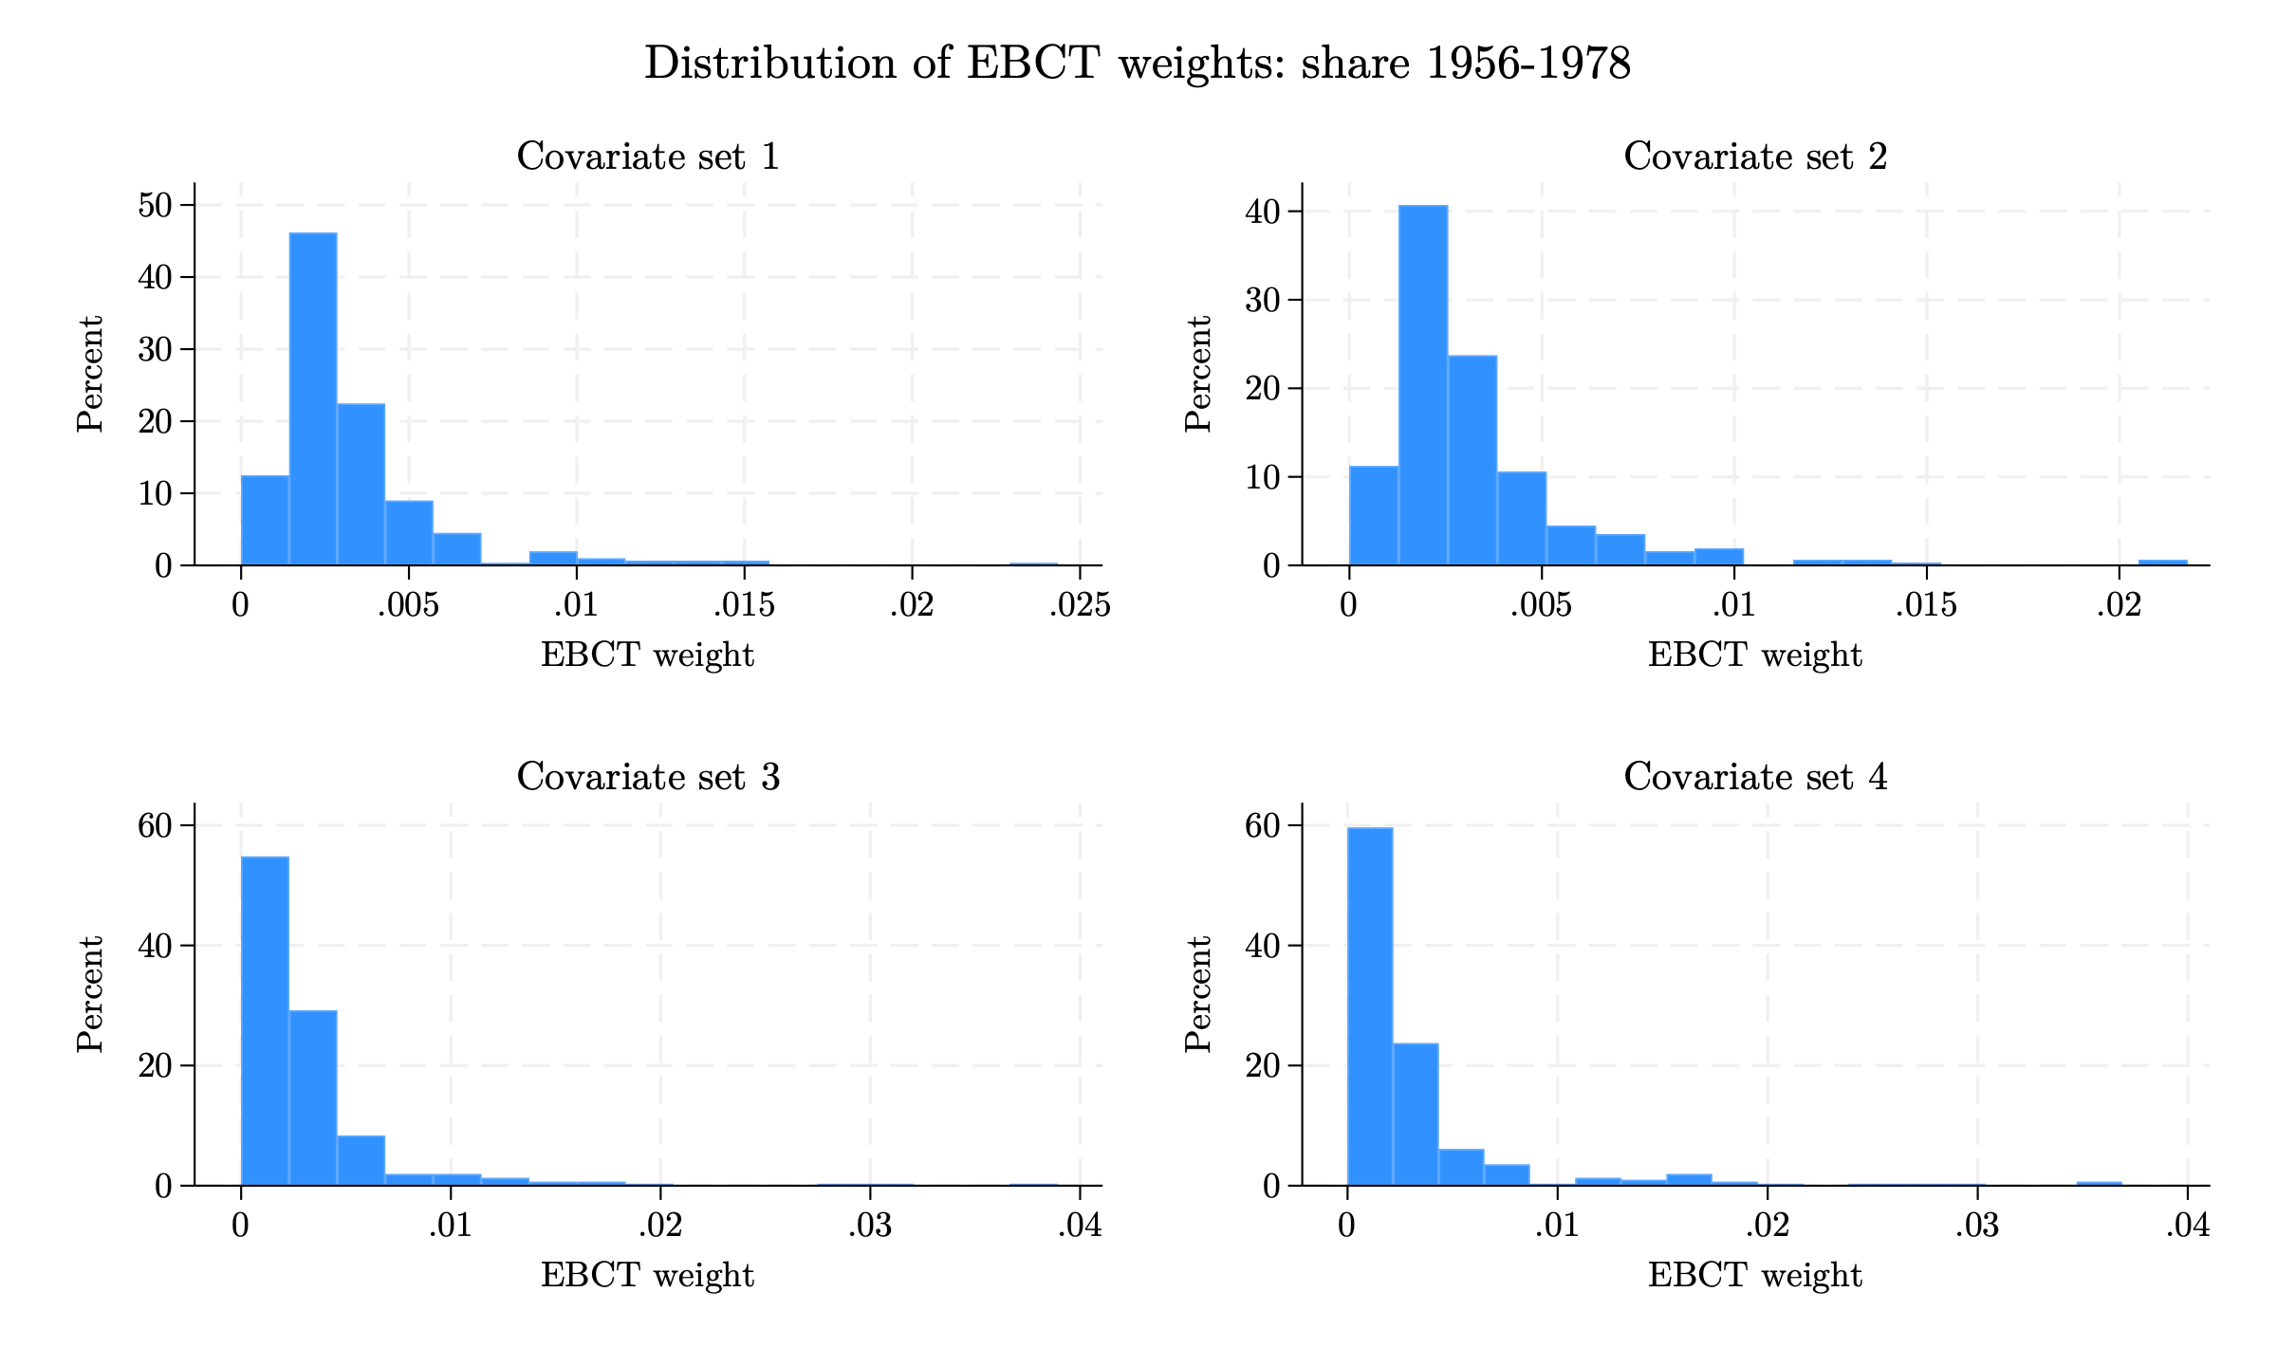
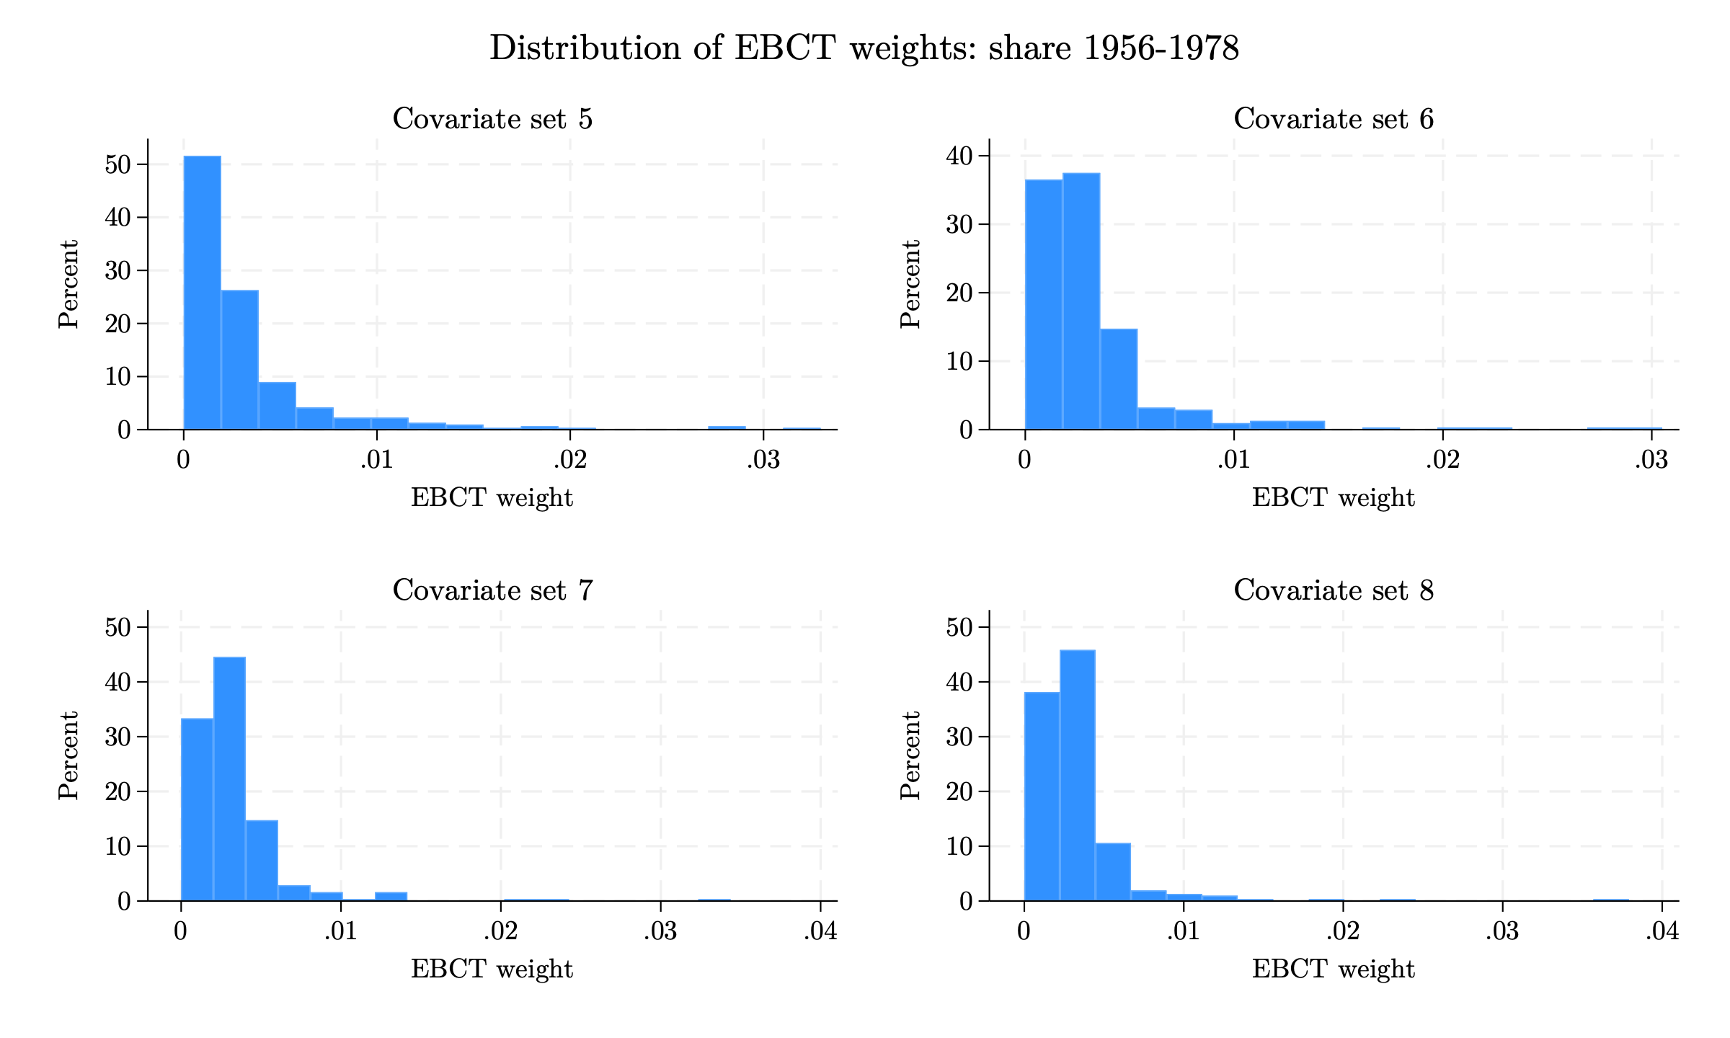
Appendix: Pre-processed Data - EB
EB weight distributions (including the other Spanish share): 1956–1978
Histograms of EBCT weights across the 8 covariate sets (left: sets 1–4; right: sets 5–8). Specifications include the other exposure window's Spanish share.
16 / 27
Notes:
Weight distributions for the 1956–1978 window in the version that INCLUDES the other exposure window's Spanish share as a covariate. Because the two shares are highly correlated, balancing one while holding the other fixed forces the algorithm to place more weight on a small set of unusual municipalities; the weight distributions here are more dispersed and right-skewed than in the version without the other share (shown in the main body).

Slide 48
Appendix: Pre-processed Data - EB
EB weight summary statistics (including the other Spanish share)
1936–1955 exposure window
1956–1978 exposure window
Set | Mean | SD | Min | p99 | Max
1 | 0.0032 | 0.0028 | 0.0000 | 0.0094 | 0.0407
2 | 0.0032 | 0.0029 | 0.0000 | 0.0094 | 0.0414
3 | 0.0032 | 0.0040 | 0.0000 | 0.0230 | 0.0383
4 | 0.0032 | 0.0041 | 0.0000 | 0.0210 | 0.0423
5 | 0.0032 | 0.0030 | 0.0000 | 0.0146 | 0.0289
6 | 0.0032 | 0.0026 | 0.0000 | 0.0183 | 0.0243
7 | 0.0032 | 0.0032 | 0.0000 | 0.0073 | 0.0479
8 | 0.0032 | 0.0031 | 0.0000 | 0.0085 | 0.0477
Set | Mean | SD | Min | p99 | Max
1 | 0.0032 | 0.0026 | 0.0000 | 0.0139 | 0.0243
2 | 0.0032 | 0.0027 | 0.0000 | 0.0131 | 0.0218
3 | 0.0032 | 0.0042 | 0.0000 | 0.0199 | 0.0389
4 | 0.0032 | 0.0050 | 0.0000 | 0.0277 | 0.0369
5 | 0.0032 | 0.0042 | 0.0000 | 0.0200 | 0.0330
6 | 0.0032 | 0.0036 | 0.0000 | 0.0202 | 0.0305
7 | 0.0032 | 0.0032 | 0.0000 | 0.0140 | 0.0344
8 | 0.0032 | 0.0033 | 0.0000 | 0.0151 | 0.0379
Summary statistics of municipality weights for each covariate set. The mean weight equals 1/312 by construction Specifications include the other exposure window's Spanish share..
Notes:
Summary statistics of the entropy-balancing weights for the version that INCLUDES the other Spanish share as a covariate. Compared with the main-body tables (which exclude the other share), the standard deviations and maxima are somewhat larger, reflecting that balancing two correlated shares simultaneously requires more uneven weights.

Slide 49
Appendix: Pre-processed Data - EB
EB (including the other Spanish share) balance check: treatment–covariate correlations
Linear correlations
Set | Bef. 36–55 | Aft. 36–55 | Bef. 56–78 | Aft. 56–78
1 | 0.463 | 0.000 | 0.423 | 0.000
2 | 0.463 | 0.000 | 0.423 | 0.000
3 | 0.463 | 0.000 | 0.423 | 0.000
4 | 0.463 | 0.000 | 0.423 | 0.000
5 | 0.463 | 0.000 | 0.423 | 0.000
6 | 0.286 | 0.000 | 0.369 | 0.000
7 | 0.463 | 0.000 | 0.423 | 0.000
8 | 0.463 | 0.000 | 0.423 | 0.000
Treatment–covariate correlation across the covariates in each set, before and after weighting. Entropy balancing drives every weighted correlation to zero (exact mean balance). Weights inlude the other exposure window's Spanish share.

Slide 50
Appendix: Pre-processed Data - EB
Event study of blank vote share (EB including the other Spanish share)
 | No EB | EB 1 | EB 2 | EB 3 | EB 4 | EB 5 | EB 6 | EB 7 | EB 8
Year × Spanish share, 1936–1955 exposure window
2011 | 0.815 (0.691) | -0.317 (1.783) | -0.121 (1.861) | -1.827 (1.275) | -1.454 (1.326) | -0.474 (1.508) | 0.866 (1.314) | -1.288 (1.560) | -1.369 (1.469)
2013 | -0.351 (0.471) | -0.994** (0.498) | -0.844* (0.483) | -0.892 (0.677) | -0.659 (0.685) | -0.834 (0.638) | -0.400 (0.532) | -1.102** (0.541) | -1.280** (0.546)
2015 | -0.034 (1.049) | -0.801 (2.166) | -0.578 (2.241) | -2.326 (2.123) | -2.462 (1.805) | -0.267 (2.555) | 0.940 (2.216) | -1.225 (2.283) | -1.731 (1.941)
2017 | -0.337 (0.335) | -0.843* (0.469) | -0.554 (0.422) | -1.252* (0.699) | -0.919 (0.697) | -0.958* (0.537) | -0.670 (0.468) | -0.881* (0.468) | -0.988* (0.509)
2019 | 0.777 (0.738) | 0.826 (1.621) | 1.179 (1.676) | -0.863 (0.934) | -0.519 (0.998) | 0.528 (1.293) | 0.531 (1.120) | 0.127 (1.037) | -0.336 (0.877)
2023 | -3.218** (1.381) | -3.783 (3.572) | -2.746 (3.645) | -5.513*** (1.494) | -4.287** (1.943) | -4.277* (2.584) | -3.433* (2.036) | -5.475*** (1.754) | -6.041*** (1.643)
2025 | -1.388*** (0.530) | 0.701 (2.036) | 0.893 (2.076) | 0.430 (1.820) | 0.230 (1.732) | 0.418 (1.713) | -0.189 (1.412) | 1.108 (2.209) | 0.567 (2.328)
Year × Spanish share, 1956–1978 exposure window
2011 | 4.047 (3.096) | -2.975 (4.440) | -3.588 (3.850) | -2.896 (4.868) | 1.963 (6.087) | 1.372 (5.913) | 10.595** (5.265) | -3.380 (4.003) | -3.631 (4.067)
2013 | -0.780 (1.613) | -4.299*** (1.451) | -4.972*** (1.801) | -3.517 (2.356) | -4.440* (2.556) | -7.414** (2.931) | -3.810* (2.039) | -5.092*** (1.780) | -5.712** (2.247)
2015 | 1.019 (4.660) | -4.804 (3.646) | -6.713*** (2.415) | -8.119** (3.746) | -2.167 (6.278) | -6.399 (5.098) | 1.420 (4.347) | -8.060*** (2.030) | -8.492*** (2.333)
2017 | -0.212 (1.065) | -2.282** (0.915) | -2.395* (1.237) | 0.154 (3.494) | -1.858 (2.621) | -4.137* (2.371) | -0.531 (2.003) | -2.789** (1.085) | -3.455** (1.469)
2019 | 2.714 (2.460) | -0.800 (3.235) | -2.753 (1.839) | -4.293 (3.154) | -2.367 (3.168) | -3.725 (3.155) | 0.164 (2.686) | -4.310*** (1.320) | -4.641*** (1.389)
2023 | -11.835*** (4.097) | -10.411** (4.131) | -14.112*** (3.763) | -16.423*** (5.543) | -3.705 (9.380) | -7.133 (8.734) | -1.756 (5.164) | -16.215*** (4.037) | -16.725*** (4.555)
2025 | -3.412 (3.002) | 2.723 (5.467) | 0.765 (6.520) | -1.019 (6.245) | -5.270 (5.107) | -9.993** (4.514) | -16.799*** (6.141) | -1.365 (7.784) | -1.674 (8.132)
R² (1936–55) | 0.449 | 0.443 | 0.449 | 0.469 | 0.472 | 0.449 | 0.451 | 0.460 | 0.457
R² (1956–78) | 0.447 | 0.451 | 0.459 | 0.462 | 0.478 | 0.468 | 0.495 | 0.473 | 0.478
Coefficients on year × Spanish share; 2021 omitted as the reference year. Each EB column is a separate regression weighted to balance the corresponding window. Clustered std. errors clustered at the municipality level in parentheses. * p<0.1, ** p<0.05, *** p<0.01. N = 4,680. Weights include the other Spanish share.
Notes:
Event study for the blank vote share using entropy-balancing weights that INCLUDE the other exposure window's Spanish share as a covariate.

Slide 51
Appendix: Pre-processed Data - EB
Event study of electoral participation – EB including the other Spanish share
 | No EB | EB 1 | EB 2 | EB 3 | EB 4 | EB 5 | EB 6 | EB 7 | EB 8
Year × Spanish share, 1936–1955 exposure window
2011 | 1.416** (0.576) | 2.260* (1.203) | 2.486** (1.122) | 1.987* (1.134) | 2.617** (1.111) | 1.724 (1.208) | 2.032* (1.129) | 2.273* (1.270) | 2.383** (1.184)
2013 | 0.713 (0.445) | 1.462 (1.066) | 1.576 (1.044) | 1.611 (1.143) | 2.050* (1.106) | 1.833** (0.920) | 2.289*** (0.698) | 1.675 (1.085) | 1.742* (1.032)
2015 | -0.272 (0.468) | 0.615 (0.624) | 0.720 (0.602) | 0.608 (0.692) | 1.004 (0.675) | 0.924* (0.532) | 1.243*** (0.471) | 0.749 (0.563) | 0.687 (0.535)
2017 | -0.624 (0.382) | 1.876 (1.580) | 2.087 (1.590) | 1.683 (1.190) | 1.642 (1.120) | 1.682 (1.176) | 1.207 (0.917) | 2.385 (1.622) | 2.286 (1.609)
2019 | 0.561* (0.318) | 0.597 (0.394) | 0.640 (0.390) | 1.227 (0.755) | 1.452* (0.768) | 1.045** (0.519) | 1.578*** (0.421) | 0.646* (0.348) | 0.663* (0.344)
2023 | 0.250 (0.292) | -0.451 (0.594) | -0.460 (0.588) | -0.412 (0.715) | -0.274 (0.802) | -0.638 (0.669) | 0.495 (0.426) | -0.635 (0.397) | -0.614 (0.378)
2025 | 0.330 (0.344) | 1.472 (1.448) | 1.524 (1.522) | 0.933 (1.304) | 0.547 (1.343) | 0.878 (1.360) | 1.489* (0.870) | 2.100 (1.456) | 1.876 (1.514)
Year × Spanish share, 1956–1978 exposure window
2011 | 5.170** (2.070) | 5.356** (2.241) | 5.690** (2.581) | 1.335 (3.662) | 0.999 (6.364) | 2.281 (6.558) | 6.256 (6.164) | 4.312** (2.074) | 3.262 (2.001)
2013 | 1.330 (1.741) | 1.990 (1.975) | 2.114 (2.165) | 1.723 (3.663) | 6.624 (4.964) | 5.027 (5.147) | -3.035 (6.116) | 0.376 (3.803) | 0.570 (4.082)
2015 | -1.438 (1.643) | 0.259 (1.392) | 0.624 (1.602) | 2.920 (2.921) | 6.453** (2.894) | 5.439** (2.511) | 2.801 (3.120) | -0.271 (1.496) | -0.299 (1.612)
2017 | -3.714** (1.882) | 0.601 (2.756) | 0.367 (2.738) | 0.509 (2.341) | 0.591 (4.176) | -0.835 (4.093) | -8.027 (5.638) | -0.916 (3.911) | -1.121 (4.188)
2019 | 0.449 (1.362) | -2.819** (1.356) | -2.107 (1.892) | -2.390 (2.207) | 4.821 (3.536) | 7.196*** (2.597) | 6.296** (2.711) | -1.495 (2.111) | -1.851 (1.906)
2023 | 1.898* (1.121) | 1.103 (1.516) | 1.349 (1.680) | 1.610 (3.501) | 2.935 (3.801) | 1.238 (3.351) | 4.044* (2.290) | 1.202 (1.495) | 0.883 (1.439)
2025 | 2.131 (1.567) | 4.004 (2.468) | 2.809 (3.111) | 3.758 (3.705) | 1.273 (4.445) | -1.154 (4.461) | -3.485 (5.363) | 2.435 (3.688) | 2.389 (3.934)
R² (1936–55) | 0.743 | 0.760 | 0.767 | 0.778 | 0.777 | 0.753 | 0.753 | 0.767 | 0.766
R² (1956–78) | 0.743 | 0.770 | 0.773 | 0.767 | 0.771 | 0.781 | 0.771 | 0.770 | 0.772
Coefficients on year × Spanish share; 2021 omitted as the reference year. Each EB column is a separate regression weighted to balance the corresponding window. Clustered std. errors clustered at the municipality level in parentheses. * p<0.1, ** p<0.05, *** p<0.01. N = 4,680. Weights include the other Spanish share.
Notes:
Event study for electoral participation using entropy-balancing weights that INCLUDE the other exposure window's Spanish share.

Slide 52
Appendix: Pre-processed Data - EB
Re-weighted ATT (EB including the other Spanish share)
 | Share of blank votes |  |  |  | Electoral turnout
 | EB, set 3 |  | EB, set 4 |  | EB, set 3 |  | EB, set 4
 | 1936–55 | 1956–78 | 1936–55 | 1956–78 | 1936–55 | 1956–78 | 1936–55 | 1956–78
Spanish share 1936–1955 × Post | -2.339*** | -4.449*** | -1.779* | -4.710*** | -1.150*** | -0.864 | -1.461*** | -0.482
 | (0.901) | (1.005) | (1.043) | (1.373) | (0.426) | (0.765) | (0.479) | (0.687)
Spanish share 1956–1978 × Post | -3.553* | -8.177* | -3.381 | -2.748 | 0.576 | 1.643 | 0.147 | -0.867
 | (2.150) | (4.507) | (2.253) | (5.409) | (0.485) | (3.699) | (0.560) | (3.262)
R² | 0.464 | 0.469 | 0.468 | 0.488 | 0.777 | 0.767 | 0.776 | 0.771
Observations | 4680 | 4680 | 4680 | 4680 | 4680 | 4680 | 4680 | 4680
* p < 0.1, ** p < 0.05, *** p < 0.01. Standard errors clustered at the municipality level in parentheses.​ Post × Spanish share, re-weighted with the best pre-trend covariate sets (3 and 4) that include the other window's Spanish share.

Slide 53
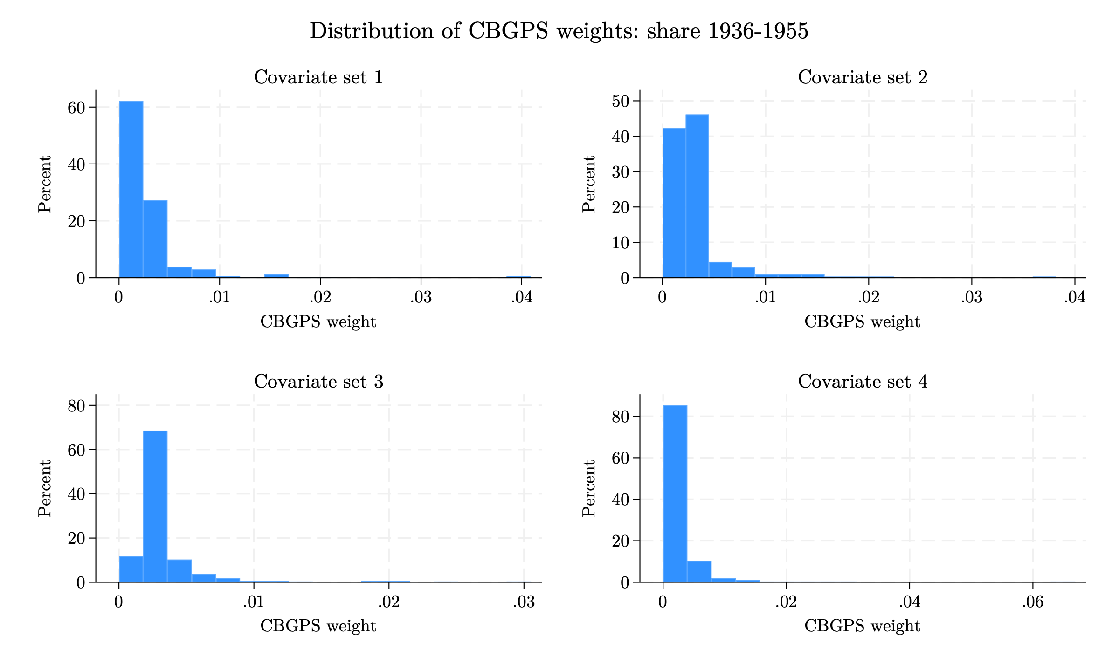
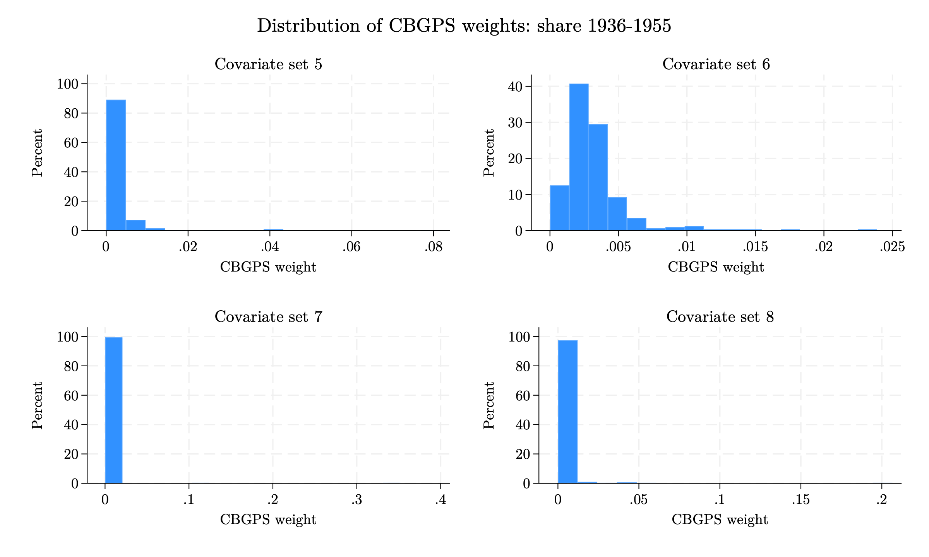
3. Pre-processed Data - CBGPS
Distribution of CBGPS weights: Spanish share 1936–1955
Histograms of CBGPS weights across the 8 covariate specifications (left: specs 1–4; right: specs 5–8).

Slide 54
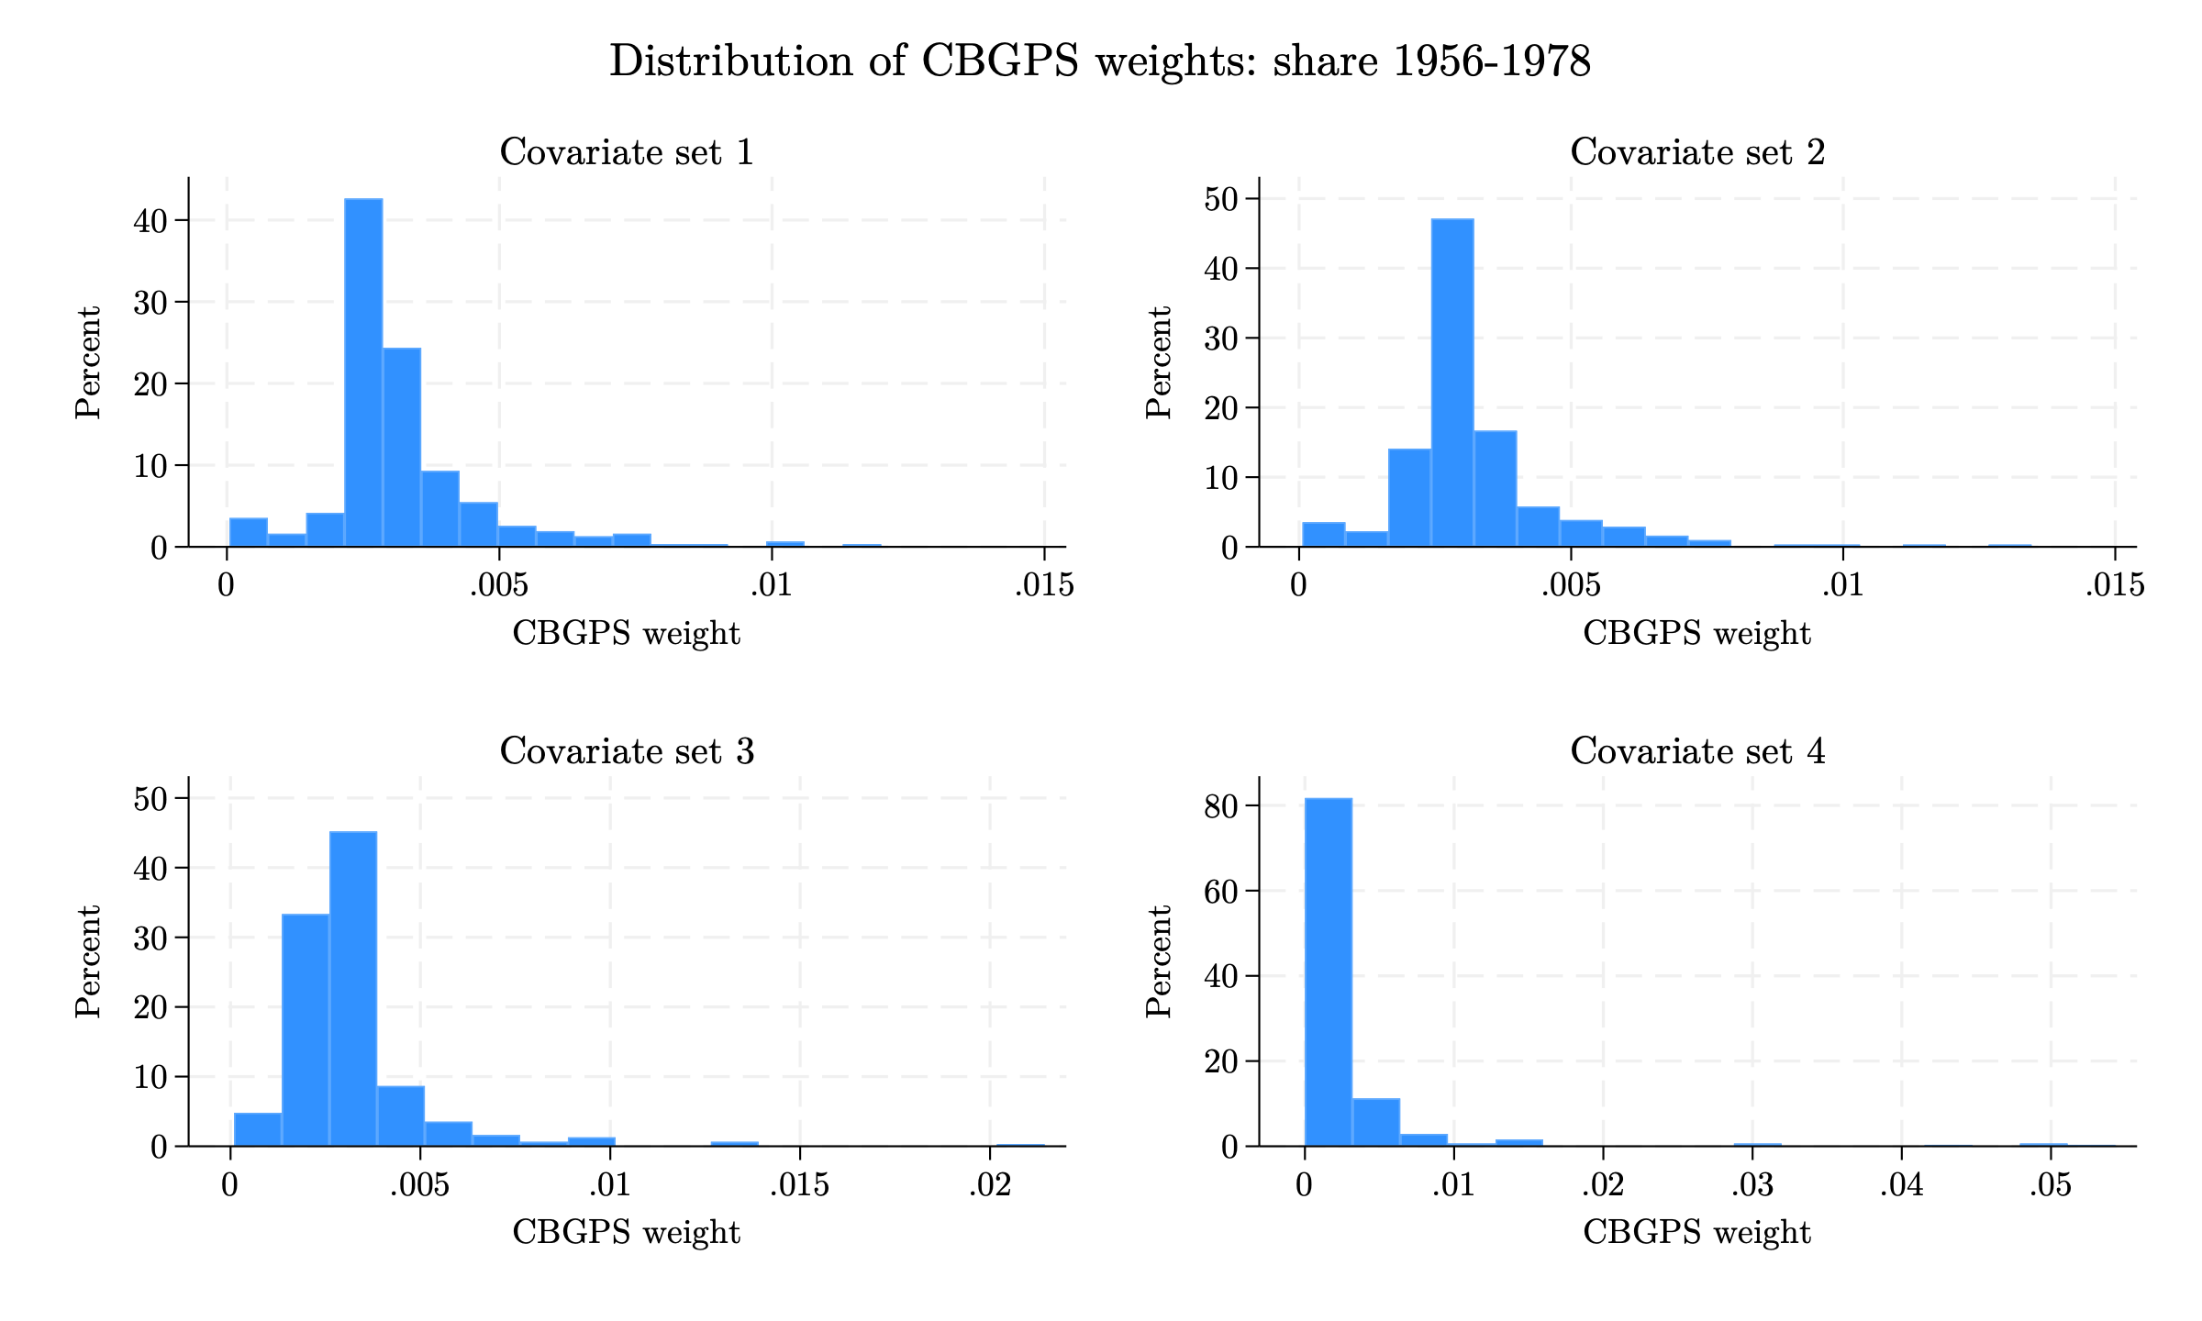
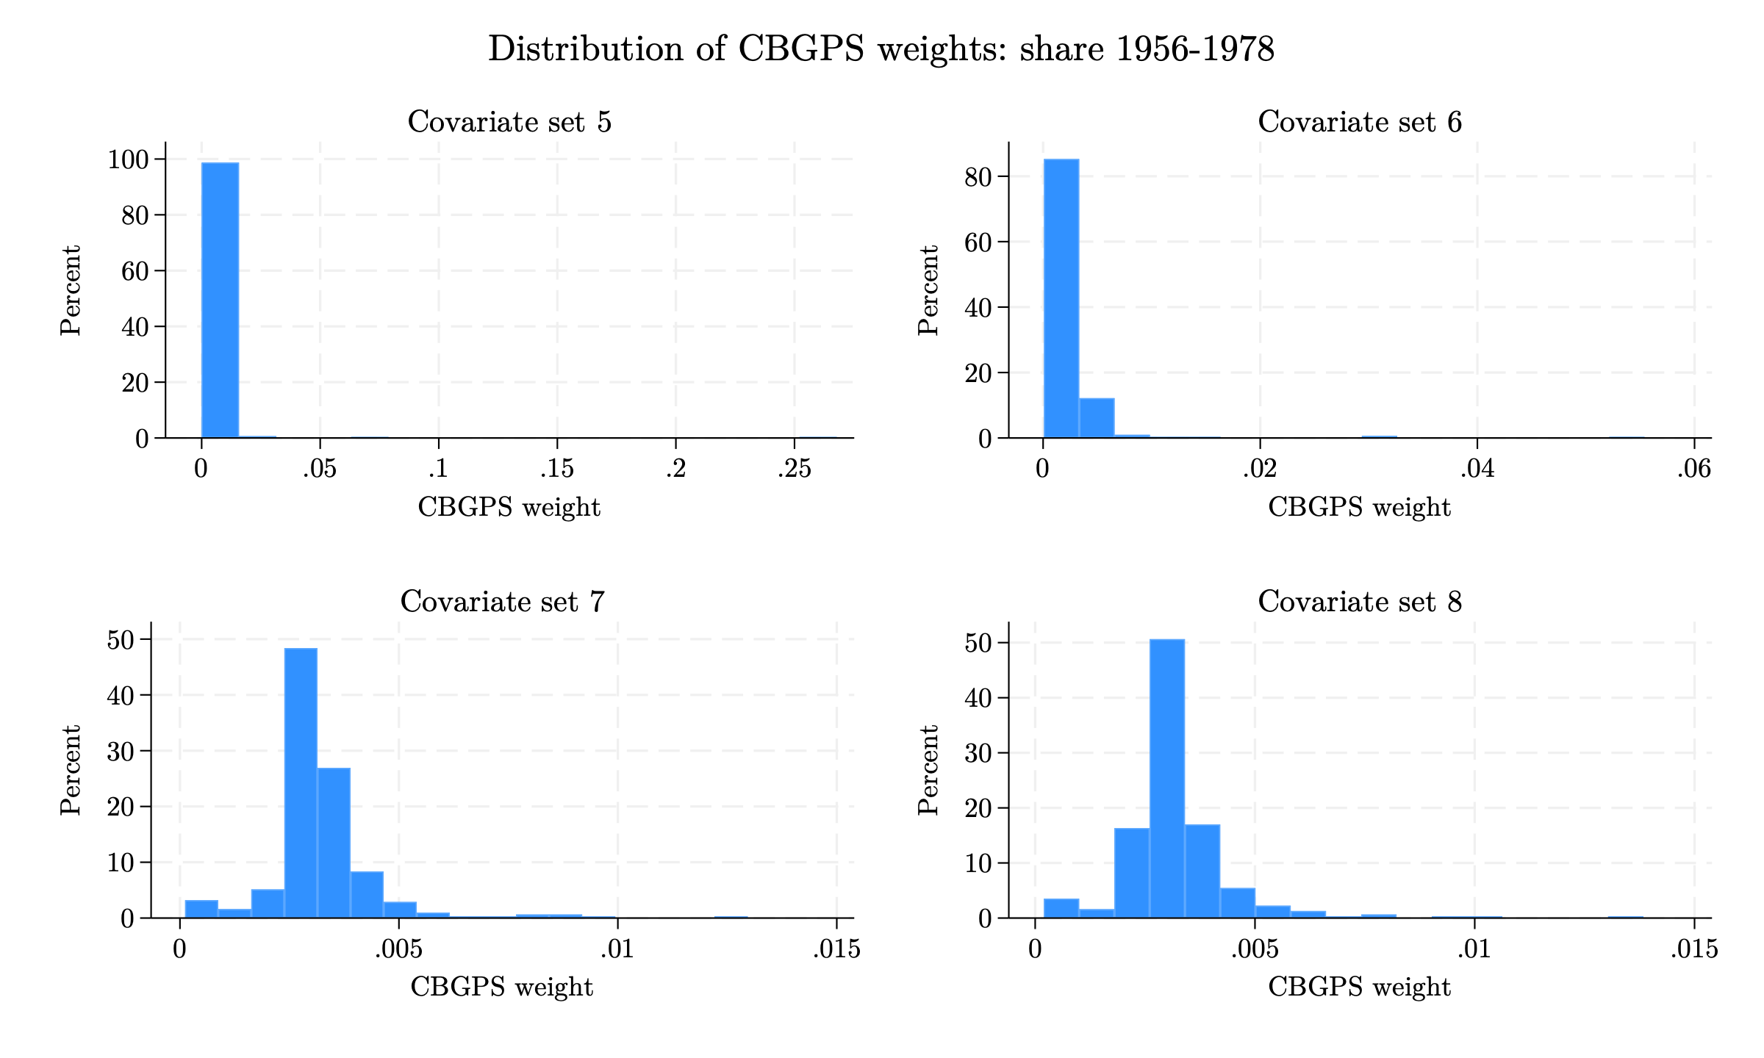
3. Pre-processed Data - CBGPS
Distribution of CBGPS weights: Spanish share 1956–1978
Histograms of CBGPS weights across the 8 covariate specifications (left: specs 1–4; right: specs 5–8).

Slide 55
Appendix: Pre-processed Data - CBGPS
Summary statistics of CBGPS weights
1936–1955 exposure window
1956–1978 exposure window
Set | Mean | SD | Min | p99 | Max
1 | 0.0032 | 0.0042 | 0.0000 | 0.0198 | 0.0409
2 | 0.0032 | 0.0033 | 0.0000 | 0.0167 | 0.0381
3 | 0.0032 | 0.0032 | 0.0000 | 0.0200 | 0.0305
4 | 0.0032 | 0.0047 | 0.0000 | 0.0202 | 0.0668
5 | 0.0032 | 0.0062 | 0.0000 | 0.0389 | 0.0817
6 | 0.0032 | 0.0024 | 0.0000 | 0.0133 | 0.0239
7 | 0.0032 | 0.0208 | 0.0000 | 0.0124 | 0.3519
8 | 0.0032 | 0.0125 | 0.0000 | 0.0385 | 0.2065
Set | Mean | SD | Min | p99 | Max
1 | 0.0032 | 0.0015 | 0.0000 | 0.0090 | 0.0120
2 | 0.0032 | 0.0015 | 0.0001 | 0.0094 | 0.0135
3 | 0.0032 | 0.0019 | 0.0001 | 0.0099 | 0.0214
4 | 0.0032 | 0.0061 | 0.0000 | 0.0416 | 0.0543
5 | 0.0032 | 0.0158 | 0.0000 | 0.0182 | 0.2678
6 | 0.0032 | 0.0039 | 0.0001 | 0.0148 | 0.0554
7 | 0.0032 | 0.0013 | 0.0001 | 0.0091 | 0.0130
8 | 0.0032 | 0.0013 | 0.0002 | 0.0081 | 0.0138
Summary statistics of municipality weights for each covariate set. The mean weight equals 1/312 by construction.

Slide 56
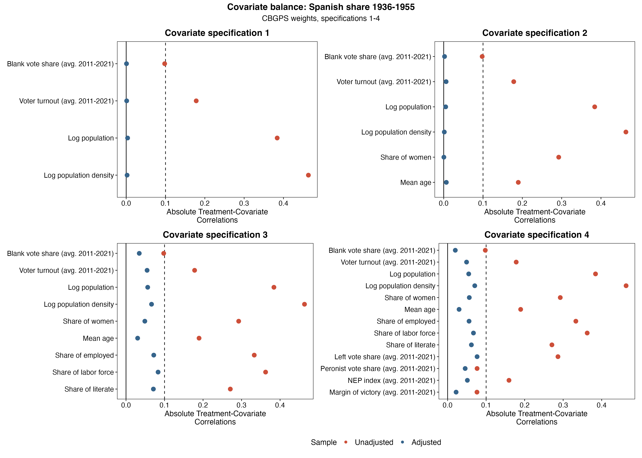
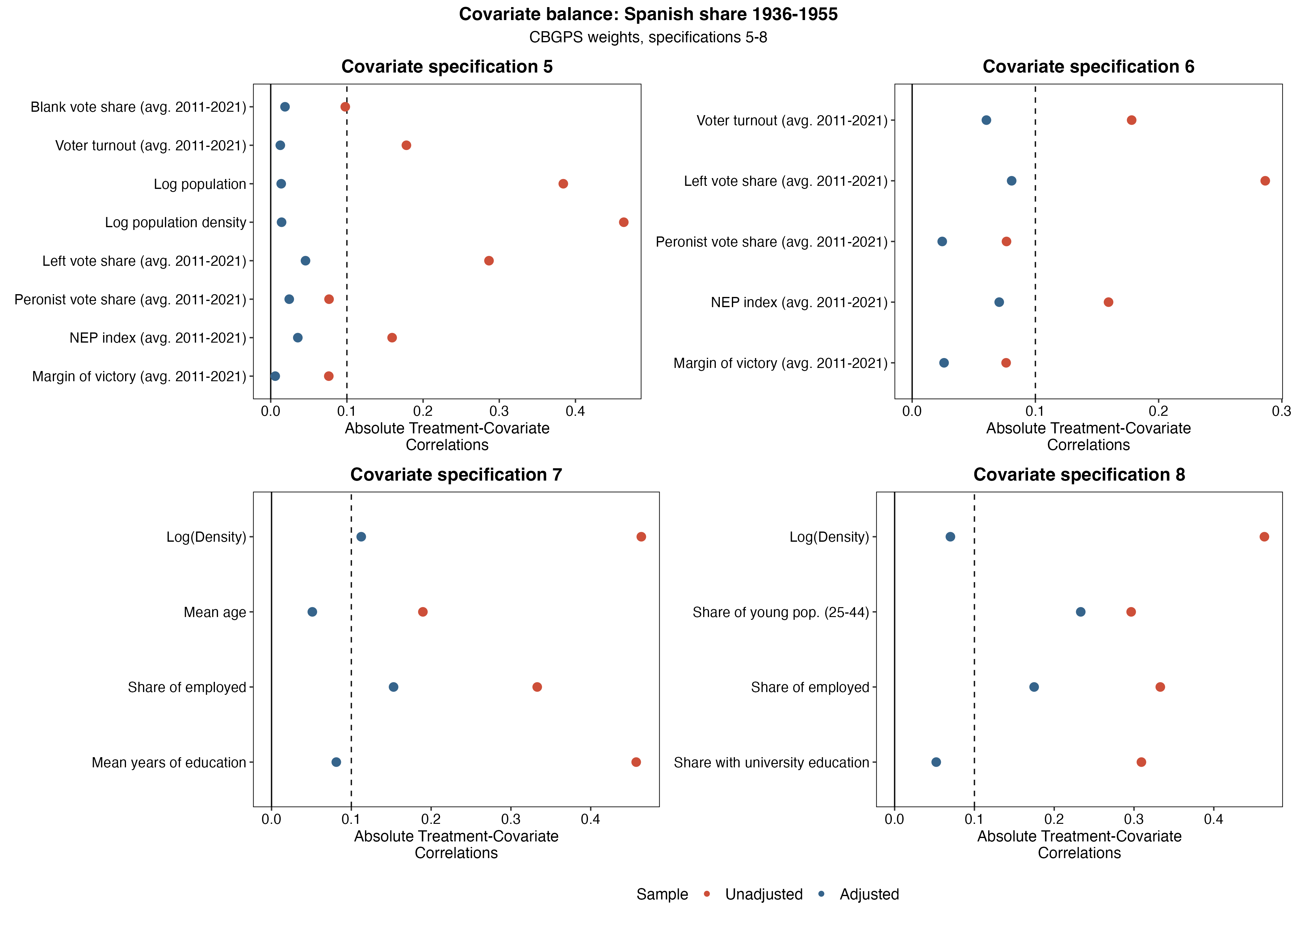
3. Pre-processed Data - CBGPS
Covariate balance under CBGPS weights: Spanish share 1936–1955
Absolute treatment–covariate correlations, unadjusted vs. CBGPS-weighted (left: covariate specifications 1–4; right: 5–8).

Slide 57
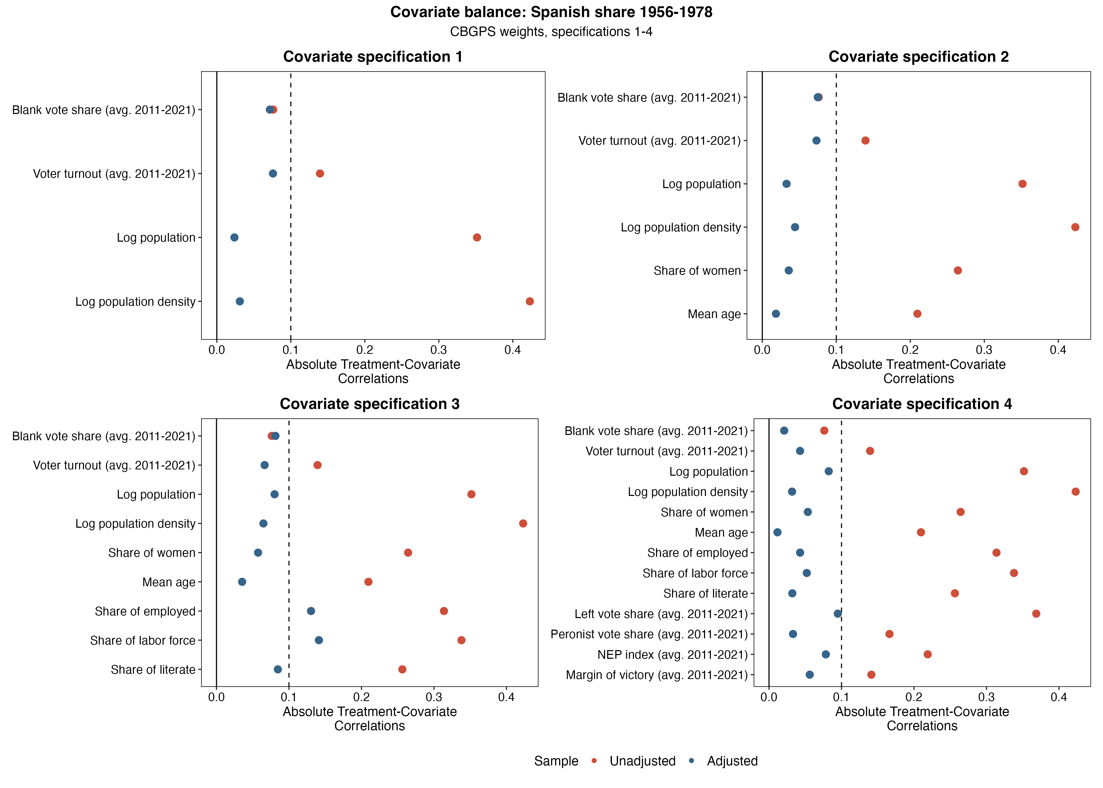
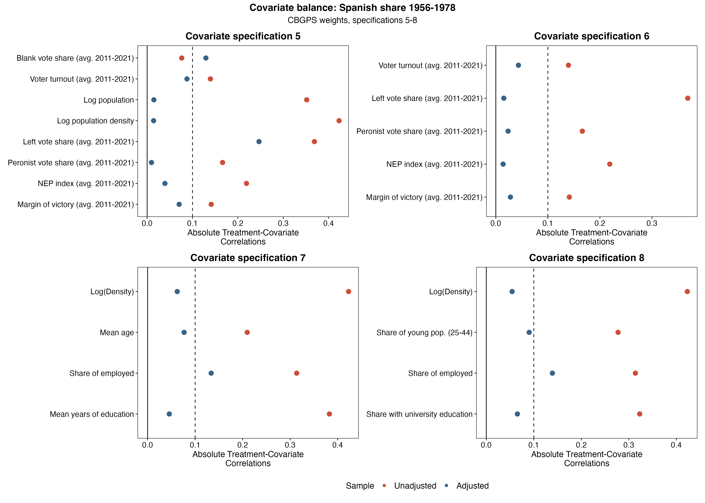
3. Pre-processed Data - CBGPS
Covariate balance under CBGPS weights: Spanish share 1956–1978
Absolute treatment–covariate correlations, unadjusted vs. CBGPS-weighted (left: covariate specifications 1–4; right: 5–8).

Slide 58
3. Pre-processed Data - CBGPS
Effective sample size under CBGPS weights
Covariate specification | Unadjusted N (1936–1955) | Effective N (1936–1955) | Unadjusted N (1956–1978) | Effective N (1956–1978)
Specification 1 | 312 | 115.6 | 312 | 256.4
Specification 2 | 312 | 151.2 | 312 | 255.0
Specification 3 | 312 | 155.1 | 312 | 228.4
Specification 4 | 312 | 98.0 | 312 | 68.4
Specification 5 | 312 | 65.6 | 312 | 12.4
Specification 6 | 312 | 199.0 | 312 | 127.2
Specification 7 | 312 | 7.2 | 312 | 268.8
Specification 8 | 312 | 19.4 | 312 | 269.3
Effective (weighted) sample size from CBGPS, out of 312 municipalities.

Slide 59
3. Pre-processed Data - CBGPS
Event study of blank vote share with CBGPS weights
 | No CBGPS | CBGPS 1 | CBGPS 2 | CBGPS 3 | CBGPS 4 | CBGPS 5 | CBGPS 6 | CBGPS 7 | CBGPS 8
Year × Spanish share, 1936–1955 exposure window
2011 | 0.815 (0.691) | 0.081 (2.132) | 0.278 (2.318) | 0.342 (1.247) | -0.528 (1.272) | -0.654 (1.736) | 1.647 (1.374) | 4.541 (2.823) | 5.637*** (2.111)
2013 | -0.351 (0.471) | -1.030** (0.458) | -1.081** (0.462) | -0.888 (0.703) | -1.210 (0.766) | -1.646* (0.898) | -0.145 (0.866) | 0.128 (0.194) | 0.165 (0.368)
2015 | -0.034 (1.049) | -0.630 (2.316) | -0.919 (2.061) | 0.765 (3.050) | -0.407 (3.187) | -1.080 (2.492) | -0.163 (1.697) | 2.254 (1.870) | 4.034*** (1.372)
2017 | -0.337 (0.335) | -0.614 (0.395) | -0.510 (0.388) | -0.669* (0.396) | -0.846* (0.442) | -0.847 (0.641) | -0.940 (0.678) | 0.060 (0.552) | 0.330 (0.515)
2019 | 0.777 (0.738) | 1.433 (2.322) | 2.140 (2.793) | 0.665 (1.231) | -0.081 (1.129) | 0.111 (1.895) | 0.422 (1.211) | 6.289 (5.613) | 8.411** (4.211)
2023 | -3.218** (1.381) | -1.893 (5.528) | -0.150 (6.665) | -4.197* (2.409) | -5.003*** (1.874) | -2.355 (3.660) | -7.698*** (2.243) | 11.866 (12.982) | 10.159 (9.376)
2025 | -1.388*** (0.530) | 1.081 (1.873) | 0.962 (1.830) | -0.224 (1.172) | -0.578 (1.202) | 0.396 (1.872) | -1.712 (1.362) | 0.052 (0.552) | 0.264 (0.789)
Year × Spanish share, 1956–1978 exposure window
2011 | 4.047 (3.096) | 11.558** (5.801) | 10.784* (6.453) | 3.978 (5.055) | -0.142 (5.155) | -1.186 (6.830) | -2.448 (4.516) | 9.991 (20.793) | 17.524 (14.143)
2013 | -0.780 (1.613) | -1.809 (2.413) | -3.187 (2.447) | -2.873 (2.537) | -5.499 (3.729) | -10.313* (5.607) | -3.933** (1.524) | -2.127 (2.269) | 0.400 (2.059)
2015 | 1.019 (4.660) | 12.058 (9.113) | 7.948 (7.388) | 6.176 (10.275) | 0.589 (10.558) | -4.471 (12.249) | -6.864** (2.750) | 1.235 (13.600) | 11.153 (9.863)
2017 | -0.212 (1.065) | -0.433 (1.911) | -0.599 (1.938) | -1.454 (1.749) | -3.490 (2.723) | -6.440 (4.550) | -2.016 (1.335) | -2.678 (3.713) | 0.963 (2.714)
2019 | 2.714 (2.460) | 8.092 (6.072) | 8.231 (7.336) | 1.132 (3.498) | -1.849 (3.902) | -3.802 (6.473) | -3.590** (1.811) | 5.981 (38.409) | 18.576 (24.612)
2023 | -11.835*** (4.097) | -1.248 (12.971) | 1.828 (15.610) | -15.511*** (5.313) | -19.409*** (6.627) | -14.614 (10.212) | -16.499*** (3.966) | 2.841 (85.381) | 8.881 (46.126)
2025 | -3.412 (3.002) | -8.971 (5.997) | -10.246* (5.579) | -2.025 (5.061) | -3.193 (5.673) | -12.409* (6.875) | 0.707 (6.059) | -4.751 (4.372) | -1.465 (4.978)
R² (1936–55) | 0.449 | 0.437 | 0.437 | 0.455 | 0.454 | 0.444 | 0.453 | 0.570 | 0.537
R² (1956–78) | 0.447 | 0.439 | 0.439 | 0.457 | 0.457 | 0.446 | 0.450 | 0.551 | 0.519
Coefficients on year × Spanish share; 2021 omitted as the reference year. Each CBGPS column is a separate regression weighted to balance the corresponding window. Clustered std. errors clustered at the municipality level in parentheses. * p<0.1, ** p<0.05, *** p<0.01. N = 4,680. Weights include the other Spanish share.

Slide 60
3. Pre-processed Data - CBGPS
Event study of electoral participation share with CBGPS weights
 | No CBGPS | CBGPS 1 | CBGPS 2 | CBGPS 3 | CBGPS 4 | CBGPS 5 | CBGPS 6 | CBGPS 7 | CBGPS 8
Year × Spanish share, 1936–1955 exposure window
2011 | 1.416** (0.576) | 3.898*** (0.926) | 3.604*** (1.143) | 1.861* (1.003) | 1.762* (1.059) | 3.928*** (1.186) | 1.775* (1.026) | 8.148*** (1.750) | 4.979*** (1.839)
2013 | 0.713 (0.445) | 2.102** (0.931) | 2.071** (0.986) | 1.156 (0.777) | 1.376* (0.765) | 3.101** (1.427) | 1.145 (0.877) | 4.174** (1.937) | 2.910* (1.628)
2015 | -0.272 (0.468) | 1.569** (0.630) | 1.549** (0.756) | 0.761 (0.552) | 0.674 (0.558) | 1.514* (0.786) | -0.176 (0.789) | 4.310*** (0.668) | 2.391** (1.158)
2017 | -0.624 (0.382) | 2.217 (1.592) | 2.124 (1.607) | 0.579 (0.630) | 0.591 (0.603) | 2.556* (1.382) | -0.270 (0.624) | 1.763 (1.077) | 0.901 (0.956)
2019 | 0.561* (0.318) | 1.107** (0.475) | 0.861* (0.480) | 1.153** (0.506) | 1.102** (0.544) | 2.040** (0.805) | 1.151* (0.691) | 3.050*** (0.665) | 1.765** (0.720)
2023 | 0.250 (0.292) | 0.424 (0.794) | 0.632 (0.908) | 0.371 (0.478) | 0.165 (0.479) | 0.229 (0.730) | 0.433 (0.658) | 3.553*** (0.847) | 2.572*** (0.929)
2025 | 0.330 (0.344) | 1.459 (1.399) | 1.609 (1.308) | 0.541 (0.739) | 0.399 (0.640) | 1.984* (1.198) | 1.019 (0.785) | 1.501*** (0.180) | 2.129*** (0.401)
Year × Spanish share, 1956–1978 exposure window
2011 | 5.170** (2.070) | 10.340** (4.541) | 8.474* (4.676) | 5.357* (2.947) | 3.211 (3.658) | 2.777 (5.398) | 5.493*** (1.903) | 41.849** (16.194) | 23.012** (10.597)
2013 | 1.330 (1.741) | 2.749 (3.483) | 1.956 (3.287) | 1.401 (2.256) | 0.474 (2.751) | 1.138 (5.997) | 3.642*** (1.294) | 24.749** (11.844) | 14.365* (8.422)
2015 | -1.438 (1.643) | 3.746 (2.717) | 3.589 (2.972) | 1.424 (1.834) | 0.544 (1.972) | 0.876 (3.066) | 1.254 (1.695) | 18.883** (8.993) | 9.181 (6.325)
2017 | -3.714** (1.882) | -6.092 (3.973) | -5.778 (4.020) | -2.892 (2.819) | -2.772 (2.870) | -3.697 (3.391) | 1.556 (2.105) | 10.218 (6.773) | 4.636 (4.847)
2019 | 0.449 (1.362) | 3.857 (2.562) | 1.897 (2.399) | 1.545 (2.376) | 0.813 (2.466) | 2.858 (3.527) | -1.039 (1.950) | 14.580** (6.513) | 6.828 (4.687)
2023 | 1.898* (1.121) | 4.212* (2.496) | 4.150 (2.743) | 1.933 (1.587) | 0.483 (1.705) | 0.346 (3.018) | 0.909 (1.350) | 13.437 (8.931) | 9.303** (4.695)
2025 | 2.131 (1.567) | -2.149 (3.235) | -2.598 (3.329) | 1.821 (2.308) | 0.605 (2.842) | -0.729 (3.904) | 4.197* (2.401) | 6.887*** (2.238) | 8.820*** (2.283)
R² (1936–55) | 0.743 | 0.761 | 0.757 | 0.757 | 0.756 | 0.757 | 0.747 | 0.783 | 0.768
R² (1956–78) | 0.743 | 0.760 | 0.756 | 0.757 | 0.756 | 0.753 | 0.747 | 0.777 | 0.767
Coefficients on year × Spanish share; 2021 omitted as the reference year. Each EB column is a separate regression weighted to balance the corresponding window. Clustered std. errors clustered at the municipality level in parentheses. * p<0.1, ** p<0.05, *** p<0.01. N = 4,680. Weights include the other Spanish share.​

Slide 61
Appendix: Data Sources
Argentine Population Census (IPUMS 1970, 1980, 2010). Microdata harmonized by IPUMS International, at the individual level. The census provides information on country of birth, year of arrival in the country, current municipality, sex, age, education attained, marital status, employment status, and household composition. Sampling weights allow us to recover municipality-level aggregates. We use the 1970 census to identify Spanish immigrants who arrived between 1936-1955, the 1980 census to identify those who arrived between 1956-1978, and the 2010 census to build pre-treatment municipal covariates (population density, education, age structure, employment, gender composition).
Electoral public data from. Detailed electoral results for national legislative elections (Chamber of Deputies) between 2011 and 2025. For each electoral section, the data include the total number of registered voters, votes cast, votes received by each political party, blank votes and null votes. The data were downloaded from DataCP, an open-access electoral data platform developed by the University of Buenos Aires
LAPOP Americas Barometer, rounds 2012, 2014, 2017, 2019 and 2023. Repeated cross-section survey with individual-level information on political attitudes, intentions to migrate, ideology, party identification, community involvement and demographic characteristics. Includes municipality and province identifiers used to link with the census.
61 / 65

Slide 62
Appendix: Treatment Variables
Historical Spanish exposure by arrival window. The two treatment variables share_1936_1955 and share_1956_1978 measure the share of Spanish-born residents in each Argentine municipality who arrived during one of the two exposure windows. Each is expressed as a percentage of the municipal population at the corresponding census, and both are constructed applying census sampling weights. share_1936_1955 is built from the 1970 IPUMS census and and share_1956_1978 from the 1980 census.
Pooled treatment variables (single-census construction). For robustness checks, we also build share_36_78_c70 and share_36_78_c80, which pool arrivals from 1936 to 1978 using only the 1970 or only the 1980 census as the source respectively. The 1970-based version reports arrivals up to 1970, while the 1980-based version captures arrivals across the full period
62 / 65

Slide 63
Appendix: Outcomes
Electoral outcomes come from DataCP and migration intentions come from LAPOP surveys.
Blank vote share. Ratio of blank votes over the number of votes cast in the section, in percent.
Voter turnout. Ratio of votes cast over registered voters in the municipality.
Ideological vote shares. We classify each party running for the Chamber of Deputies into five ideological blocs (left, center-left, center, center-right, right) and into two family groups (Peronist, Radical). The classification covers approximately 540 unique parties competing between 2011 and 2025 and was conducted manually with the assistance of AI. The vote share of each ideological bloc is computed at the municipality-election level as a percentage of valid votes (excluding blank, null, and challenged ballots). We additionally construct broad-left and broad-right vote shares by summing the vote shares of left and center-left parties, and of right and center-right parties, respectively.
Incumbency. For each election year we identify which party in the section represents the incumbent national government (Kirchnerismo, Cambiemos, Frente de Todos, Union por la Patria, La Libertad Avanza). From this we build incumbent vote share, as a percentage of valid votes (excluding blank, null, and challenged ballots).
Ideological alternation. Dummy variable indicating whether the winning ideological bloc changes between consecutive elections of the same type.
Migration intention. Do you have any intention of going to live or work in another country in the next three years? Coded 1 if yes, 0 if no.
63 / 65

Slide 64
Appendix: Merging the Datasets
Common municipal identifier. All datasets are linked at the municipality level using the harmonized IPUMS municipality code. This code is stable across the 1970, 1980 and 2010 censuses.
Census-to-electoral merge (via municipal polygons). We match the two datasets spatially using the harmonized 1970–2010 IPUMS municipality shapefile and the electoral-section shapefile from the CP electoral data. Argentine electoral sections do not match census municipalities one-to-one. Municipalities typically contain several electoral sections, while some electoral-section boundaries cross municipal borders. We therefore calculate its spatial intersection with all census municipalities and assign it to the municipality with which it shares the largest area of overlap.
Census-to-LAPOP merge (name matching + manual review). LAPOP identifies respondents' location by province name and municipality name (text fields). We (i) normalize the LAPOP province and municipality strings (unaccent, uppercase, trim whitespace) and correct the handling of CABA / AMBA / Buenos Aires; (ii) build a crosswalk of all (province, municipality) pairs in LAPOP and the harmonized census, matching by exact string equality of the cleaned province and municipality names; (iii) for the ~58 unmatched pairs, manually identify the census municipality to which each LAPOP locality belongs, and record the correction in a hard-coded case_when block. Most manual corrections map localities to their municipality.
Final panel structure. Electoral analysis: municipality x election year x election type (General/PASO), covering the 2011-2025 window; 312 municipalities. Migration analysis: individual x LAPOP round (2012, 2014, 2017, 2019, 2023); 56 municipalities. Post-reform indicator set to 1 for elections and survey rounds after 2022 (Ley de Nietos reform).
65 / 65

