Slide 1
External Citizenship and Migration Responses: Evidence from Spain's Ancestry-Based Citizenship Reform
Study for Mexico — Progress Update
04/22/2026
1 / 31

Slide 2
Research Question
Does exogenous access to EU citizenship through an ancestry-based reform alter remittance inflows?
We start with remittances as the primary outcome.
Remittances are a direct, observable financial response to migration.
Available at relatively high frequency and at subnational level.
Capture both migration decisions and labor-market outcomes abroad.
2 / 31

Slide 3
Motivation
Legal status is central to migrants' economic integration, yet most empirical work focuses on restrictive policies, while large-scale external citizenship liberalizations remain relatively understudied.
Spain's Ley de Nietos (2022) provides a plausibly exogenous shock to legal status: eligibility is determined by predetermined ancestry.
Mexico is a relevant case: it hosted a large community of Spanish exiles and is today a major emigration-origin country, with rising migration to Spain.
Unlike the well-studied Mexico–U.S. corridor, Mexico–Spain migration may operate through different legal and socioeconomic channels, potentially leading to distinct effects.
3 / 31

Slide 4
Data
Mexican Population Census (IPUMS 1960, 1970). Earlier rounds are not available. Provides place of birth, previous place of residence, and years in the current locality.
Remittance Data (CONAPO). Quarterly municipal remittance inflows (in USD), 2013–2024.
Marginalization Index (CONAPO). Municipal-level index summarizing socioeconomic deprivation; available for 2015 and 2020.
Population data from 2020 Mexican Population Census. Used for population-based controls.
Merging note. Mexican municipality (INEGI) codes drift across rounds, so we use the IPUMS-standardized INEGI as the base for the 1960/1970 censuses, and reconcile every other source through a name- and state-based crosswalk (details in the appendix).
4 / 31

Slide 5
Empirical Strategy
Spanish Stock-Based Exposure Measure
Difference-in-differences with treatment intensity, municipality and year FE.
Historical censuses do not consistently report immigrants' year of arrival, so we measure treatment intensity with the historical stock of Spanish-born residents, irrespective of arrival year.
This proxies municipal exposure to the Law: municipalities with larger historical Spanish communities were more likely to have received Spanish refugees during 1936–1978 and thus to have generated larger pools of eligible descendants.
Stock built from the place-of-birth question in the 1960 and 1970 censuses:
Eₘ = ( S₆₀,ₘ + S₇₀,ₘ ) / 2
where S₆₀,ₘ and S₇₀,ₘ are the Spanish-born population in municipality m in 1960 and 1970.
Limitations
Descendants may not reside in the same municipality where earlier generations settled. This introduces measurement errors in the municipal exposure proxy.
The census does not allow us to distinguish precisely the arrival date of Spanish exiles, limiting our ability to classify whether settlement occurred before or after the 1955 cutoff.
5 / 31

Slide 6
Empirical Strategy
Spanish Stock-Based Specification
Baseline model with municipality and year fixed effects:
log(remittances)ₘₜ = β₀ + β₁ · postₜ × log(Eₘ) + γₜ + δₘ + uₘₜ
We allow for differential time trends by interacting year FE with baseline U.S. migration (2000 or 2010), accounting for structural differences between traditional U.S.-migration municipalities and those more likely to respond to legal opportunities to Spain:
log(remittances)ₘₜ = β₀ + β₁ · postₜ × log(Eₘ) + γₜ + δₘ + θₜ · USmigₘ + uₘₜ
Robustness: share of Spanish-born residents and a dummy for presence (Appendix).
6 / 31

Slide 7
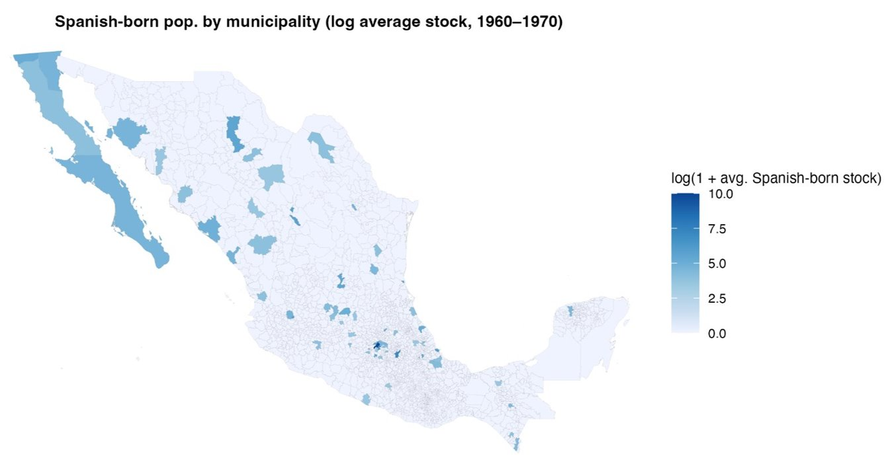
Empirical Strategy
Spanish Stock-Based Specification
Exposure: historical Spanish-born population (log of average stock, 1960–1970)
Notes:
Advantages relative to shares
Greater variation
Reduced mechanical scaling by population.
Interpretability in semi-elasticities.
Small populations do not generate noisy outliers.
Limitations relative to shares
Does not scale by population.
Less intuitive interpretation as “exposure rate”.

Slide 8
Empirical Strategy
Cohort & Window Exposure Measure (new specification)
We add a second specification that exploits the census question on years residing in the current locality.
For Spanish-born individuals, this lets us infer an "arrival-to-locality" year and classify settlement relative to key cutoffs (1955, 1975).
1960 census → municipalities with Spanish-born residents arrived 1936–1955;
1970 census → municipalities with Spanish-born residents arrived 1956–1978.
We compare outcomes in municipalities with greater exposure to early refugees (1936–1955) vs. later arrivals (1956–1978).
Limitations:
This strategy likely underestimates the 1936–1955 group due to survivor bias and the 1956–1978 group due to the absence of a 1980 census.
Arrival-to-locality year can only be reconstructed for “stayers” (individuals who migrated internally after arrival will be missed), and is therefore likely to be selected toward less mobile populations (more detail about identification of arrival-to-locality year in the appendix).
7 / 31
Notes:
Naming note: we are renaming "Timing-Based Exposure Measure" to "Cohort & Window Exposure Measure" so the reference to arrival cohorts and windows is explicit.
This strategy:
Provides a more time-specific measure of historical presence than simple stock-based measures.
Allows us to distinguish between different exile windows and directly compare early (pre-1955) and later (post-1955) arrivals.
Improves alignment between exposure definition and the institutional features of the law.

Slide 9
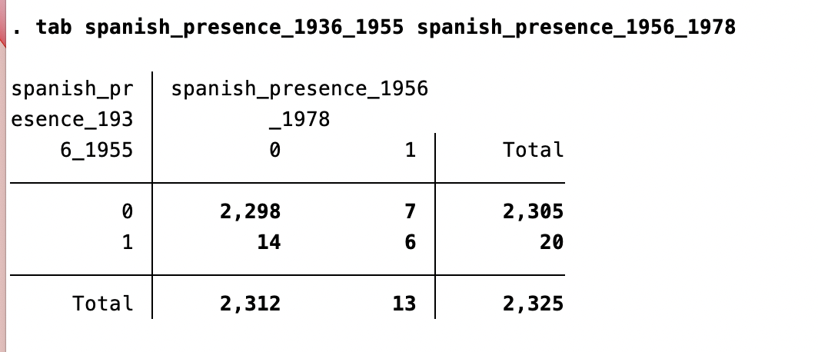
Empirical Strategy
Cohort & Window Exposure — Why Presence Dummies?
Within each window, there is very limited cross-municipality variation in the count of Spaniards (most treated cells have N = 1 or 2 in the unweighted census).
We therefore use dummies of Spanish presence by window (1936–1955 and 1956–1978) instead of shares or logs of stock:
log(remittances)ₘₜ = β₀ + β₁ · postₜ × 1{presence 36–55}ₘ + β₂ · postₜ × 1{presence 56–78}ₘ + γₜ + δₘ + uₘₜ
8 / 31

Slide 10
Empirical Strategy
Cohort & Window — Open Question on Parametrization
Current specification (slide 9): two independent dummies: β₁ on 1{36–55} and β₂ on 1{56–78}. Not wrong, but the counterfactual is a hybrid:
For β₁, the comparison group “no 36–55 presence” pools Never-treated with Late-only municipalities.
For β₂, the comparison group “no 56–78 presence” pools Never-treated with Early-only municipalities.
Each coefficient therefore mixes a “vs. Never” contrast with an “early-vs-late” contrast.
Alternative option A (4 groups). Early-only (36–55), Late-only (56–78), Both, Never.
Counterfactual: each treated group is compared against Never-treated. Clean separation of early vs. later exile cohorts, but the "Both" cell is very small (6 municipalities).
Alternative option B (3 groups). Early-any (36–55, alone or with 56–78), Late-only, Never.
Counterfactual: Early-any absorbs the "Both" group; Late-only captures arrivals that would have faced tighter entry standards under the Law's ancestry rules. Larger cells, but Early-any mixes early-only + both, so the implicit contrast changes.
Question: which parametrization best matches our identification? The answer shapes how we construct the entropy-balancing groups below.
9 / 31

Slide 11
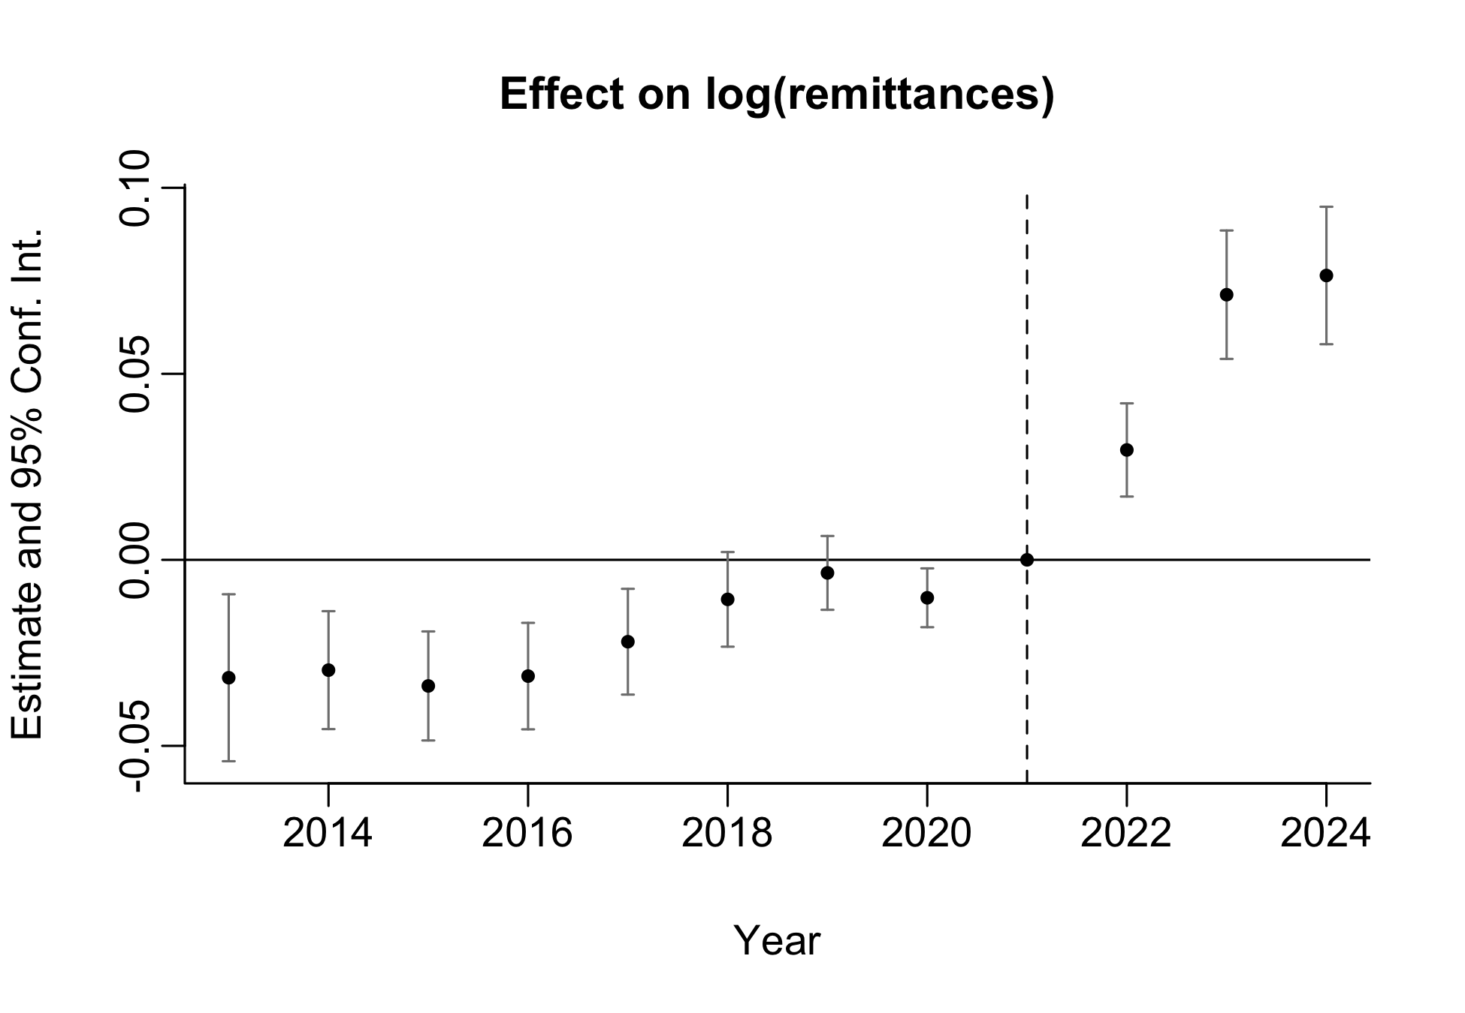
Preliminary Results: Stock-Based Exposure
1. Baseline Specification
log(remittances)ₘₜ = β₀ + β₁ · postₜ × log(Eₘ) + γₜ + δₘ + uₘₜ
10 / 31

Slide 12
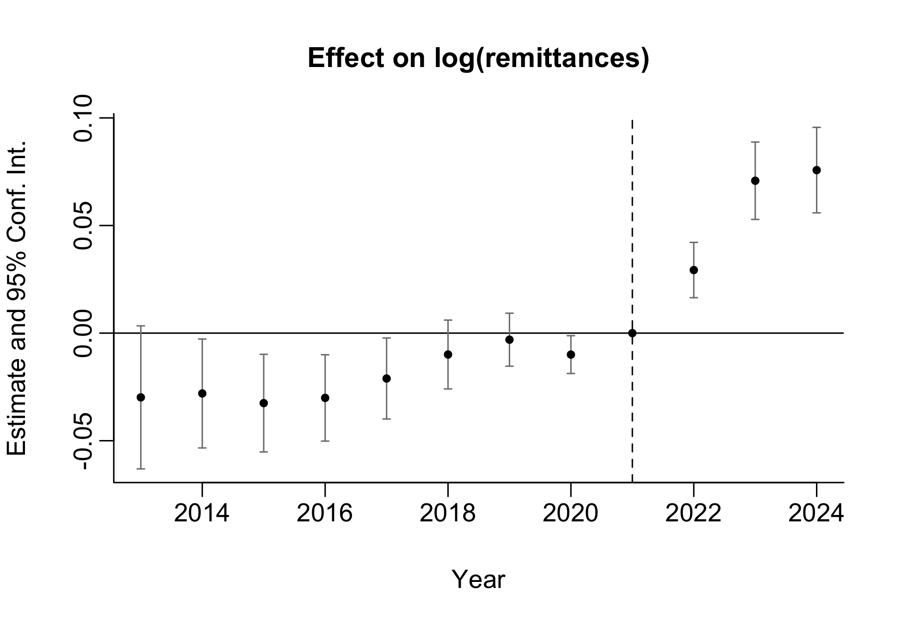
Preliminary Results
2. Differential Time Trends by Baseline U.S. Migration
log(remittances)ₘₜ = β₀ + β₁ · postₜ × log(Eₘ) + γₜ + δₘ + θₜ · USmig₂₀₁₀,ₘ + uₘₜ
11 / 31

Slide 13

Preliminary Results
3. Differential Time Trends by Baseline U.S. Migration and Non-US-Border States
log(remittances)ₘₜ = β₀ + β₁ · postₜ × log(Eₘ) + γₜ + δₘ + θₜ · USmig₂₀₁₀,ₘ + uₘₜ
11 / 31

Slide 14
Preliminary Results
Pooled Estimate (Differential Time Trends)
 | Log Remittances
 | (1) | (2) | (3)
Post × Log Spanish-born (average) | 0.078*** | 0.070*** | 0.063***
 | (0.010) | (0.011) | (0.014)
R² | 0.971 | 0.981 | 0.979
Observations | 27864 | 27864 | 24660
Municipality FE | Yes | Yes | Yes
Time FE | Yes | Yes | Yes
Migration × Time FE | No | Yes | Yes
Sample | Full | Full | No border states
Standard errors clustered at the municipality level in parentheses. * p<0.1,** p<0.05, ** p<0.01.
12 / 31

Slide 15
Feedback
Poisson specification in light of recent criticism of log(y+1).
Entropy-balanced weighted regression. Concern: Spaniards may have settled in municipalities with labor-market conditions that are more conducive to remittances. EB addresses this selection by re-weighting the control group to match the treated.
Today's update focuses on the Entropy Balancing piece. Poisson is pending until we close the EB / model parametrization decisions.
13 / 31

Slide 16
Entropy Balancing — Variables & Options
Candidate covariates: pre-period remittance outcomes (average of pre-treatment total remittances, average of pre-treatment log remittances), U.S. emigration (2000, 2010), population by age group, total population (1990, 1995, 2000, 2005, 2010, 2015, 2020), surface (km2), density in 2020, sex composition in 2020 (percentage of men, percentage of women, men to women ratio), labor covariates in 2020 (percentage of PEA, percentage of ocupation), schooling in 2020 (percentage of the population aged 15 and above with no schooling, with basic education, with upper secondary education, and with tertiary education), literacy rates (percentage of literate individuals aged 15–24 and aged 25 and above), marginalization index (1990, 1995, 2000, 2005, 2010, 2015, 2020).
Four EB specifications chosen from this menu:
Option 1 — Outcome only: average of pre-treatment total remittances.
Option 2 — Parsimonious: average of pre-treatment log remittances, U.S. emigration (2010), marginalization index (2010), population (2010), density (2020). Captures outcome level, migration networks, structural development and size/urbanity.
Option 3 — Intermediate with time dimension: adds U.S. emigration (2000), marginalization index (2000), and PEA (2020).
Option 4 — Human capital: adds percentage of population with no schooling and with basic education to Option 3.
14 / 31

Slide 17
Entropy Balancing — Pre-Arrival Covariates
To address the selection concern as tightly as possible, we would ideally balance on municipality characteristics predating Spanish arrival.
Publicly available tabulations at the municipal level are scarce for the pre-1930s period.
The 1921 census is the only pre-1930s Mexican census with municipal-level population tabulations.
Merge challenge: municipal boundaries changed substantially between 1921 and the CONAPO 2013–2024 panel; a crosswalk is feasible but non-trivial.
Open question: is it worth the effort of building that crosswalk given the likelihood of imperfect matches, or should we document the limitation and rely on post-arrival covariates?
15 / 31

Slide 18
EB — Strategies for the Cohort & Window Model
Treatment is binary but with two "intensities"
log(remittances)ₘₜ = β₀ + β₁ · postₜ × 1{presence 36–55}ₘ + β₂ · postₜ × 1{presence 56–78}ₘ + γₜ + δₘ + uₘₜ
Strategy 1. Presence (any window, 27 municipalities) vs. No presence (2,298 municipalities) — 2 groups. Balance a single dummy for any Spanish presence — simple but ignores the window structure the identification exploits.
Strategy 2. Early-only (36–55, 14 municipalities), Late-only (56–78, 7 municipalities), Both (6 municipalities), Never (2,298 municipalities) — 4 groups. Each treated group is balanced separately against Never; controls receive the average of the three resulting weights before estimation (Low convergence).
Strategy 3. Early-any (36–55 or 56–78, 20 municipalities), Late-only (7 municipalities), Never (2,298 municipalities) — 3 groups. Same averaging rule for controls.
Ideally the balancing groups should mirror the estimation groups — so the choice between is tied to the parametrization question on the cohort model.
16 / 31

Slide 19
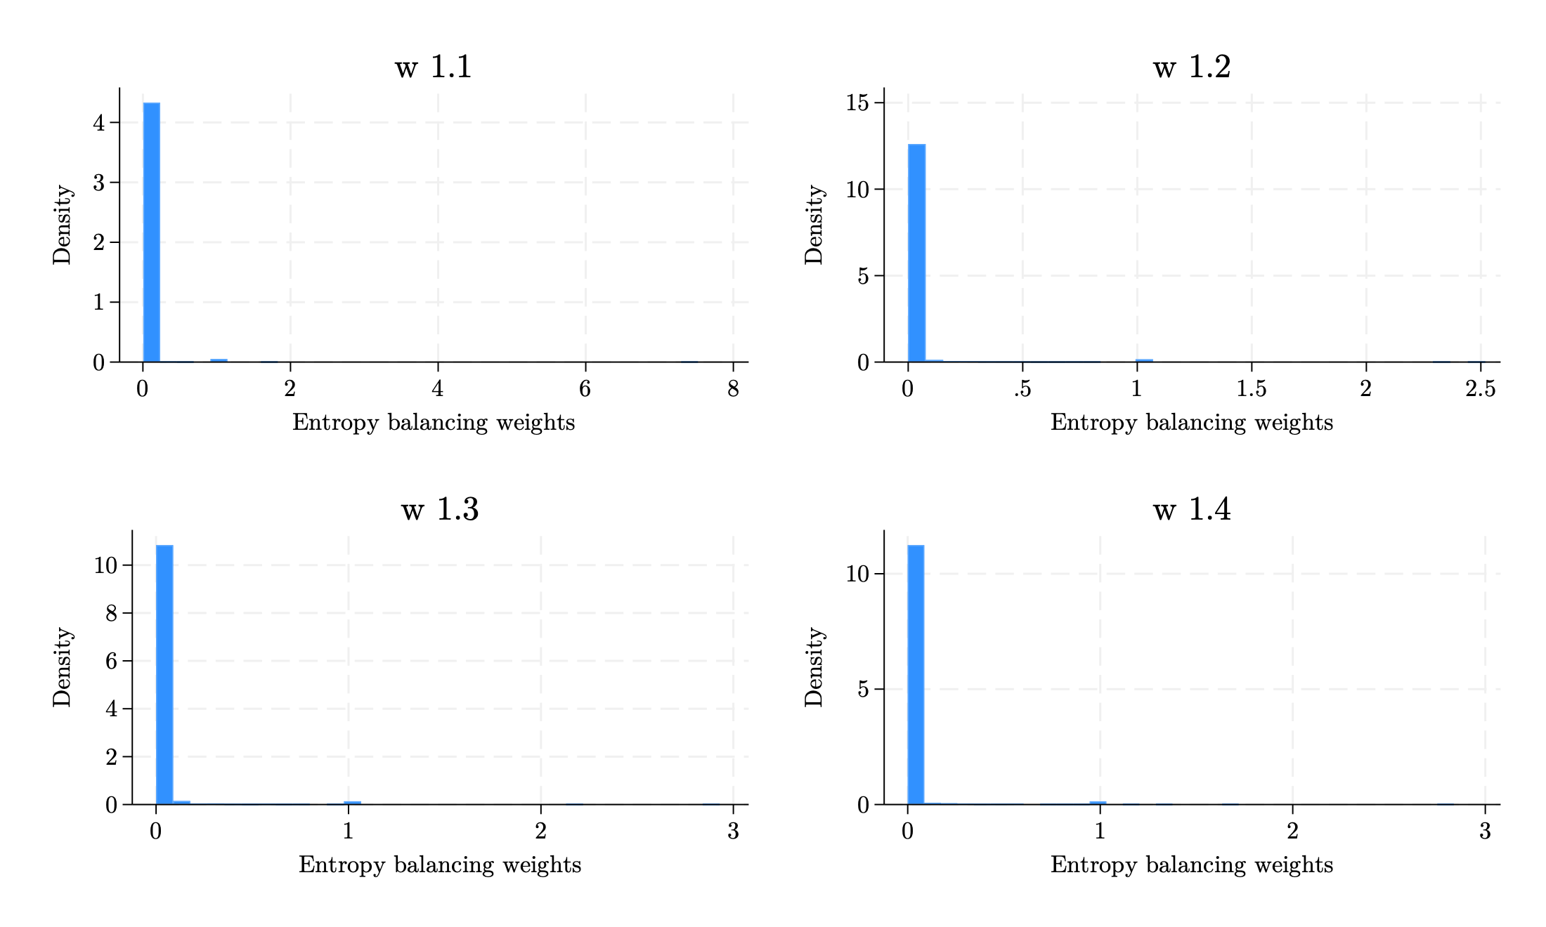
EB Results — Strategy 1 (Any Presence vs. None)
Treated = any Spanish presence across windows vs. Never.
All four EB Options converge when balacing means. Options 2–4 additionally match variances.
Some weights are relatively large.
 | Mean | Min | Max | Variance | p1 | p5 | p10 | p50 | p90 | p95 | p99
w1.1 | 0,023 | 0,005 | 7,520 | 0,037 | 0,005 | 0,005 | 0,005 | 0,005 | 0,010 | 0,016 | 1,000
w1.2 | 0,023 | 0,000 | 2,519 | 0,019 | 0,000 | 0,000 | 0,000 | 0,000 | 0,011 | 0,042 | 1,000
w1.3 | 0,023 | 0,000 | 2,929 | 0,020 | 0,000 | 0,000 | 0,000 | 0,000 | 0,010 | 0,044 | 1,000
w1.4 | 0,023 | 0,000 | 2,836 | 0,020 | 0,000 | 0,000 | 0,000 | 0,000 | 0,007 | 0,037 | 1,000
19 / 31

Slide 20
EB Results — Strategy 1 (Any Presence vs. None)
Pre-balance imbalances are large as expected — Spaniards cluster in larger, denser, more-developed municipalities.
 | Control |  |  | Treatment |  |  | Total
 | Mean | Variance | N | Mean | Variance | N | Mean | Variance | N
Remittances (pre-average) | 12.030 | 898.155 | 2,296 | 198.645 | 65,135.086 | 27 | 14.199 | 2,017.283 | 2,323
Log remittances (pre-average) | 1.260 | 2.076 | 2,296 | 4.632 | 1.544 | 27 | 1.299 | 2.200 | 2,323
U.S. migrants (2000, %) | 6.475 | 47.929 | 2,296 | 3.377 | 6.444 | 27 | 6.439 | 47.554 | 2,323
U.S. migrants (2010, %) | 3.914 | 17.352 | 2,296 | 1.244 | 906 | 27 | 3.883 | 17.242 | 2,323
MI (2000) | 0.037 | 951 | 2,295 | -1.406 | 394 | 27 | 0.020 | 968 | 2,322
MI (2010) | 0.036 | 950 | 2,296 | -1.386 | 305 | 27 | 0.019 | 966 | 2,323
Log population (2010) | 9.347 | 2.305 | 2,296 | 12.952 | 1.552 | 27 | 9.389 | 2.445 | 2,323
Log density | 3.928 | 2.753 | 2,296 | 6.248 | 3.698 | 27 | 3.955 | 2.824 | 2,323
PEA (%) | 47.736 | 73.086 | 2,296 | 56.753 | 5.041 | 27 | 47.841 | 73.227 | 2,323
19 / 31

Slide 21
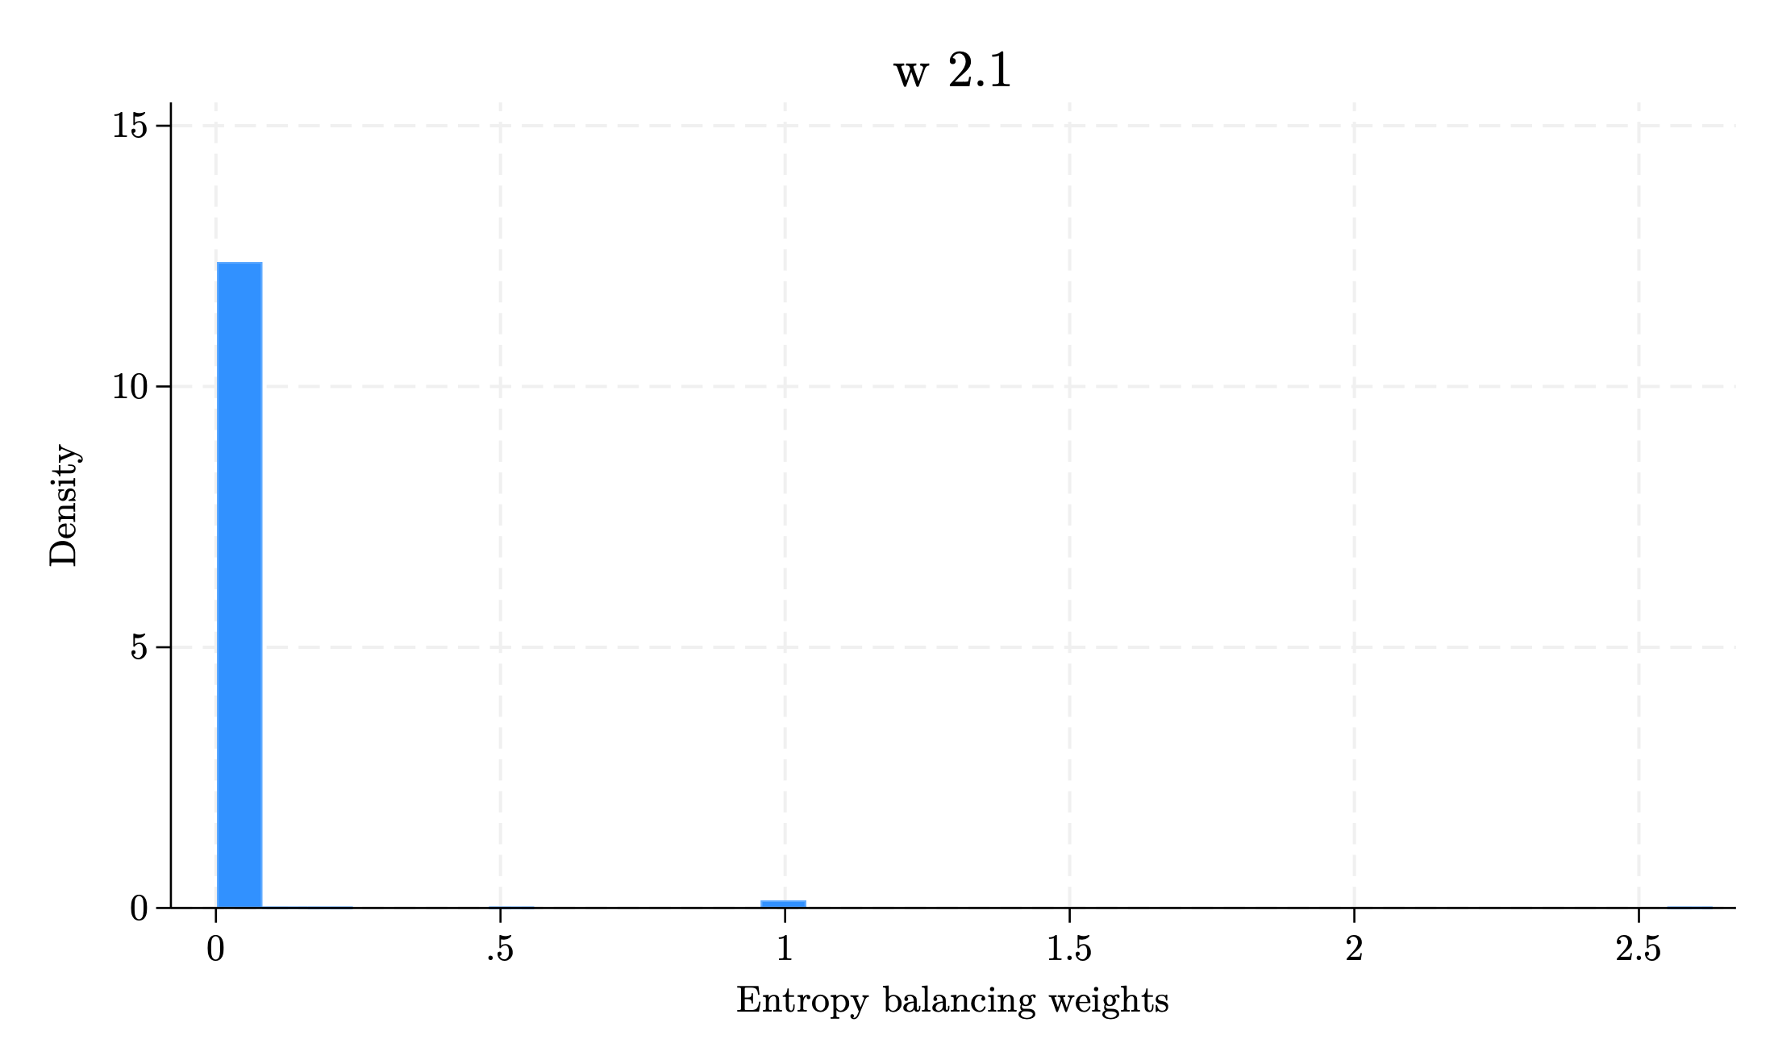
EB Results — Strategy 2 (4 groups)
Only Option 1 (outcome-only balancing) converges for all three treated subgroups against Never.
Options 2–4 , balancing both means and variances, fail to converge for the Late-only (G2) and Both (G3) subgroups given the small cell sizes (7 and 6 municipalities).
Options 2–4, balancing means only, fail to converge for group Both (G3).
Some weights are relatively large.
 | Mean | Min | Max | Variance | p1 | p5 | p10 | p50 | p90 | p95 | p99
w2.1 | 0,015 | 0,002 | 2,629 | 0,015 | 0,002 | 0,002 | 0,002 | 0,002 | 0,003 | 0,005 | 1,000
17 / 31

Slide 22
EB Results — Strategy 2 (4 groups)
Pre-balance imbalances are large, as expected, but imbalances between treated groups are relatively small.
 | Control |  |  | Treatment 1 (Early-only) |  |  | Treatment 2 (Late-only) |  |  | Treatment 3 (Both)
 | Mean | Variance | N | Mean | Variance | N | Mean | Variance | N | Mean | Variance | N
Remittances (pre-average) | 12.030 | 898.155 | 2,296 | 140.646 | 20,895.362 | 14 | 144.065 | 22,438.363 | 7 | 397.653 | 19,6334.312 | 6
Log remittances (pre-average) | 1.260 | 2.076 | 2,296 | 4.441 | 1.170 | 14 | 4.226 | 2.271 | 7 | 5.550 | 913 | 6
U.S. migrants (2000, %) | 6.475 | 47.929 | 2,296 | 3.943 | 9.615 | 14 | 3.269 | 4.274 | 7 | 2.185 | 763 | 6
U.S. migrants (2010, %) | 3.914 | 17.352 | 2,296 | 1.550 | 1.429 | 14 | 893 | 248 | 7 | 938 | 150 | 6
MI (2000) | 0.037 | 951 | 2,295 | -1.286 | 330 | 14 | -1.340 | 741 | 7 | -1.762 | 101 | 6
MI (2010) | 0.036 | 950 | 2,296 | -1.261 | 284 | 14 | -1.359 | 508 | 7 | -1.712 | 65 | 6
Log population (2010) | 9.347 | 2.305 | 2,296 | 12.710 | 1.178 | 14 | 12.617 | 1.919 | 7 | 13.909 | 1.287 | 6
Log density | 3.928 | 2.753 | 2,296 | 5.734 | 1.146 | 14 | 5.994 | 9.159 | 7 | 7.744 | 1.744 | 6
PEA (%) | 47.736 | 73.086 | 2,296 | 56.225 | 5.383 | 14 | 56.822 | 5.959 | 7 | 57.904 | 2.688 | 6
17 / 31

Slide 23
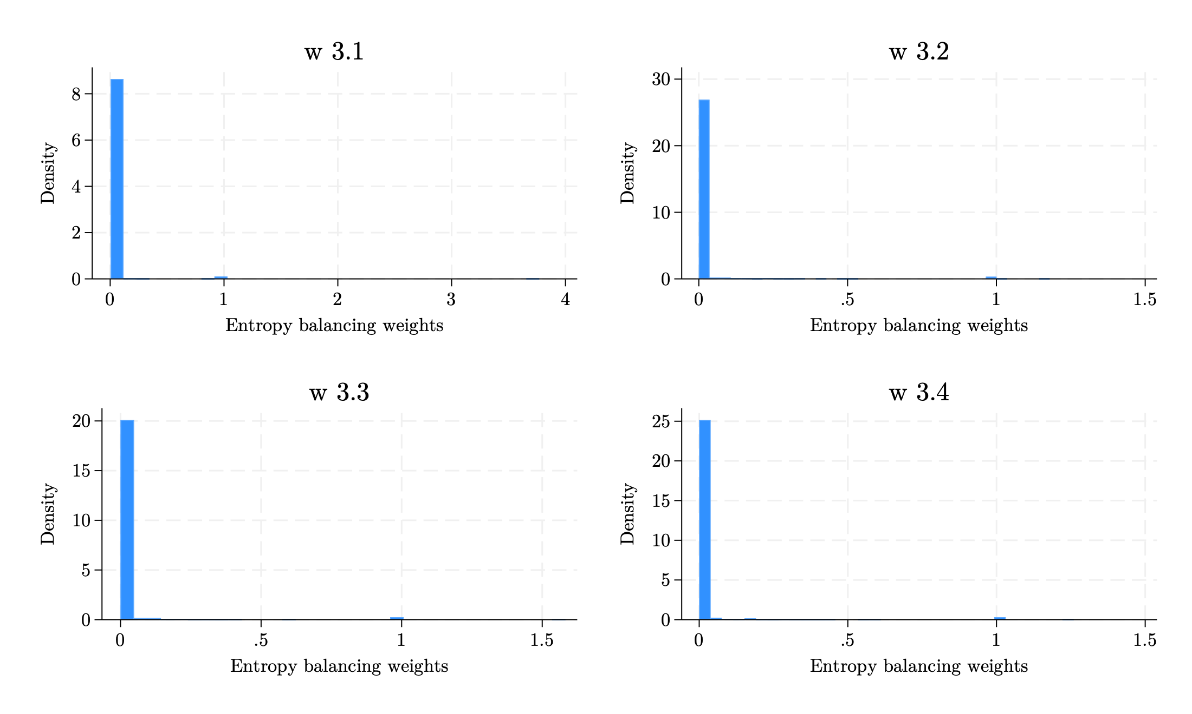
EB Results — Strategy 3 (3 groups)
All four balances converge when matching means only — not when mathcing also variances.
Weights have less extreme values with this strategy.
Some weights are relatively large.
 | Mean | Min | Max | Variance | p1 | p5 | p10 | p50 | p90 | p95 | p99
w3.1 | 0,017 | 0,003 | 3,770 | 0,018 | 0,003 | 0,003 | 0,003 | 0,003 | 0,005 | 0,008 | 1,000
w3.2 | 0,017 | 0,000 | 1,179 | 0,013 | 0,000 | 0,000 | 0,000 | 0,000 | 0,004 | 0,019 | 1,000
w3.3 | 0,017 | 0,000 | 1,583 | 0,013 | 0,000 | 0,000 | 0,000 | 0,000 | 0,006 | 0,025 | 1,000
w3.4 | 0,017 | 0,000 | 1,260 | 0,013 | 0,000 | 0,000 | 0,000 | 0,000 | 0,005 | 0,021 | 1,000
18 / 31

Slide 24
EB Results — Strategy 3 (3 groups)
Pre-balance imbalances are large, as expected, but imbalances between treated groups are relatively small.
 | Control |  |  | Treatment 1 (Early-any) |  |  | Treatment 2 (Late-only)
 | Mean | Variance | N | Mean | Variance | N | Mean | Variance | N
Remittances (pre-average) | 12.030 | 898.155 | 2,296 | 217.748 | 80,564.776 | 20 | 144.065 | 22,438.363 | 7
Log remittances (pre-average) | 1.260 | 2.076 | 2,296 | 4.774 | 1.313 | 20 | 4.226 | 2.271 | 7
U.S. migrants (2000, %) | 6.475 | 47.929 | 2,296 | 3.415 | 7.462 | 20 | 3.269 | 4.274 | 7
U.S. migrants (2010, %) | 3.914 | 17.352 | 2,296 | 1.367 | 1.100 | 20 | 893 | 248 | 7
MI (2000) | 0.037 | 951 | 2,295 | -1.429 | 303 | 20 | -1.340 | 741 | 7
MI (2010) | 0.036 | 950 | 2,296 | -1.396 | 256 | 20 | -1.359 | 508 | 7
Log population (2010) | 9.347 | 2.305 | 2,296 | 13.069 | 1.462 | 20 | 12.617 | 1.919 | 7
Log density | 3.928 | 2.753 | 2,296 | 6.337 | 2.136 | 20 | 5.994 | 9.159 | 7
PEA (%) | 47.736 | 73.086 | 2,296 | 56.728 | 5.014 | 20 | 56.822 | 5.959 | 7
18 / 31

Slide 25
EB — Stock-Based Specification
In the stock-based model the "treatment" is continuous (log Spanish-born stock), so the natural EB is continuous-treatment entropy balancing.
Continuous-treatment EB is feasible (Tübbicke 2022) but more involved than the binary case: it targets moments of the treatment–covariate joint distribution rather than group means.
Alternative: redefine the stock-based treatment as a binary dummy of Spanish presence and apply standard binary EB (see the appendix dummy specification).
Question: do we want to (a) implement continuous-treatment EB, (b) switch the stock model to a presence dummy for EB purposes, or (c) keep the stock-based model unweighted and use EB only for the cohort specification?
20 / 31

Slide 26
Synthetic DiD — What We Did
Implemented SDID (Arkhangelsky et al. 2021) on the panel of municipal remittances 2013–2024 — 9 pre-treatment years, 3 post (treatment in 2022).
Treatment is binary (Spanish-presence dummy). ATT is the extensive-margin effect of having Spanish ancestry, not the intensity effect estimated in the DiD.
Donor pool: 2,296 never-treated municipalities. For each window the control group is restricted to pure never-treated only; municipalities with presence in the other window only are excluded.
Inference for the ATT: block bootstrap clustered at municipality. Event-study coefficients re-centered against the λ-weighted pre-treatment baseline (Clarke et al. 2024 recipe).
21 / 31

Slide 27
SDID — Three Specifications
Pooled: treated = municipalities with Spanish presence in any window (N = 27); controls = the 2,296 never-treated.
Window 1936–1955 (c1): treated = presence in 1936–1955 (N = 20); controls = never-treated only, excluding the 7 municipalities with presence only in 1956–1978.
Window 1956–1978 (c2): treated = presence in 1956–1978 (N = 13); controls = never-treated only, excluding the 14 municipalities with presence only in 1936–1955.
Excluding "other-window only" municipalities removes the hybrid-counterfactual concern from slide 10: in c1 and c2 the comparison is treated vs. pure never-treated.
22 / 31

Slide 28
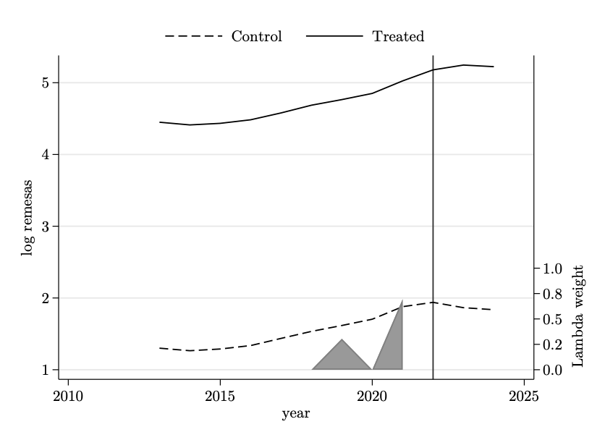

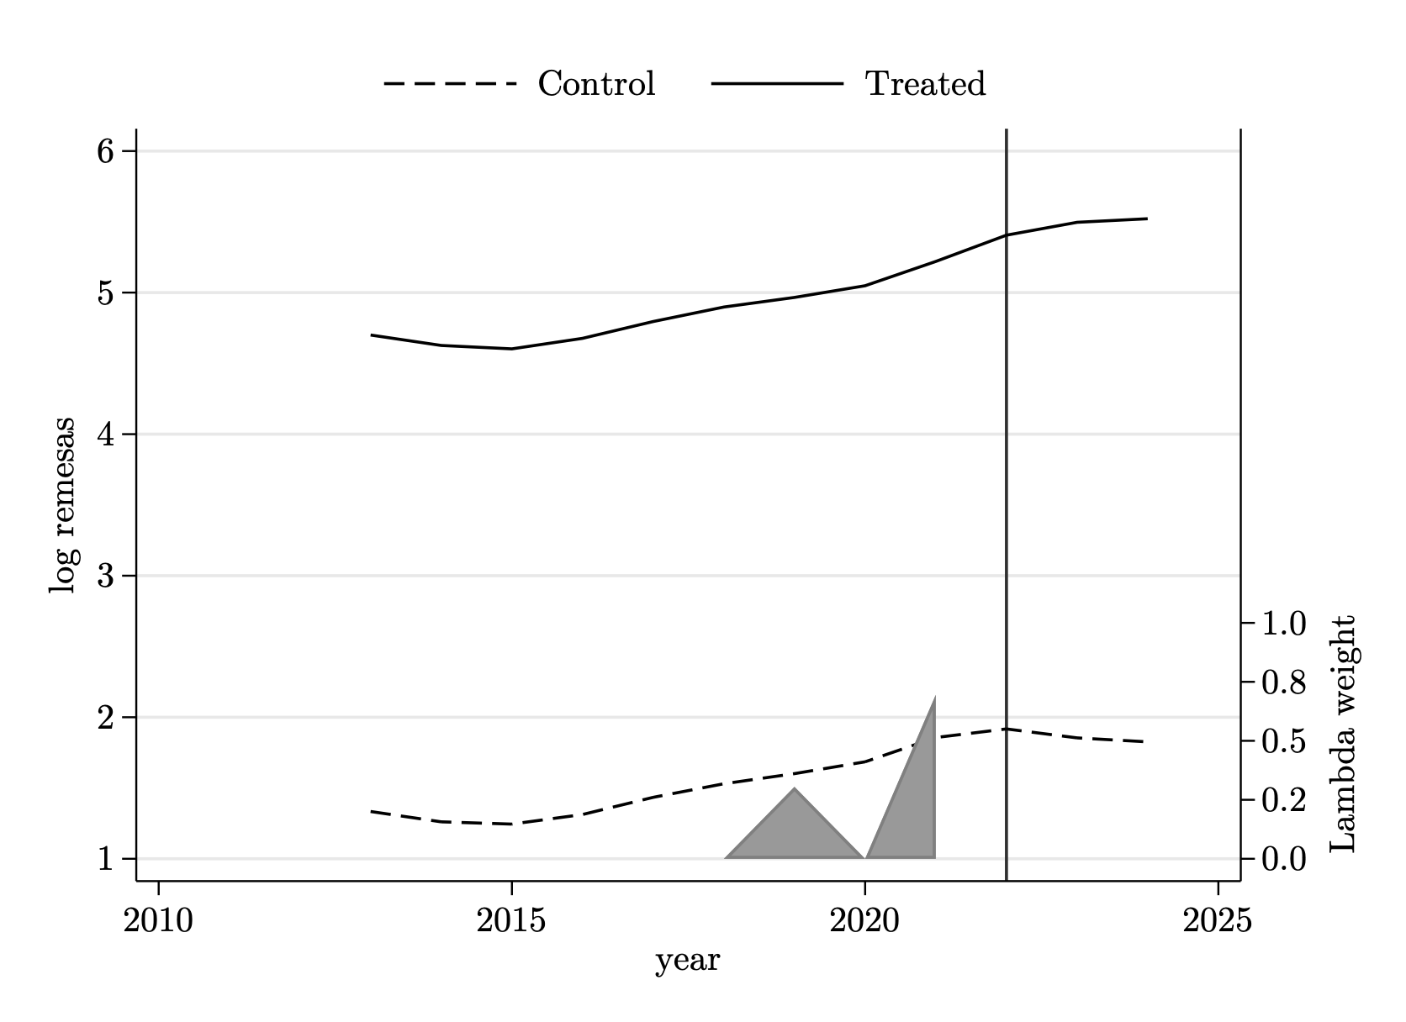
SDID — Trends (sin controles)
Pooled
Window 1936–1955
Window 1956–1978
Treated and synthetic-control series tracked closely in the pre-period in all three specs, then diverged after 2022. The grey band shows the λ time weights — concentrated on a few years close to treatment.
23 / 31

Slide 29
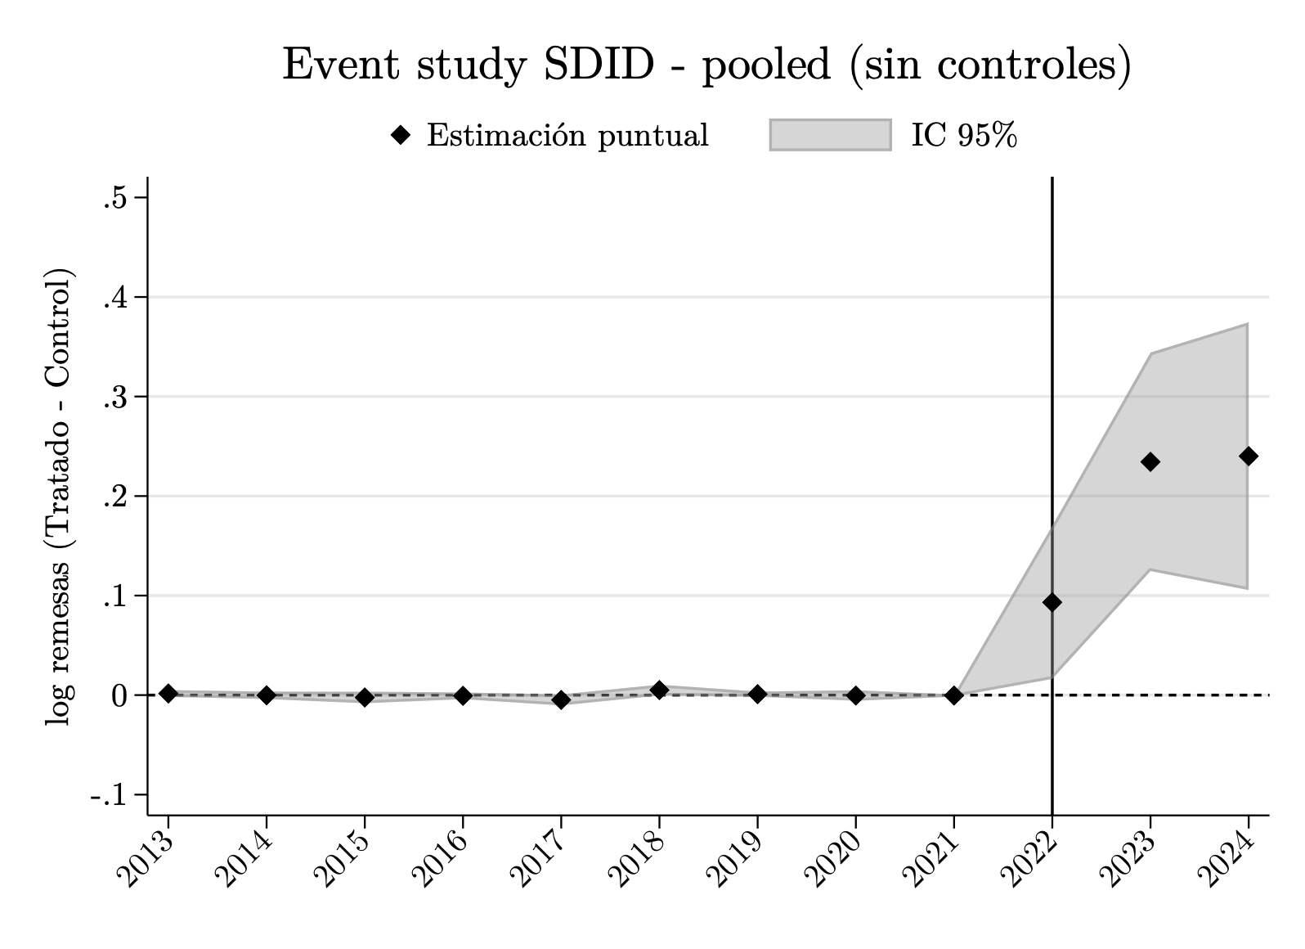
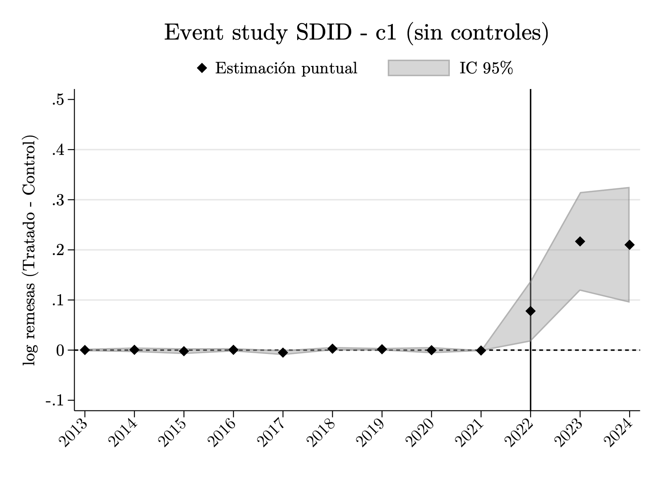
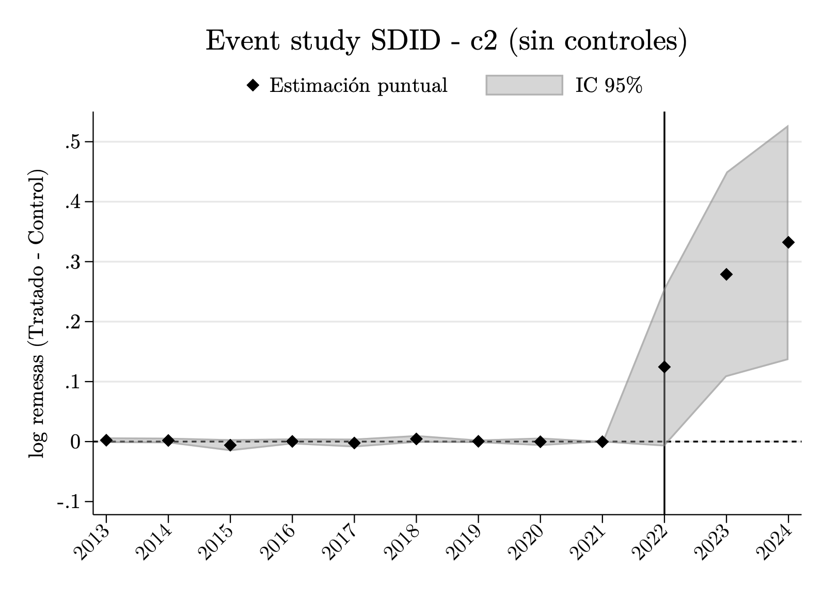
SDID — Event Studies (sin controles)
Pooled
Window 1936–1955
Window 1956–1978
Pre-treatment coefficients sit at zero with very tight CIs — mechanical: SDID forces the pre-period to match. The informative part is the post-treatment jump, with CIs widening over time.
24 / 31

Slide 30
SDID — ATT on log Remittances (sin controles)
 | Pooled | Window 1936–1955 | Window 1956–1978
ATT | 0.1892*** | 0.1683*** | 0.2452***
SE | (0.0490) | (0.0393) | (0.0825)
N | 27,876 | 27,792 | 27,708
All three specifications yield positive, statistically significant ATTs on log remittances (≈ 17–25%). Window 1956–1978 shows the largest point estimate but also the widest SE (only 13 treated municipalities).
Block-bootstrap SE clustered at municipality, 50 replications. *** p < 0.01.
25 / 31

Slide 31
Next Steps
Close the parametrization choice for the cohort & window specification (2 vs. 3 groups).
Decide EB strategy for the stock-based model (continuous treatment vs. presence dummy).
Implement Poisson pseudo-likelihood specification; rerun main and EB-weighted specifications.
Evaluate whether to build the 1921 census crosswalk for pre-arrival balancing covariates.
26 / 31

Slide 32
APPENDIX
23 / 31

Slide 33
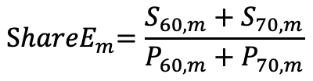
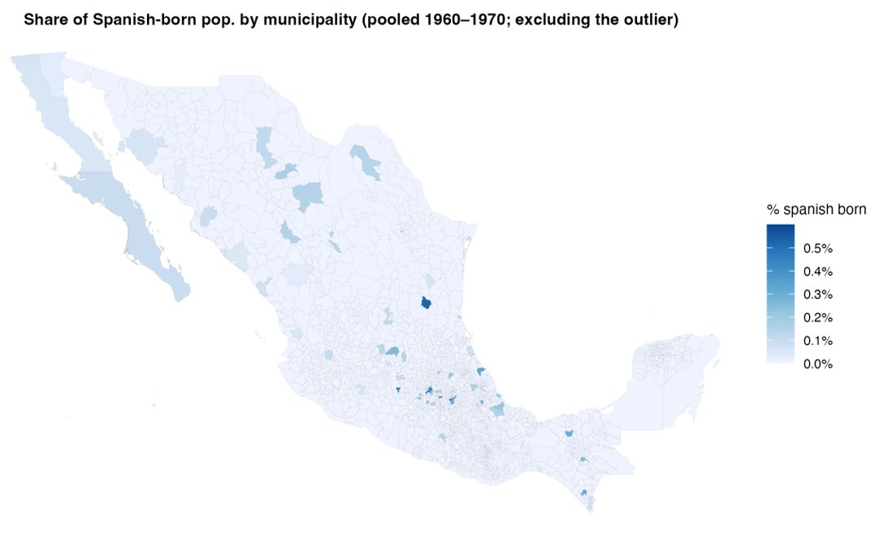
Alternative Exposure Measure Using Population Shares
Share of Spanish-born residents (pooled 1960–1970; excluding outlier):
Notes:
In the 1970 census, an outlier is observed in the municipality of San Andrés Cholula (Puebla), where the Spanish-born share reaches 5.7% (approximately 2,000 Spanish-born individuals out of a total population of 35,100, using sampling weights).

Slide 34
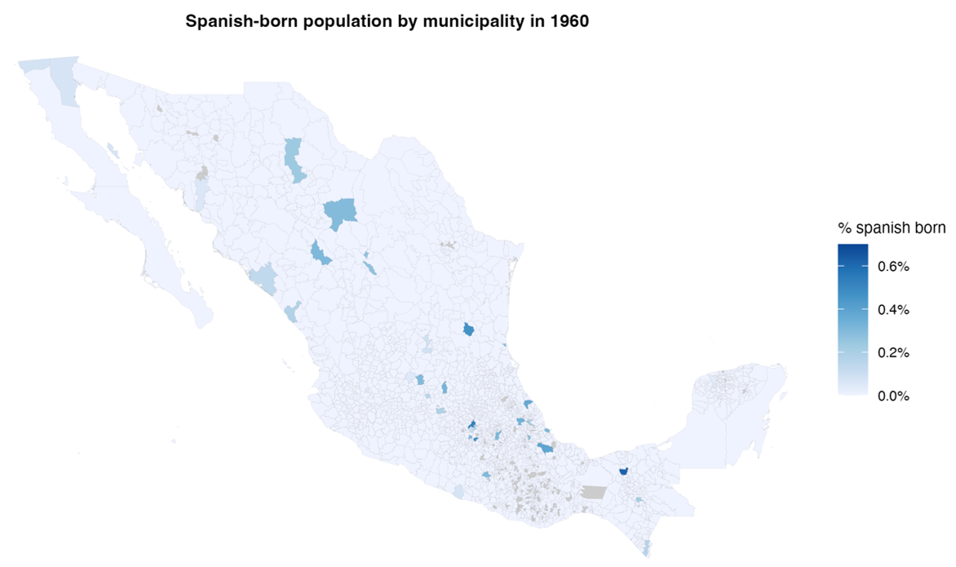
Distribution of Spanish-Born Population
Share of Spanish-born population in 1960
Notes: Grey areas correspond to municipalities not included in the 1960 census sample
Notes:
The 1960 and 1970 IPUMS census microdata are sample extracts rather than full population counts (the sampling fraction is 1% in 1960 and 1.5% in 1970). As a result, some small municipalities may not appear in the data if no sampled individuals were observed in those locations.

Slide 35
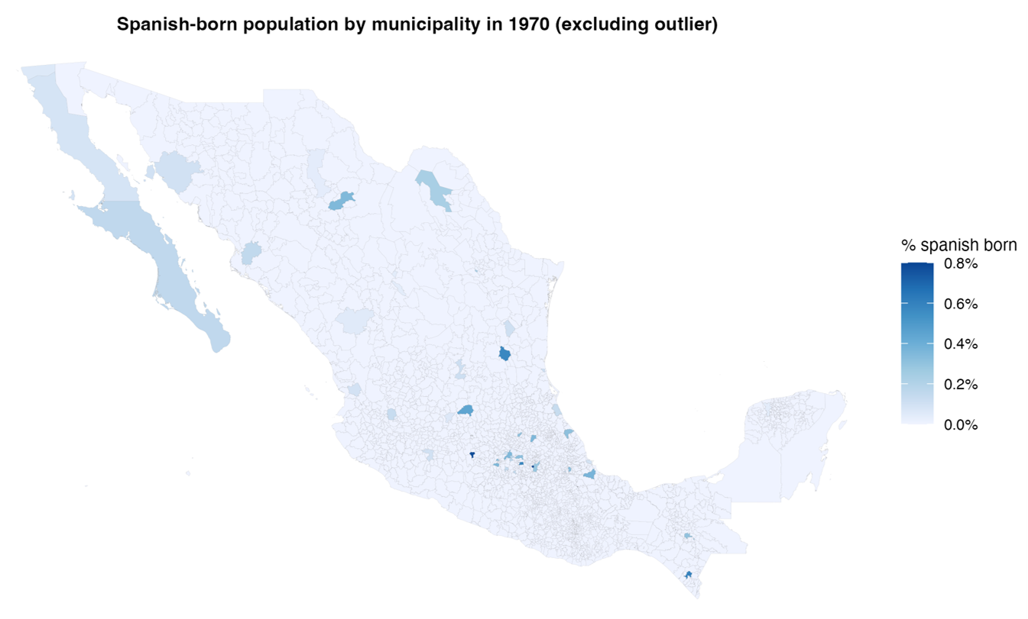
Distribution of Spanish-Born Population
Share of Spanish-born population in 1970 (excluding outlier)
Notes:
In the 1970 census, an outlier is observed in the municipality of San Andrés Cholula (Puebla), where the Spanish-born share reaches 5.7% (approximately 2,000 Spanish-born individuals out of a total population of 35,100, using sampling weights).

Slide 36
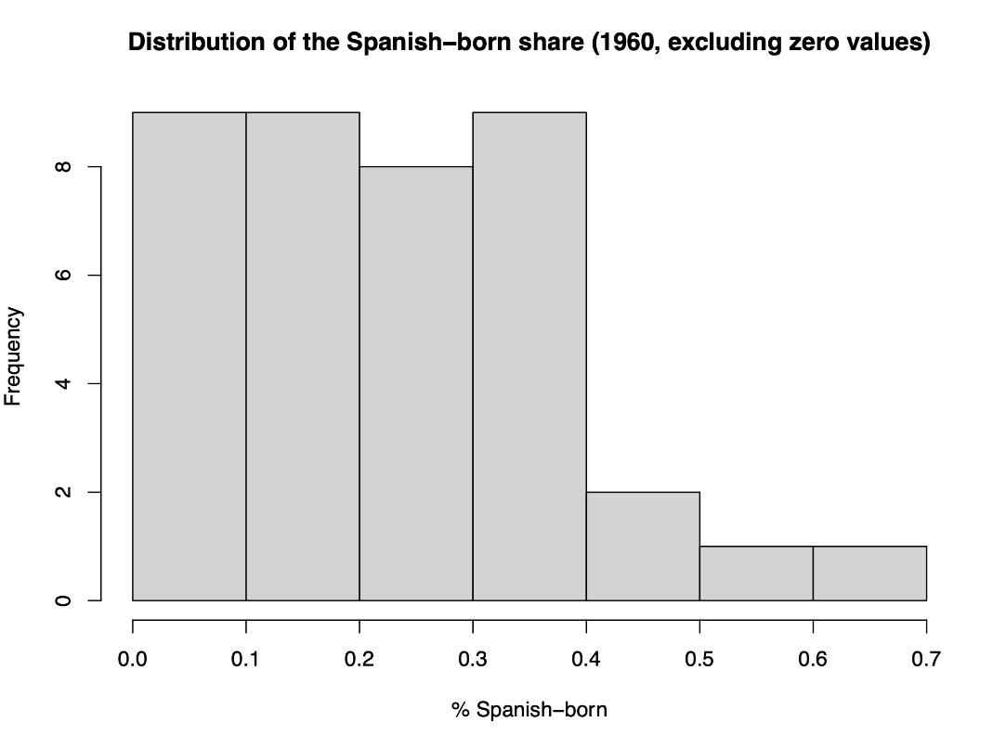
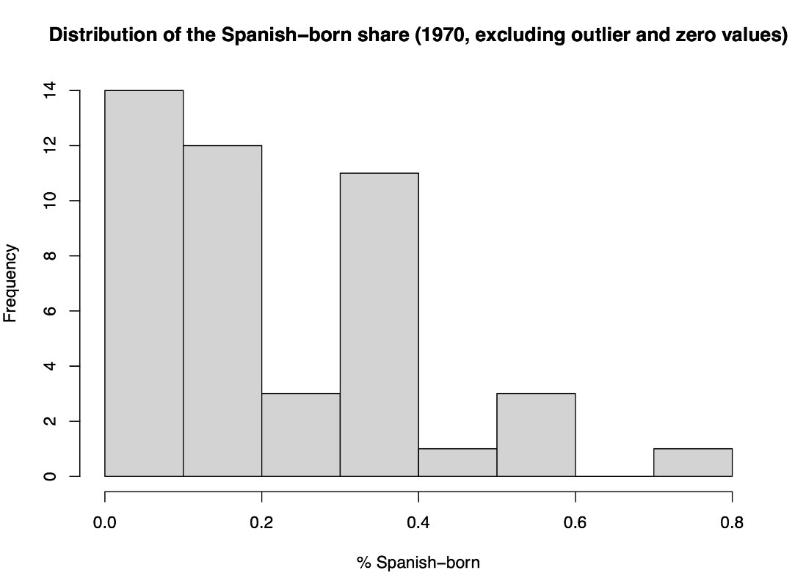
Distribution of Spanish-Born Population
Distribution of the Shares of Spanish-born population in 1960 and 1970 (excluding zero values and outliers)
Notes:
In the 1970 census, an outlier is observed in the municipality of San Andrés Cholula (Puebla), where the Spanish-born share reaches 5.7% (approximately 2,000 Spanish-born individuals out of a total population of 35,100, using sampling weights).

Slide 37
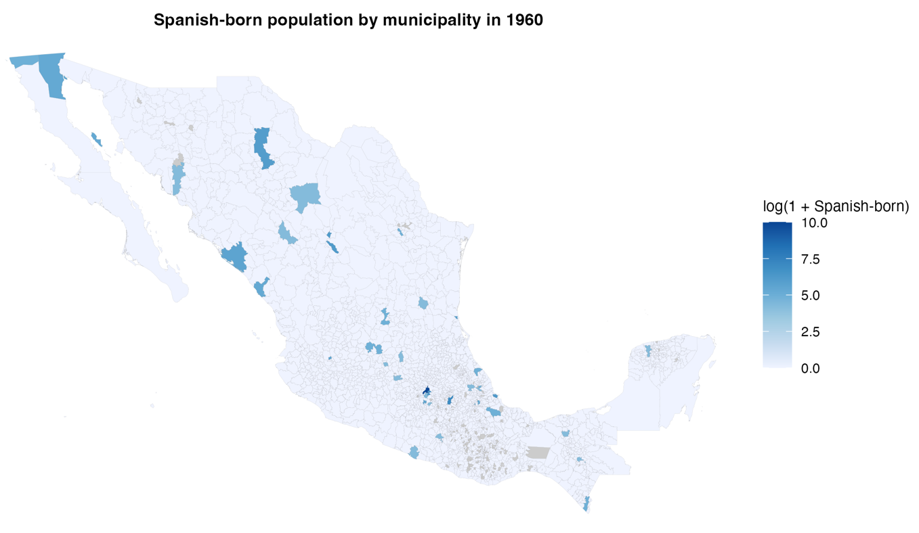
Distribution of Spanish-Born Population
Log of Spanish-born population in 1960
Notes: Grey areas correspond to municipalities not included in the 1960 census sample
Notes:
The 1960 and 1970 IPUMS census microdata are sample extracts rather than full population counts (the sampling fraction is 1% in 1960 and 1.5% in 1970). As a result, some small municipalities may not appear in the data if no sampled individuals were observed in those locations.

Slide 38
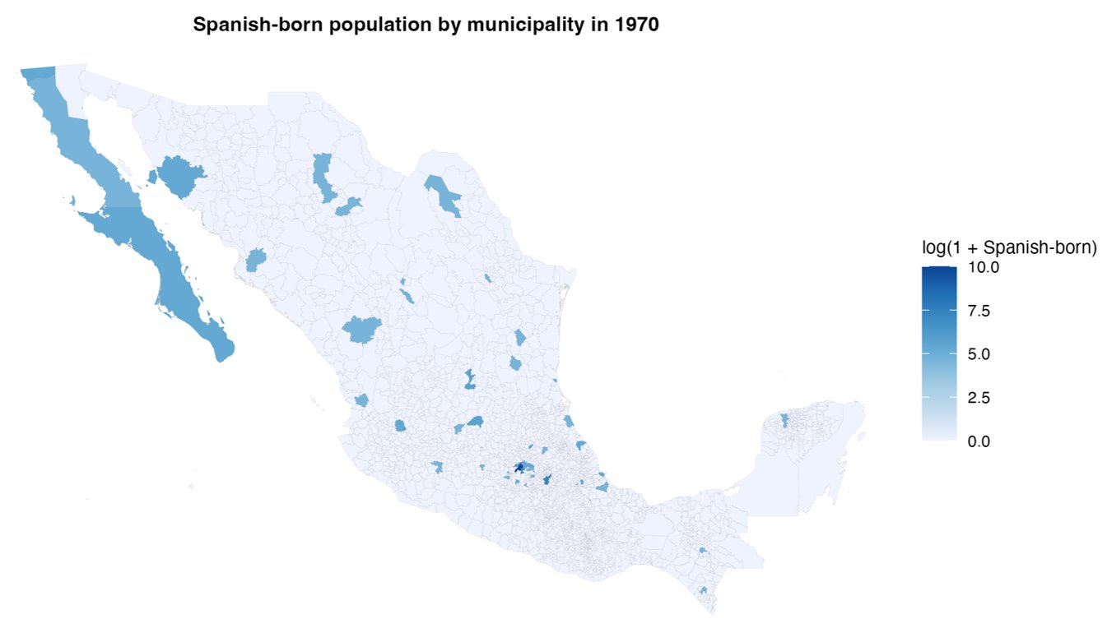
Distribution of Spanish-Born Population
Log of Spanish-born population in 1970

Slide 39
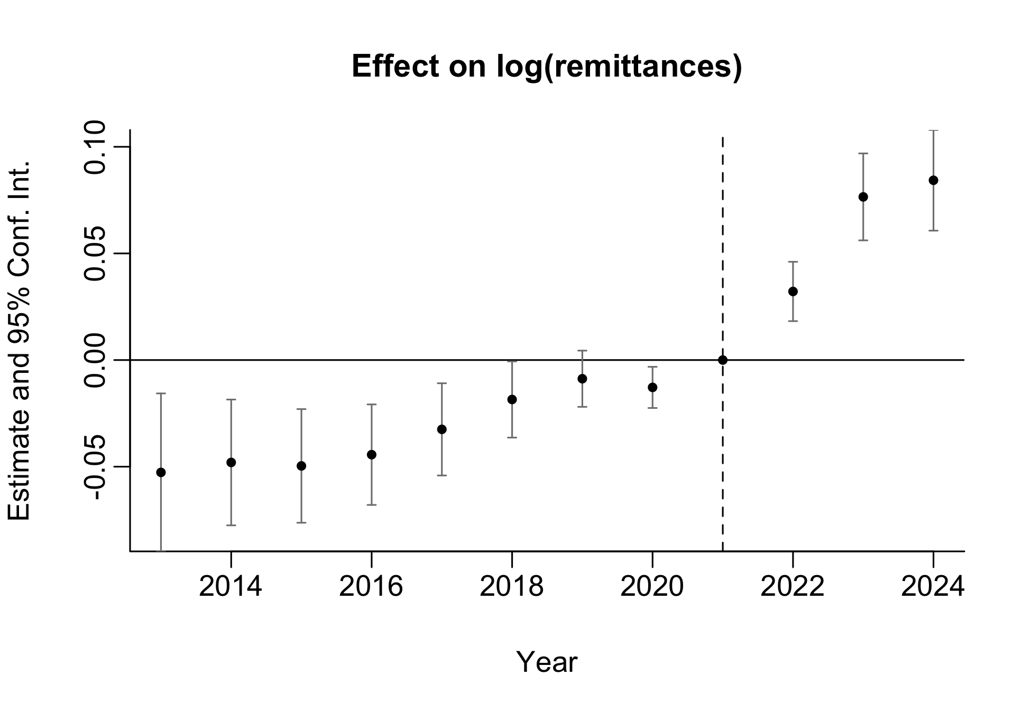
Appendix — Additional Specifications Explored
Differential Time Trends by U.S Migration (2000)
log(remittances)ₘₜ = β₀ + β₁ · postₜ × log(Eₘ) + γₜ + δₘ + θₜ · USmig₂₀₀₀,ₘ + uₘₜ
24 / 31
Notes:
Spec 12

Slide 40
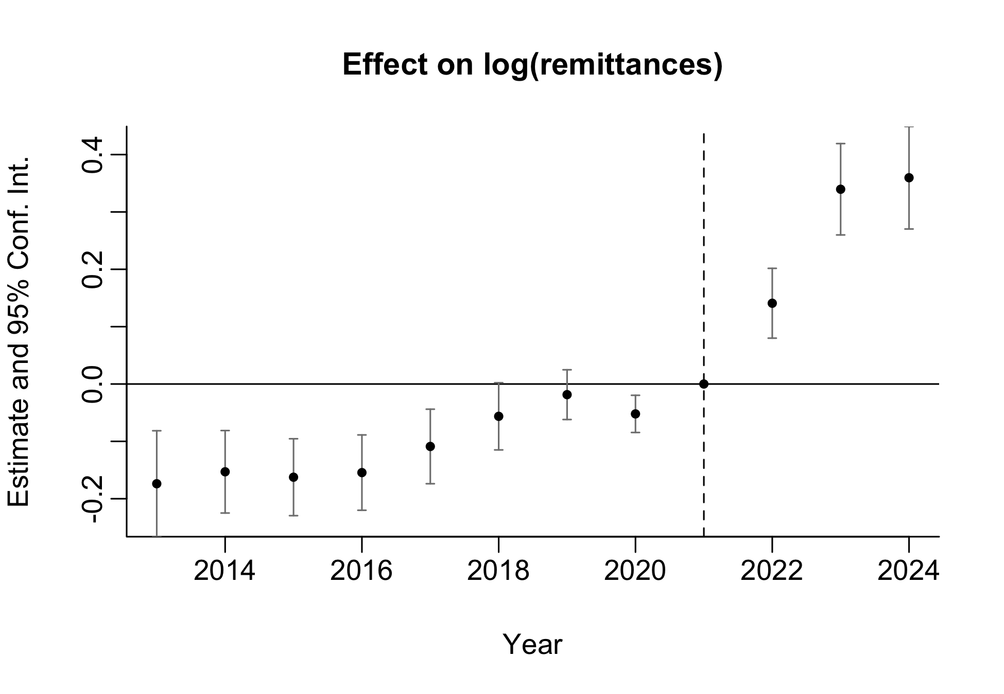
Appendix — Additional Specifications Explored
Exposure Based on a Spanish Presence Dummy
log(remittances)ₘₜ = β₀ + β₁ · postₜ × Spanish Presenceₘ + γₜ + δₘ + uₘₜ
24 / 31
Notes:
Spec 22

Slide 41
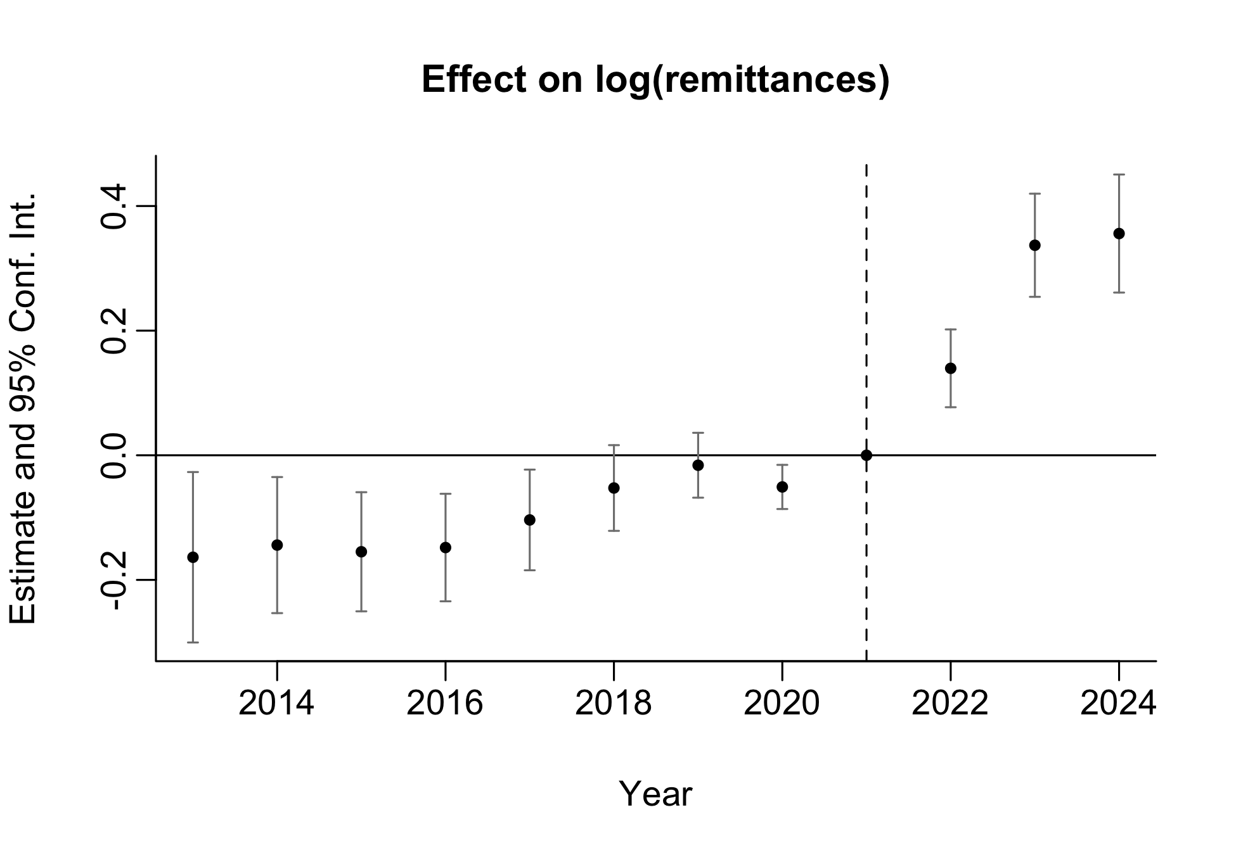
Appendix — Additional Specifications Explored
Differential Time Trends by U.S Migration (2010), Exposure Based on a Spanish Presence Dummy
log(remittances)ₘₜ = β₀ + β₁ · postₜ × Spanish Presenceₘ + γₜ + δₘ + θₜ · USmig₂₀₁₀,ₘ + uₘₜ
24 / 31
Notes:
Spec 27

Slide 42
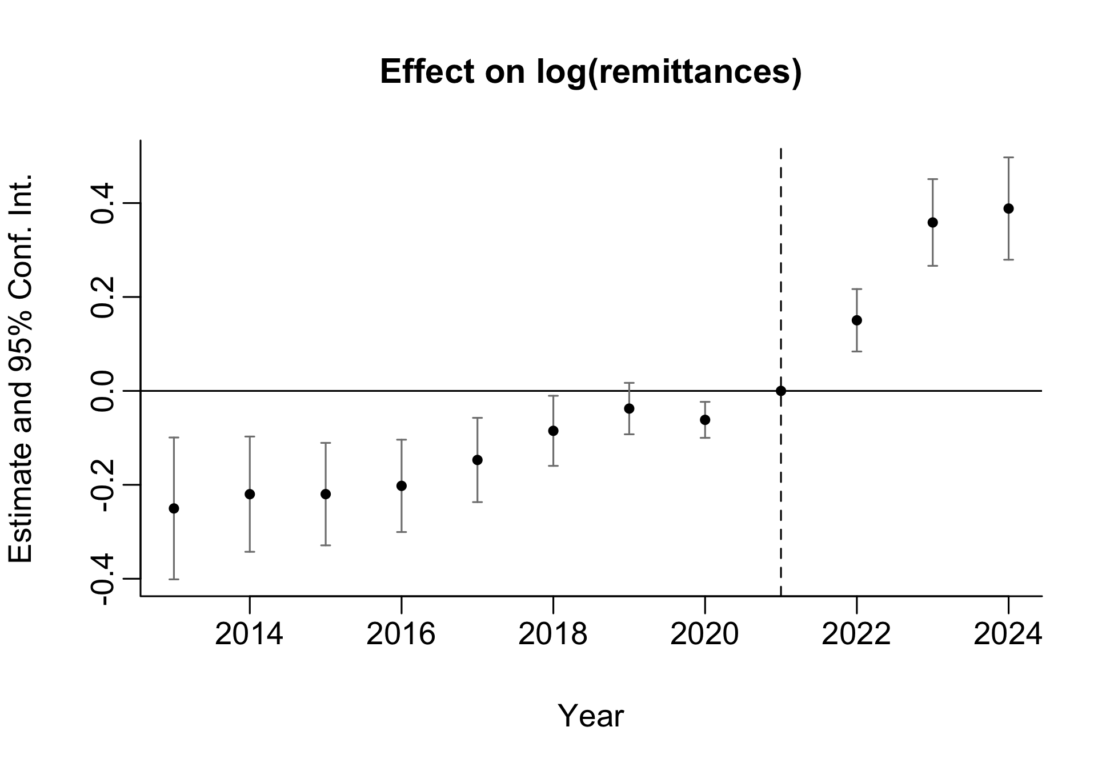
Appendix — Additional Specifications Explored
Differential Time Trends by U.S Migration (2000), Exposure Based on a Spanish Presence Dummy
log(remittances)ₘₜ = β₀ + β₁ · postₜ × Spanish Presenceₘ + γₜ + δₘ + θₜ · USmig₂₀₀₀,ₘ + uₘₜ
24 / 31
Notes:
Spec 28

Slide 43
Appendix — Merging Sources by INEGI Code
Problem. INEGI municipality codes change across census rounds and across other data sources; municipality names also vary (accents, abbreviations, multi-municipality aggregates).
Reference universe. We use the IPUMS-standardized INEGI from the 1960 and 1970 censuses as the base panel of municipalities; this gives a consistent code-to-municipality mapping for the historical exposure variables.
Other sources (remittances, marginalization index, 2020 population). For each source we apply the same procedure (illustrated below with remittances):
Full join with the reference panel by INEGI code; classify each row as exact match, name-contained, census aggregation (comma-separated label), close, mismatch, only-remittances, or only-censo.
Resolve mismatches via state-restricted crosswalks: search each unmatched name within (A) the opposite mismatch list, (B) census aggregations, (C) only-censo candidates, and (D) close matches.
Manually fix a small residual (≈ 4 records with truncated names) and remove duplicates that arise when one name is contained in another (e.g. “MORELOS” vs “GRAN MORELOS”).
Outcome (remittances example). Out of ≈ 1,030 inegis needing reassignment, the crosswalks recover the vast majority; the rest are corrected by hand. The same logic was applied to the migration data, the marginalization index and the 2020 population data.
26 / 31

Slide 44
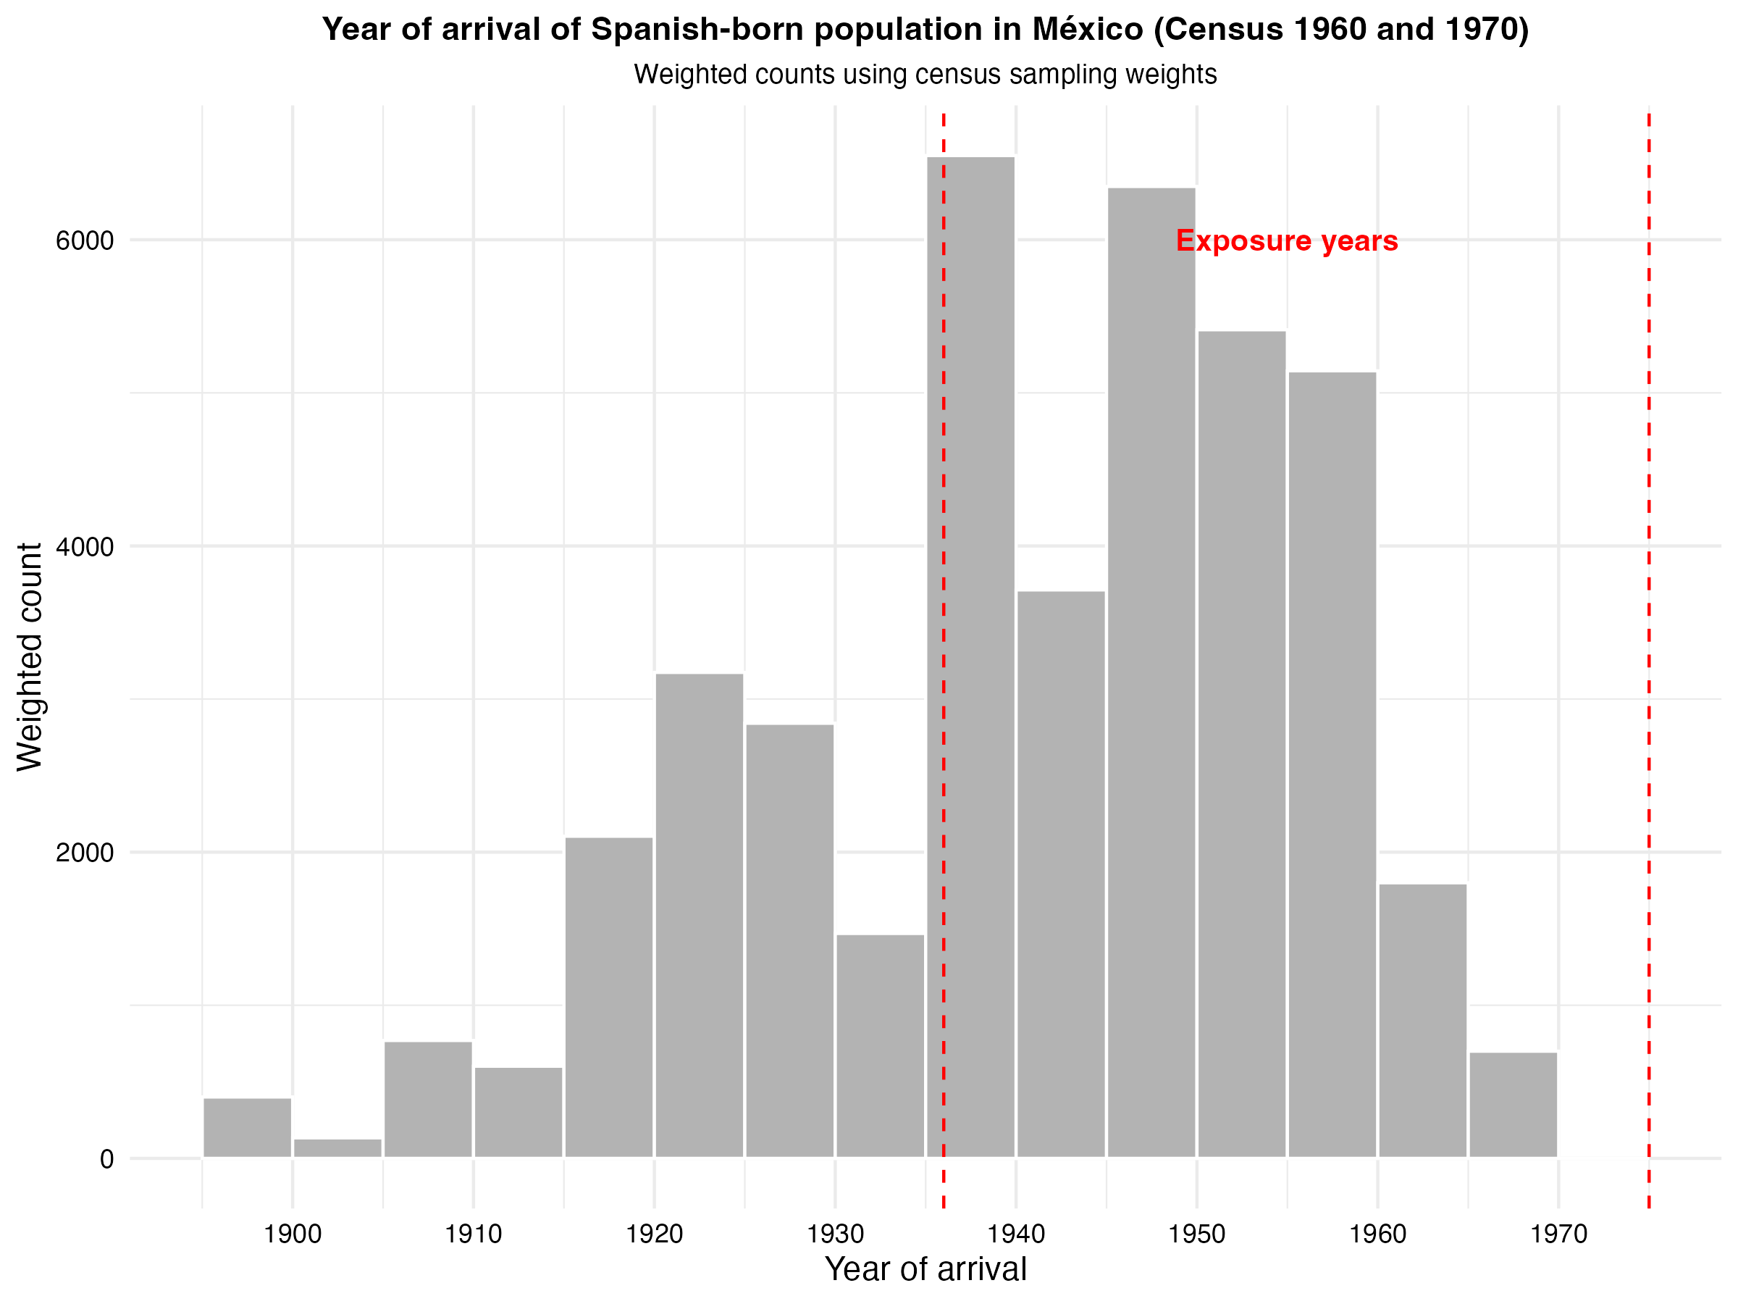
Appendix — Arribal-to-locality Year Estimation
 | Observations
 | Weighted | Unweighted
Spanish born population | 58,800 | 720
Spanish population with identifiable year of arrival | 41,163 | 507

Slide 45

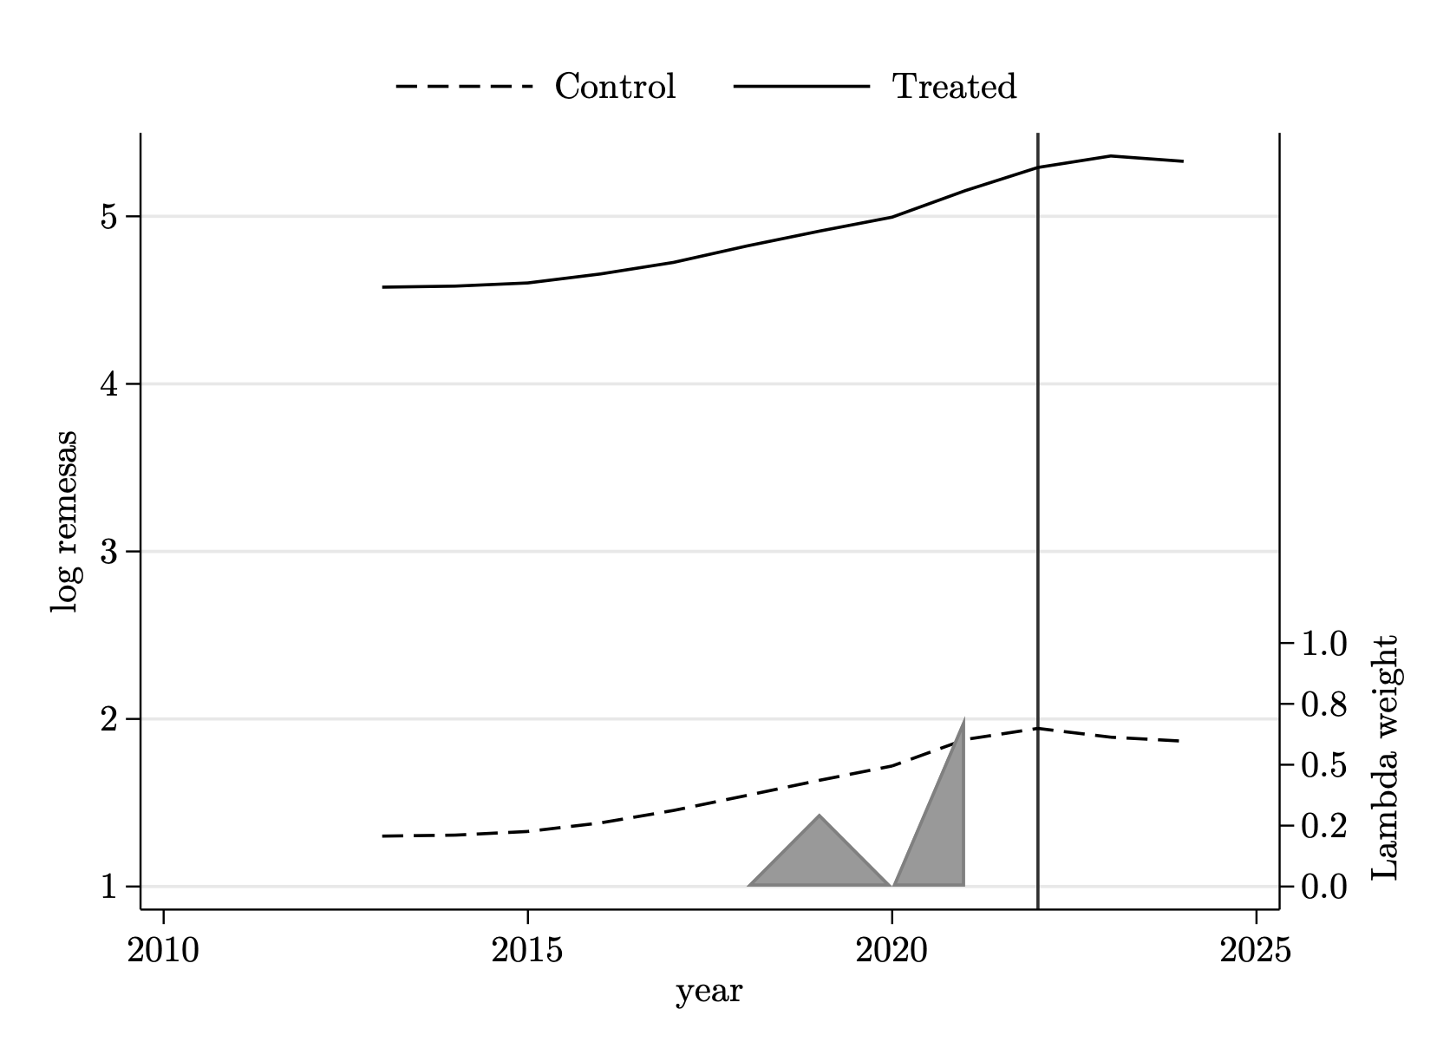

Appendix — SDID Trends (con controles)
Pooled
Window 1936–1955
Window 1956–1978
With controls (migration to US in 2010 × year, projected method). Series and time-weight bands are nearly identical to the sin-controles version — SDID reweighting already absorbs most of what the year × baseline-migration interaction does.

Slide 46
Appendix — SDID ATT (sin vs. con controles)
 | Pool s/c | Pool c/c | V1 s/c | V1 c/c | V2 s/c | V2 c/c
ATT | 0.1892*** | 0.1695*** | 0.1683*** | 0.1496*** | 0.2452*** | 0.2234***
SE | (0.0490) | (0.0499) | (0.0393) | (0.0384) | (0.0825) | (0.0825)
N | 27,876 | 27,876 | 27,792 | 27,792 | 27,708 | 27,708
Adding the year × baseline-US-migration controls (projected method, Kranz 2022) slightly attenuates the point estimates but leaves the qualitative pattern and significance unchanged.
Block-bootstrap SE clustered at municipality, 50 replications. *** p < 0.01.

