Slide 1
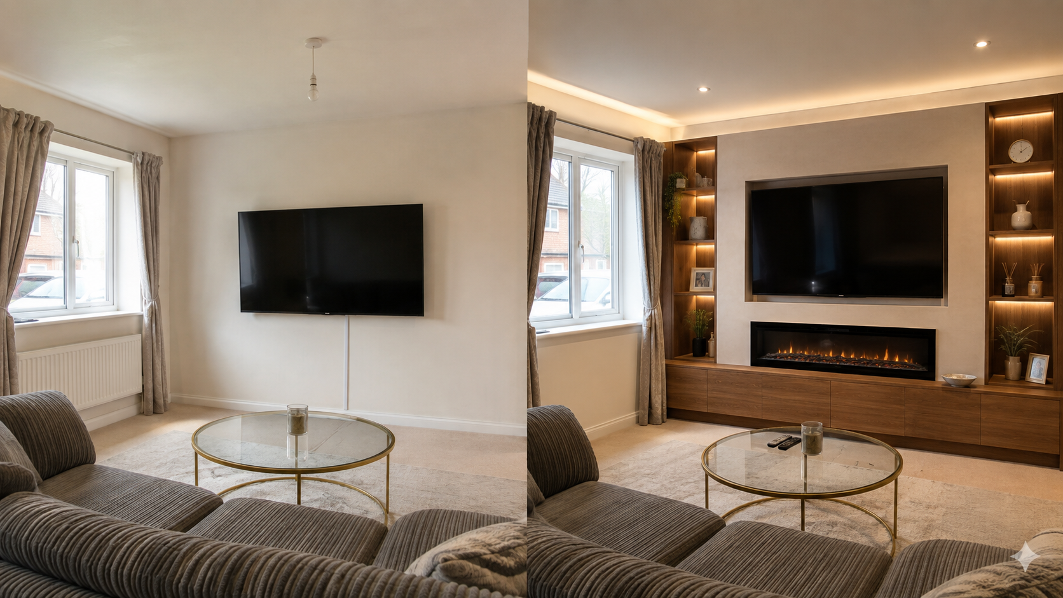
BRANDED PRODUCT + GROWTH BLUEPRINT
Form & Frame
made to lead locally.
A design-led lead-generation product for bespoke media walls — engineered to turn visual proof into qualified site visits.
YOUR ROLE: BRAND · UX/UI · CREATIVE DIRECTION · DESIGN SYSTEM
FORM & FRAME / 01

Slide 2
THE BRAND SYSTEM
Build a brand people
can recognise before they need it.
Your remit is to convert a highly visual trade service into a coherent, premium customer experience across every touchpoint.
BRAND PLATFORM
VISUAL IDENTITY
Name, promise, tone, positioning, service architecture
Mark, type, palette, photography and motion direction
PRODUCT DESIGN
GROWTH CREATIVE
Responsive site, configurator, quote, chat and booking UX
Meta concepts, before/after templates, local proof and retargeting
FORM & FRAME / 02

Slide 3
PRODUCT ARCHITECTURE
One connected system.
Not a brochure site.
01
02
03
04
05
ACQUIRE
→
CONVINCE
→
CONFIGURE
→
QUALIFY
→
CONVERT
Meta / organic / search
Case studies + proof
Visual choices + price
Brief, budget, postcode
Calendar → visit → quote
Design principle: every page exists to move a customer toward a better, more informed consultation.
FORM & FRAME / 03

Slide 4
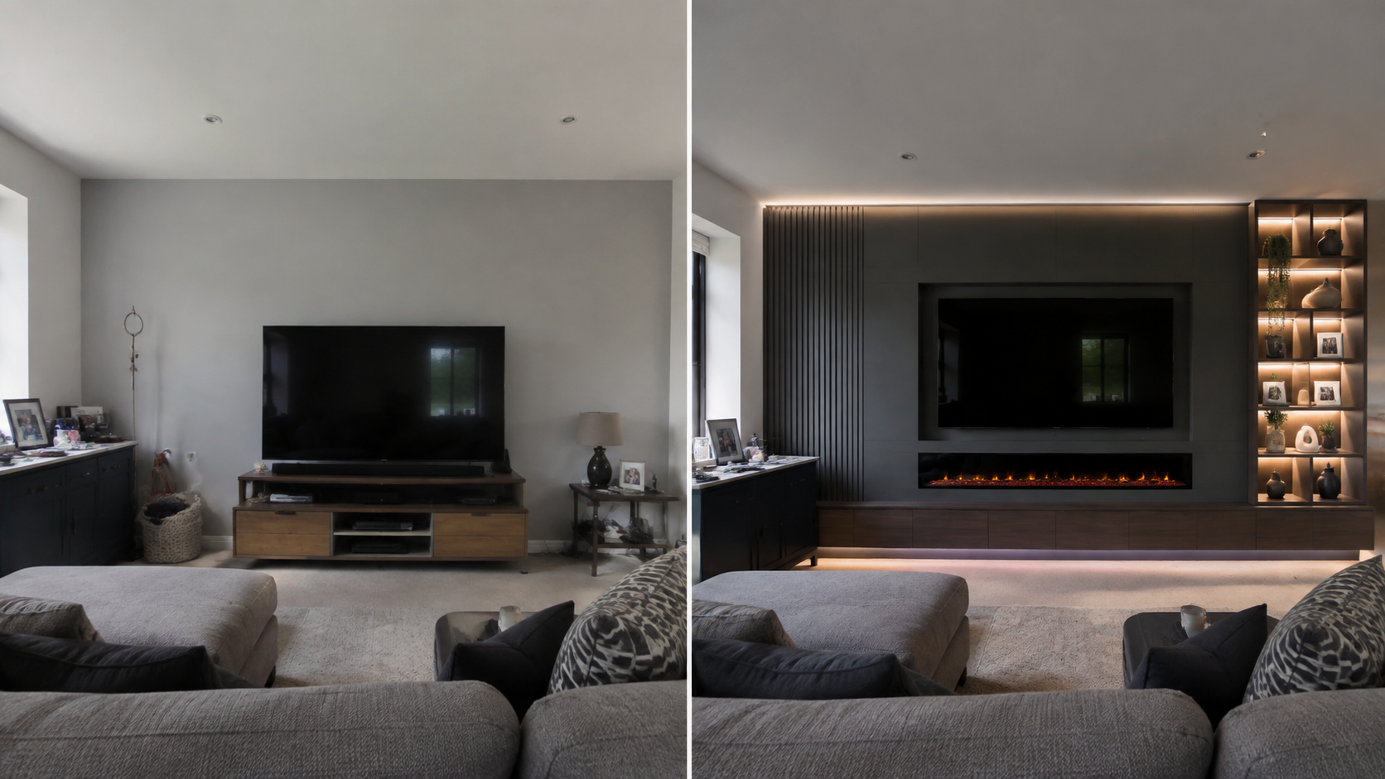
YOUR DESIGN DELIVERABLES
A design system that
can actually scale.
01
Discovery & narrative
Audience, local competitor scan, offer and positioning.
02
Identity & art direction
Logo suite, typography, colour, imagery rules, social templates.
03
UX & UI product design
Site map, user journeys, responsive component system, prototype.
04
Conversion assets
Configurator states, proforma quote, chat flows, lead capture.
05
Paid-social creative
Video hooks, carousels, before/after cards, offer variants.
FORM & FRAME / 04

Slide 5
TECHNICAL BUILD
Designed for measurement,
not just admiration.
EVENT TAXONOMY
Responsive UI · visualiser · instant price logic · quote modal · chat
→ view_project
FRONT END
→ start_configurator
Enquiries · concepts · chat logs · calendar integration · email alerts
BACK END
→ save_concept
→ open_proforma
UTM capture · Meta Pixel · Conversions API · event taxonomy · CRM status
DATA
→ start_booking
→ submit_enquiry
Admin view · response SLAs · quote workflow · portfolio CMS
OPERATIONS
FORM & FRAME / 05

Slide 6
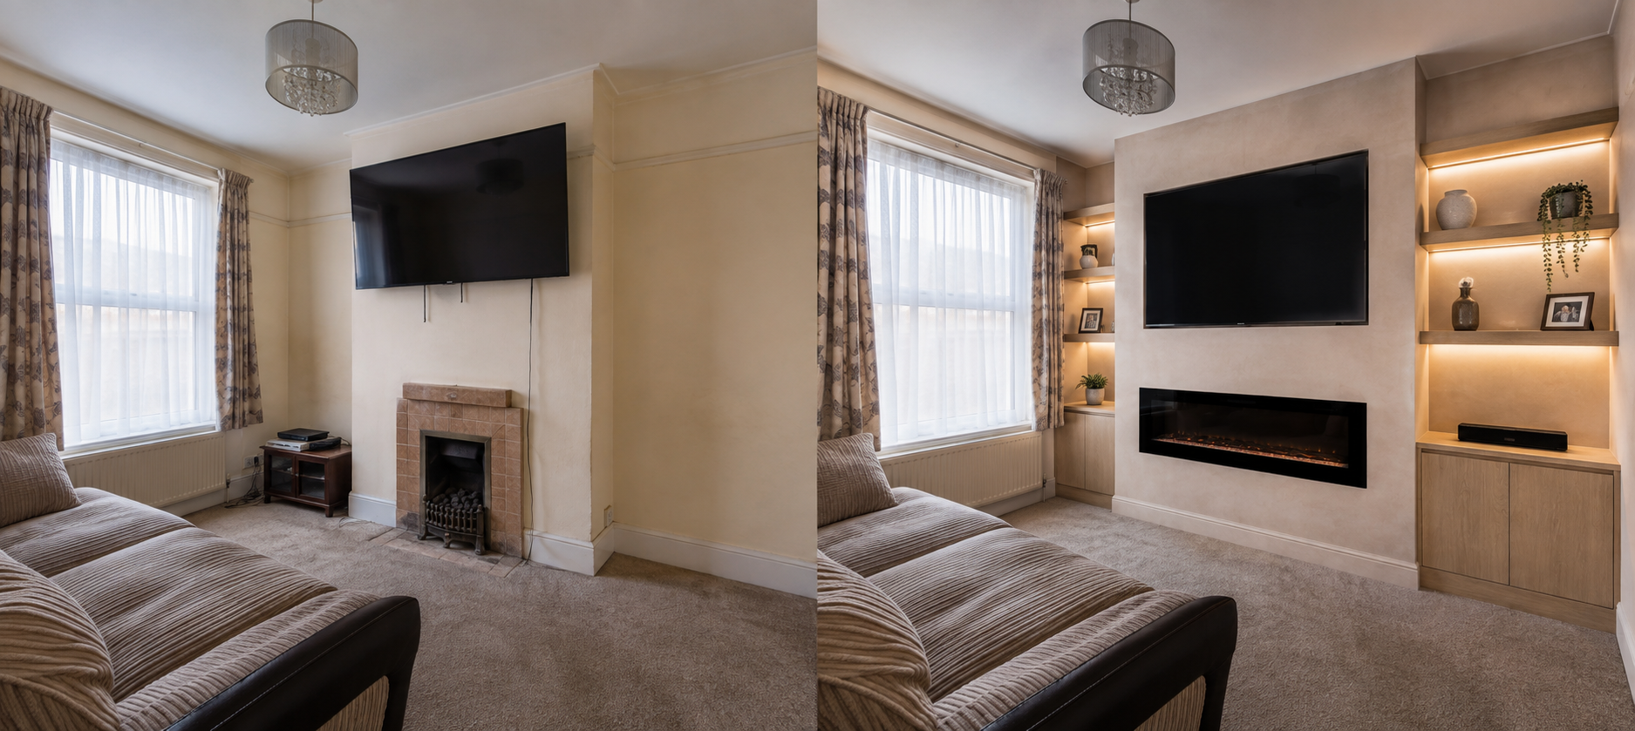
META ADS PLAYBOOK
The creative is the
targeting advantage.
01
PROOF
02
DESIRE
6–12 sec reel: bare wall → finished install
Carousel: “Which side module suits your room?”
03
INTENT
04
RETARGET
Click-to-message / quotation CTA with postcode
Video viewers, configurator starters, quote openers
FORM & FRAME / 06

Slide 7
90-DAY DELIVERY
Brand first.
Then performance.
WEEKS 1–3
WEEKS 4–6
WEEKS 7–9
WEEKS 10–12
Brand strategy, identity, content direction, UX architecture.
High-fidelity product design, technical build, tracking plan.
Portfolio production, CRM/email/calendar connections, QA.
Campaign launch, creative tests, reporting and iteration.
Your design leadership anchors every phase: coherent expression first, then measurable conversion.
FORM & FRAME / 07

Slide 8
NEXT DECISION
Make premium feel
operational.
The goal is a credible local brand with a repeatable digital system: beautiful enough to command attention, technical enough to capture demand.
01 Confirm your design scope & creative direction
02 Set launch KPIs: booked visits, quote rate, cost per visit
03 Connect calendar, CRM and email delivery
04 Build launch portfolio & start local tests
FORM & FRAME / 08

