Slide 1
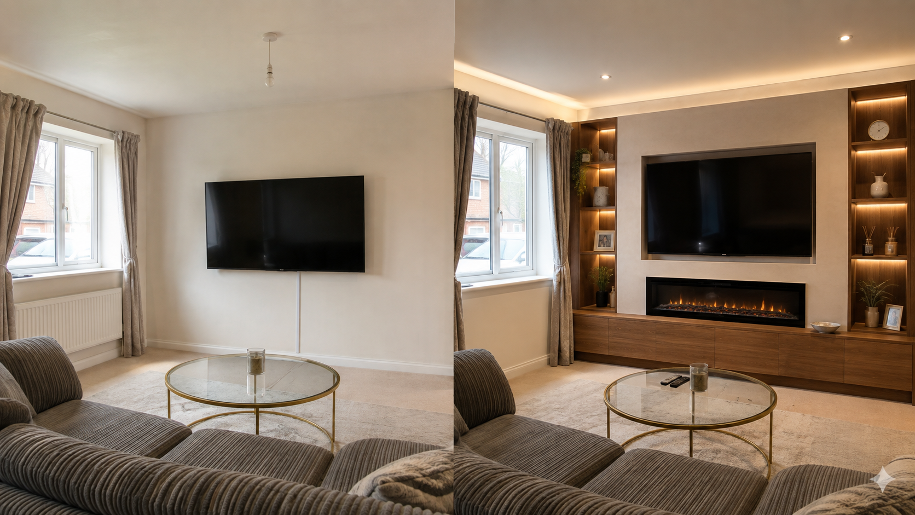
PRODUCT + GROWTH PROPOSAL
Make the wall
worth the room.
A digital-first local interior-fit-out brand built to turn intent into consultations, visualised concepts and premium installations.
FORM & FRAME
SLOUGH, BERKSHIRE · 2026
FORM & FRAME / 01

Slide 2
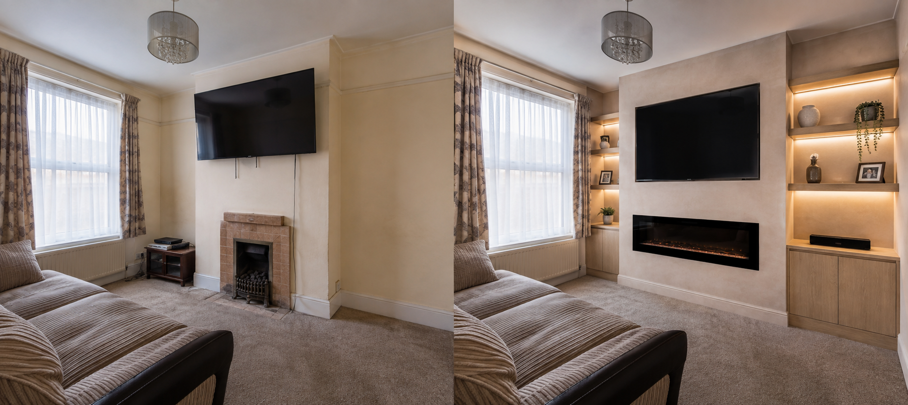
THE PRODUCT
More than a website.
A consultative sales engine.
The experience removes the usual friction between inspiration and a site visit: customers can see the work, define the brief and arrive at the conversation more prepared.
01
VISUAL PROOF
02
GUIDED CONFIGURATOR
Real before/after projects make the value visible.
Customers explore TV, storage, fire and lighting choices.
03
QUALIFIED ENQUIRY
04
HUMAN HANDOVER
Budget, postcode, timings and photos arrive in one brief.
Book a free visit; the trade team confirms and closes.
FORM & FRAME / 02

Slide 3
THE CUSTOMER JOURNEY
A simple path
from “I like this” to “visit booked”.
01
02
03
04
05
DISCOVER
→
BELIEVE
→
CONFIGURE
→
BOOK
→
CONVERT
Meta ad / Google / referral
Before + after proof
Build a first concept
Choose a consultation slot
Site visit → quote → install
The website’s job is not to replace the craftsperson. It makes the first conversation better, and protects time for the appointments most likely to convert.
FORM & FRAME / 03

Slide 4
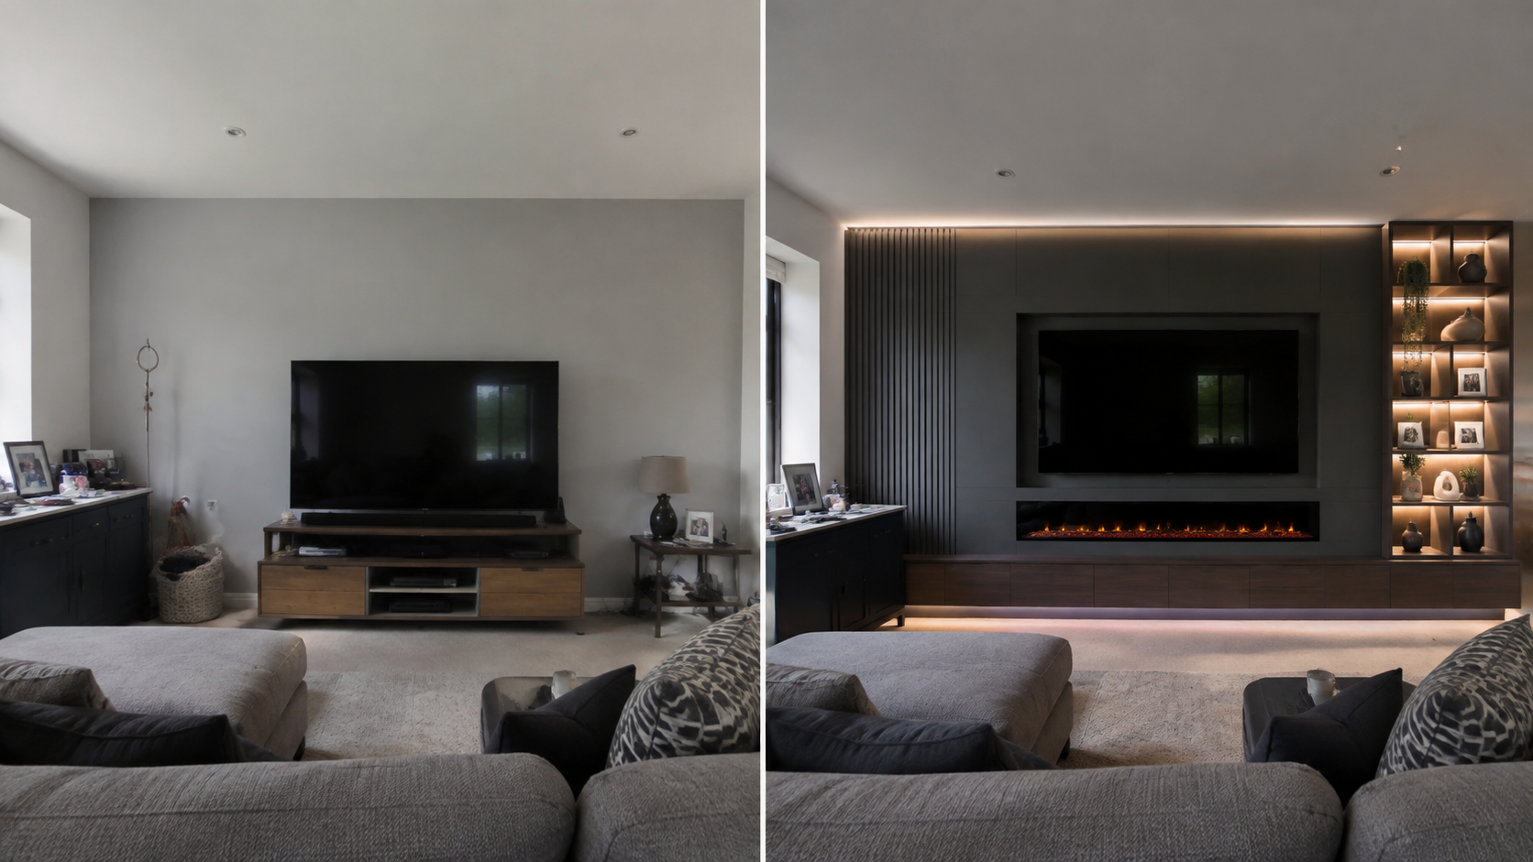
SCALABLE OPERATING MODEL
One local launch.
A repeatable operating system.
CUSTOMER LAYER
Portfolio · configurator · chatbot · booking
↓
LEAD LAYER
Enquiries · concept saves · uploads · qualification
↓
TEAM LAYER
Calendar · estimate queue · installer allocation
↓
GROWTH LAYER
Pixel events · audiences · reporting · retargeting
Scale by duplicating the operating playbook into nearby towns — not by adding more manual chasing.
FORM & FRAME / 04

Slide 5
GO-TO-MARKET · META ADS
Sell the transformation,
not the construction.
01
02
03
AWARENESS
CONSIDERATION
CONVERSION
Short before/after reels
Local radius: Slough + 20 mi
Creative: reveal, fire glow, storage
Carousel: 3 wall layouts
Landing: project detail + visualiser
Proof: reviews, process, finish
Click-to-message + booking
Lead form with postcode + budget
Retarget saved concepts & video viewers
Initial test plan: 3 concepts × 2 hooks × 2 audiences. Keep the strongest visual proof, then optimise toward booked consultations—not cheap clicks.
FORM & FRAME / 05

Slide 6
90-DAY LAUNCH PLAN
Make it useful.
Then make it repeatable.
DAYS 1–30
DAYS 31–60
DAYS 61–90
FOUNDATION
DEMAND
SYSTEMISE
Deploy site, analytics, calendar, CRM pipeline, local GBP optimisation. Photograph 6 finished jobs.
Launch Meta creative tests and retargeting. Publish 3 case studies. Train bot handover and lead response.
Review lead-to-visit and visit-to-quote conversion. Standardise quote templates. Expand radius only when capacity holds.
Success signals: more enquiry completeness · faster first response · stronger site-visit rate · richer portfolios · measurable cost per booked consultation.
FORM & FRAME / 06

Slide 7
THE DECISION
Build the local category leader.
The opportunity is to turn a highly visual craft into a more discoverable, more credible and more operationally efficient service business.
01
Confirm brand name, domain and offer
02
Connect calendar, CRM and Resend email
03
Shoot / generate a launch portfolio
04
Launch local Meta test campaigns
FORM & FRAME / READY TO BUILD
FORM & FRAME / 07

