Slide 1
Conceptual models: editing and animation

Slide 2
Animation states
graph
initial state
change record 1
change record 2
change record 3
function call
function call
function call
display state
step back
step forward
when algorithm is loaded, initial state records all attributes of graph elements
initial state is loaded graph, or its current edit state
a function call, e.g., color node, simply records the node and its new color
graph display = initial state + sequence of changes up to display state (conceptually)
A change record can record both old and new value of attribute, making it easy to step back; multiple changes in a single step can be a list of change records in a single record

Slide 3
Edit states: current situation
graph
move a node
snapshot after move
graph snapshot 1
graph snapshot 2
graph snapshot 3
move or other edit
move or other edit
move or other edit
edit state
undo
redo
graph snapshots are from Cytoscape (I think)
may not capture all relevant information
capture Cytoscape’s view of node coordinates
save command saves selective information
does not save invisible attributes, e.g., those relevant to accessibility, or comments

Slide 4
Edit states: desired
graph
load graph or exit algorithm
initial state
change record 1
change record 2
change record 3
any edit action
any edit action
any edit action
edit state
undo
redo
all attribute changes are captured
mechanism same as for algorithm states
always in edit mode whenever not running animation
initial state could encode all information in graph text, even comments, ones at the beginning only

Slide 5
Node movement
Algorithm does not move nodes (default)
node movement results in new edit state
would be new feature
could allow undo/redo between algorithm/display steps
node positions unaffected by algorithm steps
Algorithm moves nodes (declared in the code)
node movement by algorithm results in new algorithm state
node movement by user is ephemeral
no change in edit state
step forward/back causes node to snap back to position determined by algorithm

Slide 6
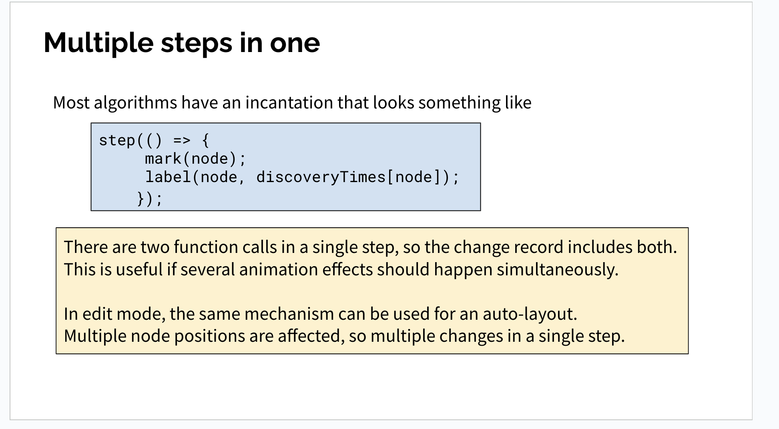
Multiple steps in one
Most algorithms have an incantation that looks something like
step(() => { mark(node); label(node, discoveryTimes[node]);
});
There are two function calls in a single step, so the change record includes both.
This is useful if several animation effects should happen simultaneously.
In edit mode, the same mechanism can be used for an auto-layout.
Multiple node positions are affected, so multiple changes in a single step.

Slide 7
Implementation notes
key to creating steps is in StepBuilder.js, but
most of the details are in immer.d.ts, so need to understand Immer (?)
uses utilities in lib.es5.d.ts
not clear how changes in graph are made in Cytoscape view
the SharedWorker class handles messages to implement what is essentially an MVC pattern
appears that CytoscapeComponent.jsx has a useEffect that updates elements when graph changes
relevant info comes from predicateConverter
control and data flow are not documented well
If you figure out how a sequence of change records translates into a graph view,
document using both text and diagrams with code locations
use the same mechanism for edit states

Slide 8
Model-View-Controller for graph
algorithm
logical graph representation
nodes, edges
all attributes of nodes and edges
Model
baseGraph in the code
model
mouse on graph panel, other edit operations
Cytoscape view
View
Controller

Slide 9
More implementation notes
creating graph from sequence of change records appears more complicated than necessary
just need a list: each item a reference to node/edge and the desired change
construct a logical representation of the graph
appears that changes are applied directly to Cytoscape representation
violates MVC pattern: logical graph is model, view is Cytoscape
especially important to separate logical and physical positions
only need the controller part for the graph
user moves a node or performs other edit operation
need a way to translate to logical representation
existing implementation appears to wait until user saves graph to transform Cytoscape view to logical graph
one reason why coordinates change when graph is saved
and why some attributes get lost (Cytoscape may not track them)

Slide 10
Use case: Edit states during algorithm execution
start an algorithm animation
during the animation, move some nodes and/or do auto layout(s)
exit from the animation
undo the node moves and auto layouts from step (2) one at a time, making sure that keyboard shortcuts work.
Comments.
During animation, change records are maintained for both the animation and the editing, but undo/redo operations are possible only after algorithm exit
A revert operation puts the graph into the state at load time, and can be undone, i.e., does not delete the list of edit changes
There is no need for the Save/Cancel popup when the animation exits – you are always in edit mode, so can save to the graph edit window at any time or revert to get the effect of Cancel
During animation you are in limited edit mode: node movements are the only operations allowed; if the algorithm moves nodes, there will be no changes in edit state (for later)

Slide 11
Basic test - to do after each change
Load a graph – 10 node graph is a good choice because it has edge weights and no special other attributes.
Do some node movement and auto-layouts, check whether undo/redo/reset work properly.
Load an algorithm – Dijkstra’s is a good choice because it uses edge weights and changes node weights.
Run it a few steps beyond the prompt for a start node, doing some node movements along the way.
Exit from the algorithm
node positions should be as they were before the exit
other attributes set by the algorithm should not be present, i.e., no colors, shapes, or node weights
it should be possible to undo/redo/reset the node movements that took place during algorithm execution
All of the above actions should be done with keyboard shortcuts when relevant.

Slide 12
Tests for arbitrary attributes
Load Graph-Format
Do some node movements
Do some edits on the text file and reload
Add an arbitrary attribute to a node (may not be recognized by Cytoscape) and reload – should not crash
Make sure that nodes turn into stars in Dijkstra’s algorithm.
Make sure other shapes arise in the sorting algorithms.

