Slide 1
CSC 492 Web-Based Galant Final Handoff
Team 37 - Stallmann
Noah Alexander, Rishabh Kurwa, Yuval Sherman, Art Schell, Andrew Watson

Slide 2
Introduction
Project Recap
Iterations
Demo
Testing
Documentation
Future Work
Division of Labor

Slide 3


Project Description – Problem & Solution
Current Galant Implementation
Web-Based Implementation
Software Requirements
Accessible on all major browsers
Feature Bloat
Core Features
Platform Dependent
Simplified Implementation
Difficult to Debug
“Better” Errors

Slide 4
Project Iterations
Iteration 1
Set up webpage and server
Workflow of uploading a graph
Iteration 2
Uploading and running an algorithm inside a thread
Basic demo of algorithm interacting with graph
Iteration 3
Creation of full API for graph algorithms
Notes:
In OPR2, we had finished Iteration 1 and started work on Iteration 2. At the current time, we have finished iteration 2 and started work on iteration 3.

Slide 5
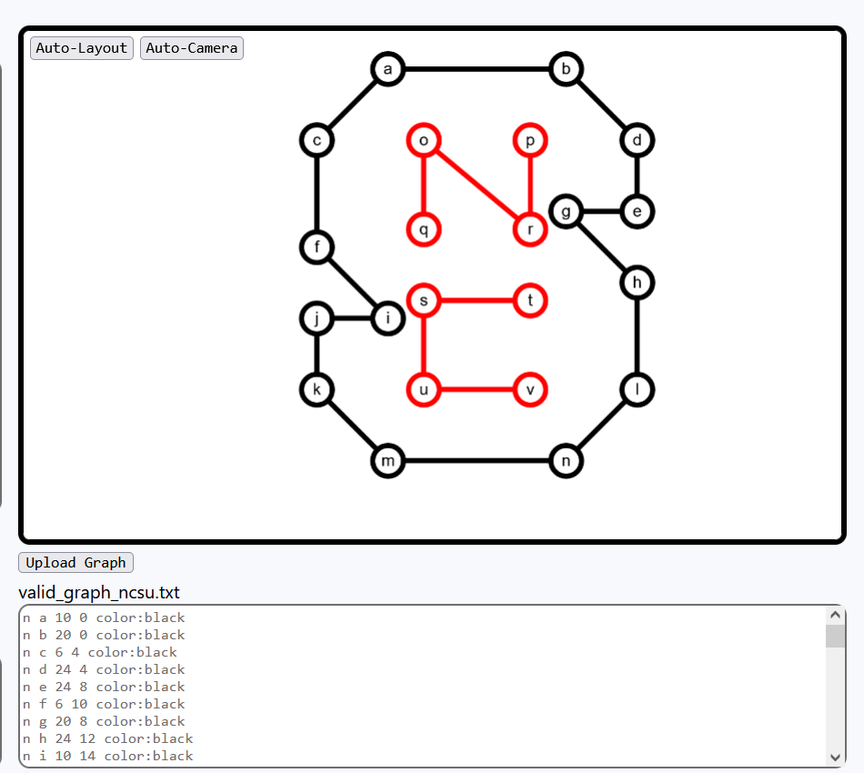
Iteration 1 - Graph
Graph file format
Graph visualization
Cytoscape
General page setup
React
Graph style / properties
Color, weight, etc

Slide 6
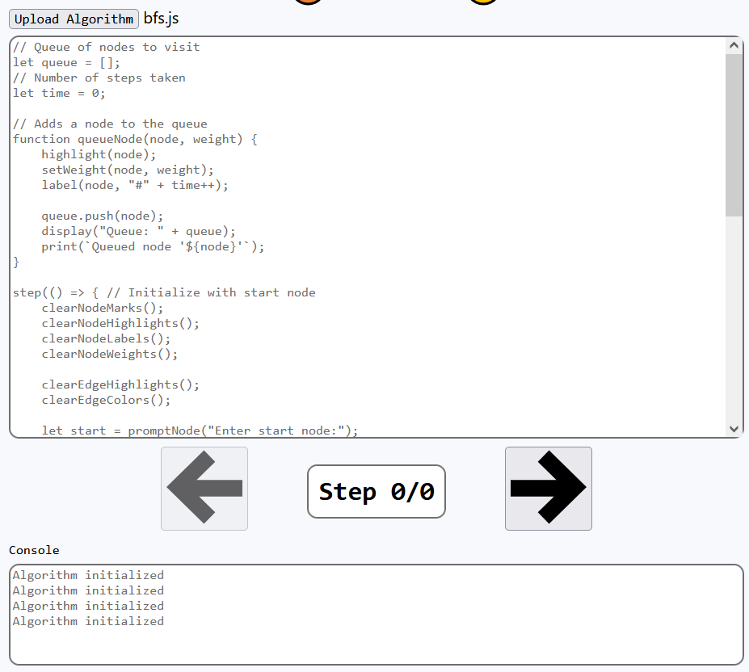
Iteration 2 - Algorithm
Algorithm frontend
Connecting graph/algorithm
React Context
Stepping forward / backward
Immer
Running the algorithm
Workers
Error handling
Notes:
Frontend: Created skeleton of algorithm view with console
We could upload and see a graph, but the Algorithm and Console sections didn’t do anything.

Slide 7
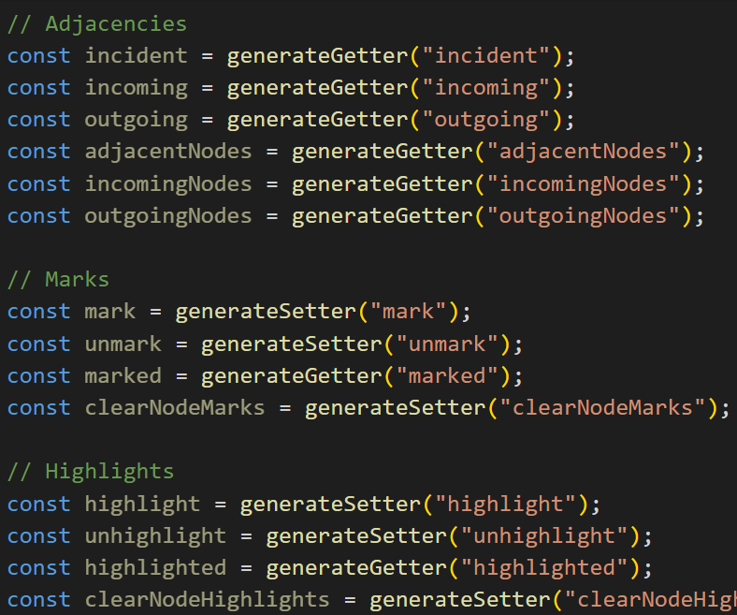
Iteration 3 - API
Find adjacent nodes/edges
Modify all graph node properties
Hide and show elements
Prompt the user
Manual control over stepping
Notes:
Backend: Designed backend of thread system.

Slide 8
Demo
https://galant.csc.ncsu.edu/

Slide 9
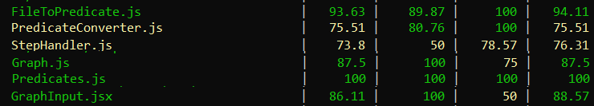
Backend Testing
We try to unit test everywhere it is possible to do so
File conversion / parsing
Step handler system
47/47 tests passing out of 4 testing suites
Unfortunately, many things are difficult to test via unit testing

Slide 10
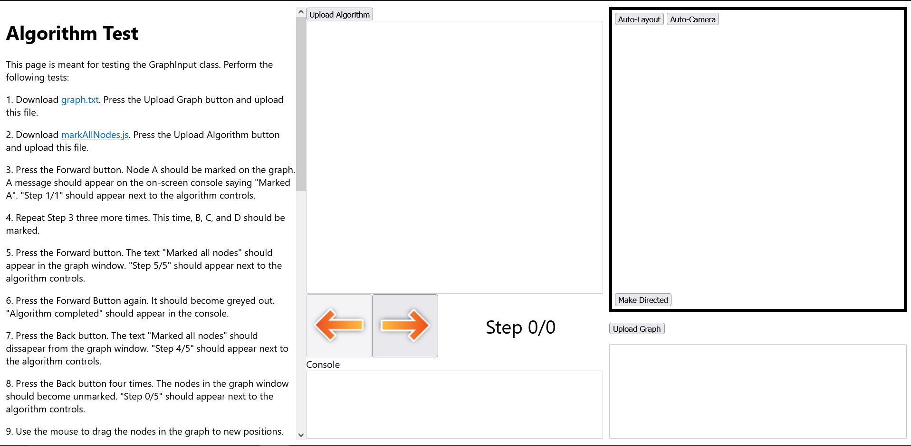
Frontend Testing
Cytoscape and Workers can’t be interacted with via Jest
Need frontend testing system
Filling out rows in a black-box test plan spreadsheet is tedious
Must be easy to complete manual tests or they won’t get done
Thus, our testing system is built into the webpage itself

Slide 11
Documentation
https://docs.google.com/document/d/1v7R5ocRcba9DPmwGUTIkEhQpy_I9cbkwk8Szm1xbqFo
https://docs.google.com/document/d/1EcHtikLKOU1H4QibT8hfvIoFW4WOXE2ABGCUvv-n9EQ/edit?usp=drivesdk

Slide 12
Resources and Technologies
Galant
Source Software
GitHub
Version Control
GitHub Actions
Project Management
CSC IT Virtual Machine
Server Host
React.js
Frontend Web Framework
Cytoscape
Graph Visuals Library
Immer
State Update Library
Jest
Backend Testing Library

Slide 13
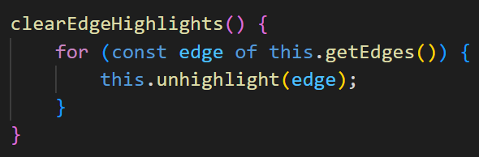
Future Work - Adding Features
Addition of new API features.
Add methods to Graph.js if applicable
Generator functions in Thread.js will automatically create API calls that update the graph accordingly.

Slide 14
Future Work - Preferences Page
Many things would benefit from user preferences
Algorithm speed when holding button down
Node size
Graph window size
Best way to add is a React Context
If this surrounds an element, it will be able to access the preferences
Should be libraries that store preferences locally

Slide 15
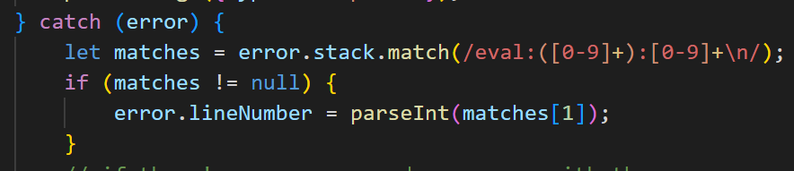
Future Work - Error Handling
Currently, reporting of the line number does not work on every browser, as each browser has its own format for stack traces.
This will be fixed at the bottom of Thread.js, where a regex finds the line number in the stack trace.

Slide 16
Future Work - Performance
Cytoscape Node HTML Labels causes a lot of lag
Cytoscape can only have one label per node
We have two labels, one for the label and one for the ID
If an alternative was found, it would speed up the page
One alternative we tried: Stacking two nodes on top of each other
Caused layering issues

Slide 17
Division of Labor - Iteration 1
VM Server Configuration - Andrew, Yuval
Cytoscape Frontend - Art
Graph Uploading - Yuval
File Conversion - Rishabh
Cytoscape Conversion - Noah

Slide 18
Division of Labor - Iteration 2
Graph Error Handling - Yuval
Graph Rescaling - Rishabh Algorithm Frontend - Rishabh Stepping Forward/Backward - Art Thread Team - Andrew, Noah
Thread Error Handling - Andrew System Integration - Art

Slide 19
Division of Labor - Iteration 3
API implementation - Noah, Andrew, Art
Graph Directedness/Visibility Toggles - Rishabh
Bugfixing and Regression Testing - Yuval

