Slide 1


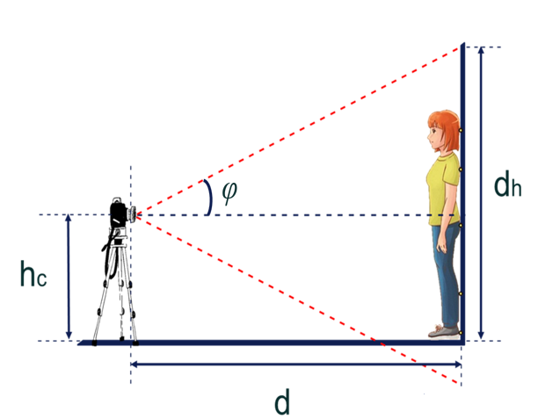
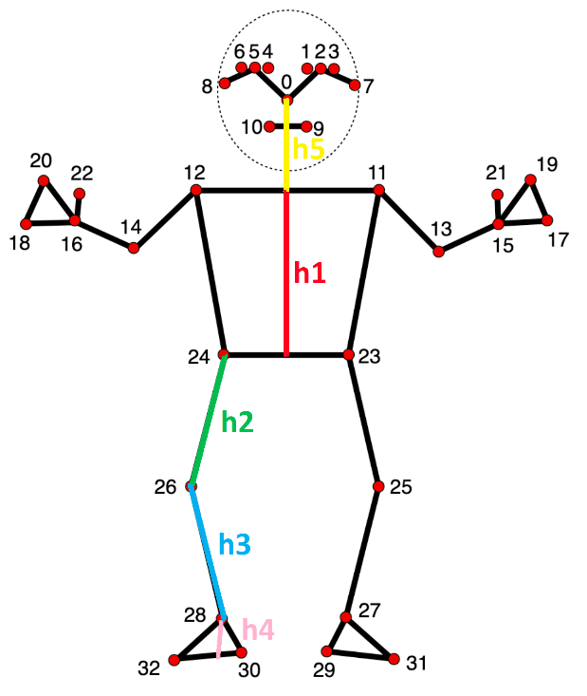
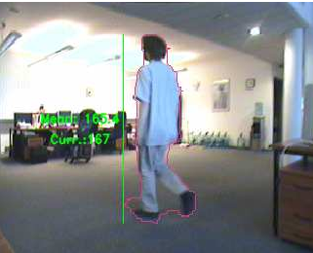
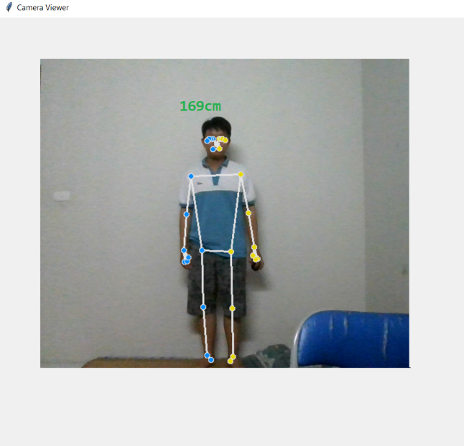
BUILDING AN APPLICATION TO MEANSURE HUMAN BODY HEIGHT USING COMPUTER VISON
Nguyễn Tiến Duy
Faculty of Information and Technology, Hanoi University of Industry, Vietnam
Introduction
Estimating height is a crucial problem in various computer vision applications, such as human pose estimation, visual surveillance, and sports analysis. In recent years, several methods have been proposed to measure human height using vision-based techniques. However, current methods require a large number of labeled images or lack accuracy when dealing with different human poses. This study employs a novel approach to height measurement by recognizing and calculating the length of the skeletal frame, then using these methods to predict the actual height.
Approach
Collect over 100 data samples consisting of images of human bodies set according to the specified parameters, accompanied by the actual height measured accurately while standing upright without shoes.
The output of this step will be the coordinates of the body landmarks of the subjects in the collected images.
Then, use geometric formulas to calculate the lengths of the skeletal segments, focusing on five main lengths: the length from the foot to the ankle, the ankle to the knee, the knee to the hip, the hip to the shoulder, and the shoulder to the nose.
Finally, use a multiple linear regression model to predict the height.
In a multivariate linear regression model, it is assumed that the relationship between the dependent variable (denoted as Y) and the independent variables (denoted as X1, X2, ..., Xn) is represented by a linear equation as follows:
Y = β0 + β1 * X1 + β2 * X2 + ... + βn * Xn + ε
Where:
Y is the dependent variable to be predicted.
X1, X2,…, Xnare the independent variables.
β0, β1, β2,…, βn are the coefficients of the model, indicating the degree of influence of each independent variable on the dependent variable.
ϵ is the error term, representing the difference between the actual value of Y and the value predicted by the model.
Training a linear regression model involves finding the coefficients β0, β1, β2,…, βn such that the error ϵ is minimized. A common method to achieve this is by using the Ordinary Least Squares (OLS) method, which minimizes the sum of the squared errors.
Objectives
Automate Height Measurement: Eliminate the need for manual measurements by leveraging computer vision techniques.
Increase Accuracy: Ensure high accuracy in height measurement across various human poses and conditions.
Results
Conclusion
The measurement results of this method have an error range from 0 cm to 2.2 cm compared to the actual height of the test subjects, whose heights range from 153 cm to 177 cm. The proposed method yields an average error of approximately 1.3 cm (with an average error rate of 0.8%).
It is evident that determining height through a non-contact method by synthesizing skeletal frames is entirely feasible.
Figure 1. Height measurement application interface
References
Acknowledgement
This research is funded by Hanoi University of Industry,
H. O. Velesaca, S. Araujo, P. L. Suarez, A. S ´ anchez, and A. D. Sappa, “Off-the-shelf based system for urban environment video analytics,” in Int. Conf. on Systems, Signals and Image Processing. IEEE, 2020, pp. 459–464.
J. L. Charco, A. D. Sappa, B. Vintimilla, and H. O. Velesaca, “Camera pose estimation in multi-view environments: From virtual scenarios to the real world,” Image and Vision Computing, vol. 110, p. 104182, 2021

