Slide 1
G2M Case Study
G2M insight for Cab Investment firm
Mamadi Fofana - LISUM02
August 2021

Slide 2
Project summary
The Client
XYZ is a private firm in US. Due to remarkable growth in the Cab Industry in last few years and multiple key players in the market, it is planning for an investment in Cab industry and as per their Go-to-Market(G2M) strategy they want to understand the market before taking final decision.
Project delivery:
The outcome of our delivery will be a presentation of actionable recommendations and insights to XYZ’s Executive to help them identify the right company to make their investment.

Slide 3
Project dataset
We have been provided with multiple data sets that contains information on 2 cab companies. Each file (data set) provided represents different aspects of the customer profile.
Below are the list of datasets which are provided for the analysis:
Cab_Data.csv – this file includes details of transaction for 2 cab companies
Customer_ID.csv – this is a mapping table that contains a unique identifier which links the customer’s demographic details
Transaction_ID.csv – this is a mapping table that contains transaction to customer mapping and payment mode
City.csv – this file contains list of US cities, their population and number of cab users
In addition to those files, we have used two third-party data files
US_City_temperature.csv for daily temperature in US city
US Holiday Dates (2004-2021).csv for list of US holiday for the study time

Slide 4
Project dataset
In order to process, we first joined all the datasets together to obtain an intermediate dataset which groups field of all datasets
To avoid too many missing data, we use inner junction between Transaction_ID.csv and Cab_Data.csv datasets which lead to 359, 392 rows instead of 440, 0098 initially in
Transaction_ID.csv dataset. The transactions ignored don’t have enough interesting data
to put them in the study
After investigation, we assume that there no evidence of outlier in the dataset
Two cities in the data set city.csv are not really cities, and therefore will be excluded to analysis regarding the temperature.
Temperatures in dataset US Holiday Dates (2004-2021).csv are in Fahrenheit degree

Slide 5
Analysis
In order to help XYZ’s Executive identify the right company to make their investment., Our analysis will be based essentially upon two measures (KPI)
Margin (Price charged – Cost of trips)
Numbers of trips
Those KPI will be analysed according different views to reach some conclusions
company
Time
Geographical
Weather
Per unit of (distance, trips)
Agent based

Slide 6
Analysis
We will try during our analysis to verify certain hypothesis
is margin per km or per travel different between the two cabs company ?
Is there any seasonality in number of trips?
is there a difference in terms of attendance between weekdays and weekend days ?
is there a difference in terms of attendance between ordinary days and public holidays
Does taxi activity correlate with temperature ?
Does margin correlate with customer income ?
is the activity of taxis different from one city to another ?

Slide 7
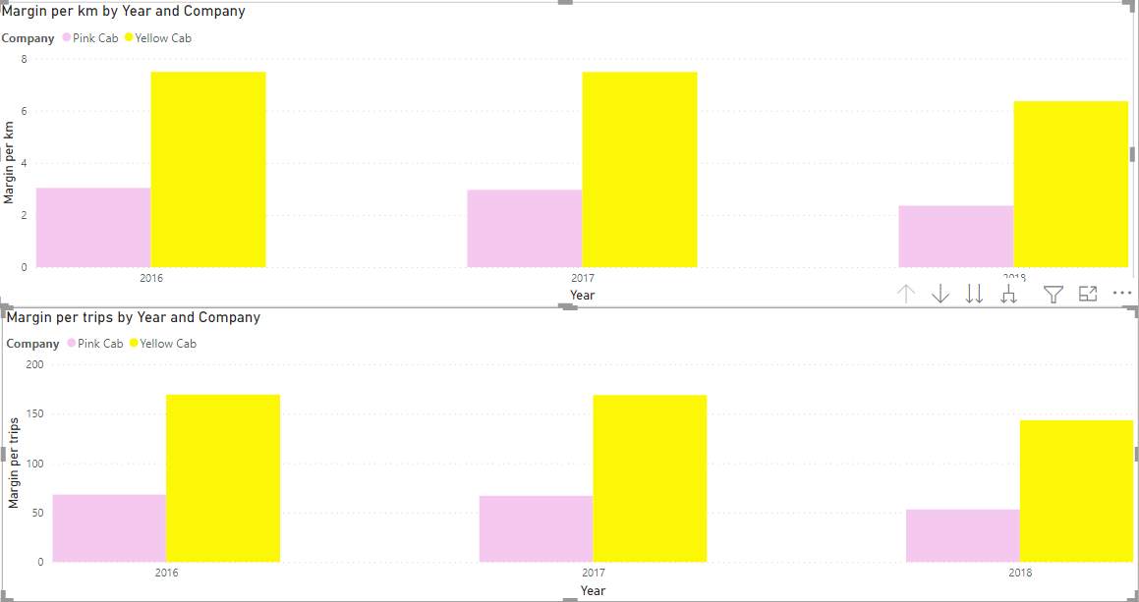
Margin analysis per unit
Yellow cab perform well than Pink cab every year for margin per km and for margin per trips

Slide 8
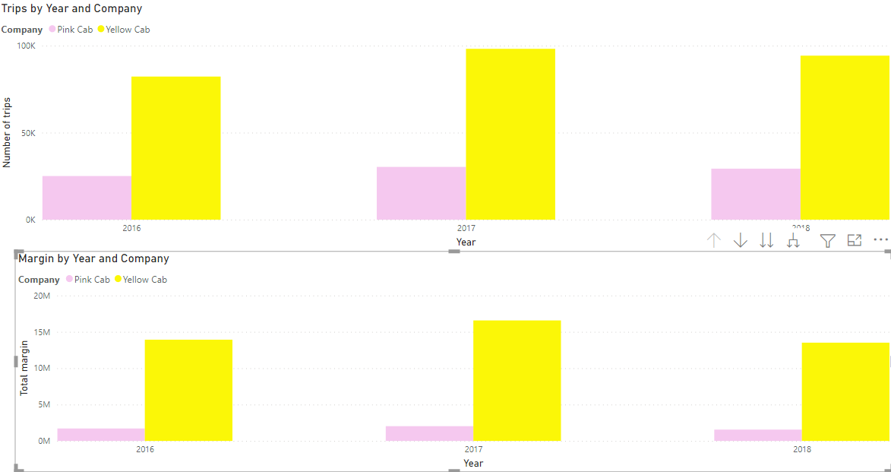
Summary Analysis by company and Year
Yellow cab perform well than Pink cab every year in terms of number of trips and total margin per year

Slide 9
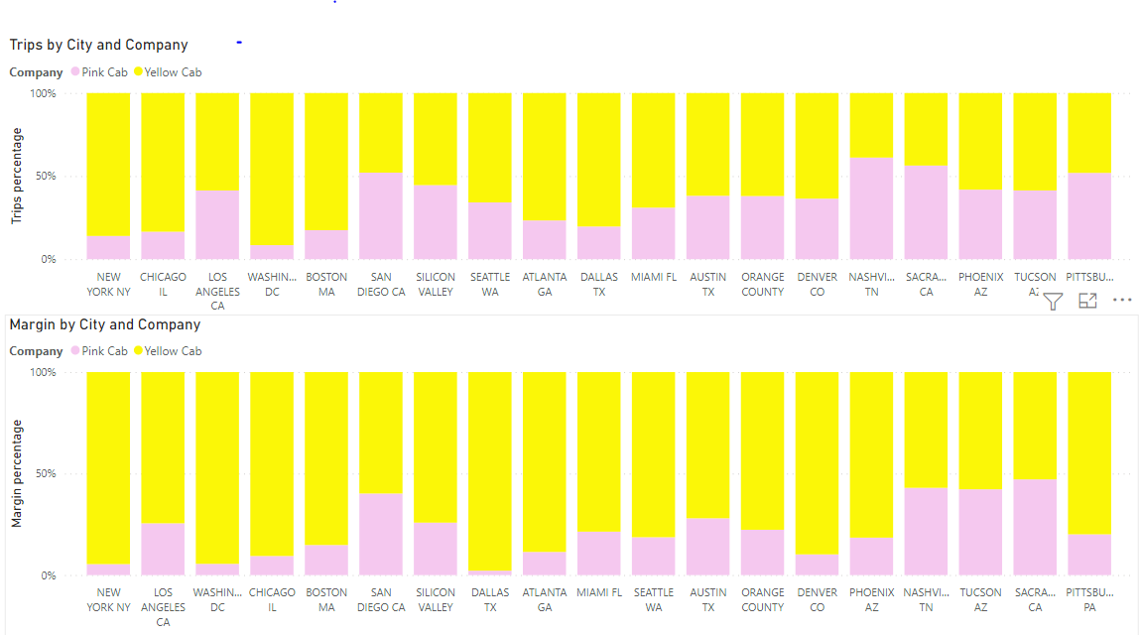
City based analysis
Yellow cab perform well than Pink cab in term of total trips in most of big cities, but this KPI is almost identical for small cities
But in term of margin, Yellow cab performs well in all of cities

Slide 10
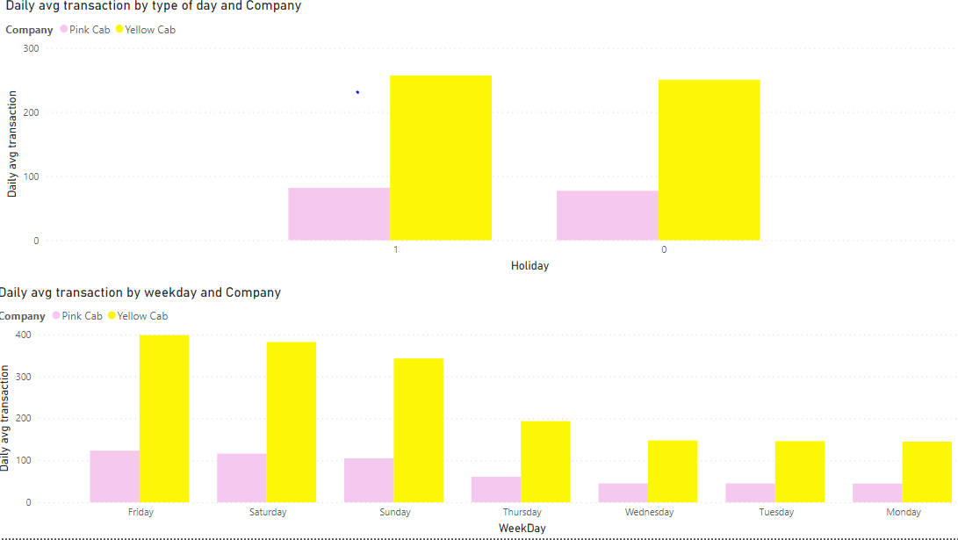
Analysis by type of day
Holiday has no significant effect in term of number of trips for both company
But average number of trips can vary a lot for both company regarding day of the week
Friday, Saturday, Sunday are day of great frequentations

Slide 11
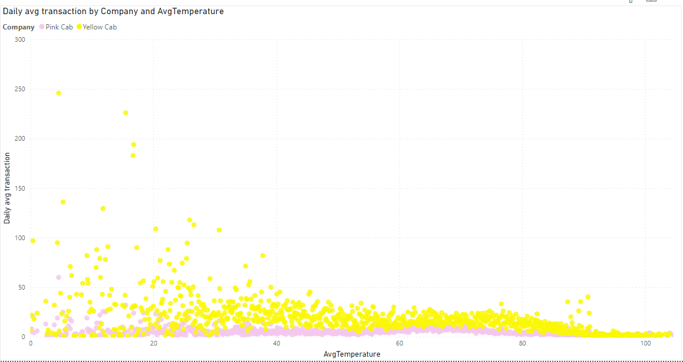
Temperature vs Trips
We observe that the average number of trips decreases significantly when the temperature increases especially for the company Yello cab
we can assume that the lower the temperature, the more customers use the taxi service

Slide 12
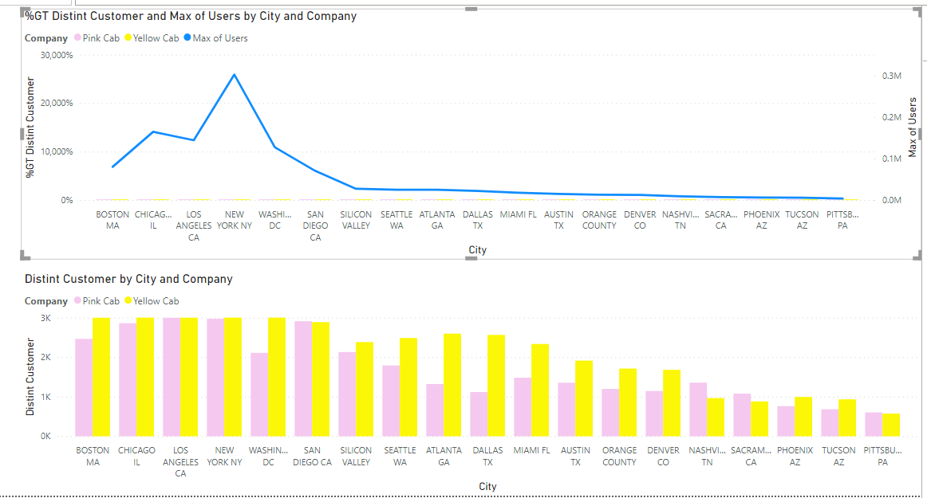
City coverage
Both companies reach a small percentage of the total number of potential customers in large cities, which is not the case in small towns.
Also in larger cities, the two companies have almost the same number of individual customers.

Slide 13
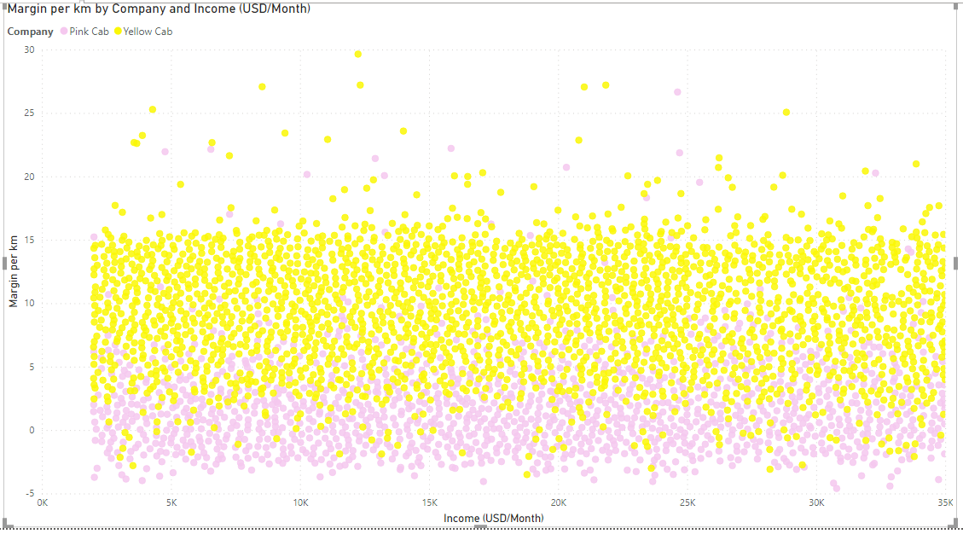
Correlation margin per km and income
There is no evidence of numerical correlation between customer income and margin per km
But we also notice that a Pink cab has more trips with negative margin that Yellow cab

Slide 14
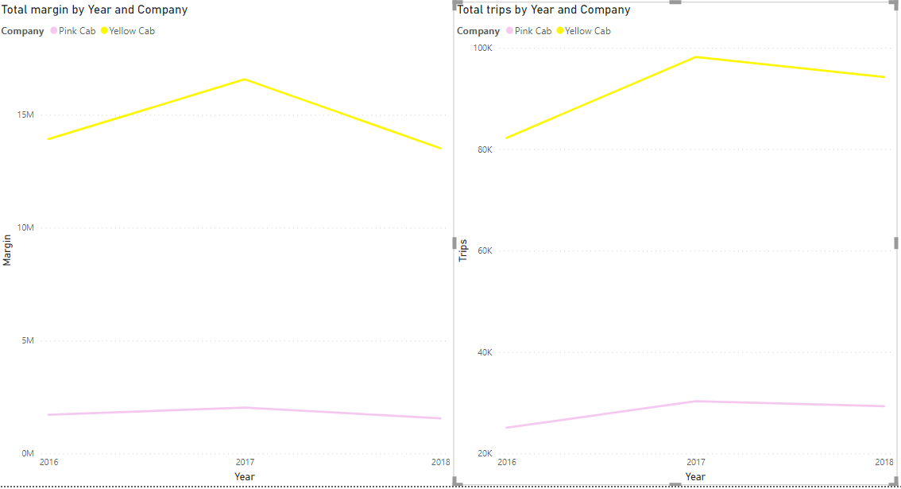
Time based Analysis
Yellow cab perform better every year than pink cab in term of margin and trips
But for both company there is no positive trend in term of margin nor trips
It could be interesting to compare those figures with global index for cab company in US for the study period

Slide 15
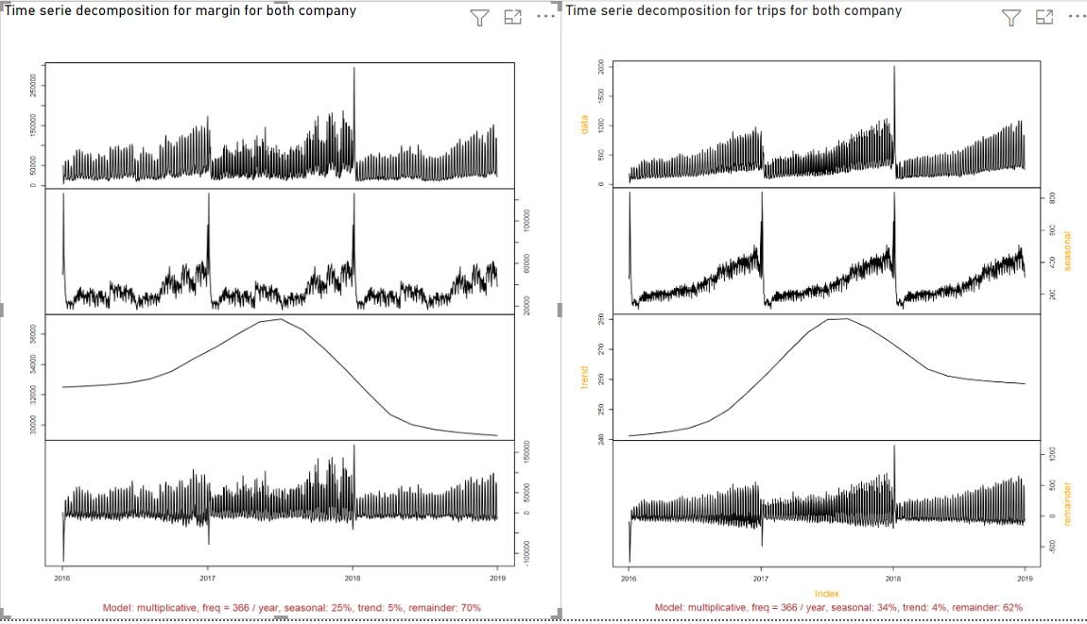
Time series analysis
We notice :
Some seasonality in term of trips and margin with a period of one year without any trend (up and down)
Cab industry seems to be cyclical

Slide 16
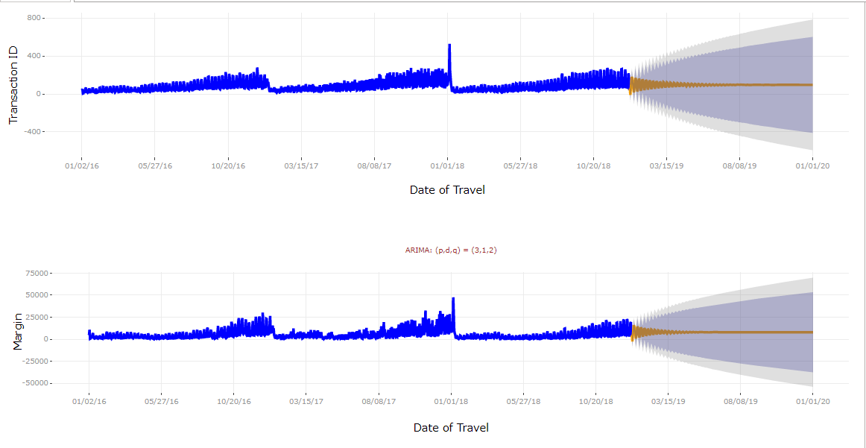
Forecasting for Pink Cab
Given of seasonality and no trend , we can estimate that margin and number of trip will be like the past data

Slide 17
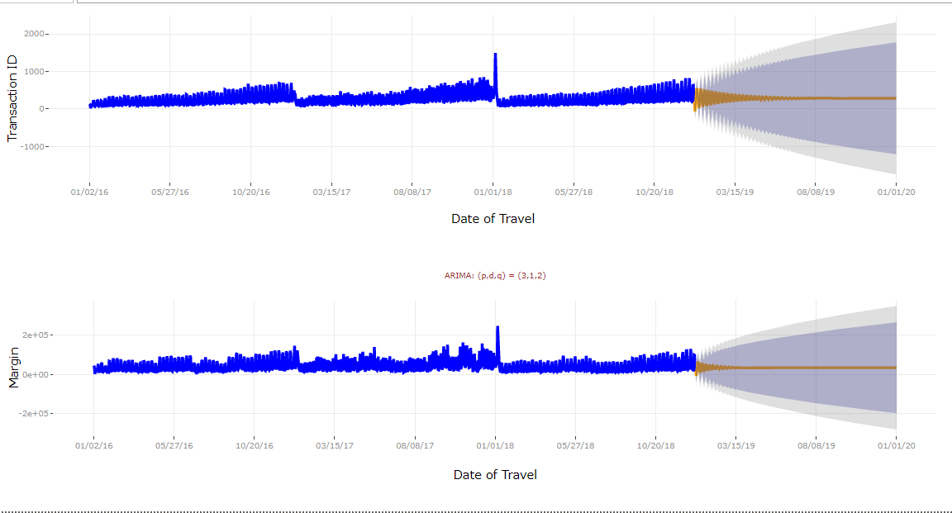
Forecasting for Yellow Cab
Given of seasonality and no trend , we can estimate that margin and number of trip will be like the past data

Slide 18
Recommendations
Following our analysis, we notice that:
In most scenarios,
Margin and total trips analysis per unit
Summary Analysis by Year
Summary Analysis by cities
Yellow taxi perform well than Pink taxi. Therefore, we recommend Yellow taxi
We also notice in overall for cab industry :
The business of cab is more interesting on Friday, Saturday and Sunday
The business of cab is more interesting when weather is bad
The business of cab is seasonal without any trend
There is untapped potential for cab business in big cities

