Slide 1
Course Capstone Project Land Use change in Tennessee
Massih Forootan
Nashville Software School
Oct 17 – Jul 18

Slide 2
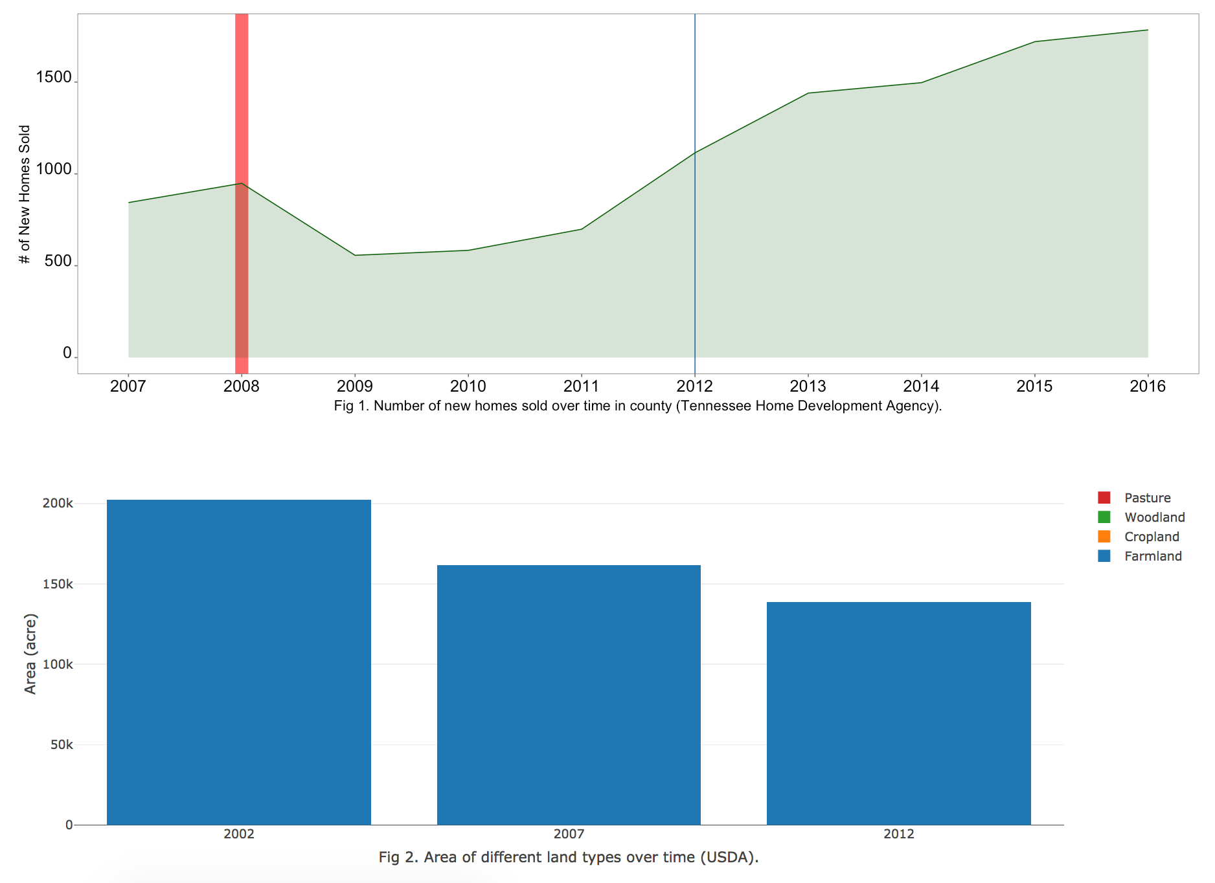
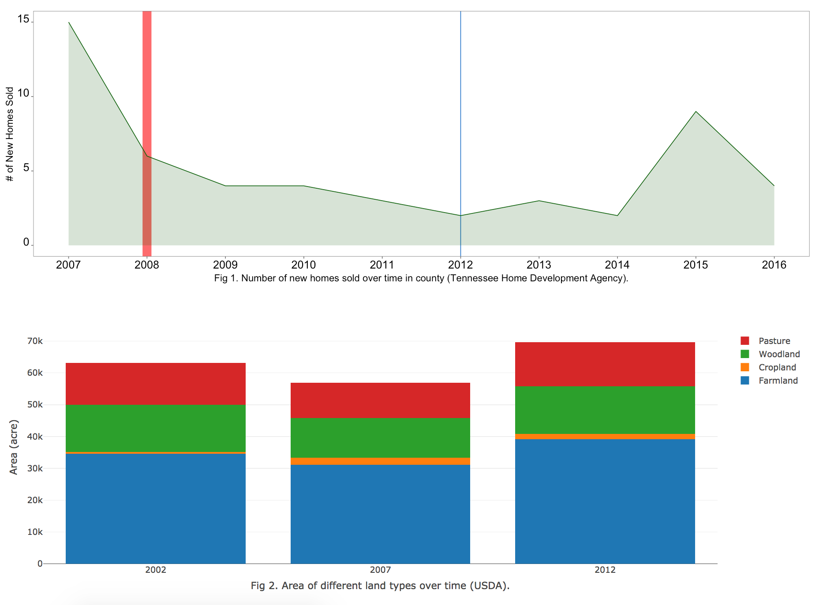
Land Use change in Tennessee – Massih Forootan
Background (Midstone project – ShinyApp)
Farmlands area has decreased during the 2002 – 2012 according to USDA Census
Meanwhile, the land used for residential/commercial is growing
The pattern of the change is not the same among different counties

Slide 3
Question: What factor(s) contribute to the decrease in farm land use?
Land Use change in Tennessee – Massih Forootan
Hypotheses:
The metrics that impact the change in farmlands are believed to be or related to the following traits, and will therefore be put on test:
Farms that make less dollar amounts due to mismanagement and/or marketing bottlenecks will gradually receive more preference for changing land use.
Farms that are smaller in area (eg after being split among next generation) will become less profitable, encouraging the land owner to consider changing land use
In both cases, the market value for residential/commercial properties in the same area, hand in hand with big industries can act as an incentive or a barrier.

Slide 4
Land Use change in Tennessee – Massih Forootan
Workflow:
Data Resources:
Some data was collected from PDF files available online, using Tabula Software.
Data for agricultural land use and product values:
Collected from USDA Cencus for Agriculture 2012 and 2007
Data for urbanization and population metrics
Collected from Tennessee Census for Urbanization and Housing
Data for home sales and prices
Collected from Tennessee Home Development Agency
Data for location of big industries headquartered in Tennessee
Collected from Ranker
cap_read.ipynb

Slide 5
Land Use change in Tennessee – Massih Forootan
Workflow:
Read the data PDF / XLS / CSV files converted into data frames and reorganized.
Clean the data: All the dataframes created are called and merged.
Dimension Reduction: Principle component analysis
Clustering: Using K-mean

Slide 6
Land Use change in Tennessee – Massih Forootan
Results
Three significant principal components identified farm specs, population/housing, and cropland specs.
Some analyzed features showed correlation with geographical coordination.
Conclusion
The main outlier counties are those that accommodate big cities, and the west TN area
It appears that availability of small farm size acts as an incentive / symptom for urbanization

Slide 7
Land Use change in Tennessee – Massih Forootan
Read the data PDF files converted into dataframes should be reorganized
1
1 | 2 | 3
2
3
cap_read.ipynb

Slide 8
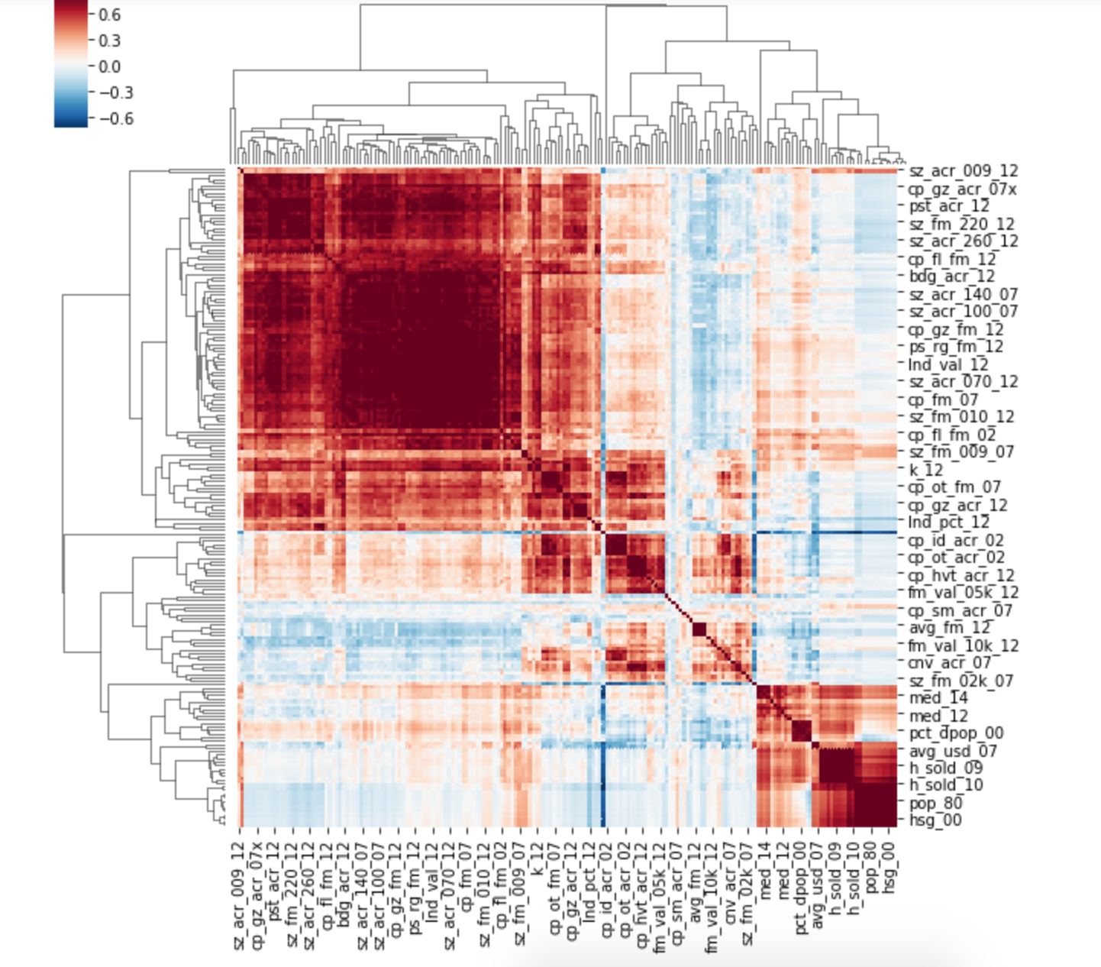
Land Use change in Tennessee – Massih Forootan
cap_pca.ipynb

Slide 9
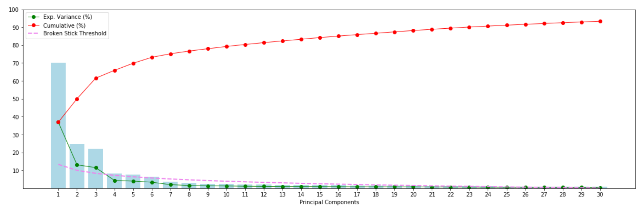
Land Use change in Tennessee – Massih Forootan
cap_pca.ipynb

Slide 10
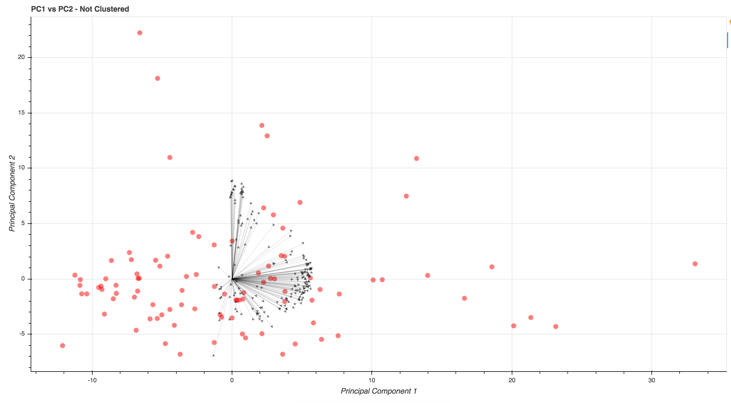
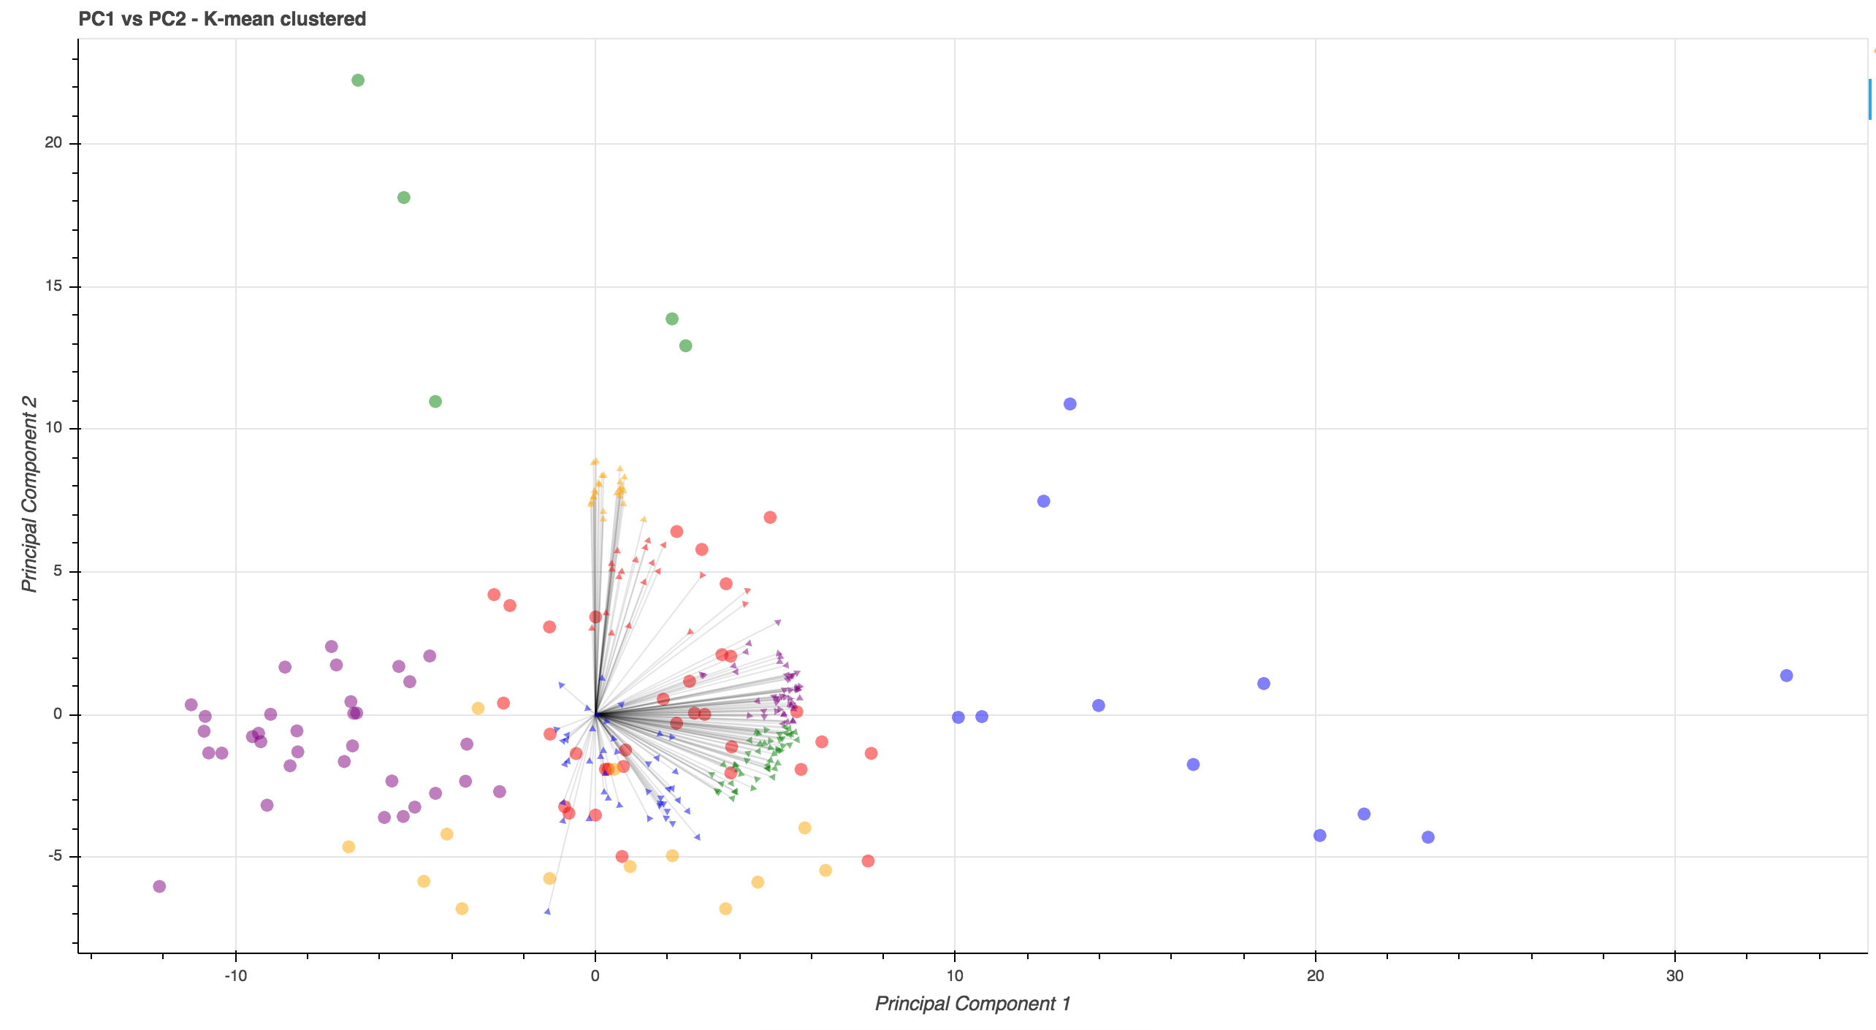
Land Use change in Tennessee – Massih Forootan
cap_kmean.ipynb

Slide 11
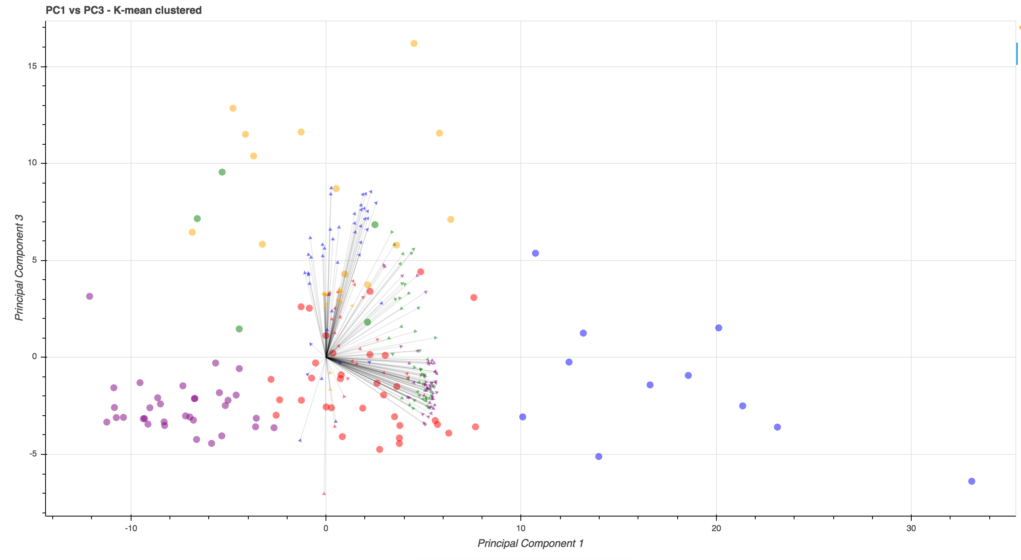
Land Use change in Tennessee – Massih Forootan
cap_kmean.ipynb

Slide 12
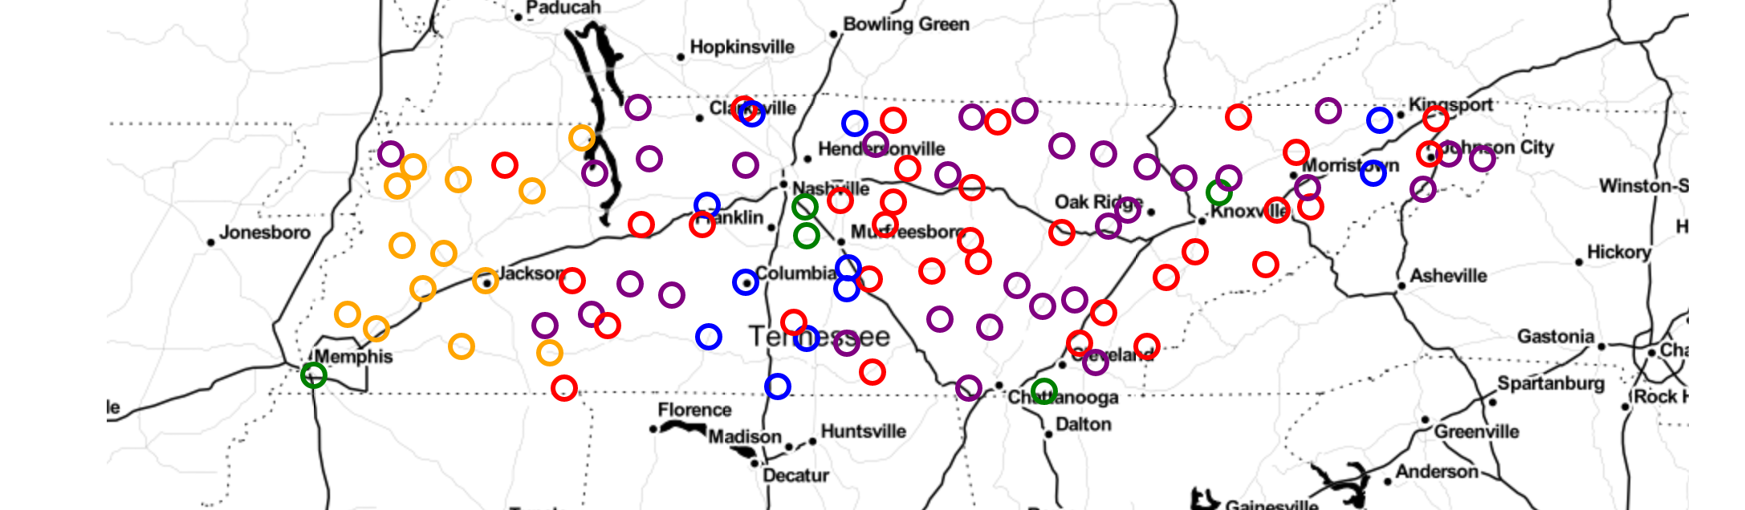
Land Use change in Tennessee – Massih Forootan
PC1/PC2 biplot and cluster county
cap_kmean.ipynb

Slide 13
Land Use change in Tennessee – Massih Forootan
Features correlated to each other
Housing unit – Population - Home sales
Idle croplands – Large size farms – Conserved land – Cropland insured
Median price – Small farms – Population change
Cropland grazed – Mid size farms – Failed croplands
Building area in farms – Woodland area
cap_kmean.ipynb

