Slide 1
Global Sentiment Analysis of the Saudi Horse Cup
Leveraging Social Media Data for Event Insights JALAWI Mohammed ALWAJI

Slide 2
Introduction to the Saudi Horse Cup
Prestigious international equestrian event held annually in Saudi Arabia
Launched in 2020, quickly becoming one of the world’s richest horse races
Features top thoroughbreds and jockeys from around the globe
Total prize purse of $35.35 million as of 2024
Showcases Saudi Arabia’s commitment to sports and international events

Slide 3
Project Overview
Aim: Analyze global sentiment towards the Saudi Horse Cup using social media data
Objectives:
Collect and analyze tweets related to the event
Identify prevailing opinions and sentiment trends
Uncover geographical variations in public perception
Provide actionable insights for event organizers and stakeholders

Slide 4
Data Collection
Source: Twitter (Platform X) platform
Method: Twikit library for efficient data scraping
Timeframe: [Specify exact dates]
Keywords: “Saudi Horse Cup”, “#SaudiCup”, “Saudi racing”, etc.
Dataset: [Mention total number of tweets collected]

Slide 5
Data Exploration
Dataset structure: [X] columns including tweet text, user info, and engagement metrics
Key features: Tweet content, timestamp, user location, retweet/like counts
Initial observations:
High engagement during event dates
Diverse geographical participation
Mix of English and Arabic tweets

Slide 6
Data Preprocessing
Text cleaning:
Removing special characters and URLs
Standardizing text (lowercase, removing extra spaces)
Handling missing data and duplicates
Feature engineering: Creating sentiment score, extracting hashtags

Slide 7
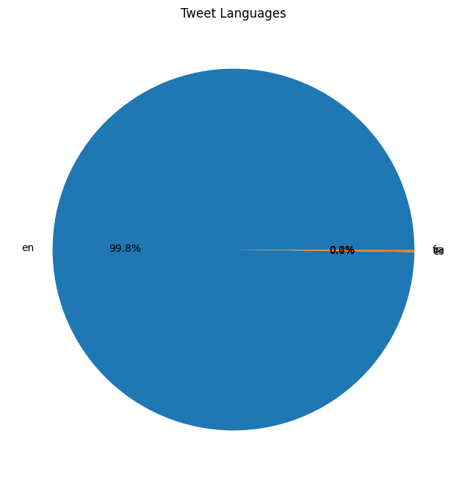
Language Distribution
English tweets dominant at [X]%
Arabic second most common at [Y]%
Focus on English tweets for in-depth analysis
Insight: Event’s international appeal and reach
Language Distribution Pie Chart

Slide 8
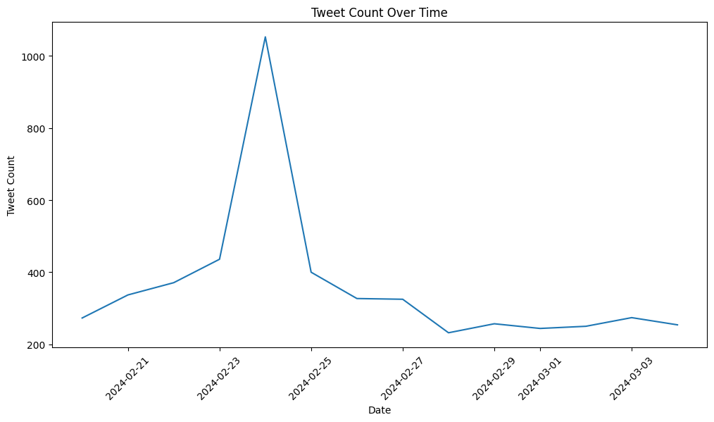
Tweet Activity Over Time
Peak activity observed on [specific dates]
Correlates with key event milestones:
Race day: [Date]
Winner announcement: [Date]
Implications for future event promotion and engagement strategies
Tweet Activity Line Graph

Slide 9
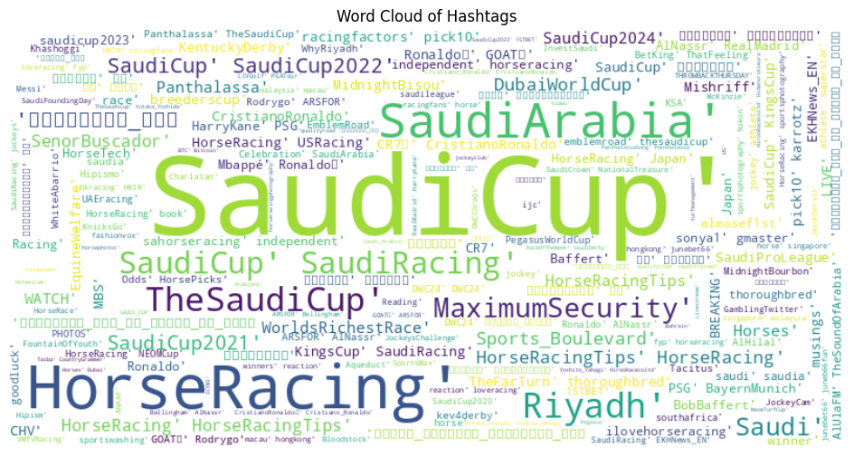
Popular Hashtags
Most frequent: #SaudiCup, #HorseRacing, #SaudiArabia
Emerging themes: [Identify interesting or unexpected hashtags]
Insights for future marketing and audience engagement
Hashtag Word Cloud

Slide 10
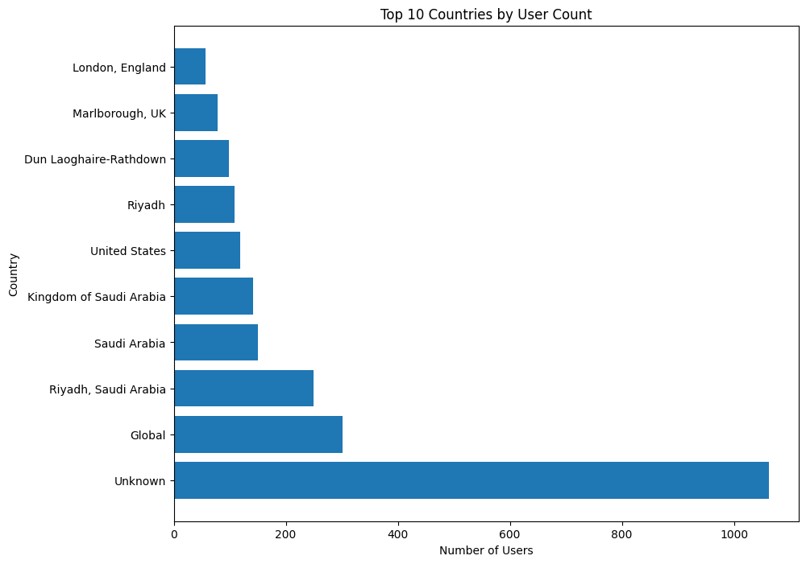
Geographical Analysis
Top engaging countries: [List top 5]
Surprising findings: [Mention any unexpected countries in top 10]
Implications for targeted marketing and international outreach
Top Countries Bar Chart

Slide 11
Sentiment Analysis Approach
Utilized BERT (Bidirectional Encoder Representations from Transformers) model
Advantages of BERT:
Contextual understanding of language
Pre-trained on large corpus, fine-tuned for our task
State-of-the-art performance in NLP tasks
Process: Tokenization → BERT model → Sentiment classification

Slide 12
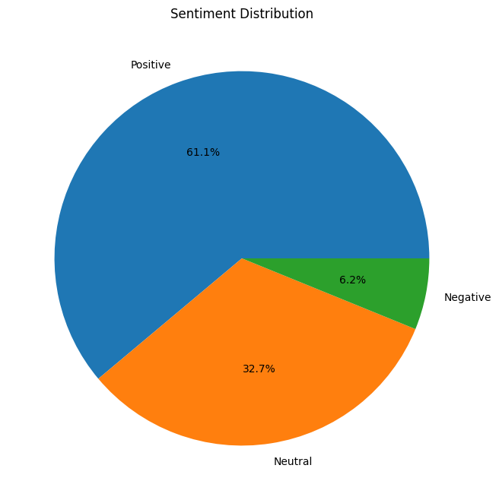
Sentiment Analysis Results
Overall sentiment breakdown:
Positive: [X]%
Neutral: [Y]%
Negative: [Z]%
Key findings: [Summarize main sentiment trends]
Comparison to initial expectations
Sentiment Distribution Pie Chart

Slide 13
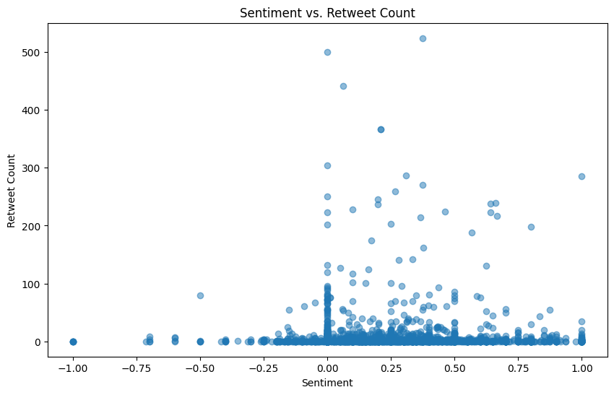
Sentiment vs. Engagement
Correlation between positive sentiment and higher retweets
Outliers: Highly retweeted negative tweets about [specific issues]
Insights for content strategy: Focus on [specific types of content]
Sentiment vs Retweets Scatter Plot

Slide 14
Key Insights and Implications
Main findings:
[Key insight 1]
[Key insight 2]
[Key insight 3]
Implications for organizers:
Enhance [specific aspect] based on positive sentiment
Address concerns about [specific issue] highlighted in negative tweets
Leverage international interest for broader marketing reach

Slide 15
Conclusion and Future Work
Recap: Valuable insights gained through data-driven analysis
Limitations: Twitter-only data, potential bias in social media representation
Future directions:
Incorporate multi-platform data (Instagram, Facebook)
Longitudinal study across multiple years
Advanced NLP techniques for nuanced sentiment analysis
Call to action: Integrate these insights into strategic planning for future Saudi Cup events

