Slide 1


Stellantis France / autobiz
Q3 Performance Trade-In
October 2025
Oct 2025
Strictly confidential

Slide 2
Q3 2025 - Executive Summary
PH_TBL
Source: autobiz

Slide 3
Q3 2025 - Executive Summary
PH_TBL
Source: autobiz

Slide 4
Executive summary
Total leads and growth Year-Over-Year
PH_TBL
Source: autobiz
Over the past three months, all brands have experienced significant growth.
By the end of September, every brand has shown an increase compared to last year except Citroën and Fiat Pro.
Fiat Pro and Citroën are still struggling to recover from the downturn they faced at the beginning of the year.

Slide 5
Executive summary
NC leads and growth Year-Over-Year
PH_TBL
Source: autobiz
Oct 2025

Slide 6

Leads by Purchase Project – xP brands
PH_TBL
Source: autobiz

Slide 7
Leads by Purchase Project– xF brands
PH_TBL
Source: autobiz

Slide 8
Sales Focus

Slide 9
NC Sales Conversion
Leads from 01/01 to 30/06/2025
xP brands
xF brands
Source: C1st – Nature (request type) = 47. VO – VN Trade-in Operation (excl. Meetdeal provider) for xP / A68 = Trade-in Value for xF brands

Slide 10
Visibilité PDV xF Site de reprise

Slide 11
NC Sales Conversion
Leads from Jan to June 25
Source: C1st – Nature = 47. VO – VN Trade-in Operation (excl. Meetdeal provider) for xP brands
Nature = A68 – Trade-in for xF brands

Slide 12
Brand Focus

Slide 13
Focus Q3 : Traffic & leads by brands xP
PH_LKR_1
PH_LKR_2
Source: GA4 (traffic) – autobiz (leads)

Slide 14
Focus Q3 : Traffic & leads by brands xF
PH_LKR_1
PH_LKR_2
Source: GA4 (traffic) – autobiz (leads)

Slide 15
PEUGEOT

Slide 16

YTD Leads Trends
PH_TBL
Source: autobiz

Slide 17
Q3 Trade In Performance - Traffic
PH_LKR_1
Source: GA4

Slide 18
Q3 Trade In Performance – Leads
PH_TBL
Source: autobiz

Slide 19
Q3 Trade In Performance – CTA
PH_TBL
Source: autobiz

Slide 20
S1 Trade In Performance – Leads

Slide 21
CITROËN

Slide 22
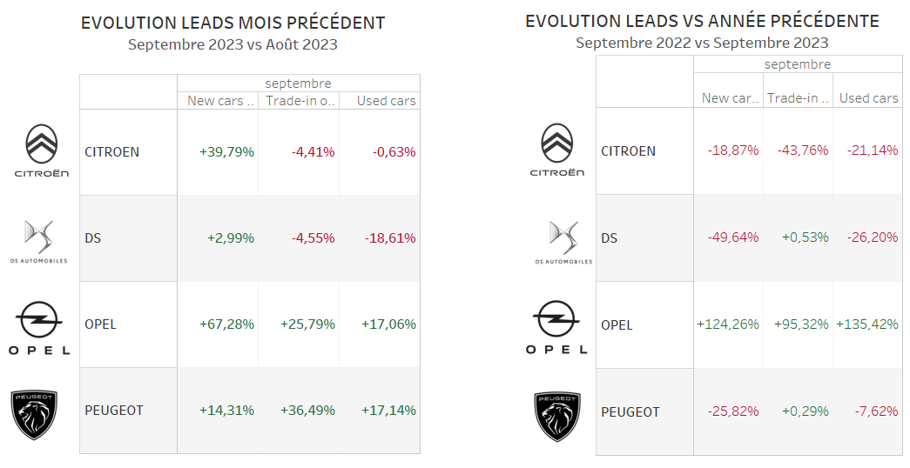
YTD Leads Trends
PH_TBL
Source: autobiz

Slide 23
Q3 Trade In Performance - Traffic
PH_LKR_1

Slide 24
Leads by marketing channel
PH_TBL

Slide 25
Q3 Trade In Performance – CTA
PH_TBL
Source: autobiz

Slide 26
Performance improvement
Ongoing topics

Slide 27
RETEX - CTA Sales Performance
Showroom CTA

Slide 28
Contacts
Marie-Adélaïde Freymuth
Head of Digital Key Account Managers
+33 (0)7.63.59.83.79
ma.freymuth@autobiz.com

