Slide 1
Electoral Engineering through Simulation
Michael Fowlie and Mark C. Wilson

Slide 2
Electoral System Properties
Fairness/Proportionality
Decisiveness/Governability
Trade-offs are not linear.

Slide 3
Measures
Proportionality
Loosemorehanby Index
Gallagher Index
Governability
Effective number of parties
Sum of squares of Shapley Shubik Power Index
Entropy of Shapley Shubik Power Index

Slide 4
MMP Review

Slide 5
Model
We use real election data as starting points
Infer voter preferences based on New Zealand Election Study.
Switch voter preferences based on some probability.

Slide 6
MMP Review
Proposal to lower threshold to 4% from 5%
Small loss in governability by lowering the threshold to 3%
Large gains in proportionality by lowering the threshold to 3%.

Slide 7
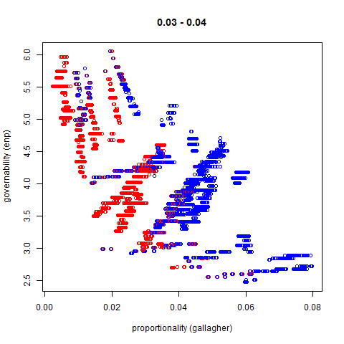
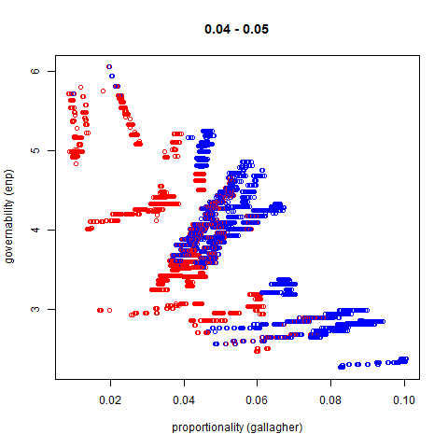
MMP Review

Slide 8
STV

Slide 9
“The Electoral Sweet Spot: Low Magnitude Proportional Electoral System” paper claims 2 or 3 winners per electorate is optimal.
We aim to validate this by statistical simulation.

Slide 10
Artificial Societies
Polya Eggenberger (Urn model)
Spatial Model

Slide 11
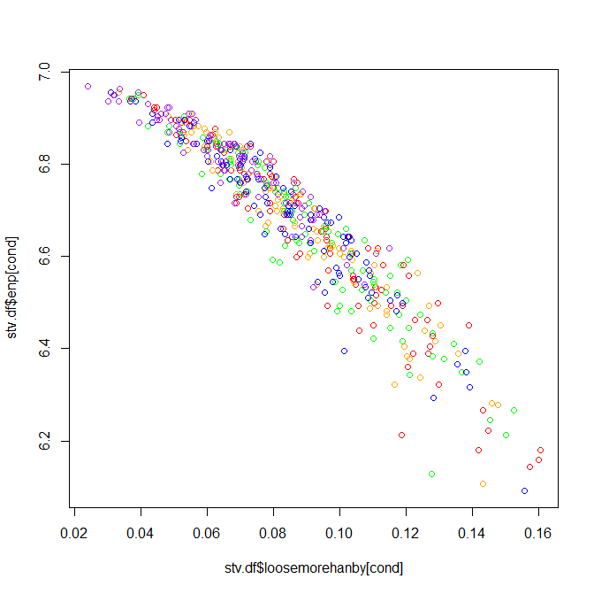
Polya Eggenberger (Urn model)

Slide 12
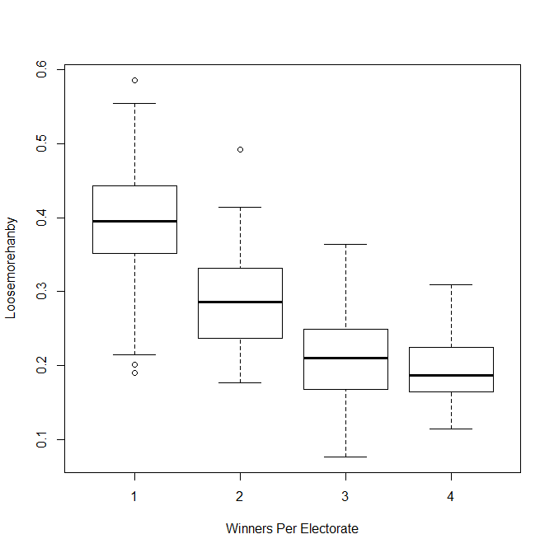
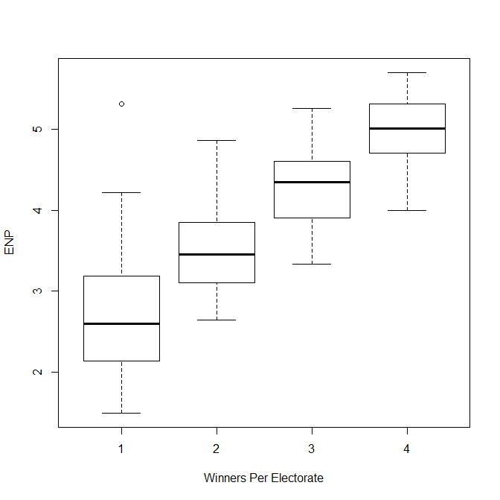
Spatial Model

Slide 13
