Slide 1
Electoral Engineering through Simulation
Michael Fowlie and Mark C. Wilson

Slide 2
Electoral System Properties
Fairness/Proportionality
Decisiveness/Governability
Trade-offs are not linear.

Slide 3
Measures
Proportionality
Loosemorehanby Index
Gallagher Index
Governability
Effective number of parties
Sum of squares of Shapley Shubik Power Index
Entropy of Shapley Shubik Power Index

Slide 4
The Electoral Sweet Spot paper claims district magnitude of 2 or 3 is optimal.
Uses data from 609 real elections in 81 different countries.
We aim to validate a theoretical basis for this by simulation of artificial societies.

Slide 5
Models for Artificial Societies
Polya Eggenberger (Urn model)
Spatial Model
We assume districts are independent

Slide 6
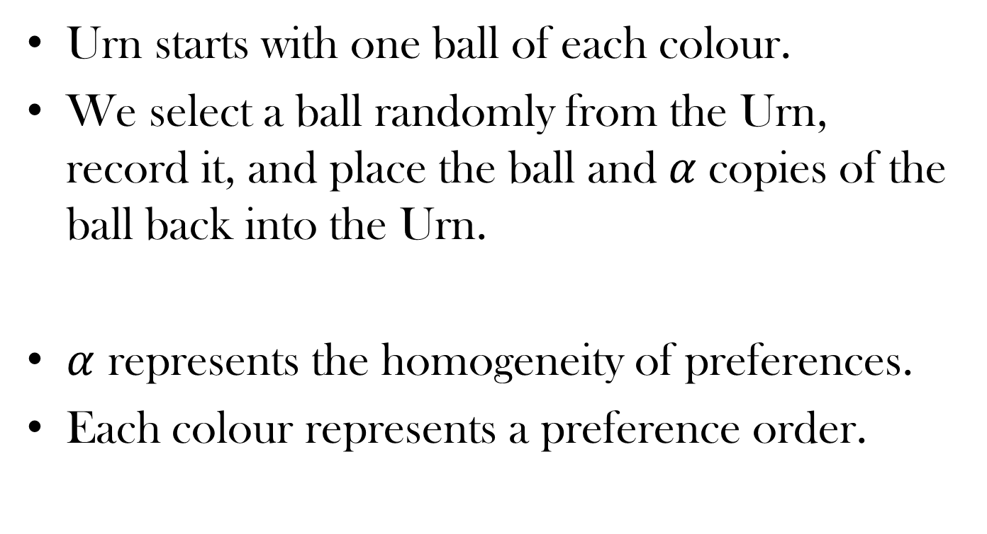
Urn Process (Intuition)
Urn starts with one ball of each colour.
We select a ball randomly from the Urn, record it, and place the ball and $α$ copies of the ball back into the Urn.
$α$ represents the homogeneity of preferences.
Each colour represents a preference order.

Slide 7
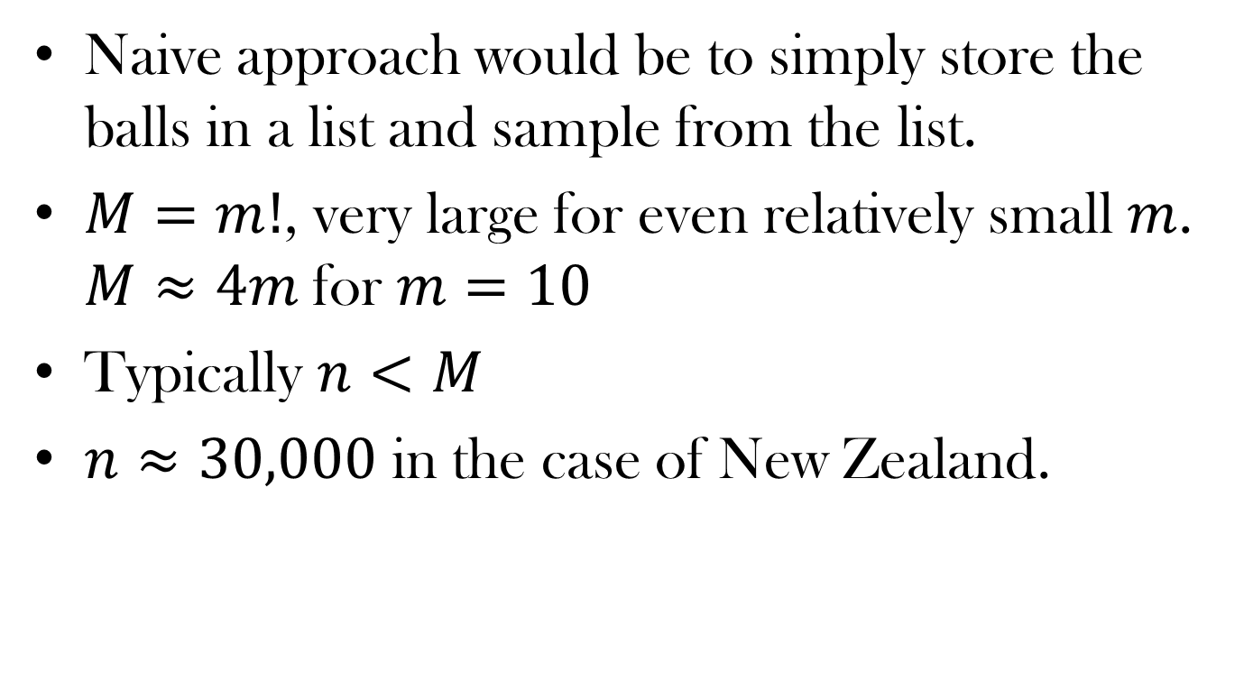
Sampling from the Urn process
Naive approach would be to simply store the balls in a list and sample from the list.
$M=m!$, very large for even relatively small $m$. $M≈4m$for $m=10$
Typically $n<M$
$n≈30,000$ in the case of New Zealand.

Slide 8
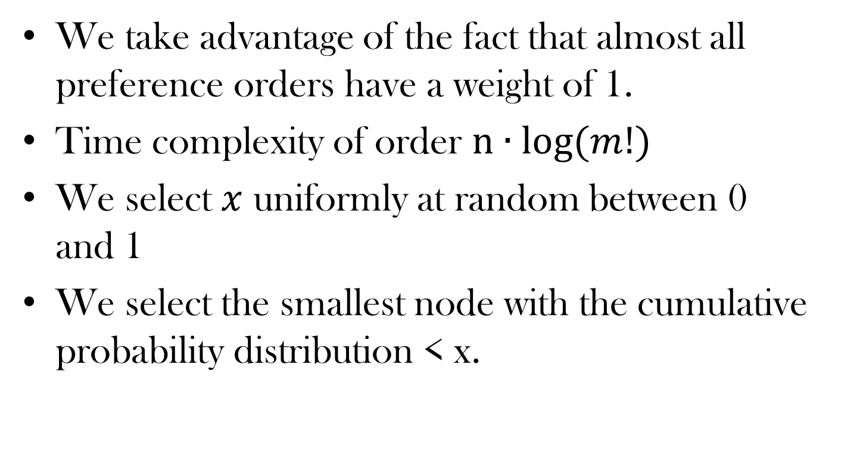
Efficiently Sampling from the Urn
We take advantage of the fact that almost all preference orders have a weight of 1.
Time complexity of order $n∙log⁡(m!)$
We select $x$ uniformly at random between 0 and 1
We select the smallest node with the cumulative probability distribution < x.

Slide 9
Tree Structure
0-1023
600
…
0-511
600
512-1023
0
…
…
0-255
100
256-511
500

Slide 10
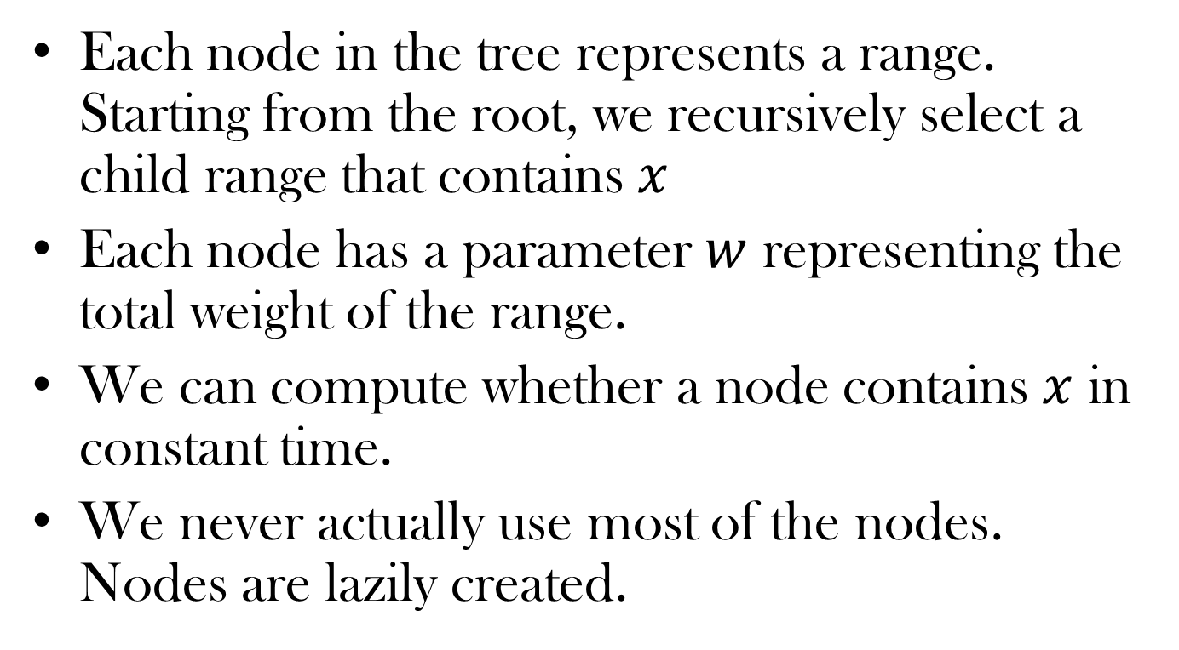
Each node in the tree represents a range. Starting from the root, we recursively select a child range that contains $x$
Each node has a parameter $w$ representing the total weight of the range.
We can compute whether a node contains $x$ in constant time.
We never actually use most of the nodes. Nodes are lazily created.

Slide 11
Spatial Model
We create parties with coordinates in an arbitrary dimensional space (e.g. 2D)
Each voter has random coordinates and selects a preference order by distance from itself to each party.
We vary the mean for each coordinate on the district level.

Slide 12
Spatial Model
Variance in selecting means for larger district.
Selecting the number of dimensions and variance in each.
Placement of parties.
Normal distribution
Normal distribution + traditional major “left” and “right” parties extremely close to the origin.

Slide 13
Preliminary Results

Slide 14
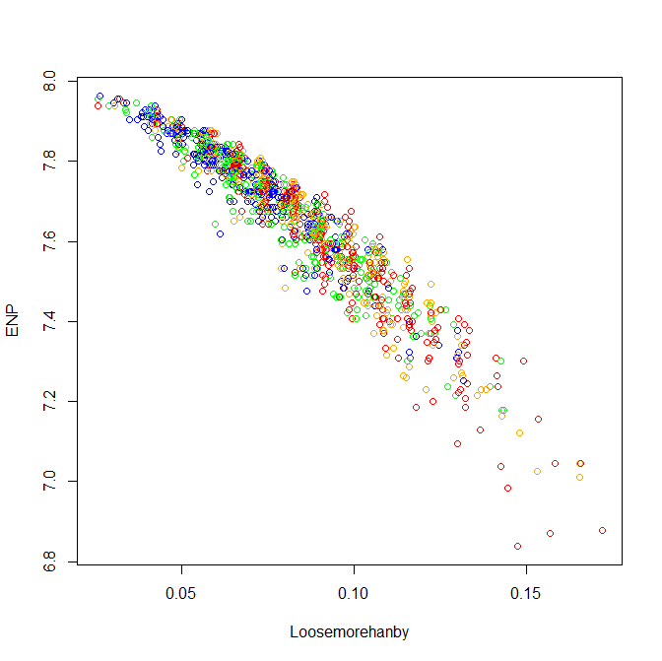
Polya Eggenberger (Urn model)

Slide 15
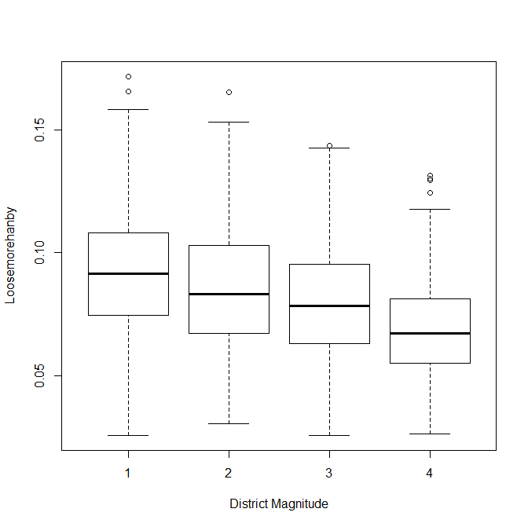
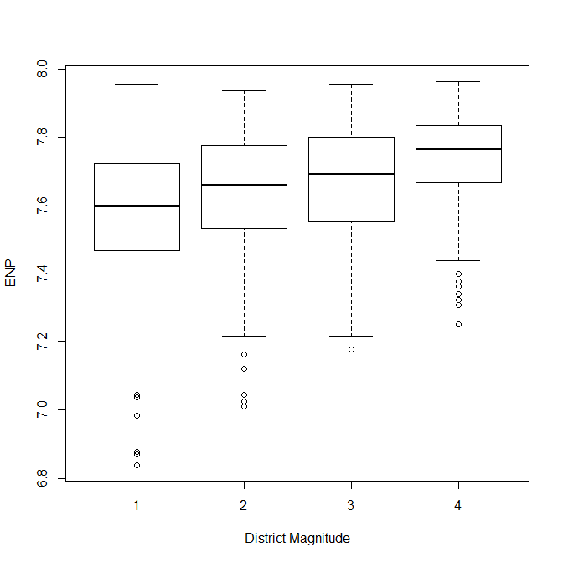
Polya Eggenberger (Urn model)

Slide 16
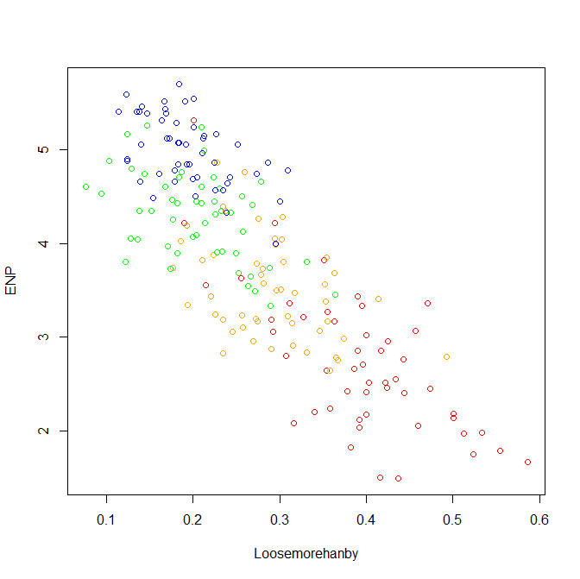
Spatial Model

Slide 17
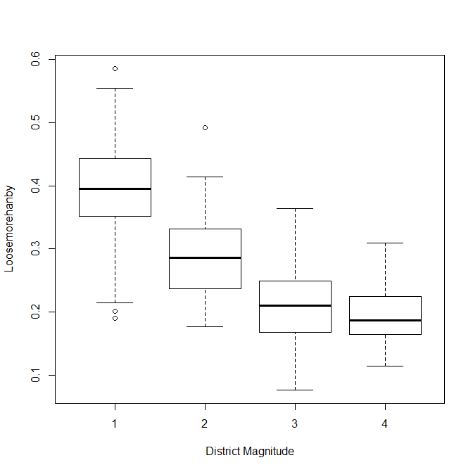
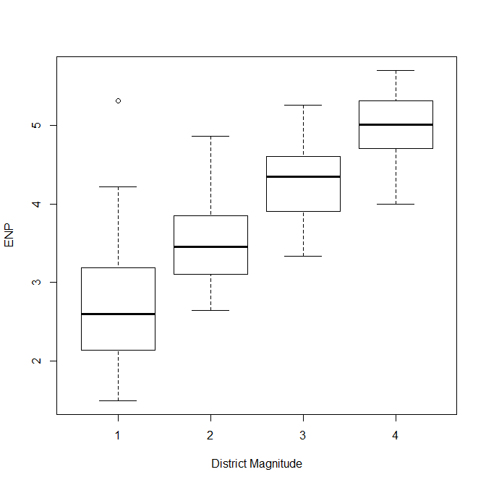
Spatial Model

Slide 18
References
Carey, John M and Hix, Simon. (2009) The Electoral Sweet Spot: Low-Magnitude Proportional Electoral Systems
New Zealand Election Study 2008. http://www.nzes.org/

