Slide 1
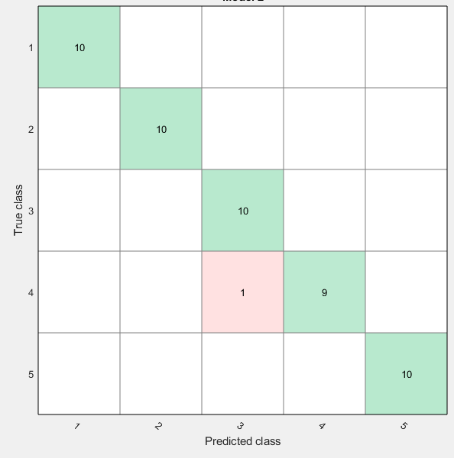
(a)

Slide 2

True class
Predicted class
(a)

Slide 3
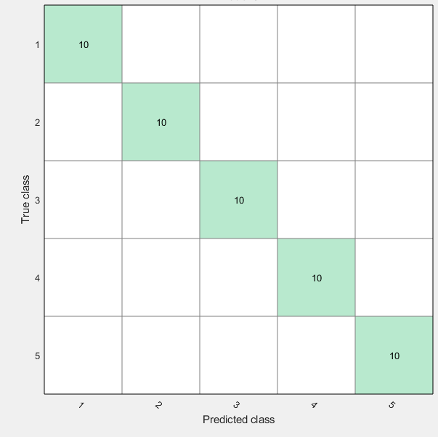
(b)

Slide 4
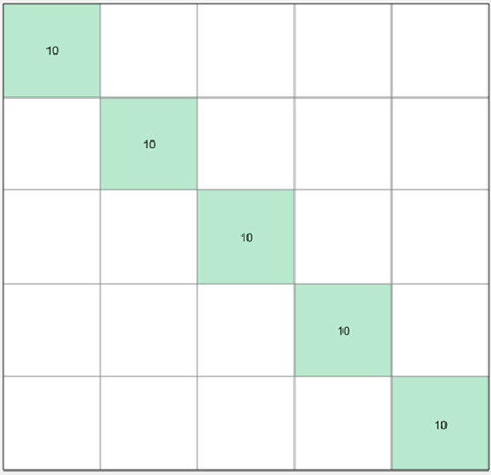
True class
Predicted class
(b)

Slide 5
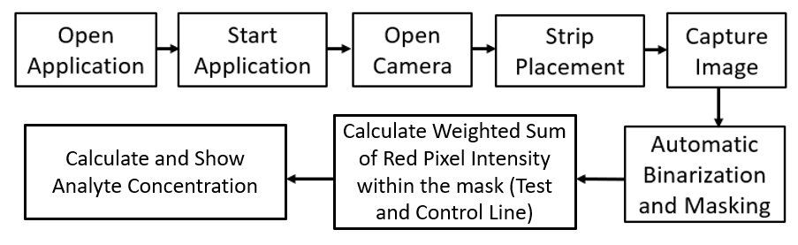
(a)

Slide 6
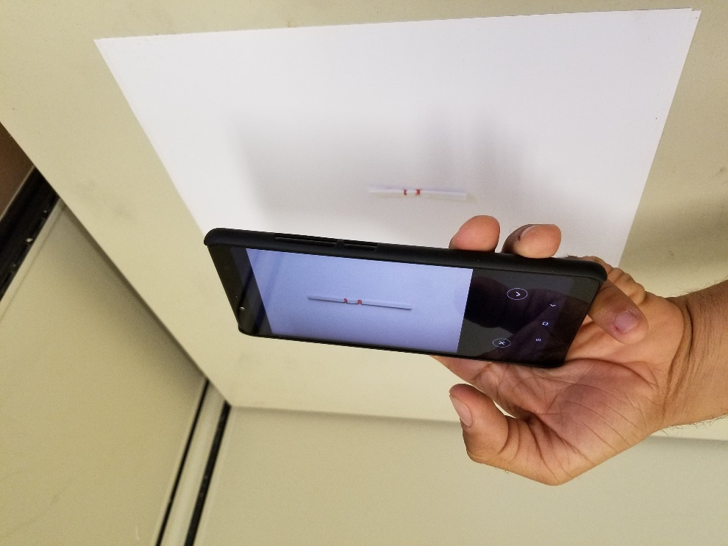
(b)

