Slide 1
Javascript快速入门
余明晖
华中科技大学自动化学院
yumh@mail.hust.edu.cn

Slide 2
Javascript的来源
JavaScript was developed by a gentleman named Brendan Eich, who was working for Netscape
Mocha, then LiveScript, and finally JavaScript.
The first browser to support JavaScript was Netscape Navigator 2.0, way back in late 1995

Slide 3
Javascript在页面中的使用方式
embed your JavaScript code right inside script tags.
<script>
alert("I'm learning JavaScript");
</script>
The second way to get JavaScript onto your page is to link to a .js file:
<script src="somefile.js"></script>

Slide 4
变量
var name = "Joe",
age = 45,
job = "plumber";
alert( name ); // Joe

Slide 5
变量
变量类型
  String
  alert( "John says \"What are you doing?\"" );
  alert( '"Let\'s go out for lunch."' );
  Numbers
  alert( 3.45e5 ); // 345000
  alert( 123e-3 ); // 0.123

Slide 6
变量
变量类型
  Booleans
  true and false
  Null and Undefined
  Object
  var obj = {
    name : "Andrew",
    age : 20,
    awake : true,
    company : {
    name : "XYZ Ltd.",
    id : 12345
    }
  };

Slide 7
变量
变量类型
  Object
  var obj = { name : "Joe", age : 10 };
  alert( obj.name ); // "Joe“
  alert( obj["age"] ) ; // 10
  Array
  var arr = ["string", 20, false];
  alert( arr[0] ); // "string"

Slide 8
变量
变量类型
  Date
  new Date("January 17, 2012")
  new Date(2009, 3, 20, 17, 30)

Slide 9
分号
  Semicolons
  var someVar = "value";
  someFunction("parameter");
  if (true) {
  doThis();
  }

Slide 10
注释
  Comments
  // This is a useless comment
  /* file: navigtion.js
  author: Andrew Burgess
  date: July 2, 2011
  purpose: provides animation for the site navigation
  */

Slide 11
运算符
Arithmetic Operators
  var four = 2 + 2, //addition operator
  hour = 24 - 13, // subtraction operator
  seventy = 7 * 10, // multiplication operator
  avg_days_per_week = 365 / 52, // division operator
  remainder = 31 % 2, // modulus operator
  msg = "the time is " + hour + " o'clock"; // addition operator used on strings
  console.log(four); // 4
  console.log(hour); // 11
  console.log(seventy); // 70
  console.log(avg_days_per_week); // 7.019230769230769
  console.log(remainder); // 1
  console.log(msg); // "the time is 11 o'clock"

Slide 12
运算符
Comparison Operators
  alert( 10 < 5 ); // false
  alert( 10 > 5 ); // true
  alert( 4 <= 3 ); // false
  alert( 4 === 3 ); // false
  alert( "cat" > "dog" ); // false
  alert( "bacon" > "chunks" ); // false
  alert( "cats" >= "cats" ); // true
  alert( "fishing" <= "sleeping" ); // true
  alert( "cat" > "CAT" ); // true

Slide 13
运算符
Unary Operators
  var i = 0;
  i++;
  alert(i); // 1
  ++i;
  alert(i); // 2
  i--;
  alert(i); // 1
  --i; alert(i); // 0
  alert( typeof 10 ); // "number"
  alert( typeof "test" ); // "string"
  alert( typeof new Date() ); // "object"

Slide 14
运算符
Assignment Operators
  var num = 10;
  num += 5; // same as num = num + 5
  alert(num); // 15
  num -= 3; // same as num = num - 3
  alert(num); // 12
  num *= 2; // same as num = num * 2
  alert(num); // 24
  num /= 6; // same as num = num / 6
  alert(num); // 4
  num %= 3; // same as num = num % 3
  alert(num); // 1

Slide 15
运算符
Boolean Operators
  var a = true;
  var b = false;
  alert( a && b ); // false
  alert( a || b ); // true
  var day = 14, year = 2011;
  alert( day > 10 || year === 2011 ); // true
  alert( day < 20 && year >= 2010 ); // true

Slide 16
条件语句
If Statements
  var year = 2011, msg = "In the ";
  if (year > 2000) {
  msg += "twenty-first century";
  } else {
  msg += "twentieth century";
  }
  console.log(msg); // In the twenty-first century

Slide 17
条件语句
Switch Statements
  var order_size = "medium";
  switch (order_size) {
  case "small":
  alert("small");
  break;
  case "medium":
  alert("medium");
  break;
  case "large":
  alert("large");
  break;
  case "extra large":
  alert("extra large");
  break;
  default:
  alert("something else?");
  }

Slide 18
条件语句
Conditional Operator
  var temp = 18,
  msg = (temp > 10) ? "Today was warm" : "Today was cold";
  alert(msg);

Slide 19
循环语句
For Loops
  var names = ["Ringo", "John", "Paul", "George"];
  for (var i = 0; i < names.length; i++) {
  alert("Say hello to " + names[i]);
  }
  var i = 0;
  for ( ; names[i] ; ) {
  //do something
  i++;
  }

Slide 20
循环语句
While Loop
  var not_home = true,
  miles_driven = 0;
  while (not_home) {
  miles_driven += 1; // drive another mile
  if (miles_driven === 10) {
  not_home = false;
  }
  }
  alert(miles_driven);

Slide 21
循环语句
For Loop, Revisited
  var person = {
  name : "Jules Verne",
  job : "Author",
  year_of_birth: 1828,
  year_of_death: 1905
  },
  prop;
  for (prop in person) {
  alert("His " + prop + " is " + person[prop]);
  }

Slide 22
函数
Function is a object
  function getGreeting(hour) {
  var hour = 10,
  message;
  if (hour < 12) {
  message = "Good Morning!";
  } else if (hour < 17) {
  message = "Good Afternoon!";
  } else {
  message = "Good Evening!";
  }
  return message;
  }
  var message = getGreeting( 16 ); // 4 PM
  alert(message); // Good Afternoon!

Slide 23
函数
Functions
  function getGreeting(hour) {
  var hour = 10,
  message;
  if (hour < 12) {
  message = "Good Morning!";
  } else if (hour < 17) {
  message = "Good Afternoon!";
  } else {
  message = "Good Evening!";
  }
  return message;
  }
  var message = getGreeting( 16 ); // 4 PM
  alert(message); // Good Afternoon!
var msg1 = getGreeting(10),
msg2 = getGreeting(1,2,3,4,5,6, "and on"),
msg3 = getGreeting(),
msg4 = getGreeting("five o'clock");

Slide 24
函数
Functions
  function sum() {
  var sum = 0, i;
  for ( i = 0 ; arguments[i]; i++) {
  sum += arguments[i];
  }
  return sum;
  }
  var sum1 = sum(1, 2),
  sum2 = sum(100, 75, 40),
  sum3 = sum(9, 1.4, 8, 2, 79, 3234, 6, 4, 5e3, 5);
  alert(sum1); // 2
  alert(sum2); // 215
  alert(sum3); // 8348.4

Slide 25
函数
Anonymous Functions
  function () {
  return "this function has no name";
  }
  var hi = (function () {
  return function () {
  return "Hi";
  }
  }());

Slide 26
函数
String Methods
  length
  indexOf
  slice, substr, and substring
  split
  toLowerCase and toUpperCase

Slide 27
函数
Numbers Methods
  toExponential
  toFixed
  toPrecision
  parseInt
  parseFloat

Slide 28
函数
Date Methods
  getDate, getDay, getFullYear, getHours, getMinutes,
  getMonth , getSeconds, getTime, getTimezoneOffset
  setDate, setMinute, setFullYear, …
  parse

Slide 29
函数
Array Methods
  join
  pop / shift
  push / unshift
  reverse
  slice

Slide 30
函数
Array Methods
  sort
  ["d", "e", "c", "a", "b"].sort();
  [0, 5, 10, 15, 20, 25] .sort();
  var arr = [5, 2, 3, 4, 1];
  arr.sort(function (a, b) {
  return a - b;
  });
  console.log(arr); // [1, 2, 3, 4, 5];

Slide 31
函数
Math Methods
  min
  max
  random
  round / ceil / floor
  pow

Slide 32
this
this will reference the global object
  var my_variable = "value";
  function my_function () { return "another_value" }
  alert( this.my_variable ); // "value”
  alert( this.my_function() ); // "another_value"

Slide 33
new
The new Keyword
  function Truck(model) {
  this.num_of_tires = 4;
  this.kilometers = 0;
  this.model = model;
  }
  var my_truck = new Truck("Hercules");
  console.log(my_truck);

Slide 34
call and apply
two methods that functions have by default
  function Truck (model, num_of_tires) {
  this.num_of_tires = num_of_tires;
  this.kilometers = 0;
  this.model = model;
  }
  var basic_vehicle = { year : 2011 };
  Truck.call(basic_vehicle, "Speedio", 4);
  console.log(basic_vehicle);

Slide 35
call and apply
two methods that functions have by default
  function Truck (model, num_of_tires) {
  this.num_of_tires = num_of_tires;
  this.kilometers = 0;
  this.model = model;
  }
  var basic_vehicle = { year : 2011 },
  user_input = "Speedio 18";
  Truck.apply(basic_vehicle, user_input.split(" "));
  console.log(basic_vehicle);

Slide 36
对象内部的属性访问
var waitress = {
name : "Ashley",
greet: function (customer) {
customer = customer || “there";
return "Hi " + customer + “! My name is " +
this.name + "; what can I get you?";
}
};
alert( waitress.greet("Joe") );
// Hi Joe! My name is Ashley; what can I get you?

Slide 37
Object Oriented JavaScript
function Computer (name, ram_amount, memory_amount) {
this.name = name;
this.RAM = ram_amount; // in GBs
this.space = memory_amount; // in MBs
}
my_computer = new Computer("MacBook", 2, 250000 );
console.log(my_computer);

Slide 38
Object Oriented JavaScript
function Computer (name, ram_amount, memory_amount) {
this.name = name;
this.RAM = ram_amount;
this.space = memory_amount;
this.files = [];
this.store_file = function (filename, filesize) {
this.files.push(filename);
this.space -= filesize;
};
}

Slide 39
Object Oriented JavaScript
Computer.prototype.store_file = function (filename, filesize) {
this.files.push(filename);
this.space -= filesize;
};

Slide 40
Object Oriented JavaScript
function Product(name) {
if (name) {
this.name = name;
}
}
Product.prototype.name = "To be announced";
Product.prototype.rating = 3;
var ipad = new Product("iPad");
alert( ipad.name ); // "iPad";
alert( ipad.rating ); // 3

Slide 41
Object Oriented JavaScript
function Person(name) {
this.name = name;
}
Person.prototype.legs = 2;
var person = new Person("Joe"), prop;
for (prop in person) {
console.log(prop + ": " + person[prop]);
}
// in console:
// name : Joe
// legs: 2

Slide 42
闭包
var revealSecret = (function () {
var secretNumber = 1024;
return function (password) {
if (password === "please") {
return secretNumber++;
}
return 0;
};
}());
console.log( revealSecret("please") ); // 1024
console.log( revealSecret("please") ); // 1025

Slide 43
DOM
<p>We're learning about the <em>Document Object Model </em>, or <strong>DOM</strong>.</p>

Slide 44
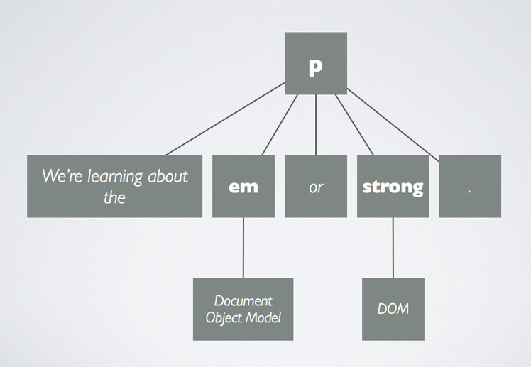
DOM

Slide 45
DOM
<div class="product">
<h2> Product Name </h2>
<img src="pic.jpg" />
<p> Description </p>
</div>

Slide 46
DOM
document.getElementById("id_name")
document.getElementsByClassName
document.getElementsByTagName

Slide 47
DOM
var products = document.getElementsByClassName("product"),
i = 0,
child;
for ( ; i< products.length; i++) {
child = products[i].firstChild;
while (child.nodeType !== 1) {
child = child.nextSibling;
}
console.log(child);
}

Slide 48
通过ID属性获得对应的元素
//原始的w3c DOM
document.getElementById(‘elementId’);
$(‘elementId’); //Prototype, MooTools
$(‘#elementId’); //jQuery
Y.one(‘#elementId’); //YUI3
dojo.byId(‘elementId’); //Dojo
Ext.getDom(‘elementId’); //Ext JS3

Slide 49
元素遍历
// 从具有指定id属性的元素开始，到达最近的class属性为category的<h2>元素然后遍历这个元素的兄弟元素直到遇到一个class属性为summary的元素
$(‘someDeeplyNestedElement’).up(‘h2.category’).next(‘.summary’);
//找到带有名为sifr的CSS class的元素，设置这些元素的直接容器的CSS文本缩进属性
$$(‘a.sifr’).invoke(‘up’).invoke(‘getStyle’, ‘text-indent: -9999px’);

Slide 50
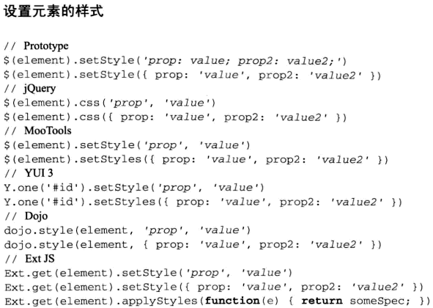
设置元素样式

Slide 51
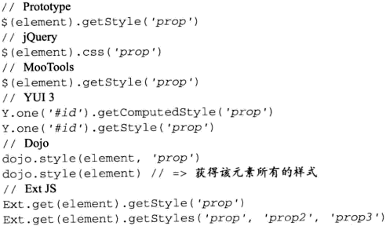
获取元素样式

Slide 52
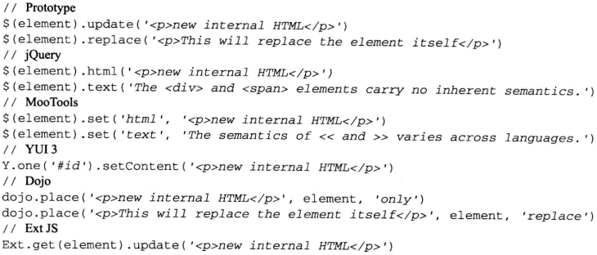
更新元素内容

Slide 53
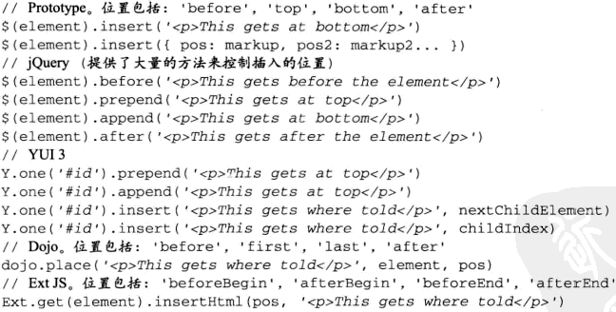
向元素中注入其他内容

Slide 54
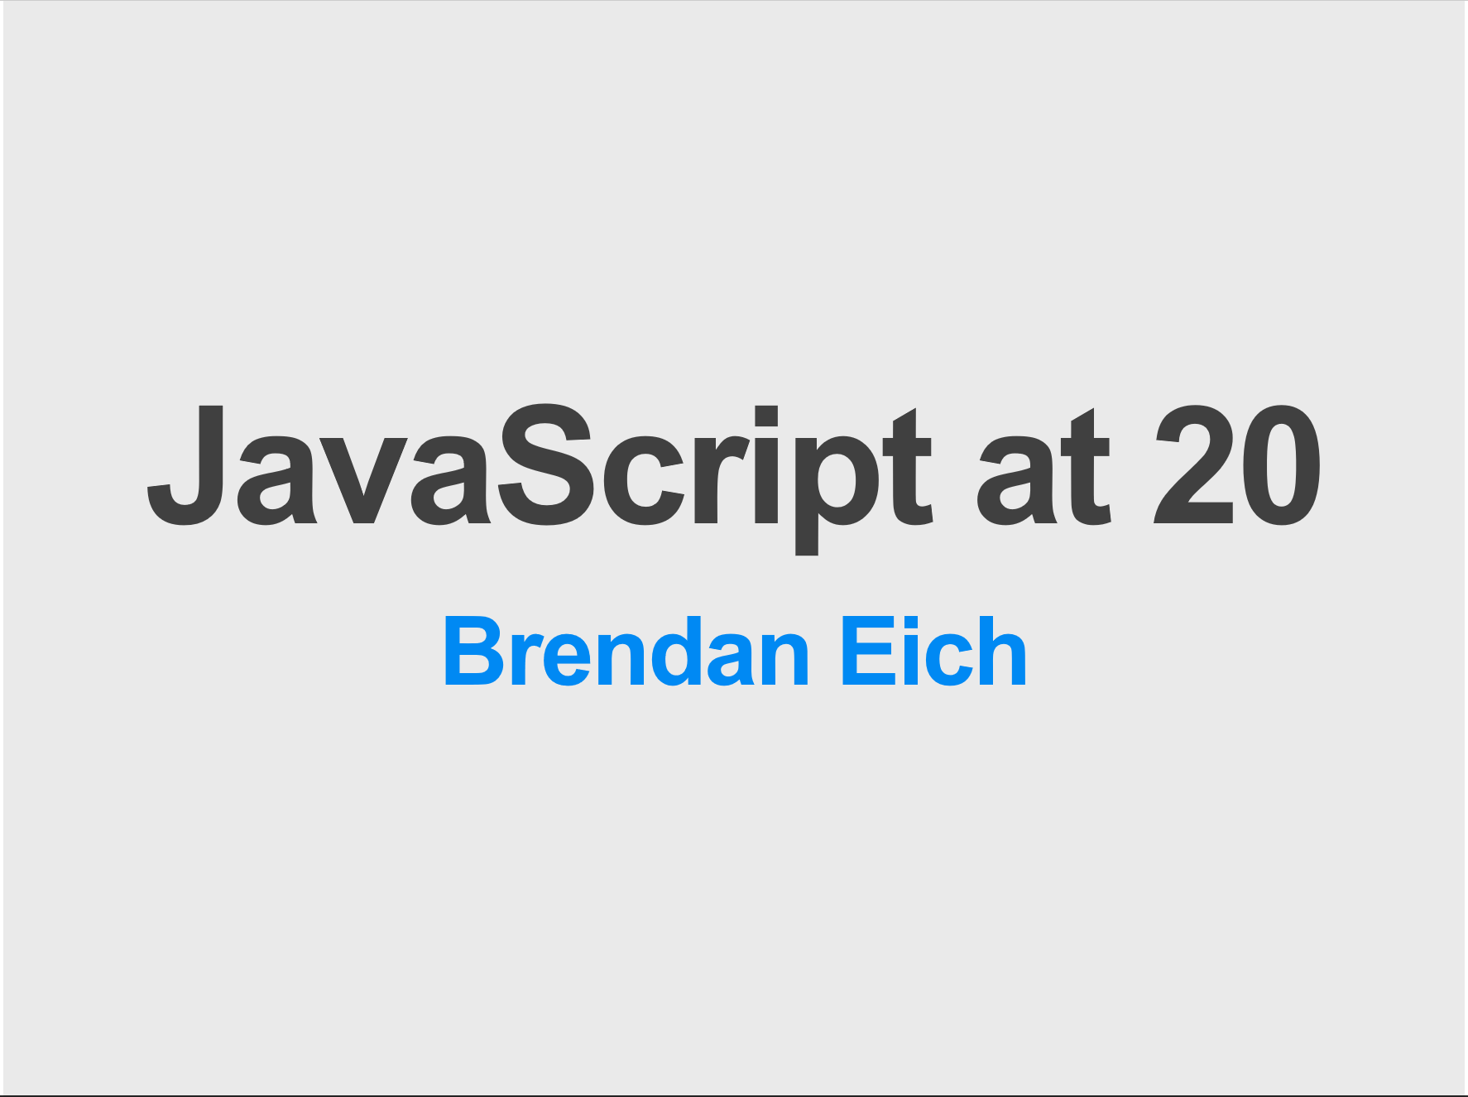
JavaScript 20年
JavaScript 20年

Slide 55
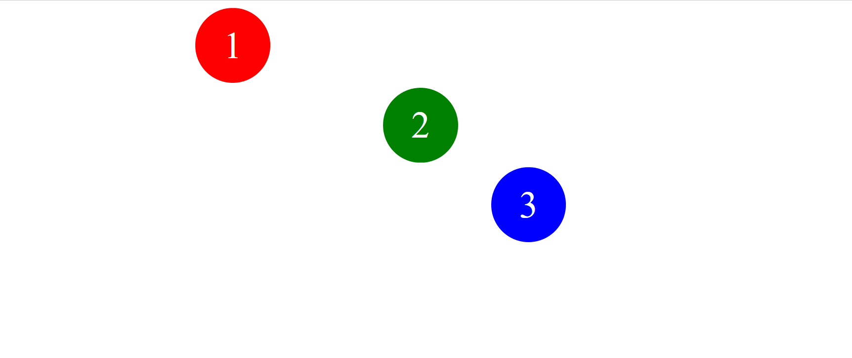
JavaScript示例
Ball demo

Slide 56

JavaScript示例
Gallery react
Notes:
C:\yumh\Internet\gallery-react>npm start

