Slide 1
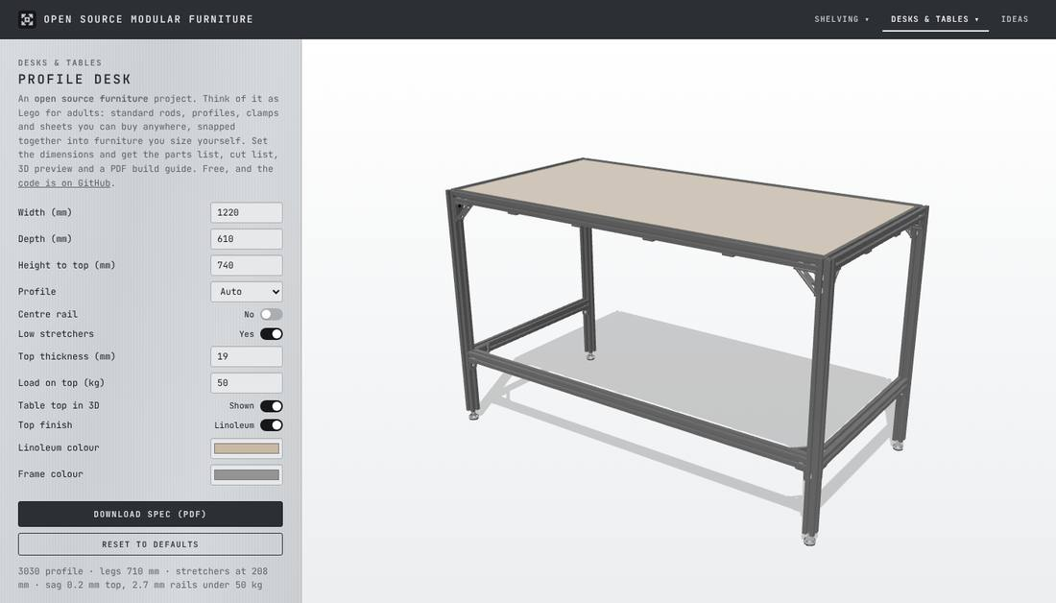
Design furniture with us
How to contribute to Open Source Modular Furniture with the Claude desktop app. No coding needed: you design, Claude builds.
Notes:
This deck walks through how you, as an industrial designer, can change the site or add a new piece using the Claude desktop app, without writing code. Claude writes the code; you make every design decision.

Slide 2
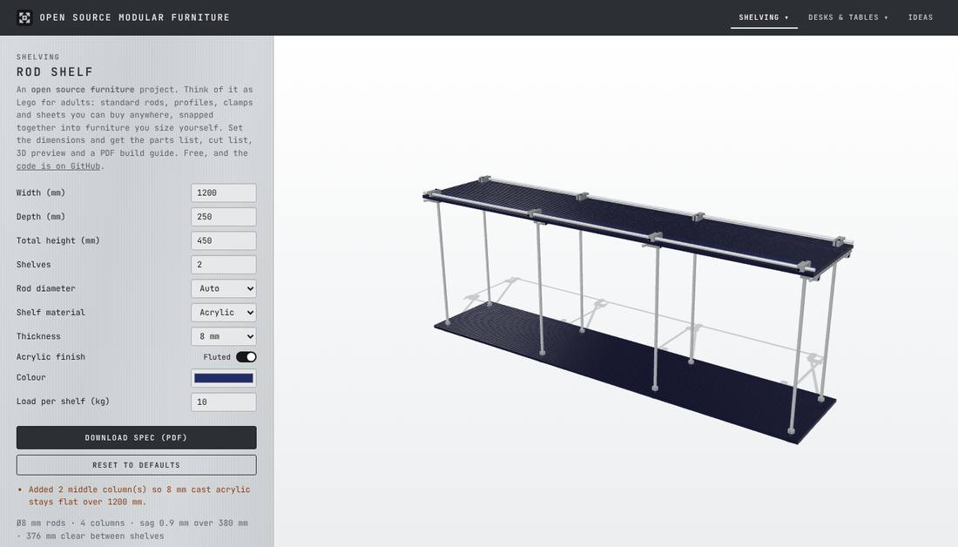
Lego for adults, sized by anyone
Standard parts you can buy anywhere, snapped together into furniture people size themselves. Each piece is a page on the site, picked from the top menu: a configurator.
Rod shelf: chrome rods, cross clamps, acrylic or wood sheets
Profile desk: T-slot aluminium, brackets, plywood top
Notes:
Live at mfprado.github.io/open-source-modular-furniture. A contribution adds a new page to the top menu, or improves one of these.

Slide 3
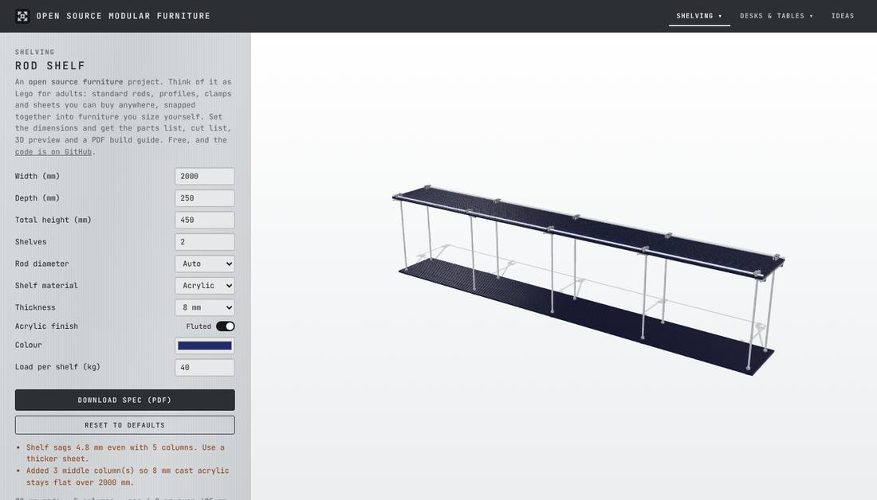
What a configurator gives people
1
Settings
Width, depth, height and options, with sensible limits
2
Rules and warnings
At 2000 mm the shelf adds middle columns and warns it still sags
3
3D preview
Click any part to see what it is and where to buy it
4
Parts list and PDF
Exact quantities, cut lengths and an IKEA-style build guide
Notes:
Real screenshot: the rod shelf at 2000 mm wide with 40 kg per shelf. The rules a designer defines are what make a configurator useful.

Slide 4
What is a pull request?
A pull request (PR) is a proposed change to the site. It holds everything you changed, and once the owner approves it, that change becomes what everyone sees on the site.
1
2
3
4
Your change
A new piece, an option, a fix
Pull request
The change, wrapped up with screenshots and notes
Owner reviews
Reads it, asks questions, approves
Live on the site
Everyone sees it
Nothing reaches the real site until the owner says yes, so you can't break anything.
Notes:
Think of a PR as a proposal: "here is the change I made, here is how I checked it". The owner reviews it before it goes live.

Slide 5
The goal: try it first
1
2
3
4
See it
Claude runs a private copy of the site on your computer. Not the real one.
Try it
Open it in your browser and use it like a visitor would.
Improve it
Tell Claude what to change, in plain words. Refresh, look again.
Send it
When you're happy, Claude creates the pull request.
↻ Repeat 2 and 3 as often as you like
This private copy is a "non-production" version: production is the real site everyone uses.
Notes:
The whole process is a loop: see, try, improve by talking, and only when you are happy does a pull request get created.

Slide 6
You design, Claude builds
You, the designer
Claude, in the desktop app
What the piece is and how it looks
Which real parts to buy, and their sizes
How it goes together, step by step
What people can change, and the limits
Saying "yes, that looks right" or "move this"
Runs the private copy of the site for you
Writes the code and the tests
Shows you what changed after every round
Saves versions as it goes
Creates the pull request
Notes:
No terminal, no code editor. Everything happens in a chat in the Claude desktop app.

Slide 7
Before you start, once
1
A GitHub account
Free, at github.com/signup. GitHub is where the project lives.
2
The Claude desktop app
Download it from claude.ai/download, install it and sign in.
That's all the setup. Everything else (downloading the project, running the site, your own copy on GitHub) is prepared, and Claude does it for you.
Notes:
If something is missing on the computer, Claude checks and gives exactly one link to install it. Signing in to GitHub is the one thing you do yourself.

Slide 8
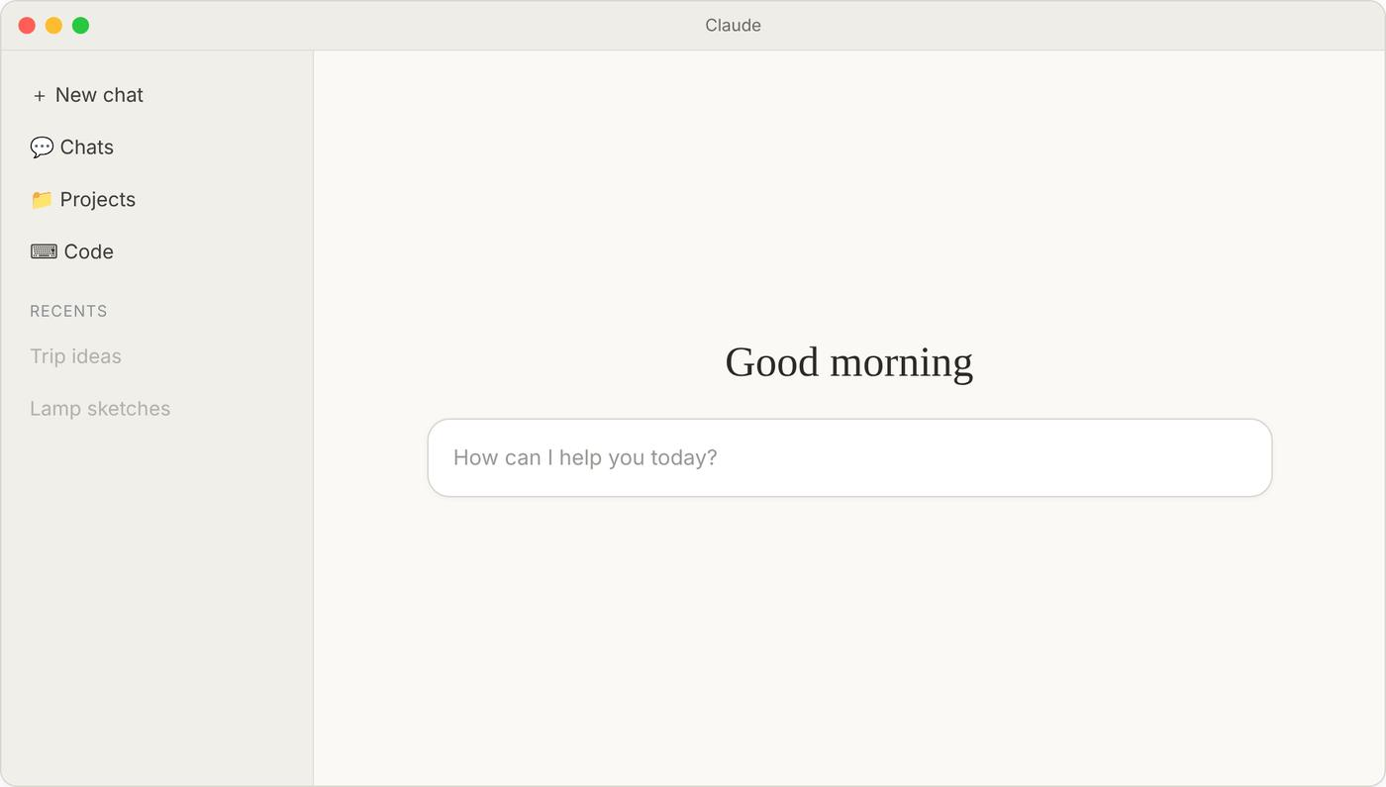
Step 0: open the Claude app
ILLUSTRATION
0
Open Claude
Open the Claude desktop app from your Applications (Mac) or Start menu (Windows), and sign in if asked.
Notes:
Illustration of the Claude desktop app home screen; your app may look slightly different.

Slide 9
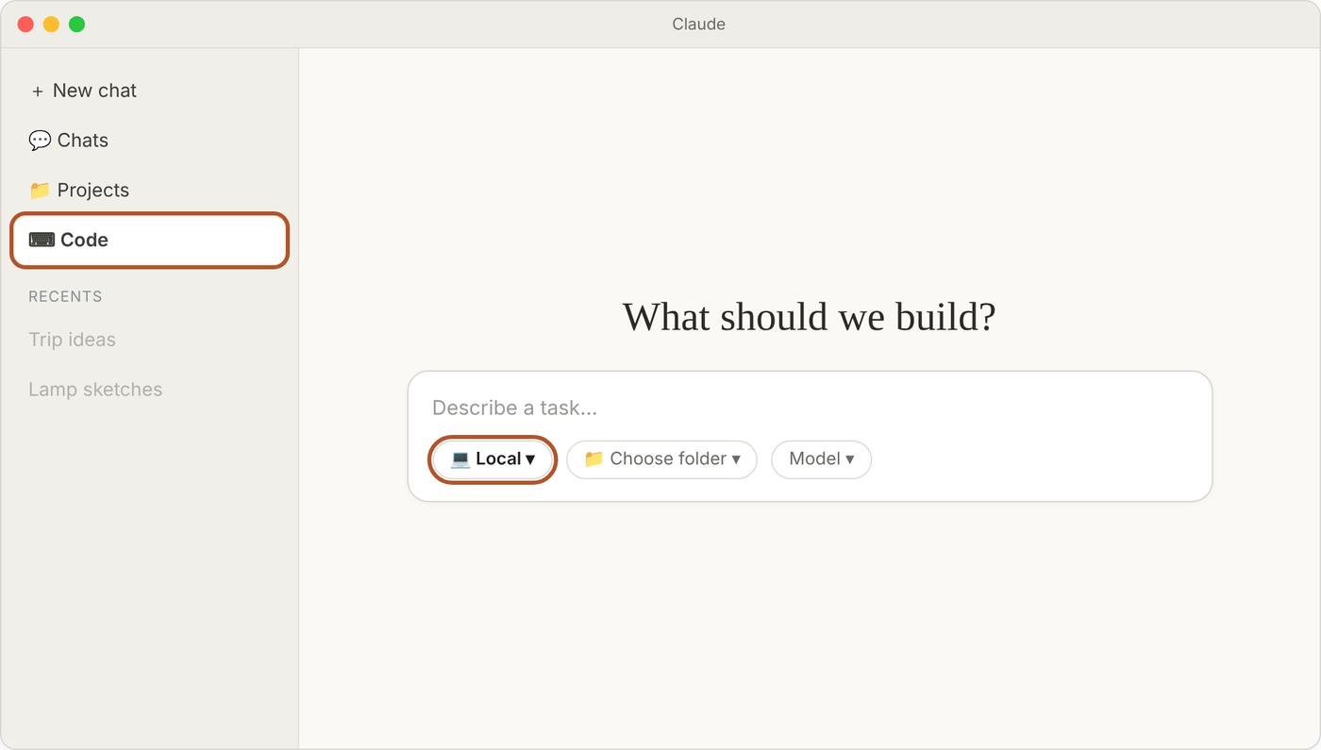
Step 1: Code, then Local
ILLUSTRATION
1
Click Code, pick Local
In the sidebar, click Code. Under the message box, set the environment to Local: Claude then works on your computer, so the site opens in your own browser.
Notes:
Illustration. Local matters: a Cloud session runs on Anthropic's computers, and then the private copy of the site would not open in your browser.

Slide 10
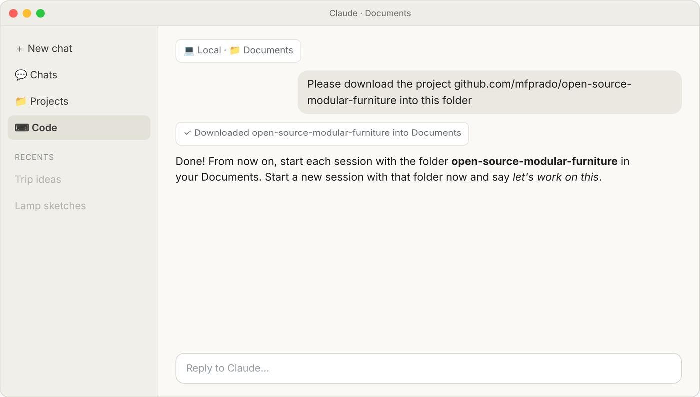
First time only: get the project
ILLUSTRATION
1×
Claude downloads it
Choose your Documents folder and ask Claude to download the project. Do this once; afterwards the project lives in Documents.
Notes:
Illustration. Claude needs Git for this; if it is missing, Claude gives you the one link to install it.

Slide 11
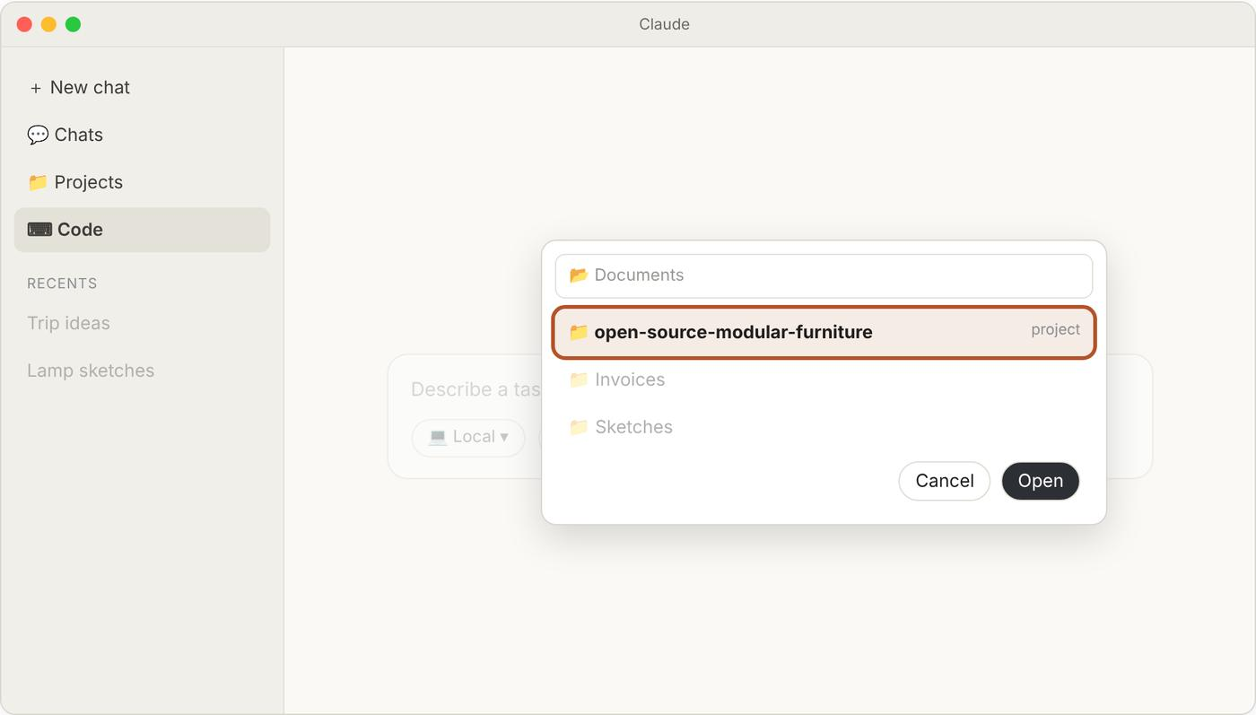
Step 2: choose the project folder
ILLUSTRATION
2
Pick the folder
Click Choose folder and pick open-source-modular-furniture in your Documents. Do this at the start of every session.
Notes:
Illustration of the folder picker. Everything Claude needs (instructions, how to start the site) is inside this folder.

Slide 12
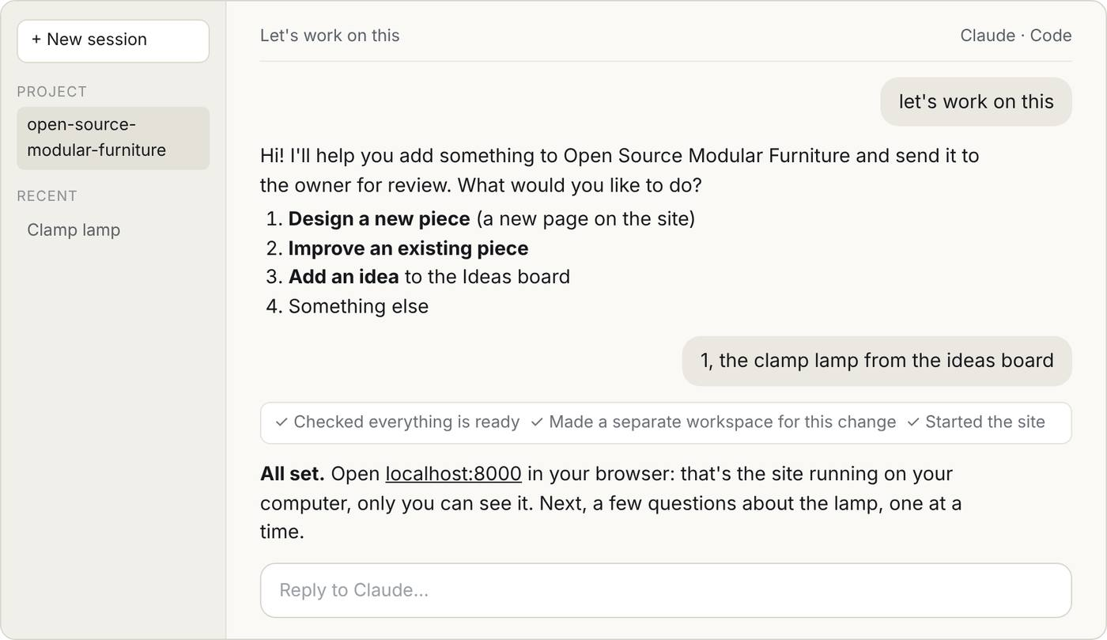
Step 3: say "let's work on this"
SIMULATED EXAMPLE
Everything is prepared
The project carries step-by-step instructions for Claude, so it knows how to guide you.
It asks what you want
Design a new piece, improve one, add an idea, or something else.
It starts your private copy
And tells you where to open it.
Notes:
Simulated conversation; exact wording will vary. The instructions Claude follows live in the project itself (the contribute skill), so every session works the same way.

Slide 13
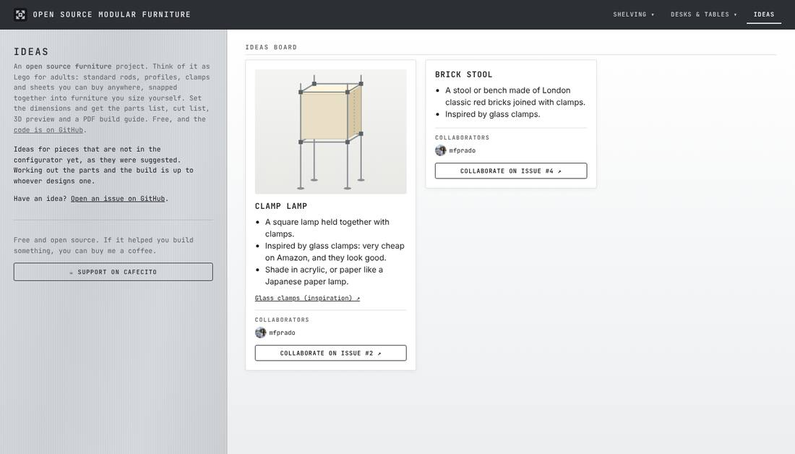
Not sure what to make?
The Ideas page (top bar, right) lists pieces nobody has designed yet, each with an open GitHub issue.
Pick one, or bring your own.
Tell Claude which one; it reads the issue and its pictures.
Notes:
The clamp lamp (issue 2) is the idea used in the simulated examples.

Slide 14
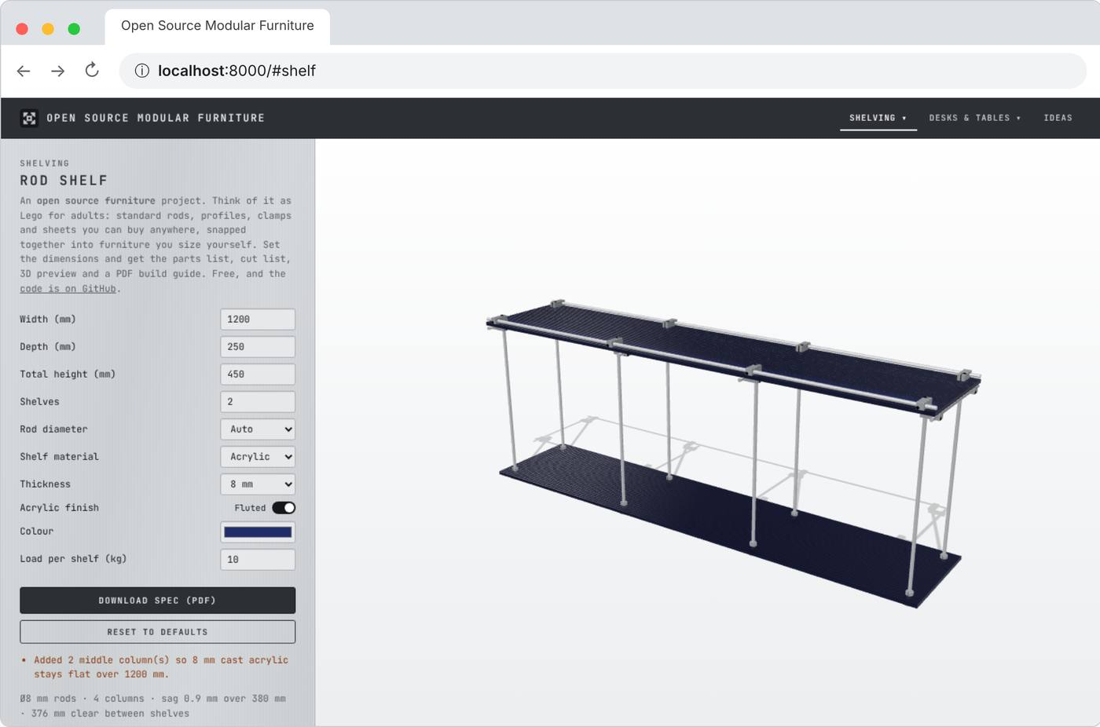
Your private copy of the site
The real site
mfprado.github.io/…
Production: the shop window. Everyone sees it. It only changes after the owner approves.
Your private copy
localhost:8000
Non-production: the prototype on your workbench. Only on your computer, and it shows your changes straight away.
Notes:
Real screenshot of the site in a browser at localhost:8000. "localhost" just means "this computer"; 8000 is the door number Claude opened it on. Breaking something here cannot break the real site.

Slide 15
Open it in Chrome, in three moves
1
2
3
Claude starts it
At the start of the session. Keep the chat open: closing it switches the copy off.
Type localhost:8000
Open Chrome, click the address bar at the top, type localhost:8000 and press Enter.
Refresh after each change
Press Cmd+R on a Mac or Ctrl+R on Windows to see what Claude just changed.
"This site can't be reached"? The copy is switched off. Nothing is broken: just ask Claude to start the site again.
Notes:
If Chrome says the site cannot be reached, the private copy is not running, usually because the session was closed. Ask Claude to start it again. The same site can also show inside the Claude app: press Cmd+Shift+B (Mac) or Ctrl+Shift+B (Windows) for its Browser pane.

Slide 16
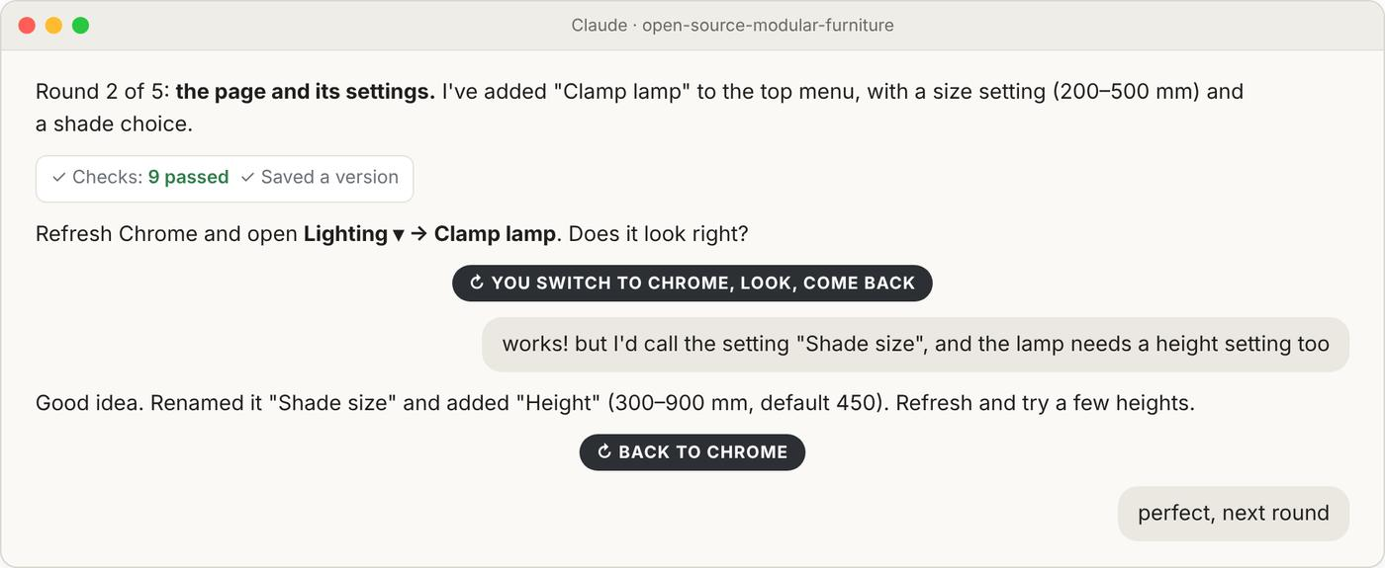
Work in rounds: chat, look, repeat
SIMULATED EXAMPLE
Claude makes one change
And tells you exactly where to look.
You switch to Chrome
Refresh, try it, come back to the chat.
You say what you think
In plain words: "rename this", "add a height setting", "perfect".
Each round is saved, so nothing is lost if you change your mind.
Notes:
Simulated round for the clamp lamp. A new piece usually takes five rounds: parts list, page and settings, 3D model, part info, PDF guide.

Slide 17
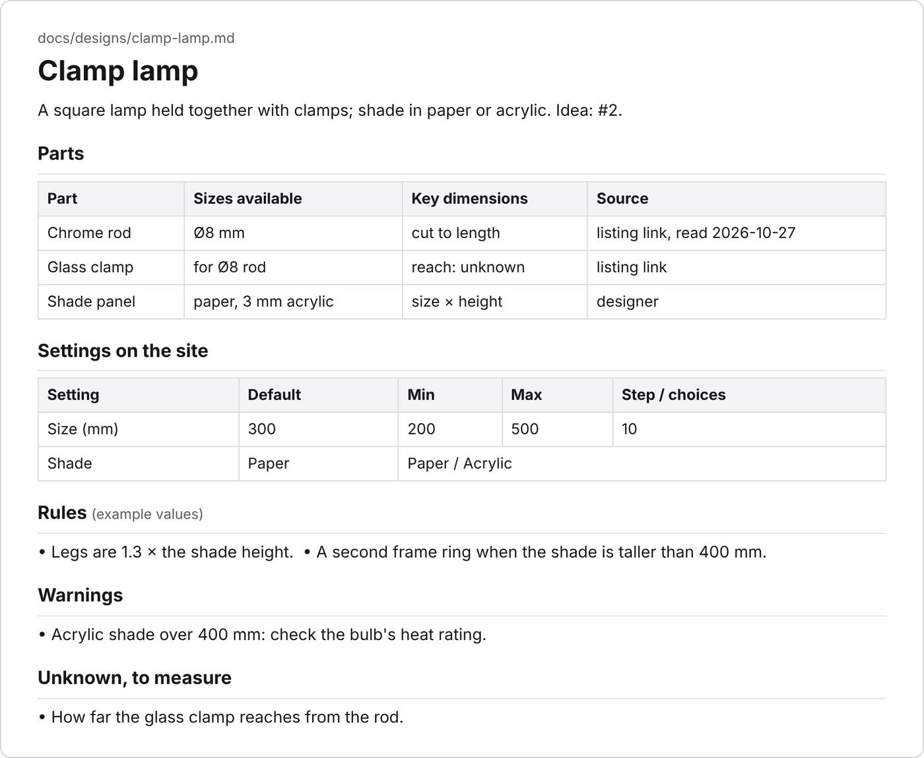
New piece? It starts with a brief
SIMULATED EXAMPLE
An interview first
Claude asks one question at a time: parts, sizes, how it goes together, what people can change.
Written down as a brief
You approve it before anything is built.
Unknown means unknown
Any size not on a listing goes on a "to measure" list.
Notes:
Simulated brief for the clamp lamp; the rule values are examples. The brief is also the first thing the owner reviews.

Slide 18
Before sending: try it all
✓
Smallest and largest sizes
✓
Each option on and off
✓
Make each warning appear
✓
Click parts in the 3D view
✓
Find it in the top menu
✓
Download and read the PDF
✓
Shelf and desk still work
✓
Narrow window, like a phone
Real example: making a warning appear (2000 mm wide, 40 kg)
Found something odd? Tell Claude, refresh, check again.
Then Claude runs its own checks and takes the screenshots for the pull request.
Notes:
Claude reads this list out one item at a time and waits for your answer.

Slide 19
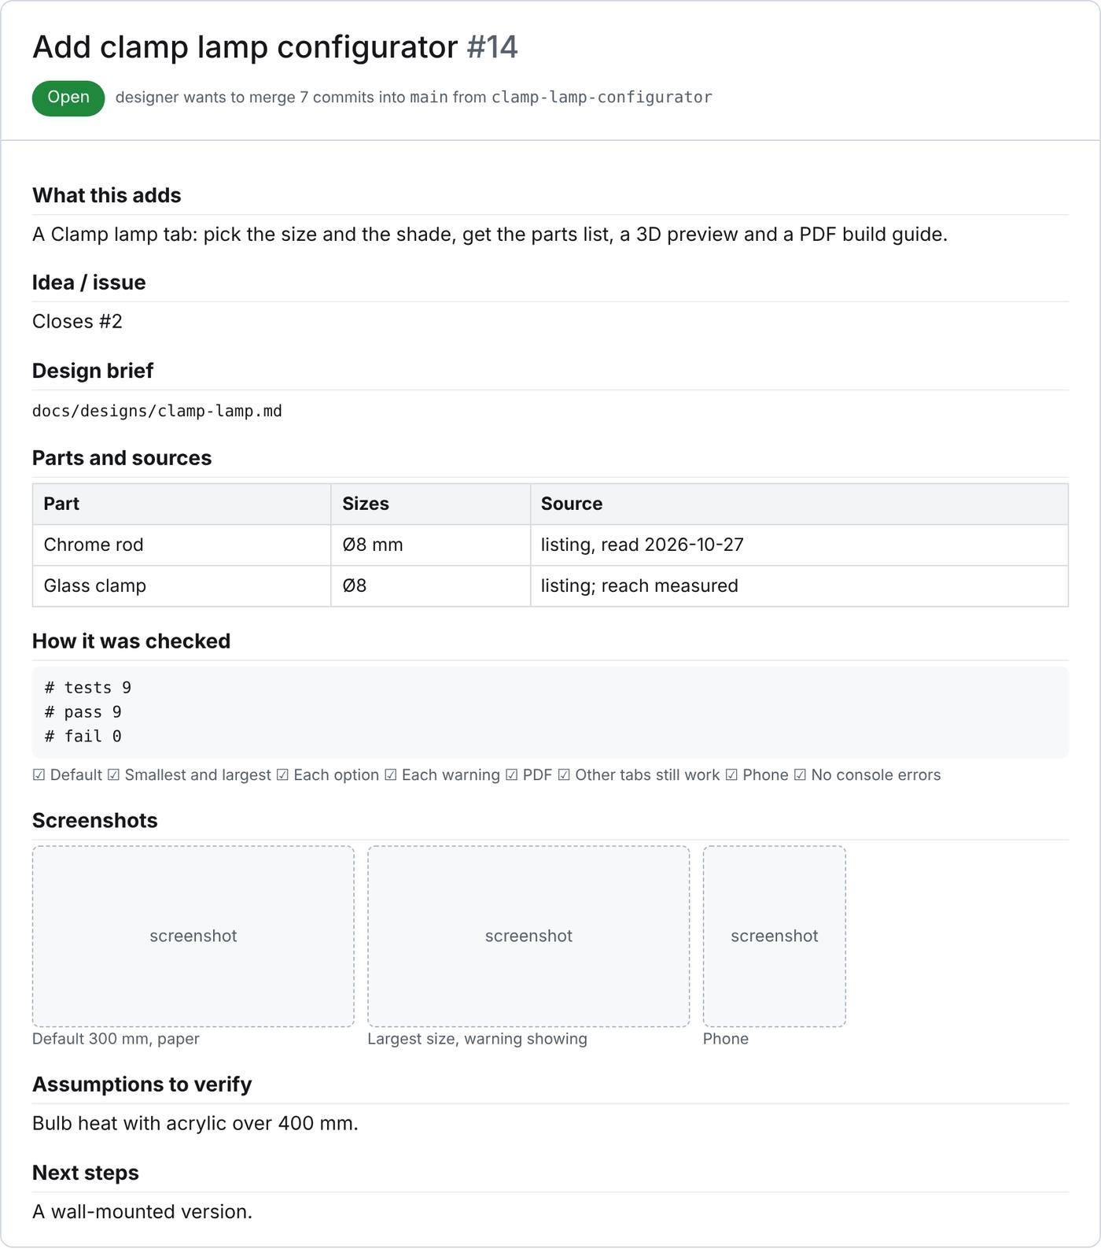
Last step: Claude creates the PR
SIMULATED EXAMPLE
When you say "I'm happy, let's send it", Claude writes the pull request in a standard shape:
What this adds
Idea / issue
Design brief
Parts and sources
How it was checked
Screenshots
Assumptions to verify
Next steps
Your one job: drag the screenshots into it on GitHub.
Notes:
GitHub only accepts images uploaded through the page, which is why the screenshots are the one manual step.

Slide 20
After you send it
1
2
3
4
Owner reviews
Starting with the brief
Comments
Questions or changes
Ask Claude
"let's work on the review comments"
Merged
Your piece is live
Changes go on the same pull request: open Code again (Local, the project folder), and Claude picks up the comments.
Notes:
If the piece came from an idea, the pull request closes that idea issue when merged, and the card leaves the Ideas board because the piece now has its own page.

Slide 21
Three things to say
"let's work on this"
"I'm happy, let's send it"
Claude app → Code → Local → folder open-source-modular-furniture, then:
"let's work on the review comments"
Notes:
That is all you need to remember. Start each one in a new session in the Code section, with the project selected.

