Slide 1
Firm collaboration: exploratory analysis of FVG companies network
M. Franzon T. Rodani

Slide 2
TABLE OF CONTENTS
01
02
03
04
DATASET
NETWORK
COMMUNITIES
SIMULATION
Descriptive analysis
Exploratory analysis
Detection on two subnetworks
ERG modeling and GOF evaluation

Slide 3
01
DATASET
Firm collaborations between companies in FVG

Slide 4
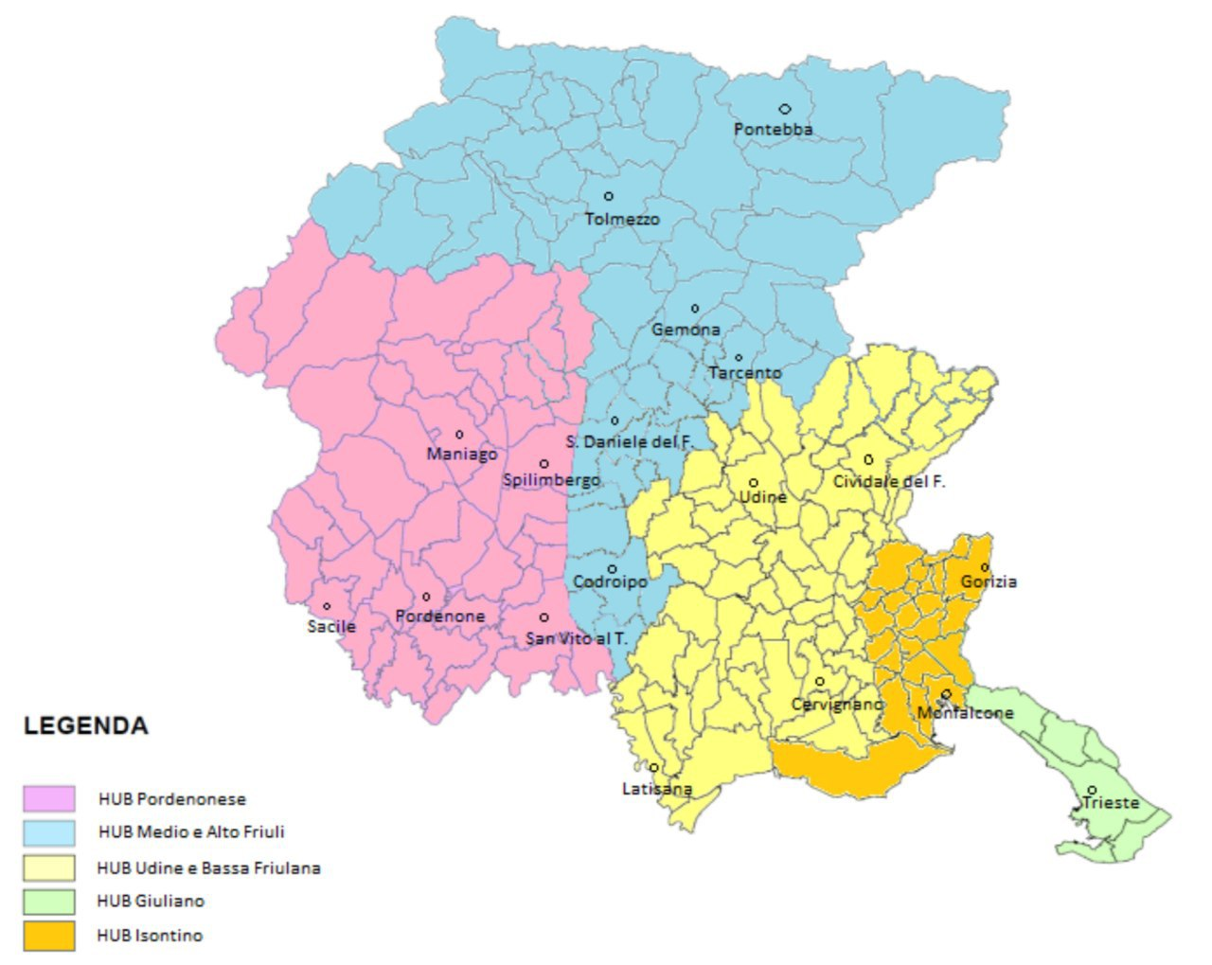
DATASET
ATECO, the national version of the EU NACE, a statistical classifications of economic activities.
SLL, the national version of the EU Labour Market Areas (LMAs). LMAs are sub-regional geographical areas where the bulk of the labour force lives and works, and are usually different than administrative boundaries
Province, which represent the institutional bodies of second level in the Italian Republic
HUB, which are geographical areas that refers to different venues of ”Agenzia regionale per il lavoro”, the regional agency that offers labour services.

Slide 5
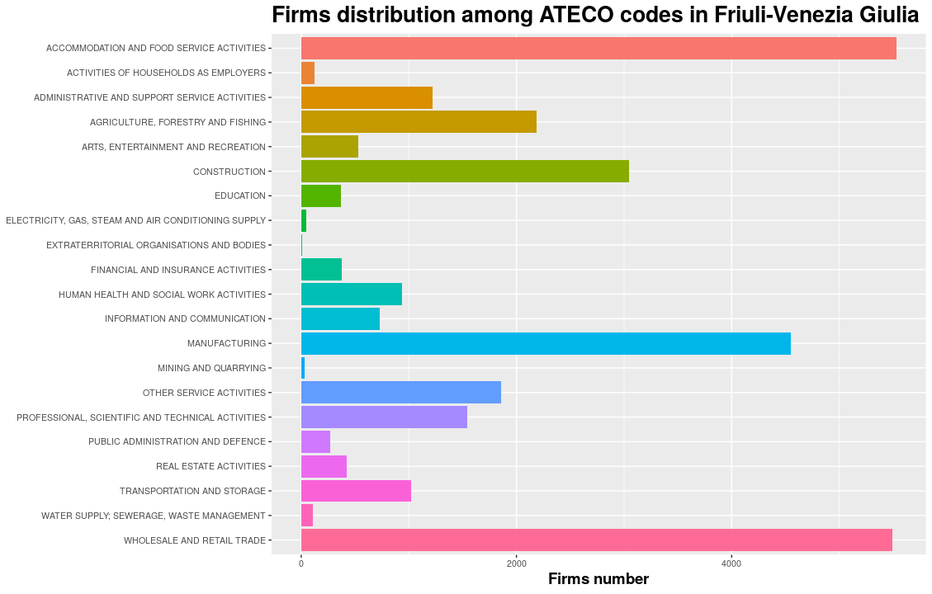
DATASET ATECO
Unbalance towards food services, retail and manufacturing

Slide 6
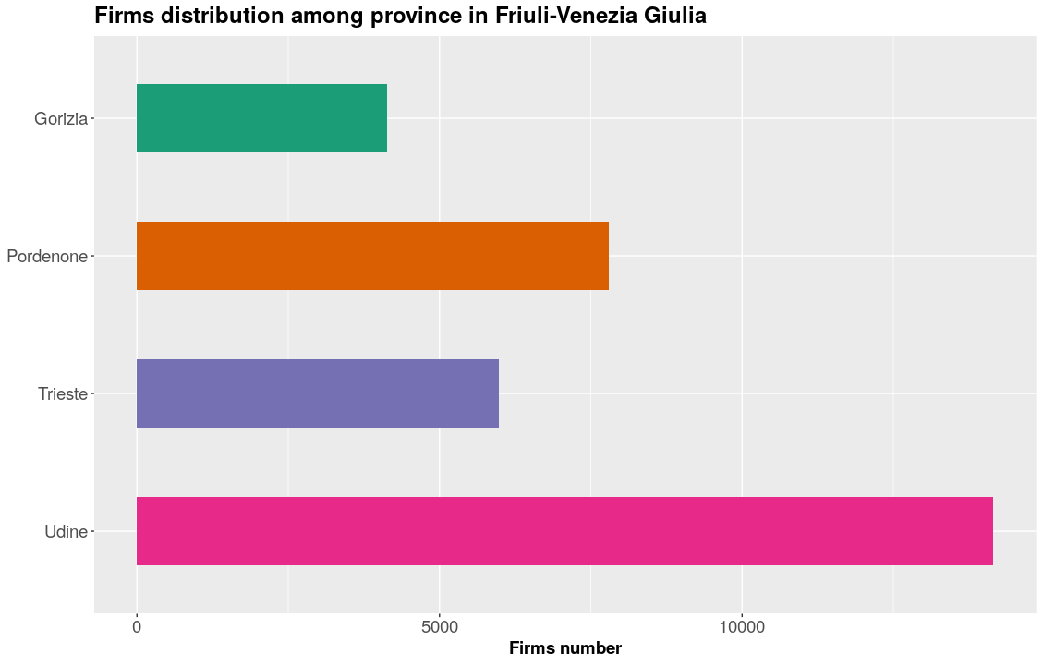
DATASET PROVINCE
Most of the firms are located in Udine province, which is the most populated

Slide 7
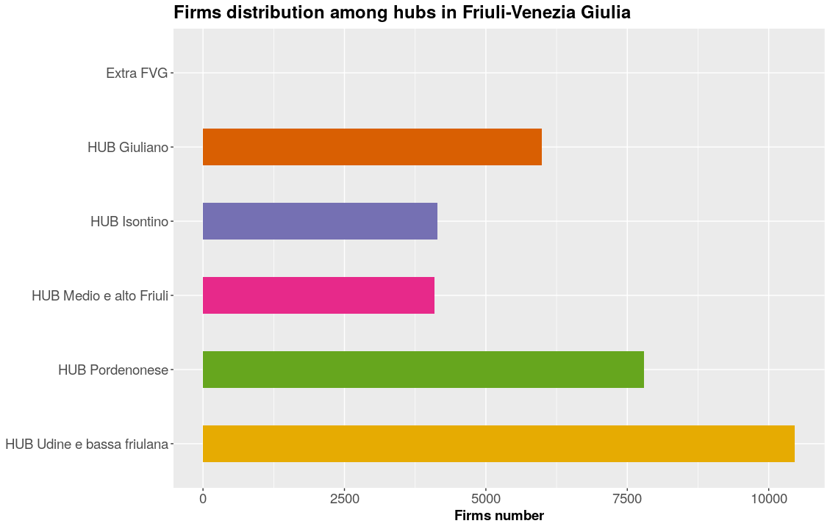
DATASET HUB
Extra FVG has only two firms

Slide 8
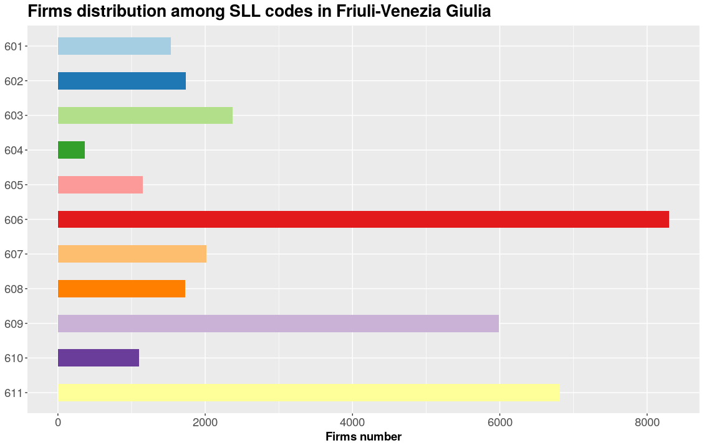
DATASET SLL
606 stands for Udine; 611 for Pordenone and 609 for Trieste

Slide 9
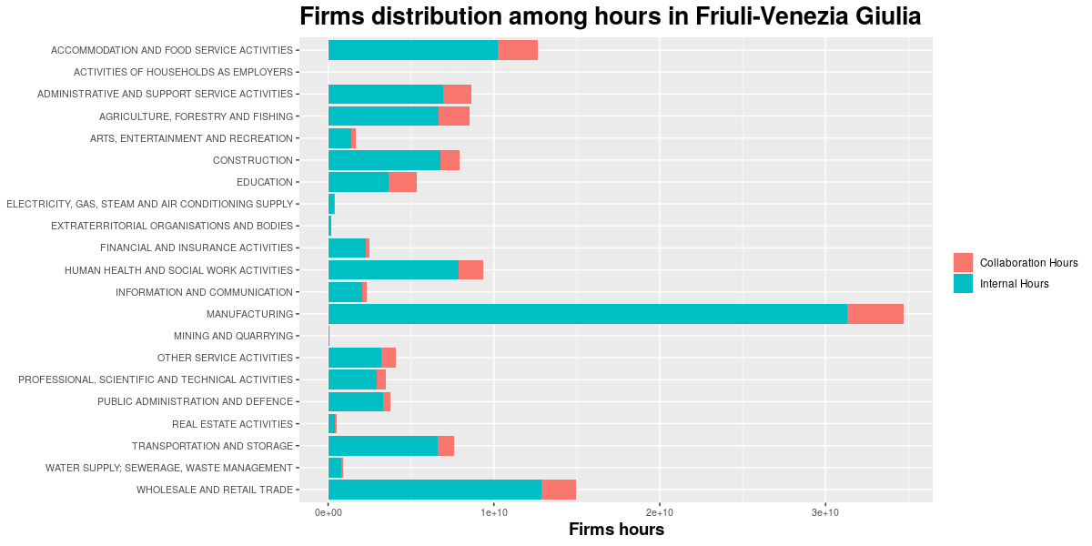
DATASET HOURS
There is an unbalance toward manufacturing, that is the 3th for number of firms.

Slide 10
CLEANING PROCESS
ATECO
HOURS
ISOLATES
Inexistent or more than one code
Lower than a threshold of 1760
Firms without collaborations

Slide 11
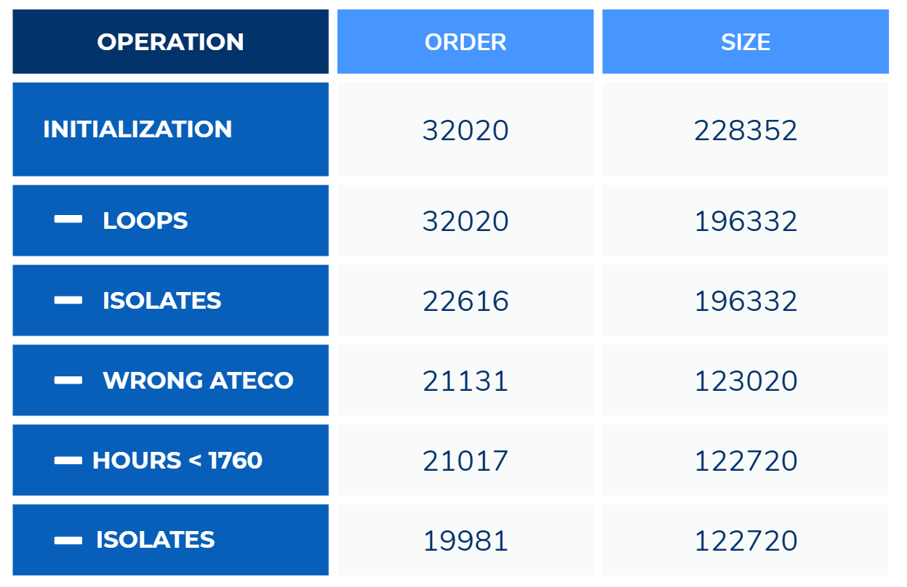
CLEANING PROCESS
OPERATION | ORDER | SIZE
INITIALIZATION | 32020 | 228352
LOOPS | 32020 | 196332
ISOLATES | 22616 | 196332
WRONG ATECO | 21131 | 123020
HOURS < 1760 | 21017 | 122720
ISOLATES | 19981 | 122720
Step by step cleanup process
Step by step cleanup process

Slide 12
02
NETWORK
Exploratory analysis

Slide 13
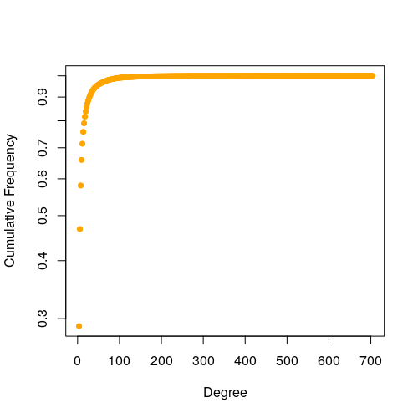
EXPLORATORY ANALYSIS
Full one-mode directed network with mutual weighted arcs
Mutual dyads = N/2, others are null
Density = 0.00031
Sparse network as k ≈ 6n, where k is the number of arcs and n the number of nodes
Degree distribution is right skewed
Centrality measures suggest clustering
 | MEAN | MEDIAN | MIN | MAX
DEGREE | 12.28 | 6 | 2 | 704
CLOSENESS | 1.191e⁻⁰⁵ | 9.661e⁻⁰⁶ | 3.294e⁻⁰⁸ | 5.005e⁻⁰⁵
BETWEENNESS | 5.205e⁻⁰⁵ | 0 | 0 | 0.230

Slide 14
SOCIOMATRIX
Collaboration matrix between firms from different province, aggregated by ATECO code.
Collaboration are dichotomized, so ij is the sum of the number of collaborations between companies of ATECO codes i and j.
Diagonal elements are the number of collaborations between companies of the same category.
Matrix are normalized between 0 and 1 in order to improve readability through the heatmaps.

Slide 15
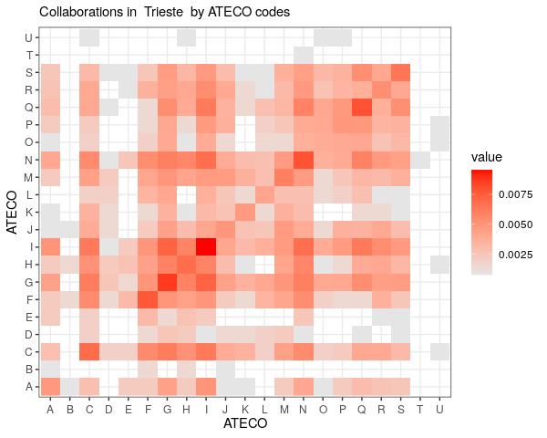
SOCIOMATRIX TRIESTE
Further analysis involved the cell CF, which is the collaboration between manufacturing and construction companies

Slide 16
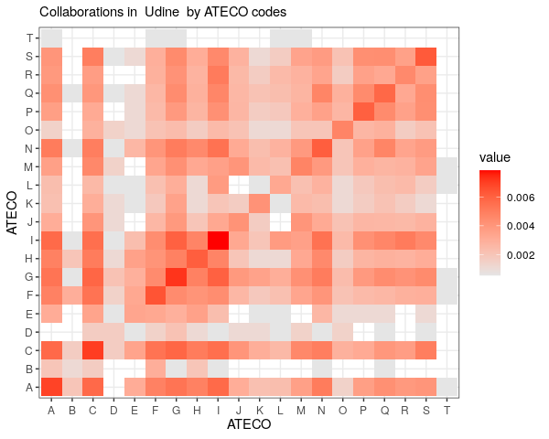
SOCIOMATRIX UDINE
Further analysis involved the cell CG, which is the collaboration between manufacturing and retails companies

Slide 17
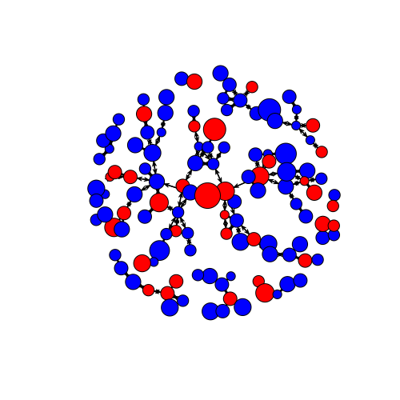
SUBNETWORK TRIESTE
Sparse network
Size = 506
Order = 152
Manufacturing nodes = 47
Construction nodes = 105
Edge density = 0.022
MANUFACTURING
CONSTRUCTION

Slide 18
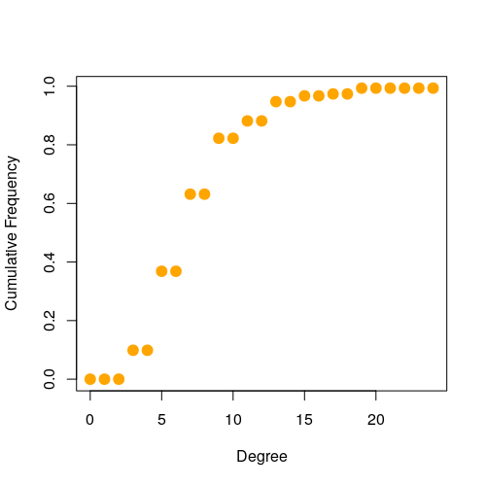
SUBNETWORK TRIESTE
 | MEAN | MEDIAN | MIN | MAX
DEGREE | 6.658 | 6 | 2 | 24
CLOSENESS | 3.581e⁻⁰⁶ | 3.581e⁻⁰⁶ | 8.066e⁻⁰⁷ | 5.286e⁻⁰⁶
BETWEENNESS | 0.049 | 0.013 | 0 | 0.572

Slide 19
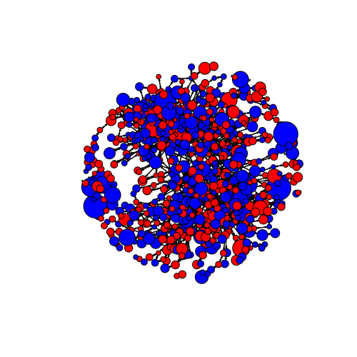
SUBNETWORK UDINE
Sparse network
Size = 5996
Order = 927
Manufacturing nodes = 456
Retail nodes = 471
Edge density = 0.007
MANUFACTURING
RETAIL

Slide 20
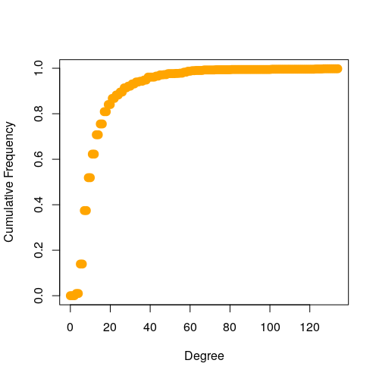
SUBGRAPH
UDINE
 | MEAN | MEDIAN | MIN | MAX
DEGREE | 12.94 | 8 | 2 | 134
CLOSENESS | 1.011e⁻⁰⁵ | 1.124e⁻⁰⁵ | 1.124e⁻⁰⁵ | 1.508e⁻⁰⁵
BETWEENNESS | 0.011 | 3.666e⁻⁰⁴ | 0 | 0.366

Slide 21
03
COMMUNITIES
Walktrap and Louvain algorithms
Notes:
Now we talking about the algorthm used for community detection and our results on the two subgraph of Udine and Trieste

Slide 22
COMMUNITIES DETECTION
WALKTRAP
LOUVAIN
This method runs short random walks of few steps and uses the results of these random walks to merge separate communities in a bottom-up manner.
computation time is O(n²log(n))
Looks for ”small” communities by optimizing modularity in a local way, it aggregates nodes of the same community and repeats iteratively until a maximum of modularity is attained.
computation time is O(n²log(n))
Notes:
The two algorithm that we use are walktrap and louvain.. Walktrap is a random walks approach which runs short random walks from 3 to 5 steps to merge separate communities in a bottom-up manner.
Nodes are then assigned into groups with small inter and larger intra-community distances via bottom-up hierarchical clustering. Finally, this algorithm could be used on directed and undirected graph, vicecersa, louvain
Only on undirected ones.
In particular the louvain algorithm is based on two main phases. The first is the optimization of the local modularity defining the number of communities, second is to aggragate nodes of the same community into the same node.
Both algorithm have a computation time of in the best case O(n²log(n)) that is a good compromise for large graphs

Slide 23
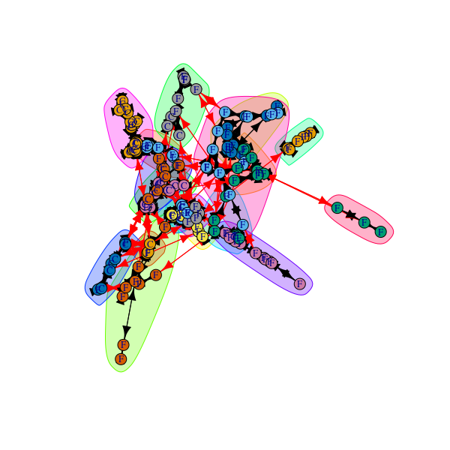
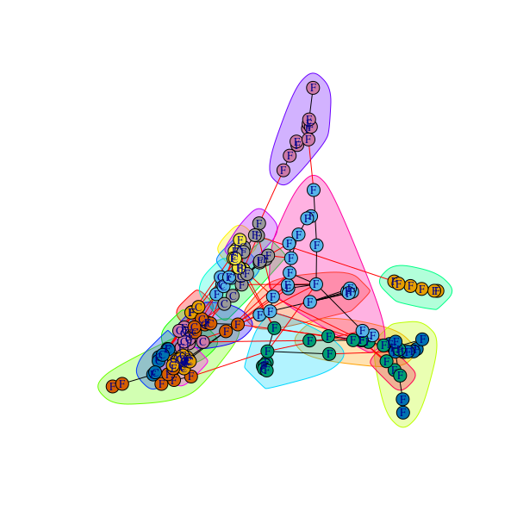
COMMUNITIES TRIESTE
WALKTRAP
LOUVAIN
 | WALKTRAP | LOUVAIN
MODULARITY | 0.848 | 0.863
# COMMUNITIES | 30 | 19
Notes:
This is the results for the subgraph of trieste. Colors suggests the community and each node il labeled with the ateco code.
We use this two algorithm also to compare the performances also in the case in which we trasform the graph into an undirected one.
We can do it without any loss of information, in fact, all the edges are mutual in our case so it is strongly connected so, an approximation to an undirected one could be reasonable
As we can appreciate from the results, the most positive modularity is reached by louvain algorithm

Slide 24
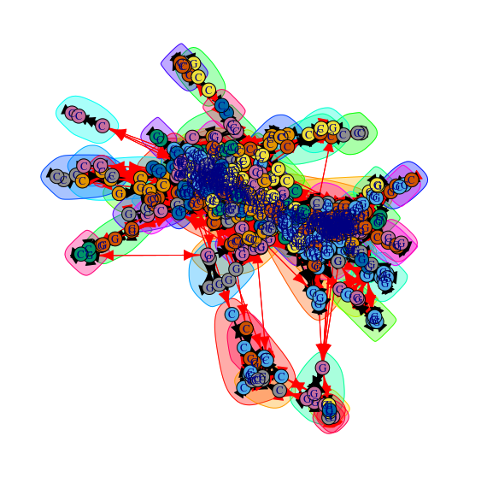
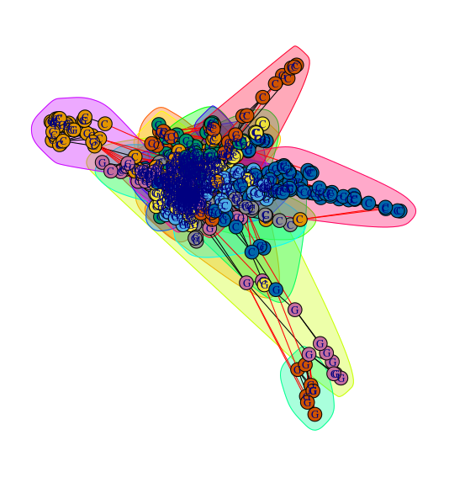
COMMUNITIES UDINE
WALKTRAP
LOUVAIN
 | WALKTRAP | LOUVAIN
MODULARITY | 0.761 | 0.799
# COMMUNITIES | 142 | 35

Slide 25
04
ERG MODELS
Simulation on Trieste and Udine subnetworks

Slide 26
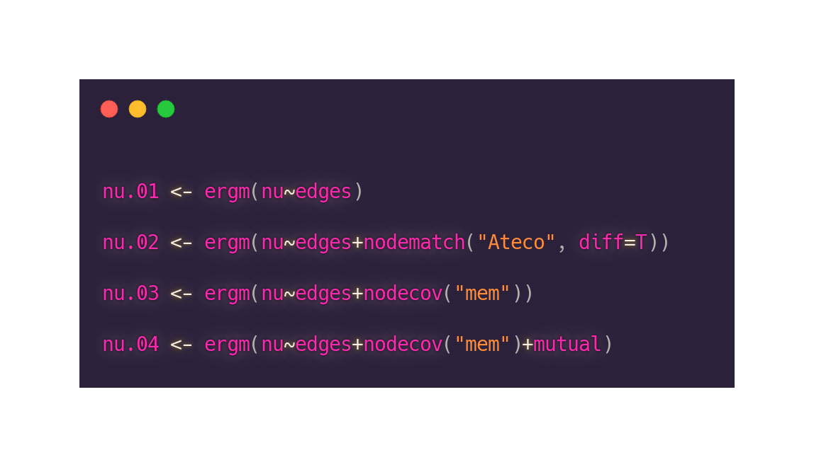
ERG MODELS
baseline model in which only edges are used as covariate
homophily on ATECO codes as factor
extracted memberships from the Louvain clustering method as covariate, which should improve at least the intra-cluster edge placement without overfitting
Mutual parameter, which reproduce the graphs perfectly as mutuality is 1

Slide 27
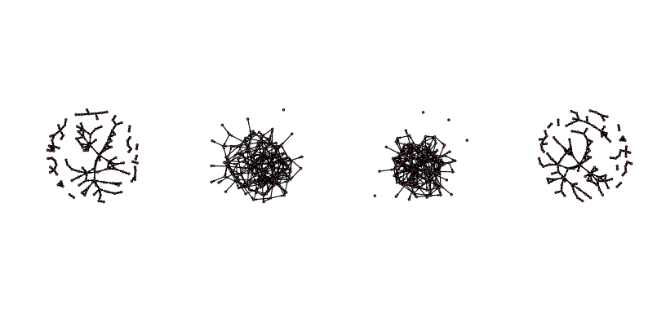
SIMULATIONS
TRIESTE
 | SIMULATION
# | 1 | 2 | 3 | 4
AIC | 2536 | 2539 | 2537 | 1835

Slide 28
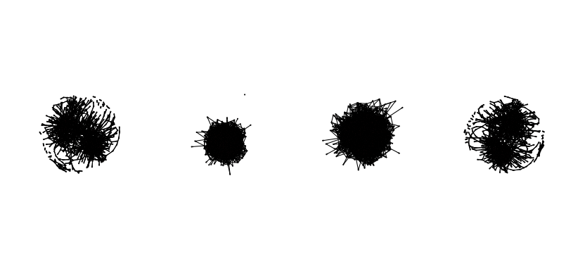
SIMULATIONS
UDINE
 | SIMULATION
# | 1 | 2 | 3 | 4
AIC | 34281 | 34283 | 34285 | 27569

Slide 29
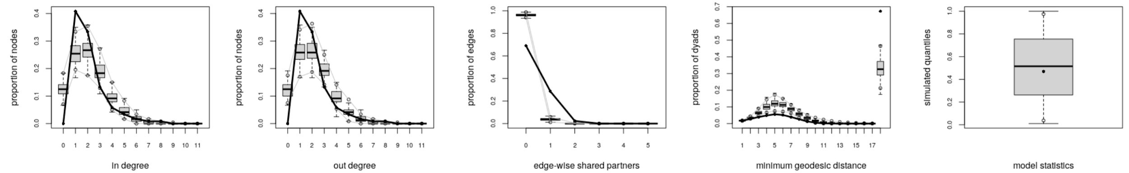
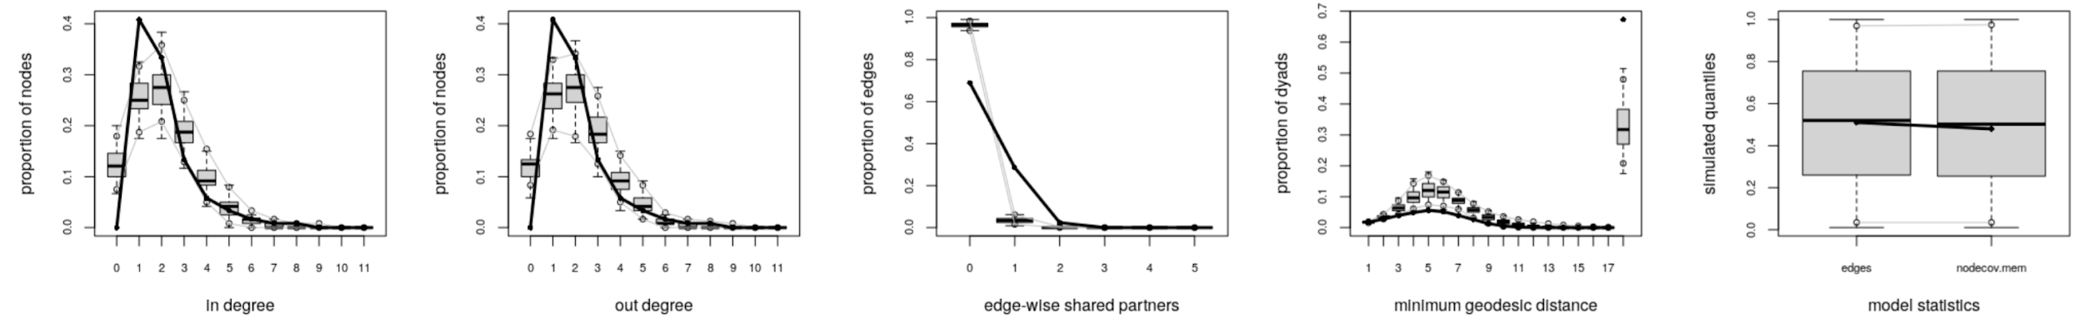
GOF
TRIESTE
EDGES
EDGES, LOUVAIN MEMBERSHIP

Slide 30
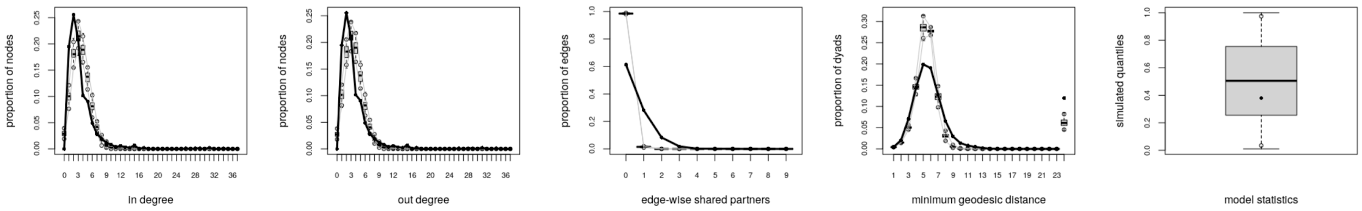
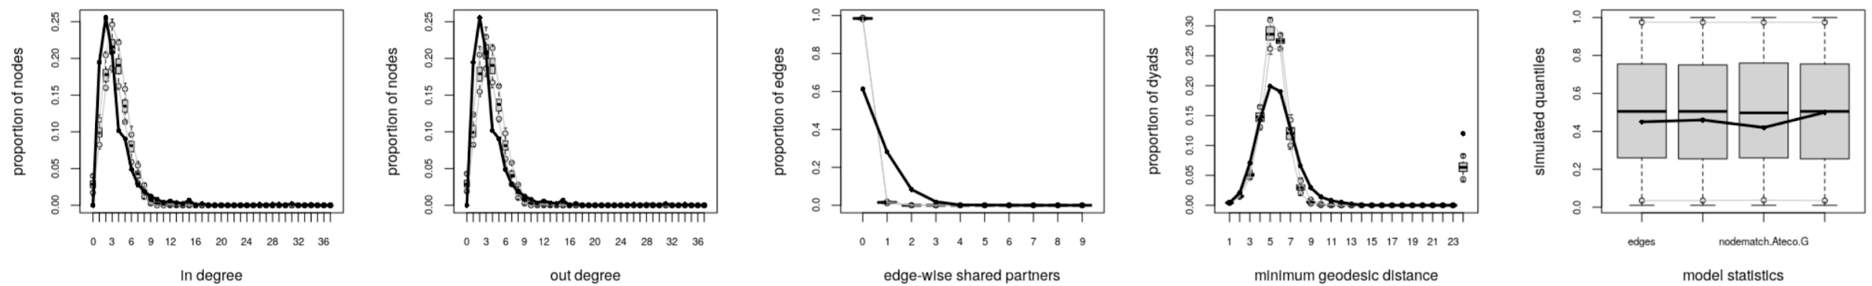
GOF
UDINE
EDGES
EDGES, ATECO HOMOPHILY, LOUVAIN MEMBERSHIP

Slide 31
CONCLUSION
This work shows an approach to understand the relationships between firms of different sectors through their collaboration
The dataset is huge with a lot of information, but also incomplete and should be treated carefully.
Firms tends to collaborate in the same sector as shown in the sociomatrices
Community detection showed good results and a more thorough analysis can expose underlying patterns in companies partnerships

Slide 32
THANK YOU

