Slide 1
Git for Beginner
Trainer:
Huynh Quang Tan (thuynh49)
Vinh Tran (vtran40)
Nguyen Nguyen (nnguyen214)
Course Duration: 3 Hours

Slide 2
Agenda
Version control system
Concept
Different types of system
Application
Git
Characteristic
How it works
Git branch
Q & A
Practice

Slide 3
Course Objectives
At the end of the course, you will have acquired sufficient knowledge to:
Understand Git concepts, tools and workflows
Manage source code on Git repositories
Practice the basic operations on Git

Slide 4
Course Audience and Prerequisite
The course is for freshers and newcomers
The following are prerequisites to this course:
Windows
Computer skills
File management
Teamwork

Slide 5
Version Control Concepts

Slide 6
What is Version Control?
Method to centrally store files
Record a copy per change
Log who, when, where, what
Recover files if something wrong
Also called as revision control / source control

Slide 7
Why Version Control?
Ability to back-up
Integrate sources / sub systems
Collaboration with other people
Troubleshooting
Productivity

Slide 8
How it helps you …
Change code in small steps
Log changes in versions
Feel safe when changing code
Easy to try out things

Slide 9
How it helps team...
Allow team to work on same source base
Handle collision by merging function
Answer who did what
Team work productivity

Slide 10
Version Control System
Tool to manage file changes
Three types
Localized
Centralized
Distributed

Slide 11
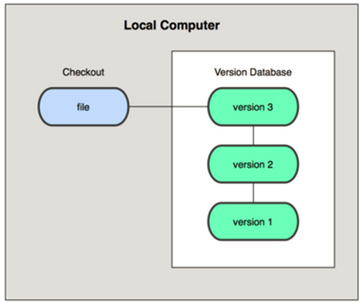
Localized Version Control System
Check out files on Local computer
Notes:
A simple database that kept all the changes to files under revision control

Slide 12
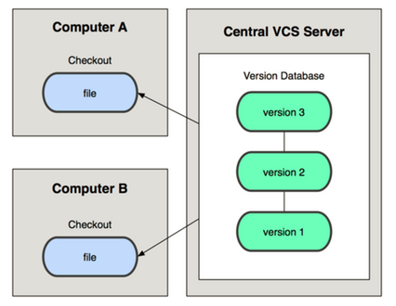
Centralized Version Control System
Check out files from Remote server
Notes:
People needed to collaborate with developers on other systems - a single server that contains all the versioned files. e.g. CVS, Subversion, Perforce
If the server goes down, nobody can collaborate or see different versions.
If the drive in the server is corrupted, everything is lost.
GIVE EXAMPLES

Slide 13
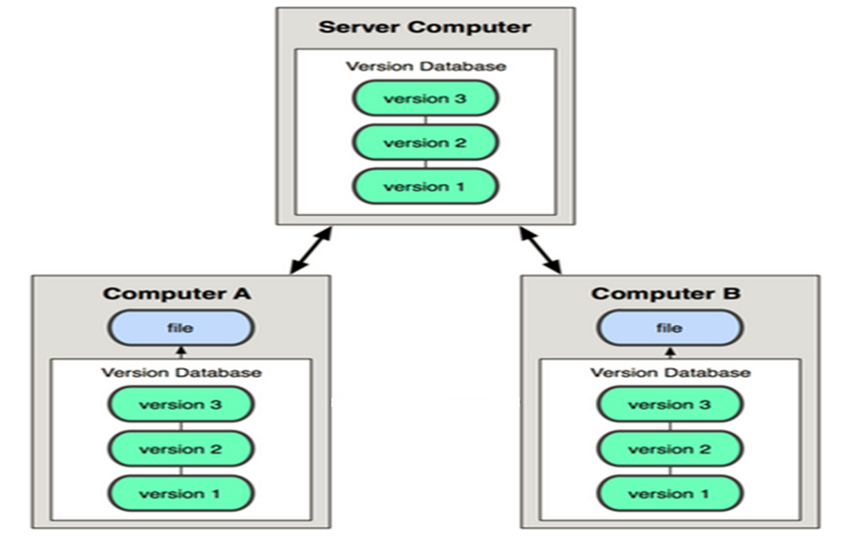
Distributed Version Control System
Check out files from Server or from peer
Notes:
Clients fully mirror the repository. Thus if any server dies, and these systems were collaborating via it, any of the client repositories can be copied back up to the server to restore it. Every checkout is really a full backup of all the data.
THIS IS GIT

Slide 14
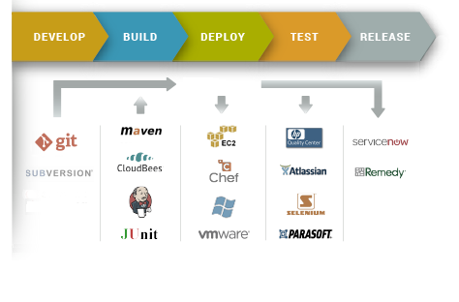
Version Control in Real World
Continuous Integration (CI) process

Slide 15



Slide 16
Git
Distributed Version Control System
Multiple redundant repositories
Each dev environment has a copy of repositories & history
One of the most popular Source Code Management System
Reference at https://git-scm.com/

Slide 17
Why Git?
Distributed Version Control System
Work offline
Easy branches switching
Best branching & merging mechanism
Free Opensource

Slide 18
Git Basics

Slide 19
Preparation
PCs with Git and TortoiseGit installed and Git account setup in advance
Download Git: https://git-scm.com/downloads
Download TortoiseGit: https://tortoisegit.org/download/
Register GitHub Accounts on https://github.com/ for each PC
Clone Source Code from Github repositories to local PC
Repository for Training:

Slide 20
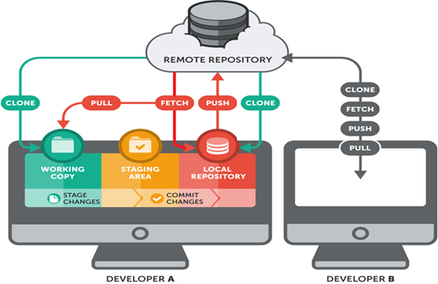
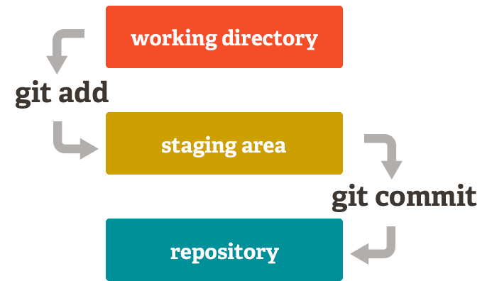
Code flows in Git

Slide 21

Three stages of Git – Working directory
Create: create a new file
Modify: modify content of a file
Delete: delete a file
Specials:
Move or rename: delete an existing file and create a new copied file.

Slide 22

Three stages of Git – Staging area
Stores a set of changes in the previous stage that will be formed into a commit. Actions:
Add changes to upcoming commit
Remove changes from upcoming commit
(Mark/Ignore changes that will not be committed)

Slide 23

Three stages of Git – Committed to Repository
After committed, a revision is recorded to Git repository, characteristic:
A SHA-1 hash is generated, attached to new commit
It is not simple as ordinal number, or a pattern that people can remember easily
Additional information will be needed to identify a specific commit:
Which file(s) changed
Who changed
When it is changed
MOST IMPORTANT: Commit message – must be clear
Purpose of the change
Change for which request
Which branch the revision belongs to, or headless

Slide 24
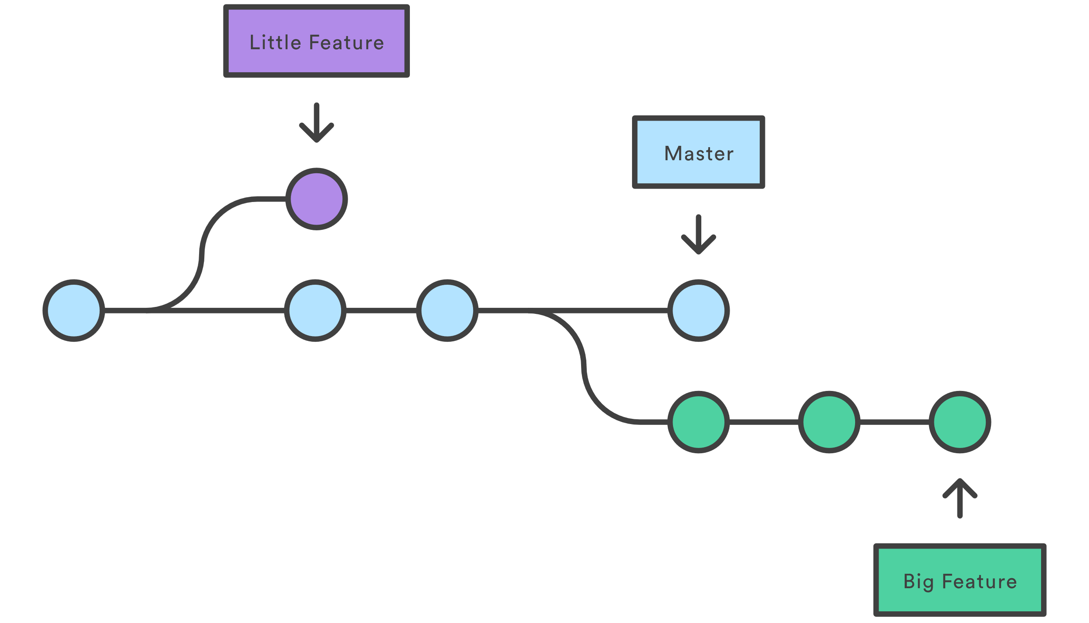
Branches on Git
What is branch?
A branch is a pointer to the commits
The default branch name is master
Notes:
Why branch?

Slide 25
Merging
Merging
Combine two branches i.e.: master and test
Command on master branch (show GUI example)
Managing branches
Show branches with command (show GUI example)

Slide 26
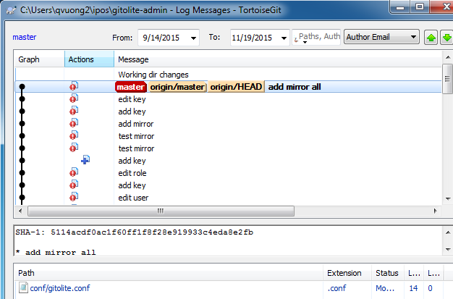
Git Basics - Viewing the Commit History (with the aids of a GUI tool)
How to view history
Limit log output
Use GUI to visualize history

Slide 27
Questions & Answer

Slide 28
Showcases
Github vs Github Enterprise – log in and credentials
Repository on web and cloned to a working directory
Commit changes
View logs
Create a branch
Create and check out a new branch
Switch to an existing branch
Checkout branch
Merge branches

Slide 29
Practice

Slide 30
Basic Exercises
Register GitHub account on https://github.com/ (Final project Github Repos)
Creating GitHub Repos
Download and Install TortoiseGit
Clone code (recursive) from GitHub Repos to local PC
Create new code files in the cloned repo.
Add and commit new code files to remote repo.
Push new code files (with ticket# message) to GitHub.
Create GitHub Branches
Push new code files to GitHub Branches
Merge/rebase code between branches
Fork and Clone code files from other account’s GitHub Repos
Create pull request to other account’s GitHub Repos
Add collaborators to GitHub Repos
Revert/Reset code to previous commit

Slide 31
Basic Exercises
Register GitHub account on https://github.com/ (Final project Github Repos)
Creating GitHub Repos
Download and Install TortoiseGit
Clone code (recursive) from GitHub Repos to local PC
Create new code files in the cloned repo.
Add and commit new code files to remote repo.
Push new code files (with ticket# message) to GitHub.
Create GitHub Branches
Push new code files to GitHub Branches
Merge code between branches
Notes:
Why clone recursive?

Slide 32
Thank You!

Slide 33
Revision History
Date | Version | Description | Updated by | Reviewed and Approved By
Aug 10, 2015 | 0.5 | Ready for review | Thien Tran | Quang Tran
Nov 26, 2015 | 1.0 | Ready for review | Quan Vuong | Quang Tran
Aug 2017 | 2.0 | Retheme with DXC template |  | Quang Tran
July 2019 | 3.0 | Updating contents with Gihub and Study Cases | Huynh Quang Tan
Oct 2019 |  | Revise content to meet organization needs | Vinh Tran

