Slide 1
R Bootcamp: R Projects and {here}
August 23-24, 2021

Slide 2
Learning Objectives
Describe the benefit of organizing files by course/project
Set up the working directory in R
Understand file paths
Understand what an R Project is
Describe the advantages of using R Projects for your data analytics workflow
Understand how to use the here() function in locating files

Slide 3


Readings
Project-oriented workflow by Jenny Bryan and Jim Hester
Workflow: projects in R for Data Science
Why should I use the here package when I’m already using projects by Malcolm Barreett

Slide 4
Working directory
“The working directory is just a file path on your computer that sets the default location of any files you read into R, or save out of R.” ¹
In R, you can only have one working directory at any point in time.
¹ https://bookdown.org/ndphillips/YaRrr/the-working-directory.html

Slide 5
Working directory
To print your current working directory, you use getwd()
This file path means that if I ask R to import a dataset (or export a file out of R), it will look for that file (or export a file) in the mfredataportal folder I have saved in the mfre folder in my Desktop.

Slide 6
setwd()
You can change your working directory using the setwd() function
For example, if I want to change the working directory from the mfredataportal folder in my Desktop to summerbootcamp folder, I will run the following code
setwd("C:/Users/krishlim/OneDrive - UBC/Desktop/mfre/summerbootcamp")

Slide 7
Issue with setwd()
The challenge in using setwd() is that this file path only works on my computer.
You will get an error if you specified your working directory as setwd("C:/Users/krishlim/OneDrive - UBC/Desktop/mfre/summerbootcamp")
The reason is that you don’t have C:/Users/krishlim/OneDrive – UBC/Desktop/mfre/summerbootcamp folder structure in your computer.

Slide 8
Issue with setwd()
Because setwd(…) is so prevalent, it is quite common to see your colleagues use this code to set the working directory.
You will also usually see them include a comment to change the working directory to a path that works in your computer.

Slide 9
R Projects and here()
One way to avoid starting your script with setwd() is to use R Projects and the {here} package.
https://www.tidyverse.org/blog/2017/12/workflow-vs-script/

Slide 10
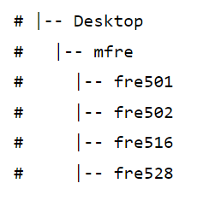
R Projects and here()
Organize all your files into folders in your computer. For example you can create an mfre folder in your Desktop with fre501, fre502, fre516, fre528 as subfolders.
This folder structure means that all relevant FRE501 files (that you created or downloaded from Canvas) should “live” in your fre501 folder, not in your Downloads or Documents folders.

Slide 11
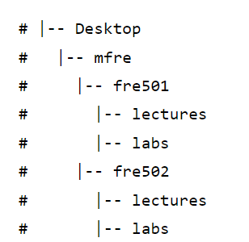
R Projects and here()
You may opt to create folders within each course to be even more organized. For example, you may create a “lectures” folder that will contain all the lecture notes, and a “lab” folder that will contain all the data and code you may use in the course.

Slide 12
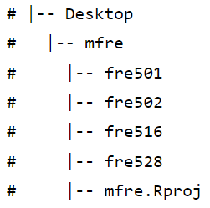
R Projects and here()
Create an R Project by clicking File -> New Project -> Existing Directory then locate the mfre folder you just created in your Desktop. This will create a file called mfre.Rproj in the top-level folder.

Slide 13
R Projects and here()
Double click mfre.Rproj every time before you open an R script. This will open a new instance of Rstudio with the working directory set to your mfre folder.

Slide 14
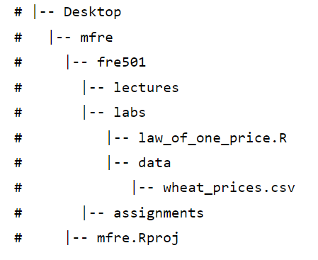
R Projects and here()
Let’s say you want to run the law_of_one_price.R script that is stored in the labs folder of fre501. You will need to double click the mfre.Rproj, which will launch Rstudio, before opening the law_of_one_price.R script.

Slide 15
R Projects and here()
Let’s say you have opened your law_of_one_price.R script and you want to read in wheat_prices.csv.
Our recommendation is that you use the here() function, so your code will look like read_csv(here(“fre501”, “labs”, “data”, “wheat_prices.csv”))

Slide 16
R Projects and here()
The here() function sets the starting point fo the directory from the project level (i.e. the mfre folder). So the code read_csv(here(“fre501”, “labs”, “data”, “wheat_prices.csv”)) tells R to start at the mfre folder then go to the fre501 folder then go to the labs folder then go to the data folder and then find the wheat_prices.csv.

Slide 17
R Projects and here()
read_csv(here(“fre501”, “labs”, “data”, “wheat_prices.csv”))
Each subfolder will go into a pair of quotation marks. With this function, you don’t have to remember if you use front or back slashes to indicate the next level of the file path.

Slide 18
R Projects and here()
If you wanted to save a plot you created from the law_of_one_price.R script in the assignments folder, you can use ggsave(here(“fre501”, “assignments”, “image01.png”)).

Slide 19
R Projects and here()
If you don’t use the here() function, you will have to “go up” one level form the labs folder to the 501 folder, and then go into the assignments folder.
The codes differ if you run it within the console and if you run it in R Markdown.
The advantage of the here() function uses the same syntax either in console or Markdown, hence our strong recommendation to use the here() function. Read here for more details.

Slide 20
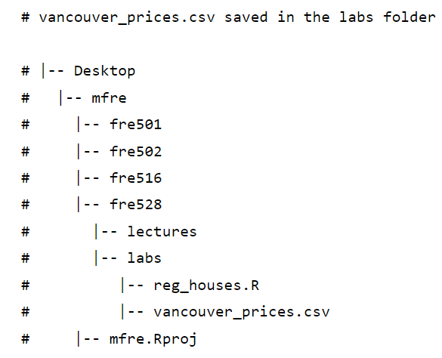
Another example
Let’s say you wanted to open reg_houses.R script. First open the mfre.Rproj file. Then open the reg_houses.R script.
If you want to read in the vancouver_prices.csv data saved in the fre528/labs folder, then run
read_csv(here(“fre528”, “labs”, “vancouver_prices.csv”)

Slide 21
Another example
read_csv(here(“fre528”, “labs”, “vancouver_prices.csv”)
This code can be read as, starting from the mfre folder, go into the fre528 folder then the labs folder and then read the Vancouver_prices.csv file.

Slide 22
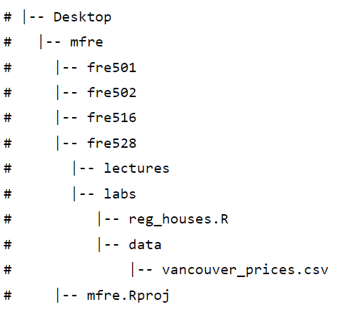
Another example
Let’s say that you saved the csv file inside a data folder within the labs folder, then your code should be
read_csv(here(“fre528”, “labs”, ”data”, “vancouver_prices.csv”)

Slide 23
Practice, practice, practice
It may be a bit confusing at first, but with practice and good file organization, using R Projects and here() function will make sense!

Slide 24
Recap
Using R Projects and the here() function will facilitate eaiser code collaboration and organize your workflow.
Create an mfre folder in your Desktop and one folder for each course. After downloading any file from Canvas, make sure you move that file to the relevant course folder.
Create an R Project for each of your MFRE courses.
Open this R Project before creating/opening any script.
Use here() for file paths.

