Slide 1
R Bootcamp: Interacting with R/RStudio
August 23-24, 2021

Slide 2
Learning Objectives
Become familiar with RStudio’s interface
Know how to run codes in R using scripts or directly in console
Understand what a package is
Install and load a package
Use the {pacman} package to install and load packages
Create objects using the assignment operator
Add comments

Slide 3


R and RStudio
R is a programming language and a free statistical software environment
RStudio is an integrated development environment (IDE) for R programming.
When I say R, I mean we will code using R in RStudio.
Always remember: R is the programming language. RStudio is the IDE.

Slide 4
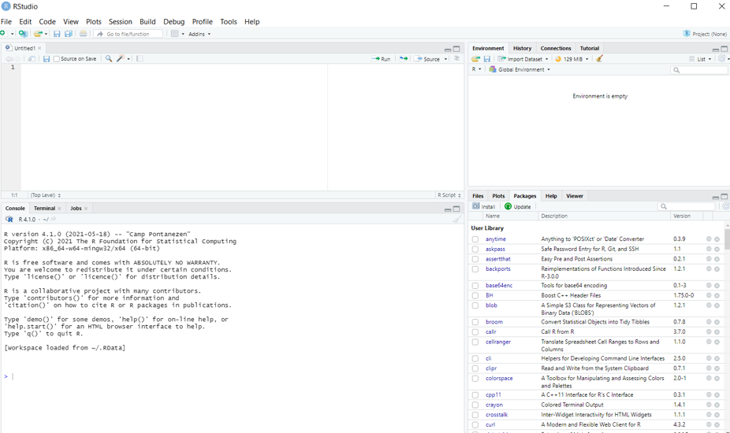
RStudio Interface
This panel is where you type your code and can save it for use later on. You will have to “run” your code (ctrl/cmd + Enter) for R to evaluate the code.
Environment – see objects created (dataframes, etc.)
History – history of codes run
Files – files/folders in the working directory
Plots – plots you have generated
Packages – list of R packages already installed
Help – syntax / documentation
The console is where you will see the output of the codes you just ran. You can type codes here too, and it will be evaluated right away. But you can’t save and access the codes here at another time
Notes:
When you open Rstudio for the first time, you will see the following interface
The upper left is the source editor. This is like Stata’s do file. This is where you write your code, which we call “script.” Basically it’s just a textfile but saved with a .R extension. You will likely spend most of your time writing in Rstudio on the source editor. Your code will not be evaluated until you click “run” or ctrl/cmd+enter. You should do most of your coding here, so you can save it and get back to it later.
The lower left window is the R Console. It’s the brain or the heart of R. If you were to run your codes in R instead of Rstudio, you would only see this window. If you type a code here, it will execute it immediately. For example, you can type 1+1 into the console, and R will give you an output of 2.
The upper right is the workspace browser and history. You can see the objects in your workspace as well as the commands you have executed.
The lower right contains the files/plots/packages/help/viewer and also access R help.

Slide 5
RStudio Interface
You can also change some settings (Tools > Global Options)
Theme (Appearance)
Parentheses (Code > Display tab > check rainbow parentheses)
Code wrapping (Code > Editing tab > check Soft-wrap R source files)

Slide 6
Interacting with R
Two ways to code
In console (can’t save codes for access later on)
In Script files (source editor)
To execute/run our code from the source editor
ctrl + enter in Windows
cmd + return in Mac
Note: .R scripts is analogous to .do file in Stata
Notes:
The basis of programming is that we write instructions for the computer to follow. And we tell the computer to follow those instructions. We write or code instructions in R because it is a common language that both you and the computer understand. We call the instructions commands, and we tell the computer to follow the instructions by executing/running those commands.
Because we want our code and workflow to be reproducible, it is better to type the commands in the script editor and save the script for later on. This way there is a complete record of what we did.

Slide 7
Interacting with R
If you see the “>” prompt in the source editor, that means R is ready to accept new commands
If you see the “+” prompt, that means R is waiting for you to enter more text, i.e. your code is still incomplete
Missing a parenthesis or quotation
To cancel this incomplete command, press Esc on your keyboard while inside the console window

Slide 8
Packages
“A package bundles together code, data, documentation, and tests, and is easy to share with others”
If you are struggling to accomplish a certain task, it is very possible that someone has already solved your problem and created a package for it.
https://r-pkgs.org/intro.html

Slide 9
Packages
As of June 2019, there are 14,000 packages on the Comprehensive R Archive Network (CRAN)
Because there are so many packages out there, there are many ways to perform the same task.
In MFRE, different course/lab instructors may have different ways of coding or prefer different packages/functions.

Slide 10
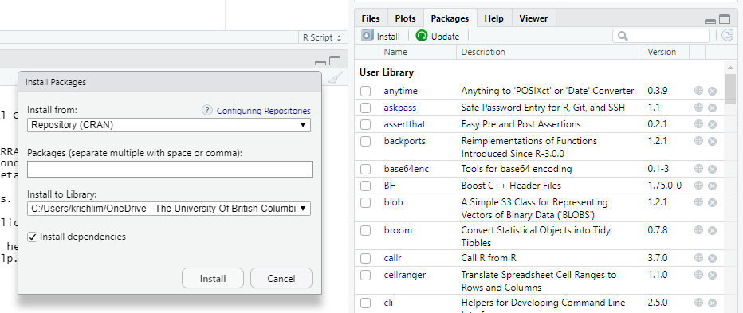
Packages
You install packages with the command install.packages(“package_name”)
Don’t forget the quotation marks!

Slide 11
Packages
To install multiple packages at once, you can use the code
install.packages(c(‘package1’, ‘package2’,…))
Try it now!
Install the packages tidyverse and readxl

Slide 12
Packages
We always have to load libraries every time to start a new R session – key difference with Stata
A few ways to load a library
Click the checkbox beside the package you want in the package tab on lower left panel in RStudio
Type in library(package_name) in the console
Quotation marks are now optional.
You may also see some people use require(package_name)

Slide 13
A more efficient way
Google it – “How to load a bunch of libraries in R”
We can use the p_load() function in the pacman package to check if a certain package is already installed, and if not, install and then load it.
The p_load() function can be used to load multiple packages at the same time
https://statsandr.com/blog/an-efficient-way-to-install-and-load-r-packages/
Notes:
Package::function() makes it easy to identify which package that particular function lives in. Can be useful when there are multiple functions of the same name

Slide 14
A more efficient way
install.packages(“pacman”) - do this only once
pacman::p_load(tidyverse, readxl, googlesheets4, readstata13,here, magrittr, cansim, stats, broom, modelsummary, flextable)
The pacman::p_load() syntax means that R loads the p_load() function only from the {pacman} package.
You can use this syntax even without doing library(pacman).
The packages inside the parentheses of p_load() change depending on your needs.

Slide 15
Interacting with R
You can get output from R by typing math expressions in the console
1+2
2+4*1^3
100 %/% 60 # How many whole hours in 100 min
100 %% 60 # How many minutes are left over?

Slide 16
Interacting with R
You can get output from R by typing logic statements in the console
1 > 2 & 1 > 0.5 # The “&” stands for “and”
1 > 2 | 1 > 0.5 # The “|” stands for “or”
3 + 4 == 4 + 3 # The “==“ stands for “equal to”
3 + 4 != 4 + 3 #The “!” is negation

Slide 17
Creating objects in R
To do useful and interesting things, we assign values to objects
In R, we use <- or = as assignment operators
Which assignment operator to use?¹
You will find most R users use <- because = have a particular use within functions.
You can read more about this issue here and here
Bottom line: Use whichever you prefer. Just be consistent.
¹ https://raw.githack.com/uo-ec607/lectures/master/04-rlang/04-rlang.html#28

Slide 18
Creating objects in R
You can name your objects anything you want, but they cannot start with a number and cannot use R reserved words (i.e. if, else, for)
R is also case sensitive (age is different from Age)
snake_case
PascalCase
camelCase
https://colinfay.me/r-assignment/

Slide 19
Creating objects in R
When we assign values to an object, R does not automatically print the object.
x <- 3 # creates an object x; does not print anything
(x <- 3) # creates an object x; prints the value of x
x # prints the value of x
2 * x #x is now stored in the memory; we can use it

Slide 20
Creating objects in R
We can also overwrite the value of an existing object
x <- 10 # we can also change the value of an object
x * 3

Slide 21
Commenting your code
It is very important to comment on your code
In R, we use the # character
Anything after # up to the end of the line will be treated as a comment, and R will not evaluate it as code
To comment/uncomment a chunk of code, highlight the lines then press ctrl + shift + c on your keyboard

Slide 22
Recap
We use R/RStudio interchangeably
There are 4 panels in R/Rstudio.
We can run codes directly in the console. Or we can type the codes in the upper left panel to save for future use.
There are multiple ways to install packages in R – install.packages(), pacman::p_load(), or manually through the packages tab
<- and = are both assignment operators. Can use either as long as you are consistent.
# indicates the start of the comment

