Slide 1
R Bootcamp
August 23-24, 2021

Slide 2
Learning Objectives
To understand the usefulness of functions in programming
To define a function
To set default values in the arguments of functions
Understand how to use UN ComTrade user written function

Slide 3
Resources
Creating Functions in Programming with R, Software Carpentry
Functions, R for Data Science

Slide 4
Functions
Why do we use functions?
Reduce likelihood of errors!
Repeat operations with just a single command instead of copy and pasting
Perform tasks more efficiently

Slide 5
Functions
A function is a set of code that performs a particular task when called.¹
¹ https://www.w3schools.com/r/r_functions.asp

Slide 6
Why use functions?
What does this code chunk do?
Do you notice any error?
df$var1_c <- (df$var1_f – 32) * 5 / 9
df$var2_c <- (df$var1_f – 32) * 5 / 9
df$var3_c <- (df$var3_f – 32) * 5 / 9
df$var4_c <- (df$var4_f – 32) * 5 / 9
https://r4ds.had.co.nz/functions.html

Slide 7
Why use functions?
The code chunk converts 4 variables from Fahrenheit to celcius.
But in copying and pasting the codes, I forgot to change var1_f to var2_f
This mistake is very common
df$var1_c <- (df$var1_f – 32) * 5 / 9
df$var2_c <- (df$var1_f – 32) * 5 / 9
df$var3_c <- (df$var3_f – 32) * 5 / 9
df$var4_c <- (df$var4_f – 32) * 5 / 9

Slide 8
Functions
Instead of copying and pasting, we can write a function that we can use multiple types
We will define a function called f_to_c that converts temperatures from Fahrenheit to Celcius
f_to_c <- function(temp_f){
temp_c <- (temp_f - 32) * 5 / 9
return(temp_c)
}

Slide 9
Functions
We begin a function by typing
function_name <- function(argument_names)
In our example, we call our function f_to_c that takes the Fahrenheit temperature (temp_f) as an arumgent
f_to_c <- function(temp_f)

Slide 10
Functions
Next, we add in curly brackets ( {} ) that will contain the body of the function, which are the codes that will be executed when we call the function.
f_to_c <- function(temp_f){
code_chunk
}

Slide 11
Functions
Then we add the code statments. We typically indent the statements for readability.
f_to_c <- function(temp_f){
temp_c <- (temp_f – 32) * 5 / 9
return(temp_c)
}
This function creates a temporary variable called temp_c that takes the parameter provided (temp_f) and performs the calculation. Then it returns temp_c.

Slide 12


Functions
Give it a try!
# convert 32F to C
f_to_c(32)
# convert 150F to C
f_to_c(150)

Slide 13
Give it a try!
Create a new function called square that takes 2 values (var1 and var2). Var1 will be the base, and var2 will be the power.
Then test your function: if var1 = 2 and var2 = 3, the result should be 8

Slide 14
Give it a try!
square <- function(var1, var2){
result <- var1^var2
print(result)
}
square(2,3)

Slide 15
Setting default values
We can also set default values.
Let’s try to use the square() function we just created. But now let’s just provide one argument, instead of 2. What happens?
square(2)

Slide 16
Setting default values
We can explicitly assign values to the function, such as var2 = 3. This means that if no value is provided for var2, then it will use 3 as default. If a value for var2 is provided, then the function will use that value.
Let’s edit the square() function to add a default value.

Slide 17
Setting default values
square <- function(var1, var2 = 3){
result <- var1^var2
print(result)
}
square(2)
square(2, 4)

Slide 18
It takes practice
It will take time to get used to writing functions.
At times, it may feel that writing functions may take a longer time than copying and pasting. However, the benefits are worth it!

Slide 19
UN Comtrade function
Sometimes, you may be asked to use a function that has already been coded for you. One example is get.Comtrade() function. Some documentation here
This function extracts trade data from the UN Comtrade database.
You will not need to learn how to code such a function that is as complicated as the get.Comtrade() function, but you will need to learn how to read the documentation to use it.

Slide 20
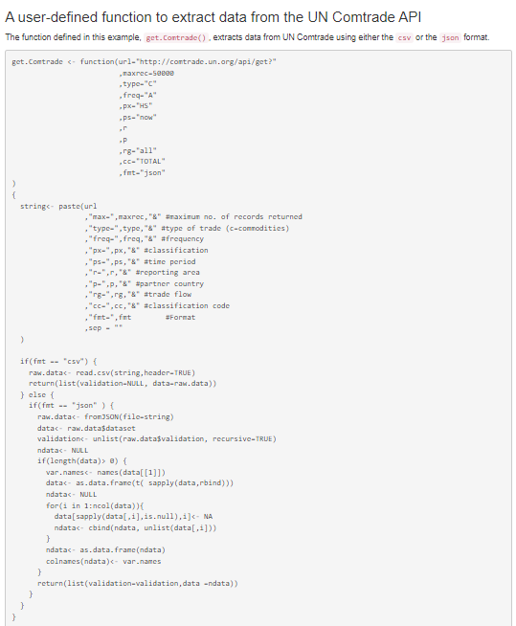
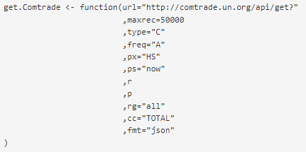

Slide 21
UN Comtrade function
Maxrec = max records
Type = C is for commodity (currently the only one available)
Freq = A is for annual, M is for monthly
Px = “HS” is the classification
Ps = “now”
R = region
P = partner
Rg = “all” is the default, 1 = imports, 2 = exports
cc = classification code
Fmt = json or csv format

Slide 22
UN Comtrade Function
Let’s try to download the following data:
Netherlands (r = “528”) as the reporting country
Netherlands/reporting country (0), Indonesia (170), Malaysia (320), Columbia (360), Guatemala (458)
ps = year (e.g., ps = “2020” for the year 2020)
rg = 1 for imports
cc = “151110” for crude palm oil (see here for others)
raw <- get.Comtrade(r="528", p="0,170,320,360,458", ps="2020",
rg=1, cc="151110")

Slide 23
Recap
Showed how functions can help reduce coding errors
Defined a function that converted Fahrenheit to Celcius
Set default values in functions
Applied knowledge on functions with the get.Comtrade() function

