Slide 1
System Design & Architectur

Slide 2
Basics
Necessity for a Blackjack Game API
  Implement own game
    + full control of the api
    + complete understanding of all game mechanics
    - waste time
    - potential game logic fault
  Find available Open Source implementation
    + use time to build agents
    + guarantee correct game implementation
    - may need modifications to fit purpose

Slide 3
Blackjack API
Provide an Interface for players
Prevent illegal actions
Take care of game logic
Support for advanced features
  Wagers / Purse
  Split & Double
  Multiplayer
Monte Jack (everything except multiplayer)
http://garrettsmith.net/montejack/

Slide 4
Modifications needed
Multiplayer
Added Publish-Subscribe-Pattern
  For observation of the game environment.
  Example: New card decks available
Publicize some methods for omnisciency

Slide 5
BaseAgent
Implements the PlayerHandler of the API
Base Class for our Agents (DRY)
Handles Gamelogging
Agents only have to implement playTurn(Hand)

Slide 6
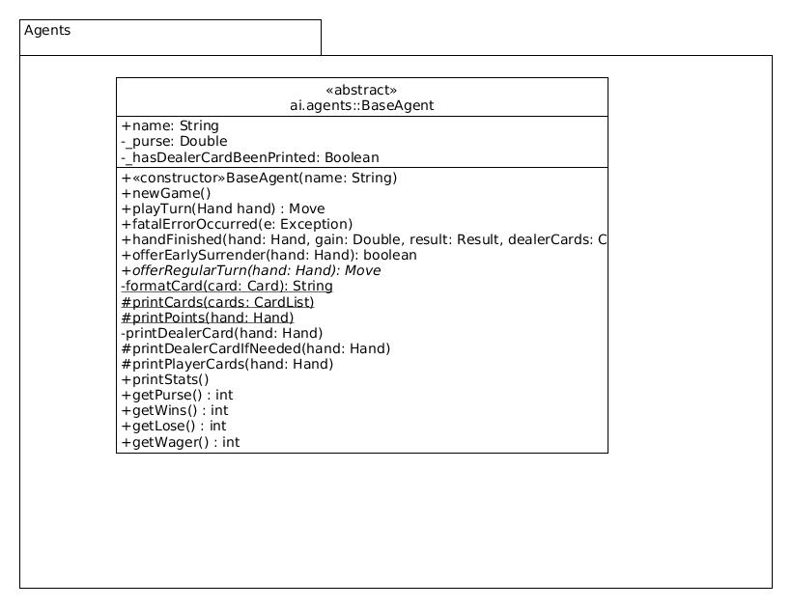
UMLs

Slide 7
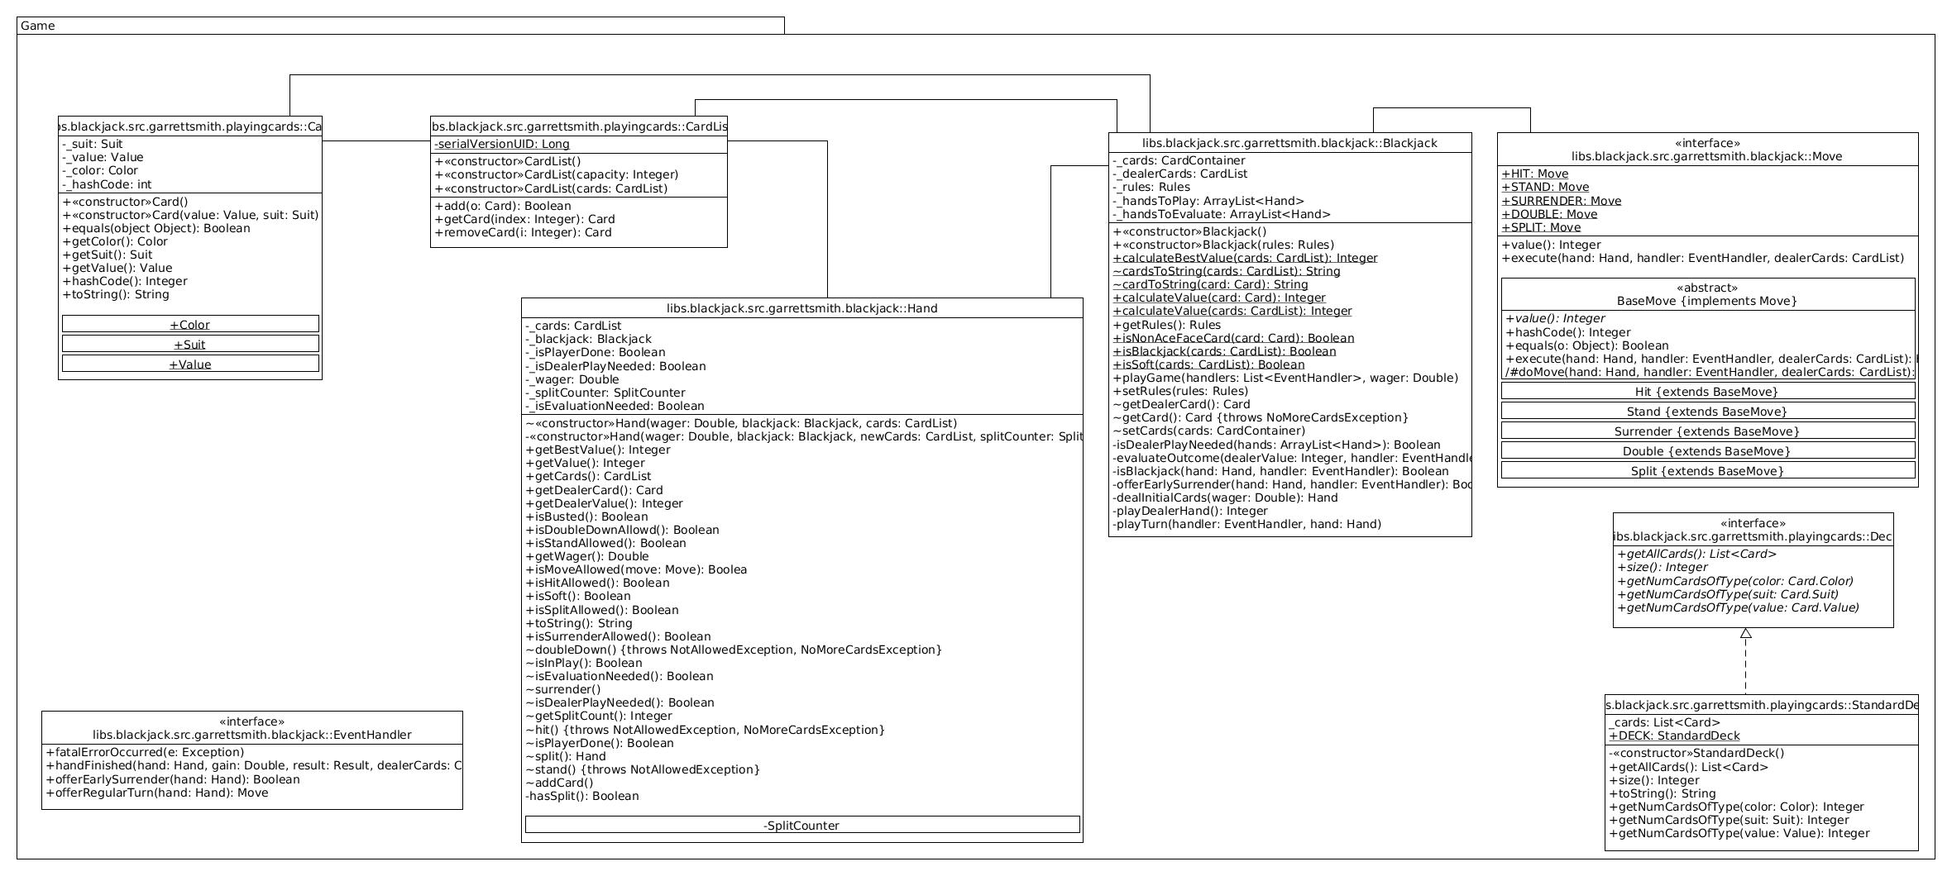

Slide 8
