Slide 1
Agent Implementation
Simple
Goal
AlwaysStandAgent
ReflexAgent
HitUntilAgent
SaveAgent
Model
BasicStrategyAgent
HighLowAgent
PredicateAgent
Learning
Omniscient
LearningAgent
WallHackAgemt

Slide 2
Methods to implement
All agents will extend the abstract class BaseAgent
Our Agents need:
Default-Constructor
Method: playTurn()
Optional: override dealerCreateNewDecks()
Notes:
Default constructor:
To set the name
Optional-Method:
to reset the wage

Slide 3
Simple – ReflexAgent
4 possible moves:
double down
stand
split
hit
Use java.util.Random to get a random integer value between 0-3
Do this as long as one of the move is allowed

Slide 4
GoalBased – HitUntilAgent / SaveAgent
Both of the agents check whether they are above a certain value or not.
HitUntilAgent
SaveAgent
Hits until his hand card value is below 17
Problem: Ace has card value 1, he maybe hits too often
Will only hit if it isn‘t possible to get a value greater than 21
Same logic as HitUntilAgent without his problem

Slide 5
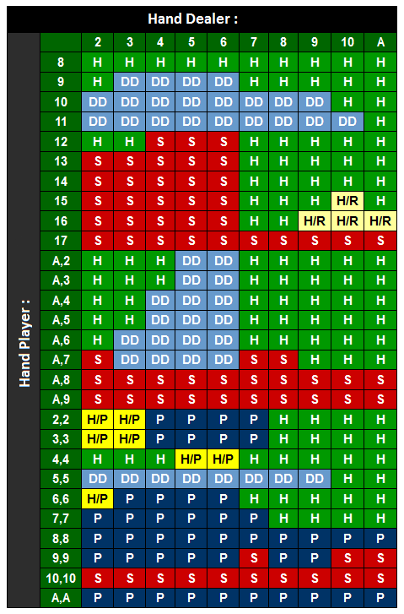
ModelBased - BasicStrategy
Performes a move based on his and the dealers‘ hand
Seperation in 3 different Agents:
BasicStrategySplitAgent
BasicStrategySoftAgent
BasicStrategyHardAgent
Problems: No information which moves are allowed in the next round -> H/P is always a hit in our case
Notes:
Legende: S = stand
H = hit
P = Split
DD = doubledown
H/P = Split, if DD is allowed afterwards, else hit -> We always hit H/R = Surrender if allowed, else hit

Slide 6
Learning – LearningAgent
2 maps: one for loosing / one for winning history
Check whether the the player cards were used in a previous game:
Yes: Check if win or loose rate was higher: -> perform the same action as last time
No: use the BasicStrategyAgent to do a move
Save the last result

