Slide 1
Strategies
General
Soft 17
Card Counting
Strategy Table

Slide 2
Strategies : General
Never over 21
Dealer >= 7 & Spieler < 16 -> HIT
Dealer <= 6 & Spieler <= 11 -> HIT
Dealer >= 7 & Spieler >= 17 -> STAND
Dealer <=6 & Spieler >= 12

Slide 3
Strategies : Soft 17
Ass + 6 -> STAND
Hand >= 17 STAND
Hit Soft -> Ass +6 HIT

Slide 4
Strategies : Card Counting
High Low:
Introduces in 1963 by Harvey Dubner
5 Steps

Slide 5
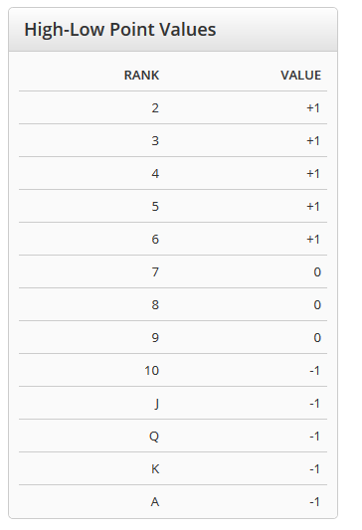
Strategies : Card Counting
Step 1:
Assign a point value to each rank

Slide 6
Strategies : Card Counting
Step 2:
Start with „Running Count“ of Zero
Keep adding or subtracting from the Running Count
Example:
3,5,K,7,Q,A,8,5,4,2 -> 1+1-1+0-1-1+0+1+1+1 = +2

Slide 7
Strategies : Card Counting
Step 3:
Divide the „Running Count“ by the number of decks remaining
-> „True Count“
Example:
Running Count = 7
4 Decks left -> 7 /4 = 1.75 ~ 2

Slide 8
Strategies : Card Counting
Step 4:
The greater the „True Count“, the more to bet
When and how much you bet depends on your own style
Try to make your play look natural ->
Increase bets after win
Decrease after a loss
Stay the same after push

Slide 9
Strategies : Card Counting
Step 5 (for some hands):
Play according to the „True Count“ AND a table of „Index Numbers“
The greater the count, the more inclined you will be to STAND, DOUBLE, SPLIT and SURRENDER
Example:
P: 15 , D: 10, True Count: 4 -> STAND if True Count >= 4

Slide 10
Strategies : Table
First time 1958
Left column hand of Player
Horizontal column hand of Dealer

Slide 11
