Slide 1
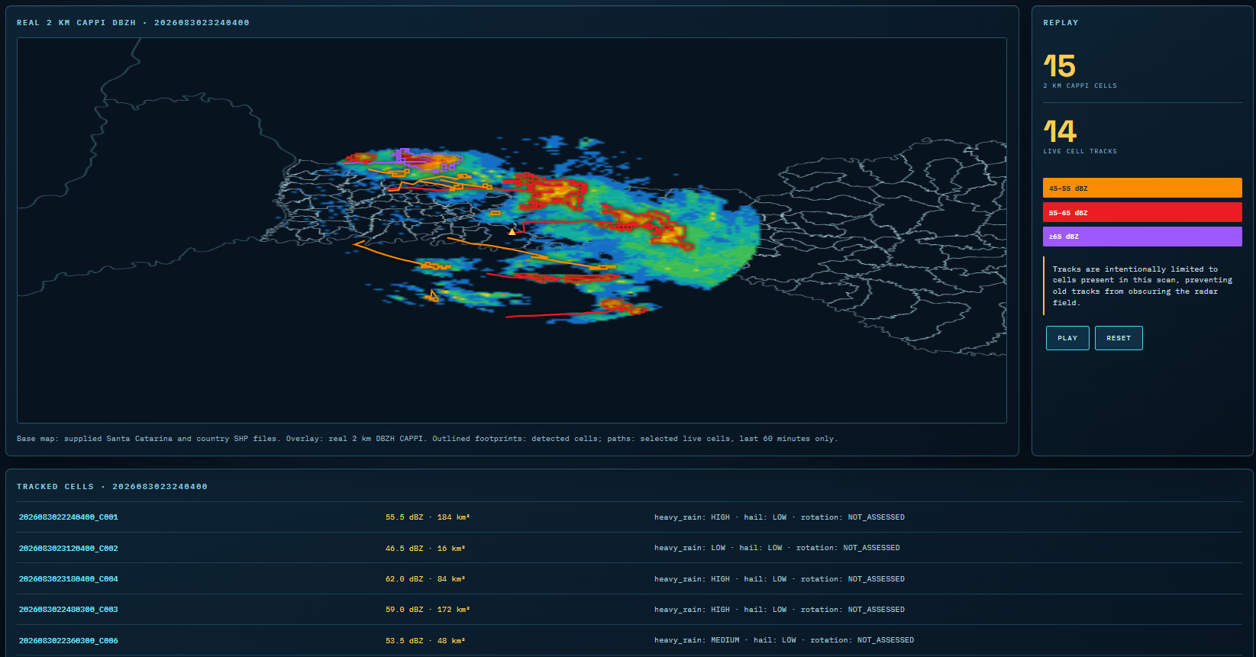
01 / THE PROJECT
Severe Convective
Radar Intelligence
From native radar volumes
to traceable storm-cell intelligence.
Chapecó · Santa Catarina · Brazil
Archived observations: 30 August 2026
Murilo Fretta
SEVERE CONVECTIVE RADAR INTELLIGENCE / ENGINEERING CASE STUDY
01 / 08
Notes:
Introduce the project as an engineering case study using real archived weather-radar observations. The interface replays historical timestamps; it is not a live operational warning service. Explain the goal: turn complex sensor files into inspectable cells and trajectories with traceable processing.

Slide 2
02 / WHY THIS IS A DATA ENGINEERING PROBLEM
One radar. Many dimensions.
Every derived storm object starts with a correctly interpreted observation.
2,045
233
14
Native Rainbow .vol files
Timestamp groups
Elevation slices
DECODE THE OBSERVATION
PRESERVE THE CONTEXT
Read actual fields, scaling, timestamps,
range and elevation metadata.
Keep source files, missing values and
coverage explicit through processing.
SEVERE CONVECTIVE RADAR INTELLIGENCE / ENGINEERING CASE STUDY
02 / 08
Notes:
The archive contains separate moment volumes, rather than one tidy table per scan. Available moments include reflectivity, differential reflectivity, native KDP, correlation coefficient, differential phase, velocity and spectrum width. Field availability does not imply every moment contributes to the current tracking algorithm. The current cell path uses DBZH.

Slide 3
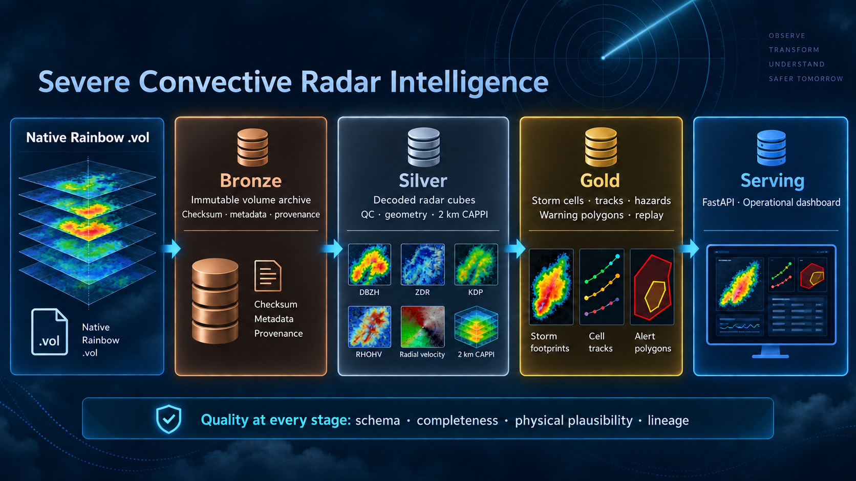
03 / ARCHITECTURE
A medallion pipeline with traceable outputs
SEVERE CONVECTIVE RADAR INTELLIGENCE / ENGINEERING CASE STUDY
03 / 08
Notes:
Walk from left to right: preserve Rainbow source files in Bronze; decode sweep-aware Zarr groups and check quality; derive coverage-aware 2 km CAPPI, cells and tracks in Gold; serve products with FastAPI and the React dashboard. The illustration is conceptual: CAPPI products are stored under Gold in the current repository. Hazard scores and analytical polygons are heuristic products. The current dashboard is a 2D image and SVG view, not a validated 3D product.

Slide 4
04 / DATA QUALITY
Trust is built at every transformation.
Validation covers the file, the measurement and the derived product.
01 SOURCE
02 SCIENCE
03 DELIVERY
Preserve originals
SHA-256 checksums
Metadata inventory
Dimensions and units
Coverage masks
Geometry checks
Timestamp alignment
Explicit missing scans
Traceable outputs
A successful pipeline run is only useful when its outputs are credible.
SEVERE CONVECTIVE RADAR INTELLIGENCE / ENGINEERING CASE STUDY
04 / 08
Notes:
Explain the difference between software validity and scientific validity. Parsing successfully does not guarantee correct geometry, units or coverage. Preserve gaps and exclusions rather than implying complete observations. These are implemented controls and checks, not a claim of comprehensive clutter removal, attenuation correction or independently verified forecast skill.

Slide 5
05 / DETECTION AND TRACKING
From reflectivity pixels to persistent cells
Cell boundaries come from connected CAPPI pixels; tracks associate objects between scans.
DETECT
ASSOCIATE
DISPLAY
2 km altitude CAPPI (ASL)
DBZH ≥40 dBZ
Minimum area: 16 km²
Hungarian assignment
Speed gate: ≤150 km/h
Peak DBZH change: ≤25 dBZ
Cell perimeter + trajectory
Active cells in each scan
Recent history: 12 points
40–<45 dBZ
45–<55 dBZ
55–<65 dBZ
≥65 dBZ
Reflectivity classes describe intensity; they do not confirm hail or tornadoes.
SEVERE CONVECTIVE RADAR INTELLIGENCE / ENGINEERING CASE STUDY
05 / 08
Notes:
The altitude is 2 km above sea level, while the Cartesian grid spacing is also 2 km. Four connected grid pixels meet the 16 km² minimum area. Connectivity includes diagonals. Association uses actual elapsed time between scans. Current limitations include simple one-to-one association and no mature split/merge model. The tail is capped at 12 points, which is not exactly one hour because archive cadence and gaps vary. The side legend classifies detected cells by peak DBZH; weaker echoes remain visible in the raster.

Slide 6
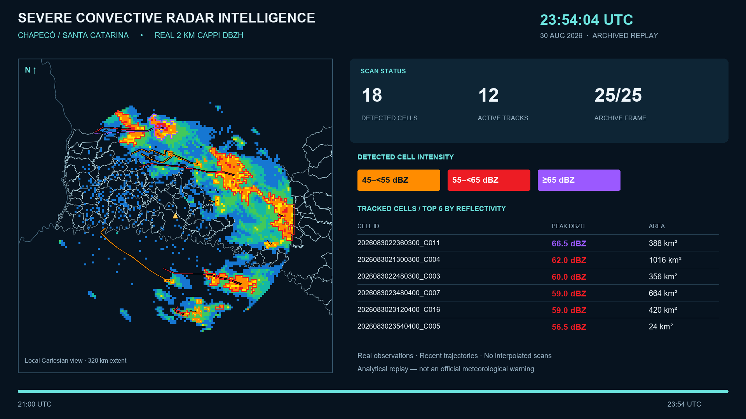
06 / THE INTERFACE
Inspect the storm, its shape and its history.
PLAY REPLAY / 21:00–23:54 UTC / 1.5× / ~35 seconds
SEVERE CONVECTIVE RADAR INTELLIGENCE / ENGINEERING CASE STUDY
06 / 08
Notes:
Use this screenshot to walk through the actual interface: supplied municipal and country boundaries, the real 2 km CAPPI, outlined cell footprints and trajectories, the scan-specific side legend, and the cell table. Replay changes presentation timing while retaining observation timestamps. The screenshot includes heuristic heavy-rain and hail fields and rotation marked NOT_ASSESSED. Explain that display projection and physical validation remain improvement areas. The MP4 is embedded in this slide. In PowerPoint Slide Show, click the video to play the 1.5× replay (about 35 seconds), from 21:00 to 23:54 UTC. This replaces the static dashboard image.

Slide 7
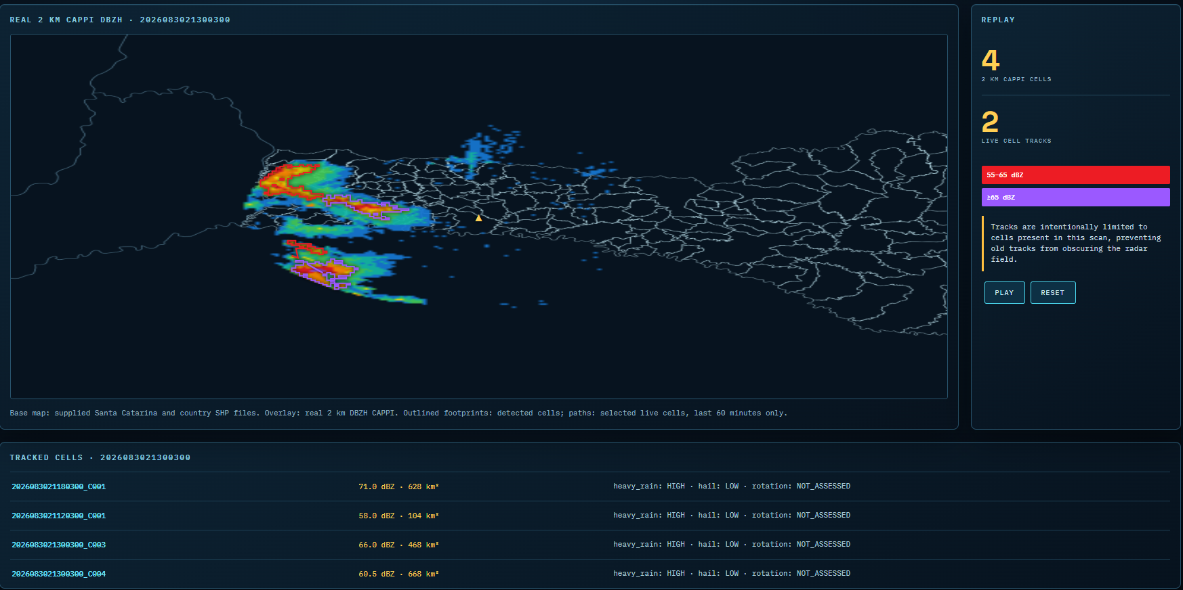
07 / ARCHIVE RESULTS
A complete run makes coverage visible.
Recorded processing outcome for the supplied historical archive.
217
16
2,127
Processed timestamps
Excluded timestamps
Tracked-cell observations
What the numbers mean
Processing coverage, not detection accuracy.
Track points are cell observations,
not distinct storms or verified impacts.
SEVERE CONVECTIVE RADAR INTELLIGENCE / ENGINEERING CASE STUDY
07 / 08
Notes:
The local archive checkpoint reports 217 processed timestamps, 16 exclusions and 2127 track-point records. These measure engineering throughput and available products, not recall, false-alarm rate or confirmed storm severity. Review exclusion reasons in the archive manifest. Independent event truth and quantitative skill evaluation remain future work.

Slide 8
08 / LESSONS AND NEXT STEPS
Data quality makes the result explainable.
The strongest outcome is a traceable path from source observation to visual evidence.
WHAT I LEARNED
WHAT COMES NEXT
Metadata are part of the measurement.
Raw files must remain recoverable.
Missing coverage must stay visible.
Every visual needs a traceable source.
Validate projection and cell matching.
Evaluate velocity and rotation safely.
Compare against independent events.
Measure quality and performance.
Explore the code and architecture
https://github.com/mfretta/severe-convective-radar-intelligence
SEVERE CONVECTIVE RADAR INTELLIGENCE / ENGINEERING CASE STUDY
08 / 08
Notes:
Close by connecting the work to data engineering: provenance, reproducible processing, explicit quality and understandable outputs. The project is an analytical prototype based on archived data. Rain and hail scores are heuristic; rotation is not assessed. Invite questions about design decisions and point to the GitHub repository. Suggested presentation length: eight to ten minutes.

