Slide 1

The Design Process and behind the scenes inspiration and challenges

Slide 2
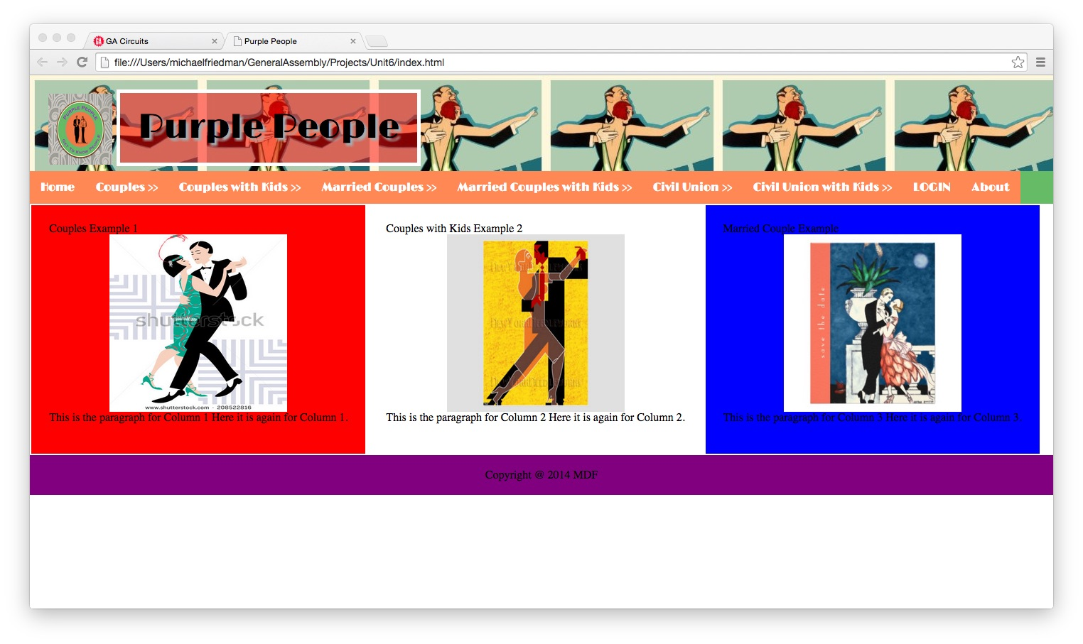
Current Site Design … In Progress
Current Website

Slide 3
Target Audience
Purple People audience is to help couples meet socially, in their city or town.
A sort of Welcome Wagon for New couples or couples that have had a hard time meeting couples socially.
Everyone is so busy, moving around, with work and/or raising kids, and it seems that everyone has a mobile device that could make the meeting process easier and more dynamic.

Slide 4
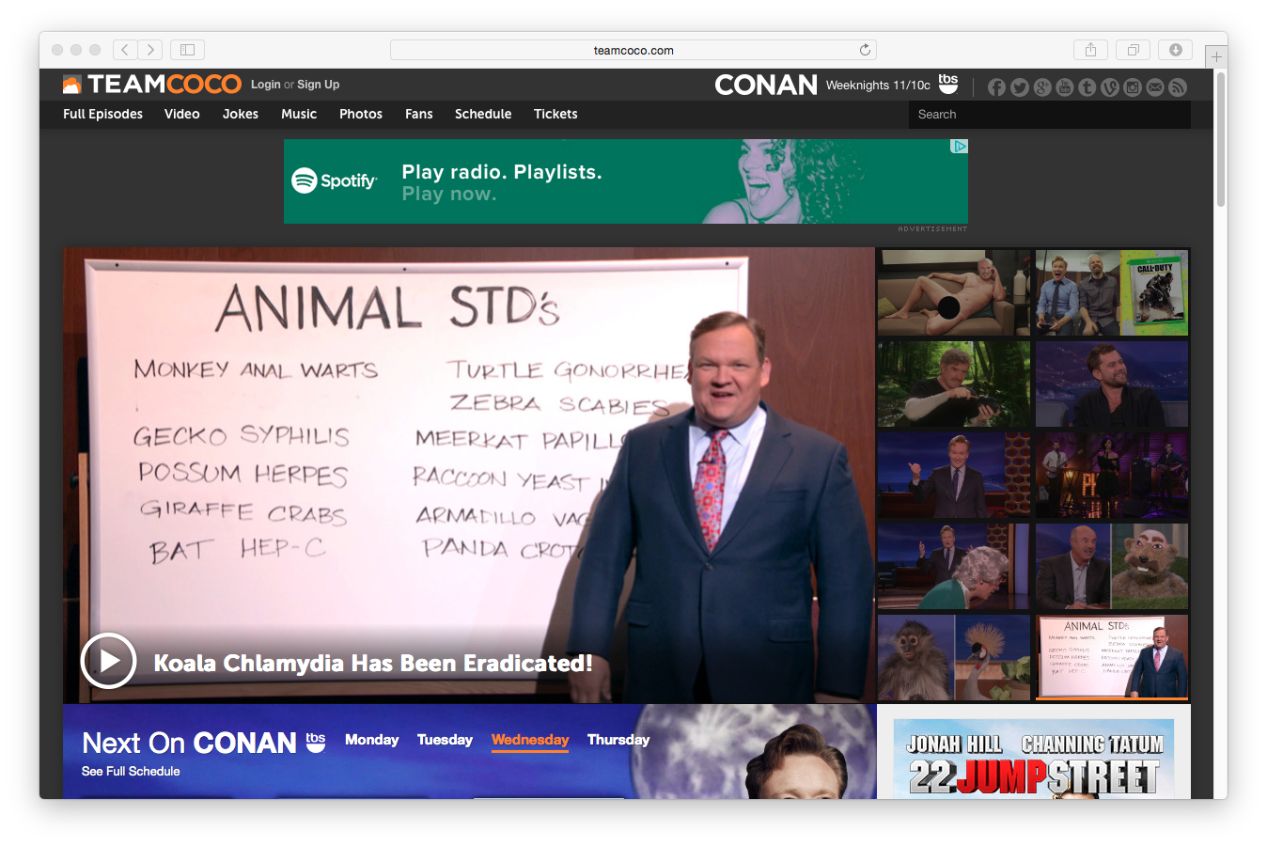
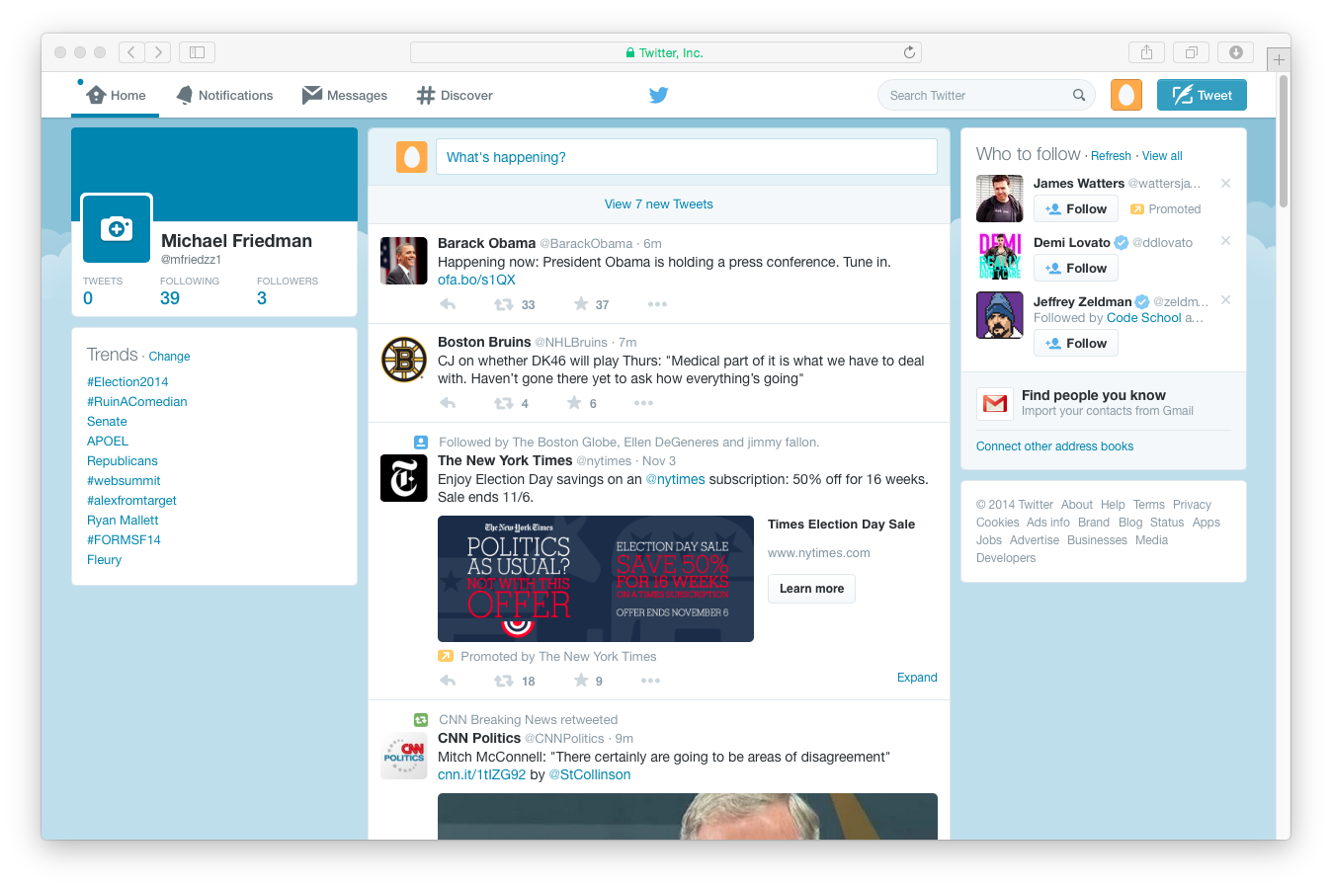
What existing websites inspired you?
Team Coco provides great use of Social Media on his site, and provides more Pictures than Text. I don’t like the advertisement banner under the Menu, but do appreciate the ‘Hover’ stories on the right side, that go to the full story on the left hand side.
The simplicity of the twitter design in respect to their navigation menu on the top, and the 3 column layout with the aside on the right hand side.

Slide 5
Parts of the design you are most proud of?
I am most proud of the Navigation Menu Layout, being able to incorporate an Art Deco font here.
I have been working on the Logo for the site, and have changed designs quite drastically.

Slide 6
Struggles in the Design Process
I felt it was very hard to get the right fonts, sizes, colors, floats, and how to make them all work together. I am still working on this
How the website will function, with the site layout, and how to present it to my audience
How not to get in over my head, and work back word to correct design issues
How to properly use Github; I am still learning!

Slide 7
Parts of the development process that you over came
I was able to simplify my design, and not get in over my head. Readability and ease of use is my ultimate goal.
I have worked at reducing my color palette selections, & making them more relevant to the site.
The logo has been redesigned and is a work in progress. I was able to work with constructive criticism, to help over haul the logo design.
I have simplified my font choice, and limited the font types used.

Slide 8
Struggles you encountered Developing your page
Learning more about Github and version control and project management has helped me learn more about the design process.
How to get the elements to play nicely together. Floats, Focal Points, Aligning elements (Logos, Headers, Nav Menus, etc) and keeping them in proportion and in place are one of the toughest things I have had to do.
What Content should go where
Creating a Great, functional website is hard work! Harder than I knew. I have a new found respect for Web Designers!
Does Adobe Illustrator make this process a lot easier? Can GA provide a student discount for this software for its students?

Slide 9
What you have learned so far
I have learned how to setup and use Github
I have learned that there are a lot of different aspects of creating a Great Website. I have learned how colors, fonts, padding, work with each other.
The Design process is very critical, and is just as important as the code that produces the website.
Simplify, Simplify, Simplify. Don’t overthink, and use baby steps to get things working. Make a workable web page, and then pretty it up, and add more functionality. Make sure you understand how you did what you just did, and how it affects other elements on your web page.
I have learned how to choose the best fonts and typefaces for my website.
All my fellow classmates and instructors have so much to share, and so many brilliant ideas. I am honored and humbled that I am learning from everyone involved with this class.
How to budget your time, in getting these units completed, and how each unit builds on the last one.

