Slide 1



Forecasting Energy Demand
By Matthew Fritscher, ryan supple, Gabriel orosco

Slide 2

Framing the problem
PROBLEM:
Due to limitations in energy storage Energy companies need to produce enough energy to service a population, but limit energy waste. To do so, these companies need to accurately predict the energy usage of an area within a short time frame.
OBJECTIVES:
Forecast a week in advance for the week of 6/23-6/29 2019
'Backcast' 8 different weeks in the past
CONSTRAINTS:
Can use only the given temperatures and calendar information
It is not known which weather stations are in or near which energy zones
MEASURES OF SUCCESS:
The predictions are evaluated based on Root Mean Squared Error (RMSE); i.e., the lower this error, the better this forecasting model scores
ASSUMPTIONS:
Data provided is somewhat accurate
Weather Stations and Energy zones are within relation of each other

Slide 3
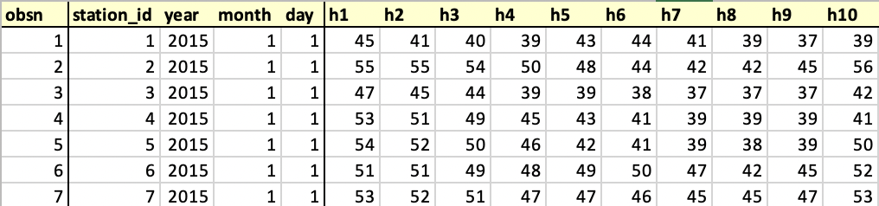
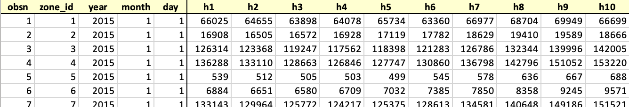
Data Overview
Temperature
Temperature history from 9 different weather station in the region
Dating back to Beginning of 2015
Temperature record every hour at each station
Energy Loads
Historical hourly Energy loads in kW from 15 different zones
Missing a total of 8 weeks throughout the data dating back to beginning of 2015
Date broken down into 3 different day month year columns

Slide 4
Data Cleaning
In the temperature dataset a couple of temperature readings Identified seemed like outliers. For these outliers, the average temperature was taken from the last accurate readings and placed in it's place.
In the energy loads dataset incorrect leap days were identified. For example, the date 2015/2/29 existed in the data, but wasn't a real date in 2015 as it is not a leap year.

Slide 5


Data Exploration
Identifying possibly trends:
Holidays
Businesses closed, Families gathered, Vacations Taken
Weekends
Offices closed, People at home
Seasons
A/C usage in Summer, Heater usage in Winter
Day-Night Cycle
Daily Activity, Sleepless Nights

Slide 6
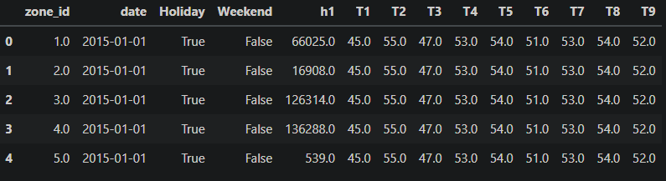
Data wrangling
Pivoting the data
When setting up the final model, separated by each hour, the 9 different temperatures were brought in as variables for each observation. Therefore, 24 data frames were made from the two datasets in order to make the predictions for each hour of each day.
For example, the data frame for h1 looked like:

Slide 7
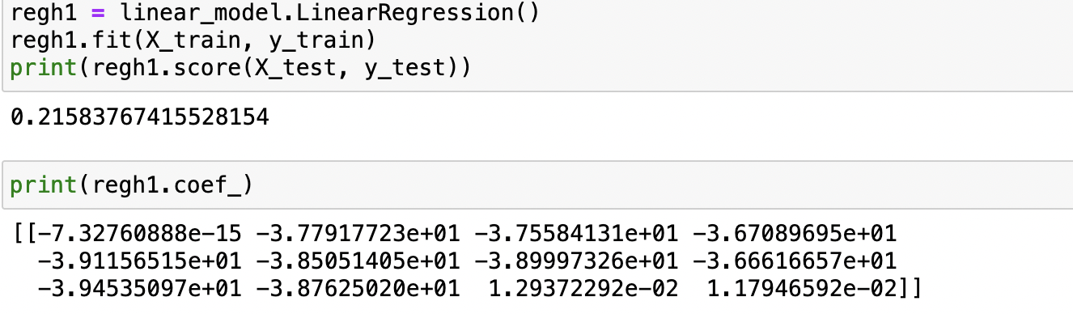
Predicting Energy – Early Models
Seasonal Naïve Model
~ RMSE = 115,000
Seasonal Average Naïve Model
~RMSE = 630
Linear Regression Model
~RMSE = 16,000
ARIMA Model
~RMSE = 10,000

Slide 8
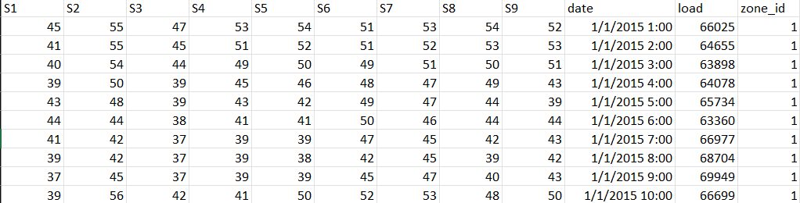
Data wrangling Revisited
Improving data transposition and joining tables
Finally, instead of having 24 separate tables, the hours were transposed as part of the date field. Then the temperatures for all 9 stations were brought in, based on date. Now the data is ready to be applied to model with the 9 temperature columns to be used to predict load demand.

Slide 9
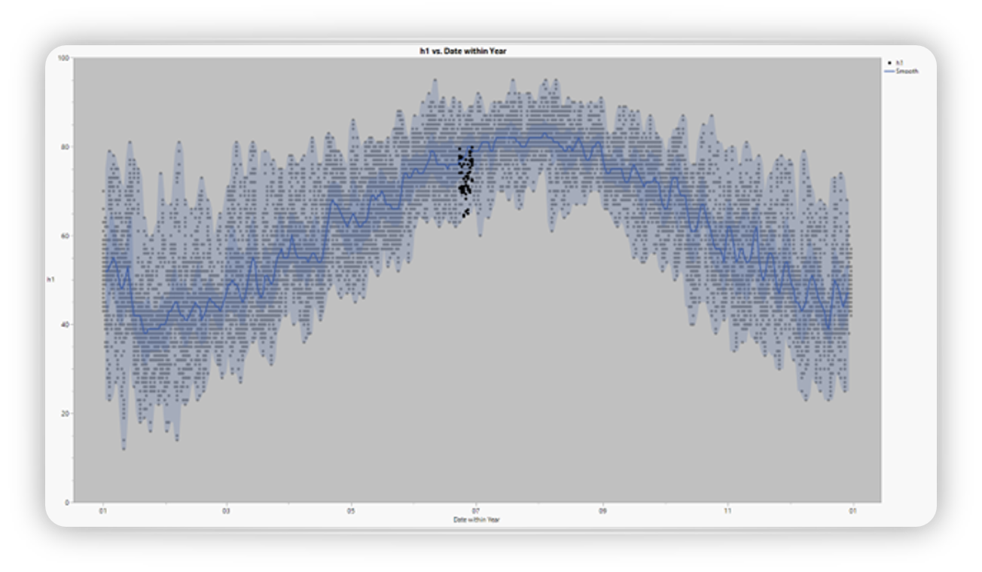
Predicting temperatures
Prior to ultimately predicting energy demand, recall that there were missing temperatures for June 2019.
To predict temperatures, the use of Long Short-Term Memory model allowed for forecasting of temperatures for each station for all 24 hours.
If these temperature predicted are sub-par, then so will the energy predictions. "Garbage in, garbage out"
https://github.dev/mfritscher555/ISDS-7075-Project/blob/main/final_project/predictive_models/tensor_flow_temp.ipynb
The chart below is a time-warped time series of the temperature history(isolated to one hour).

Slide 10
Predicting Energy – lstm model
Long Short-Term Memory is a type of neural network. With the data transposed, the idea was to train the model to predict energy demand for every hour for each zone.
Built the model using the keras package in Python
Transformed the data so that the temperatures were standardized
Use of the Rectified Linear Activation Function (relu) within the LSTM model – allows the neural network to learn non-linear dependencies

Slide 11
Predicting Energy – lstm model
Challenges:
The Neural network had difficulties learning the difference between energy demand at each station
For example, station 5 accounted for around 0.05% of all energy demand
The model over-estimated the low-demand stations
The model under-estimated the high-demand stations
Difficult to tune the hyperparameters in a way that yielded optimal results
Possible Solutions:
Implement dummy variables (was tested)
Perhaps another strategy could be to separate the time series by station, train and fit the model, develop predictions, insert the predictions into a data-frame, and integrate all predictions back into the original format.
Research further the ways to create the LSTM model so that tuning the parameters become more intuitive or research and implement other methods such as Vector Autoregression

Slide 12
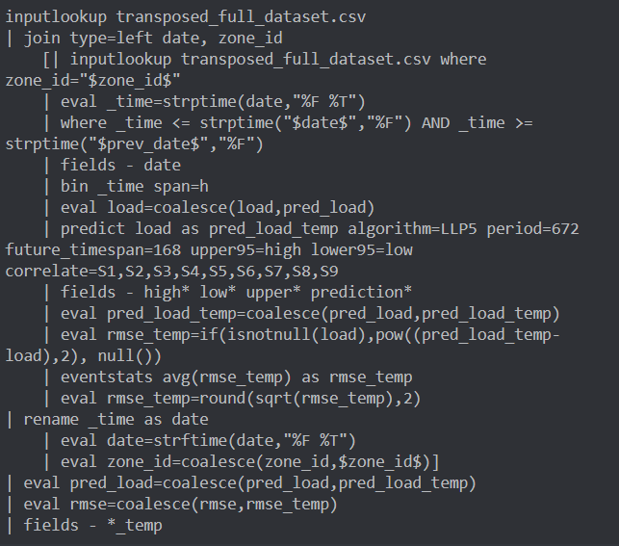
Predicting Energy – Local level trend combined with seasonal local level
“If the time series is periodic, LLP5 computes two predictions, one using Local level trend (LLT) and the other using Seasonal local level (LLP). The algorithm then takes a weighted average of the two values and outputs that as the prediction. The confidence interval is also based on a weighted average of the variances of LLT and LLP”
This model uses the 9 temperature variables in order to predict the loads for each hour of each day.

Slide 13
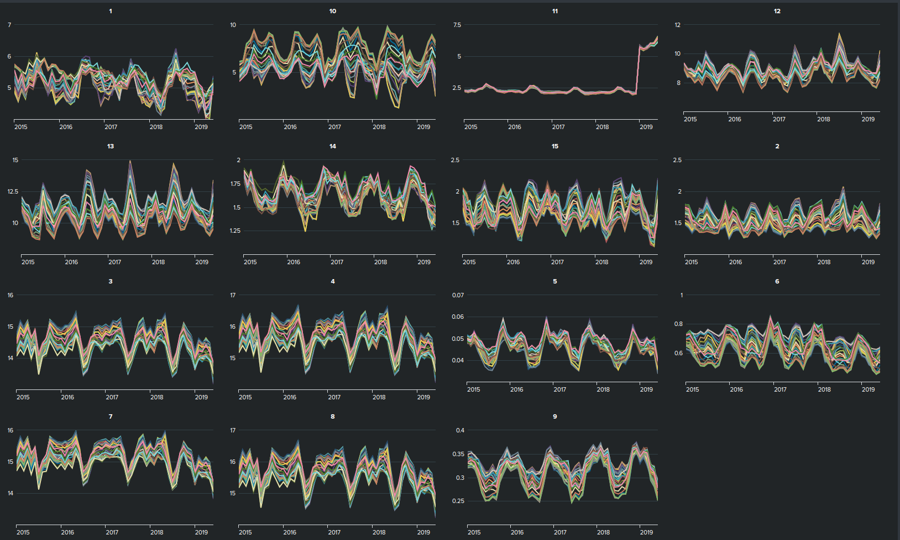
Predicting Energy – LLp5
Limitations:
For Station 11, the energy demands sharply increased, i.e., the loads deviate from its previous seasonal pattern in 2019.
This causes problems when the model tries to fit the future data for June 2019
Results:
The final RMSE of this model is 210.96

Slide 14
Results
Surprises:
Seasonal Average Naïve model outperformed more sophisticated methods
It was surprisingly challenging to join the temperature data to the hourly energy loads
Takeaways:
Data preparation is the most important step for Forecasting
Data pivoting/transposition created an opportunity to create the best model
Conclusion:
The predictions generated by the LLP5 model provide a general sense of the energy demand will be for the week of 6/23-6/29 2019. Given that the values for the energy demand are quite high and have a large range (anywhere from 55-1,965,005), a RMSE of 210.96 is acceptable.

Slide 15
References
https://docs.splunk.com/Documentation/Splunk/9.0.2/SearchReference/Predict
https://www.tensorflow.org/api_docs/python/tf/keras/layers/LSTM

