Slide 1
POMS-HK 2019
Michael Freeman INSEAD
Curbing the Opioid Crisis: The Value of a Second Opinion in the Primary Care Setting
Joint work with:
Katherine Bobroske and Stefan Scholtes – Cambridge Judge Business School
Lawrence Huan, MD

Slide 2
Life expectancy in the US has been declining for the past three years
Between 2000 and 2015:
Increases in opioid-related deaths shortened life expectancy by 0.21 years (49,000 deaths in 2015 alone)
Advances in heart disease, cancer, diabetes, etc. have increased life expectancy by 2.25 years
OECD.org; Dowell et al. 2017 (JAMA) https://amp.economist.com/ https://www.drugabuse.gov/
Notes:
https://www.drugabuse.gov/related-topics/trends-statistics/overdose-death-rates
https://amp.economist.com/united-states/2018/01/04/life-expectancy-in-america-has-declined-for-two-years-in-a-row
https://www.washingtonpost.com/national/health-science/us-life-expectancy-declines-again-a-dismal-trend-not-seen-since-world-war-i/2018/11/28/ae58bc8c-f28c-11e8-bc79-68604ed88993_story.html?noredirect=on&utm_term=.c30b2a822bea
“The data continued the longest sustained decline in expected life span at birth in a century, an appalling performance not seen in the United States since 1915 through 1918. That four-year period included World War I and a flu pandemic that killed 675,000 people in the United States and perhaps 50 million worldwide.”
The opioid crisis is quickly eclipsing the AIDS epidemic, takin g an estimated 49,000 lives in 2017
“The steepest rise in mortality was among 25- to 34-year-olds. In that age group deaths per 100,000 people from any cause increased by 11% from 2015 to 2016. Mortality from drug overdoses in the same age group shot up by 50% from 2014 to 2016.” – Economist
JAMA: “Drug-poisoning deaths increased from 17,415 in 2000 to 52,404 in 2015; the age-adjusted death rate per 100,000 population increased from 6.2 to 16.3 (difference, 10.1) with most of the increase (7.4) related to opioid deaths.” Meanwhile, advances in heart disease, cancer, diabetes, etc. contributed to a 2.25 year gain in life expectancy.

Slide 3
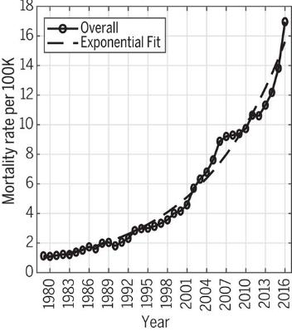
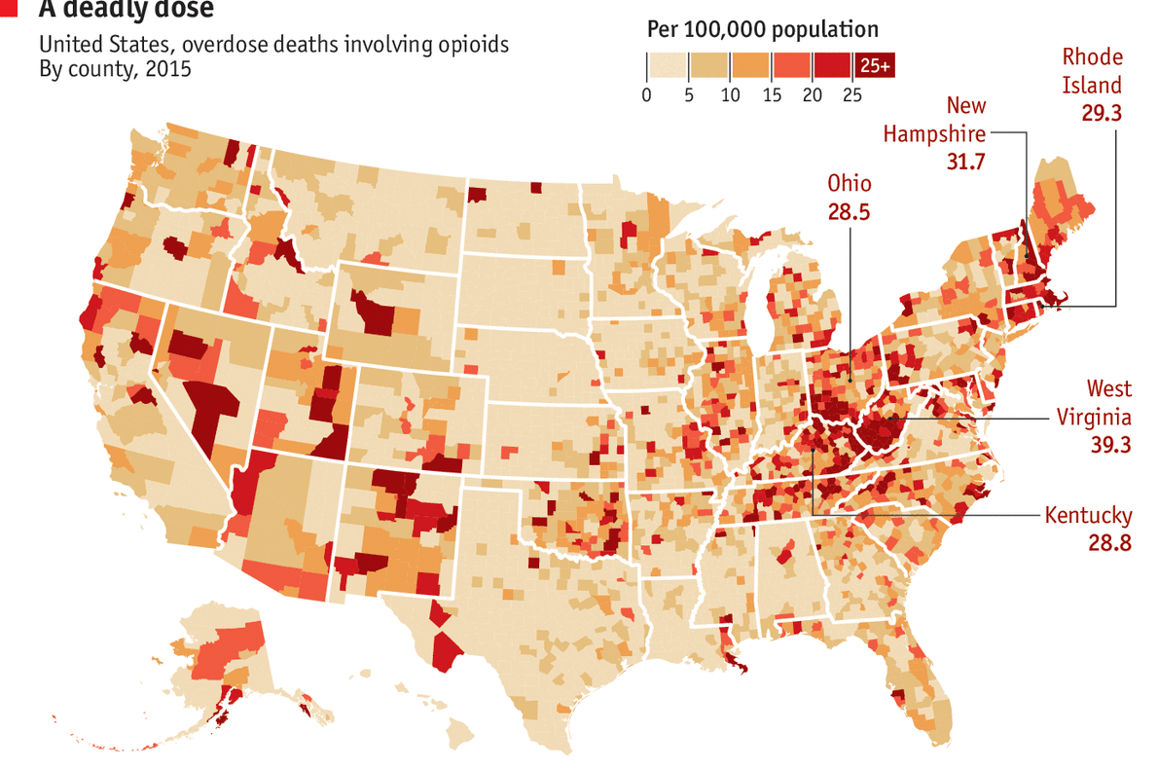
The majority of opioid literature focuses primarily on segmentation
Opioid mortality rates across time and geography:
Images: Jalal et al. 2018 – Science; Economist.com sourced from Centres for Disease Control and Prevention
Notes:
Exception is Doctor et al. 2018 – sending letters to primary care physicians

Slide 4
Many first-time opioid prescriptions are given in the primary care setting for non-malignant pain*
Opioid-naïve period (6+ months)
Doctor
chooses treatment
plan
Patient fills index opioid prescription
54,000 patients
Patient
comes for a follow-up
appt
11,600 patients
Scheduling process
71.1%
28.9%
Appointment with the same doctor
Appointment with a different doctor
*Grosser, et al. 2017 (Science)
9.1%
(≥20 MME/day after 6 months)
Long-term active opioid use?

Slide 5
How might the follow-up appointment impact a patient’s long-term opioid use?
 | Continuity of Care | Second Opinion
Definition | The same general care provider will diagnose, treat, and oversee the complete care of a patient. | After the primary treatment, the patient is referred to or seeks care from a different doctor.
Information | Tacit | External
Accountability | Long-term (episode or patient-level) | Short-term (appointment)
Behaviour | Anchoring
Notes:
CC – back to the doctor that already prescribed opioids
Accountability at the episode level and tacit knowledge (wouldn’t be captured in the medical notes)
New source of information/perspective and confirmation bias/anchoring
Explain within the context of opioids (how
“Focusing on the main drivers” – unclear which ____ is better when (bring back to the opioid story….)
Same – tailor treatment plan, different – new perspective that could lead to better alternative treatment pathways
Long term vs. short term goal

Slide 6
We leverage a complex database of medical and pharmaceutical claims to abstract the patient journey
Pharma Claims
MEMBER_ID | PRESCRIBER_ID | FILLED_DATE | DRUG_GPI | DRUG_NAME | QUANTITY | MME_DOSE_UNIT
1002 | MD01 | 7/19/2015 | GPI01 | TRAMADOL HCL TABLET | 20 | 5
1002 | MD02 | 8/1/2015 | GPI01 | TRAMADOL HCL TABLET | 180 | 5
1002 | MD02 | 10/14/2015 | GPI02 | HYDROCODONE-ACETAMINOPHEN TABLET | 10 | 5
1002 | MD03 | 10/21/2015 | GPI03 | OXYCODONE W/ ACETAMINOPHEN TABLET | 30 | 11.25
1004 | MD02 | 5/4/2015 | GPI04 | MORPHINE SULFATE TABLET EXTENDED RELEASE | 90 | 15
1004 | MD05 | 8/11/2015 | GPI06 | HYDROCODONE-ACETAMINOPHEN TABLET | 20 | 5
1006 | MD02 | 7/19/2015 | GPI01 | TRAMADOL HCL TABLET | 90 | 5
1006 | MD04 | 12/16/2015 | GPI02 | HYDROCODONE-ACETAMINOPHEN TABLET | 18 | 5
1006 | MD01 | 6/5/2016 | GPI07 | OXYCODONE W/ ACETAMINOPHEN TABLET | 30 | 7.5
1006 | MD05 | 10/27/2016 | GPI05 | METHADONE HCL TABLET | 60 | 5
1007 | MD06 | 11/3/2015 | GPI02 | HYDROCODONE-ACETAMINOPHEN TABLET | 24 | 7.5
… | … | … | … | … | … | …
Medical Claims
MEMBER_ID | PROVIDER_ID | SERVICE_START_DATE | LOCATION | PRIMARY_DIAGNOSIS_CATEGORY
1002 | MD01 | 2/20/2015 | OFFICE | RESPIRATORY SYSTEM
1002 | MD02 | 10/13/2015 | OFFICE | NERVOUS SYSTEM
1002 | MD07 | 4/7/2016 | INPATIENT | RESPIRATORY SYSTEM
1002 | MD07 | 4/8/2016 | INPATIENT | RESPIRATORY SYSTEM
1002 | MD02 | 4/13/2016 | SNF | RESPIRATORY SYSTEM
1002 | MD01 | 4/27/2016 | SNF | RESPIRATORY SYSTEM
1002 | MD03 | 5/11/2015 | SNF | RESPIRATORY SYSTEM
1004 | MD02 | 3/10/2015 | OFFICE | MUSCULOSKELETAL SYSTEM AND CONNECTIVE TISSUE
1004 | MD02 | 4/3/2015 | OUTPATIENT | MUSCULOSKELETAL SYSTEM AND CONNECTIVE TISSUE
1004 | MD02 | 5/2/2015 | OFFICE | MUSCULOSKELETAL SYSTEM AND CONNECTIVE TISSUE
1004 | MD02 | 5/11/2015 | OFFICE | NERVOUS SYSTEM
1004 | MD05 | 8/11/2015 | OFFICE | MUSCULOSKELETAL SYSTEM AND CONNECTIVE TISSUE
1006 | MD04 | 5/4/2016 | OUTPATIENT | MUSCULOSKELETAL SYSTEM AND CONNECTIVE TISSUE
1006 | MD01 | 6/1/2016 | OFFICE | MUSCULOSKELETAL SYSTEM AND CONNECTIVE TISSUE
1007 | MD06 | 3/14/2015 | OFFICE | MUSCULOSKELETAL SYSTEM AND CONNECTIVE TISSUE
1007 | MD06 | 11/2/2015 | OFFICE | MUSCULOSKELETAL SYSTEM AND CONNECTIVE TISSUE
1007 | MD07 | 11/20/2015 | ER | DIGESTIVE SYSTEM
1007 | MD08 | 11/20/2015 | OUTPATIENT | DIGESTIVE SYSTEM
… | … | … | … | …
Notes:
Basic unit of observation = claim
Dr. Huan

Slide 7
After data cleaning, we find a difference in opioid usage rates
Potential sources of endogeneity
Doctor shopping
Acuity or pain level
Etc.
Patient
has a follow-up
appt
Appointment with the same doctor
Appointment with a different doctor
Raw opioid usage 10.4% 5.3%
Raw opioid usage 10.4% 5.3%
Controlled for observables 9.6% 8.0%
Notes:
Ideally randomly assign…. because we want to only capture the effect of changing doctors (not a myriad of other correlated factors). So we use a methodology that extract the unbiased part of that decision whether or not to change doctors.
Our hypothesis is that whether patients going to that first doctor switched for their follow-up appointments might be related to whether my patient of interest is going to switch doctors. But this rate should have nothing to do with my patient’s pain level, attitude toward doctor shopping, etc. (which is the original issue with using the raw variable).
Controls include: age, line of business (medicare/Medicaid/commercial), socioeconomic: rural, high school/college degree, % unemployed in area, % below poverty, avg commute distance, owner occupied, comorbidities (asthma, cad, chf, copd, depression, diabetes, hypertension, obesity), condition chapter, male/female, base of first opioid, first provider prescriber type, # appts/doctors in last 6 months (potentially signals acuity or effort), any observed history of opioids
Recursive bivariate probit

Slide 8
Why might we be concerned about endogeneity?
There are multiple reasons why a patient that has a second opinion may be predisposed to becoming more or less likely a chronic opioid user based on unobservable factors:
More likely
Less likely
Intentional doctor shopping: a patient may seek out multiple doctors to obtain a higher quantity of opioids
A patient that is referred to a different doctor may have more complex needs
Scheduling: patients with high levels of pain may be more willing to see a different doctor if their original doctor is unavailable
A patient who changes provider maybe intentionally seeking an alternative to opioids
Scheduling: patients who have a bad reaction to opioids may return quickly, and the original doctor may be unavailable

Slide 9

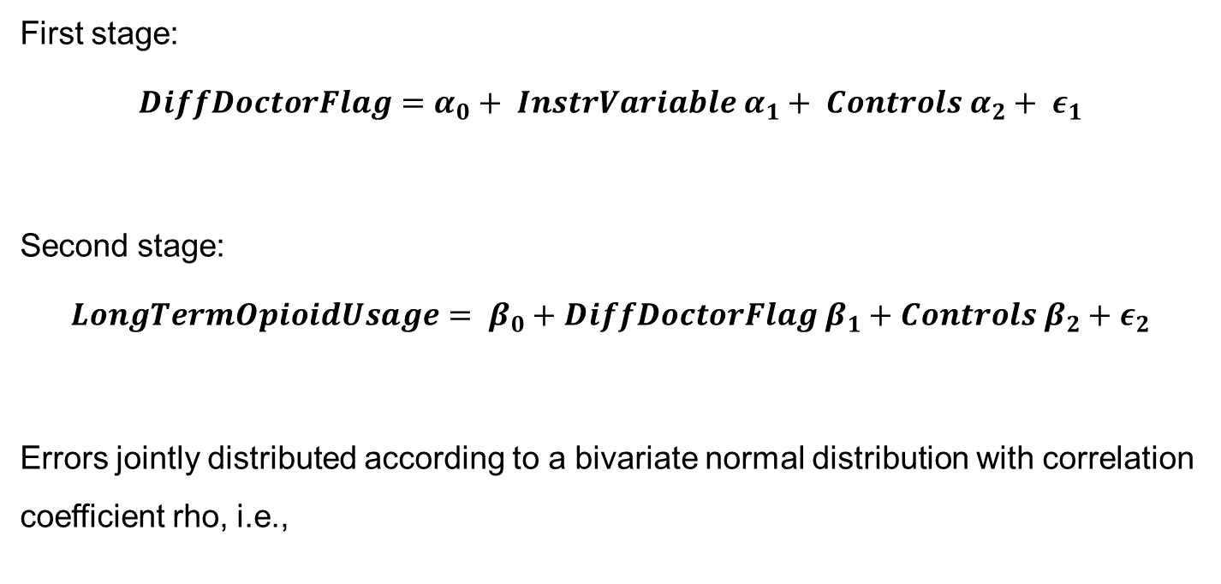
A simultaneous equation model can resolve endogeneity issues
First stage:
$$DiffDoctorFlag=α_{0}+ {InstrVariable α}_{1}+ {Controls α}_{2}+ ε_{1}$$
Second stage:
$$LongTermOpioidUsage= β_{0}+{DiffDoctorFlag β}_{1}+{Controls β}_{2}+ε_{2}$$
Errors jointly distributed according to a bivariate normal distribution with correlation coefficient rho, i.e.,
Angrist and Pischke, 2009
Notes:
Rho = cov(opioid user, instrumental var) / cov(diff doct flag, instrumental var)

Slide 10
Instrumental variables improve reliability of coefficient estimates
Instrumental Variable
Likelihood that the prescribing doctor’s other patients* switch doctors for their follow-up appointment. *In the 12 months prior to the start of the episode
✓
Relevance Criteria: correlated with the causal variable of interest
Exclusion Restriction: uncorrelated with the dependent variable
✓
Notes:
Relevance: If other patients are switching from the first provider (for any reason including: scheduling issues in the practice, a culture of fragmented care in the region, etc.) then the patient of interest is also more likely to switch doctors. (0.37 correlation)
Exclusion: Other patients’ switching behaviour should not directly affect the patient of interest’s likelihood of becoming opioid dependent

Slide 11
After data cleaning, we find a difference in opioid usage rates
Potential sources of endogeneity
Doctor shopping
Acuity or pain level
Etc.
Patient
has a follow-up
appt
Appointment with the same doctor
Appointment with a different doctor
Raw opioid usage 10.4% 5.3%
Raw opioid usage 10.4% 5.3%
Controlled for observables 9.6% 8.0%
Controlled for observables 9.6% 8.0%
Corrected for endogeneity 10.8% 5.0%
5.8 pct pts; 45% relative reduction
Notes:
Controls include: age, line of business (medicare/Medicaid/commercial), socioeconomic: rural, high school/college degree, % unemployed in area, % below poverty, avg commute distance, owner occupied, comorbidities (asthma, cad, chf, copd, depression, diabetes, hypertension, obesity), condition chapter, male/female, base of first opioid, first provider prescriber type, # appts/doctors in last 6 months (potentially signals acuity or effort), any observed history of opioids
Recursive bivariate probit

Slide 12

Scheduling all first-prescription opioid patients with a different provider could have large implications for long-term opioid use
In 2016, 287 new patients started long-term opioid use:
0.15%
70.0%
5.8%
2,120,846
patients fully eligible in dataset
3,167
included in the primary care prescribing analysis
2,218
saw the same doctor for their follow-up
128
estimated to have avoided long-term opioid use if they had switched providers
If we extrapolate to the United States:
323,000,000
size of the US population
19,525
new long-term opioid users avoided annually
Notes:
Back of the envelope

Slide 13

Thank you!
Questions?

Slide 14
Appendix

Slide 15
Instrumental variables should satisfy both the relevance criteria and exclusion restriction
Proposed IV | Relevance Criteria | Exclusion Restriction
PAST_SWITCH_PROP: Proportion of other patients (patients in who saw the doctor in the 12 months prior to the index appointment) who visit the same first doctor and who switch to a different doctor for their next appointment | If other patients are switching from the first provider (for any reason including: scheduling issues in the practice, a culture of fragmented care in the region, etc.) then the patient of interest is also more likely to switch doctors. (0.37 correlation) | Other patients’ switching behaviour should not directly affect the patient of interest’s likelihood of becoming opioid dependent
DOCTOR_PREV_SEEN: An indicator that flags whether the patient of interest has had an appointment with their first opioid-prescribing provider in the 6 months prior to the index appointment | If the patient of interest has already established a relationship with the prescribing doctor, he/she will be less likely to switch doctors during the next appointment. (-0.21 correlation) | Whether or not the patient of interest has seen their first prescribing doctor in the opioid-free 6 month period should not directly affect the patient’s likelihood of becoming opioid dependent

Slide 16
Regression Output: Stage 1 Matched Dataset
> Stage 1: DIFF_PROVIDER_FLAG ~ PROV_PAST_CHANGE_PROP + PROV_PAST_APPT_RARE + ALL_CONTROLS
Estimate Std. Error z value Pr(>|z|)
(Intercept) -1.214004553 0.317386841 -3.825 0.000131 ***
PROV_PAST_CHANGE_PROP 4.086169239 0.179436128 22.772 < 0.0000000000000002 ***
PROV_PAST_APPT_RARE 0.497872483 0.073179554 6.803 0.0000000000102 ***
FP_SPECIALTY_CATGENERAL 0.342690834 0.303752467 1.128 0.259239
FP_SPECIALTY_CATINTERNAL 0.196103002 0.069316756 2.829 0.004668 **
FP_SPECIALTY_CATNP -0.341569773 0.115663389 -2.953 0.003146 **
FP_SPECIALTY_CATPA -0.492488749 0.100126731 -4.919 0.0000008714134 ***
GENDERM 0.053872342 0.058643699 0.919 0.358285
OBS_HISTORY_OF_RX 0.014724922 0.058243746 0.253 0.800411
PROV_IN_PRIOR_6MO -0.101428195 0.079989331 -1.268 0.204790
APPT_IN_PRIOR_6MO 0.009232194 0.024154562 0.382 0.702303
TOTAL_INITIAL_MME_SQRT 0.004389126 0.005057539 0.868 0.385483
FP_SHARED_OFFICE_CT_LOG -0.054312412 0.021648347 -2.509 0.012113 *
FP_RX_CLASSIFICATIONHIGH 0.137602180 0.083014364 1.658 0.097404 .
FP_RX_CLASSIFICATIONLOW -0.025384411 0.067607794 -0.375 0.707314
FP_SMALL_RX_CT -0.205313416 0.114808455 -1.788 0.073726 .
Additional Controls:
AGE_BUCKET
LOB_CATEGORY
SOCIO_ECONOMIC
COMORBIDITIES
MONTHS_SINCE_LAST_APPT
PRIMARY_ICD_CHAPTER_KEY
FIRST_OPIOID_DRUG_BASE
PATIENT_STATE
---
Signif. codes: 0 ‘***’ 0.001 ‘**’ 0.01 ‘*’ 0.05 ‘.’ 0.1 ‘ ’ 1

Slide 17
Regression Output: Stage 2 Matched Dataset
> Stage 2: LONG_TERM_OPIOID_USAGE ~ PREDICT(DIFF_PROVIDER_FLAG) + PROV_PAST_APPT_RARE + ALL_CONTROLS
Estimate Std. Error z value Pr(>|z|)
(Intercept) -3.2516035473 0.7947247531 -4.091 0.0000429 ***
DIFF_PROVIDER_FLAG -1.4067865689 0.3987816679 -3.528 0.000419 ***
PROV_PAST_APPT_RARE 0.3246261738 0.1761171595 1.843 0.065294 .
FP_SPECIALTY_CATGENERAL 0.2515352659 0.6459806737 0.389 0.696991
FP_SPECIALTY_CATINTERNAL 0.1212145727 0.1618635598 0.749 0.453936
FP_SPECIALTY_CATNP 0.3051785188 0.2444848841 1.248 0.211939
FP_SPECIALTY_CATPA -0.1193653379 0.2452174708 -0.487 0.626419
GENDERM 0.0798937563 0.1331725557 0.600 0.548555
OBS_HISTORY_OF_RX -0.1777068444 0.1364320461 -1.303 0.192735
PROV_IN_PRIOR_6MO -0.1047401473 0.1699245020 -0.616 0.537636
APPT_IN_PRIOR_6MO 0.0058181815 0.0425649193 0.137 0.891276
TOTAL_INITIAL_MME_SQRT 0.1129241293 0.0088290337 12.790 < 0.0000000000000002 ***
FP_SHARED_OFFICE_CT_LOG -0.0082442516 0.0493418806 -0.167 0.867304
FP_RX_CLASSIFICATIONHIGH 0.2976924870 0.1698439336 1.753 0.079646 .
FP_RX_CLASSIFICATIONLOW -0.2195976888 0.1859653110 -1.181 0.237661
FP_SMALL_RX_CT 0.0362768863 0.2417575324 0.150 0.880721
Additional Controls:
AGE_BUCKET
LOB_CATEGORY
SOCIO_ECONOMIC
COMORBIDITIES
MONTHS_SINCE_LAST_APPT
PRIMARY_ICD_CHAPTER_KEY
FIRST_OPIOID_DRUG_BASE
PATIENT_STATE
---
Signif. codes: 0 ‘***’ 0.001 ‘**’ 0.01 ‘*’ 0.05 ‘.’ 0.1 ‘ ’ 1
The average treatment effect of seeing a different doctor for the follow-up appointment is (95% confidence interval):
- 5.78 percentage points ( - 10.39 pct pts, -2.81 pct pts )

Slide 18
The study focuses on the beginning of the patient’s opioid journey
Index opioid prescription filled
Dependent Variable:
Patient’s opioid usage 6 months after the index prescription
6-month opioid-free clean period
t = t₀
t₀ – 6 months ≥ t > t₀
t = t₀ + 180 days
t₀ - 14 days ≤ t ≤ t₀
t₀ < t ≤ t₀ + 30 days
Initial prescribing appointment
Independent Variable:
Follow-up appointment may be with the same or a different provider
Patient data is available for at least 12 months
Notes:
Follow-up appointment = independent variable of interest (potentially impactable)

Slide 19
The study focuses on the beginning of the patient’s opioid journey
Patient fills the initial opioid prescription
The patient’s daily opioid dosage (in milligram morphine equivalents, MME) is calculated 6 months after the initial prescription
Patient does not fill any opioid prescriptions in the 6 months prior to the index opioid prescription
t = t₀
t₀ – 6 months ≥ t > t₀
t = t₀ + 180 days
t₀ - 14 days ≤ t ≤ t₀
t₀ < t ≤ t₀ + 30 days
The initial appointment (used to determine the patient’s primary condition) is designated as the closest appointment with the opioid-prescribing doctor, no more than 14 days before the patient fills the index opioid prescription
The follow-up appointment is identified as the next office visit for the same condition (one of the first 3 diagnosis chapter codes must match those in the initial appointment). If this follow-up appointment happens with a different doctor, the patient is flagged as having a second opinion
Patient is eligible with one of the health plans in the dataset for the full 12 months surrounding the index opioid prescription so that all medical claims are observed
Notes:
Follow-up appointment = independent variable of interest (potentially impactable)

