Slide 1
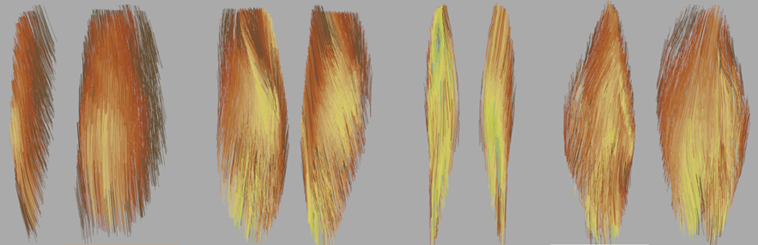





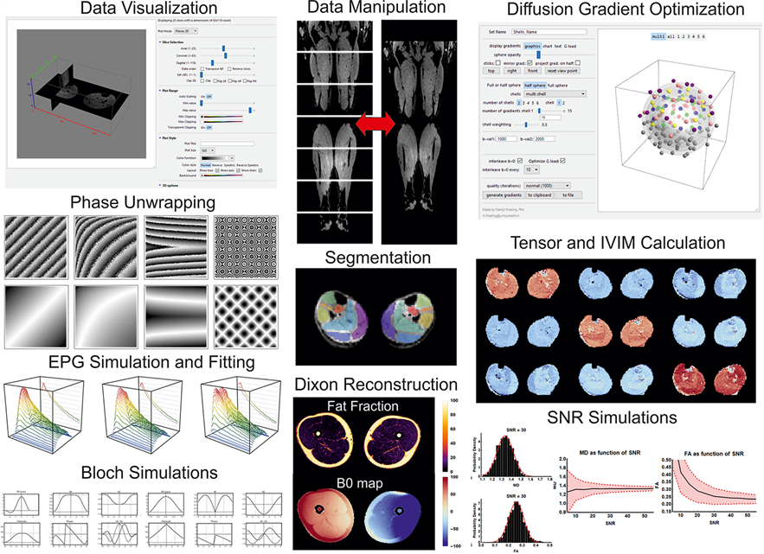





www.QMRITools.com
QMRITools is a versatile toolbox for quantitative magnetic resonance imaging (MRI) analysis.
It runs within the latest version of Wolfram Mathematica and was originally designed for analyzing DWI data in skeletal muscle.
However, it has since expanded its capabilities to encompass the analysis, processing, and simulations of quantitative MRI and spectroscopy data for muscle, nerve, and cardiac applications. The toolbox's functions continually expand alongside the ongoing research it supports.

