Slide 1
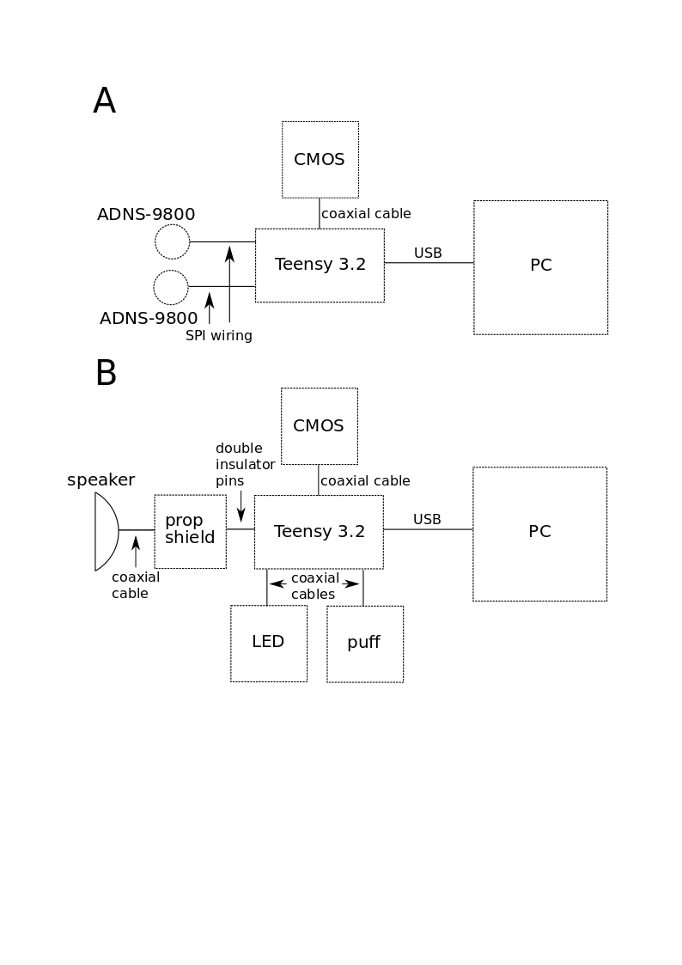
Figure 1

Slide 2
Figure 2
Motion sensor display image
Tone puff image

Slide 3
Figure 3
Motion control image (max-minus-min)
Traces and speed trace
Traces and speed trace

Slide 4
Figure 4
Picture of traces shown alongside motor output in cm/s
Statistical analysis correlating neural activity with motor output

