Slide 1


Slide 2

Figure 2 (audio schematic)

Slide 3
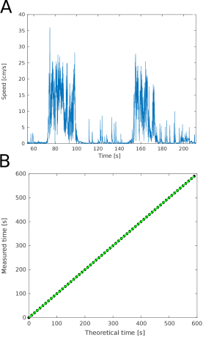
Figure 3

Slide 4
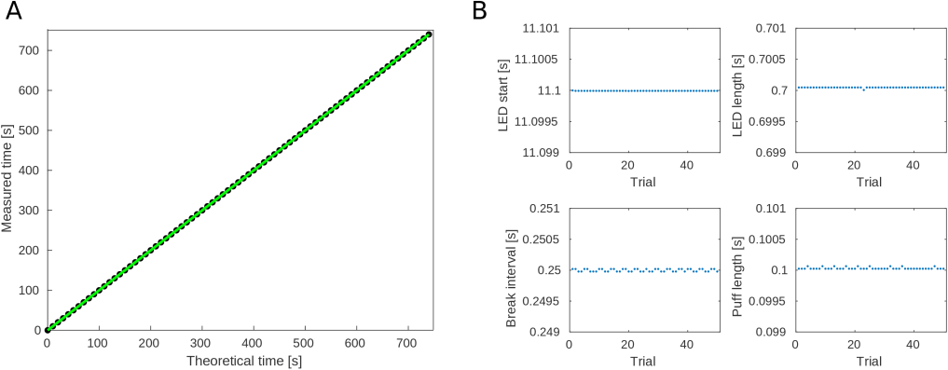
Figure 4

