Slide 1

Osric's Office & Appliances

Slide 2

Mohammed Almuzel
Martin Zanaj
Jason Lu
Marco Seman
Audrey White
Maricruz Zamora

Slide 3
Introduction/Overview Problem Description – Osric's Scheme
Technicians are in high Demand.
Long waiting time for customers.
Unable to hire more skilled technicians.
Need to ration services by prioritizing customers.

Slide 4
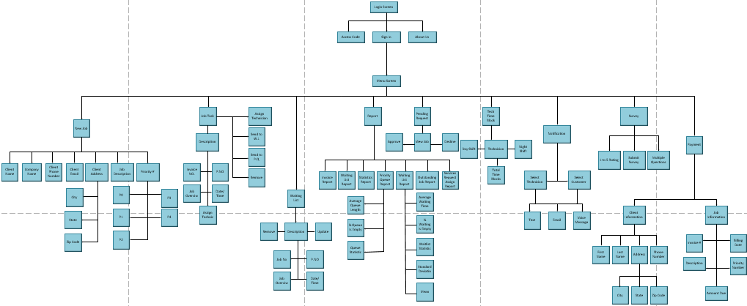
System Design

Slide 5
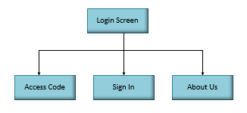
Login Screen
Our first page should prompt the administrator (assistant) to login.

Slide 6
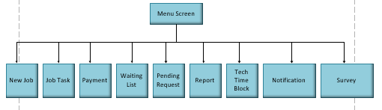
Menu Screen
In the menu screen, the Administrator will select an option of their choosing.

Slide 7
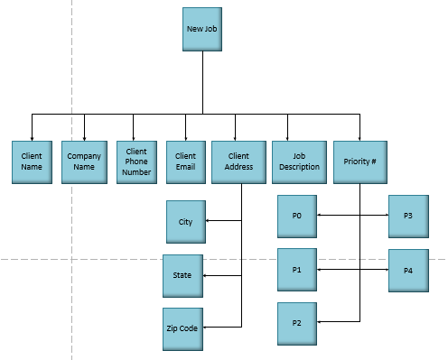
New Job
The administrator will submit a new job and will fill out the following info.

Slide 8
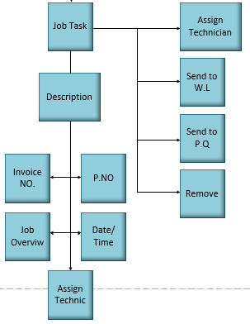
Job Task
The administrator will be able to take a job and edit it based on the requirements.

Slide 9
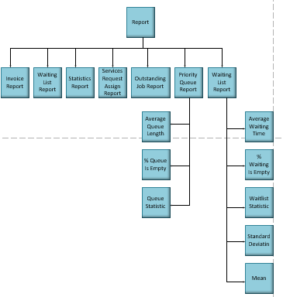
Report Screen
The administrator will be able to view the following statistics report.

Slide 10
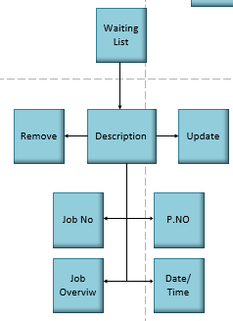
Waiting List
The assistant will be able to view the waiting list, remove a job, update which will sort the waiting list based on their priority, date, and time.

Slide 11
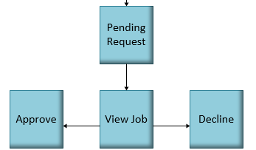
Pending Request
The manager will be able to view a job, and determine whether to decline/approve the request.

Slide 12
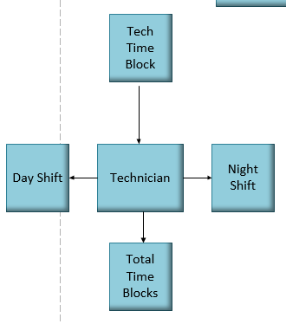
Technician Time Block
There will be a need to input the amount of time blocks for the technician.

Slide 13
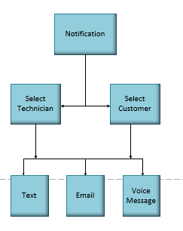
Notification
The customer/technician will be notified whenever a job is either complete, uncomplete, or postponed.

Slide 14
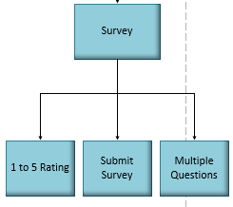
Survey
After a job is complete, the customer will receive a survey of 5 questions to rate the quality of service.

Slide 15
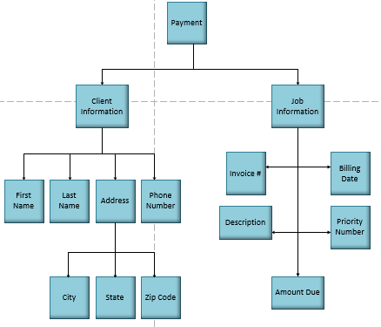
Payment
The assistant will input different metrics about the job, such as the amount due, and the customer will be able to submit a determinate payment.

Slide 16
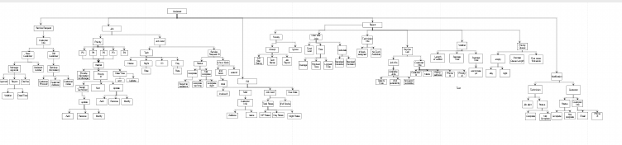
The Decomposition Diagram

Slide 17
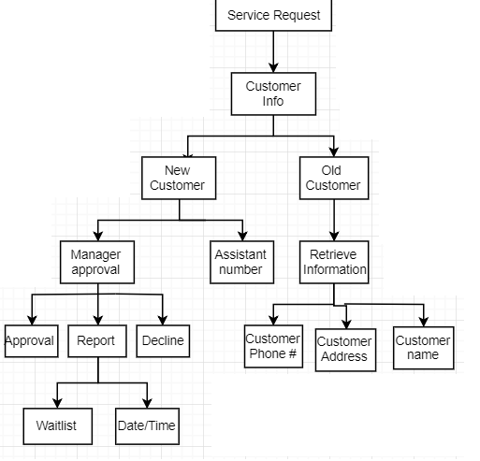
Service Request

Slide 18
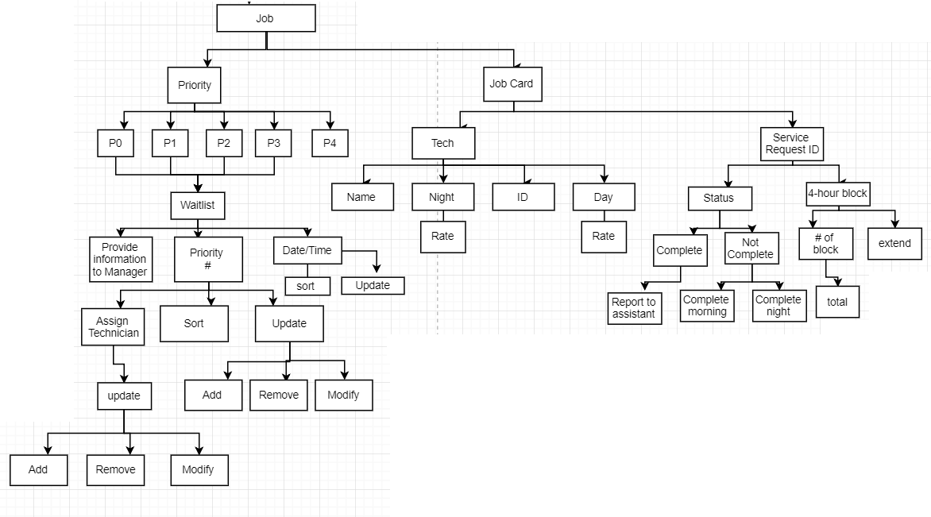
Job

Slide 19
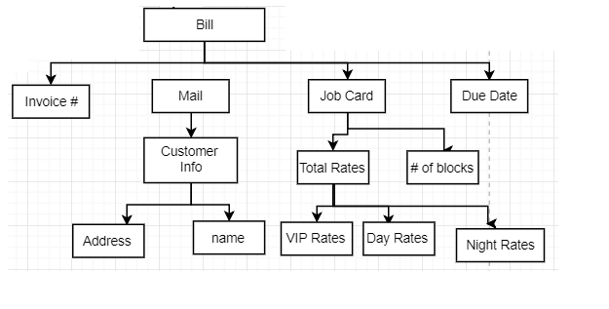
Bill

Slide 20
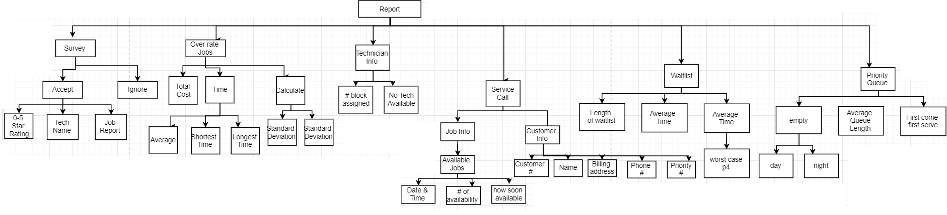
Report

Slide 21
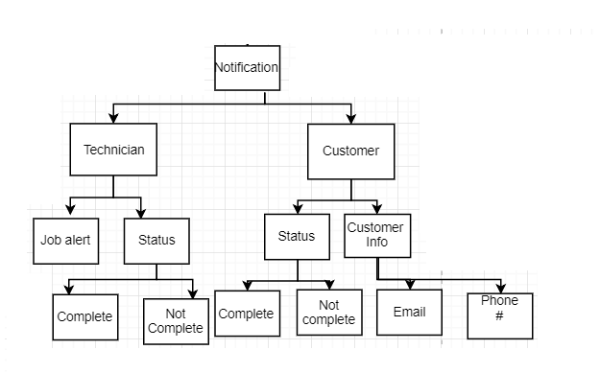
Notification

Slide 22
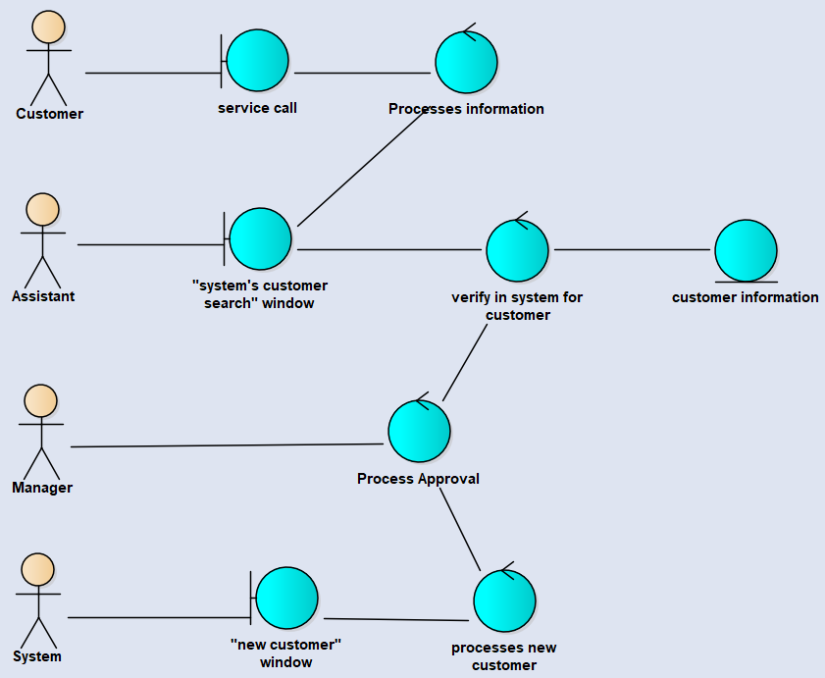
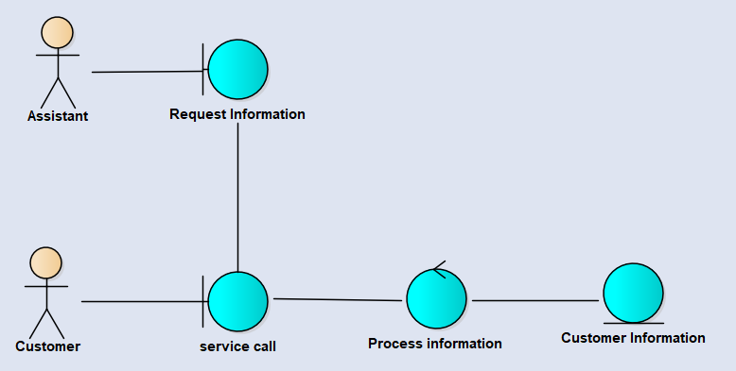
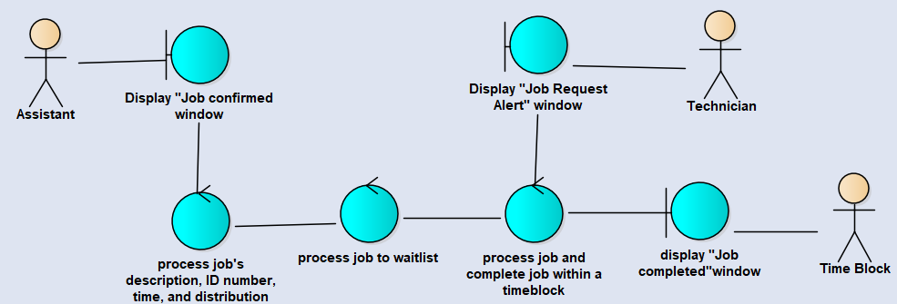
Detailed Design

Slide 23
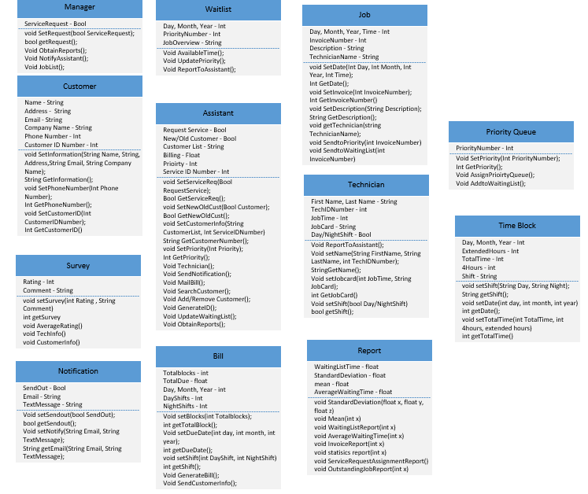

Slide 24
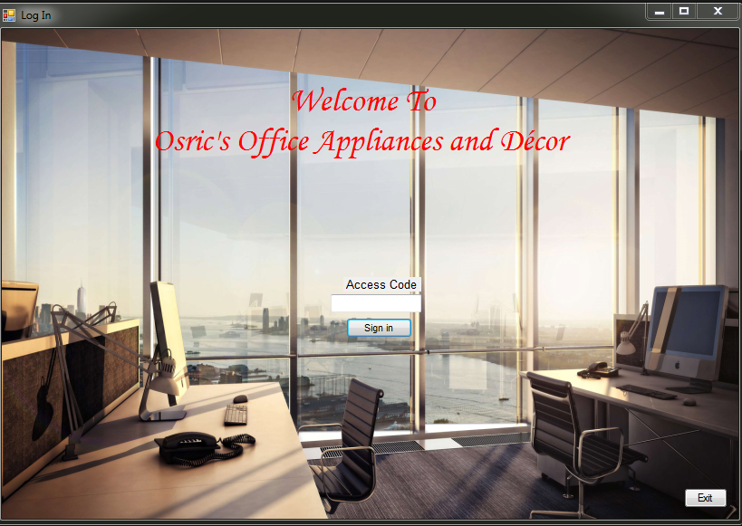
User Interface
Log In: Assistant will use their access code for logging in the system.

Slide 25
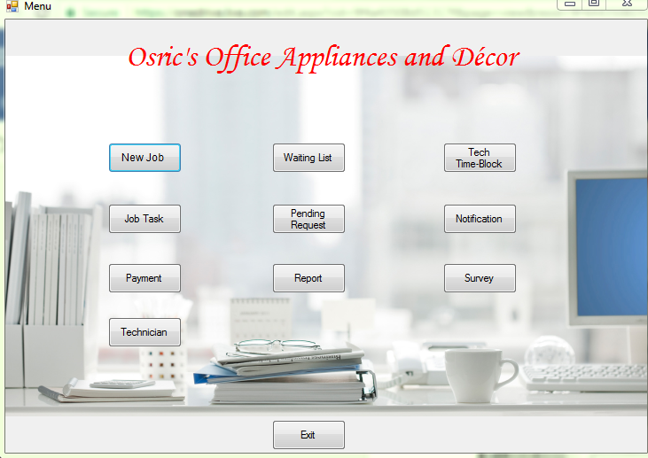
Menu: This is the view of the assistant which can check the different operations.

Slide 26
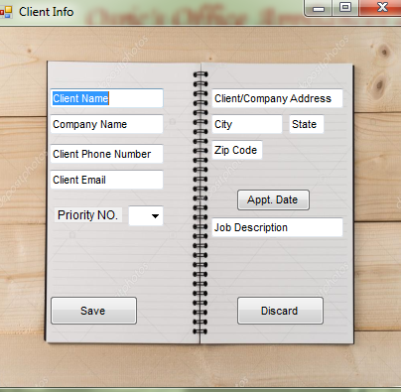
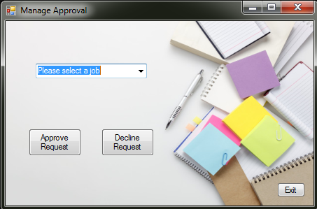
Client Info: This is the interface regarding the client information. Such interface will pop-up if there is a new, or existing customer.
Manage Approval: The manager will either approve the job or decline the job according to data from within the system.

Slide 27
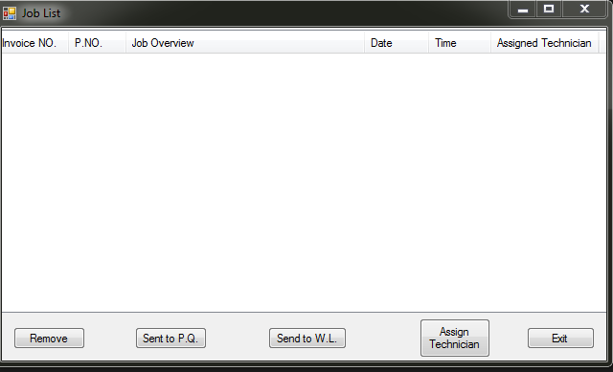
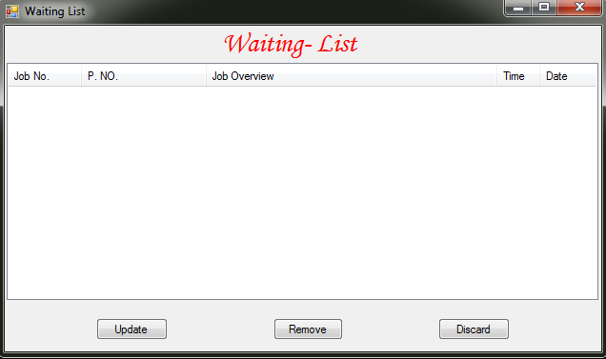
Job List: The job list will be an overview of the different jobs that have been assigned that are present in the system.
Waiting List: The waiting list will be used as a “sitting” place for the different jobs awaiting to be completed. Each job sitting in the first position will be the next one to be picked up by the next available technician.

Slide 28
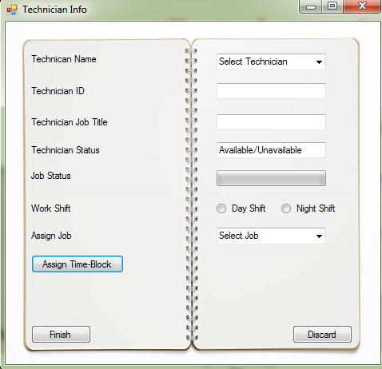
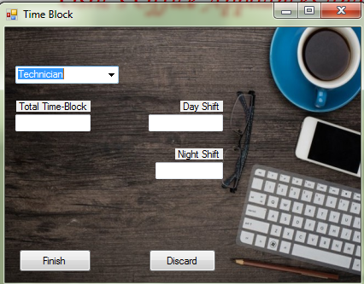
Technician: This interface contains some of the basic information about the technician (av/unav).
Time Block: The amount of time that it will take to complete a determinate job.

Slide 29
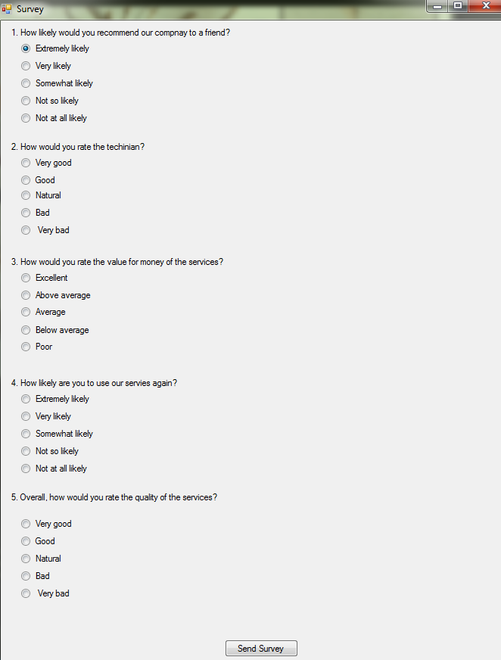
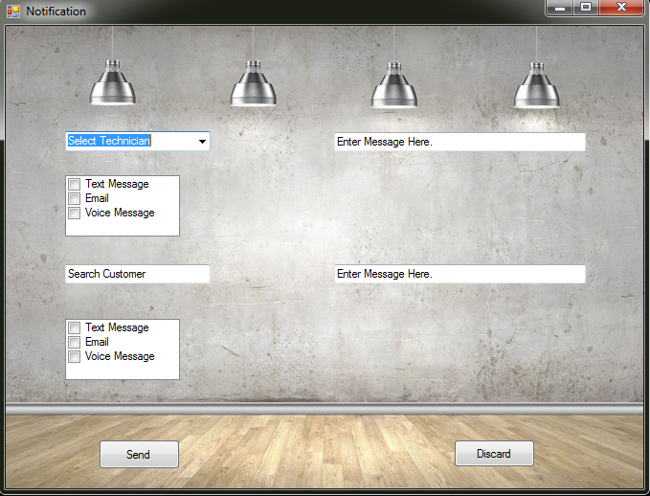
Survey: Once a job is completed the customer will be able to complete an optional survey.
Notification: Throughout the job request until the competition there will be constant communication.

Slide 30
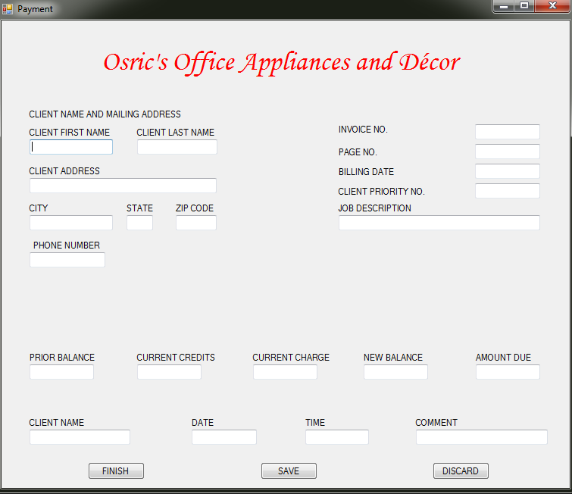
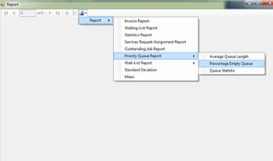
Payment: Once each job is completed a payment invoice will be generated and sent to the customer.
Report: The system should be able to provide the different metrics and reports that are shown below.

Slide 31
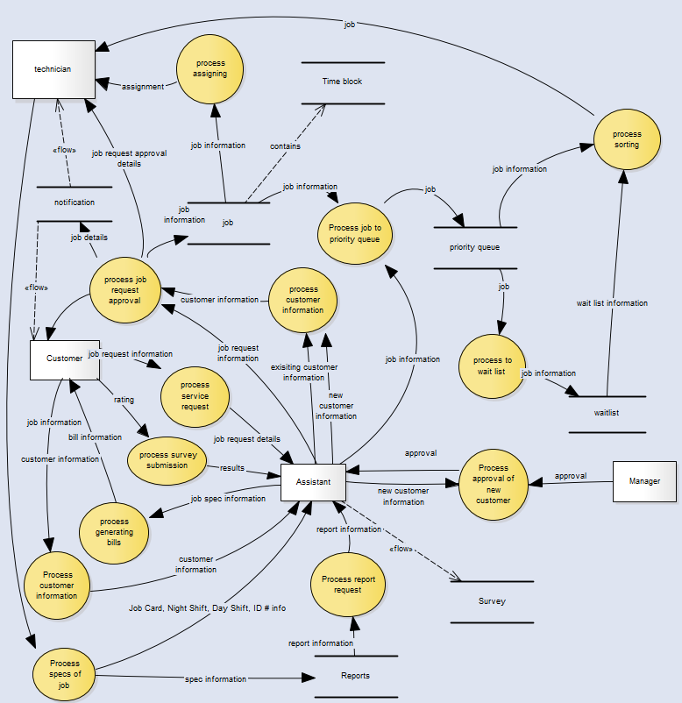

Slide 32
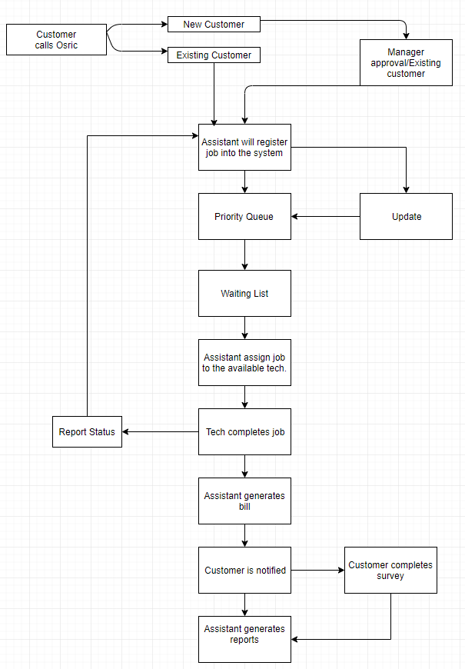

Slide 33
