Slide 1
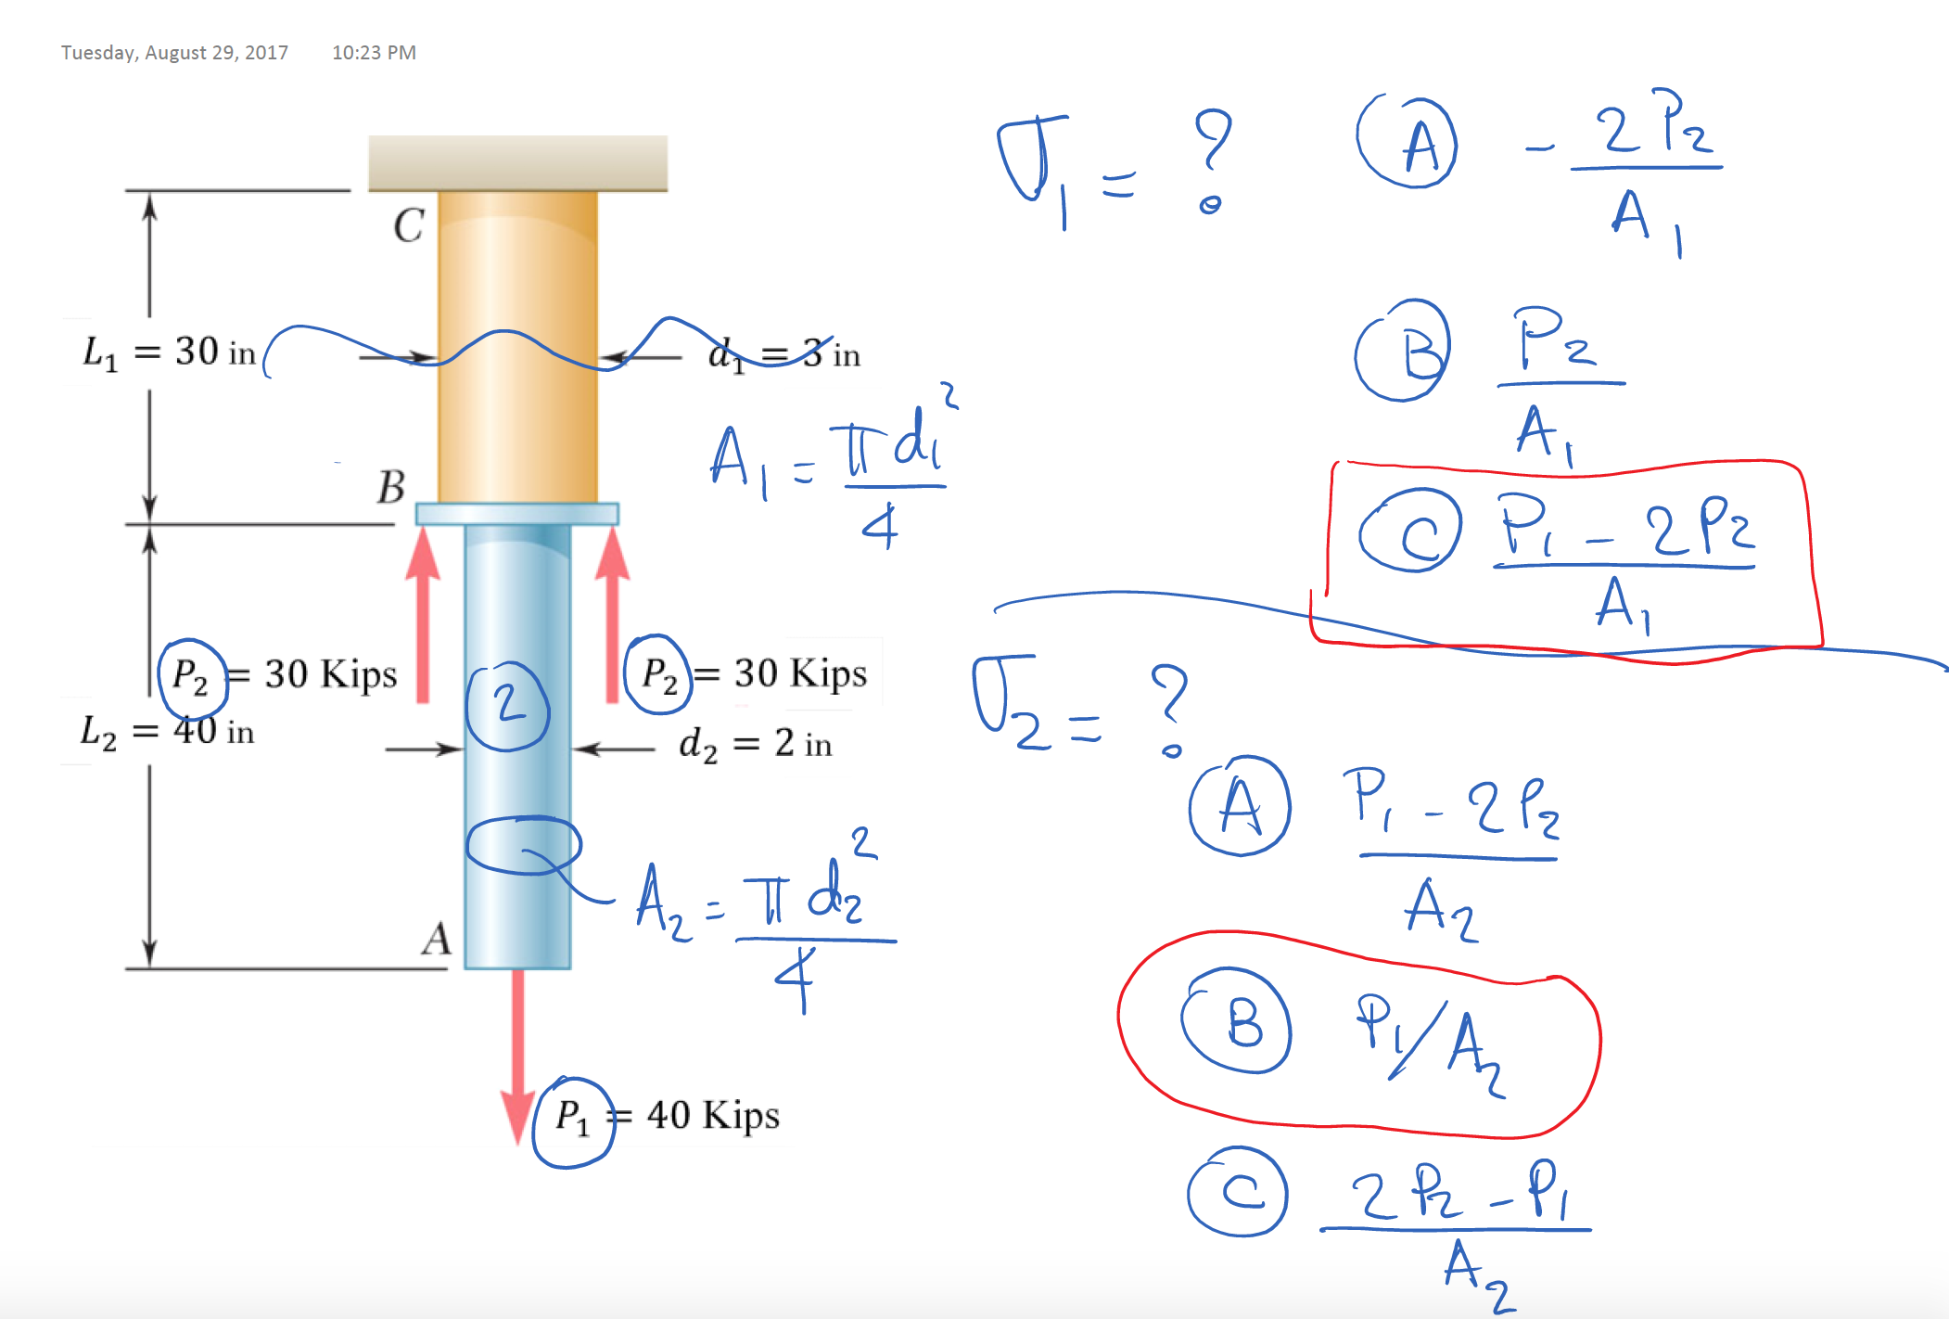

Slide 2
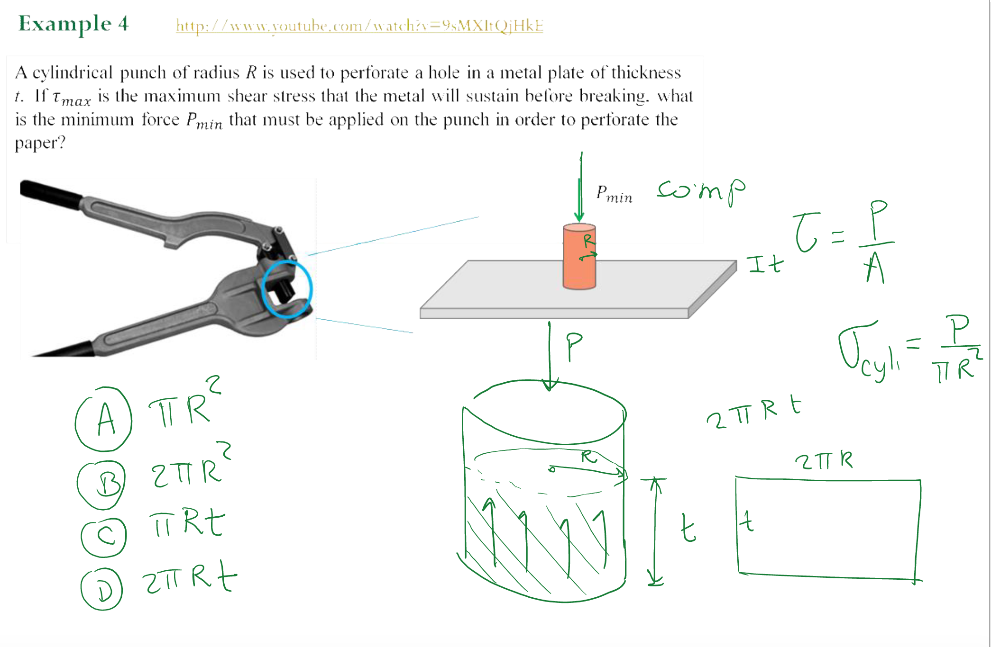

Slide 3
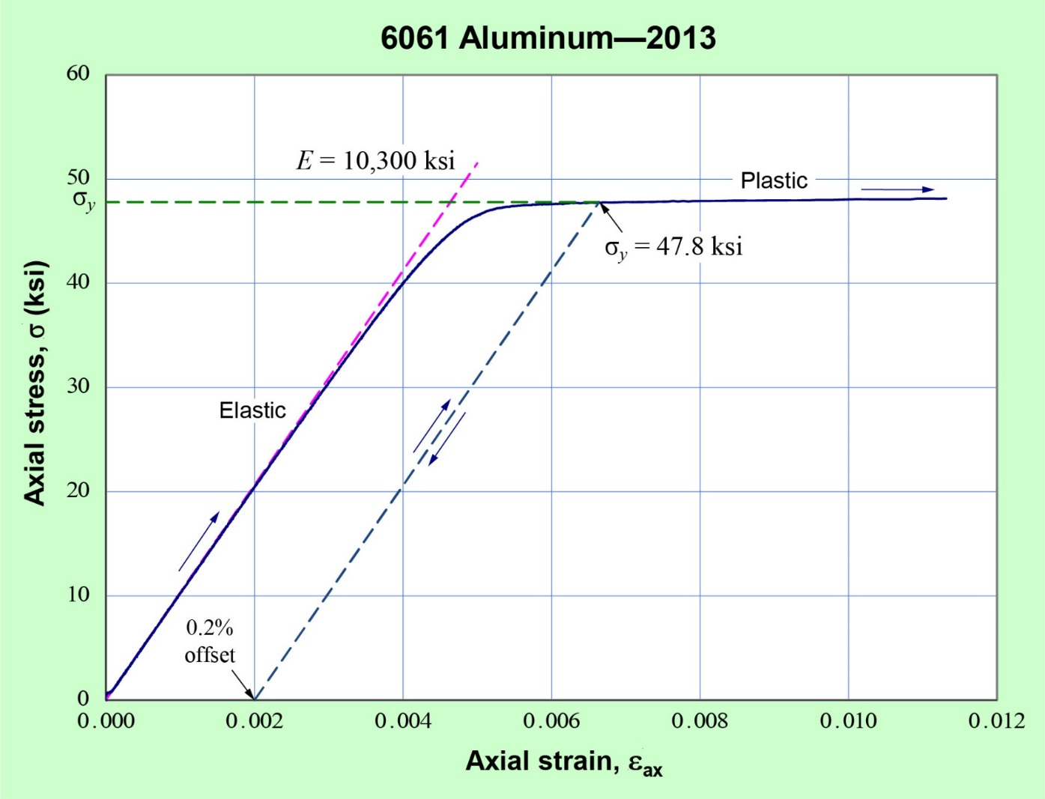
The material below is loaded until it reaches a stress equal to 30 ksi, which corresponds to a strain equal to __________ . After unloading, the material has permanent strain equals to ___________.
0.003, 0
0.002, 0
0.003, 0.002
0.002, 0.003

Slide 4
